Slide 1

Machine Learning Sommelier
March 17, 2018
MIRIAM / NATHAN / TIWAA

Slide 2
ML-Sommelier: Overview
User sends a Tweet to a Twitter BOT with a desired wine flavor profile
Machine-Learning model recommends a wine variety
Recommendations are tweeted

Slide 3
ML-Sommelier: Data
ML-Sommelier reads a CSV file:
https://www.kaggle.com/zynicide/wine-reviews
The dataset was previously scraped from Wine Enthusiast.
winemag-data_first150k.csv
150,000 rows of data, reduced to approx 98,000 rows after removing duplicates
Columns: country, description, points, price, variety, winery, designation, province and region
ML model predicts variety based on input description

Slide 4
Send a Tweet now!
See the model in action!
Tweet at our WineBot now: @mberkow2017
Describe the type of wine you like to drink
Examples:
Fruity, light ruby-to-garnet colored red
Ripe cherries and strawberries, spice and vanilla aromas. Well-balanced, earthy tones, lingering fruit

Slide 5
ML-Sommelier: Components
A Twitter BOT that listens for a tweet requesting a wine recommendation, calls the machine learning model to get the recommendation, and then tweets out two responses:
Recommended variety of wine, along with the 3 top-rated wineries for that variety, and their average price
Recommended variety of wine, along with the 3 least expensive wineries for that variety, and their average price
Machine learning model that reads a CSV file with Wine Enthusiast descriptions of wines, the wineries, points, and prices. The model uses a neural network and natural language processing to be able to predict the wine variety based on an input description.
Tabular data about the wines, varieties, and vineyards created using Tableau are incorporated into a website accessible from the Twitter BOT’s page

Slide 6
ML-Sommelier: Twitter BOT
Uses Tweepy
Looks for mentions with wine descriptions
Calls the ML model to determine wine variety
(e.g., Pinot Noir)
Reads the CSV to determine:
3 of the top wineries for the wine variety
3 of the least expensive wineries for the wine variety
Sends 2 tweets

Slide 7
ML-Sommelier: ML Model
Natural Language Processing
Count vectorizer
One-hot encoding
Neural Network
1 hidden layer
750 nodes
364 outputs
R² = 0.6
Model saved in AWS due to large size

Slide 8
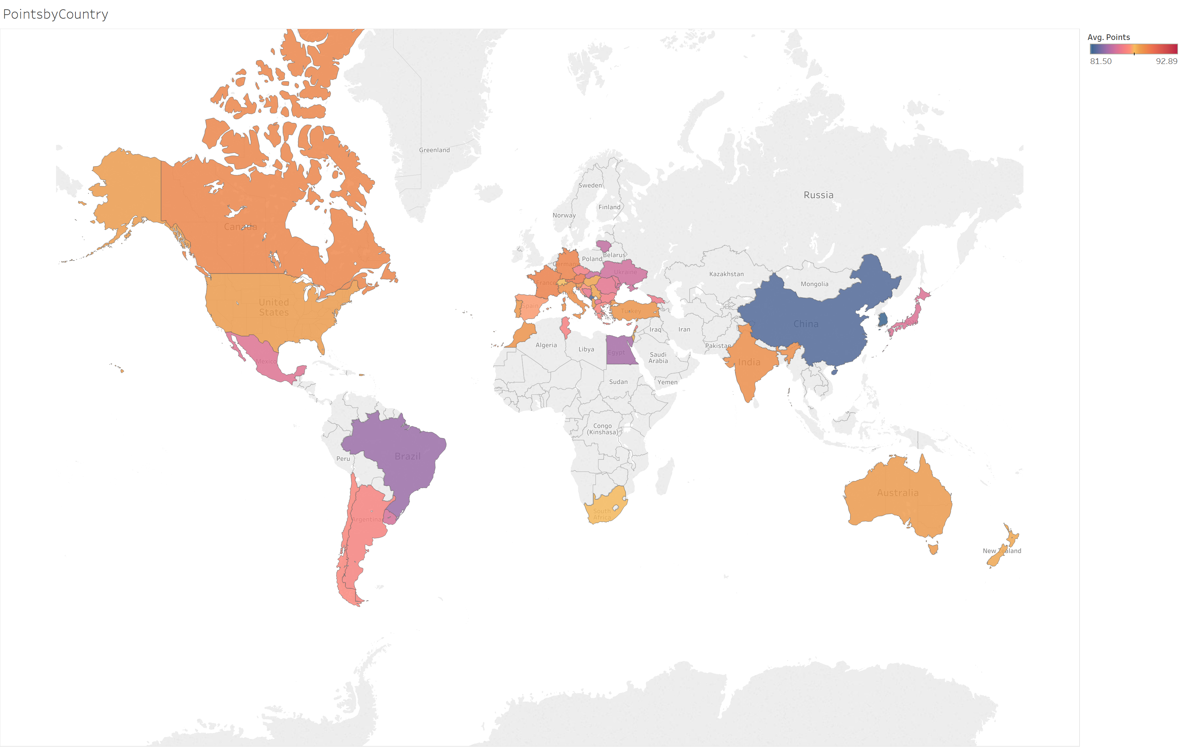
Points by Country

Slide 9
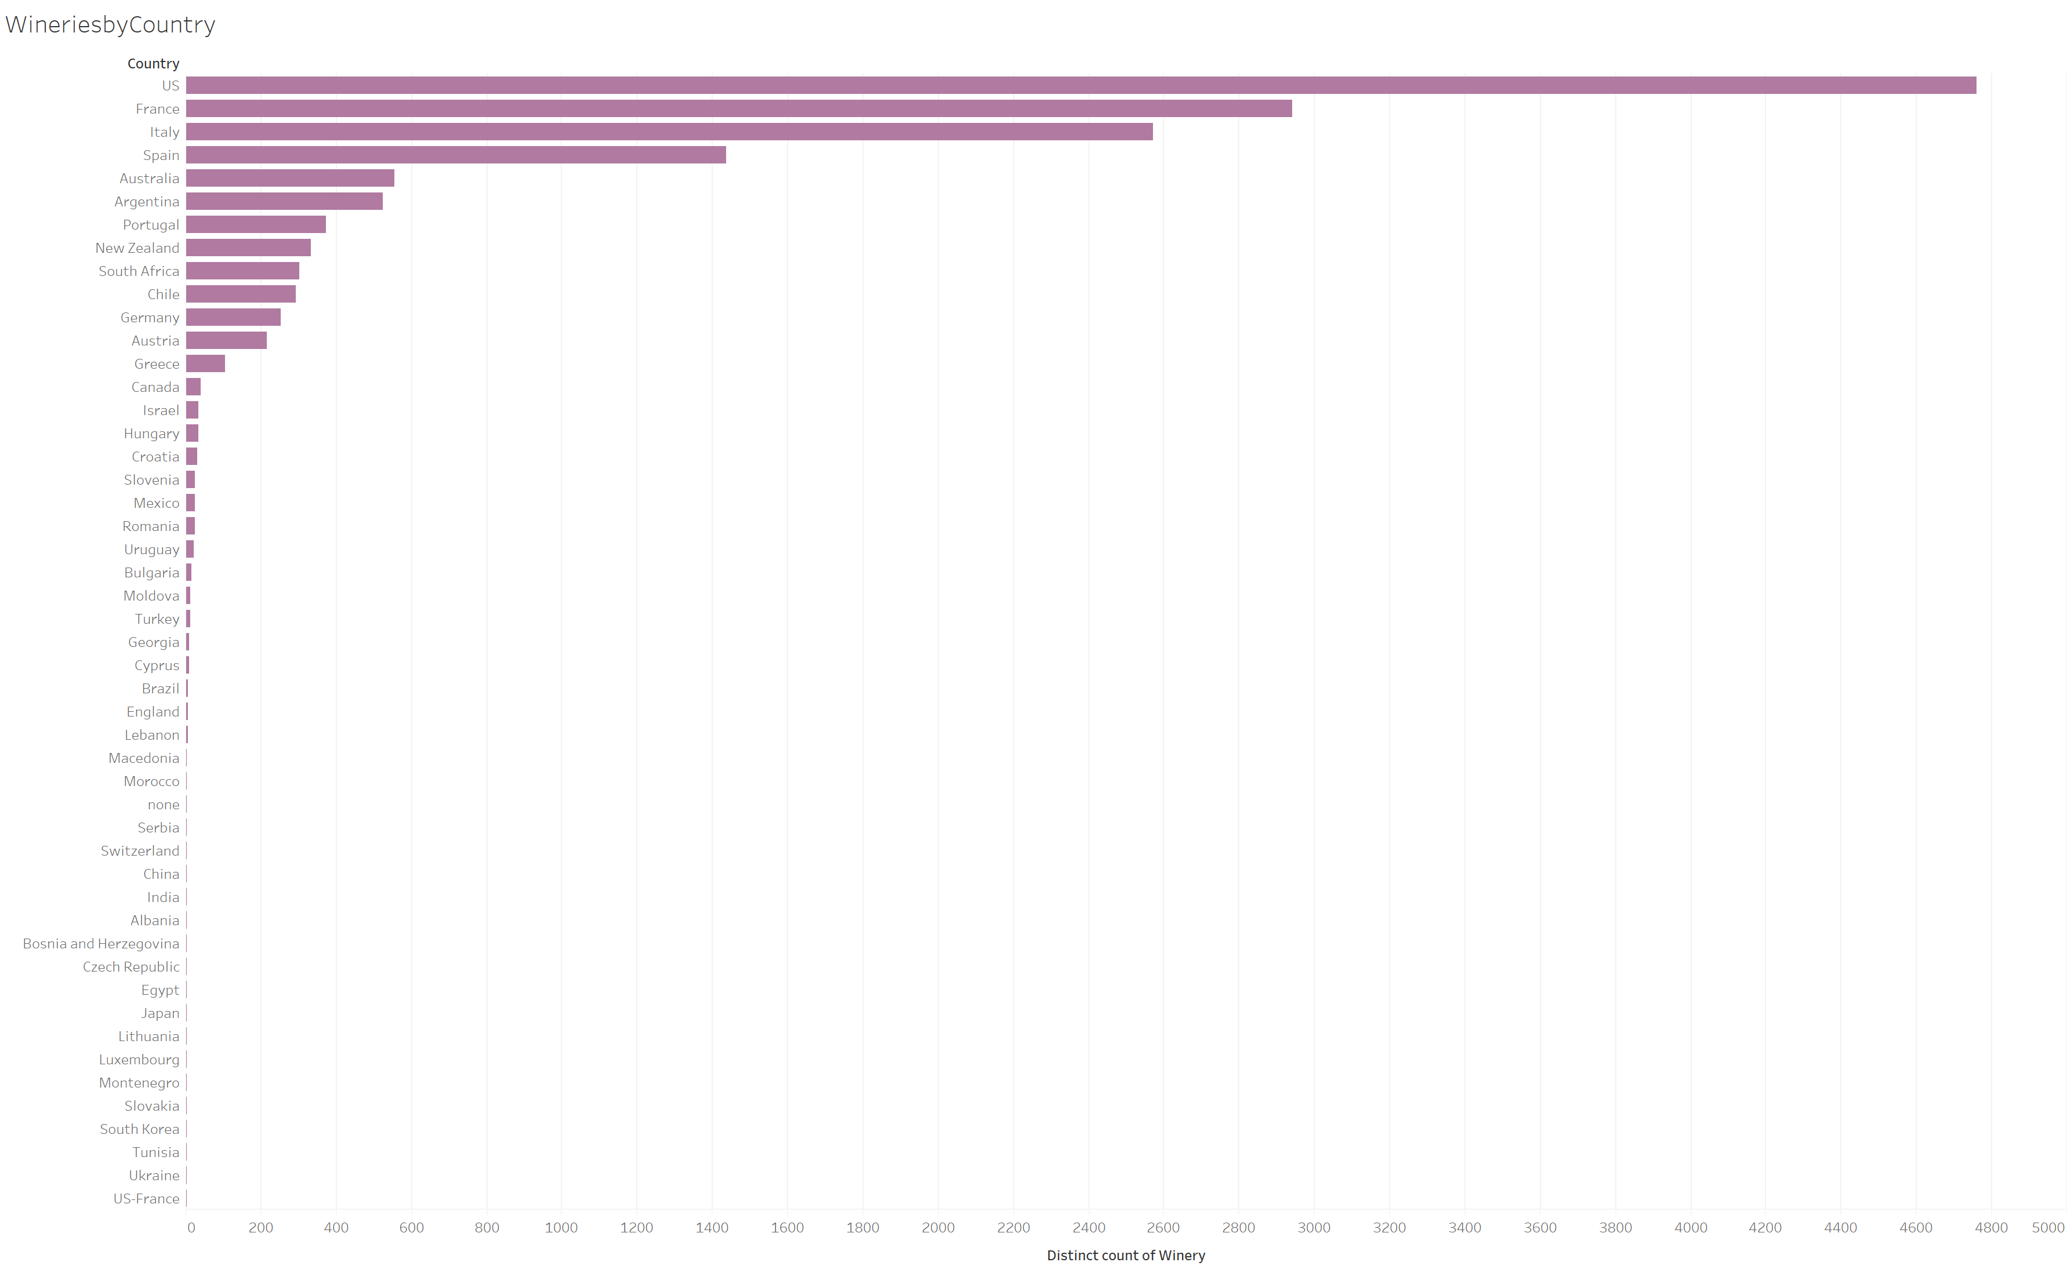

Slide 10
