Slide 1
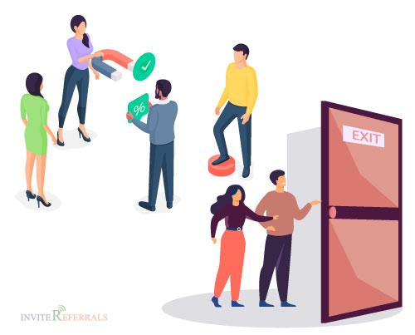
Customer Churn Analysis
Presented By:
Miriam Mwongela

Slide 2

Introduction
Customer churn: When customers stop using a company’s services, threatening recurring revenue.
Business impact: High churn causes lost revenue, reduced customer lifetime value, and slower growth.
Retention: Retaining customers is generally more cost-effective than acquiring new ones.
Project aim: Identify factors influencing churn and determine suitable statistical and predictive approaches to assess churn likelihood.
Business value: Enable proactive targeting of at-risk customers with retention strategies.

Slide 3
Exploratory Data Analysis
The dataset consists of 1 CSV file containing 7,043 records with 21 features, made up of numerical, binary, and categorical features as follows:
1. Numerical features:
Tenure – the number of months the customer has been with the company.
MonthlyCharges – the monthly amount charged to the customer.
TotalCharges – the total amount charged to the customer over their tenure.
2. Binary features:
SeniorCitizen – whether the customer is a senior citizen (0 – no, 1 – yes).
Partner – whether the customer has a partner (Yes, No).
Dependents – whether the customer has dependents (Yes, No).
PhoneService – whether the customer has phone service (Yes, No).
PaperlessBilling – whether the customer uses paperless billing (Yes, No).
Churn – whether the customer left the company (Yes, No).
3. Categorical features:
Gender – gender of the customer (Male, Female).
MultipleLines – whether the customer has multiple phone lines (Yes, No, No phone service).
InternetService – type of internet service (DSL, Fiber optic, No).
OnlineSecurity – whether the customer has online security (Yes, No, No internet service).
OnlineBackup – whether the customer has online backup (Yes, No, No internet service).
DeviceProtection – whether the customer has device protection (Yes, No, No internet service).
TechSupport – whether the customer has technical support (Yes, No, No internet service).
StreamingTV – whether the customer has streaming TV (Yes, No, No internet service).
StreamingMovies – whether the customer has streaming movies (Yes, No, No internet service).
Contract – type of customer contract (Month-to-month, One year, Two year).
PaymentMethod – method used to make payments (Electronic check, Mailed check, Bank transfer (automatic), Credit card (automatic)).
The TotalCharges column contained non-numeric entries for customers with zero tenure. These were converted to missing values and replaced with 0, since these customers had not accumulated any charges. The column was then converted to a numerical data type.

Slide 4
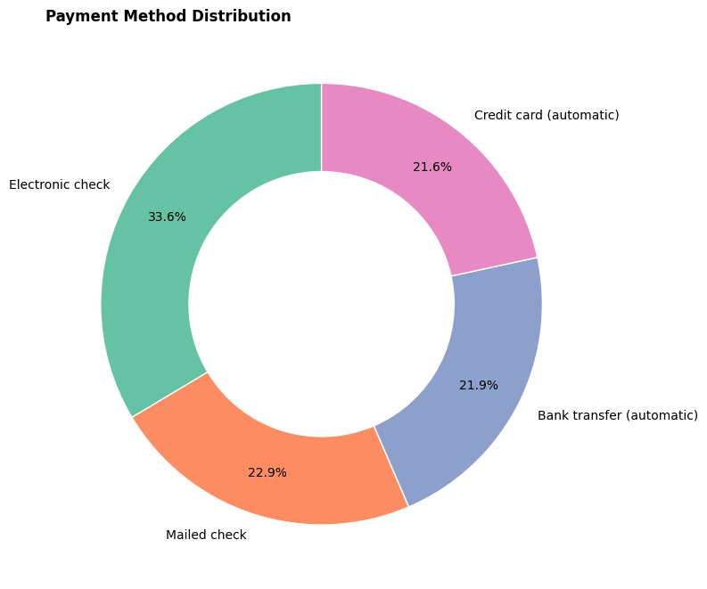
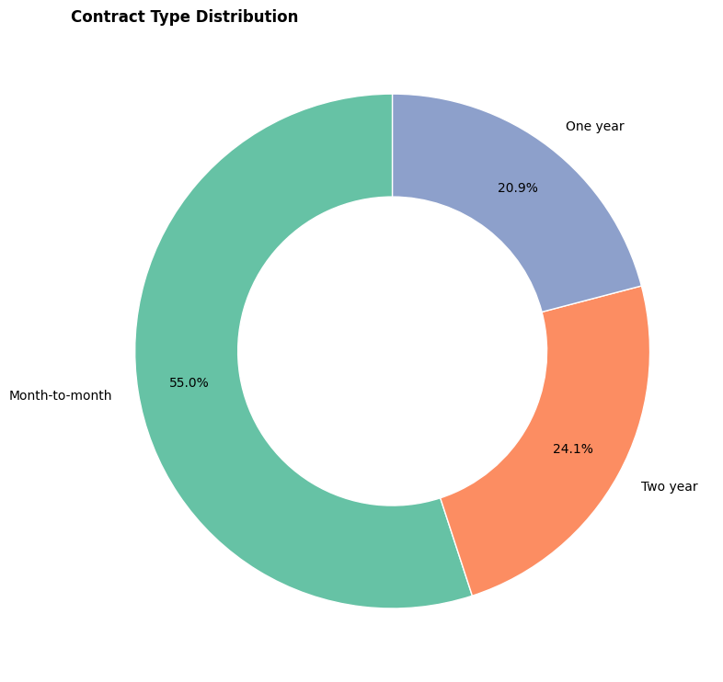
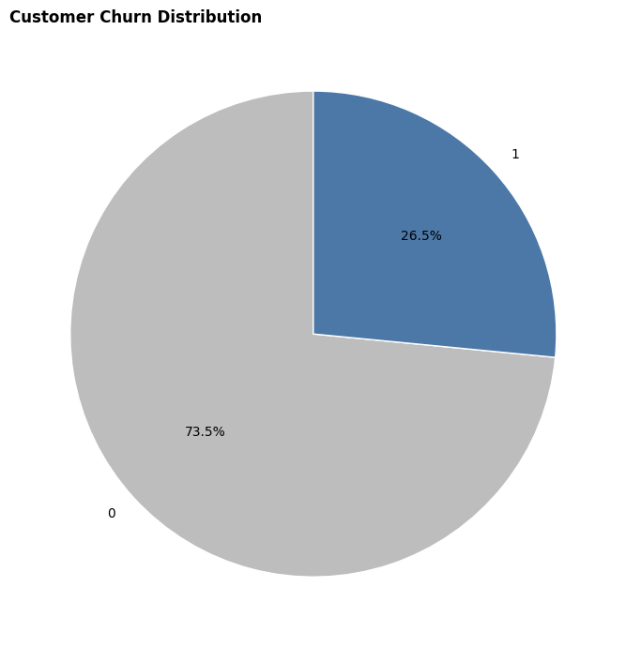
Business Overview
3
Contract Types
4
Payment Methods
11
Services Offered
7043
No. of Customers
5174
Customers not Churned
The donut chart shows that most customers pay using Electronic Check (33.6%) for the services
26.5% of the customers have exited the company while 73.5% are still customers of the company
Out of the 3 contract Types, Month-to-Month is the most preferred one (55.0%)

Slide 5
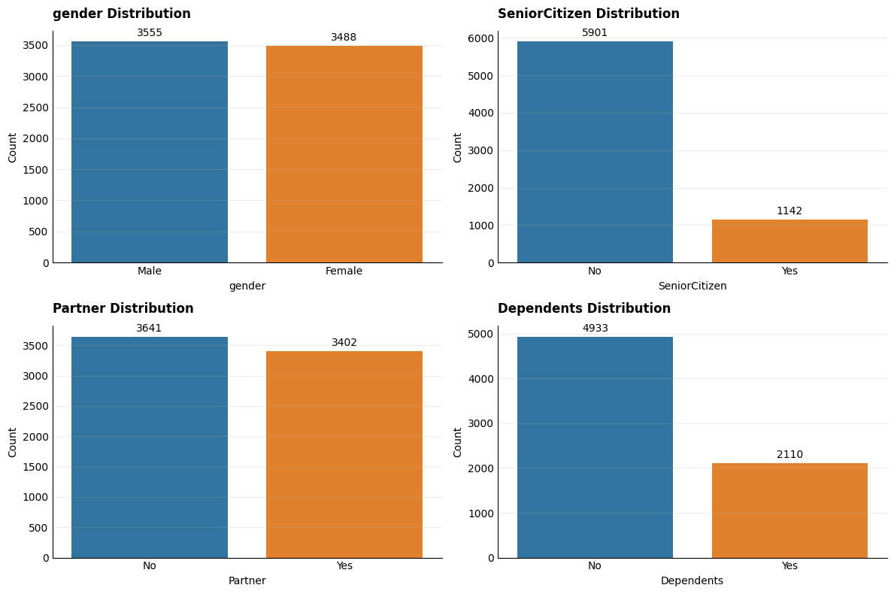
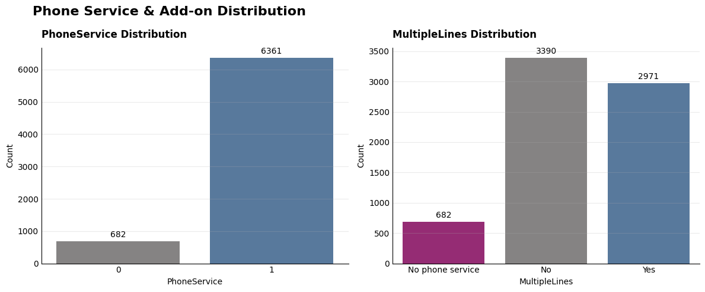
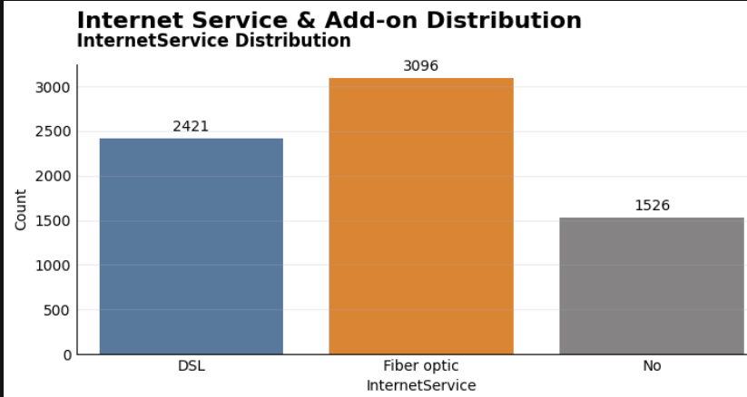
Customer Analysis
Services Analysis

Slide 6
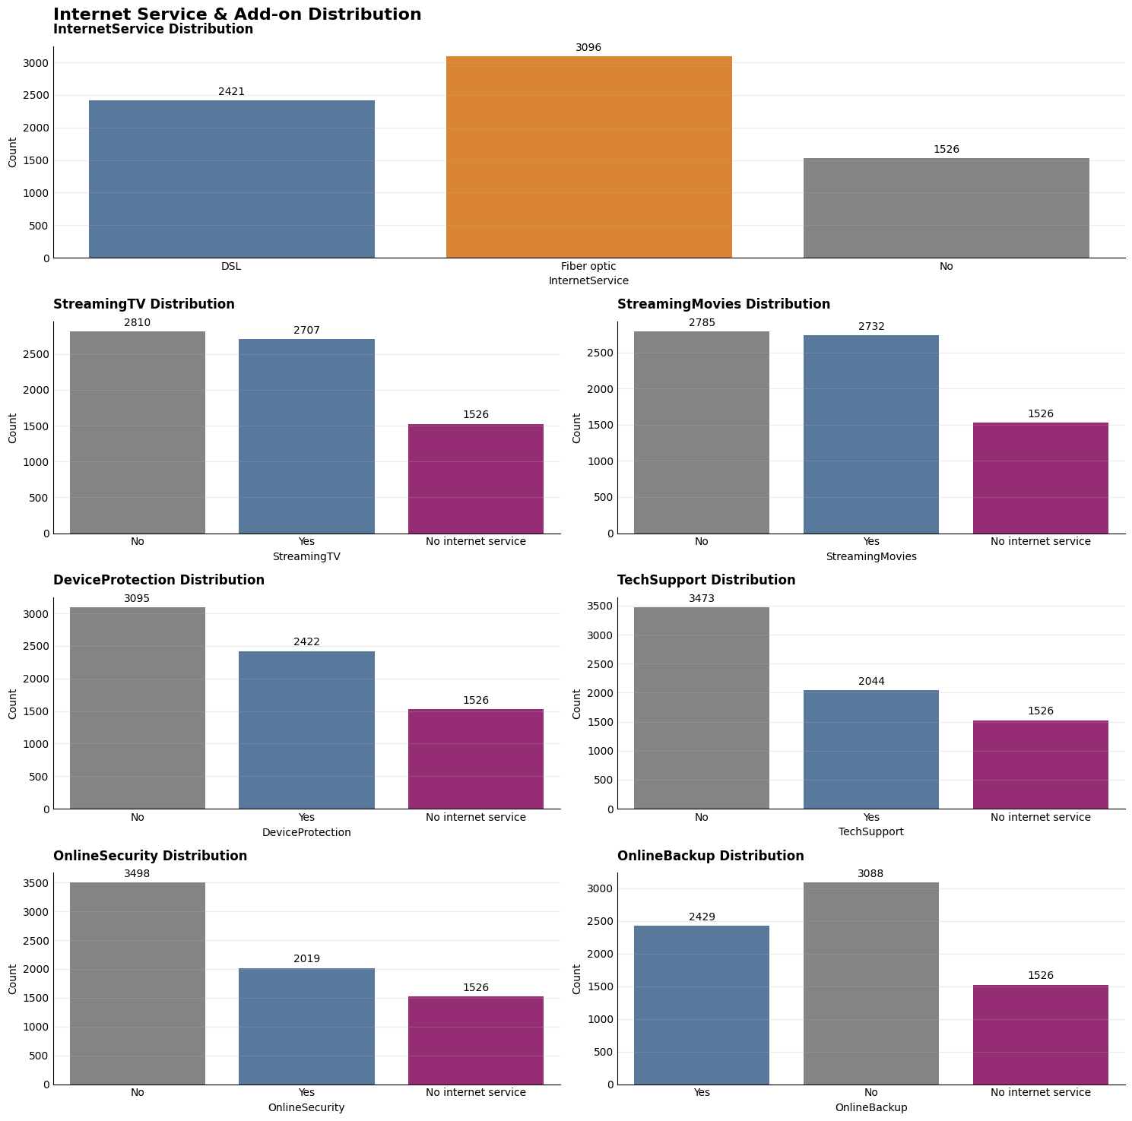

Slide 7
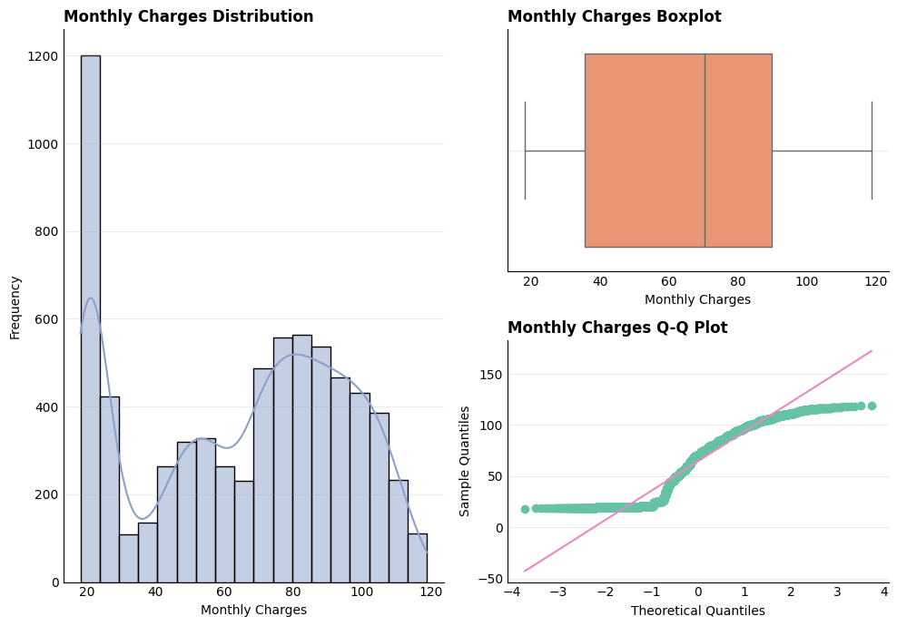
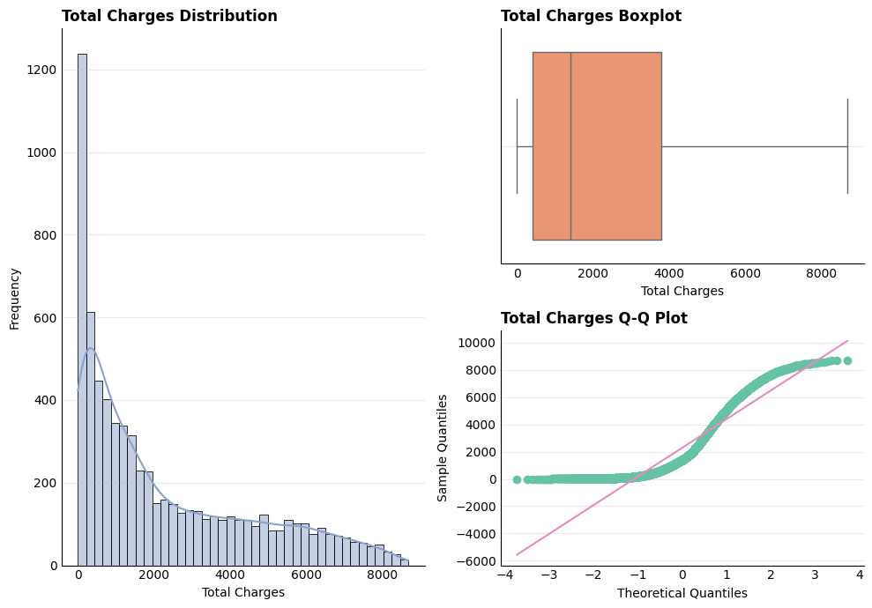
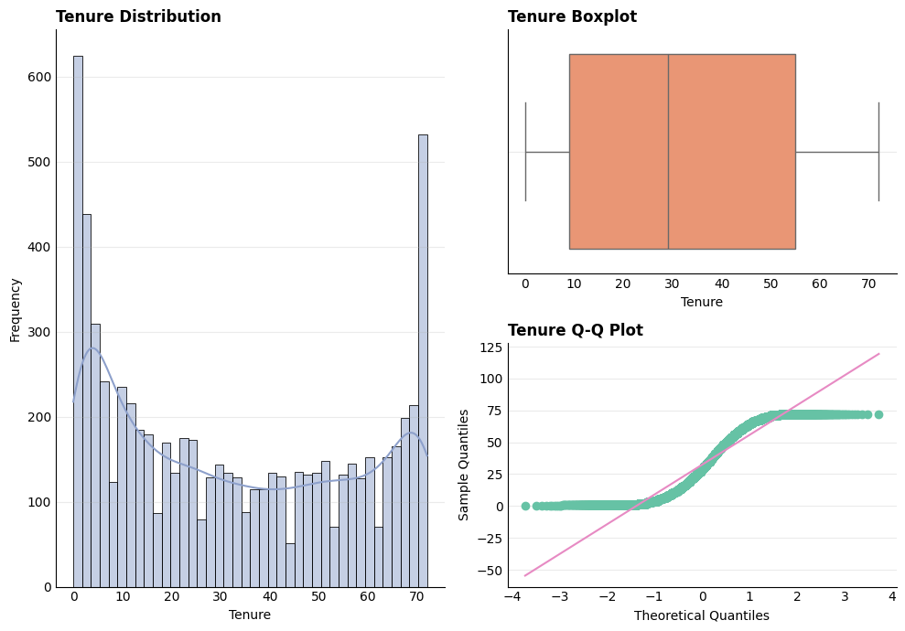
The boxplot shows a median of approximately $70 and
No prominent outliers
The boxplot confirms the TotalCharges are positively right skewed
Median of approximately $1800
The median tenure is around 30 months.
The middle 50% of customers lie approximately between 9 and 55 months.
Monthly Charges are not normally distributed.
Lowest charges are around $25 - $30
Highest charges concentration are around $70 - $100
Total Charges is highly positively skewed
Most customers having relatively low accumulated charges
A smaller number have very high charges.
Tenure is Multimodal.
Total tenure is 72 months, 6 years with the company.
Most customers don’t stay a whole month as clients

Slide 8
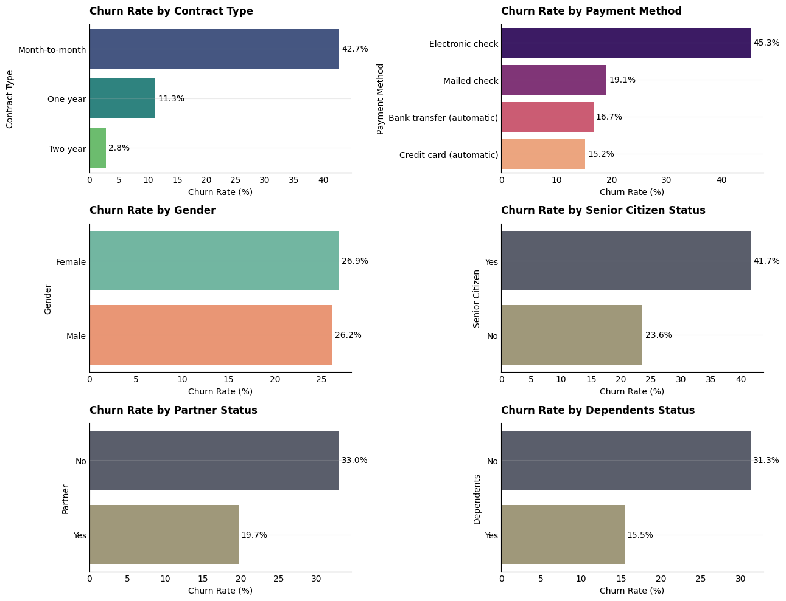
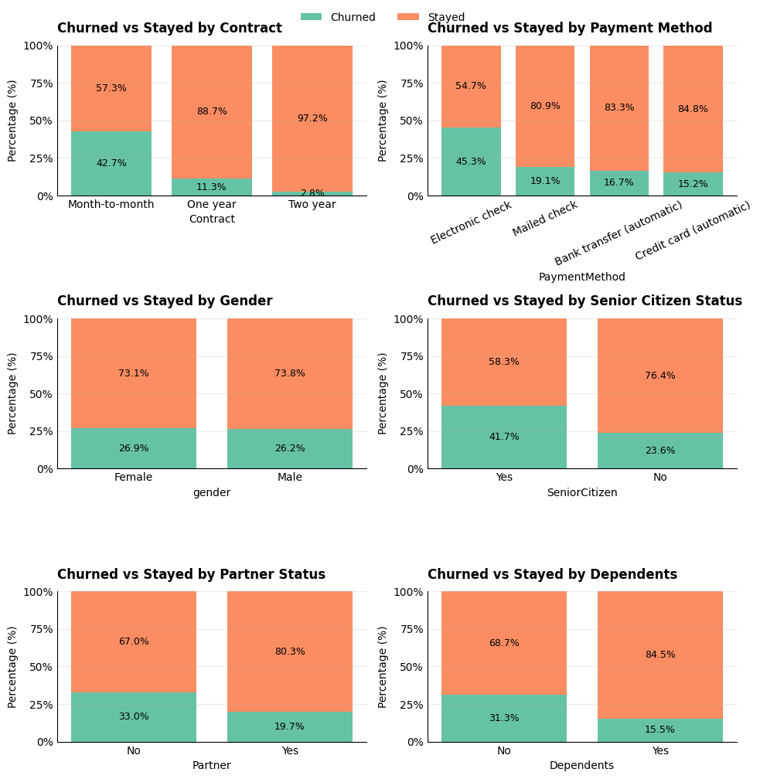
Churn Rate Analysis

Slide 9
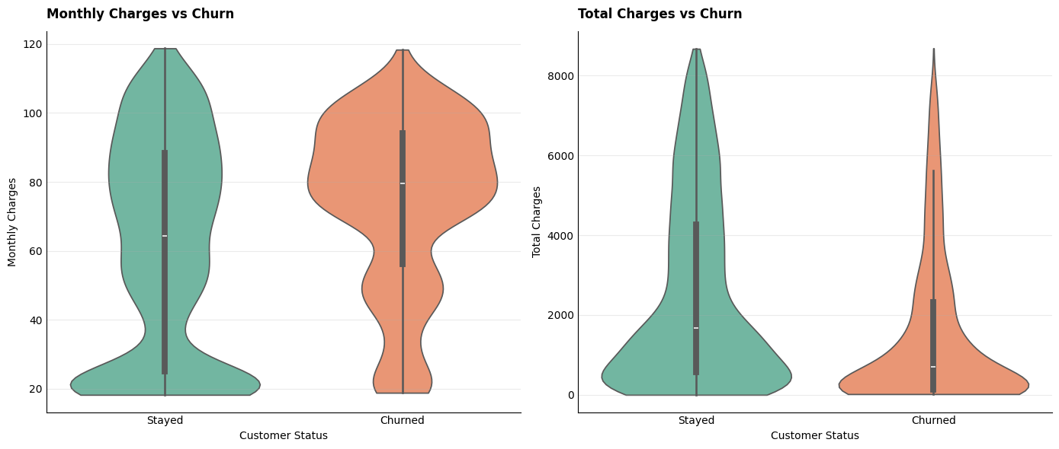
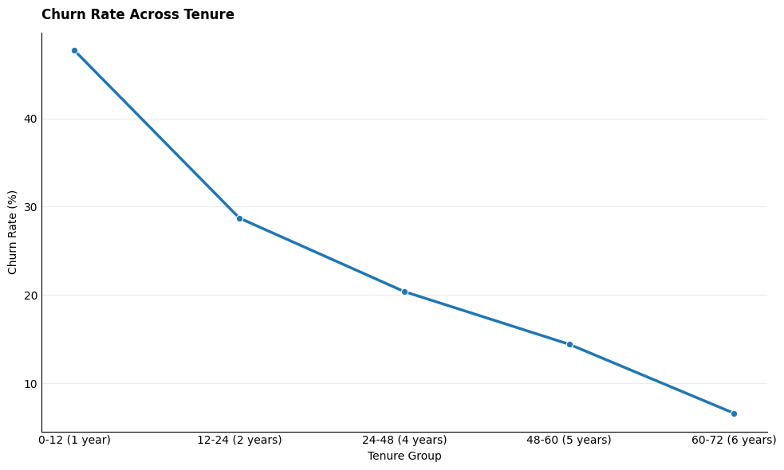
tenure_group | churn_rate(%)
0-12 (1 year) | 47.68
12-24 (2 years) | 28.71
24-48 (4 years) | 20.39
48-60 (5 years) | 14.42
60-72 (6 years) | 6.61
Monthly Charges & Total Charges Analysis
Higher monthly charges are associated with churn, while lower total charges largely reflect the shorter tenure of customers who leave early.
Basically, churned customers tend to pay more per month but leave before accumulating high lifetime value, meaning the company loses future revenue precisely from some of its higher-paying customers.
Customer’s churn rate gradually decrease from year 1 to year 6

Slide 10
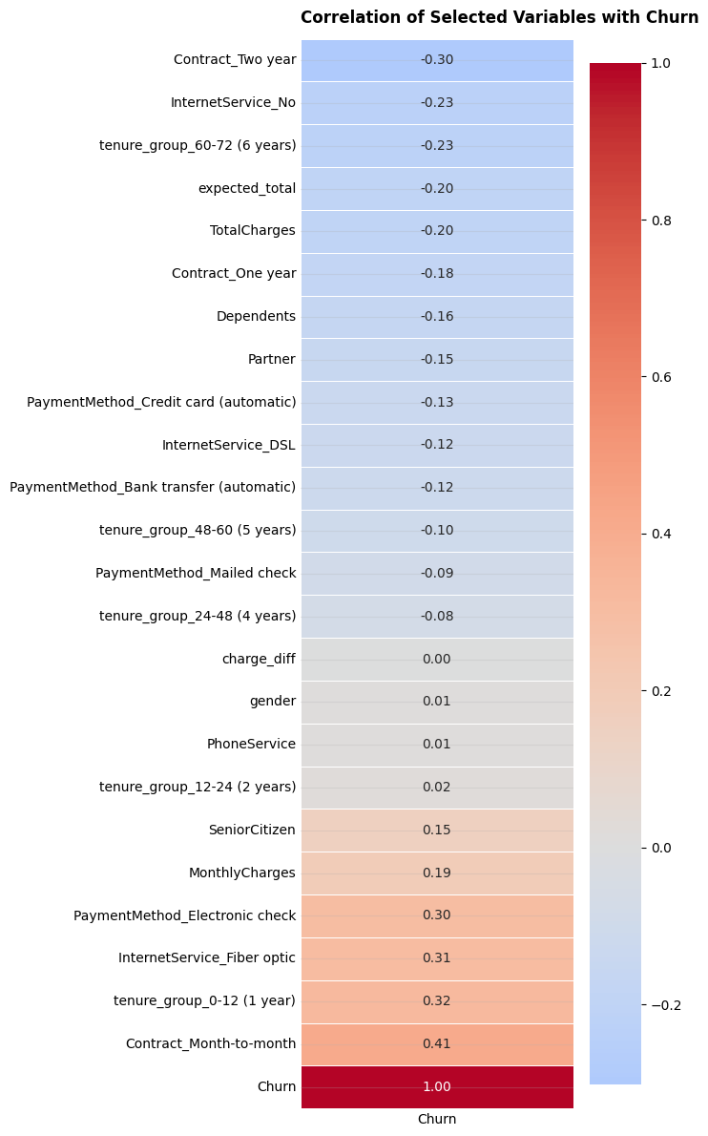
Correlation Analysis
Customers with
2 year contract (-0.30)
no internet services (-0.23)
longer tenure, 6 years (-0.23)
tend to have lower churn.
A correlation close to 0 means there is little or no linear relationship between the variable and churn.
Charge_diff (0.00)
Gender (0.01)
Phone Service (0.01)
2 years of tenure (0.02)
. These customers are more likely to churn from the company
Electronic Check Payment Method (0.30)
Fiber Optic Internet Service (0.31)
Shorter tenure, 1 year (0.32)
Month-to-month contract type (0.41)

Slide 11
Research Question
From our data we notice:
Customers on month-to-month contracts churn the most — contract type is the strongest single driver of churn in the data.
Customers who churn tend to pay higher monthly charges but have lower total charges overall — they leave early, before their costs (or value to the company) build up.
Fiber optic internet and electronic check payments are both linked to higher churn, while no internet service and long-term contracts are linked to lower churn — churn risk seems to cluster around certain service and payment combinations, not just one factor.
Research Questions are:
Is there a significant relationship between contract type and customer churn?
Do Monthly Charges and Total Charges differ significantly between churned and retained customers?
Is there a significant relationship between InternetService type and PaymentMethod combined and customer churn?

Slide 12
Hypothesis Testing
H₀:
No significant difference in charges between churned and stayed customers.
H₁:
Significant difference in charges between churned and stayed customers.
Significance level: 0.05
H₀:
InternetService and PaymentMethod are not significantly associated with customer churn.
H₁:
InternetService and PaymentMethod are significantly associated with customer churn.
H₀ ​:
Contract type and churn are independent.
H₁ :
Contract type and churn are not independent.
Significance level: 0.05
Chi-square Test Results:
Chi-square statistic: 1184.5966
Degrees of freedom: 2
P-value: 0.0000
Cramér's V:
0.4101
Mann-Whitney U Test - Monthly Charges
U Statistic: 6003125.5000
P-value: 0.0000
Mann-Whitney U Test - Total Charges
U Statistic: 3381224.0000
P-value: 0.0000
Chi-square Test Results:
Chi-square statistic: 1083.1290
Degrees of freedom: 11
P-value: 0.0000
Cramér's V:
0.3922
(p<0.01) < 0.05
Reject H₀ and accept H₁
(p< 0.001>) < 0.05 for both Monthly Charges and Total Charges
Reject H₀ and accept H₁
There is a statistically significant, moderate association between contract type and customer churn.
(p<0.01) < 0.05
Reject H₀ and accept H₁
There is a statistically significant difference between churned and retained customers for both Monthly and Total Charges
There is a statistically significant, moderate association between the combined InternetService and PaymentMethod categories and customer churn.

Slide 13
Customer Churn Rates by Internet Service and Payment Method
Internet_Payment | Customers | Churned | Churn Rate %
Fiber optic_Electronic check | 1595 | 849 | 53.23
Fiber optic_Mailed check | 258 | 110 | 42.64
DSL_Electronic check | 648 | 207 | 31.94
Fiber optic_Bank transfer (automatic) | 646 | 187 | 28.95
Fiber optic_Credit card (automatic | 597 | 151 | 25.29
DSL_Mailed check | 613 | 127 | 20.72
No_Electronic check | 122 | 15 | 12.29
DSL_Credit card (automatic) | 594 | 72 | 12.12
No_Mailed check | 741 | 71 | 9.58
DSL_Bank transfer (automatic) | 566 | 53 | 9.36
No_Bank transfer (automatic) | 332 | 18 | 5.42
No_Credit card (automatic) | 331 | 9 | 2.72

Slide 14
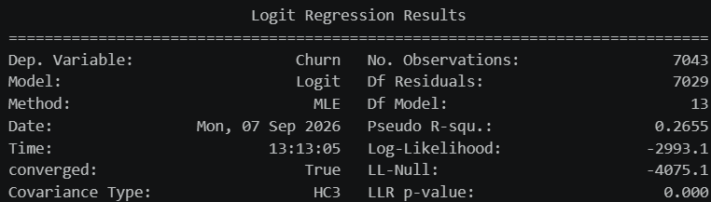
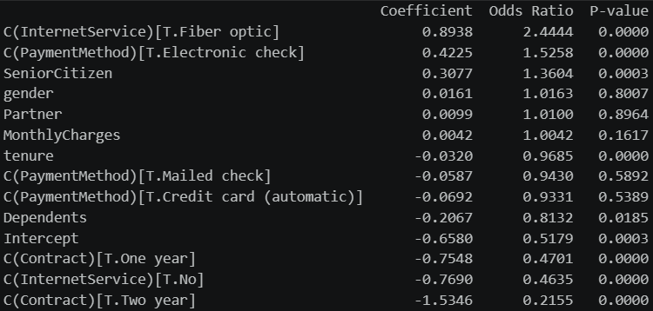
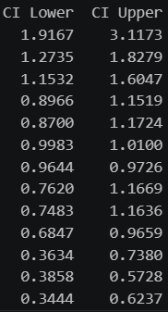
Model
The logistic regression model is statistically significant, meaning the predictors collectively have a significant association with customer churn.
Pseudo R²: 0.2684, indicating moderate explanatory power.
Meaning that the selected predictors provide meaningful information for predicting customer churn.
There is insufficient evidence that these variables independently predict churn after controlling for the other variables in the model.
P > 0.05
Gender
Partner status
Monthly Charges
Mailed check payment
Credit card payment
Factors associated with lower churn
Month-to-month customers are the highest-risk contract group, while longer-term contracts are strongly associated with retention.
Longer customer tenure is associated with lower churn - This suggests that newer customers are more vulnerable to churn
Customers with dependents have lower churn odds
Customers with no internet service have lower churn odds than DSL customers
Customers with higher churn odds
Fiber optic customers are the highest-risk group identified by the model - approximately 144% higher odds of churn than DSL customers.
Electronic check users are also more likely to churn
Senior citizens have higher churn odds - approximately 36% higher than non-senior customers.

Slide 15


