Slide 1
MIRIAM NTHENYA MWONGELA
GLOBAL FOOD PRICE ANALYSIS
Project Name:
12-June-2026

Slide 2
Executive Summary
The Global Food Price Analysis project runs from 2010 to 2017. It covers 55 countries with exchange rate data. All food prices are converted into US dollars. Data comes from Kaggle and the World Bank. Excel and Power BI are used to clean and visualize the dataset. The dataset holds more than 740,000 rows. A star schema is applied with fact and dimension tables. Dashboards are built for markets, commodities, volatility, and FX trends. The project serves governments, international organizations, analysts, and supply chain firms. One challenge is aligning monthly food prices with yearly exchange rate data. Another challenge is formula errors. Recommendations include adding newer data, monthly FX rates, and predictive analytics.
Background
Food prices matter because they affect families, economies, and food security. Leaders and aid groups watch them to see trends and plan actions.
Comparing prices across countries is tricky since currencies differ and exchange rates keep changing. To solve this, the project converts all prices into US dollars, making comparisons fair and clear.
Power BI is used to clean the data and show it in charts and dashboards. This makes patterns and changes easy to see, helping people make better decisions.

Slide 3
Stakeholders & BI Requirements
Government Ministry (Agriculture / Trade / Finance)
International Organizations (FAO / WFP / World Bank)
Requirements:
Requirements:
Monitor food price changes across countries
Identify countries with high or unstable food prices
Track impact of exchange rates on food prices
Support policy and pricing decisions
Detect food insecurity risk through price levels and volatility
Identify regions with unstable or high-cost food markets
Support global food aid and intervention planning
Market Analysts
Supply Chain Firms
Requirements:
Requirements:
Analyze commodity price behavior across markets
Identify trends, volatility, and price patterns
Compare pricing across countries and time
Identify price trends for planning procurement
Understand commodity stability for risk reduction
Compare markets for sourcing decisions

Slide 4
Analytical Questions
What is the overall structure of the dataset in terms of countries, markets, commodities, and average food prices (USD)?
How do food prices vary across countries and continents?
Which countries have the highest average food prices?
How are commodities distributed in the dataset?
How do food prices change over time (2010–2017)?
What is the relationship between exchange rates (FX) and food prices?
Which commodities show the highest price increases or decreases over time?
Which commodities are the most and least volatile?
What is the relationship between commodity price level and price volatility?
Which commodities are most frequently occurring in the dataset?

Slide 5
Project Workflow
1
2
Dataset
Data Collection & Preprocessing (ETL)
Global Food Dataset retrieved from an Excel file
Exchange rates (USD FX) pulled from the World Bank Api
Dataset represents:
Commodities: Food
Time Period: 2010 – 2017
Countries: With available FX data for USD conversion
Data imported into Power BI (Power Query)
Cleaning and transformation performed:
Standardizing country names
Cleaning market type values
Structuring continent grouping
Preparation of dataset for modelling

Slide 6
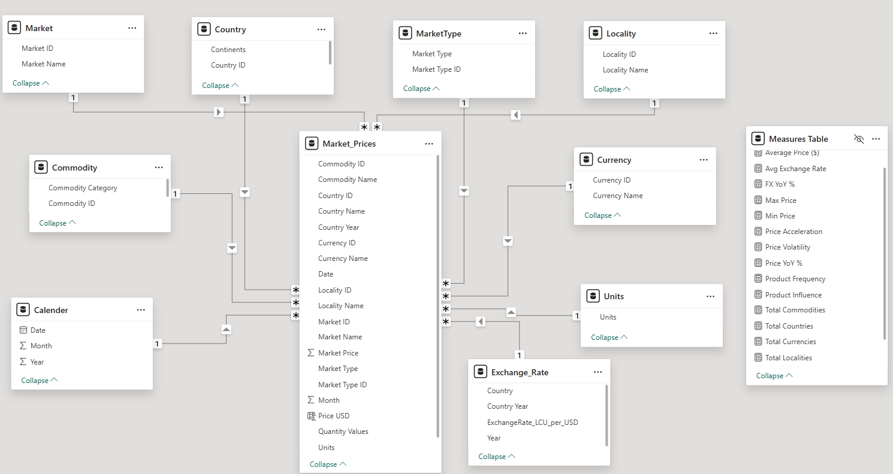
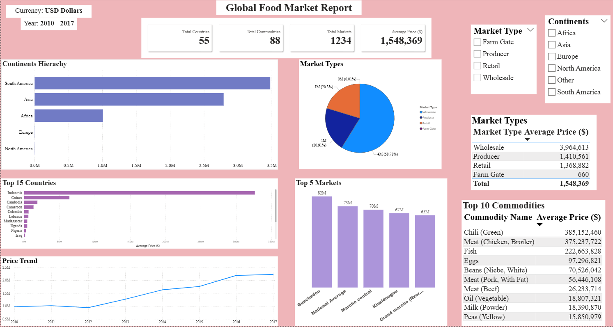
3
4
Data Model
Report View
Market Overview Dashboard

Slide 7
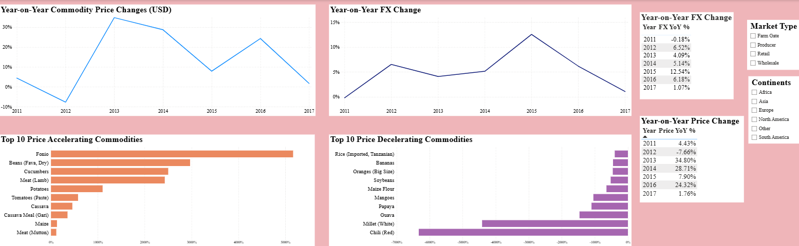
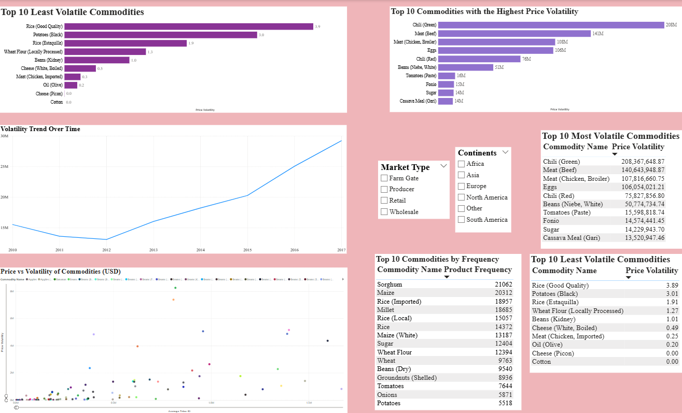
Report View
Cont’d
Price Analysis Dashboard
Product Analysis Dashboard

Slide 8
User Journey
START
Product Analysis
Volatility Analysis
Price vs Volatility
Market Overview
Product Frequency
KPI Summary
Country & Continent Analysis
Market & Commodity Overview
Price Analysis
YoY Price Trends
FX Trends
Accelerating & Decelerating Products

Slide 9
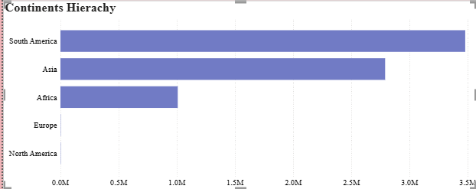
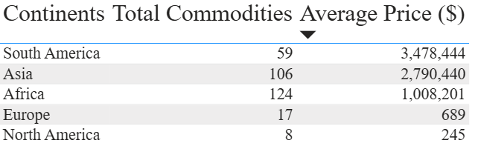
Period: 2010 – 2017
Commodity: Food
Countries: Those with FX Data
Insights
Overall Market Structure
Continents
South America tops the list at $3.48M with only 59 commodities. High prices here aren’t about variety.
Asia follows at $2.79M across 106 commodities. Still fewer items, but strong price levels.
Africa averages $1.01M with the widest range,124 commodities. More varieties, yet lower prices.
Europe shows $689 from 17 commodities. Too little data to reflect real markets.
North America records $245 with just 8 commodities. Also not meaningful..
South America and Asia currencies’ are stronger and more stable against the US Dollar. When prices are converted, they keep more of their value. That’s why average food prices look higher in these regions.
African currencies are weaker against the Dollar. This makes converted prices look lower, even though the real cost for local people may be heavier than it appears.

Slide 10
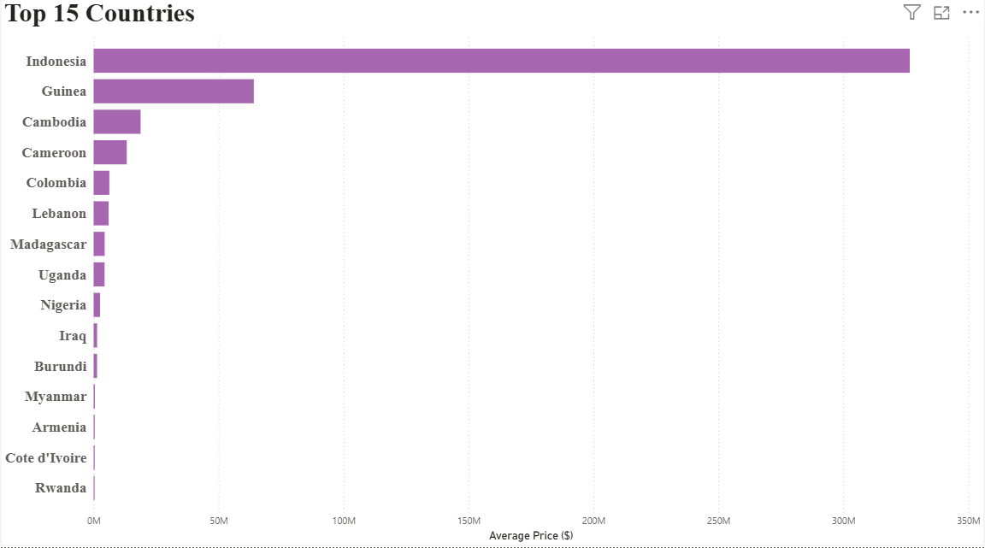
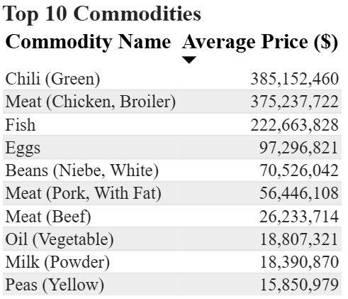
Countries
Indonesia
Indonesia is the biggest outlier. Its average food price is $326.58M, far above everyone else. This points to either very high price levels or unusual values that need closer review.
Gap to Guinea
Second place is Guinea at $64.10M. That’s a drop of more than $262M compared to Indonesia. The gap between the top two is huge.
Top five
Indonesia, Guinea, Cambodia, Cameroon, and Colombia dominate the ranking. Their prices are much higher than the rest.
Rapid decline
After the leaders, prices fall fast. From Indonesia’s $326.58M down to Rwanda’s $377,059 in 15th place, the difference is steep and uneven.
Disparity
Food prices are not evenly spread. They vary a lot from one country to another.
Middle ranks
Countries ranked around 10th to 15th are closer in value. The biggest differences are concentrated at the very top.
Commodities
Significant price drop between Fish ($222.66 M) and Eggs (97.29 M)
Lower Price Group
Vegetable oil, powdered milk, and yellow peas all record less than $20M.
Prices are highly skewed.
A few commodities show extremely high averages, while most are much lower.

Slide 11
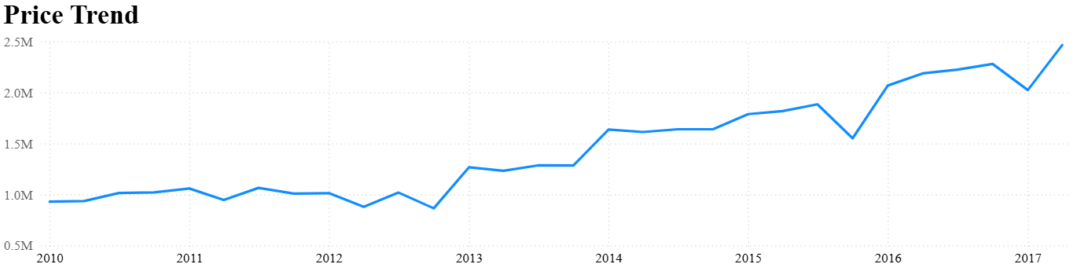
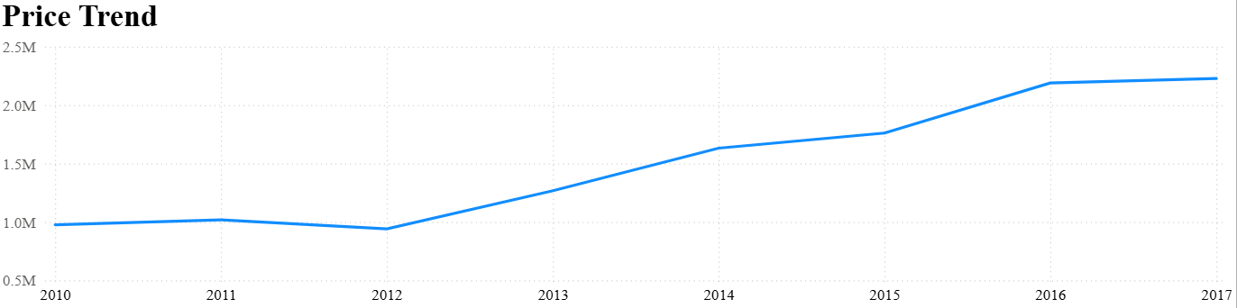
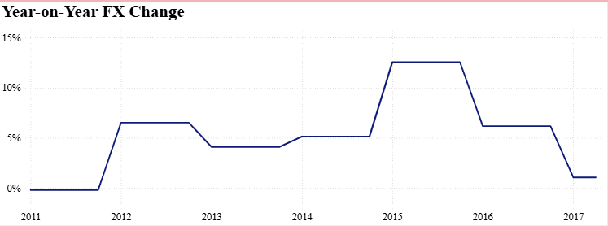
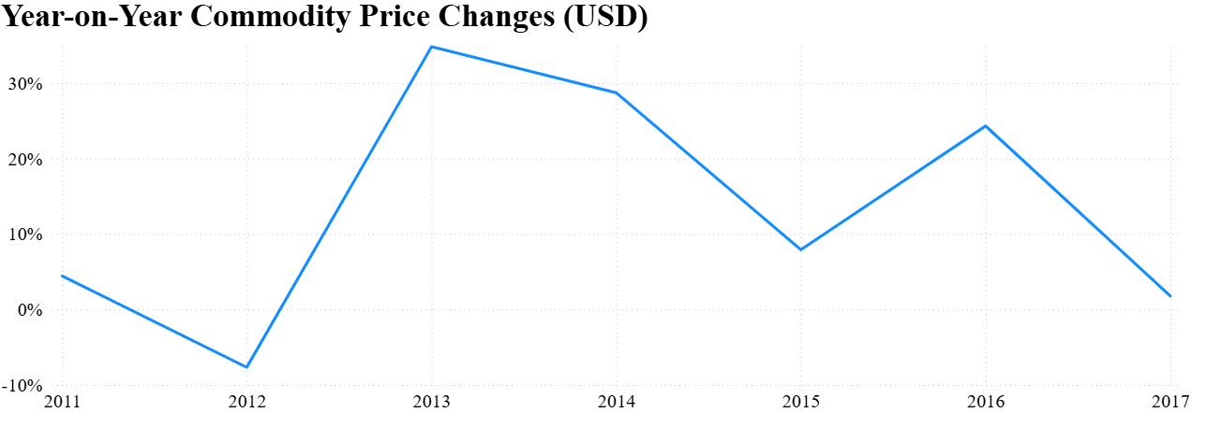
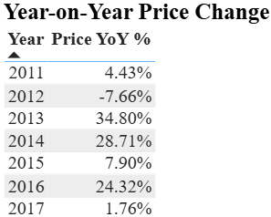
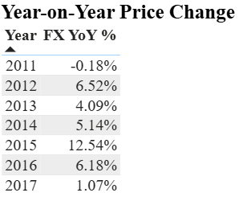
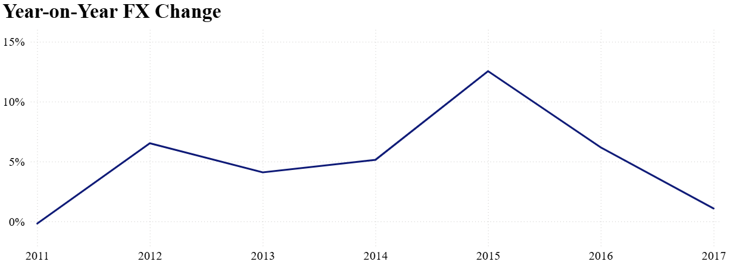
Time Trends
Drilled to the lowest level of data (Quarter)
Highest level data (Year)

Slide 12
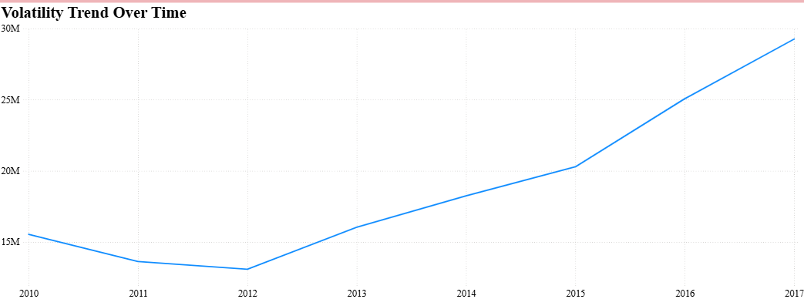
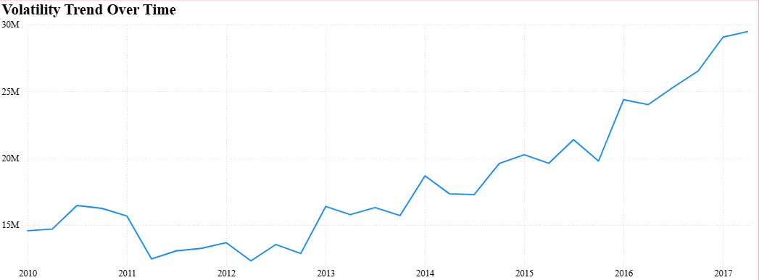
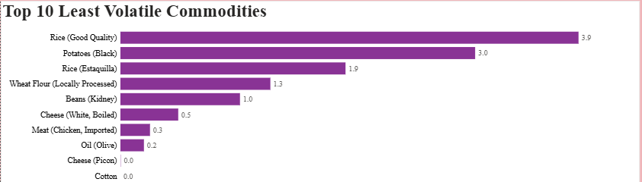
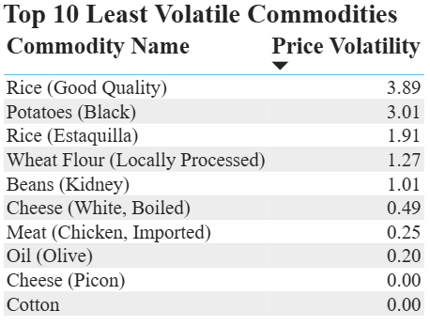
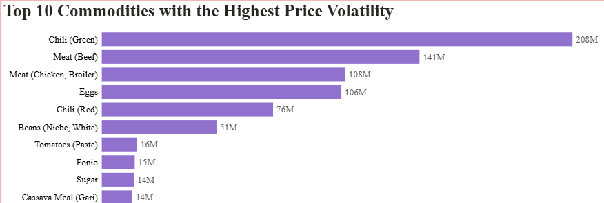
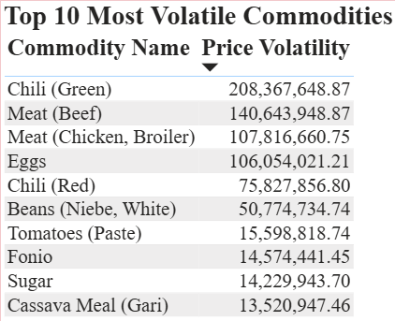
When YoY FX rates change, the prices also change.
Increase in FX rate, increases the Price
Volatility
High volatility: high uncertainty/risky commodities.
Low volatility: stable commodities
2015 Qtr4 – 2017 Qtr2 price volatility has been increasing substantially

Slide 13
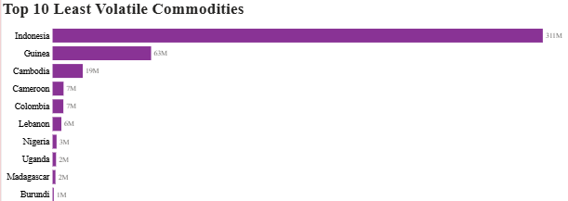
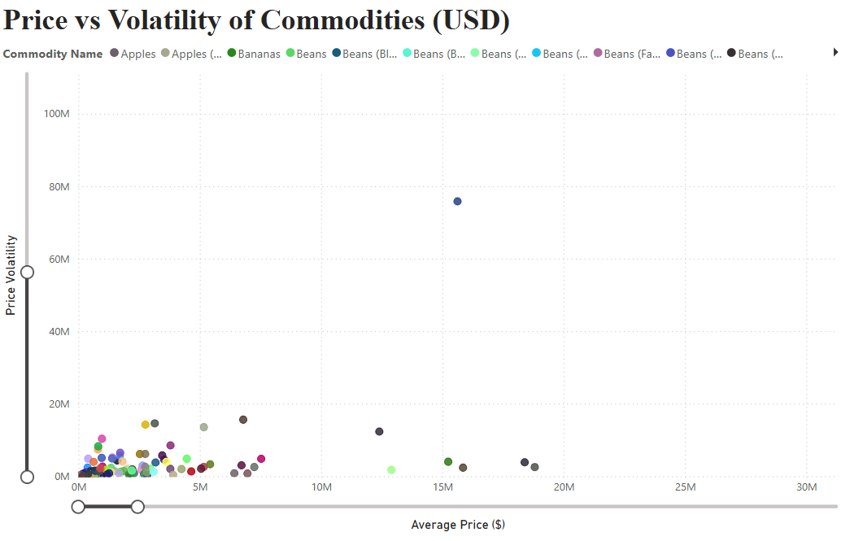
Volatility
From 2015 Q4 to 2017 Q2, prices moved up and down a lot more. The market looked unstable, with bigger swings, even though overall prices didn’t really rise.
Exchange rates
In the same period, Year‑over‑Year exchange rate growth kept falling. By 2017 Q2, currencies were putting less pressure on prices than they did in 2015 Q4.
Price growth
Between 2016 Q1 and 2017 Q4, the speed of price increases slowed. Prices still shifted, but the upward push lost strength.
Stability vs. volatility
From 2016 Q1 to 2017 Q4, average prices stayed steady. The market had short‑term jumps and drops, but no lasting rise in overall levels.
Clustered
Most commodities sit close together. On average, they’re around USD 3M. Their volatility is under 10%, which means prices are moderate and don’t swing too much.
Outliers
A few commodities break away from this calm picture. They show much higher or more unstable prices, clearly standing out from the rest.
Overall, the market is steady and mid‑range, though there’re a lot of commodities that stand out.

Slide 14
Technical Specifications
Data Source
Environment
Data Model
Dataset | Source | Format | Size
Global Food Prices | Kaggle | .csv | 740,000+ rows
Exchange Rate (LCU per USD) | World Bank | .xlsx/.csv | Annual, 74 countries
Item | Detail
Tool | Power BI Desktop + Excel
Refresh | Static — one-time load
Currency | USD
Design:
Star Schema
Fact Table:
Market_Prices
Dimension Tables:
Calendar
Country
Commodity
Market
MarketType
Locality
Currency
Units
Reference Table
Exchange_Rate
ETL Summary
DAX Formulas
Step | Detail
Tool | Excel + Power BI Power Query
Filters Applied | 2010–2017 Food only 55 countries with FX data
Date Column | Created via #date([Year], [Month], 1)
Dimension Tables | Extracted from fact table into separate tables
Null Handling | Rows with missing prices excluded
Average Price ($)
Price YoY %
FX YoY %
Price Volatility
Price Acceleration
Total Countries
Total Commodities
Total Markets
Product Frequency

Slide 15
Assumptions
User Accessibility Design
Privacy Considerations
Time Period: Data covers 2010 – 2017
Commodities: Focus is on food items only
Currency: All prices converted to US dollars for fair comparison.
Exchange rates: World Bank gives rates by year. For monthly prices, the yearly average was used.
Volatility: Measured by standard deviation, showing stable vs unstable foods.
Interactive slicers: All dashboards have slicers for market type and continent. This lets one focus on the parts that matter most to them.
Visual variety: Data is shown in many ways. There are bars, lines, pies, scatter plots, and tables. This gives users options depending on how they like to see information.
Consistent filters All pages use the same filters: years 2010 to 2017, food items only, and 55 countries. This keeps everything aligned and easy to follow.
Public data: The project only uses open sources: Kaggle for food prices and the World Bank for exchange rates. No personal details are included.
Intended use The report is for policy, research, and market analysis. It’s not for resale without credit to the sources.

Slide 16
Challenges
Combining the 2 data sources was difficult
Food prices were monthly. Exchange rates were yearly. This mismatch made alignment hard
Incorrect relationships between Market_Prices (Fact table), Calendar, and Exchange Rates, resulted to some DAX formula producing incorrect results e.g. Price YoY %, FX YoY %
Visualizing FX YoY % and Price YoY % in a single line & column visual proved difficult
The original dataset contained local currencies for 55+ countries. Analyzing the data with these local currencies gave inaccurate results.
THANK YOU!

