Slide 1


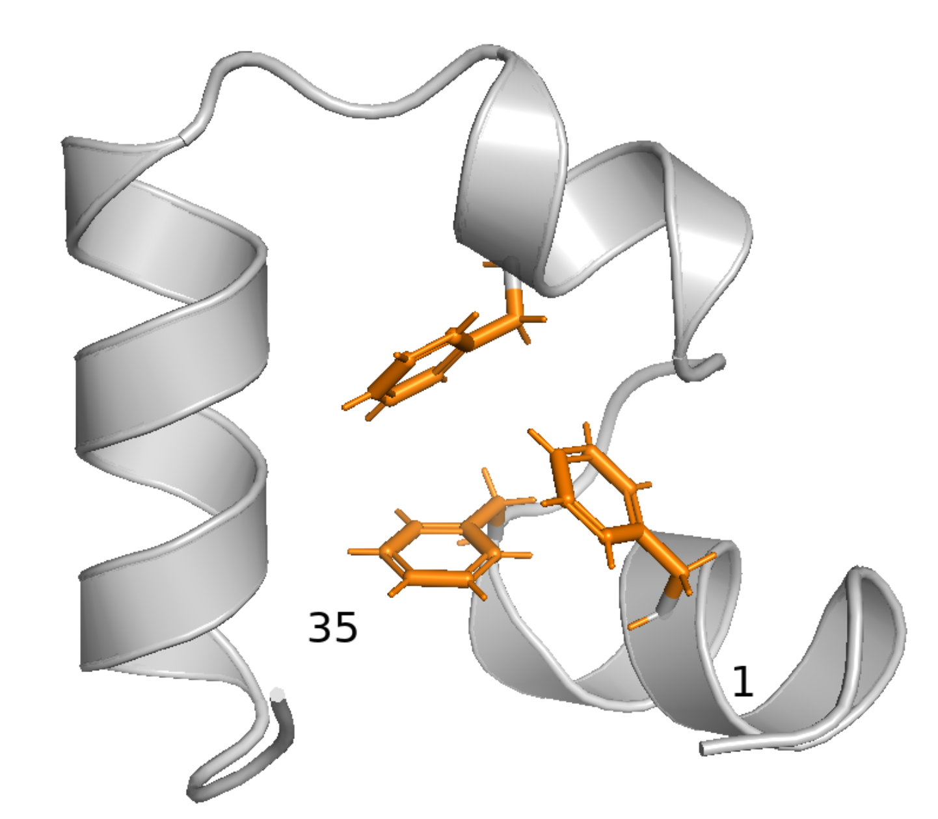
BIOLOGICAL DATASETS FOR COMPUTATIONAL PHYSICS
Markov State Modelling of the HP35 domain
Student: Miriam Zara - ID 2163328
Instructor: Prof. Monika Fuxreiter, PhD
Academic year 2025-2026
PDB 2F4K
J. Kubelka, T.K. Chiu, D.R. Davies et al.
Sub-microsecond protein folding, J. Mol. Biol. 2006

Slide 2
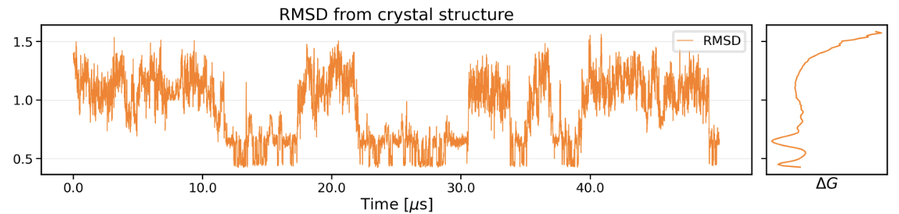
INTRODUCTION
HP35 (Nle/Nle mutant)
Data:
original: K. Lindorff-Larsen, S. Piana, R.O. Dror and D.E. Shaw, How fast-folding proteins fold, Science 2011
preprocessed: D. Nagel, S. Sartore, and G. Stock, Selecting Features for Markov Modeling: A Case Study on HP35, J. of Chem. Theory and Comp. 2023
nm
timestep approx. 200 ps
Villin headpiece subdomain (HP35)
Established case study
35 residues, ultra fast autonomously folding domain: < 1 mus in the Nle/Nle mutant
Biological question:
Does HP35 have resolvable metastable substructure (long-lived states that are structurally well defined) beyond simply folded and unfolded?
Tools: Markov State Modelling (MSM) on a single 300 mus MD trajectory at T=360K
Methodological question: How does the MSM pipeline affect the results?
PDB 2F4K
J. Kubelka, T.K. Chiu, D.R. Davies et al.
Sub-microsecond protein folding, J. Mol. Biol. 2006

Slide 3
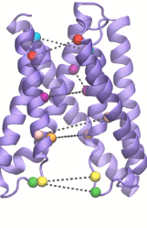
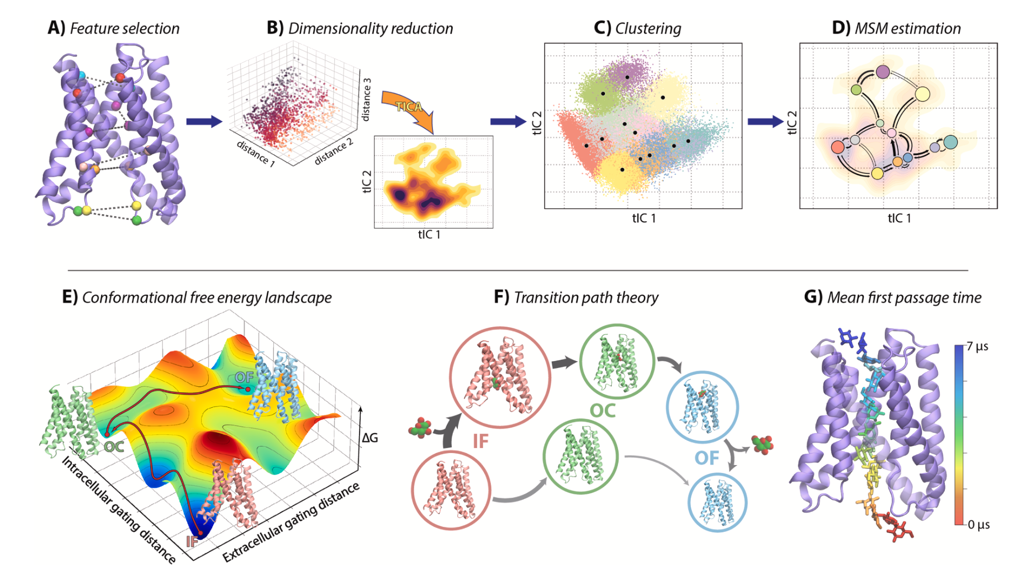
INTRODUCTION
The MSM pipeline has no unique recipe (yet)
1
→
2
→
3
→
4
Features
Reduce
Cluster
Transition matrix
→
!
structures
→
populations
Garbage in, garbage out
→
lifetimes
→
pathways
PCA maximizes variance : high amplitude motion = important
tICA maximizes autocorrelation: slow = important
Clustering algorithms rely on euclidean distance
A good dimensionality reduction maps rapidly interconverting points close in the space: “kinetic” distance ⩬ geometric distance

Slide 4
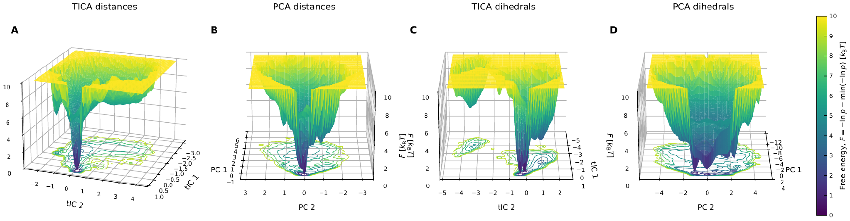
METHODS
Four sets of reduced coordinates for the transition matrix estimation
Feature choice, dimensionality reduction and clustering are all judgement calls — and different reasonable choices can resolve different metastable states. So instead of committing to one pipeline, I built four.
PCA
tICA
42 contact distances
pca-distances
tica-distances
62 backbone dihedrals
pca-dihedrals
tica-dihedrals
maximal
variance
maximal
autocorrelation
Free energy on the first two reduced coordinates: one dominant minimum for the distance models, two for the dihedral models, plus a well-separated basin in both tICA projections.

Slide 5
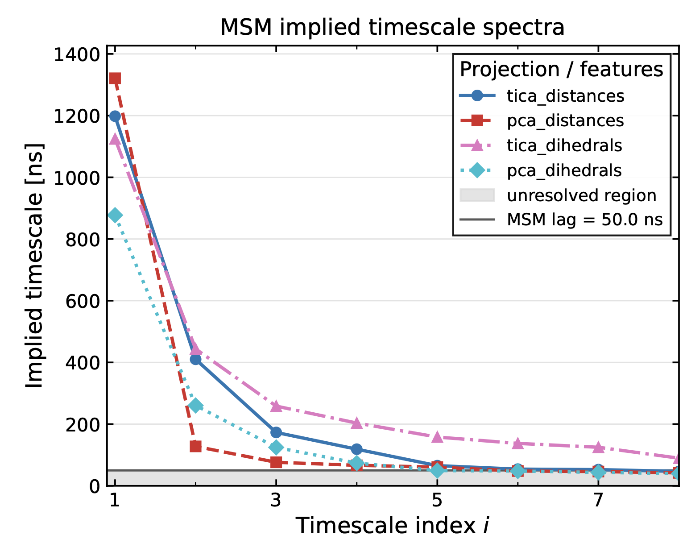
METHODS
Common parameters across pipelines
3
→
4
→
5
Cluster
Transition matrix
Validate
k-means++ on the
reduced coordinates
max. likelihood,
detailed balance
implied timescales
+ CK test
k = 50
τ = 50 ns
microstates
(scanned 30 / 50 / 100)
Markov lag
(scanned 10–100 ns)
More clusters give resolution but fewer transitions per state and a network that can disconnect; the lag must be long enough for Markovianity yet well below the 0.7 µs folding time. All four pipelines share the same k and τ, so whatever differs between the models comes from the features and the reduction — not from the discretisation.
4

Slide 6
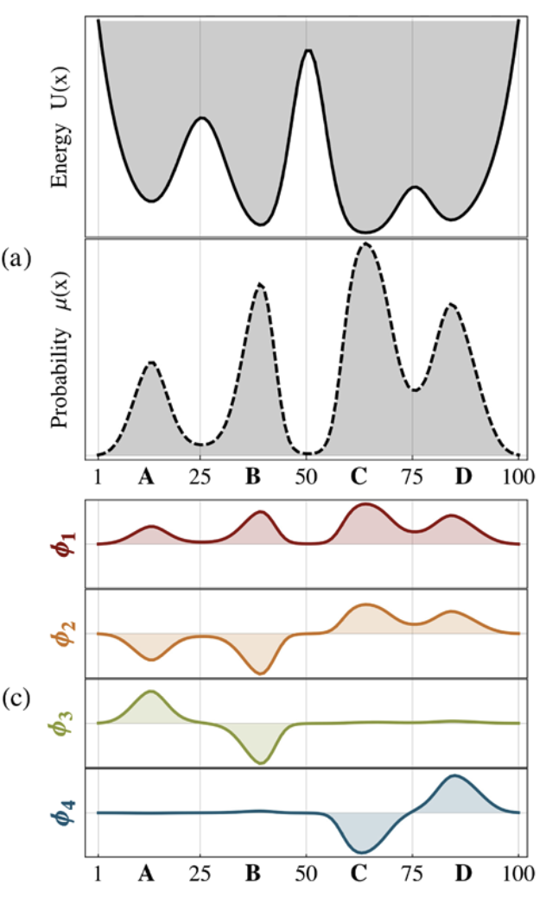
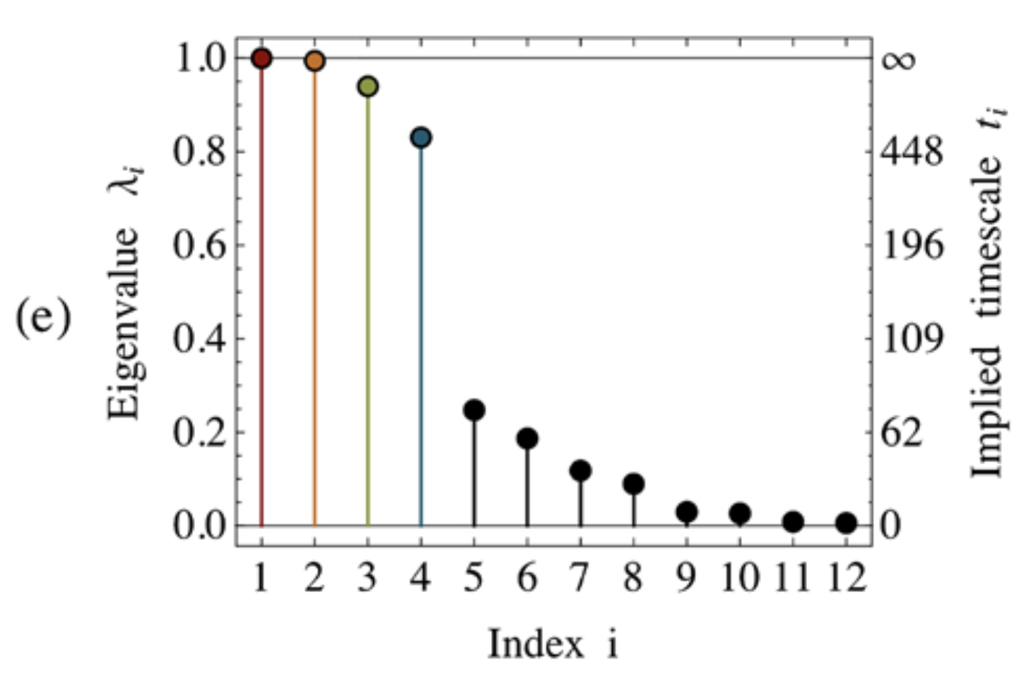
METHODS
Resulting MSMs were coarse-grained with PCCA++
PCCA++ identifies slow processes using the eigenvectors sign patterns
G.R. Bowman, V.S. Pande and F. Noe,
An Introduction to Markov State Models and Their Application to Long Timescale Molecular Simulation Springer (2013)

Slide 7
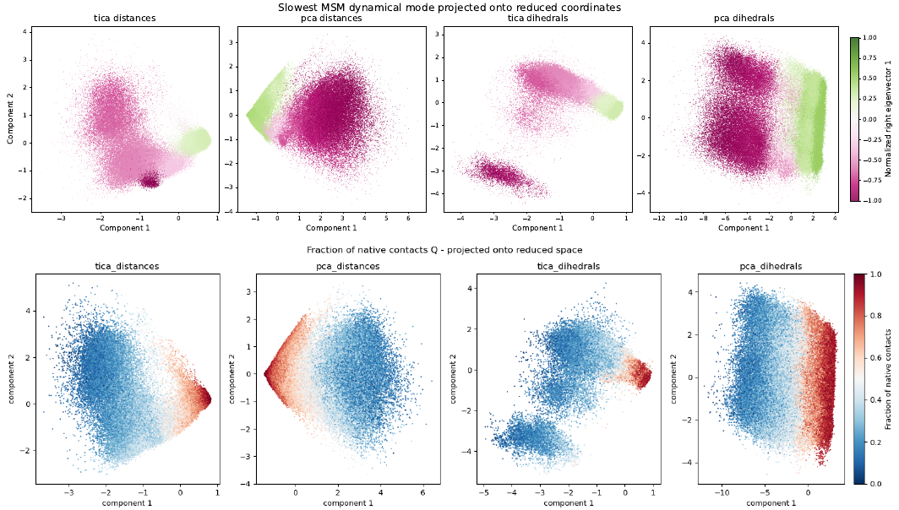
RESULTS
Slowest process separates folded and unfolded conformations

Slide 8
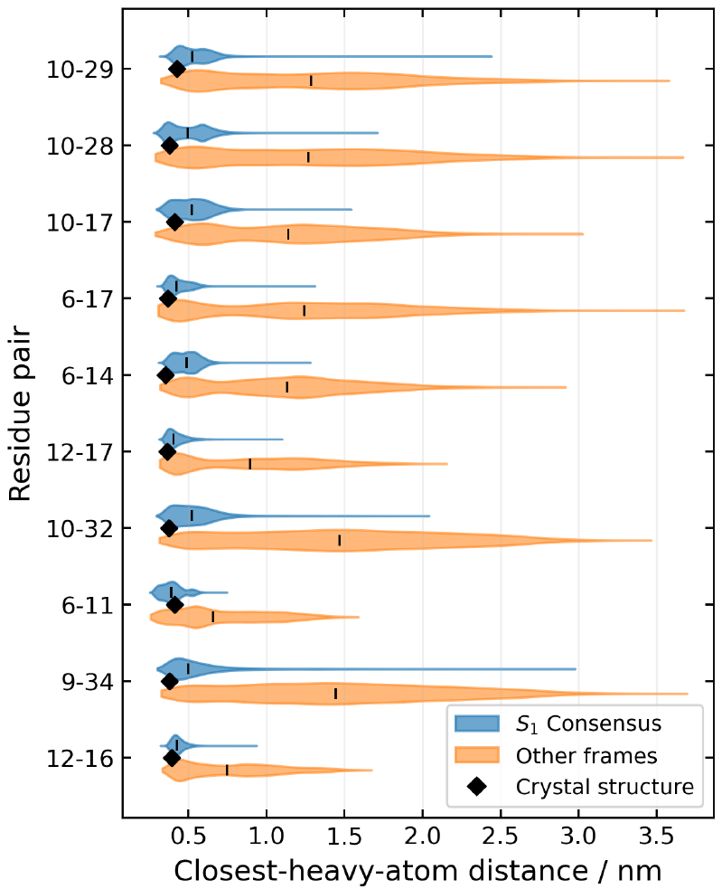
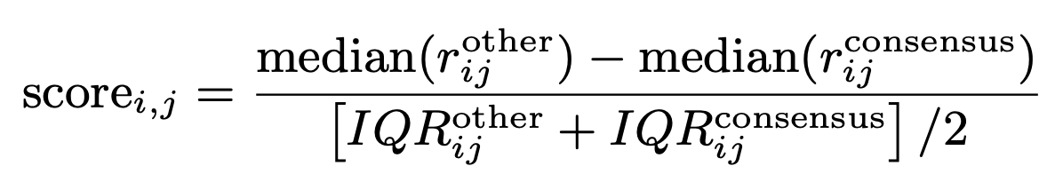
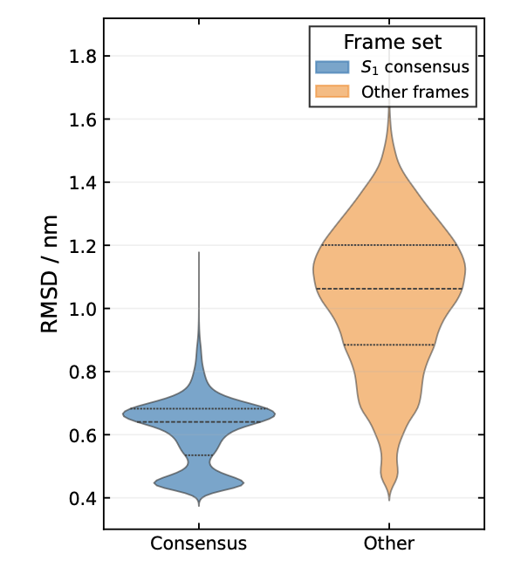
RESULTS
Folded-side basin is distinguished by hydrophobic core and close packing,
not by helix formation alone
Consensus folded set frames assigned to S₁ with χ > 0.8 by all four models — 61% of the trajectory. Median RMSD 0.65 nm, versus ~1.1 nm for everything else.
Every native contact was then ranked by how sharply it separates the consensus set from the rest — a median difference normalised by the spread of the two distributions.
31–32% unfolded
67–68% folded
consistent with Piana et al. for this trajectory
Frames assigned to opposite states
1.6 %
tica-distances vs pca-distances
2.3 %
pca-distances vs pca-dihedrals
≈ 8 %
tica-dihedrals vs each of the others
7

Slide 9
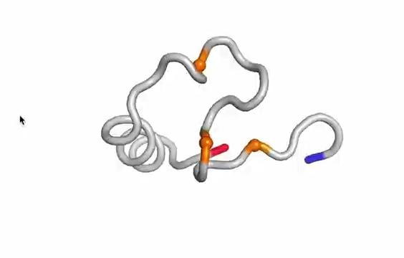
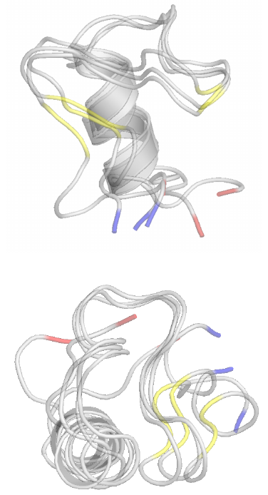
RESULTS
A finer partition: each tICA model finds a different new state
The tICA spectra keep several processes above the resolution limit, so I pushed both tICA models to three macrostates.
tica-distances
A compact non-native state
S₀
~1% population · ~1 µs single visit
Helix 3 stays folded, while residues 6–14 form a stable β-hairpin-like segment in place of helix 1.
Distinguished by the backbone dihedrals of Phe6, Lys7 and Gly15 — β region here, α_{R} elsewhere.
A non-native topology ⇒ a plausible off-pathway intermediate, i.e. a putative kinetic trap. Rare but long-lived: one visit in 305 µ
8

Slide 10
RESULTS
A finer partition: each tICA model finds a different new state
The tICA spectra keep several processes above the resolution limit, so I pushed both tICA models to three macrostates.
tica-dihedrals
A loop rearrangement
S₀
3–6% population · 0.32 µs median residence
The structural signature is much weaker. The only clear difference is the Leu20–Pro21 loop joining helices 2 and 3: its φ/ψ angles sit in the β region here, and in α_{R} in the other two macrostates.
Entered only from the unfolded state, and always returns to it — no S₁ → S₀ → S₂ passage is observed.
So this is a local rearrangement inside the unfolded ensemble — not a folding intermediate.
8

Slide 11
RESULTS
Inside the folded-side basin: a locked and unlocked N terminus
8

Slide 12
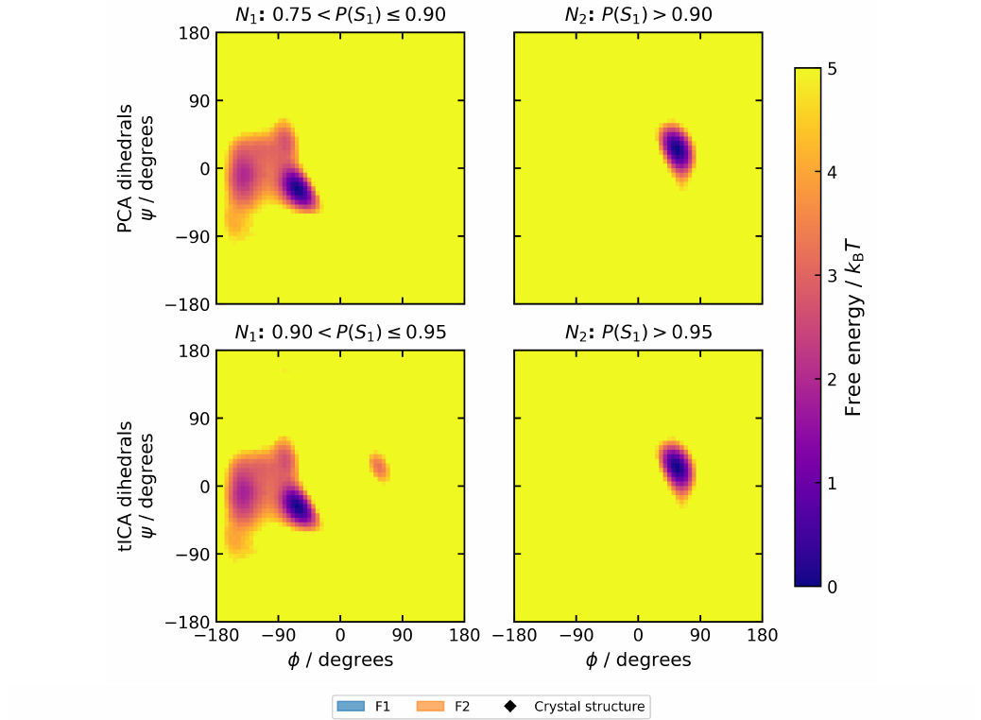
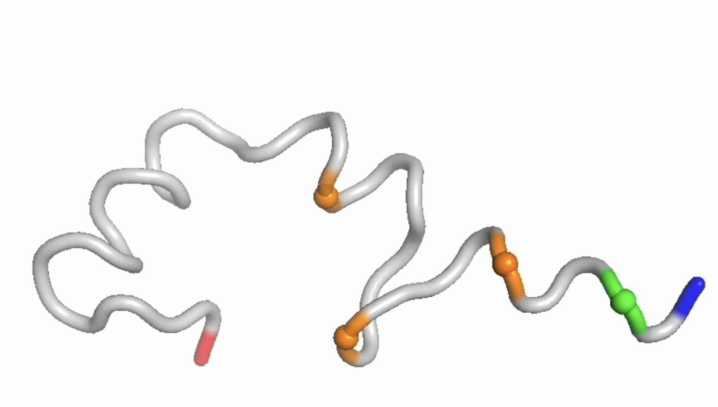
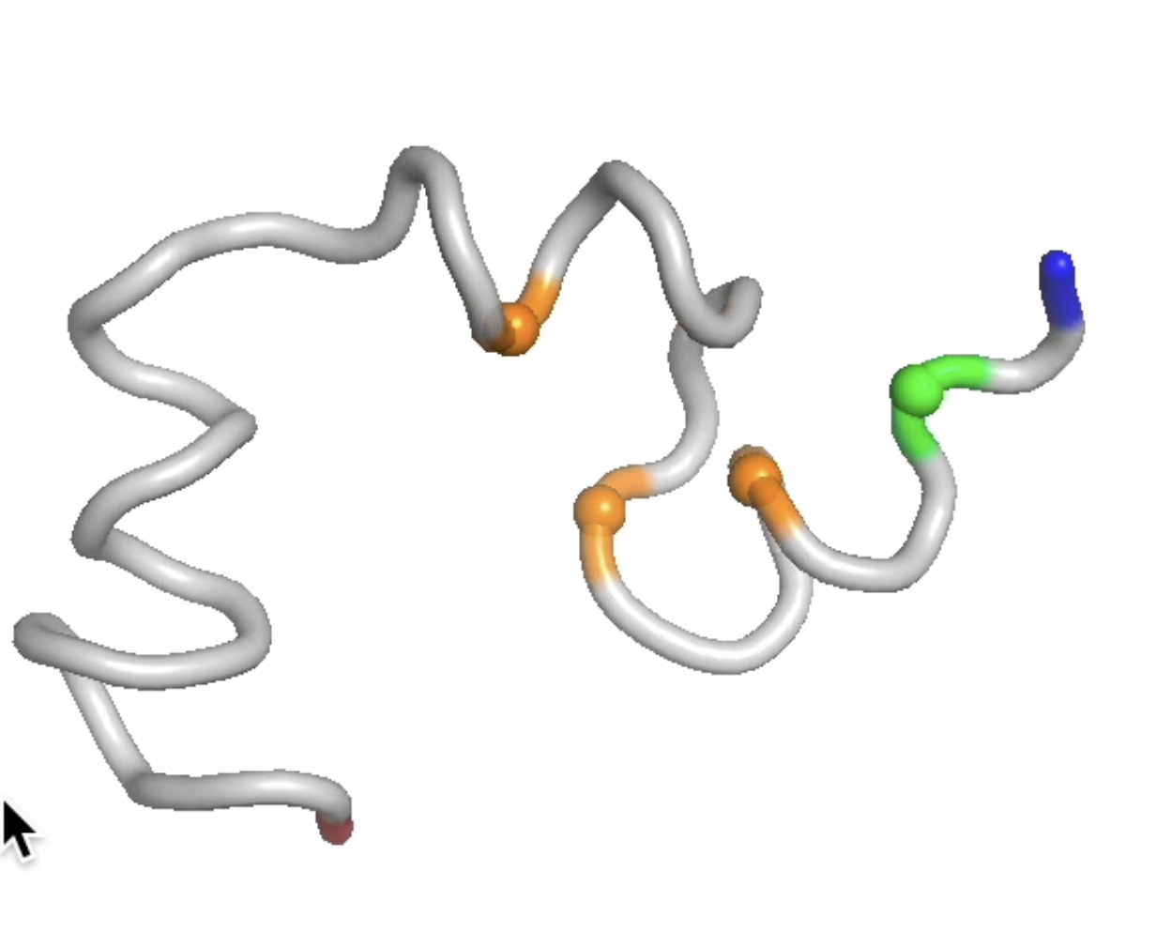
RESULTS
Inside the folded-side basin: a locked and unlocked N terminus
RMSD, the 10–29 contact and the membership distributions of both dihedral models are all bimodal inside the folded basin — yet PCCA++ with three states does not split it. So I subdivided it by hand, at the peaks of the membership probability.
“unlocked”
F₁
34–35%
Asp3 in αR · those Leu1 contacts present/absent (fluctuating ->mobile terminus)
F₂
31–32%
Asp3 in αL
native contacts of Leu1 absent
(φ, ψ) of Asp3 in the two subpopulations, for the PCA (top) and tICA (bottom) dihedral models. The whole distinction rests on one residue.

Slide 13
RESULTS
Inside the folded-side basin: a locked and unlocked N terminus
(φ, ψ) of Asp3 in the two subpopulations, for the PCA (top) and tICA (bottom) dihedral models. The whole distinction rests on one residue.

Slide 14
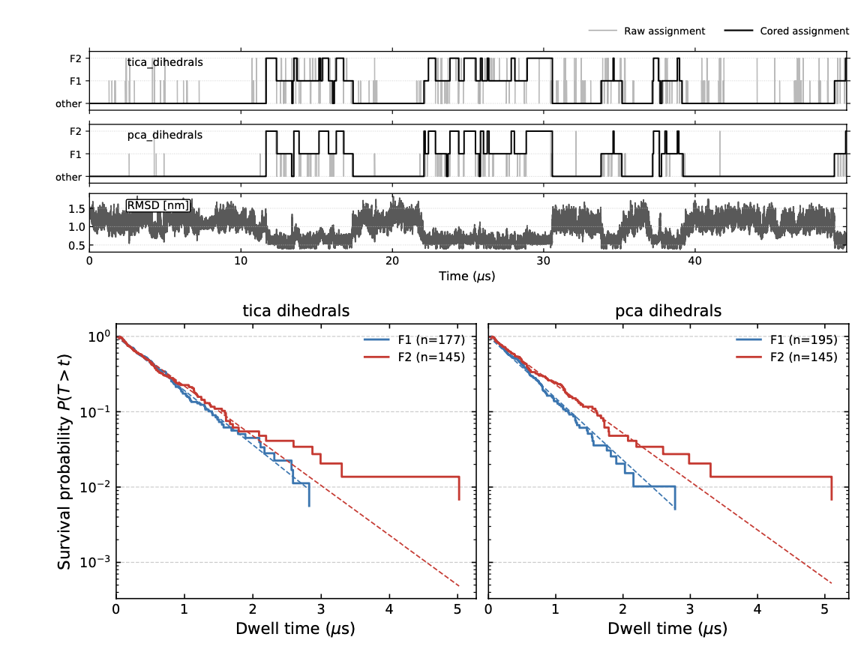
RESULTS
Inside the folded-side basin: a locked and unlocked N terminus
Both are metastable in their own right: median residence ≈ 0.4 µs (mean ≈ 0.6 µs), with near single-exponential dwell-time distributions.
Comparable to the loop state that PCCA++ does resolve (0.32 µs) — so these are probably genuine kinetic subdivisions that would appear with more macrostates.

Slide 15
DISCUSSION
Findings about HP35 and model-dependence
1
One dominant process
≈ 1/3 unfolded, ≈ 2/3 folded — separated by the hydrophobic core and helix-1/helix-3 packing, not by secondary-structure content.
2
A ≈1% compact non-native state
lifetime ~1 µs, a β-hairpin-like segment in place of helix 1: a putative kinetic trap, resolved only from contact features.
3
Two substates in the folded basin
of comparable population, differing in the N-terminus — Asp3 in αR vs αL, and the native contacts of Leu1.
The methodological point: one trajectory, four defensible pipelines, and different answers: one says two-state, one finds a trap visible only in contact space, one finds a loop state visible only in dihedral space, dihedral-based models split the “folded” side of the main basin into an almost-folded and a folded conformation, distance-based models do not.

Slide 16
CONCLUSIONS
Some insights and lot of room for improvements
1
2
3
More macrostates
Systematic state comparison
Kinetics, not just populations
PCCA++ beyond n = 3, especially for the tICA models — the substates found by hand should emerge there.
match metastable states across all four pipelines, rather than pairwise at the two-state level.
transition path theory at the microstate level: dominant folding pathways and fluxes between states.
Thank you
Questions welcome — I have backup slides on the discretisation choice, the CK test, coring and the F₁/F₂ dwell times.
Data github.com/moldyn/HP35-DESRES Code github.com/miriamzara/MSM
12

Slide 17
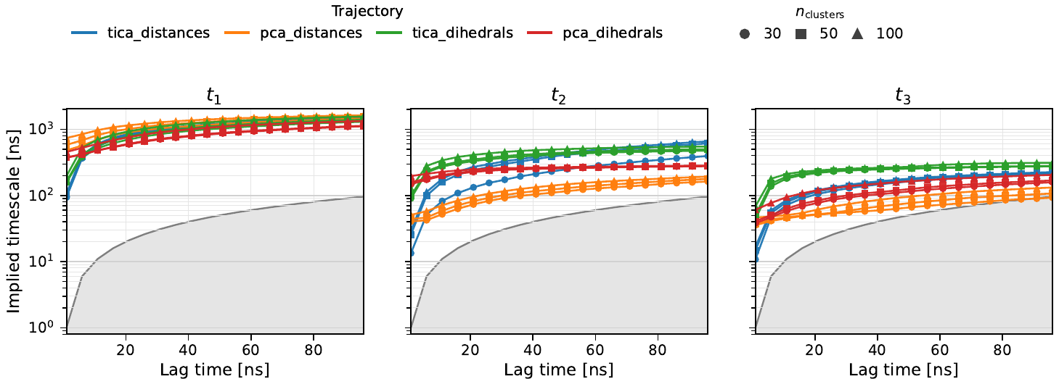
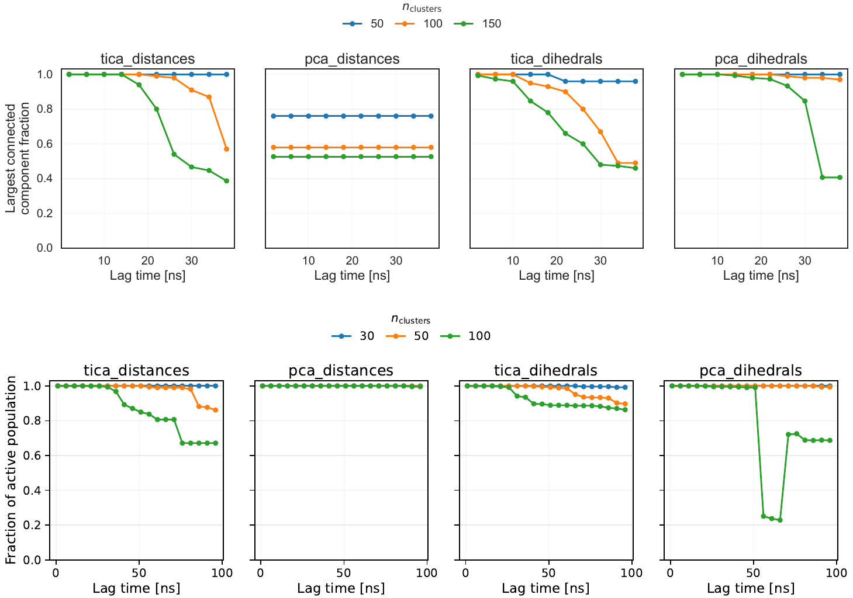
BACKUP
Choice of number of clusters and lagtime
k = 50
τ = 50 ns
Timescales converge for all four pipelines and depend far more on the pipeline than on k. Connectivity degrades with more clusters and longer lags: at k = 100 the microstate network starts to disconnect. k = 50, τ = 50 ns is the compromise — and the choice remains partly qualitative.
Top: implied timescales vs lag (SF2). Bottom left: largest connected component and active population vs lag (SF3).
14

Slide 18
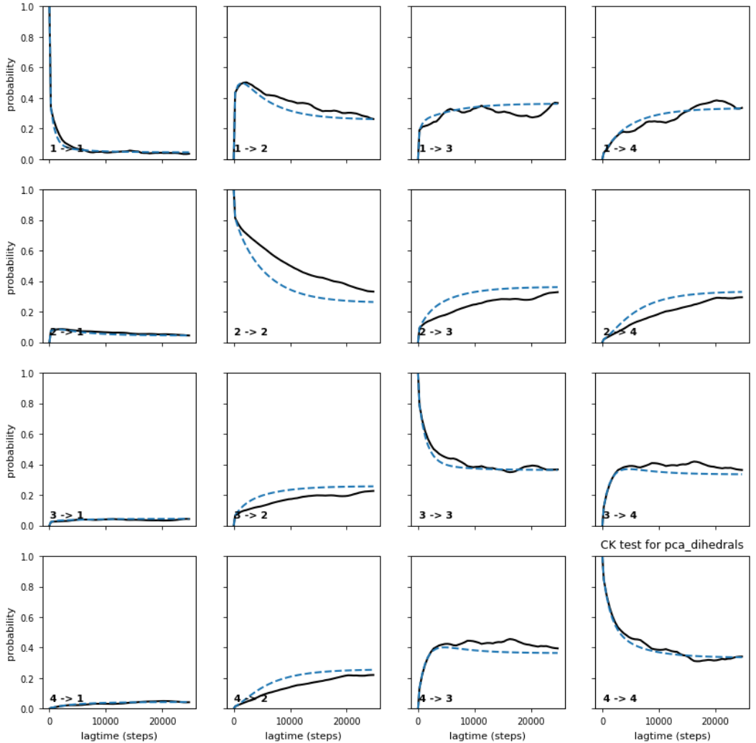
BACKUP
Chapman–Kolmogorov test
The test. The microstate MSM at τ = 50 ns is lumped into four metastable sets. For a range of lag times kτ, the transition probabilities predicted by the τ = 50 ns model (dashed) are compared with those estimated independently at each lag (solid).
The two track closely and relax to consistent stationary values, so the model is approximately Markovian at the chosen lag.
Shown for pca-dihedrals; the other three behave similarly.

Slide 19
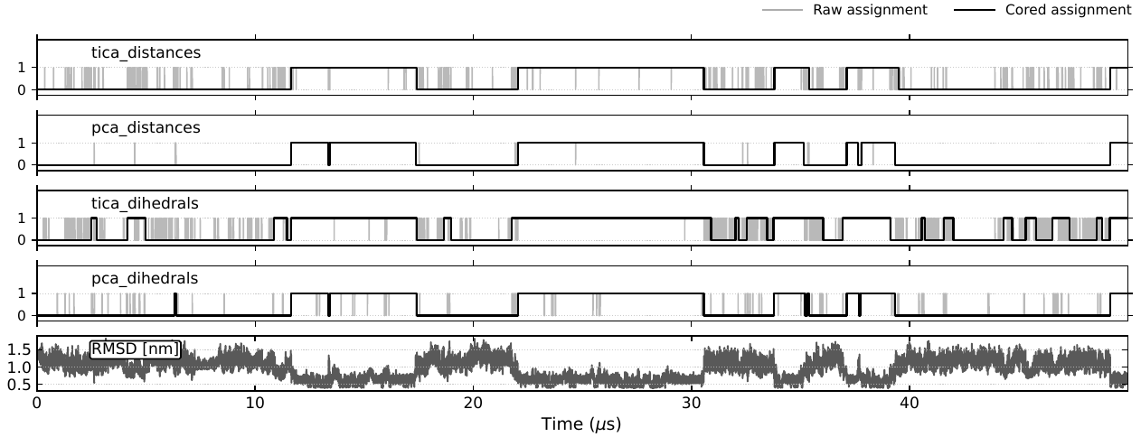
BACKUP
Dynamical coring removes boundary recrossings
The problem. Assigning every frame to its highest-membership macrostate produces rapid recrossings near a state boundary. These inflate the apparent number of transitions, and mostly reflect boundary noise rather than genuine interstate crossings.
The fix. A transition into a new macrostate is registered only once the trajectory stays there for at least t_{min} = τ = 50 ns, so only long-lived occupancies survive. Grey = raw assignment, black = cored. All lifetimes and empirical populations quoted here are computed from the cored trajectory.
17

Slide 20
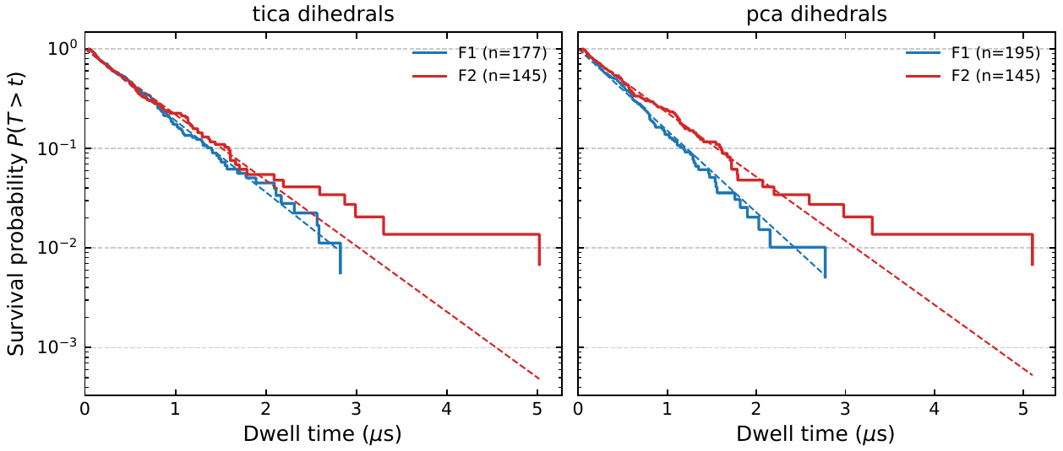
BACKUP
F₁ and F₂ lifetimes
Model | State | N visits | Mean [µs] | Median [µs] | Population
tica-dihedrals | F₁ | 177 | 0.603 | 0.463 | 0.350
tica-dihedrals | F₂ | 145 | 0.658 | 0.435 | 0.313
pca-dihedrals | F₁ | 195 | 0.529 | 0.412 | 0.338
pca-dihedrals | F₂ | 145 | 0.676 | 0.480 | 0.321
Residence times in the two folded sub-basins, from the cored microstate trajectory of each dihedral model.
Yes, in the kinetic sense that matters here. The dwell-time distributions are close to single-exponential (right), which is what a single metastable basin should give, and the median residence of ≈ 0.4 µs is comparable to the loop macrostate that PCCA++ does resolve on tica-dihedrals (0.32 µs).
That PCCA++ resolves one and not the other is not a contradiction: F₁/F₂ are a finer subdivision that should appear with more than three macrostates.
Survival probability P(T > t) with an exponential fit, for both dihedral models.
18

