Slide 1


Project Estimator & Planning Suite (PE&PS) Ramp up guide

Slide 2

Topics
Introduction to PE&PS
PE&PS roles and responsibilities
PE&PS training curriculum
PE&PS Estimation process steps
Additional resources
Next steps

Slide 3
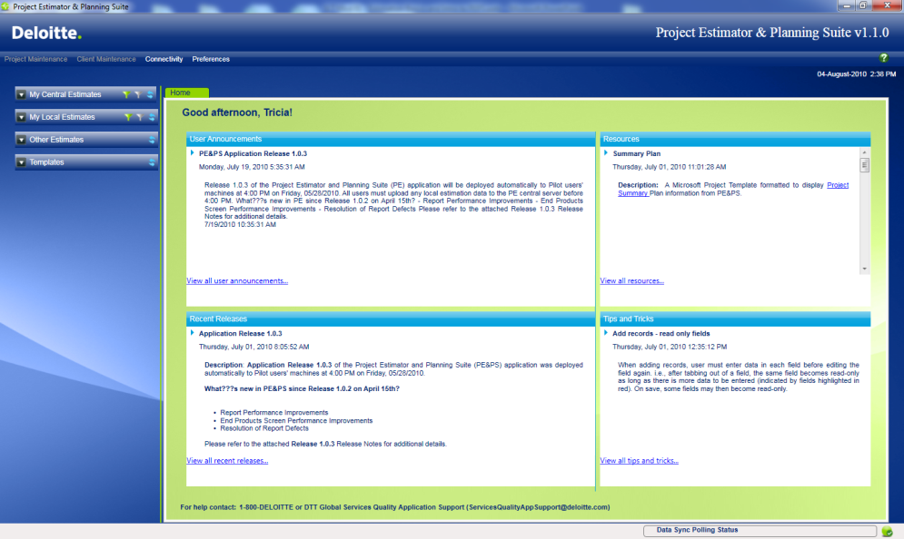
Introduction to PE&PS
What is PE&PS?
PE&PS is primarily a Windows-based Client-Server application for project scoping, estimating and work planning
It is an enhancement to the existing Excel PE tool that has evolved over the last 10 years
Why the move to the Application?
Excel as a development platform did not meet the needs of the practice any longer
User interface is much more user friendly than Excel
Data integrity is higher
Ability to keep history on data and do analysis that will improve estimation data
Alignment with PMC, ARIS, and RMC
PE&PS drives consistent estimation of costs, effort, and resources during sales and delivery of our ERP projects, with the goal of increasing quality and profitability
3

Slide 4
What will PE&PS do for me?
PE&PS is an effective tool to use during both the selling and delivery of a project.
Selling of projects
Delivery of projects
Helps clearly articulate to our clients the basis of our estimates
Creates a consistent and repeatable approach that reduces risk in project estimation because it has a standard approach for gathering estimation data and analyzing reports
Links your scope to your effort, so you don’t over estimate your project
Integrates with EVD methods, such as project plans, SOW (future release), pricing model, etc.
Repository for scope items during a project for scope maintenance and project plan generation
Creates estimation and project planning at the end of a project phase to re-estimate the next phase (e.g. end of Blueprint phase to estimate the Realization phase)
Produces project plans in MS Project and integrates with PMC
Proposal
Project Preparation
Blueprint
Realization
Final Preparation
Go Live and Support
During the Proposal phase, you are estimating costs for the entire program
Parametric estimating beyond Realization would be focused on future releases
PE&PS

Slide 5
PE&PS Roles
All U.S. Deloitte employees will have access to the PE&PS application and will be assigned one of the following security roles:
Project Creator
Deloitte Senior Managers, Specialist Leaders, Directors, or Principals who have completed the required PE&PS training and finished one estimate will be granted ‘Certified Estimators’
Can create projects (estimates) and new versions
Project Creators can give other Deloitte team members access to their projects. Typically, they will give access to consultants assisting them on proposals or in a PMO.
They can grant Update Access, View Access, or No Access for each module (Scope, Schedule, Cost, etc.)
Project Participant
Deloitte project or pursuit team members
Cannot create projects
Can only view projects where access has been given; actions performed will be mostly around scope setting
These users will have access to training materials for on the job training as needed

Slide 6
PE&PS Responsibilities
Lead Estimator
The role of the Lead Estimator is held by a SM/SpL or Director on the US pursuit / project team
Leads the pursuit team and is the single point of communication from the team to the coach and “CoE”
Owns the estimate
Proficient in PEPS and the estimation process
Responsible for data gathering spreadsheets
Defines the project schedule
Actively involved in the estimation process
Analyzes estimation results
Make scope and staffing decisions
Owns the staffing plan
Approves the final estimate
PM CoE
Supports the estimation process
Analyzes the scope provided by the Lead Estimator
Enters / imports scope from the data gathering spreadsheets
Analyze the data gathering spreadsheets and PEPS outputs
Provide outputs of PEPS to the Lead Estimator
Make recommendations on adjustments to scope, schedule and fixed head count
Make adjustments based on the approval of the Lead Estimator
Manage the integration from PEPS to the staffing model, pricing model and MS Project
Does not own the estimate
PE&PS Coach
Most knowledgeable in the tool and estimation process
SME during the estimation process
Supports the Lead Estimator ramp up on the tool
Provides leadership on the estimation process
Single point of contact to the PEPS team if issues arise that the coach cannot resolve
Does not own the estimate
The role of the coach is held by someone from the SAP Coaching Team in Services Quality
Lead Estimator
PM CoE
PE&PS Coach

Slide 7
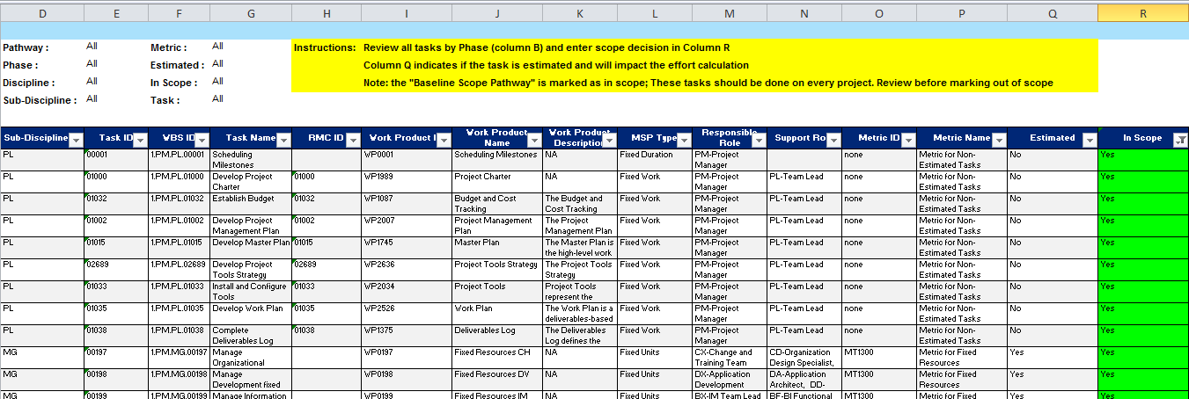
Data Gathering Worksheets
There are 4 templates which help gather data for the estimation process:
Method Scope – what work the team will be doing
Package Scope – package modules/sub-modules
Product Scope – what we are producing from that work (metrics)
FTE Scope – for fixed resources
Below is a screen shot from the method scope data gathering worksheet: This worksheet is used to identify which tasks within the method are in scope.

Slide 8
PE&PS Estimation process steps
0
PE&PS Prep
1
Set Up
Project
2
Record Method Scope
3
Define Schedule
4
Record Product Scope
5
Define Project Resources
6
Review Effort and Costs
7
Complete Staffing Model
8
Complete Pricing Model
9
Generate Summary / Work Plan
Step 0.1 Identify Lead Estimator
Step 0.2 Lead Estimator completes training
Step 0.3 Request Coach
Step 1.1 Create Client (Optional)
Step 1.2 Create Project
Step 1.3 Provide Access
Step 2.1 Confirm phases in scope
Step 2.2 Select Method Framework
Step 2.3 Select Method Tasks
Step 3.1 Define Work Hours
Step 3.2 Setup Releases
Step3.3 Setup Rollouts
Step 3.4 Define Phase Schedule
Step 4.1 Record Detailed End Product Scope
Step 4.2 Record End Product Scope
Step 5.1 Confirm Teams
Step 5.2 Confirm Roles
Step 5.3 Define Deloitte/Client Allocation
Step 5.4 Define Resources
Step 6.1 Run Effort and Cost Reports
Step 6.2 Review and adjust Task Estimates
Step 6.3 Review and adjust Rate Groups
Step 6.4 Review and adjust Rate Group Allocation
Step 7.1 Run Staffing Plan Interface
Step 7.2 Build Staffing Plan
Step 8.1 Engage Pricing COE
Step 8.2 Run Pricing Model Interface
Step 8.3 Build Pricing Model
Step 9.1 Generate Master Plan
Step 9.2 Generate Summary Plan
Step 9.3 Perform Capacity Planning (Optional)
Step 9.4 Generate Work Plan (Optional)
Key Points:
Start on your estimate as soon as you can.
A large estimate can take more than 2 weeks to complete with a final pricing model.
Schedule your pricing calls once you start working on your estimate.
You should give a minimum of 5 days working time on your estimate prior to your first pricing call.
The subsequent pricing calls should then be scheduled at least two days a part to refine your estimate.
Define your pursuit or project leads for the applicable disciplines and get them involved with providing method and metric scope inputs as soon as you start your estimate.
Make sure your estimated hours and initial costs are as close to ‘Final’ prior to moving to Step 8.
Step 8 is to finalize staffing and pricing and not re-estimate effort.

Slide 9
Record Data in
PE&PS
Project estimating and summary planning process
Lead Estimator
Prep
Data Gathering
and Project Set-up
Review & Update
Initial Pricing Call /
Staffing Model
Pricing Model /
Final Pricing Call
Project Plan
0
PE&PS Prep
1
Set Up
Project
2
Record Method Scope
3
Define Schedule
4
Record Product Scope
5
Define Project Resources
6
Review Effort and Costs
7
Complete Staffing Model
8
Complete Pricing Model
9
Generate Summary / Work Plan
Lead Estimator Prep
Identify Lead Estimator
Lead Estimator completes training
Data Gathering and Project Set up
Lead Estimator downloads and completed data gathering worksheets
Lead Estimator completes Project Set-up Q&A
Coach Sets up Project
Record Data in PE&PS
Data entered into PE&PS by proposal team
Data entered into PE&PS by PM CoE team (Optional)
Coach available for clarification and interim reviews
Review and Update
Proposal team and Coach review estimate
Proposal modifies data as required and reviews again
Coach completes final review and final suggested changes
Initial Pricing Call / Staffing Model
Project initiates initial pricing discussion
Proposal team updates staffing model
Coach assists with Staffing model functionality
Pricing Model / Final Pricing Call
Proposal team generates Pricing Model
PCOE will assist in pricing model reviews
Project team meets with PPD to review final price
Project Plan
Adjustments to PE&PS completed after pricing call (if required)
Project team generates and updates Summary/Work Plan
Notes:
Mike

Slide 10
Step 0: PE&PS Prep
0
PE&PS Prep
1
Set Up
Project
2
Record Method Scope
3
Define Schedule
4
Record Product Scope
5
Define Project Resources
6
Review Effort and Costs
7
Complete Staffing Model
8
Complete Pricing Model
9
Generate Summary / Work Plan
Objective: To prepare the Lead Estimator for work in the PE&PS tool
Description | The Lead Estimator will be identified and will complete the PE&PS required training
Prerequisite Information | Lead Estimator is Senior Manager/Specialist Leader or higher Responsible for creating the staffing plan and pricing model
Other Resources | SQ Coach
Step 0.1
Identify Lead Estimator
Step 0.2
Complete Training
Step 0.3
Request Coach

Slide 11
Step 1: Set Up Project
0
PE&PS Prep
1
Set Up
Project
2
Record Method Scope
3
Define Schedule
4
Record Product Scope
5
Define Project Resources
6
Review Effort and Costs
7
Complete Staffing Model
8
Complete Pricing Model
9
Generate Summary / Work Plan
Objective: The purpose of this step is to establish a project in the PE&PS tool so an estimate can be conducted
Description | During Project Setup, the estimator needs to determine the project approach and decide which Methodology and IndustryPrint to use, before proceeding to set up the project in PE&PS. If the client does not exist already, it needs to be created. The estimator also needs to give access to other team members working on the estimate.
Prerequisite Information | Client name and Project name Release Strategy (How many releases will this project have?) Method to be used IndustryPrint to be used Product Package to be used Basic Project Information such as start date, PPD and project manager Users you requiring access
Other Resources | Demo: Setup a project Demo: Provide project access Demo: Create a new version Demo: Create a new client Demo: Home and version window navigation Demo: Lock / unlock a version Demo: Download / upload a version
Step 1.1
Create client (optional)
Step 1.2
Create project
Step 1.3
Provide access

Slide 12
Step 2: Record method scope
0
PE&PS Prep
1
Set Up
Project
2
Record Method Scope
3
Define Schedule
4
Record Product Scope
5
Define Project Resources
6
Review Effort and Costs
7
Complete Staffing Model
8
Complete Pricing Model
9
Generate Summary / Work Plan
Objective: Record the method scope consisting of phases, disciplines, sub-disciplines, and method tasks.
Description | Define the method scope of the project. Use a hierarchical approach in selecting the disciplines, sub-disciplines and tasks A task cannot be in scope if the discipline and sub-discipline are not selected
Prerequisite Information | Which phases of the method will be in scope for the project Which disciplines, sub-disciplines will be in scope for the project Which method tasks will be in scope for the project
Other Resources | Demo: Confirm phases and select disciplines and subdisciplines Demo: Select method tasks
Step 2.1
Confirm Phases in Scope
Step 2.2
Select method Framework
Step 2.3
Select method Tasks

Slide 13
Step 3: Define Schedule
0
PE&PS Prep
1
Set Up
Project
2
Record Method Scope
3
Define Schedule
4
Record Product Scope
5
Define Project Resources
6
Review Effort and Costs
7
Complete Staffing Model
8
Complete Pricing Model
9
Generate Summary / Work Plan
Objective: The purpose of this step is to define the schedule for the project.
Description | Define the releases and the rollouts Define the weeks per phase and the start date of each phase The hours for Deloitte and client resources will be confirmed
Prerequisite Information | What is the project rollout strategy? How many releases will the project have? How many rollouts will each release have? How many hours will the resources work? Do we need to make provisions for resource contingency? Is there any productivity improvement between releases?
Other Resources | Demo: Set work hours Demo: Define releases and rollouts Demo: schedule project phases
Step 3.1
Work Hours
Step 3.2
Releases
Step 3.3
Rollouts
Step 3.4
Phase Schedule

Slide 14
Step 4: Record Product Scope
0
PE&PS Prep
1
Set Up
Project
2
Record Method Scope
3
Define Schedule
4
Record Product Scope
5
Define Project Resources
6
Review Effort and Costs
7
Complete Staffing Model
8
Complete Pricing Model
9
Generate Summary / Work Plan
Objective: Record the end product scope, consisting of metrics such as IndustryPrint processes and sub-processes, and RICEF objects. The details of each of the metrics, where available, are also recorded
Description | Define the product scope of the project, expressed as metric quantities. Metrics are used to calculate effort for variable resources working on the project and are expressed as a number Examples of metrics are number of IndustryPrint process groups, processes, and sub-processes, Integration test cycles and cases, RICEF objects, number of training courses, and number of users on the system. For all of the disciplines and sub-disciplines in scope, the relevant metric quantities need to be recorded A detailed list of some of the metrics can also be recorded. For example, the list of IndustryPrint process groups, processes, and sub-processes in scope will provide the details for the IndustryPrint metrics
Prerequisite Information | Metric information Available metric detail information
Other Resources | Demo: Review detailed product list Demo: Record end product scope
Step 4.1
Record Detailed End Product Scope
Step 4.2
Record End Product Scope

Slide 15
Step 5: Define Project Resources
0
PE&PS Prep
1
Set Up
Project
2
Record Method Scope
3
Define Schedule
4
Record Product Scope
5
Define Project Resources
6
Review Effort and Costs
7
Complete Staffing Model
8
Complete Pricing Model
9
Generate Summary / Work Plan
Objective: To review role allocation for Deloitte and client for Variable roles and to add any fixed roles to the estimate.
Description | The estimator determines for each variable role what percentage will be supplied by the client and what percentage will be supplied by Deloitte The estimator also adds headcounts for fixed roles for each phase
Prerequisite Information | Project Organizational structure How many fixed resources will we need? How many client resources will be available? How will our project rollout strategy impact our resources needs? How many resource do I need for phases that are not estimated, such as Planning phase
Other Resources | Demo: Review team types Demo: Review roles Demo: Define Deloitte / client allocation (variable roles) Demo: Define Deloitte / client allocation (fixed roles)
Step 5.1
Team Types
Step 5.2
Roles
Step 5.3
Deloitte/Client Allocation

Slide 16
Step 6: Review Effort and Costs
0
PE&PS Prep
1
Set Up
Project
2
Record Method Scope
3
Define Schedule
4
Record Product Scope
5
Define Project Resources
6
Review Effort and Costs
7
Complete Staffing Model
8
Complete Pricing Model
9
Generate Summary / Work Plan
Objective: Review the standard estimates and make adjustments as needed.
Review the cost estimates, and make adjustments to the rate group per role.
Description | Consider factors that impact the standard estimates and costs Review standard estimates; update the adjustment factor or standard hours Review the estimated cost Review the rate groups and allocation of rate groups to roles; update as needed
Prerequisite Information | Define factors that will impact standard estimates Review how many hours are needed for each role per phase Review the average and blended rate for each role Determine expense costs
Other Resources | Demo: Review task estimates Demo: Review rate groups Demo: Define rate group allocation Demo: Review blended rates
Step 6.1
Run Effort and Cost reports
Step 6.2
Review/adj Tasks Estimates
Step 6.3
Review and adjust Rate Groups
Step 6.4
Review/adj Rate Group Allocation

Slide 17
Step 7: Complete Staffing Model
0
PE&PS Prep
1
Set Up
Project
2
Record Method Scope
3
Define Schedule
4
Record Product Scope
5
Define Project Resources
6
Review Effort and Costs
7
Complete Staffing Model
8
Complete Pricing Model
9
Generate Summary / Work Plan
Objective: To review Fiscal outputs in order to generate the Staffing Plan
Description | As soon as the estimator is satisfied with the effort hours for this estimate, they will produce the Staffing Plan The level of resources and the source of resources need to be decided on while still remaining within the budgeted rate for the resources The staffing data will be used to populate the Pricing Model
Prerequisite Information | What levels of resources are available to staff this project with? Where will I source resources from? Do I have specific staff already allocated for certain roles?
Other Resources | Demo: Review fiscal reports Demo: Generate pricing model interface
Step 7.1
Run Staffing Plan Interface
Step 7.2
Build Staffing Plan

Slide 18
Step 8: Complete Pricing Model
0
PE&PS Prep
1
Set Up
Project
2
Record Method Scope
3
Define Schedule
4
Record Product Scope
5
Define Project Resources
6
Review Effort and Costs
7
Complete Staffing Model
8
Complete Pricing Model
9
Generate Summary / Work Plan
Objective: Import PE&PS Staffing model into Pricing model
Description | Engage Pricing COE (this should be done at the start of the proposal effort is the project is over $20M) When the estimator is satisfied with the effort hours for this Staffing Plan, they will update the Pricing model Update Pricing Model with required information
Prerequisite Information | Completed and approved Staffing Plan Current Pricing Model from PCOE
Other Resources | Demo: Generate pricing model interface
Step 8.1
Task report
Step 8.2 Effort report
Step 8.3 Cost report
Step 8.4 FTE report

Slide 19
Step 9: Generate Summary/Work Plan
0
PE&PS Prep
1
Set Up
Project
2
Record Method Scope
3
Define Schedule
4
Record Product Scope
5
Define Project Resources
6
Review Effort and Costs
7
Complete Staffing Model
8
Complete Pricing Model
9
Generate Summary / Work Plan
Objective: To produce a MS Project Plan and link it to Deloitte’s Project Management Center
Description | A MSP project plan is generated from the PE Application Scheduling occurs in MS Project Plan is linked to PMC for reporting
Prerequisite Information | Knowledge of MS Project Knowledge of PMC Completed estimate and phase schedule
Other Resources | Demo: Generate summary and master plans
Step 9.1
Generate Master Plan
Step 9.2
Generate Summary Plan
Step 9.3
Capacity Planning (Optional)
Step 9.4
Generate Work Plan (Optional)

Slide 20
What training is available?
You will find training materials in the Learning tab of the Additional Resources section of the PE&PS home page.
Self Learning
Purpose: Become familiar with PE&PS functionalities and improve PE&PS skills by accessing and viewing training decks, course recordings, and demonstration videos from the PE&PS website
Web-Based Training:
Course 1: Estimation Basics and Introduction to PE&PS
Course 2: Inputs
Course 3: Interpreting Effort Results
Course 4: Cost, Staffing, and Pricing Model
Course 5: Project Planning
Detailed Instruction decks: Power Point decks from previous EVD for SAP Instructor-Led-Training sessions provide step-by-step procedures on performing an estimate using PE&PS
Course 1: Introduction to PE&PS and Estimation Basics
Course 2: PE&PS Inputs and Outputs
Course 3: Interfaces - Pricing/Staffing and Project Plan
Demonstration videos: Web recordings of each step in the estimation process
Click on the “PE&PS help demos” under the Related links section
Additional Resources
Quick Reference Card: Navigation and estimation tips
Overview Demo Deck: High-level overview for new PE&PS users

Slide 21
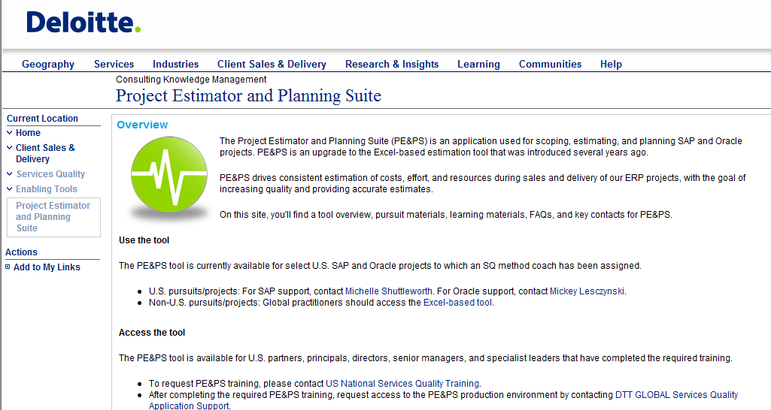
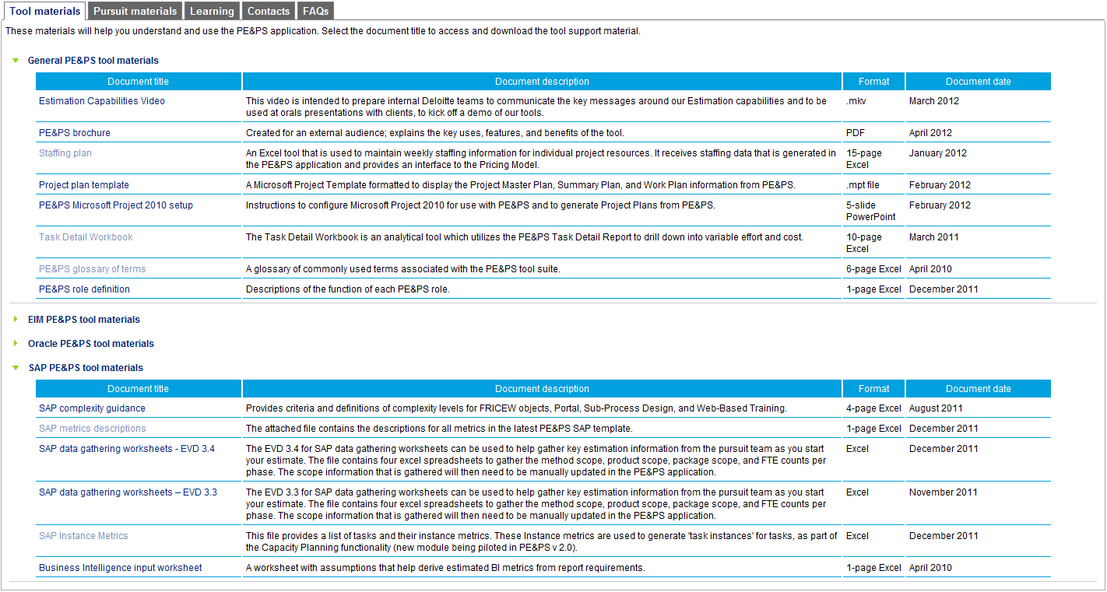
Where do I go for additional information and resources?
On the Services Quality home page you will find a link to the PE&PS page under the Enabling tools section.
Additional resources
At the bottom of the PE&PS page you will find Additional resources
Key contents:
Tool materials
Pursuit materials
Learning materials
Contacts
FAQs
Other Resources:
Detailed Procedures
Screen Demos
Type PE&PS into the “Jump to” box on DeloitteNet or click on: https://kx.deloitteresources.com/C6/PEPS/default.aspx
21

Slide 22

Next steps
Visit the PE&PS webpage for more information
Install PE&PS on your laptop
Choose from Express edition or Full edition
Complete the 5 WBT courses
Course 1: Estimation Basics and Introduction to PE&PS
Course 2: Inputs
Course 3: Interpreting Effort Results
Course 4: Cost, Staffing, and Pricing Model
Course 5: Project Planning
Request access to the PE&PS training environment
Request PCOE support if project is > $20M
Request coach support for your estimation
Receive access to the production environment
The PE&PS Access Request Form should be used to request access and coaching support: https://kx.deloitteresources.com/C6/PEPS/default.aspx

Slide 23

As used in this document, “Deloitte” means Deloitte Consulting LLP, a subsidiary of Deloitte LLP. Please see www.deloitte.com/us/about for a detailed description of the legal structure of Deloitte LLP and its subsidiaries.
This publication is for internal distribution and use only among personnel of Deloitte Touche Tohmatsu, its member firms, and its and their affiliates. Deloitte Touche Tohmatsu, its member firms, and its and their affiliates shall not be responsible for any loss whatsoever sustained by any person who relies on this publication.
None of Deloitte Touche Tohmatsu, its member firms, or its and their respective affiliates shall be responsible for any loss whatsoever sustained by any person who relies on this publication.
Deloitte refers to one or more of Deloitte Touche Tohmatsu, a Swiss Verein, and its network of member firms, each of which is a legally separate and independent entity. Please see www.deloitte.com/about for a detailed description of the legal structure of Deloitte Touche Tohmatsu and its member firms.
Notes:
23

