Slide 1
Global Finance Transformation
Portfolio Management Toolkit

Slide 2
Table of Contents
Description
Objectives
Process Overview
Client Interviews
Common Data Requests
Benchmarks and Best Practices
Assessment Tools
Typical Executable Recommendations
SMAs, References and Qualifications

Slide 3
Description

Slide 4
Description – What is Portfolio Management?
Are we doing enough of the “right” things?
Are we doing the “right” things?
Optimize Capital
Outlay
Allocate Capital
CAPITAL
STEWARDSHIP
Manage Capital
Outlay
Are we doing the “right” things “right”?

Slide 5
Description – Why Portfolio Management?
Achieving Vision
Shifting customer requirements
Are we doing the “right” things?
Advent of new Technologies
Are we doing enough of the “right” things?
Strategy Alignment and Value Creation
Change in
Competitive Landscape
Decrease in Capital available
Are we doing the “right” things “right"?
Project Portfolio
Economic
Downturn
Repeatable Assessment and Realignment
Time
Notes:
Leon
Given the portfolio of possible projects, a discipline needs to be established that ensures that resources are focused on those which maximize shareholder value.
Are we doing the “right” things?
Are programs/projects aligned with strategic objectives?
Are resources deployed against projects with highest strategic value?
Are we doing enough of the “right” things?
Given our strategic objective, will the projects underway close the gap?
Will we hit current fiscal year targets or should we manage expectations of stakeholders?
Are we doing the “right” things “right"?
What are our organization’s current capabilities in program/ project management (e.g. budgeting, scheduling, risk management, benefit realization, etc.)?

Slide 6
Description
Portfolio Management Enables the Alignment of Effort to Strategy
Enterprise Portfolio Management (EPM) Framework
Enterprise
Strategy Development
Portfolio
Translating strategy into a single integrated model
to manage multiple
portfolios
Strategy Translation
Alignment
Programs
Interdependencies
within the portfolio are
addressed through
program management
Elements
Single elements (projects,
assets, contracts, people)
are managed individually

Slide 7
Description
Key Business Objectives Addressed by Portfolio Management
With finite resources, capital, and time, how can an organization better manage the capital allocation and alignment of work with strategic imperatives?
1
Allocate Capital
Align your investments with business strategy
Make the right choices when prioritizing investments
3
Optimize Capital Outlay
Review and reprioritize projects
Reallocate and redistribute resources and capital
2
Manage Capital Outlay
Gain visibility to project portfolio
Manage project execution

Slide 8
Objectives

Slide 9
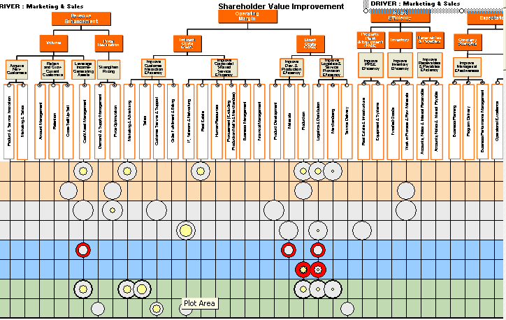
Objectives – Allocate Capital
Align investments with business objectives
Pain Points:
The Propositions:
Project value is hard to define
  Unable to scope projects to deliver the optimum value
  Can’t measure where the portfolio will have the most impact on value
  No link between portfolio and share price
Value measurement standards do not exist
  Measurement is different for each project
  Hard to capitalize on project process maturity
  Too many variables per projects to compare
Governance processes are poorly defined
  Management of capital allocation is not properly established
  Strategy is not documented, and not clearly understood
  Can’t identify where the portfolio fails to support business
  Unable to obtain clear sponsorship from business
A standard framework to identify all projects impacts on Balance sheet, income statement and share price
My Objective: reduce COGS.
My Portfolio: 65% of initiatives support revenue growth? Better start asking questions…
STRATEGIC INVESTMENTS
A clear categorization of your investment types, allowing alignment to business objective (innovation, growth, productivity, maintenance), and with an adapted business case to reflect project diversity and allowing comparison and prioritization
OPERATIONAL INVESTMENTS
Innov.
Growth
Productivity
Maintenance

Slide 10
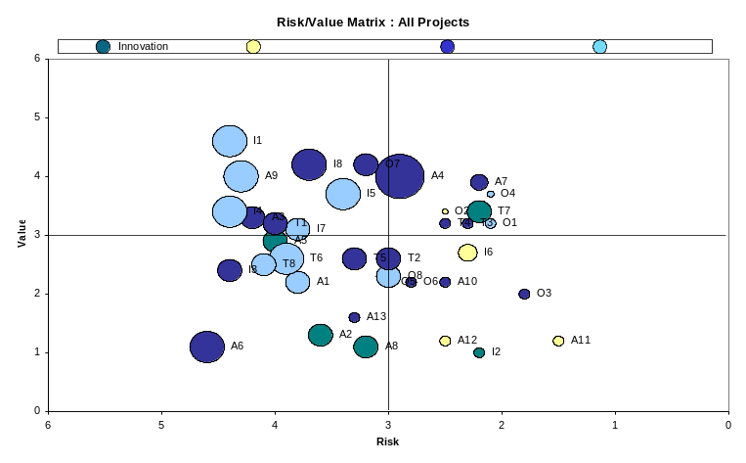
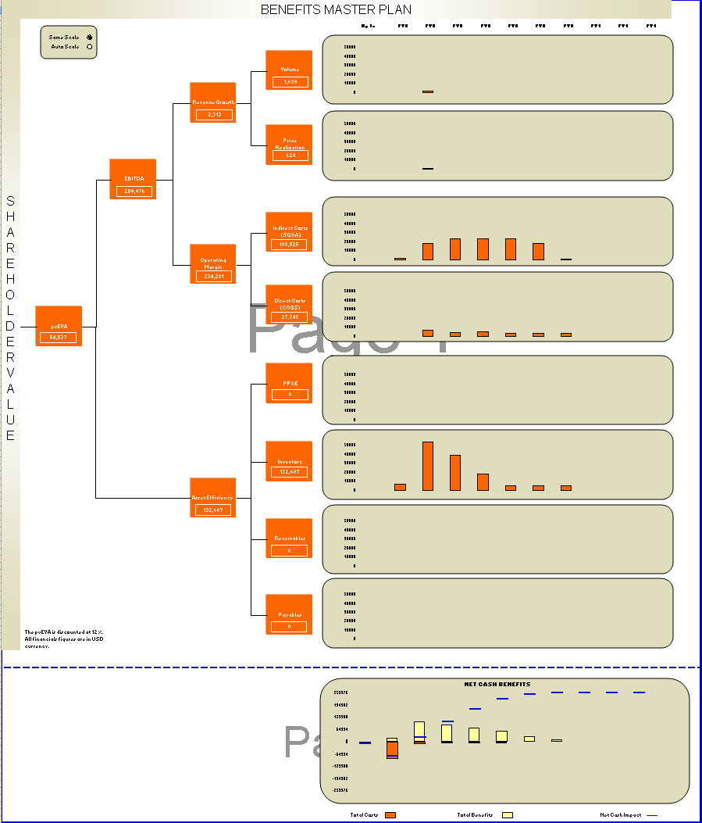
Objectives – Allocate Capital (continued)
Make the right choices when prioritizing your investments
Pain Points:
The Propositions:
Projects can’t be compared
  Investments underway are not the ones with the most value
  Projects generate non comparable benefits
Project prioritization process is unclear
  Business Units don’t participate in project selection
  No common criteria to prioritize projects
Investments can’t be justified
  Politics play a bigger role than business value
  Incomplete or non-existent financial data
  Undocumented benefits
  Difficult to justify some types of projects
High Value
A value / risk matrix to clearly identify the projects with the more enterprise value and the less risk or complexity
Low Value
High Risk
Low Risk
A view of the planned benefits and their impact on the company for the next years, allowing you to control the portfolio’s execution and estimated impact on the company.

Slide 11
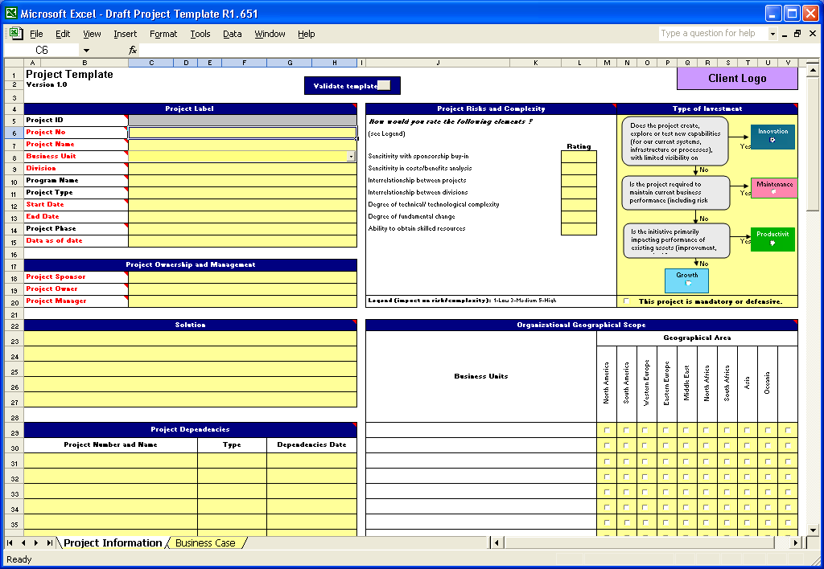
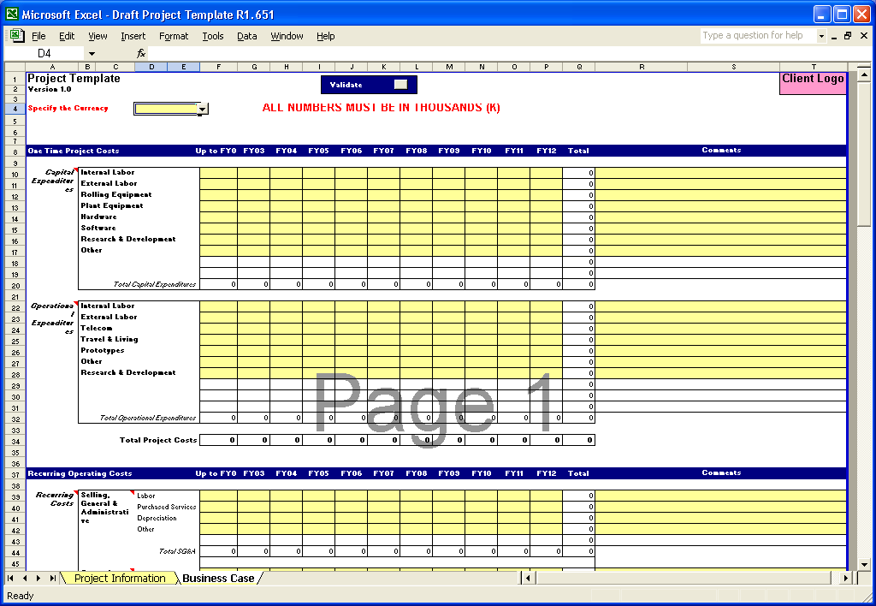
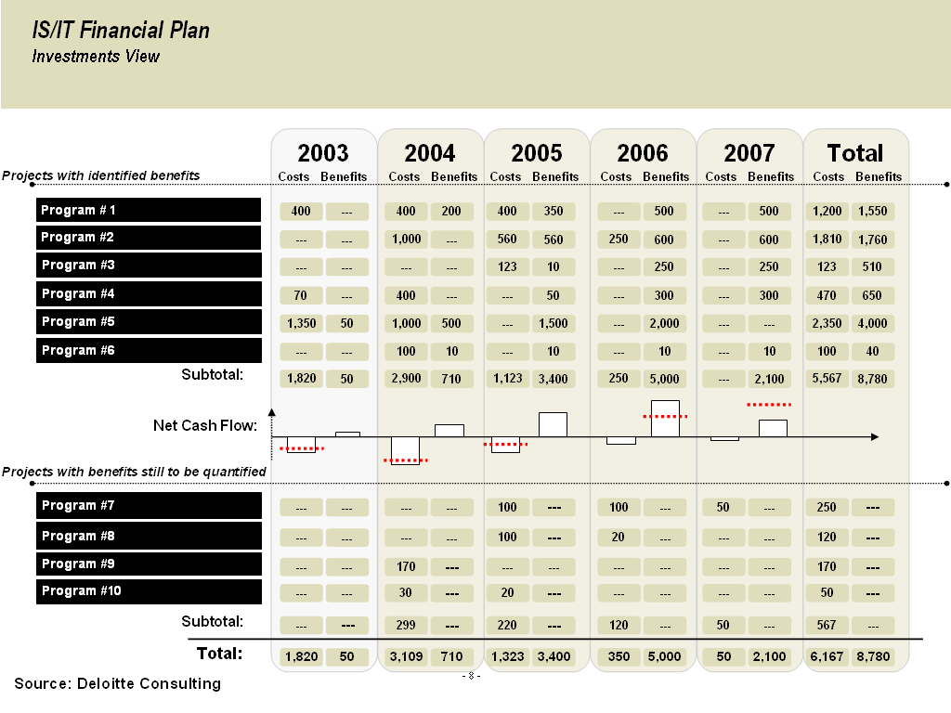
Objectives – Manage Capital Expenditure (cont.)
Gain visibility on project portfolio
Pain Points:
The propositions
Project information is hard to collect
  No standardized way to document projects
  Incomplete documentation
  Non-centralized information
  Projects at different stages of their life cycle
No portfolio view
  Project investments are unorganized. No framework, no tool, no time, no resource
  Too many projects or information to analyze
  Programs reflect capital authorization instead of logical sequencing
Communication about portfolio is inexistent
  Business is not interested
  Unsure about what to communicate
  No clear executive view of the portfolio and its business impacts
  No business language to report about projects
A simple spreadsheet to collect project information and to guide project managers through what they should document
Portfolio
A logical grouping of initiatives in a project – program – portfolio hierarchy
Program
1
Program 2
Project A
Project
B
Project
C
Project
D
Project E
A single view of your current and proposed portfolio, which project, when, for how much, highlighting the financial impact and the payback period

Slide 12
Objectives – Manage Capital Expenditure
Manage project execution
Pain Points:
The Propositions:
No integration with the other processes
  Program Management vs. 6-sigma
  Portfolio management and strategic planning process vs. budgeting activities
  Continuous reviews vs. PMO gates
Weak project tracking and monitoring processes
  No visibility in project performance and progress
  No understanding of project financial health
No visibility into project objectives
  Unable to identify duplicate activities
  Unable to take advantage of project synergies
Policies
and
Standards
Roles
and
Respons.
Methods &
Approaches
Tools and
Enablers
Organizational
Structure
Deployment
and
Monitoring
A consistent framework to integrate all your existing standards and approaches into the Managing for Value responsibilities

Slide 13
Objectives – Optimize the Outlay of Capital
Review and reprioritize projects; Reallocate resources & capital
Pain Points:
The propositions
Unable to adapt to changes
  Impossible to kill sick projects
  Portfolio does not follow changing objectives
  Business case evolves, but project are not re-assessed
No continuous view of the portfolio life
  Conflicting projects occur
  Redundancies, double counting benefits
  New opportunities at mid-year aren’t considered
Inability to allocate resources to the right place at the right time
  Limited understanding of supply and demand of resources
Monitor Portfolio Status & Performance
Re­
prioritize/ Optimize Portfolio
Identify New Opportunities
A rolling execution process to monitor and maintain portfolio alignment and objectives.
An ability to compare and prioritize projects of different lengths, styles, status at any stage of their execution.

Slide 14
Process Overview

Slide 15
Process Overview - Approach to Establishing an Enterprise Portfolio
An enterprise portfolio allows the capital stewardship model to facilitate continuous alignment of initiatives with strategic objectives of the company, given resource constraints and risk tolerances
Allocate Capital
1
2
Develop
Prioritization
Model
3
Collect
Project
Information
Set up
Portfolio
4
Analyze
Portfolio
5
Prioritize
Project &
Programs
Optimize Capital Outlay
8
Monitor
Programs
& Projects
6
Communicate
& Report
7
Manage
Capital Outlay
Deploy and
Execute Projects

Slide 16
Process Overview – Enterprise Portfolio Objectives
Capital Stewardship Model | Establish Enterprise Portfolio Steps | Objectives
Initiate Capital Portfolio | Set up portfolio Develop prioritization model Collect project information | Formalize the portfolio management process and obtain commitment on objectives Develop and weight value and risk criteria used in the prioritization process and establish thresholds and constraints Gather project information using a standard project template
Allocate Capital | Analyze portfolio Prioritize projects and programs | Assess the portfolio and new projects or programs based on value contribution to the company, alignment with strategic objective, net cash flow; and annual constraints such as resources and budget. Create a prioritized list of projects in compliance with constraints and thresholds to execute
Manage Capital Expenditures | Communicate and report Deploy and execute project | Prepare a clear view of portfolio performance to communicate plans to the company’s executives Execute and manage projects meeting allocation criteria
Optimize Capital Outlay | Monitor projects and programs | Support the development of your rolling plan by re-assessing the value of each project in your portfolio when new information or market insight are available.
1
2
3
4
5
6
7
8

Slide 17
Client Interviews

Slide 18
Client Interviews – People to Interview
Capital Stewardship Model | Key Message | Business Unit | Corporate
Initiate Capital Portfolio | What are the “right” things to do? | BU VP of Finance BU VP of IT BU President Program Office Manager | CFO (or equivalent) CIO (or equivalent) Corporate Program Management Office (PMO) Director
Allocate Capital | Are we doing the “right” things? | BU VP of Finance BU VP of IT BU President Program Office Manager | VP Strategic Planning CFO (or equivalent) CIO (or equivalent) Corporate Program Management Office (PMO) Director
Manage Capital Expenditures | Are we doing the “right” things “right”? | BU Directors BU VP/Directors of Finance BU VP/Directors of IT Program Office Manager | CFO (or equivalent) CIO (or equivalent) Corporate Program Management Office (PMO) Director
Optimize Capital Outlay | Are we doing enough of the “right” things? | BU VP of Finance BU VP of IT BU President Program Office Manager | CFO (or equivalent) CIO (or equivalent) Corporate Program Management Office (PMO) Director

Slide 19
Client Interviews
Initiate Capital Portfolio
1
2
3
Category | Questions for Business Unit | Questions for Corporate
Governance | How do you translate the corporate strategy into targets for your business unit to clearly understand? Are there separate strategic goals set regionally or independently by the business unit? Are these targets and milestones tangible, realistic and in line with the corporate vision? | How do you set your corporate strategy? Is it clearly understood by your stakeholders and business units? How realistic are the targets and vision? What are the value metrics that you are focused on? E.g. financial, productivity, etc? How do you set financial thresholds for projects? How do you compare vs. your competitors?
Process | What is the process for selecting investment areas to milestones based on resource constraints? How do you categorize your investments? How do you categorize work? E.g. do you use maintenance, innovation, growth, and productivity? How do you align projects against your capabilities? | How do you select investment areas to achieve short and long term goals given capital and resource constraints? Do you have capital and resource constraints? How do you classify them? Do you have a process for ideas becoming projects? Do you have criteria for rejecting projects?

Slide 20
Client Interviews
Initiate Capital Portfolio (cont.)
1
2
3
Category | Questions for Business Unit | Questions for Corporate
Data | How do you categorize your assets and capabilities? Do you logically categorize and group resources? Do you have a project inventory for your business units? Do you know how many proposed projects, in-flight projects, base/operation work, and completed projects are in your business unit? Do you have a set of key metrics you capture for all your projects? Are there specific resources responsible for maintaining and updating projects? | What are the key risk factors that effect your business? E.g. regulatory compliance issues Do you have weighting factors for investment types? If so, how do you set them? Do you have visibility into all projects and work across all business units? Are there any duplicate pieces of work in your enterprise? Are you able to capture synergies for projects across business units?
Technology | Are you using a tool to capture project information? Is there a work repository? | Do you have a standard tool to manage your portfolio? How complex are integrations within your current systems? How many repositories are currently tracking financials and project information?

Slide 21
Client Interviews
Allocate Capital
4
5
Category | Questions for Business Unit | Questions for Corporate
Governance | How do you ensure alignment with the corporate strategy? How does corporate business priority translate into your business units? | What are your investment strategies? How do our investments balance and align with the different components of value? Based on the longer term vision, what are the opportunities today? Given the portfolio of possible initiatives, are you certain that resources are focused on those which maximize shareholder value?
Process | How do you sequence and decide on the timing of projects How do you gain stakeholder alignment? Who are the key players within the stakeholder group? | What business processes are key to your business, e.g. value chain? Is your current spend appropriately allocated between new projects and base business?

Slide 22
Client Interviews
Allocate Capital (cont.)
4
5
Category | Questions for Business Unit | Questions for Corporate
Data | Do you score your projects based on prioritization criteria and metrics? What are your resource and asset constraints? | What criteria should be used and how will they be used to prioritize projects/programs? How do you compare projects and make the right decisions? Do you understand the risk and return of proposed investments?
Technology | How easily can you access information regarding projects? Do you have the ability to store decision information? | Does your technology allow you to store decisions regarding capital allocations? Can you access project information easily?

Slide 23
Client Interviews
Manage Capital Expenditures
6
7
Category | Questions for Business Unit | Questions for Corporate
Governance | How do you evaluate the performance of projects against schedule and work plan, e.g. projects starting/ending on schedule, projects completed Do you establish a project management team, e.g. steering committee, executive sponsor, project manager? Do you have standard roles for team members? | Are the sponsors committed to the delivery of projects at leadership levels in the organization? Do you have the necessary capabilities to execute? Are you achieving the expected benefits or is there a gap developing? Do you have effective governance and risk management to facilitate a fast response to issues and opportunities based on benefit realization? How do you ensure projects remain financially viable or bring projects back into financial alignment? How well have you done at delivering on the original business cases?
Process | What are your project status reporting processes, e.g. delivery of milestones and expected value How do you ensure resource development, e.g. on boarding, and training Do you have set roles and responsibilities of project team? | Do you have standard project management methodologies?

Slide 24
Client Interviews
Manage Capital Expenditures (cont.)
6
7
Category | Questions for Business Unit | Questions for Corporate
Data | What are your indicators of financial health by project, e.g. budget variance, year-to-date cost/return Do you know your forecasted project demand? | How do you report on the status and condition of projects in your portfolio? Do you have visibility of the progress of projects through all of their execution phases/milestones?
Technology | Do you use the standard technology tool to track information? How do you report on your projects performance? | Do you have a standard technology tool to capture and report on your portfolio?

Slide 25
Client Interviews
Optimize Capital Outlay
8
Category | Questions for Business Unit | Questions for Corporate
Governance | How does your business unit balance capital and resource allocation among categories of work, i.e. operations, innovation, productivity and growth? How do you align incentives and performance for entire team? | Given your targets, will the projects underway or proposed close the gap? Will you hit current fiscal year’s targets (or long-term targets)? How is the industry landscape changing, competitor initiatives, new technologies, customer needs? How do you align incentives and performance to project executives?
Process | How do you manage the availability and assignments of key resources? How do you ensure accountability of stakeholders? | How do you manage expectations of stakeholders? How do you optimize the mix and balance of projects throughout the project life cycle while maximizing resource utilization?
Data | What is the overall portfolio heath and financial viability for your business unit? | Are the projects being worked on still relevant given the changes in the environment?
Technology | Does your tool allow you to view interdependencies among projects? Can you analyze the impacts of stopping or delaying a project would have on other pieces of the portfolio? Can you view resources and capabilities? | At what level do you have visibility to into your projects/portfolios currently? How to you report and make decisions on project management issues?

Slide 26
Common Data Requests

Slide 27
Common Data Requests
Initiate Capital Portfolio
1
2
3
Enterprise Portfolio Steps
Data Element
Data Description
Detail Examples
1
Set up portfolio
Structure of portfolio
Framework for categorizing investments
Establish pools of resources
Strategic goals and objectives
Categories of work, i.e. maintenance, innovation, growth, productivity
Financial thresholds
Industry benchmarks
Resource information: capacity, utilization, sKill set
Business strategy
2
Develop prioritization model
Defining key criteria and metrics
Governance model
Value criteria and metrics
Risk profile
Weighting factors for investment type and key criteria
Financial viability
Alignment with strategy
Business priority
Risk elements, i.e. regulatory, audit, financial, inter-department integration
Priority of key criteria
3
Collect project information
Project inventory
Proposed projects
Projects in flight
Base business/ operational work
Completed projects
Project description
Duration, start and end dates
Business case, i.e. cost, benefits
Resources requested
Project manager, sponsor
Organizations impacted

Slide 28
Common Data Requests
Allocate Capital
4
5
Enterprise Portfolio Steps | Data Element | Data Description | Detail Examples
Analyze portfolio | Understanding of business priorities among stakeholders Visibility across enterprise | Alignment and allocation of the portfolio to business unit strategic initiatives | Stakeholder organizations and names of key roles within group Business priority, i.e. enterprise, and how it translates to the stakeholder organizations Investment strategies Project inventory across enterprise
Prioritize projects and programs | Enterprise business strategy Alignment with value map | View of the portfolio based on priority | Alignment with business process, e.g. value chain Scoring of projects based on prioritization criteria and metrics Resource and asset constraints Sequence and timing of projects
4
5

Slide 29
Common Data Requests
Manage Capital Expenditures
6
7
Establish Enterprise Portfolio Steps | Data Element | Data Description | Detail Examples
Communicate and report | Dashboards and views of portfolio | Status and condition of projects in portfolio View of portfolio across project life cycle | Enabling technology Tool selection Reporting capabilities Financial health by project, e.g budget variance, year-to-date cost/return Performance of projects against schedule and work plan, e.g. projects starting/ending on schedule, projects completed Forecasted project demand
Deploy and execute project | Portfolio and project delivery Project governance | Project management methodologies Progress of projects through execution phases | Status reporting processes, e.g. delivery of milestones and expected value Project management team, e.g. steering committee, executive sponsor, project manager Issue management and resolution processes Resource development, e.g. on boarding, and training Roles and responsibilities of project team
6
7

Slide 30
Common Data Requests
Optimize Capital Outlay
8
Establish Enterprise Portfolio Steps | Data Element | Data Description | Detail Examples
Monitor projects and programs | Ongoing management of capital and resource allocation | Review investment prioritization in the portfolio Review of resource allocation Understand external industry trends and climate | Balance of capital and resource allocation among categories of work, i.e. operations, innovation, productivity and growth Overall portfolio health and financial viability: ROI Budget & chargebacks, Benefits & cost, e.g. sunk cost of cancelled projects External industry climate, e.g. competitive activity, new technologies Availability and assignments of key resources Accountability of stakeholders Alignment of incentives and performance for entire team
8

Slide 31
Benchmarks and Best Practices

Slide 32
Benchmarks & Best Practices – Leading Practices
Capital Stewardship
Strategically driven investment decision-making process, and long term capital plans incorporated with strategy plans
Continuous capital planning process, and capital expenditure is a single investment bucket for the enterprise (16)*
Coordination between operations management and portfolio management, and processes for better hands off between teams (19)
Clear roles and responsibilities for corporate and the lines of business(1)
A corporate performance council composed of the senior management team(1)
Program Management Office empowered to facilitate the effort and not sole owners (18)
Strategic reserves, pooled contingencies and spending authority levels into capital allocation decisions(1)
Technology and tools to support the automation of the process and enable; time, resource, cost, scope, procurement, communication, risk, quality and portfolio management. They should be capable to develop analysis, budget integration and resources forecasting (18)
Constant communication and well-planned cultural change (10)
Governance is built on cross-unit performance targets and measurements (12)
*Legend: References found in the SMAs, References and Qualifications section of this presentation

Slide 33
Benchmarks & Best Practices – Leading Practices
Initiate Capital Portfolio
1
2
3
Set up Portfolio
1
Develop Prioritization Model
2
Collect Project Information
3
Develop a categorization framework to differentiate between investment types(1)
Increase corporate value through: maintenance, productivity, growth and innovation(1)
Establish pools of resources for each investment type(1)
Maintain a single repository for all investments (6)
Once strategic goals have been established (i.e. revenue growth, cost reduction, increased flexibility, etc.), they should be prioritized and future spending should be allocated by goal (in terms of percentages of the budget). (4)
Different combinations of investments should be assembled in trial portfolios to point out the tradeoffs that need to be made in investment allocation.(4)
Develop criteria to prioritize projects relative to value and risk(1)
Corporate KPIs and goals considered in criteria development(1)
Develop weightings for different investment types and criteria(1)
Identify capacity constraints(1)
New process-based, cross-unit objectives and bonuses that support new activities. (12)
Set realistic goals, implement incrementally (10)
Develop set of metrics for projects that enable managers to manage their resource in alignment with the goals and objectives. (15)
Business unit planning used to identify investment opportunities(1)
Collect consistent information that is comparable across projects(1)
Standard decision package and templates for all projects(1)
Business cases are generally performed for each individual investment(4)
A single repository should be used and it should be accessible to multiple groups within the organization (5)
Data should enter the portfolio management tools directly and without manual input. (Resource utilization and project information should be input directly from project management systems and financial management tools
Projects should include necessary upgrades to existing infrastructure to improve asset life cycle management(10)
Organize projects by business units, size and objective to identify overlaps in execution and resource allocation. (18)
* References found in the SMAs, References and Qualifications section of this presentation

Slide 34
Benchmarks & Best Practices – Leading Practices
Allocate Capital
4
5
Analyze Portfolio
4
Prioritize Projects & Programs
5
Take a portfolio view across LOBs for corporate allocation of capital*
In determining investment strategies using a top-down approach, business owners should be involved in order to prioritize the investments in line with business strategies. (9)
A bottom-up approach to determining investment strategies can be used to reduce IT costs and increase application development efficiency. (9)
Create consistent categories to align projects (18)
Prioritize based on business process – not functional requirements (12)
Rank projects using objective criteria then review and prioritize*
Projects should be prioritized using consistent evaluation criteria (6)
Investment decisions should be made based on reduction of risk, increase in business flexibility, and enabling business value rather than on cost alone(4)
Shut-down sub-optimal work(10)
Optimize the sequence and timing of investments. (14)
* References found in the SMAs, References and Qualifications section of this presentation

Slide 35
Benchmarks & Best Practices – Leading Practices
Manage Capital Expenditure and Optimize Capital Outlay
8
6
7
6
Deploy and Execute Project
7
Monitor Changes
Communicate & Report
8
Rather than simply inventorying and categorizing projects, you should focus on reporting on the performance of the portfolio. Doing so provides the visibility necessary to identify and cancel redundant and poorly performing projects. More specifically, graphical reporting provides added visibility into current projects and the pipeline. (6)
The PfM tool selected should provide a configurable interface to accommodate each user constituency that will have different requirements for reporting. (5)
The tool should allow for standardizing of common tasks and reports, and should allow for additional reports and functions to accommodate the PfM management process as it expands. (5)
The future cash flows of a potential new project should be connected to the future cash flows of the rest of a portfolio rather than solely analyzing the NPV of the individual project. (1)
Instead of narrowing down the pool of potential portfolios, the various trial portfolios should be maintained and updated continuously. If any individual assets or projects show up consistently across the different portfolios, a safe bet can be made that at least in the short term, that project should be implemented. (1)
Establish performance and process based bonuses that support new objectives. (12)
Present role based views via preprogrammed reports, summary graphics, and a search-and-drill-down feature. (15)
Centralization of work requests that provides a unified view. (15)
Enterprise views that permit cross-enterprise resource allocation.
Preset reporting, rich graphics and search capabilities that provide visibility.
Halt or cancel projects that are no longer relevant
Standardize resource skills /capabilities with categories
Establish processes to identify and react to changing market environment
* References found in the SMAs, References and Qualifications section of this presentation

Slide 36
Benchmarks & Best Practices – Benchmarks
Who is adopting Portfolio Management?
82% of companies surveyed by Forrester have adopted or are in the process of adopting PfM
Only 22% currently use PfM to identify and cancel redundant and underperforming projects (6)
Who is using a tool to help with Portfolio Management?
Only 8% of companies use a commercial PfM tool (6)
Most companies use an in-house tool or spreadsheet (88%), but those who use commercial believe they save from the removal of redundant projects and are better able to manage their overall technology spend. Spreadsheets, which are used by 35% of companies surveyed, offer no process to highlight redundant projects and no easy way to compare data across projects. (6)
What are the key findings from companies using Portfolio Management?
70% of investment dollars are spent on run business
At a minimum portfolios should be reviewed quarterly, although with shorter development cycles, many organizations are opting to review on a monthly basis (18)
By 2005, companies that implement a disciplined application portfolio management strategy should be able to reduce their IT expenses by at least 20% and future application transformation costs by 30% (0.7 probability) (9)
Companies placing emphasis on PPM will reap cost savings of 25% – 45%, by reducing redundant work, making better informed decisions and allocating resources more efficiently.
* References found in the SMAs, References and Qualifications section of this presentation

Slide 37
Assessment Tools

Slide 38
What is an Assessment Tool?
Builds the imperative for Portfolio Management
Performs a diagnostic of organization
  Align stakeholders understanding of business issue
  Scope and size problem at organization
  Identify focus areas for future work
Understand Current State
Identify Portfolio Management Opportunity
Outline Approach and Plan
Objectives/
Key Activities
Document current state of portfolio management in organization
Understand industry trends and benchmarks in portfolio management
Understand and gain alignment on business issue
Document high level processes involved
Identify key metrics used to align portfolio
Document a basic project inventory
Benchmark organization with regard to the industry
Identify internal leading practices
Identify gaps and pain points
Identify quick win opportunities and focus areas for project
Sequence key business unit and critical areas for execution
Results
Common understanding of issues identified
Stakeholder alignment
Scope and size of problem
Understand industry benchmark
Project scope, approach and high-level execution plan

Slide 39
Understand Current State: Steps
Understand Current State
Identify Portfolio Management Opportunity
Outline Approach and Plan
Step #1: Gain Common Understanding of Issues
Key indicators of portfolio management issues:
Initiative overload
Stated frustration with portfolio of programs
Portfolios delivering duplicate or non complimentary benefits
Too many initiatives compared to their investment budget
Unclear priority of strategic initiatives
Limited belief that the sum total of initiatives will deliver their strategic objectives
No obvious criteria for decisions relating to big change programs
Step #2: Gain Stakeholder Alignment
Key indicators that stakeholders need help aligning around portfolio management:
Stakeholders admit they have little idea what the aggregated benefits of their change initiatives will bring
Stakeholders can’t see how their strategic objectives will be delivered
Organizations admits to initiative overload
Stakeholders are worried that their organization’s business as usual activities will be impacted by the amount of planned change

Slide 40
Identify Portfolio Management Opportunity
Understand Current State
Identify Portfolio Management Opportunity
Outline Approach and Plan
Step #1: Identify Applicable Processes
Potential processes in scope could be:
Annual budgeting
Operational planning
Strategic planning
Resource management
Project management
Step #2: Conduct Project Inventory
Project inventory should include all projects, proposed, current and historical:
Proposed projects
  Innovation
  Operations
Projects in flight
Base business/ operational work
Completed projects/ project history

Slide 41
Identify Portfolio Management Opportunity
Understand Current State
Identify Portfolio Management Opportunity
Outline Approach and Plan
Step #3: Determine Key Metrics
Key metrics could include:
Value at risk: estimated value to be lost (or costs to be avoided) if the project is not undertaken
Alignment with business strategy
Basis for future growth
Regulatory compliance
Impact on value creation and cash flows: Project impact on the company’s cash flow (or any other financial metric commonly used in the organization)
Risk
Step #4: Benchmark Company Against Industry
Determine where the organization is compared to peers based on the following polling questions:
In which step in the portfolio management lifecycle does your organization have the greatest gap from current to desired state?
On a continuum of increasing capability, where do you see your organization?
On a continuum of increasing capability, how do the project portfolio costs and benefits get integrated into your company’s operations?
What stage of maturity do you believe your organization is with regard to project portfolio management processes?

Slide 42
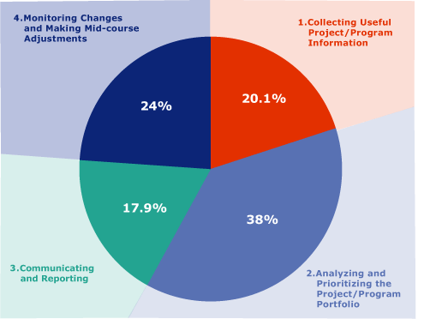
Identify Portfolio Management Opportunity
#1: In which step in the portfolio management lifecycle does your organization have the greatest gap from current to desired state?
Almost 40% of companies see significant gaps in the prioritization of projects, and, thus, the allocation of capital
Source: Deloitte dBriefs Webinar;
September 2005; ~490 participants
Copyright © 2005 Deloitte Development LLC. All rights reserved.
Notes:
David

Slide 43
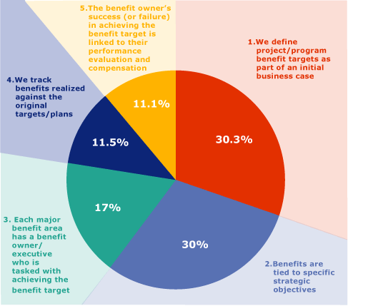
Identify Portfolio Management Opportunity
#2: On a continuum of increasing capability, where do you see your organization?
Over 60% of companies have started to tie benefits to strategies
Source: Deloitte dBriefs Webinar;
September 2005; ~490 participants
Notes:
David

Slide 44
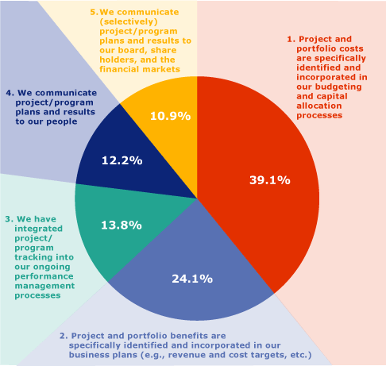
Identify Portfolio Management Opportunity
#3: On a continuum of increasing capability, how do the project portfolio costs and benefits get integrated into your company’s operations?
Almost 40% of companies are in only stage one of effectively integrating portfolio costs and benefits into its operations
Source: Deloitte dBriefs Webinar;
September 2005; ~490 participants
Notes:
David

Slide 45
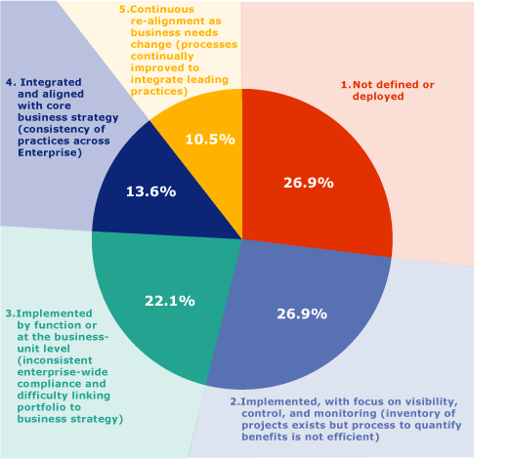
Identify Portfolio Management Opportunity
#4: What stage of maturity do you believe your organization is with regard to project portfolio management processes?
Only 10% of company’s have a mature portfolio management process in place
Source: Deloitte dBriefs Webinar;
September 2005; ~490 participants
Notes:
David

Slide 46
Outline Approach and Plan
Understand Current State
Identify Portfolio Management Opportunity
Outline Approach and Plan
Step #1: Determine Target Area
Target the area within organization that has the most pain points with respect to portfolio management. Key indicators of pain include:
  Large total number of projects
  Projects significantly over budget
  Majority of resources working on more than one project
  Inability to communicate project link to business strategy
Analyze organizational structure, as different structures will determine approach
  Decentralized v. centralized
  Progam/product based v. team/functional based
Determine culture and size to further focus location of project
Start portfolio management project in the targeted area
“Go where the PAIN is”

Slide 47
Outline Approach and Plan
Understand Current State
Identify Portfolio Management Opportunity
Outline Approach and Plan
Step #2: Evaluate Company on the Portfolio Management Continuum:
Portfolio management integrated with core business strategy and is flexible enough to re-align when needed
Project success is linked to individual performance evaluation
Project and program results, cost and benefit, are communicated employees and selectively to financial markets
OPTIMIZE
Portfolio management is implemented in one or more of the business units, but is not enterprise-wide
Projects have assigned owners tasked with achieving benefit target
Benefits are specifically identified and incorporated into business plan
Project and program results are tracked
OPERATION-ALIZE
Portfolio management has not been defined or has been deployed with little focus on benefits tracking and project visibility
Project costs and benefits are incorporated in budgeting and capital planning process with no specific accountability assigned
Benefits are tied to a business case and/or strategic objectives, but not effectively or consistently tracked and monitored
BUILD FOUNDATION

Slide 48
Outline Approach and Plan
Step #2 (cont): Evaluate Company on the Portfolio Management Continuum:
Key indicators to place a company on the continuum of Project Management maturity include the following:
BUILD FOUNDATION
OPERATIONALIZE
OPTIMIZE
Unpredictable
and poorly controlled
Dependent on
individual efforts
Standard, consistent processes
Processes measured
and controlled
Focus on continuous improvement
No formal procedures or plans for projects
Processes are not standard or managed
Little data availability
Informal or incomplete processes used to manage projects
Problems not documented or corrected
Data collection and analysis are informally conducted but not documented
Processes are partially recognized and controlled by project managers
Understands projects basic commitments
Processes are efficient for individual project planning, but not programs or portfolios
Processes are more robust and demonstrate both systematic planning and control characteristics
Problems are identified and informally document for project control purposes
Data is collected across the organization for project planning and control
Analyzed data is shared with project team to help them work together
Project teams consist of cross-functional resources when necessary
Information and processes are documented
Organization can plan, manage, integrate, and control multiple projects efficiently
Processes are well defined, quantitatively measured, understood, and executed
Process data is standardized, collected, and stored to analyzed processes
Decisions are based on fact
Entire organization is trained in appropriate project management roles
Continuously improve processes
Document and act on lessons learned
Problems are fully understood and addressed
Data is collected automatically and analyzed to improve processes
Innovative ideas are pursued, tested, and organized to improve processes

Slide 49
Outline Approach and Plan
Step #3: Determine Approach
Determine where in the enterprise project approach (slide 15), the organization should begin their project
Set milestones at each of the subsequent enterprise process components to ensure achievement of key metrics and success factors
Start:
Operationalize
Start: Build
Foundation
1
Set up
Portfolio
2
Develop
Prioritization
Model
3
Collect
Project
Information
4
Analyze
Portfolio
5
Prioritize
Project &
Programs
8
Monitor
Programs
& Projects
6
Communicate
& Report
7
Deploy and
Execute Projects
Start:
Optimize

Slide 50
Typical Executable Recommendations

Slide 51
Typical Executable Recommendations
Executable recommendations are influenced by several factors, therefore must be adapted to the specific client project being worked on
Use the Project Approach and Plan that was outlined in the last phase of the assessment to ensure the appropriate execution
Step #1: “Go where the PAIN is”: Target the area within organization that has the most pain points with respect to portfolio management
Step #2: Evaluate where the organization is on the continuum:
BUILD FOUNDATION
OPERATIONALIZE
OPTIMIZE
Step #3: Follow the defined approach at the appropriate starting point
Start:
Operationalize
Start: Build
Foundation
1
Set up
Portfolio
2
Develop
Prioritization
Model
3
Collect
Project
Information
4
Analyze
Portfolio
5
Prioritize
Project &
Programs
8
Monitor
Programs
& Projects
6
7
Communicate
& Report
Deploy and
Execute Projects
Start:
Optimize

Slide 52
Typical Executable Recommendations:
Build Foundation – Quick Hits
BUILD FOUNDATION
OPERATIONALIZE
OPTIMIZE
Quick Hits |  | Long Term
Establish project portfolios aligned with strategic objectives Define a prioritization model for the metrics for foundational decision-making process | Governance | Establish a comprehensive view of enterprise portfolios
Create a project initiation process for prioritizing and evaluating proposals Establish process for identifying and assigning available resources | Process | Develop a decision making process for portfolio management that is driven by the corporate vision and strategy Generate balanced scorecards to highlight key metrics for portfolio and associated projects Develop a process to allocate resources across organizational teams Ensure standard (or near-standard) processes and results across enterprise
Capture key information for new projects including description and contact information Determine key strategic and operational metrics to track project performance against | Data | Capture key information regarding base business work Capture and track project performance including milestones, financial health and resources assigned Establish a data integrity approach to maintain and update data
Determine need for technology enabler | Technology | Establish a single repository for project info.

Slide 53
Typical Executable Recommendations:
Operationalize – Quick Hits
BUILD FOUNDATION
OPERATIONALIZE
OPTIMIZE
Quick Hits |  | Long Term
Communicate how portfolios are supporting the strategic objectives | Governance | Build a risk and contingency framework that measures risks against their criticality to business objectives
Integrate with annual planning and budgeting processes Develop process to forecast and plan for work fluctuations over time | Process | Track resource utilization for all work, base business and projects Create process to forecast resource utilization and identify gaps in skill or resource capacity
Capture more sophisticated project information including expected value, and cost structure Capture resource capabilities, competencies, and skillsets | Data | Generate sophisticated reports and scorecards to track portfolio metrics
 | Technology | Implement appropriate technology tools, aligned with the program framework, to enable the processes and organization

Slide 54
Typical Executable Recommendations:
Optimize – Long-term
Governance:
Process:
BUILD FOUNDATION
OPERATIONALIZE
OPTIMIZE
 | Long Term
Governance | Establish a communication and reporting process to external stakeholder, e.g. Wall Street and shareholders
Process | Establish a continuous and iterative capital stewardship process, not solely an annual process Enhance decision-making process to revise portfolio based on changes in strategy, market factors or regulatory recommendations Develop strategic staffing process to ensure optimal staffing Focus on continuous improvement
Data | Data is collected automatically and analyzed to improve processes
Technology | Technology enables decision-support functionality

Slide 55
Typical Executable Recommendations
Organization Characteristic Considerations
The approach to implement a Portfolio Management process must be mindful of several characteristics of the company:
Centralized v. Decentralized:
Large v. Small:
Deploy standard definition of processes and metrics based on corporate strategy and drivers
Communicate clear and quantifiable corporate strategy and performance targets
Translate strategy into concrete and meaningful corporate investment opportunities
Maximize value of the total company
Deploy processes and metrics in one business unit and achieve success before moving on
Communicate progress against business unit performance targets
Identify opportunities in various business units and plants
Prioritize and selection of investments based on business unit and corporate value contribution
Establish rigor around management of capital allocation
Ensure flexibility of process to re-align and adjust to changing environment
Establish rigor around allocation of capital
Establish standard processes to tie project benefits to long term goals

Slide 56
Typical Executable Recommendations
Organization Characteristic Considerations (cont.)
The approach to implement a Portfolio Management process must be mindful of several characteristics of the company:
Significant Project Activity v. Limited Project Activity:
Product-driven industry v. Service industry
Focus on standardizing data and metrics to evaluate diverse portfolio of projects
Ensure visibility into upcoming work demand to forecast resource requirements
Develop management rigor to ensure successful project execution and benefits realization
Focus on managing capital outlay processes to “do the right things right”
Focus on resource allocation, utilization and productivity
Ensure balance of projects within limited portfolio (innovation, maintenance, etc)
Develop processes to analyze ability and capacity to launch additional work
Focus on capital allocation processes to “do the right things”
Establish rigor around management of capital allocation
Ensure flexibility of process to re-align and adjust to changing environment
Focus on communications and reporting process to external stakeholder
Develop management rigor to ensure successful project execution and benefits realization

Slide 57
SMAs, References and Qualifications

Slide 58
SMAs, References and Qualifications – Subject Matter Advisors
Region
S&O
US
Leon Darga (Detroit)
Dan Tindall (San Francisco)
Richard Woodward (San Francisco)
Carlos Munoz (San Francisco)
Region
S&O
UK
Tim Mobley (London)
Region
S&O
CAN
Jean Claude Aube (Montreal)
Sébastien Blais (Montreal)
Luc Thibault (Montreal)
Mathieu Courtat (Montreal)
Simon McDougall (Montreal)
Region
S&O
EMEA
Dave Higgins (Brussels)
Bert Vries (Netherlands)
Region
S&O
APA
Victoria Sartor (Australia)

Slide 59
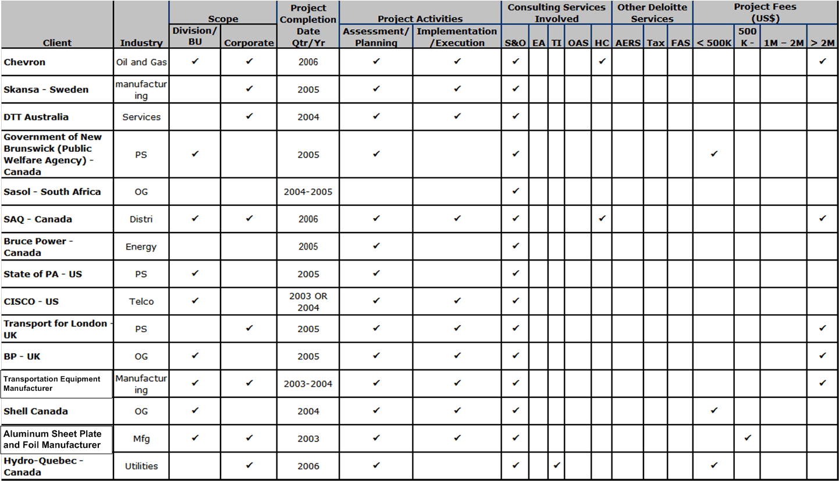
SMAs, References & Quals – Qualifications Summary

Slide 60
SMAs, References and Qualifications – Case Study
Client: Cisco Systems
  Slide information
  Confidential? YES
Background & Business Issues
Cisco Systems is one of the largest high –tech manufacturers
The CIO was tasked to analyze the portfolio of IT initiatives and projects and:
  demonstrate the linkage between IT investments and corporate strategy
  optimize the project portfolio by pursuing initiatives that create the greatest value
  rationalize spending based on project contribution to specific drivers of value
Scope, Objectives & Approach
Take inventory of projects and check their alignment with specific drivers of enterprise value (e.g., revenue growth, margin improvement, improvement of asset efficiency).
Develop cost/benefit analysis of the project portfolio to quantify the return (measured as contribution to value driver) versus the spend.
Conduct a ‘proof of concept’ portfolio analysis engagement by reviewing a sample of Cisco’s top IT initiatives (12 total) using the Deloitte Portfolio Value Framework and Portfolio Landscape
Align the Deloitte Enterprise Value Map to Cisco’s process-centric methodology, following Cisco's organizational design review and orientation by processes
Recommend a how-to approach to integrate value analysis into the portfolio management process
Improve Cisco’s portfolio management methodology
Results Achieved
Management was surprised that the process revealed that their initiative alignment was on target: while there was inevitable overlap among projects at lower levels, key value drivers were supported by every project - no key business objective was unsupported by an initiative, and no projects or initiatives were aimed outside corporate strategy.
A further specific finding of this detailed analysis was that two projects contributed more than 90% of cash flow, while representing only about one-third of the cost of the portfolio.
• The CIO confirmed the alignment of the portfolio of initiatives with the business strategy.
Overlapping initiatives were combined resulting in significant cost savings.
The CIO could make more informed decisions on spending — relative to the enterprise value creation:
– by improving the quality of spending as a driver of value;
– by improving the return on specific investments in the project portfolio to bring them in line with the company’s most important value objectives.
Vendor Used
Functions Covered
Consulting
Contact
LCSP: Richard Woodward (650) 372-4595

Slide 61
SMAs, References and Qualifications – Case Study
Client: Chevron
  Slide information
  Confidential? YES
Background & Business Issues
Chevron is the nation’s second largest oil and gas company, and was recently named in Fortune’s Top 5 largest company in the USA.
Chevron has achieved face-paced growth over the last several years, resulting in the need for many large IT initiatives, including the integration with UniCal in the summer of 2005
Thus, a significant need was identified to ensure the alignment of Business and IT strategic decisions and objectives with project execution and assignment of work.
Scope, Objectives & Approach
In the spring of 2005, Chevron launched an initiative to optimize capital and resource allocation across the IT initiatives
Deloitte was asked to lead the development of critical processes to support the Portfolio and Resource Optimization (PRO) effort and streamline the deployment of PRO to IT organizations enterprise-wide. As part of this effort, Chevron needed to accelerate deployment in order to achieve results and show wins quickly.
Deloitte worked with the PRO team to develop a consistent and repeatable approach to both accelerate enterprise deployment and facilitate coordination and integration across the project’s multiple threads, including technology/data, process, people, and deployment. This approach established a shared services model to gain greater efficiencies and streamline efforts across the project’s threads.
Results Achieved
Deloitte provided consulting and deployment services (project management, process development, data integrity, metrics, training and communications, and deployment strategy) for the portfolio and resource optimization strategy for the enterprise’s IT functions including the Information Technology Company, and all embedded IT organizations in other Operating Companies (OPCOs)
Chevron was able to increase the rate of PRO deployments to IT customers while reducing cost and risk. Additionally, all of the best practices and lessons learned from each customer deployment were compiled and integrated back in to the MPPR Deployment Approach. The framework of this approach can also be leveraged for future Chevron initiatives.
Vendor Used
Mercury- ITG
Functions Covered
Information Technology Company
Contact
LCSP: Richard Woodward (650) 372-4595

Slide 62
SMAs, References and Qualifications – Toolkit Key Contacts
Carlos Munoz
  Sr. Manager
  San Francisco office
  415-783-5390
Amy Haller
  Manager
  Irving office
  469-417-3371
Vaishal Shah
  Senior Consultant
  Boston office
  617-437-3594

Slide 63
SMAs, References and Quals – Benchmarks and Leading Practices References
Deloitte Consulting - ”Leading Practices in Capital Allocation and Portfolio Management” – September 2005
McKinsey – Autumn 2004 – Perspectives on Corporate Finance and Strategy – Boris Galonske, Stephan Gorner, and Volker H. Hoffman
Forrester – Sept 29, 2004 – Defining IT Portfolio Management – Chip Gliedman
Forrester – Sept 30, 2004 – The Portfolio Management Troika – Chip Gliedman
Forrester – Sept 27, 2004 – Managing A Portfolio of IT Investments – Lauren Hughes
Forrester – Nov 5, 2004 – Trends 2005: IT Portfolio Management – Chip Gliedman
Gartner – July 23, 2003 – Application Portfolio Management for Investment/Efficiency – D. Vecchio
Forrester – September 2005 – Optimizing The IT Portfolio for Maximum Business Value – Craig Symons
Forrester – December 2005 – The Forrester Portfolio Management Matrix – Chip Gliedman
Forrester – June 2005 – Forrester Finance Forum Wrap Up: Hot Topics in IT – Bruce D. Temkin and Adele Sage

Slide 64
SMAs, References and Qualifications – Benchmarks and Leading Practices References (continued)
McKinsey – 2003 Number 3 – Getting IT spending right this time – Diana Farrel, Terra Terwilliger, and Allen P. Webbs
Forrester – February 2005 – Integrated IT Management Drives Efficiency – Margo Visitacion, Phil Murphy, and Thomas Mendel, Ph.D
Forrester – February 2005 – Where Should the CIO Report? – Marc Cecere and Heather Liddell
Forrester – May 2005 – US IT Spending Benchmarks for 2005
Giga Information Group, Inc – April 2003 - Processes and Tools: The Nuts and Bolts of Project Portfolio Management – Margo Visitacion
Metagroup – February 2005 – Establishing an Approach to Enterprise Portfolio Management: Coordinating Projects and Assets for the Adaptive Business – White Paper

Slide 65
Appendix

Slide 66
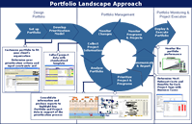
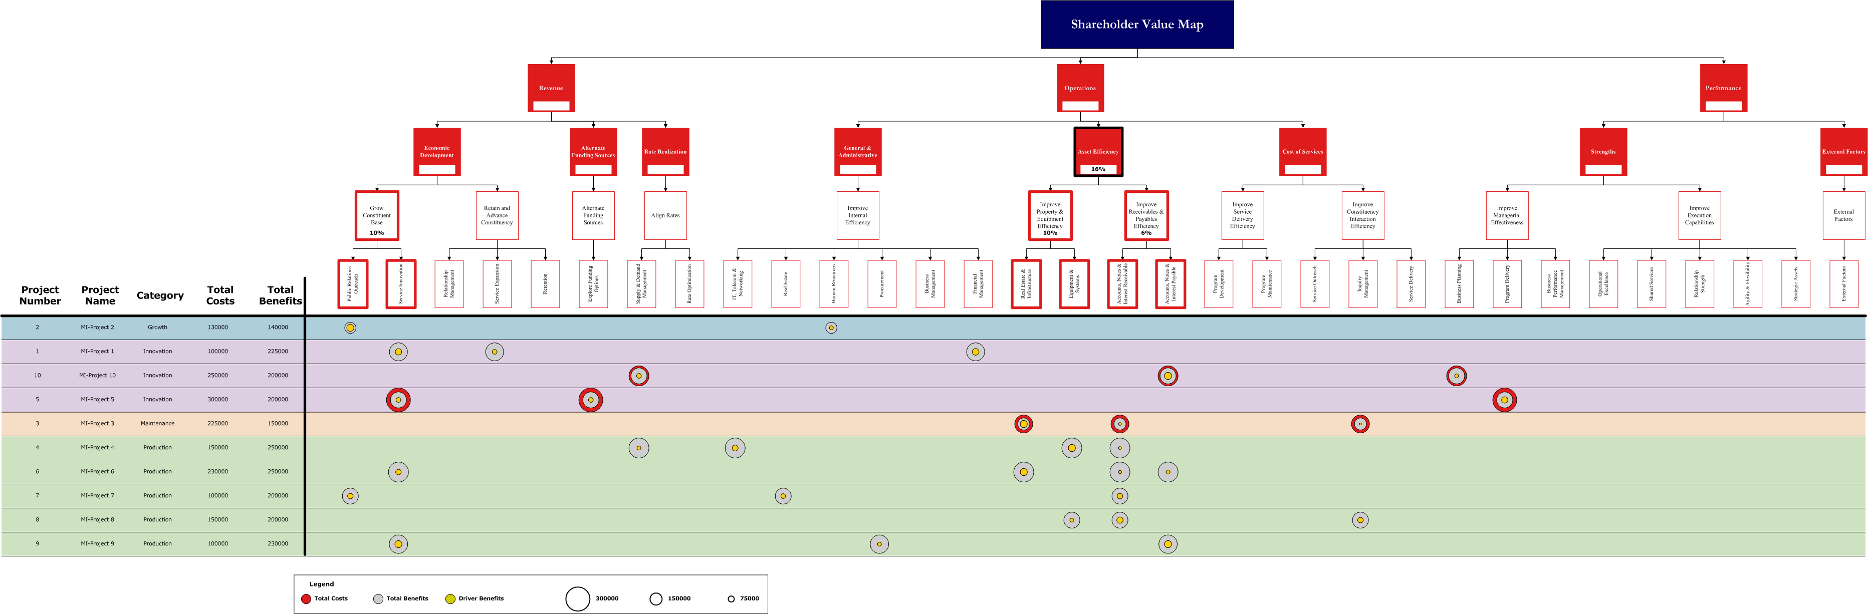
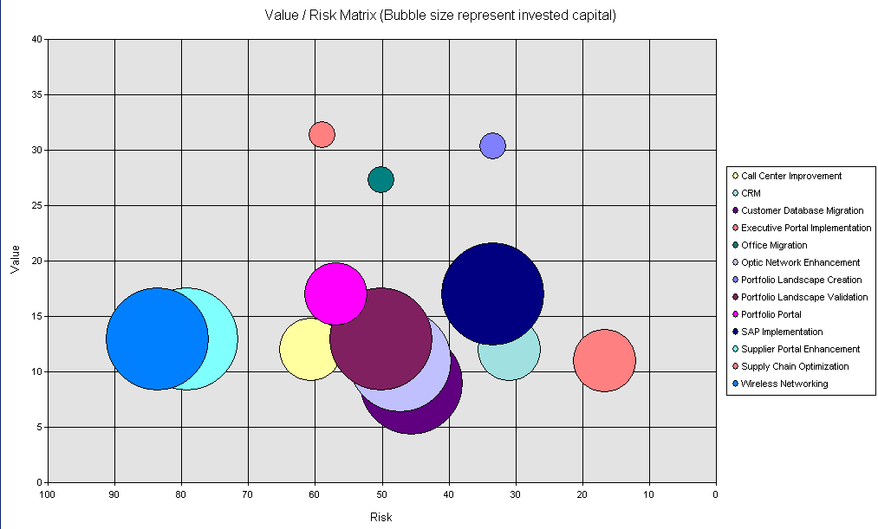
There Are 3 Key Tools In The Portfolio Management Tool Suite: Portfolio Landscape, MapIt!, PriorIT!
Project Portfolio Management Tools Description
Portfolio Landscape is the most robust of the three tools, offering functionality to accelerate teams through the various portfolio management phases.
Portfolio Landscape’s functionality includes:
  A template for consistent data gathering and analysis
  Sorting and grouping of several projects' data
  A comprehensive set of standard reports
  Strategic value and risk/complexity assessment analyses
  Project Portfolio Alignment Maps using the Enterprise Value Map
Portfolio Landscape
The MapIt! Tool functionality is extracted from Portfolio Landscape and built as a stand-alone tool.
MapIt! provides teams with the ability to develop a Project Portfolio Alignment Map with less data requirements than Portfolio Landscape as this is the main output of the tool.
MapIt! can be used in situations where clients want a quick assessment of the alignment of their projects in relation to strategic and business objectives, but for whom a full Portfolio Landscape analysis is not necessary.
MapIt!
The PriorIT! Tool functionality is extracted from Portfolio Landscape and built as a stand-alone tool.
PriorIT! provides teams with analysis to help prioritize projects on the basis of their risk and value contribution to the portfolio.
PriorIT! can be used in situations where clients want a quick assessment of the risk versus value tradeoffs for their portfolio, but for whom a full Portfolio Landscape analysis is not necessary.
PriorIT!

Slide 67
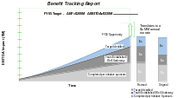
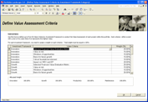
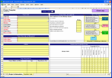

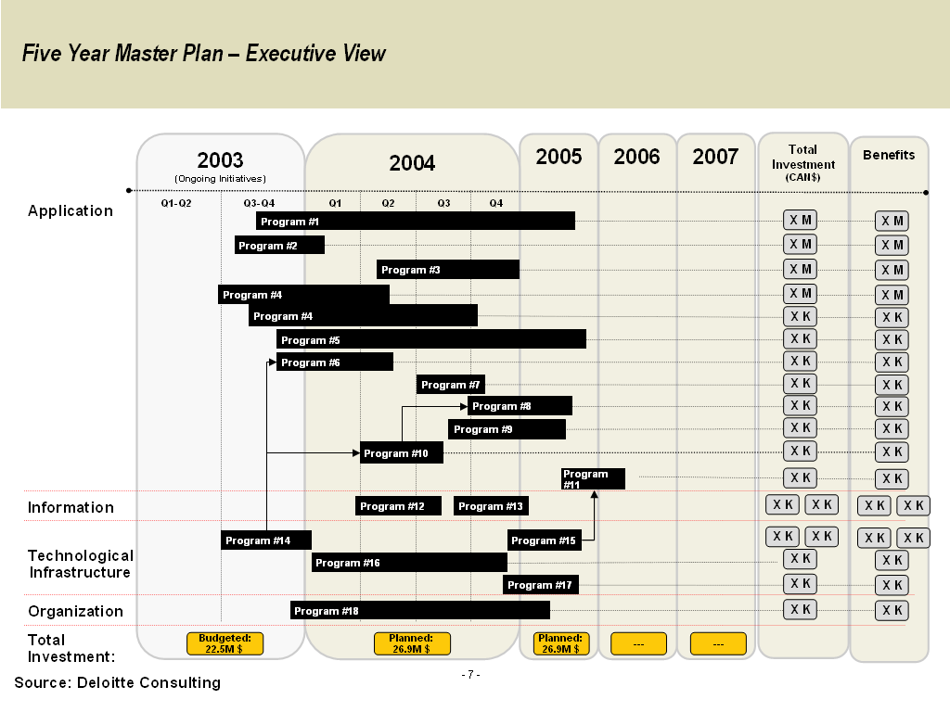


Portfolio Landscape Overview
Portfolio Landscape is the most robust of the three tools, offering functionality to accelerate teams through the various portfolio management phases. Portfolio Landscape:
  Provides a methodical approach to planning and analyzing project portfolios
  Simplifies and standardizes project data collection
  Facilitates multi-perspective analysis of project portfolios
Portfolio Landscape Approach
Design Portfolio
Portfolio Management
Portfolio Monitoring & Project Execution
Set up
Portfolio
Develop
Prioritization
Model
Monitor
Changes
Deploy &
Execute
Portfolio
Monitor
Programs
& Projects
Collect
Collect
Project
Project
Collect
Project
Information
Monitor the portfolio performance
Customize portfolio to fit your client’s organization
Determine your prioritization criteria and input constraints and thresholds
Collect project data with standardized template
Communicate
& Report
Analyze
Portfolio
Analyze
Analyze
Portfolio
Portfolio
Prioritize
Project &
Programs
Prioritize
Determine Most Relevant Costs and Benefits for Each Project Type with Business Cases
Prioritize
Consolidate information and produce reports to highlight key Portfolio and Project data in support of the prioritization process
High Value
Low Value
High Risk
Low Risk

Slide 68
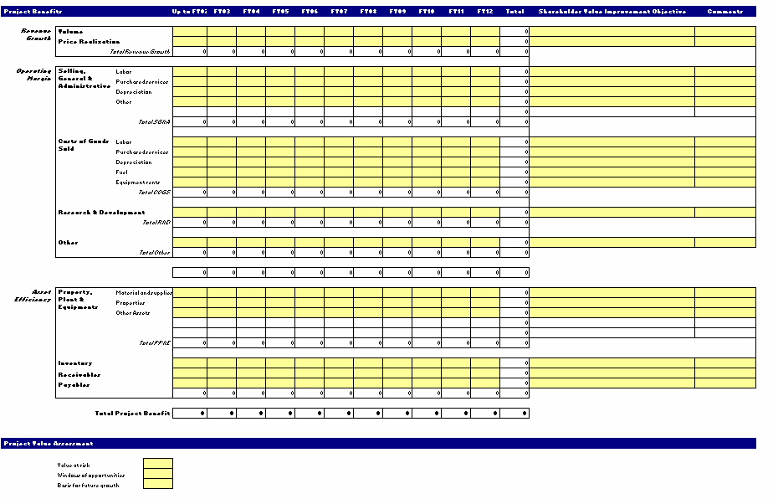

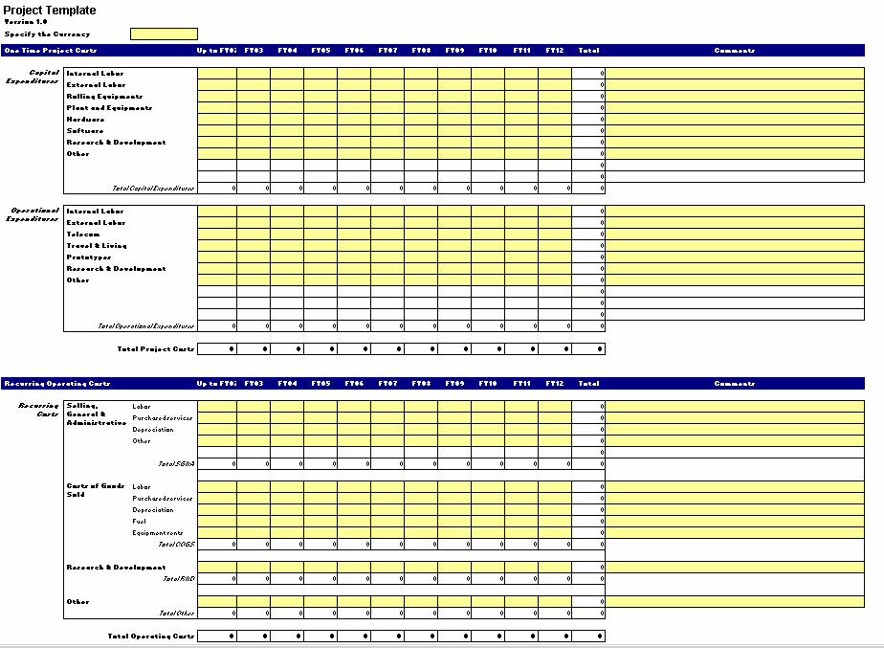

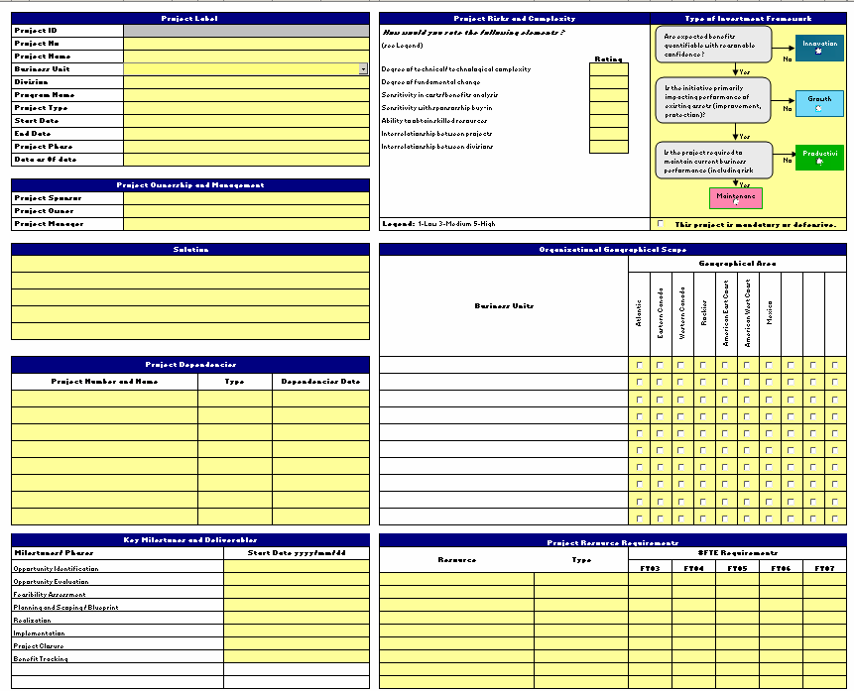

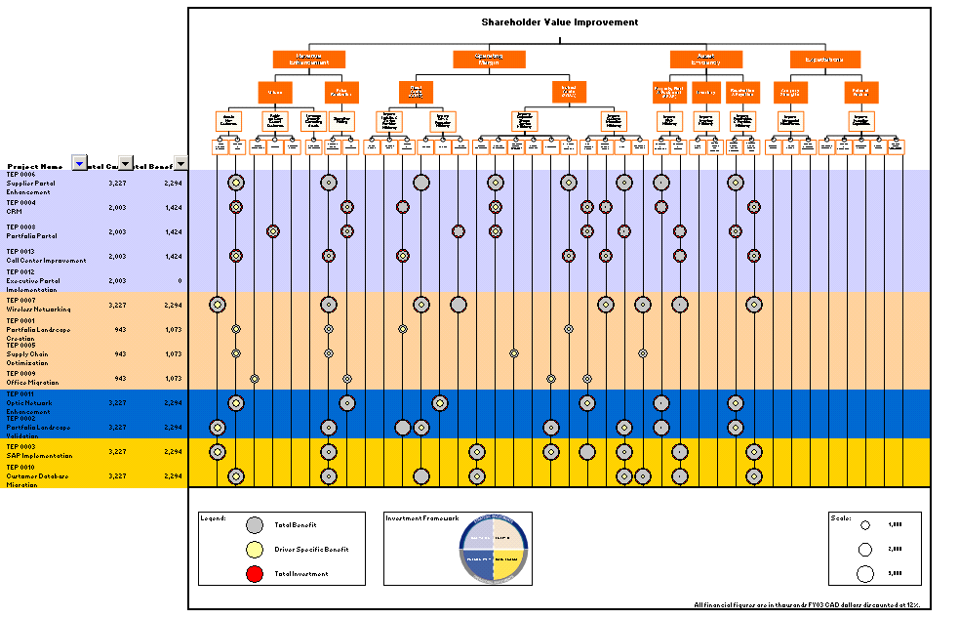
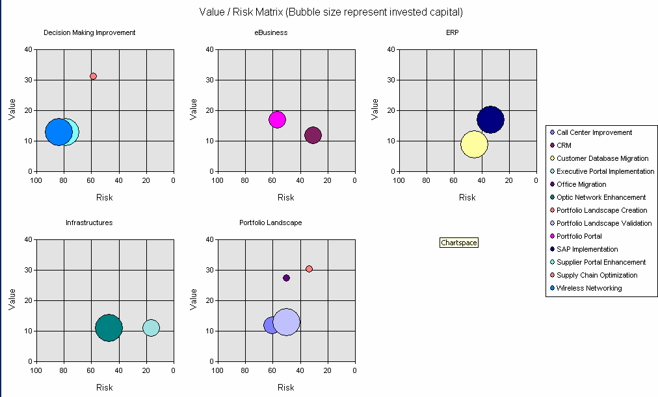
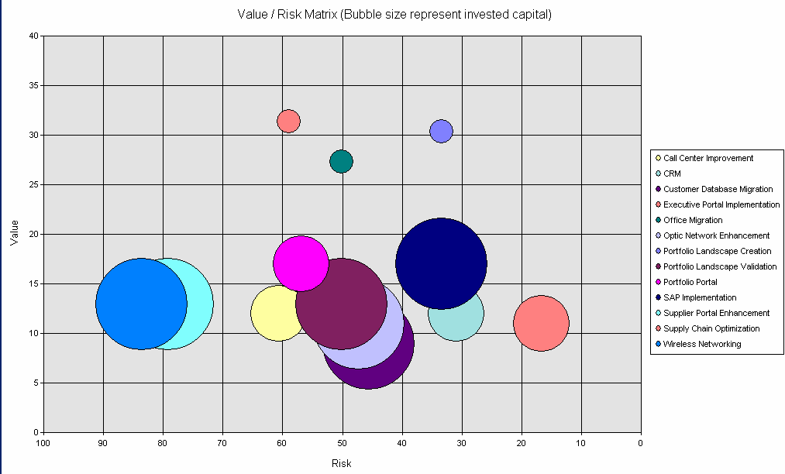
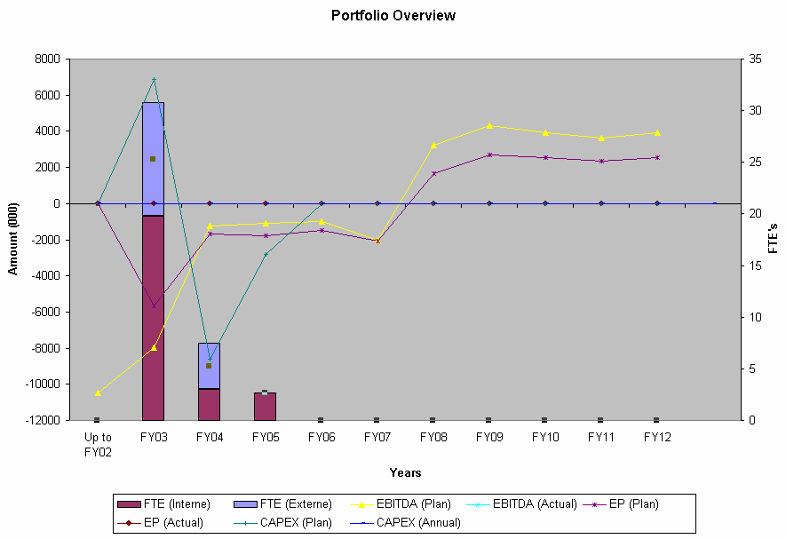
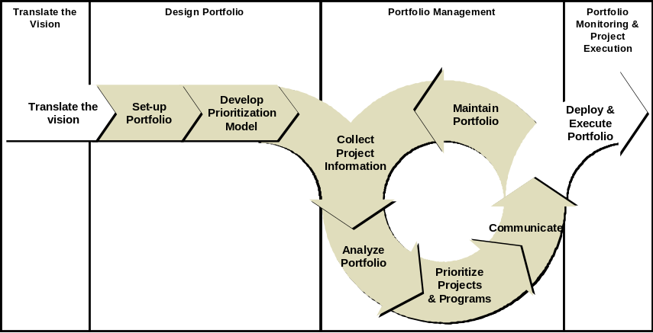
Portfolio Landscape Overview
Portfolio Landscape is a delivery tool, typically performed as a client engagement
The tool is access database driven and interfaces with different excel reporting and calculation sheets
The tool must be customized and configured for client use and is not an ‘off the shelf’ tool
Some training may be required before use
For more information, see the Portfolio Landscape Link from the Project Portfolio Management site
Project Information Templates
Portfolio Views / Analysis
Portfolio Landscape Interface
See the EVM website for links to these tools

Slide 69
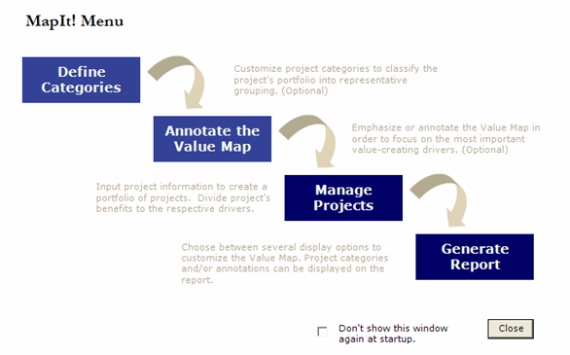
MapIt! Tool Overview
MapIt! is an access database tool that provides quick and easy access to the development of a Project Portfolio Alignment Map
  Determine the quantitative impact of the project portfolio across the value drivers
  Assess the strategic intent of the component projects (growth, innovation, productivity or maintenance)
  Adopt value-oriented business case framework
The most recent release of MapIt! includes the ability to customize your analysis further by using the base Enterprise Value Map or using Industry / Service line specific Value Maps as the underlying framework
For more information, see the MapIt! Link from the Project Portfolio Management site

Slide 70
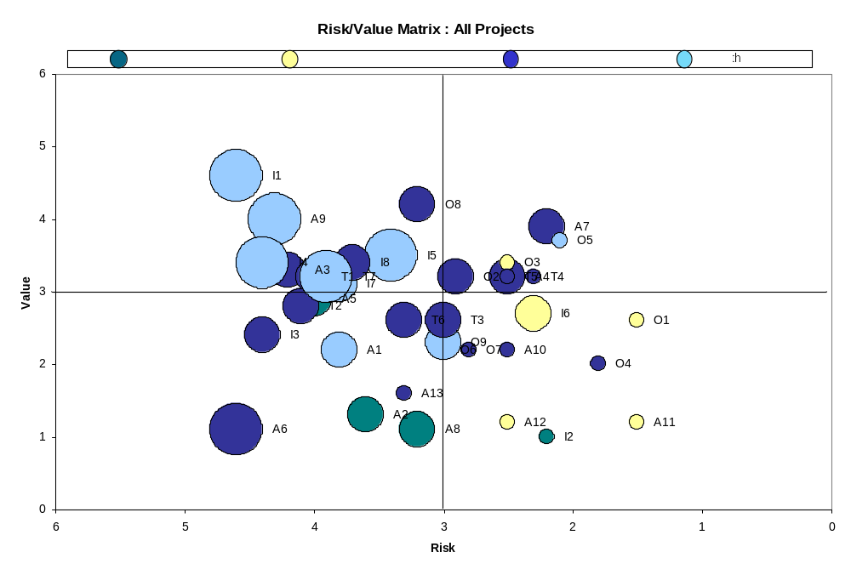
PriorIT! Tool Overview
PriorIT! is an excel-based tool that helps teams prioritize projects on the basis of the risk versus value tradeoffs within the portfolio
  Work with the client to develop risk and value criteria appropriate to the client’s portfolio
  Rank the importance of the criteria based on project type
  Rate each project in the portfolio according to the criteria, the tool automatically calculates an overall risk and value score and plots the results
For more information, see the PriorIT! Link from the Project Portfolio Management site
Do Now
Plan Now
Reassess

Slide 71
Tools References
Go to the Project Portfolio Management intranet site found on Consulting’s KM system, deloitteresources.com, under Tools and Support
  Click on the appropriate tool link on the right hand side navigation bar
  You will be asked to fill out a simple survey in order to access the tools
  As your email address will be on file via the download survey, you will be emailed directly about any further upgrades or information about the Project Portfolio Management tools
From the Project Portfolio Management intranet site, you will also find support and educational materials including
  Detailed User Guides
  Tool-specific Overview Presentations
  Project Portfolio Management Training Seminar
  Other support and training materials
Visit the site often, we regularly update with helpful information and announcements about the tools!

