Slide 1
RESPONSIBLE CONSUMPTION AND PRODUCTION (SDG 12)
Because “Reuse It” is the New “Buy It”
Prepared by-
Amulya Gupta IT-1
Mirika Jain IT-2

Slide 2
What It Means?
Responsible Consumption and Production =
Using what we have smartly so we don’t mess up the planet for the next generation.
In college life:
Printing only what’s needed.
Not wasting food in the canteen.
Reusing notebooks and bottles.
Supporting sustainable brands (or local thrift stores).

Slide 3
Why We Should Care?
We buy → use → throw → repeat.
Every T-shirt = 2,700 litres of water.
1/3 of all food is wasted while many go hungry.
The Earth’s “resources” reset day (Earth Overshoot Day) comes earlier each year.
🗣 “We don’t inherit the Earth from our parents, we borrow it from our children.”

Slide 4
Goal of SDG 12
UN Goal 12: Ensure sustainable consumption and production patterns.
In short:
🛒 Consume less, waste less, and produce better.
Targets:
Reduce waste (especially food & plastic)
Encourage recycling & responsible industry
Make consumers aware (that’s us!)

Slide 5
Our habits today:
Online shopping → packaging pile-ups 📦
Fast fashion → wear once, post, forget 👕
E-waste → old phones collecting dust 📱
Canteen leftovers → dustbin meals 🗑️
What We Can Do (As Students)
Small steps that actually help:
Carry your own bottle & tiffin.
Use digital notes instead of printing every PDF.
Host zero-waste college fests.
Thrift or swap clothes with friends.
Compost food waste in hostel gardens.
🧠 Sustainability starts from the dorm room, not the boardroom.

Slide 6
Circular Economy (The Cool Loop)
Instead of “Make → Use → Dump”, we go:
“Make → Use → Reuse → Recycle → Repeat”
Example:
Old jeans → tote bag
Scrap paper → handmade notebooks
Old phones → spare parts for labs
♻️ Nothing wasted, everything reused.

Slide 7
India’s Green Moves
Mission LiFE: Lifestyle for Environment (by PM Modi).
Swachh Bharat Mission: cleaner cities, less plastic.
Plastic bans: slowly making a difference.
College clubs & NGOs: Slum swaraj, Naye Pankh, NSS clean-ups.
🌿 India is turning green — one reusable cup at a time.
Global & Brand Examples
Patagonia: repairs old clothes for free.
IKEA: uses recycled materials.
Phool.co (India): makes incense from temple flowers.
Goonj: turns old clothes into rural products.

Slide 8
Our College Can Do This
Eco-friendly canteen: No plastic spoons or cups.
Paperless admin work (use Google Forms).
Waste segregation bins in every block.
Sustainable college merch (cotton tees, cloth bags).
Sustainability drives & awareness posters made by students.
📅 One green week a semester = big long-term impact.

Slide 9
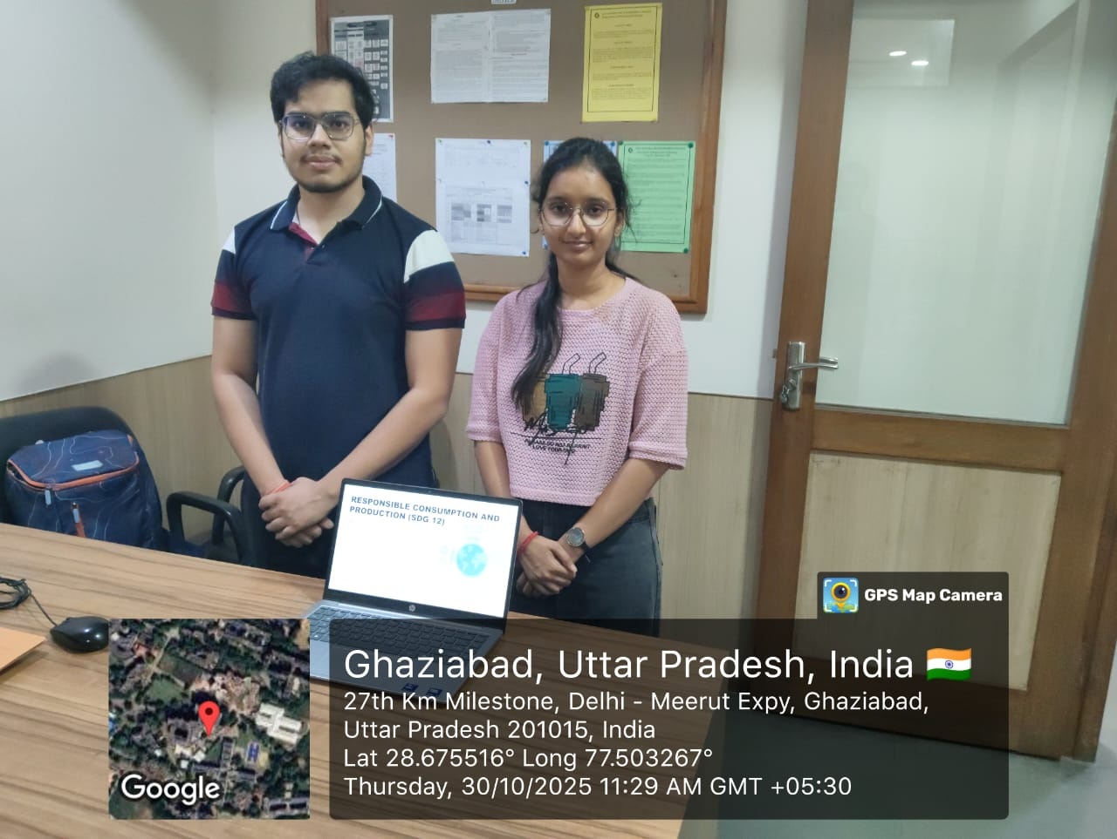
If We All Join In
We’ll see:
✅ Cleaner surroundings
✅ Lower costs (less waste = more savings)
✅ Healthier lifestyle
✅ Future-ready eco mindset
💬 Sustainability is not a trend — it’s a team effort.
“Responsible consumption” is basically being smart, not stingy.

Slide 10
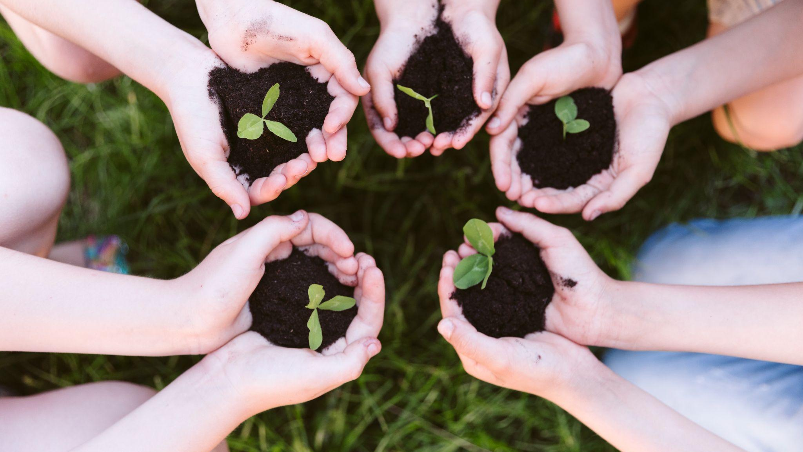
Be the generation that fixes, not finishes, the planet.
Thank You!

