Slide 1










$$γ$$
Hyperparameter
$$γ$$
$$β$$
$$β$$
Per Line Point Mixture
$$α$$
Hyper parameter
$$π$$
Per Polygon Line Segment Mixture
q
Line assignments per polygon-point
$$ψ$$
Points
$$α$$
$$π$$
q, g
$$ψ$$
S
Number of Line Segments
S
P
P
Number of Polygons

Slide 2
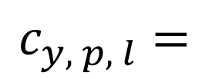
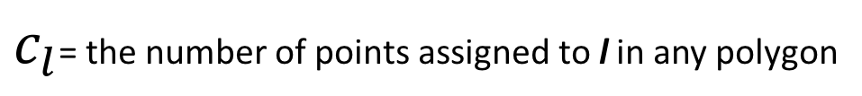
$$c_{y, p, l}=$$
Polygons y
line l
Point p
$c_{l}$= the number of points assigned to l in any polygon

Slide 3
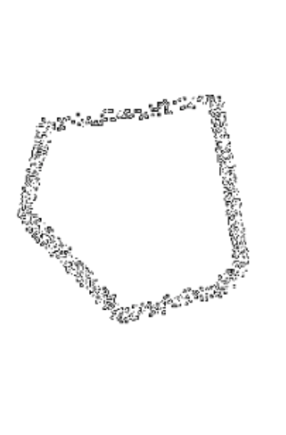
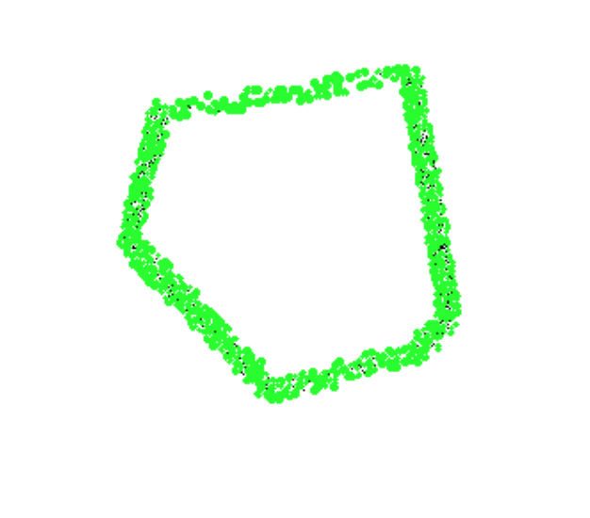

a) Edge detection on points
b) Hough-Transform Probabilistic
c) Hough-Transform

Slide 4
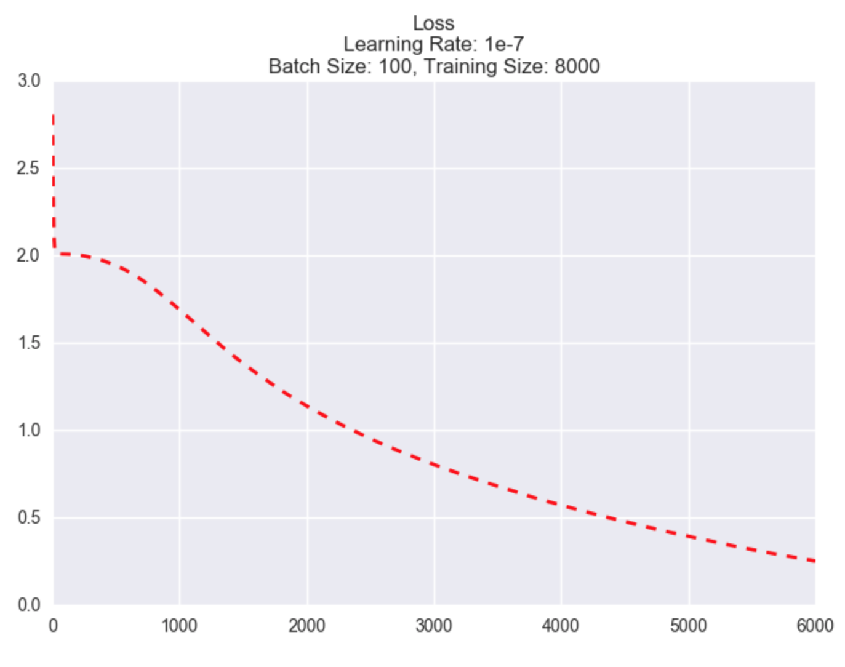
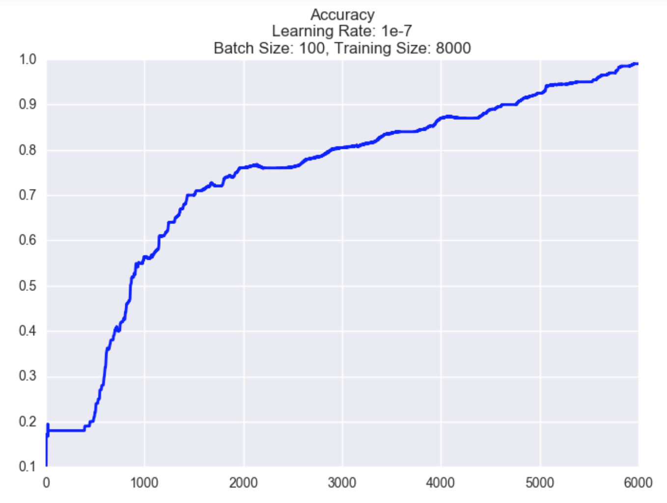
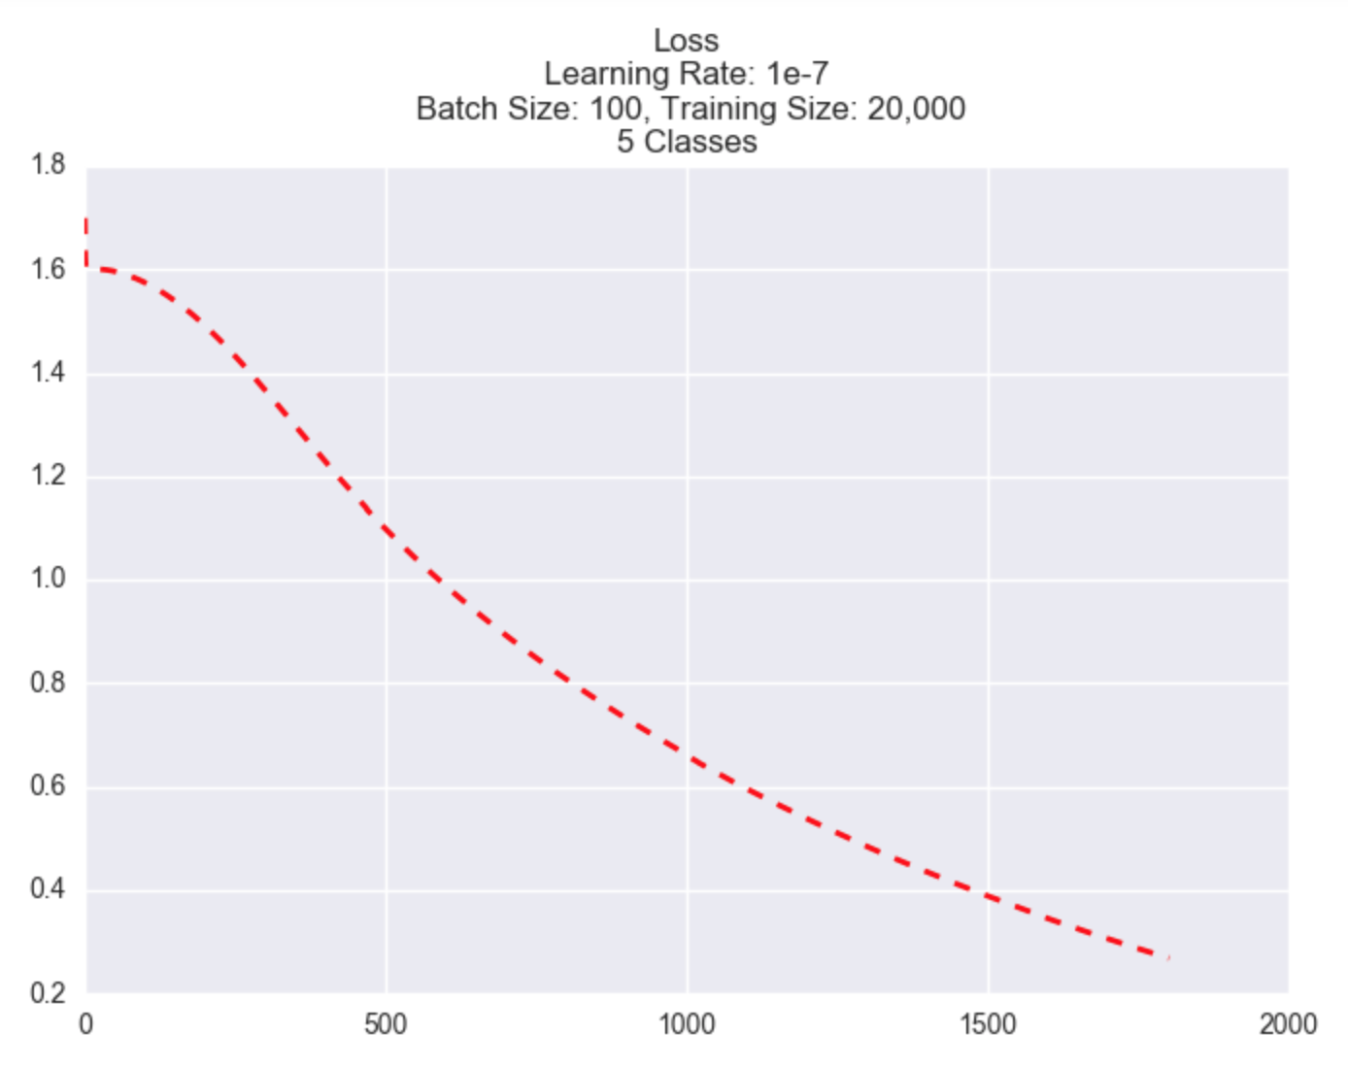
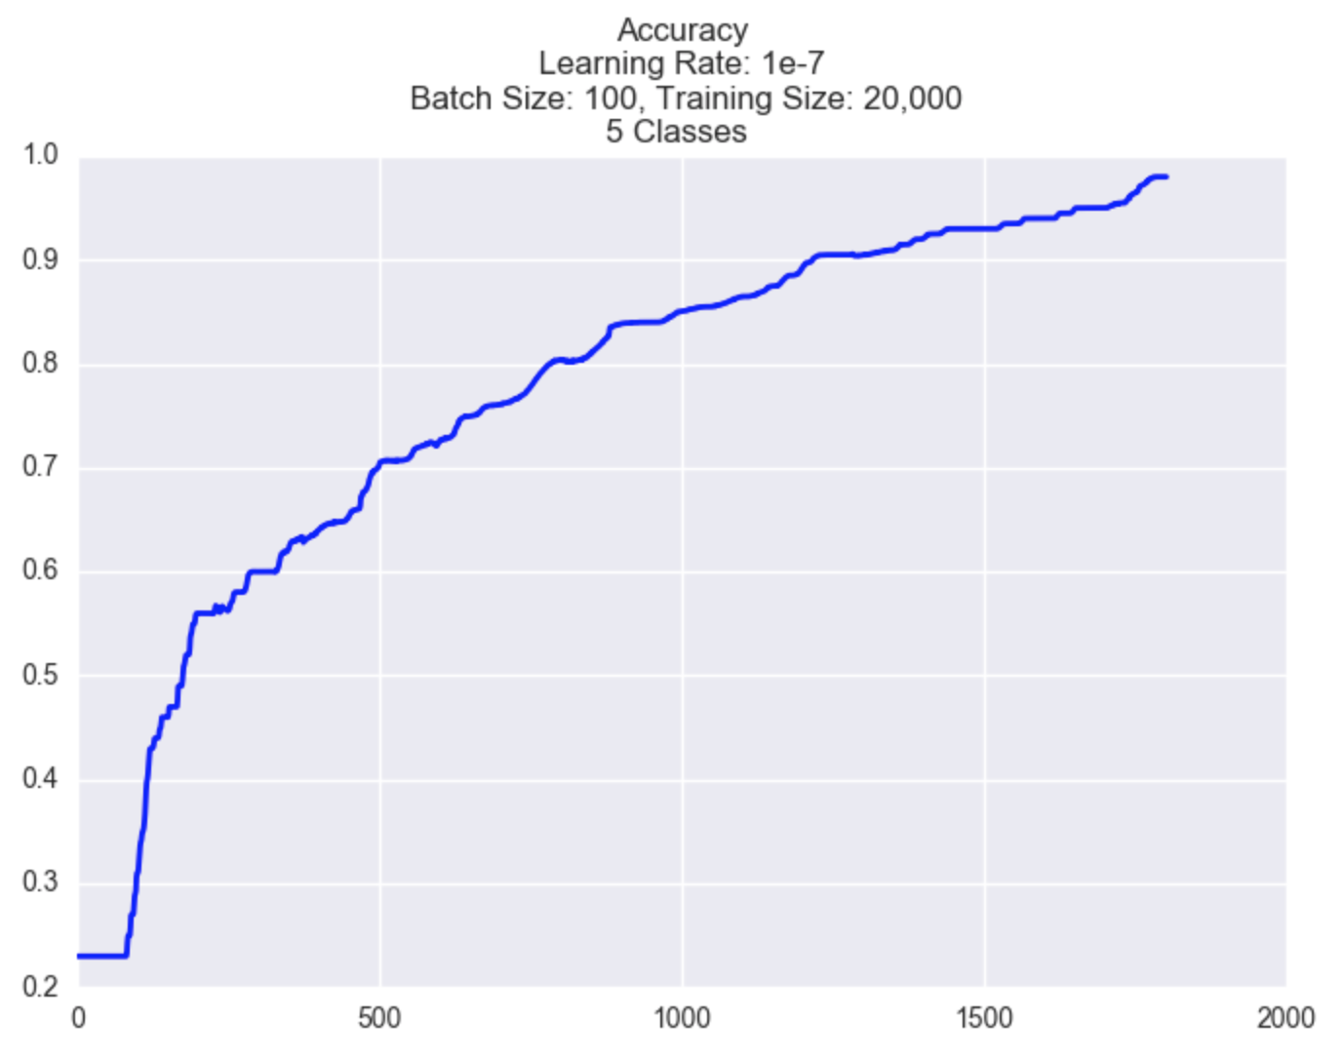

Slide 5
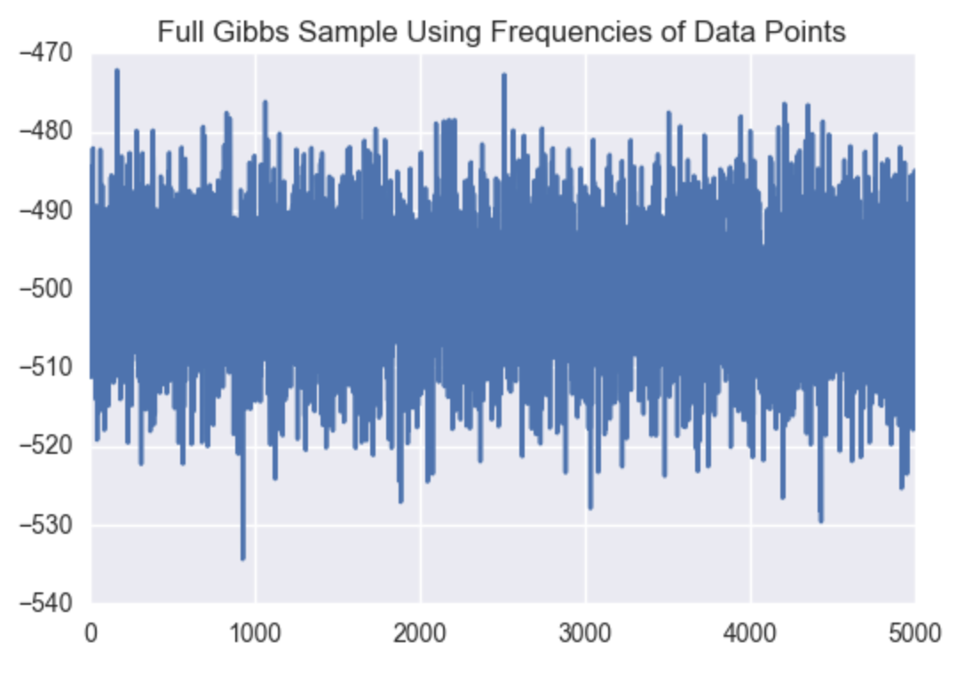
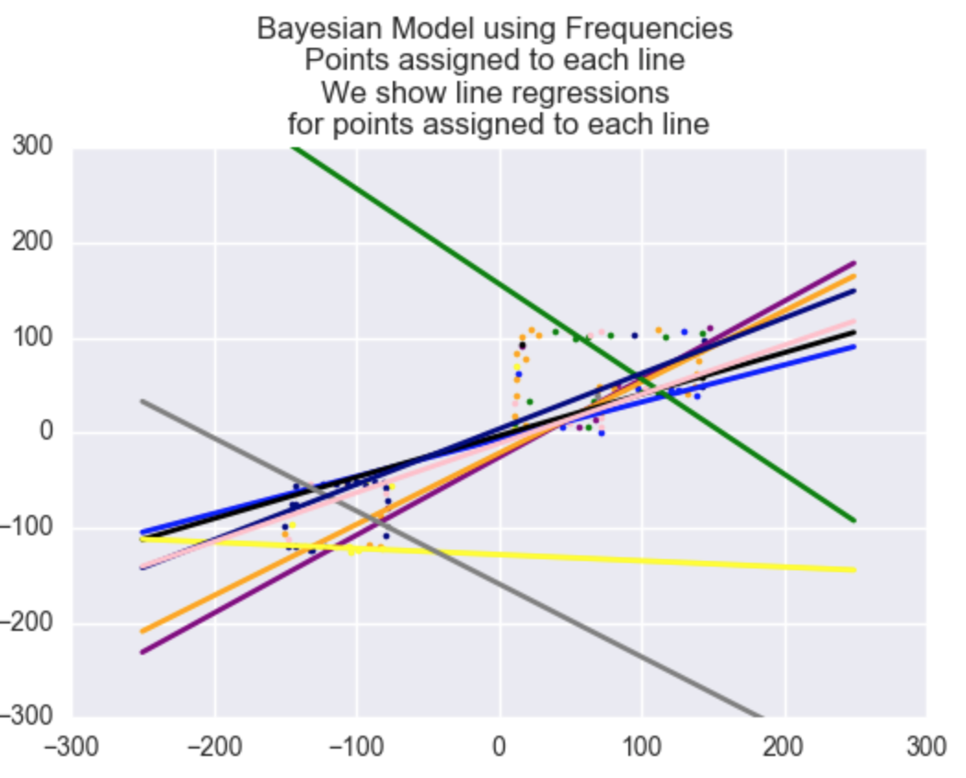
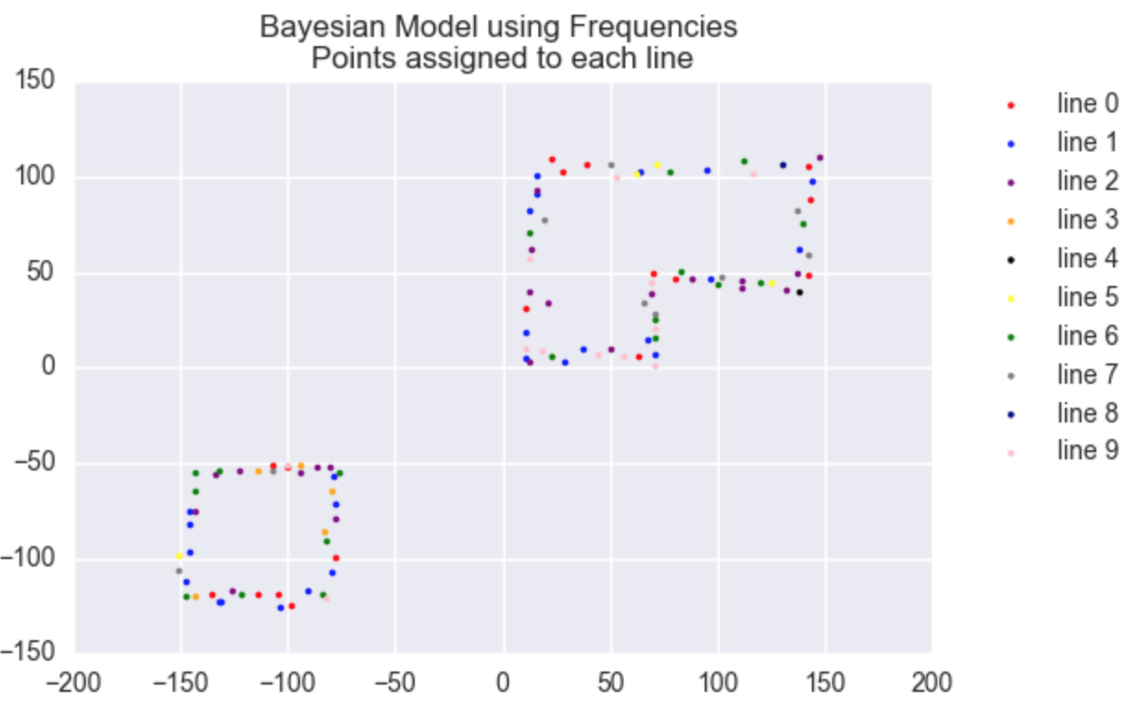

Slide 6
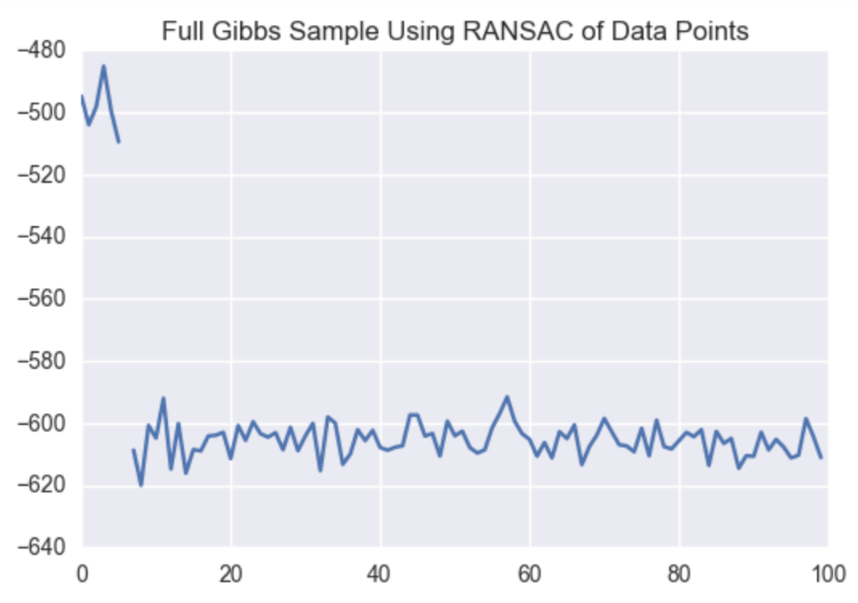
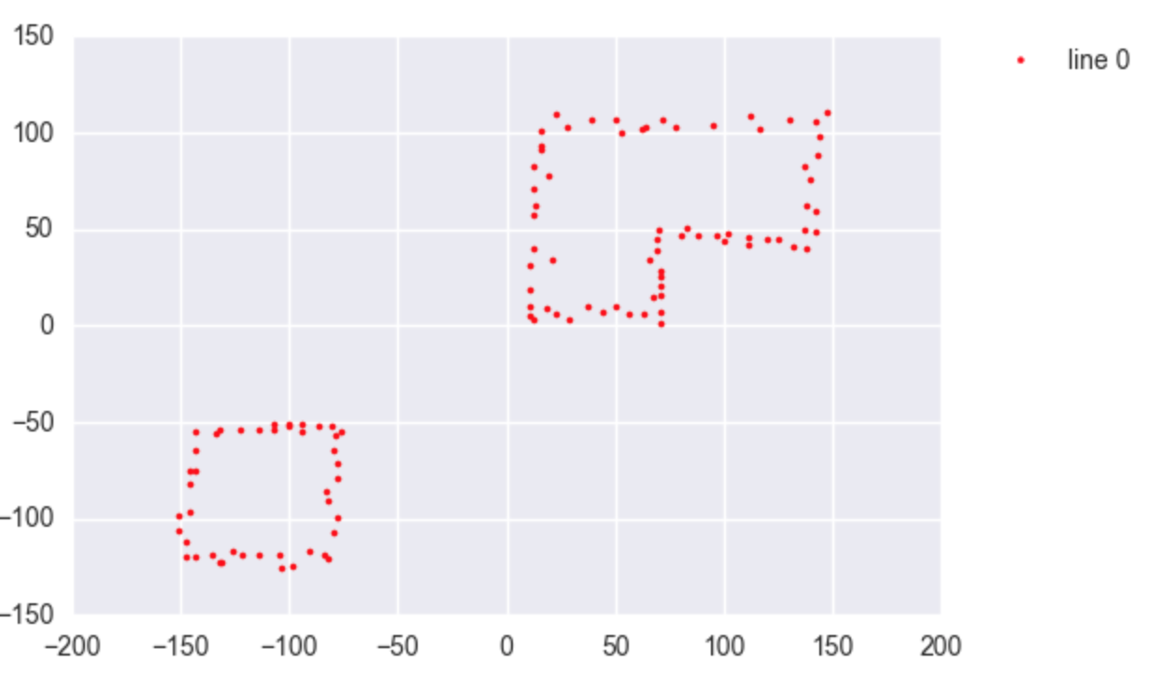

Slide 7
