Slide 1
Towards Efficient Metaquering
Rachel Ben-Eliyahu - Zohary
AI 2017

Slide 2
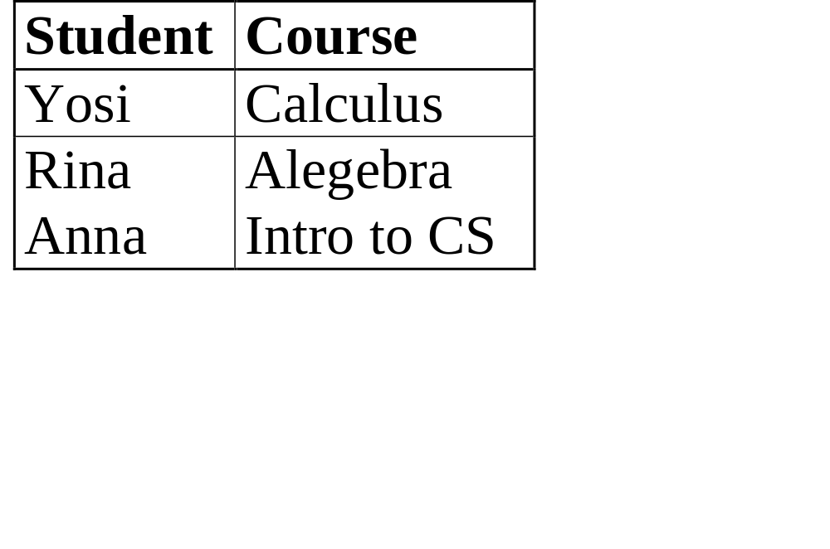
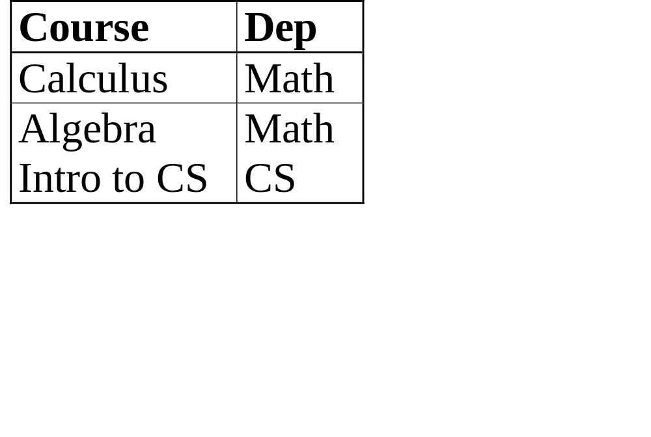
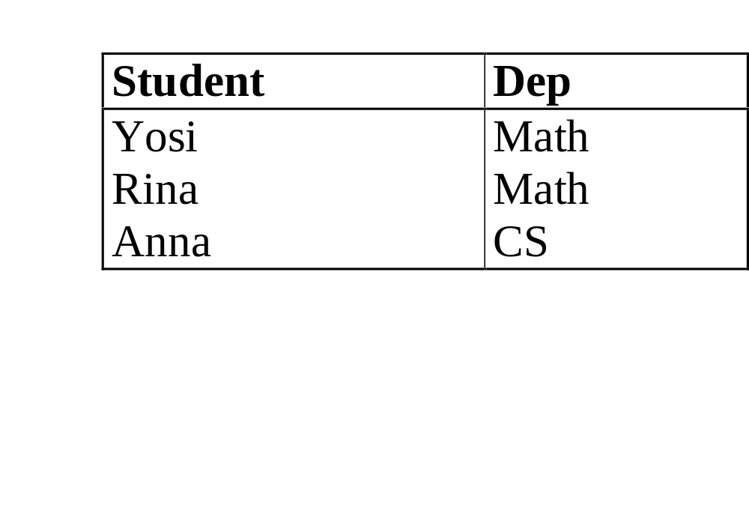
Example
stud-course
course-dep
AI 2017
stud-dep

Slide 3

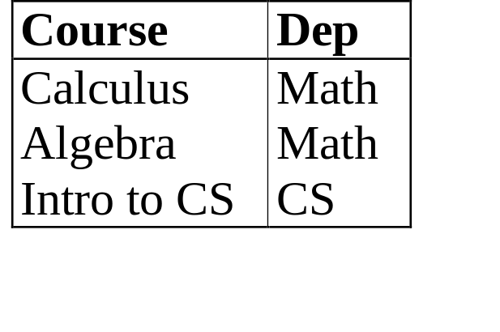
Example
stud-course
course-dep
stud-dep
Metaquery: P(X,Y) & Q(Y,Z) R(X,Z)
Answer: stud-course(Student,Course) & course-dep(Course,Dep) stud-dep(Student,Dep)
AI 2017

Slide 4
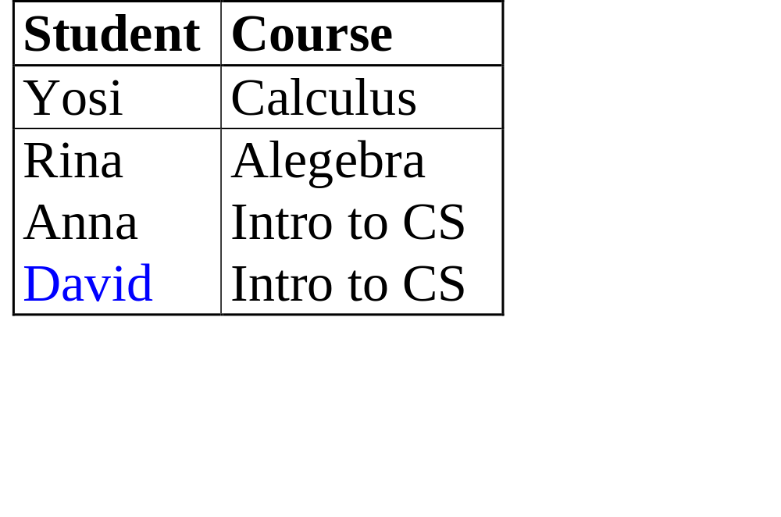
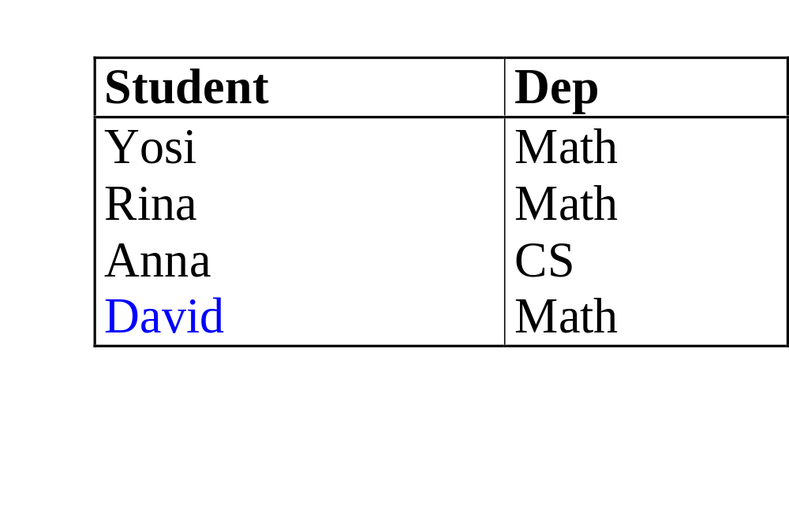
Life is not so simple
stud-course
course-dep
stud-dep
AI 2017

Slide 5
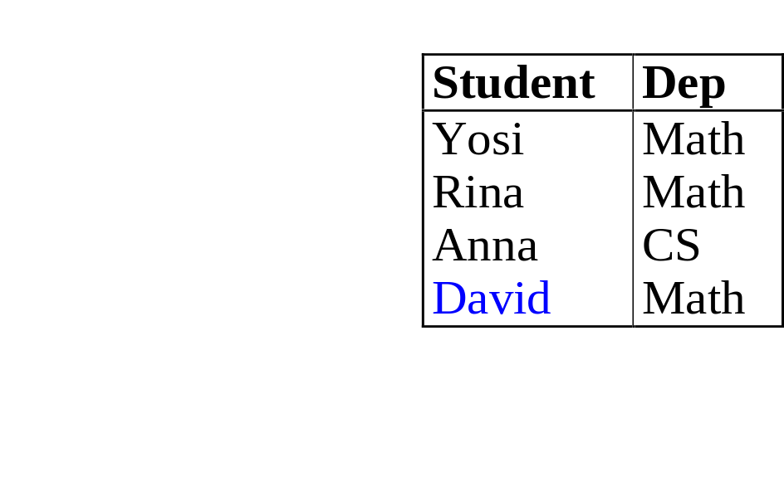

Life is not so simple
Metaquery: P(X,Y) & Q(Y,Z)
R(X,Z)
Answer: stud-course(Student,Course) & course-dep(Course,Dep)
stud-dep(Student,Dep), confidence: 0.75
AI 2017

Slide 6
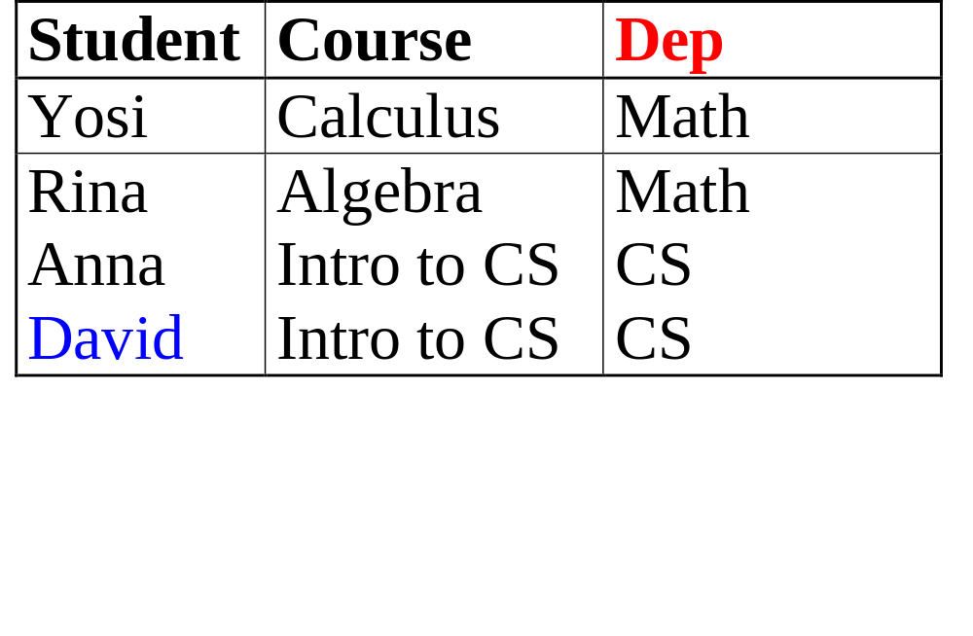
Answer: stud-course(student,course) & course-dep(course,dep)
stud-dep(student,dep), confidence: 0.75
Why? Join of the relations stud-course and course-dep is:
If we project on student and department, we get that only 3 of the
4 tuples appear in the relation stud-dep.
AI 2017

Slide 7
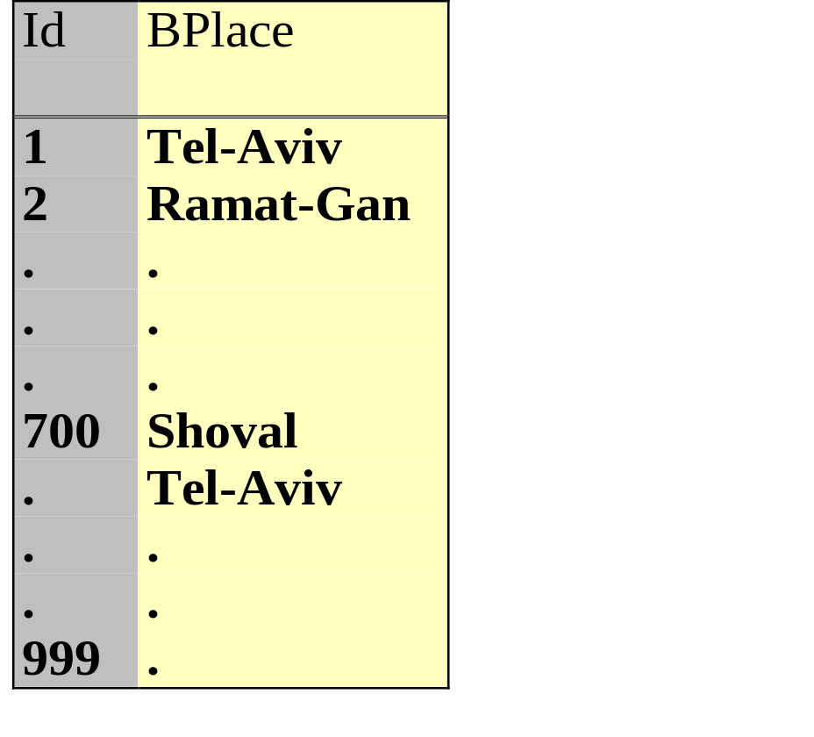
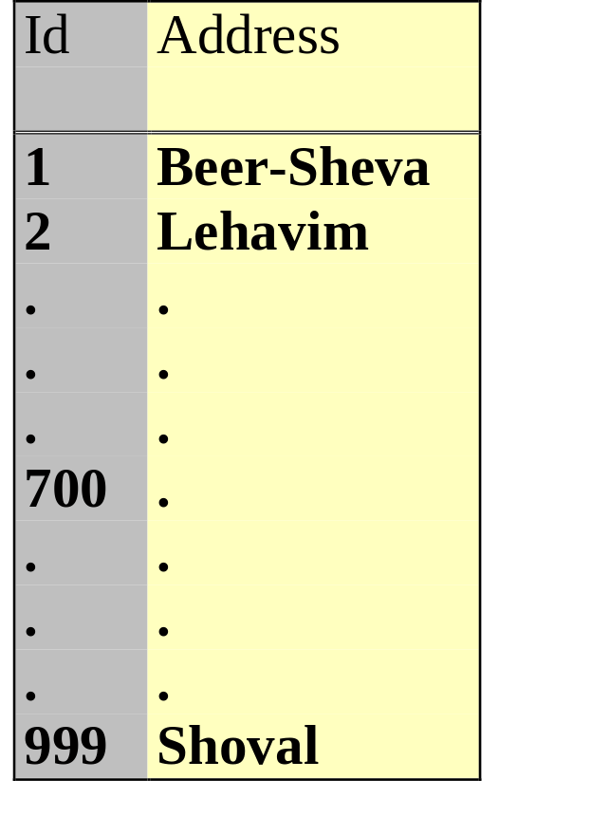
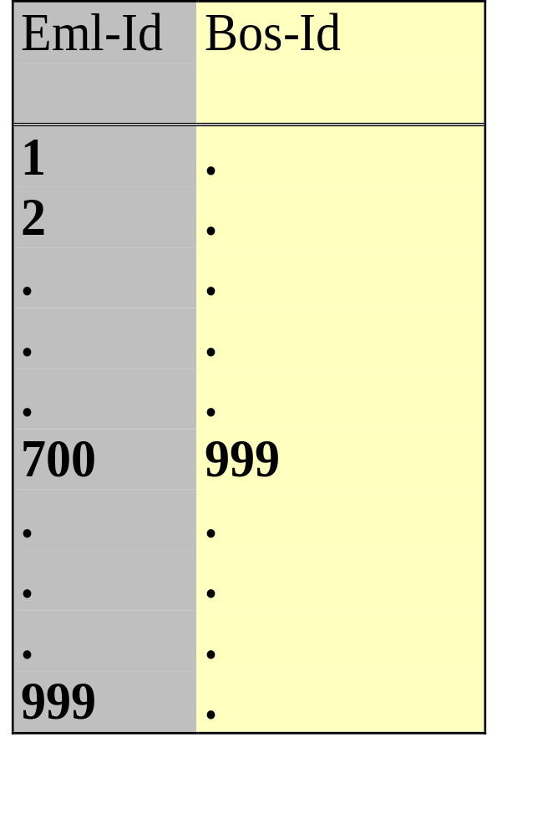
Support : Motivation
Empl-Hist
Empl-Add
Boss
AI 2017

Slide 8
Support : Motivation (cont.)
Empl-Hist: All Employees except one (id 700) were born in
central Israel. 700 was born in Kibutz Shoval.
Empl-Add: All Employees leave in southern Israel,
only one (id 999) lives in Kibuz Shoval.
Boss: Employee 999 is the boss of employee 700.
Metaquery: P(X,Y) & Q(Z,Y) R(X,Z)
One answer:
Empl-Hist(X,Y) & Empl-Add(Z,Y) Boss(X,Z)
with confidence 1.0!!
AI 2017

Slide 9
Support : Motivation (cont.)
We need SUPPORT to avoid unstable rules like:
“If an employee A was born in one place
and employee B lives in the same place,
Then B is the boss of A.”
AI 2017

Slide 10
Support: Definition
LHS RHS
Shen (1997) defines Support as:
size of LHS join
size of LHS Cartesian product
Not good enough.
AI 2017

Slide 11
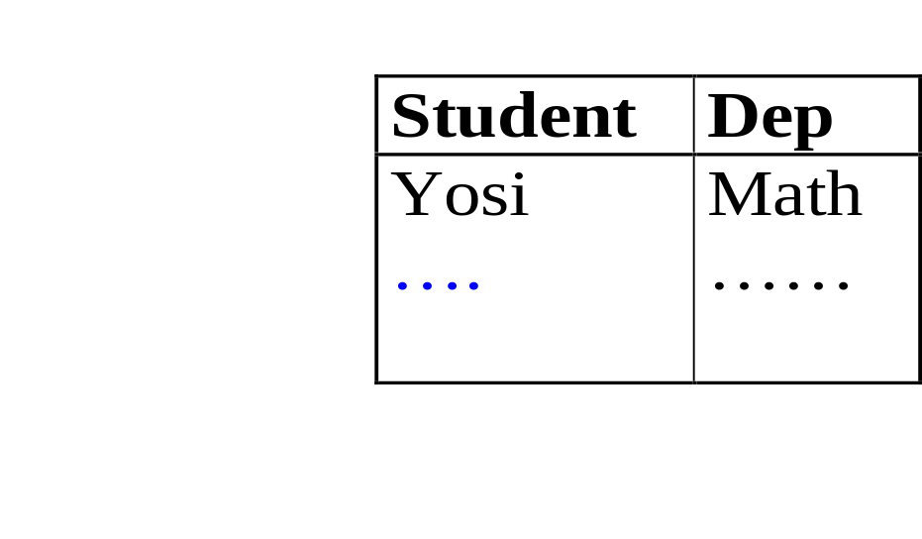
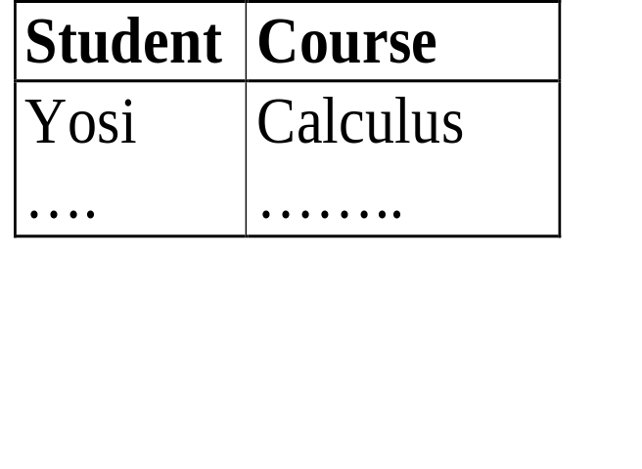
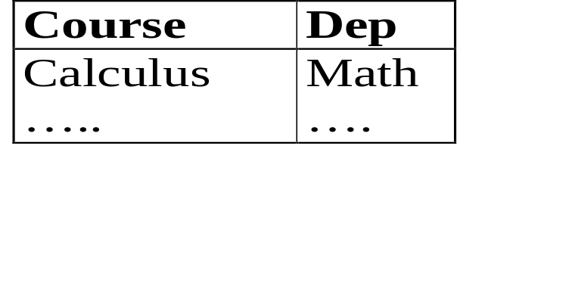
Support:
According to Shen
10,000 students
1000 students
size of LHS join (10,000)
size of LHS Cartesian product (10,000,000)
stud-course(Student,Course) & course-dep(Course,Dep)
stud-dep(Student,Dep), support = 0.001
AI 2017

Slide 12
Support: Our Definition
Let R1…Rn be the relations in the LHS.
The support of the rule is the maximum over S(i), where S(i) is the fraction of Ri that appears in the join of R1…Rn.
AI 2017

Slide 13
Support:
According to our definition
10,000 students
1000 students
S (stud-course) = 1.0, S (course-dep) = ? (< 1.0?)
Maximum over S(i) is 1.0.
stud-course(Student,Course) & course-dep(Course,Dep)
stud-dep(Student,Dep), support = 1.0
AI 2017

Slide 14
Complexity: The MQ problem.
Given a database DB and a meta query
P1(X11...Xk1) & ... & Pn(Xn1...Xkn) -->
P0(X01...Xk0),
are there relations p0...pn in DB such that the rule
p1(X11...Xk1) & ... & pn(Xn1...Xkn) -->
p0(X01...Xk0)
with support >0 and confidence > 0?
AI 2017

Slide 15
MQ is NP-hard
Reduction from Clique
AI 2017

Slide 16
Complexity
Definition 4.1 (The MQ Problem).
Instance: A database DB and a metaquery MQ of the form (1).
Question: Is there an instantiation σ for MQ in DB such that the rule MQσ holds with
support and confidence values greater than 0?
AI 2017

Slide 17
Complexity (cont.)
The CLIQUE Problem:
Given an undirected graph G = (V ,E) and a positive integer k, determine whether there is a clique in the graph of size at least k.
AI 2017

Slide 18
Complexity (cont.)
Given an undirected graph G = (V ,E) where |V| = n. We can assume that n≥k
(otherwise the answer is obviously “NO”).
We construct a database DB and a metaquery
MQ as follows.
AI 2017

Slide 19
Complexity (cont.)
DB will have two relations: rV and rE.
rV contains exactly one tuple,
which is the list of all vertices in V ,
rE is the set of all edges in E
Note that DB is un-typed.
AI 2017

Slide 20
Complexity (cont.)
MQ will be the following metaquery:
P(X1,X2, . . . ,Xn)←
Q(X1,X2),Q(X1,X3), . . . ,Q(X1,Xk),
Q(X2,X3),Q(X2,X4), . . . ,Q(X2,Xk),
...
Q(Xk−1,Xk).
AI 2017

Slide 21
The process of answering a metaquery can be
divided into two stages.
instantiation stage : we are looking for sets
of relations that match the pattern determined
by the metaquery.
filtration stage: we filter out all rules that match the
pattern of the metaquery but do not have enough
support and confidence.
Efficient Algorithms for Metaqueries
AI 2017

Slide 22
The instantiation stage
The process of instantiating a metaquery is similar to
solving a Constraint Satisfaction problem (CSP)
where we are basically looking for all solutions
of the CSP problem.
In our experiments we used a very simple CSP
algorithm (forward checking with Back-jumping)
but other more advanced algorithms may be used.
AI 2017

Slide 23
Example:
P(X,Y) & Q(Y,Z) R(X,Z)
AI 2017

Slide 24
Instantiate(SR)
\ Instantiate(SR)
[Input:]
SR: a set R_0,R_1,...,R_n of relational patterns,
partially instantiated, each with a set of constraints
C_0,...,C_n. Initially the constraints sets are all empty.
[Output:]Relations $r0,r1...rn$ that match the relational patterns in SR
and a consistent binding of the variables in SR to attributes.
\
[Input:]
SR: a set R_0,R_1,...,R_n of relational patterns,
partially instantiated, each with a set of constraints
C_0,...,C_n. Initially the constraints sets are all empty.
[Output:]
Relations r0,r1...rn that match the relational patterns in SR and a consistent binding of the variables in SR to attributes.
AI 2017

Slide 25
Instantiate(SR)
1. If SR is completely instantiated then return SR.
2. Pick the next uninstantiated relation variable R_i from SR,
{here we should use CSP variable ordering techniques}
3. Pick up the next possible instantiation r to R_i
(r should meet the constraints in C_i and should be of the same arity as R_i).
{Here we should use CSP value ordering techniques }
AI 2017

Slide 26
Instantiate(SR) … cont.
4. For each relational pattern R_j not yet instantiated do:
if R_j has a common attribute variable X with
R_i, add to C_j the constraint that X must be bound to an attribute with typeT_X, where T_X is the
type of the attribute that X is bound to in $r$.
5. Call Instantiate recursively.
AI 2017

Slide 27
The Filtration Stage
The filtration stage itself is composed of two steps:
1. filtering out rules with low support
2. filtering out rules with low confidence.
We compute confidence only for rules with
sufficient support.
In our research we have focused so far on
algorithms for computing support.
AI 2017

Slide 28
Computing Support
Since the Join is an expensive operation,
we try to detect rules with low support using
some low-cost procedures.
We compute an upper bound on the support
and then compute the exact support only for rules
with high enough upper bound of support.
AI 2017

Slide 29
Three alternatives to compute support:
The Join approach: computing the equijoin of
the body of the rule, then computing S_i for
each relation in the body, and then taking the maximum.
The histogram approach: Using histograms to estimate
support. Computing the support using the Join approach
only for rules with high estimated support.
The histogram + memory approach: same as the histogram
approach, except that we store intermediate results in
memory, and reuse them when needed.
AI 2017

Slide 30
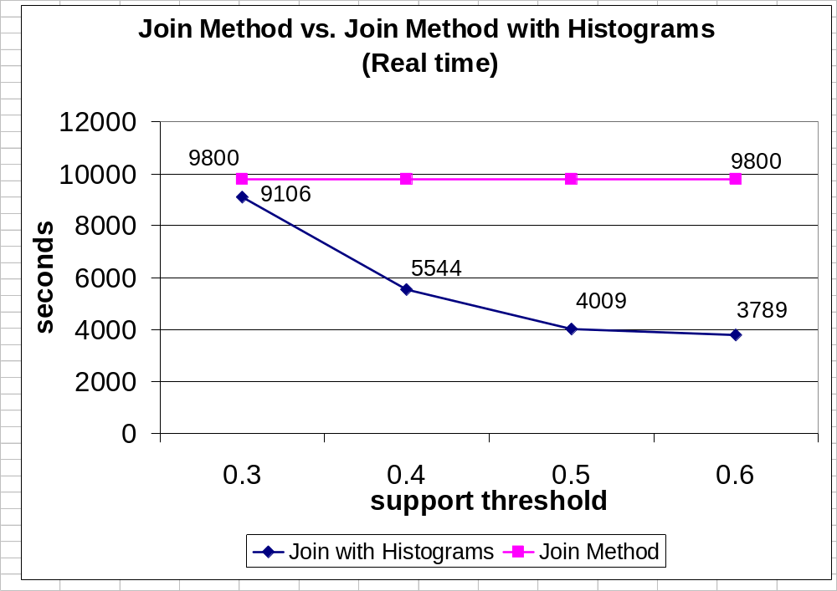
AI 2017

Slide 31
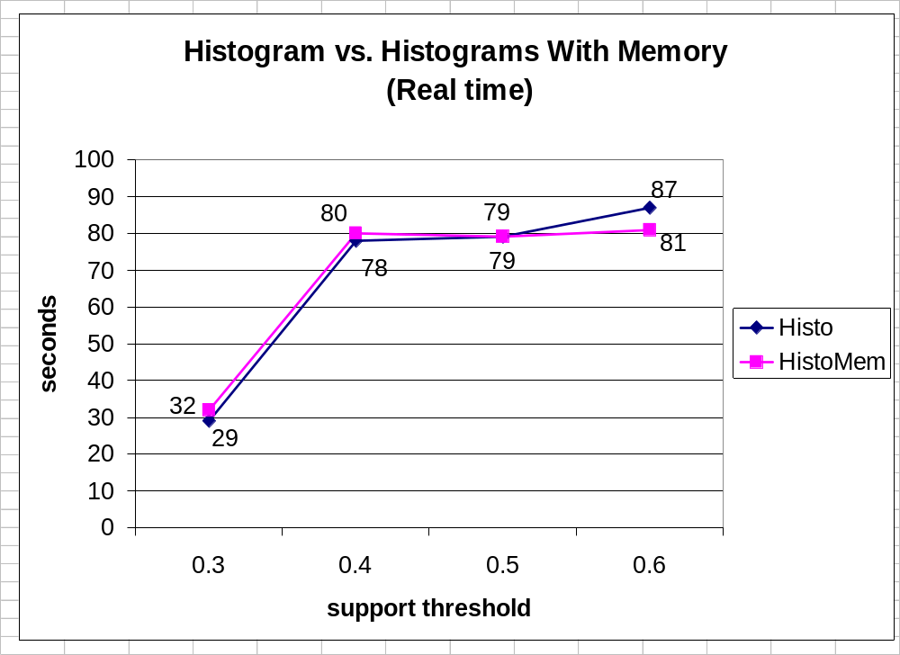
AI 2017

Slide 32
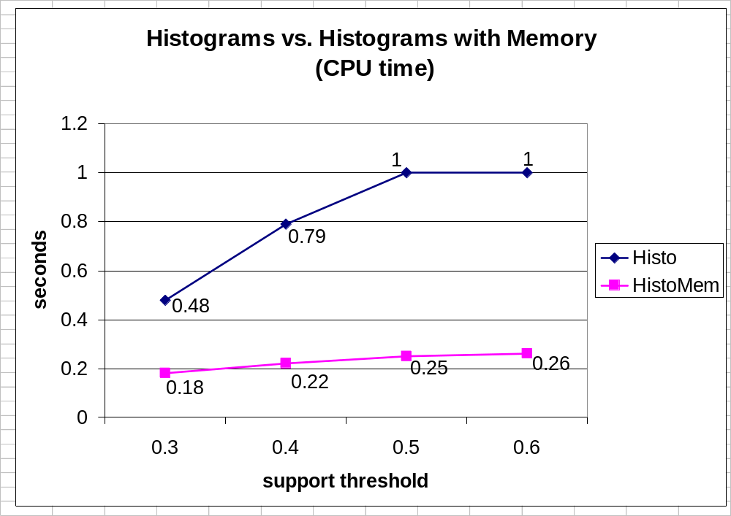
AI 2017

