Slide 1
Software for traffic violation of a right hand rule
Students: Skarica M., Megla L.
Supervisor: Caglioti V.
Final project for Image Analysis course

Slide 2
Overview
Project goal
Project implementation
Vehicle recognition
Tracking
Traffic violation recognition
Key findings / results
Conclusion

Slide 3
Project Goal
Real world
Crossroads without traffic lights or traffic signs
Application of a right hand rule
Software for recognizing right hand rule violations
Track violations on every intersection without traffic lights/signs
Easy and profitable

Slide 4
Procedure / Methodology
Acquisition of video material
Classical digital camera attached to an elevated object
Frame rate: 30fps
Software implementation
Testing and Results

Slide 5
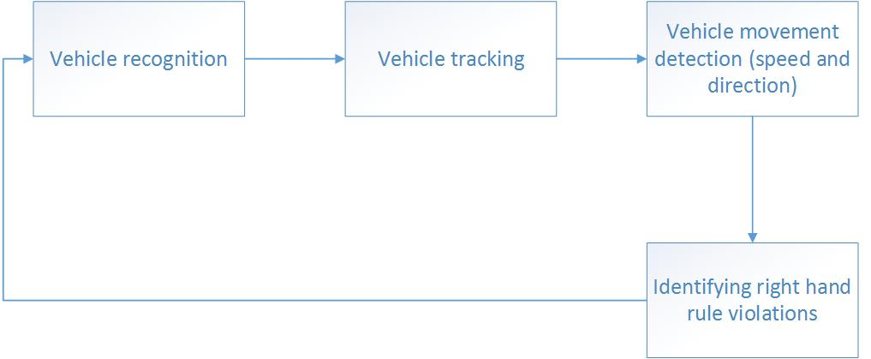
Software implementation procedure

Slide 6
Vehicle recognition
Foreground estimation
Gaussian Mixture Models
Filter application
Remove noise
Blob analysis
Extract moving cars from estimated foreground

Slide 7
Foreground estimation: Gaussian Mixture Models
The most important part of vehicle recognition step
GMM models each pixel with mixture of different Gaussians
„Pixel process” – value of a pixel over time
History of each pixel is modeled by mixture of K Gaussian distributions
The best distributions are taken for background estimation; others are considered as foreground.

Slide 8
Vehicle tracking
Kalman filter
Predict car’s location in each frame
Determine likelihood of each detection being assigned to each moving car
Car tracks (i.e records)
One track = one moving car in the video
Fields: id, age, bbox, bbox_initial, velocity, priority, kalmanFilter, totalVisibleCount, consecutiveInvisibleCount
Important: maintain the state of a tracked cars; delete cars that left the frame or wrong assignments

Slide 9
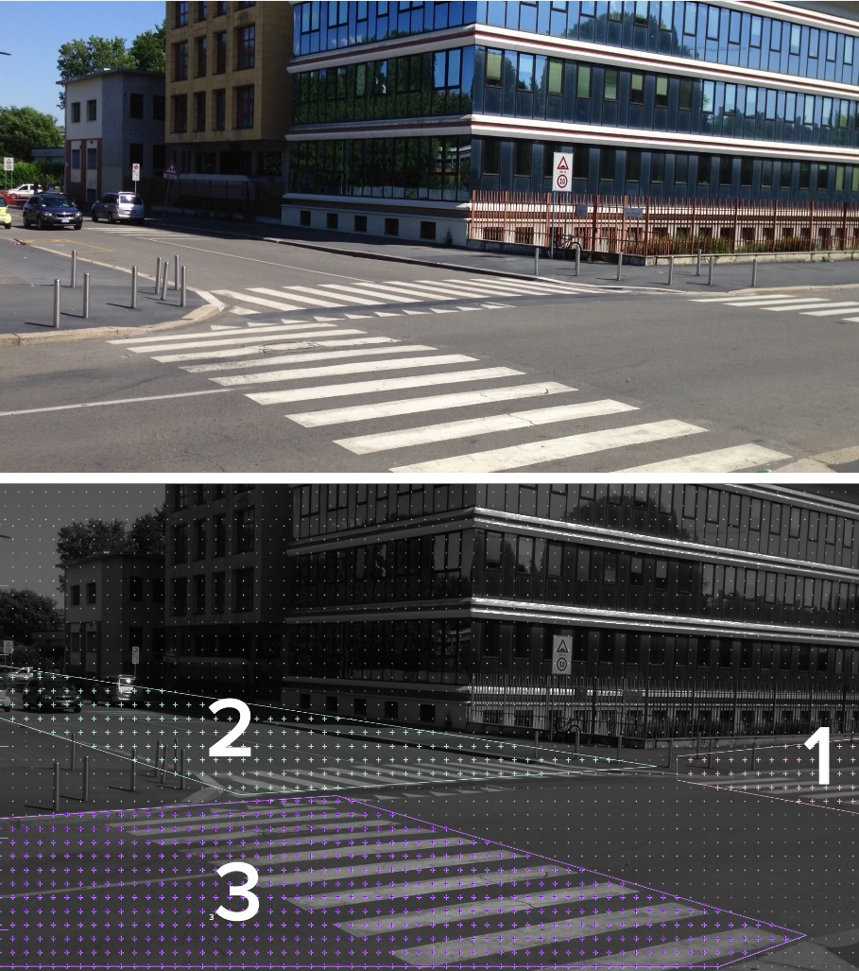
Violation detection
Assignment of priorities
Each car has assigned priority which helps us determine which car has the right to pass first
The priorities are assigned in descending order
Example: car coming from the left has priority 3 and it has the right to pass first; Car having priority 2 has the priority over car having priority 1 etc.
Detecting car’s priority

Slide 10
Violation detection
difference between velocity \footnotemark of the vehicle with priority 2 and the one with lower priority has to be greater than \textit{ minDeltaVelocity = 250}. Meaning, the vehicle with the higher priority has to have a much lower velocity, as though it was stopping or slowing down
Recognition of the violation
right-hand side rule violation could happen between cars of priority (1, 2) and (2,3)
the distance between the left bounding box edge of vehicle with priority 2 and the one with priority 1 has to be greater than 10; meaning we make sure the cars have passed each other

Slide 11
Violation detection
difference between velocity \footnotemark of the vehicle with priority 2 and the one with lower priority has to be greater than \textit{ minDeltaVelocity = 250}. Meaning, the vehicle with the higher priority has to have a much lower velocity, as though it was stopping or slowing down
The distance between the top bounding box edge of vehicle with priority 1 and the one with priority 2 has to be greater than 10; meaning we make sure the car with priority 1 didn't make a left turn and is now "above" the car with priority 2
The overlap ratio of their bounding boxes has to be greater than 0.2
Difference between velocity of the vehicle with priority 2 and the one with lower priority has to be greater than 250; meaning the vehicle with the higher priority is slowing down
If the above conditions are satisfied, the situation is considered as a violation.

Slide 12
Results
The software is tested on 5 videos obtained by a digital camera
If the violation happens, software outputs which car made a violation; if there is no violation, software outputs a non violation sign
Video | Output - test
video_data_sunday/IMG_5108.mov | Correct classification
video_data_sunday/IMG_6914.mov | Correct classification
video_data_sunday/IMG_6915_01.mov | Correct classification
video_data_sunday/IMG_6917.mov | Problems with bounding boxes – doesn’t detect the violation
video_data_sunday/IMG_6919.mov | Correct classification

Slide 13
Problems and future work
No testing video for violation of the right-hand side rule between vehicles with priority 2 and 3
Slightest shake of a camera can cause the surrounding background to be detected as a moving object, renders the software useless in traffic violation detection
Future Goal: further refine motion detection so it also handles even more complex cases

Slide 14
Thank you for the attention

