Slide 1
CONWAY'S GAME OF LIFE · STATISTICAL MECHANICS
Flammenkamp's Constant
Self-organization, attractors, and the limits of proof
2.87115 %
What is the asymptotic density of live cells
in a random GoL soup?
empirical constant
Achim Flammenkamp
Turing-complete system
No analytic proof
large-scale simulations, 1994–2004
GoL computes anything a UTM can
undecidability is the hard barrier
Conway to LangGraph · University of Bologna | FLAMMENKAMP'S CONSTANT

Slide 2
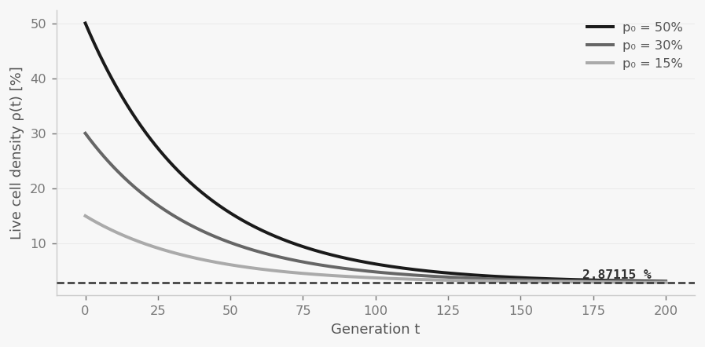
OBSERVATION
Random Soups Converge
01
Initial soup
Each cell alive with probability p₀ ∈ (0,1), independently. Maximum disorder, maximum entropy.
02
Transient dynamics
Local clusters form, interact, annihilate. Gliders, still lifes and oscillators emerge from noise.
03
Quiescent state
The grid settles into isolated stable objects (ash). No further global evolution is possible.
04
Attractor density
Regardless of p₀ (over a wide range), the final live-cell density converges to the same value.
Density ρ(t) from three initial conditions → Flammenkamp attractor.
Approximate model: ρ(t) ≈ ρ∞ + (ρ₀ − ρ∞) e^{−t/τ}
Conway to LangGraph · University of Bologna | SOUP CONVERGENCE

Slide 3
THE CONSTANT
ρ∞ = 2.87115 %
2.87115
Universal attractor
ρ∞ is independent of p₀ for a wide range (~0.10 < p₀ < 0.90). This is the signature of a thermodynamic fixed point.
∀ p₀ ∈ (0.1, 0.9) : ρ(t→∞) → ρ∞
%
Exponential relaxation
≈ 1/e (e = 2.718...)
Density relaxes exponentially to ρ∞ with time-scale τ_L ~ L^z, z = 1.66 ± 0.05 (Bagnoli et al., 1993).
10⁸ random soups
ρ(t) ≈ ρ∞ + (ρ₀ − ρ∞) e^{−t/τ_L}
grids up to 10⁴ × 10⁴
Spatial correlations
Correlation length ξ(t) ~ t^{1/z} before saturation. Cells are NOT independent — mean-field fails quantitatively.
Flammenkamp, 1994–2004
ξ(t) ~ t^{1/z}, z ≈ 1.66
Conway to LangGraph · University of Bologna | THE NUMBER

Slide 4
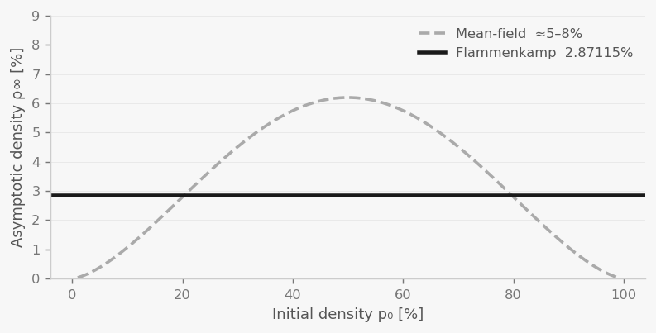


MEAN-FIELD ANALYSIS
Why Mean-Field Fails Here
Mean-field approximation
Assume cells are independent: P(alive) = ρ(t).
Birth rule: dead cell with exactly 3 live neighbors.
P(birth) = C(8,3)·ρ³(1−ρ)⁵ = 56ρ³(1−ρ)⁵
Exercise
Survival: live cell with 2 or 3 live neighbors.
P(survive) = C(8,2)ρ²(1−ρ)⁶ + 56ρ³(1−ρ)⁵
See notebook !
Fixed point: ρ* = P(birth) + ρ·P(survive) − ρ
MF prediction: ρ* ≈ 5–8% (depends on p₀)
MF predicts ~5–8% vs. Flammenkamp 2.87%
Asymptotic density vs. p₀. MF overestimates ρ∞
because it ignores spatial correlations and cluster structure.
What mean-field ignores
→ Spatial clusters: still lifes and oscillators are highly correlated structures.
→ Correlations extend over ξ(t) ~ t^{0.6}: cells are far from independent.
→ Ash objects are large, sparse and stable — not capturable by local ρ alone.
Conway to LangGraph · University of Bologna | MEAN-FIELD vs REALITY

Slide 5
COMPUTABILITY
Why No Analytic Proof Exists
1
GoL is Turing-complete
Any computable function can be encoded as a GoL initial configuration. Gliders act as wires; collisions implement logic gates (AND, OR, NOT).
▼
2
Turing-completeness ⟹ Halting Problem applies
For any Turing-complete system, there is no general algorithm to determine whether a given computation terminates. Rice's theorem generalizes this.
▼
3
Long-term behavior is undecidable
Given pattern P, it is formally undecidable whether P will ever stabilize, or which attractor it will reach. Proved as a corollary of the Halting Problem.
▼
4
ρ∞ cannot be derived analytically — the barrier is fundamental
Computing ρ∞ would require predicting the fate of every configuration — equivalent to solving the Halting Problem. This is not a gap in technique; it is a formal impossibility.
Conway to LangGraph · University of Bologna | UNDECIDABILITY

Slide 6
PHYSICS READING
Flammenkamp's Constant as a Physical Object
Fixed-point attractor
Order parameter
Renormalization group
Statistical mechanics
Phase transitions
RG flow
ρ∞ is a fixed point of the density map T: ρ↦T(ρ). The system flows toward it from any initial condition, like a thermodynamic equilibrium state.
ρ(t) plays the role of an order parameter. GoL undergoes an order–disorder transition from soup to ash. ρ∞ is the equilibrium value of the absorbing state.
Mean-field is the zeroth-order RG approximation. ρ∞ is the true fixed point of the full RG flow; MF truncation gives the wrong answer because correlations are relevant.
T(ρ∞) = ρ∞
Φ = ρ∞ (absorbing state)
ρ*_MF ≈ 5–8% ≠ ρ∞ = 2.87%
Self-organized criticality
Finite-size scaling
Undecidability as phase
BTW sandpile
Spin systems near Tc
Edge of chaos (Wolfram Class IV)
Like the Bak–Tang–Wiesenfeld sandpile, GoL self-organizes to a critical state without tuning a control parameter. ρ∞ is the critical density of the absorbing-state transition.
τ_L ~ L^{1.66} is the relaxation timescale. This power-law FSS is structurally identical to spin models near their critical temperature.
Class IV CAs live at the boundary of order and chaos. GoL is Class IV: its long-term behavior is undecidable. ρ∞ exists and is measurable, but is not derivable — like Chaitin's Ω.
no tuning parameter → ρ∞
τ_L ∝ L^z, z = 1.66 ± 0.05
Class IV ↔ undecidable long-run
Key takeaway: ρ∞ = 2.87115% is an empirical constant like α or G — its existence is clear, its value is measured, but its derivation lies beyond current mathematics.
Conway to LangGraph · University of Bologna | PHYSICS READING

