Slide 1
BTW Sandpile
Abelian structure & the identity configuration
Why the order of topplings does not matter — and what the neutral element looks like
Dhar (1990) · Levine & Peres (2010) · Levine & Propp (2010)

Slide 2
The abelian property — Dhar's theorem (1990)
Theorem (Dhar 1990)
Physical intuition
Let σ be any configuration and let grains be added
at sites i₁, i₂, …, iₙ (with repetition allowed).
After full relaxation, the final stable configuration
does not depend on the order of topplings.
Local rule
each toppling only moves grains to neighbours
σ + eᵢ₁ + eᵢ₂ + … + eᵢₙ = σ + eᵢ_π(1) + … + eᵢ_π(n)
Commuting topplings
two non-adjacent topplings are independent and commute trivially
for any permutation π of {1, …, n}
Consequence
Adjacent sites
The set of stable configurations forms a
commutative monoid under grain-wise addition + relaxation.
each site topples the same total number of times regardless of order
Dhar, Phys. Rev. Lett. 64, 1613 (1990)

Slide 3
The sandpile group 𝒢(Λ)
Elements
Group law
Group axioms
The group elements are the
For a, b ∈ ℛ :
Closure: (a+b)° ∈ ℛ
recurrent configurations ℛ
Associativity: from abelian property
on the lattice Λ with a
a ⊕ b := (a + b)°
Commutativity: from abelian property
fixed sink node at the boundary.
Identity: ∃! e ∈ ℛ (see next slides)
Add grain-wise, then
Inverse: ∃ a⁻¹ ∈ ℛ for every a
|𝒢| = |ℛ| = det Δ
relax to the stable recurrent
configuration.
The group order |𝒢| = det Δ grows exponentially with the grid size N — e.g. for a 4×4 grid |𝒢| = 4,096,000.
Dhar (1990) · Björner, Lovász & Shor (1991) · Levine & Peres (2010)

Slide 4
Computing the identity — algorithm
Algorithm (Creutz 1991)
Why it works
1.
Start from the all-2 configuration σ_max = 2·𝟏
The all-2 configuration is the
maximum stable element (all sites
at z_crit − 1 = 3 for 2D BTW).
2.
Add σ_max to itself, relax: σ₁ = (σ_max + σ_max)°
Adding it to itself produces a
fixed point because:
3.
Add σ_max again, relax: σ₂ = (σ₁ + σ_max)°
e ⊕ σ_max = σ_max
4.
Repeat until σ_k = σ_{k+1} (fixed point)
so the fixed point must satisfy
the identity axiom e ⊕ a = a.
The fixed point is the identity e
5.
Complexity: O(N⁴) topplings for an N×N grid
Creutz (1991) · Levine & Peres (2010) · Also: Caracciolo et al. (2008)

Slide 5
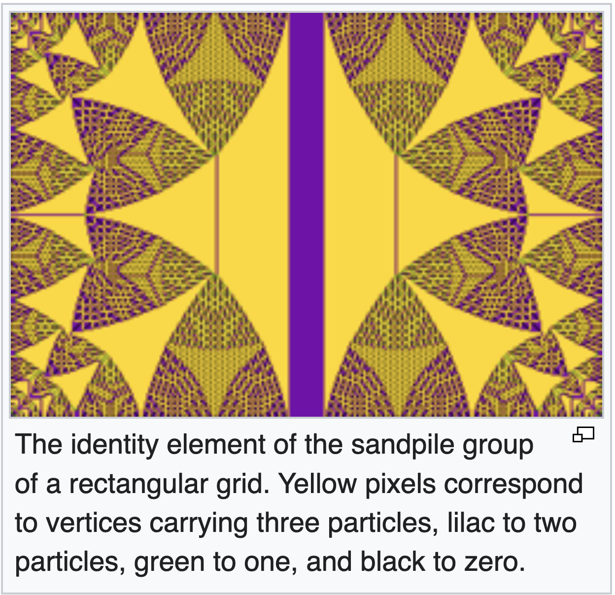
The identity configuration
https://eavan.blog/posts/big-identity-sandpiles.html?utm_source=hnblogs.substack.com
[image]
[image]
https://higgsmass.medium.com/the-science-of-complexity-9940e0f902c1
https://www.pawelmandera.com/2017/12/24/sandpile/
N = 100
N = 200

Slide 6
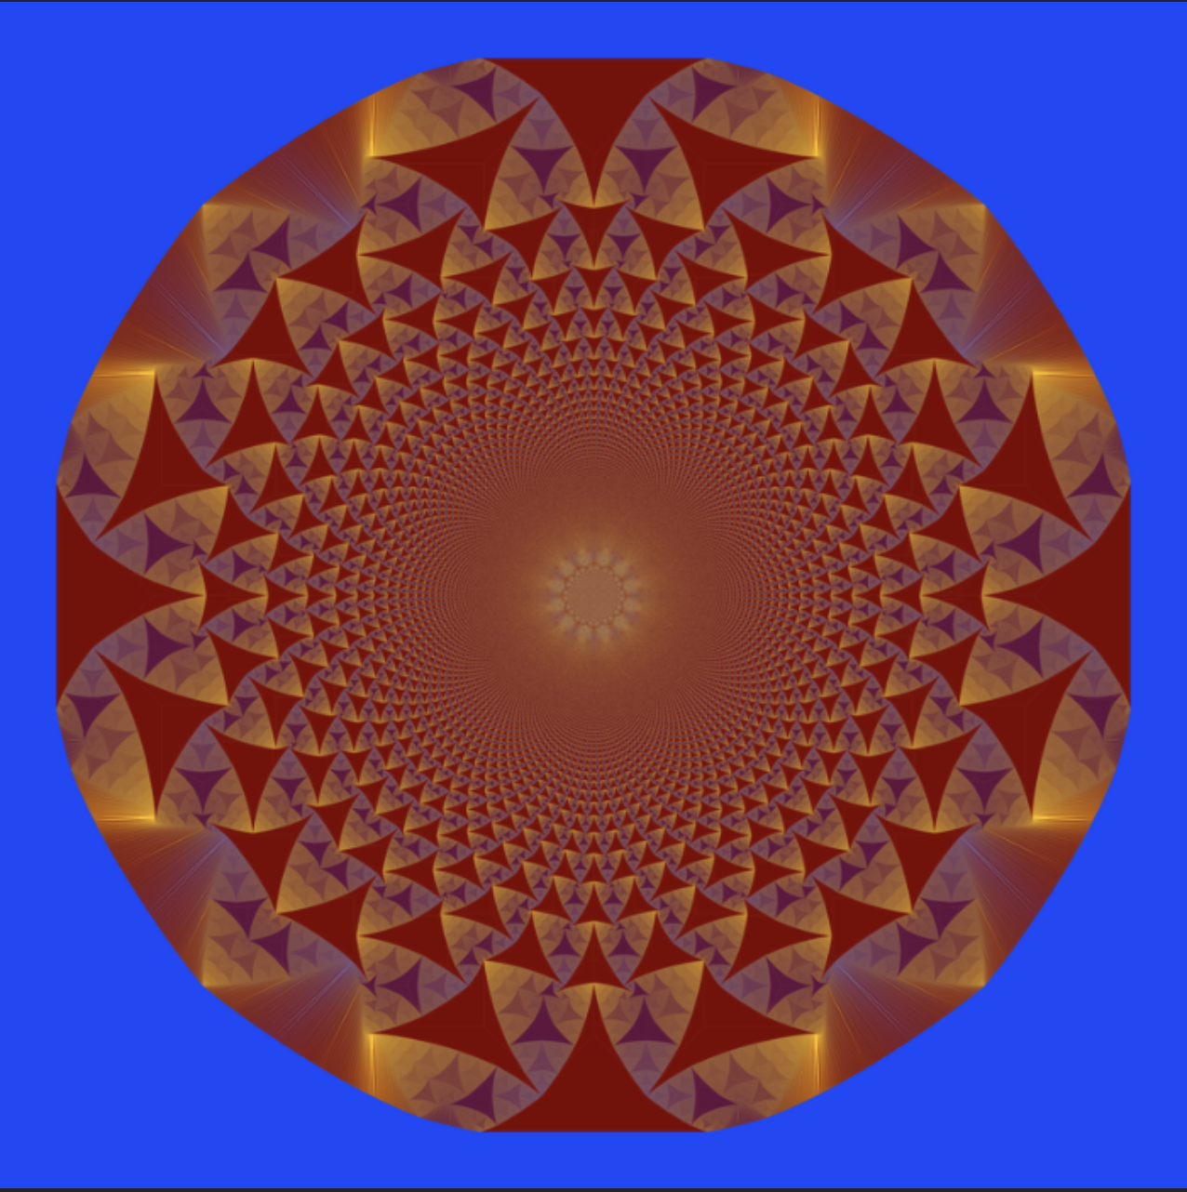
Fractal structure of the identity
Self-similarity (Levine & Peres 2010)
The identity on a grid of size 2N is related
to the identity on a grid of size N by a
precise scaling + superposition rule.
Fractal dimension
The boundary between regions of constant
height has fractal dimension:
d_f ≈ 1.21 ± 0.01
(Ostojic 2003, numerical estimate)
Identity on N = 1000 grid
Levine & Peres (2010) · Caracciolo, Paoletti & Sportiello (2008) · Sadhu & Dhar (2009)

Slide 7
Summary — from abelian property to fractal identity
#
Concept
Result
Reference
1
Abelian property
Final state independent of toppling order
Dhar (1990)
2
Sandpile group 𝒢(Λ)
Recurrent configs form a finite abelian group
Dhar (1990), Björner et al. (1991)
3
Group order
|𝒢| = det Δ (matrix-tree theorem)
Kirchhoff; Dhar (1990)
4
Identity algorithm
Fixed point of σ ↦ (σ + σ_max)°
Creutz (1991)
5
Fractal identity
Self-similar pattern; d_f ≈ 1.21
Ostojic (2003); Levine & Peres (2010)
6
Scaling limit (PDE)
Odometer → obstacle PDE Δu = −2·𝟏
Levine & Peres (2010); Pegden & Smart (2013)
Dhar (1990) · Creutz (1991) · Levine & Peres (2010) · Pegden & Smart (2013)

