Slide 1
EasyChat
A simple instant messaging application
to keep in touch with your friends

Slide 2
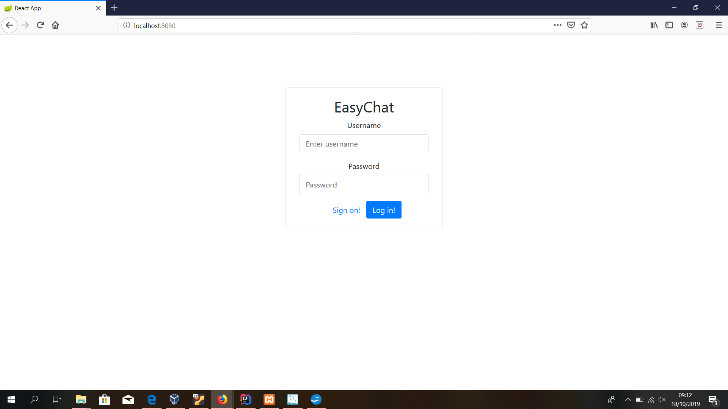
Application index: login/Sign form
Login area:
If credentials provided are valid
you are redirected to the main page
Login error:
If credentials are not registered
Inside the current db, you get an error text message
to video.
Sign on:
If a user is still not registered
Here can do it

Slide 3
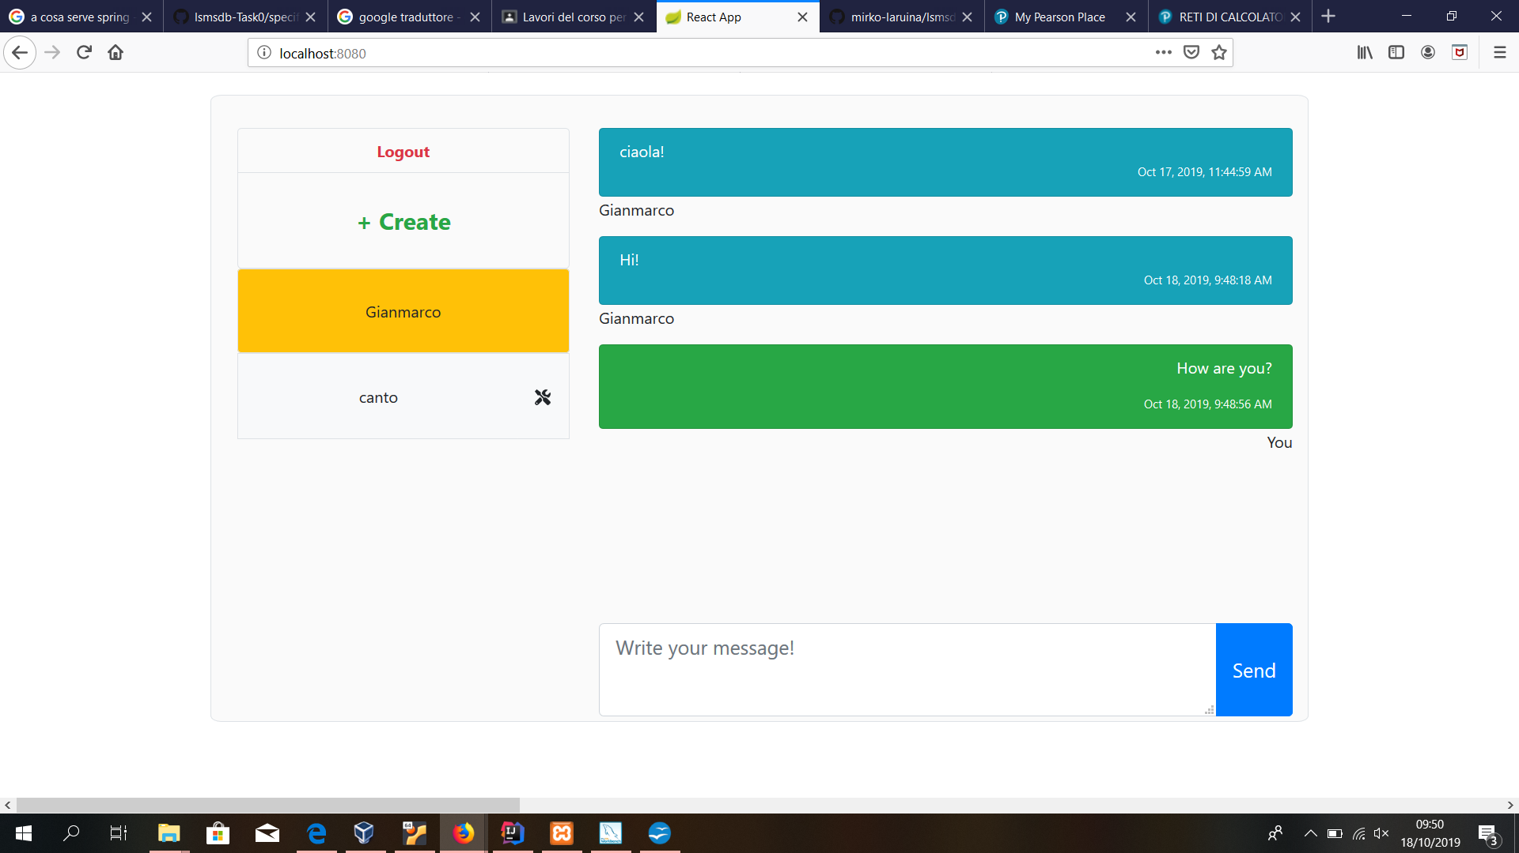
Main page of EasyChat
This button manages new personal chat or group creation
Log out button:on click session ends and
You are redirected to login form
Personal chat
Group chat
Here you can send
Messages to the active chat
Active chat
Group settings

Slide 4
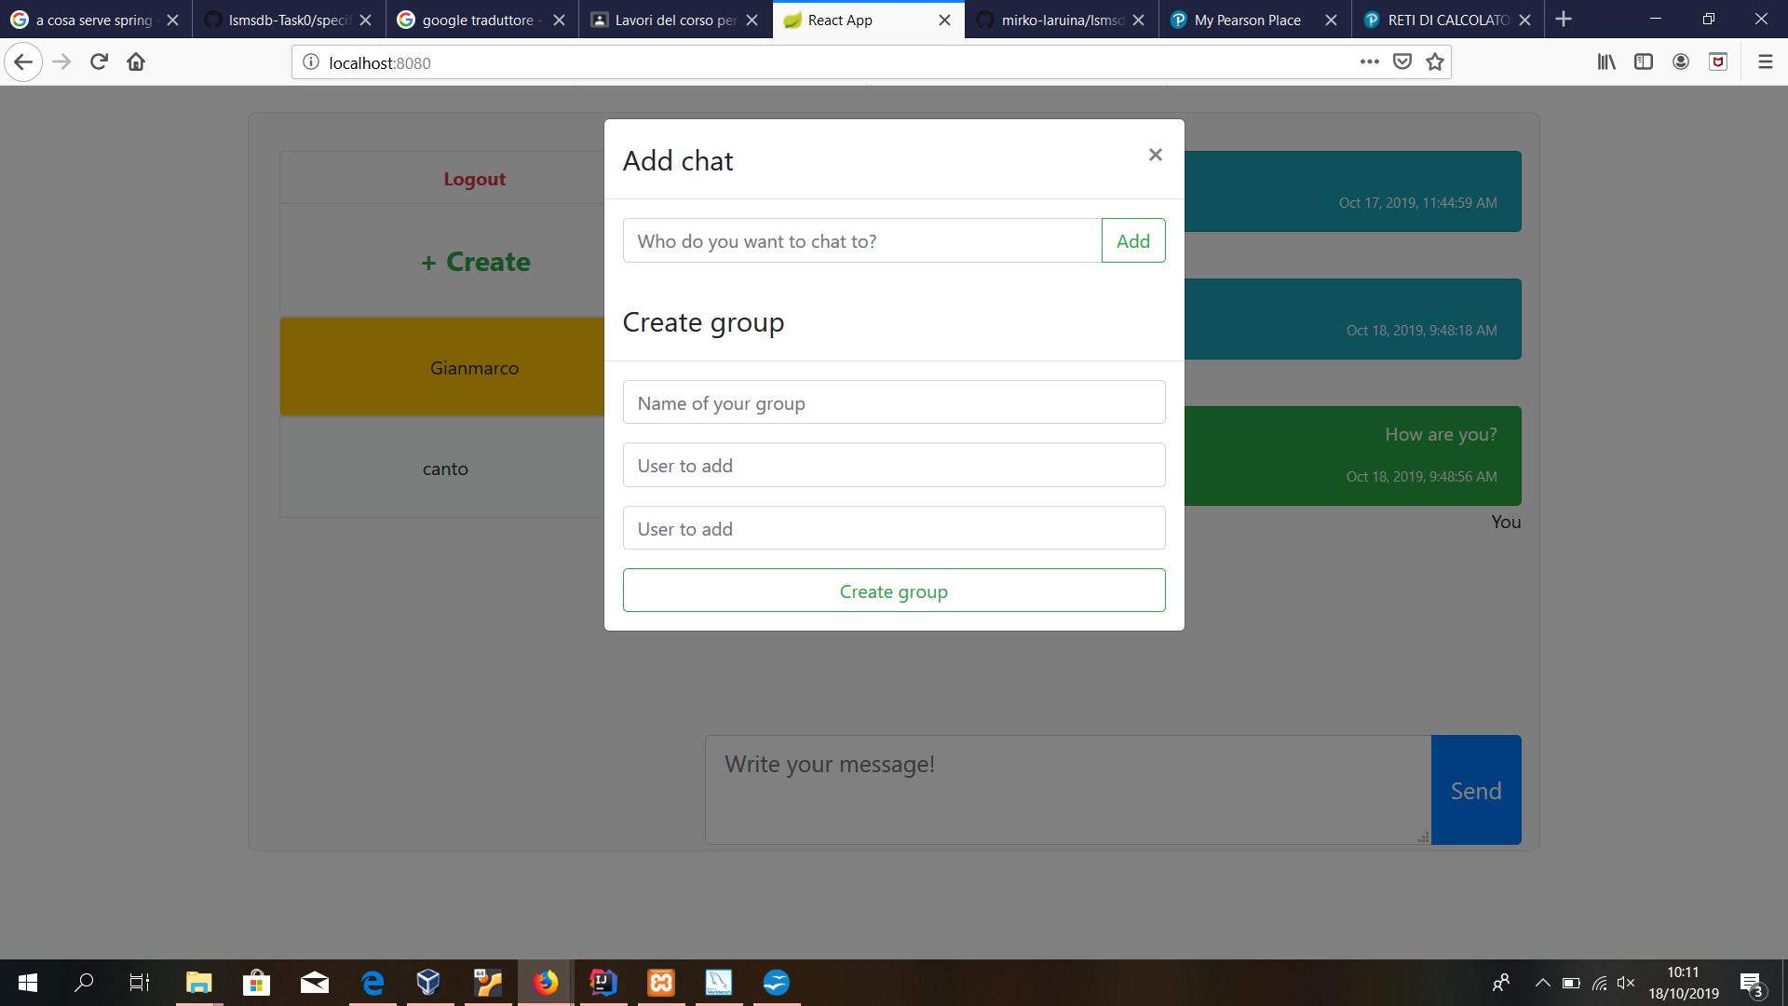
+Create button: on click
User not found error:
If the texted user does not result in db
you get an error text to video
You can select a name for the group
Creating a new group you will become admin of this one.

Slide 5
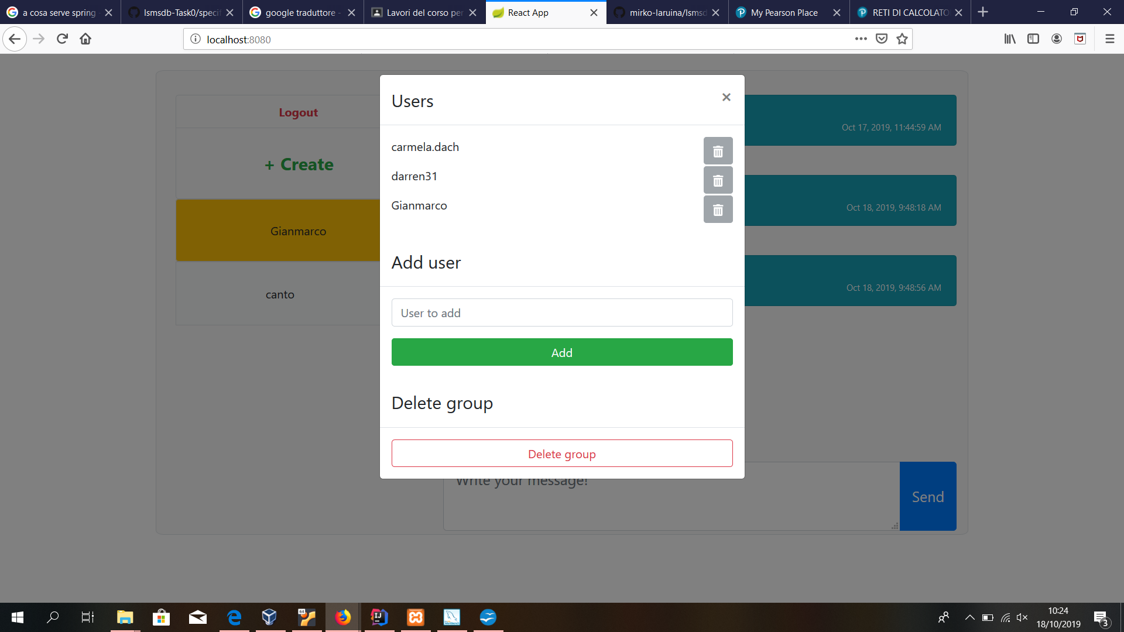
Group setting: on click
Group cancellation,members exclusion and member addition
are operations needing
group admin privilege

