Slide 1
EasyChat
A simple instant messaging application
to keep in touch with your friends

Slide 2
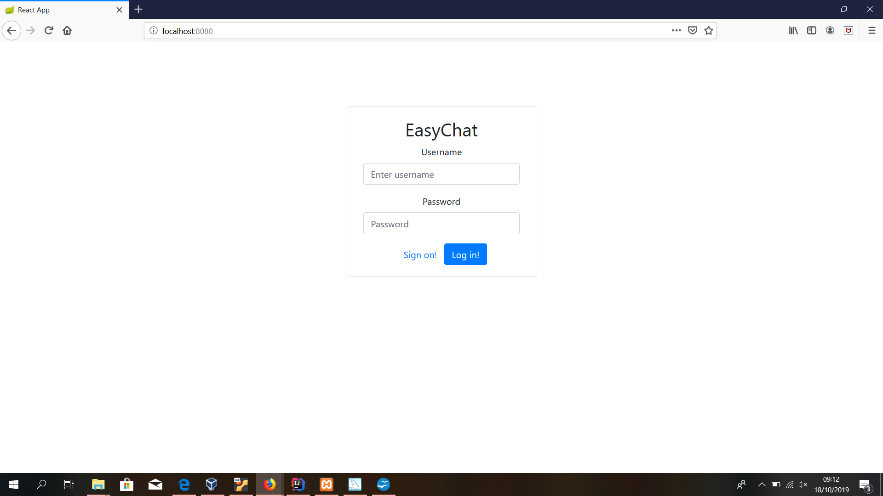
Application index: login/Sign form
Login area:
If credentials provided are valid
you are redirected to the main page
Login error:
If credentials are not registered
Inside the current db, you get an error text message
to video.
Sign on:
If a user is still not registered
Here can do it

Slide 3
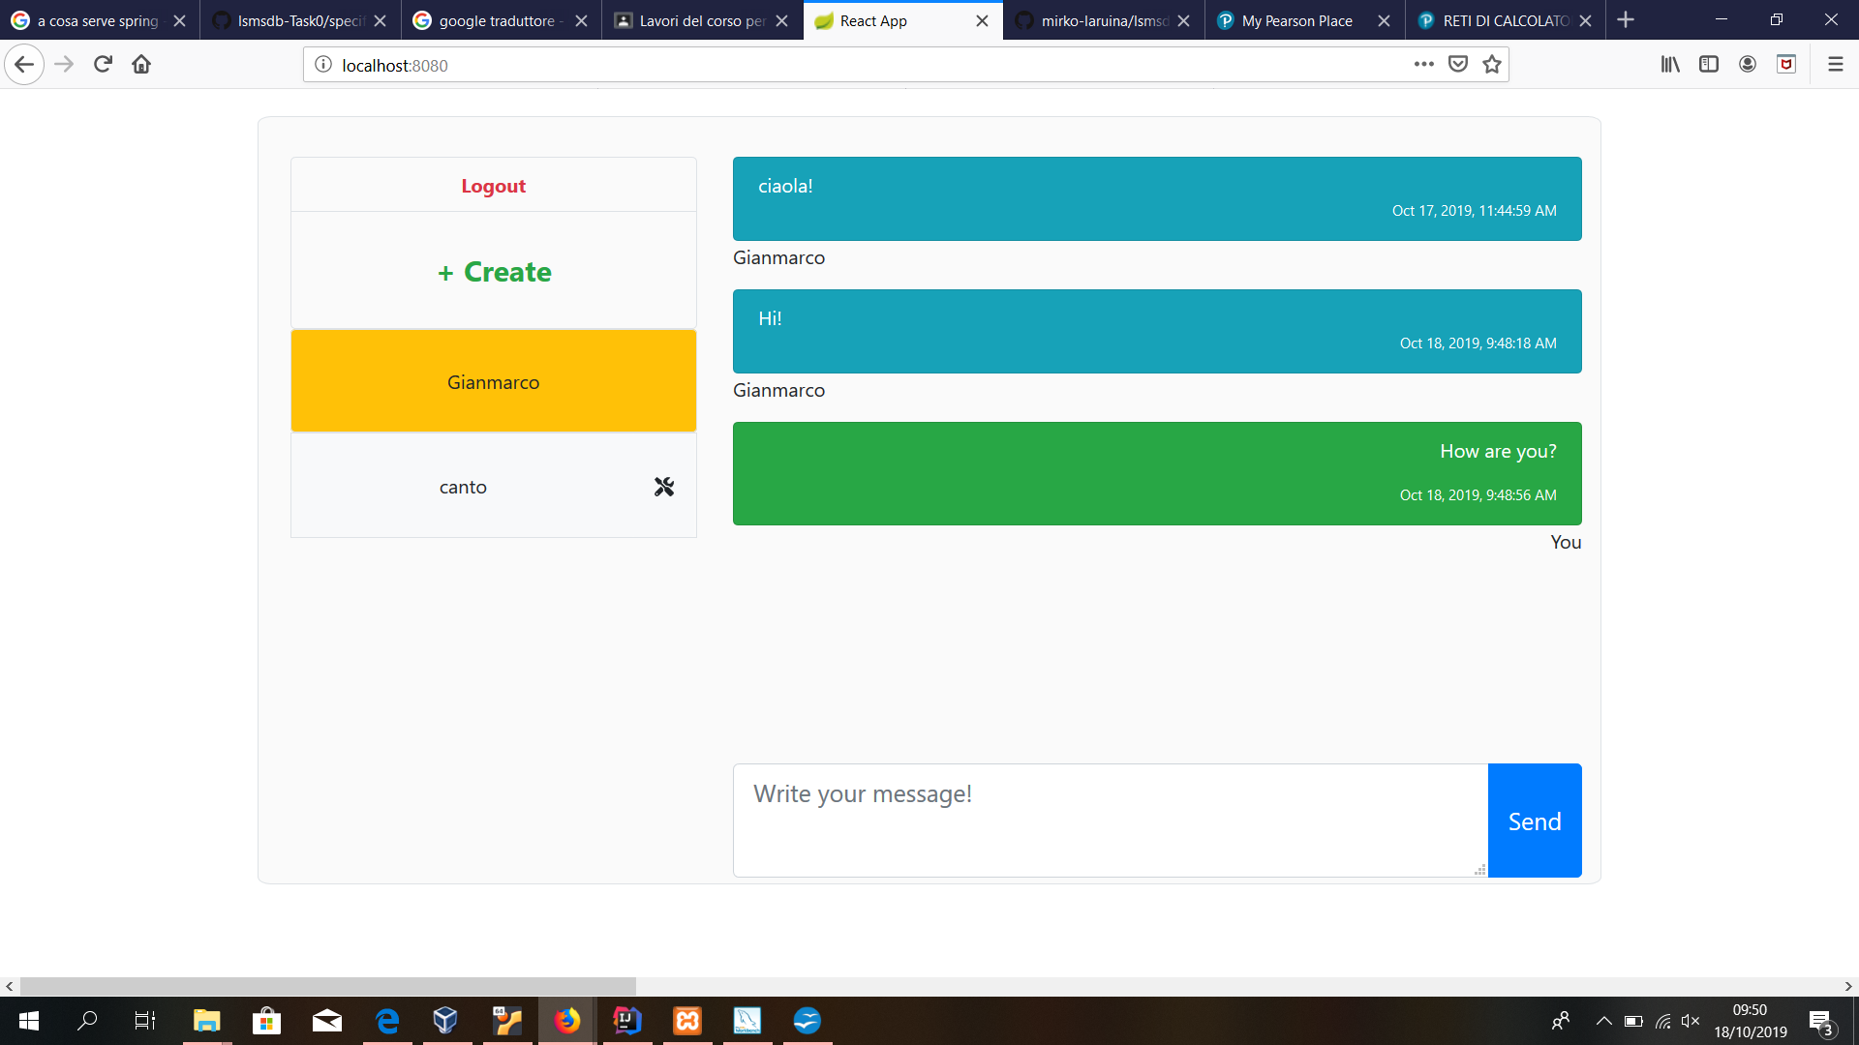
Main page of EasyChat
This button manages new personal chat or group creation
Log out button:on click session ends and
You are redirected to login form
Personal chat
Group chat, click on it for activation
Here you can send
Messages to the active chat
Active chat
Group settings

Slide 4
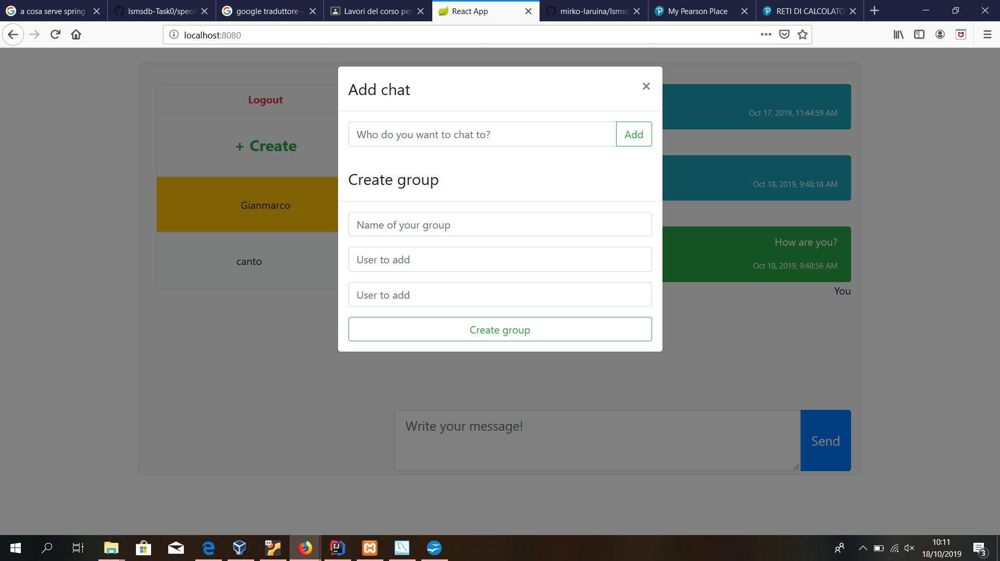
+Create button: on click
User not found error:
If the texted user does not result in db
you get an error text to video
You can select a name for the group.
Creating a new group, you will become admin of this one.

Slide 5
+Create button: on click
User not found error:
If the texted user does not result in db
you get an error text to video
You can select a name for the group
Creating a new group you will become admin of this one.

Slide 6
+Create button: on click
User not found error:
If the texted user does not result in db
you get an error text to video
You can select a name for the group
Creating a new group you will become admin of this one.

Slide 7
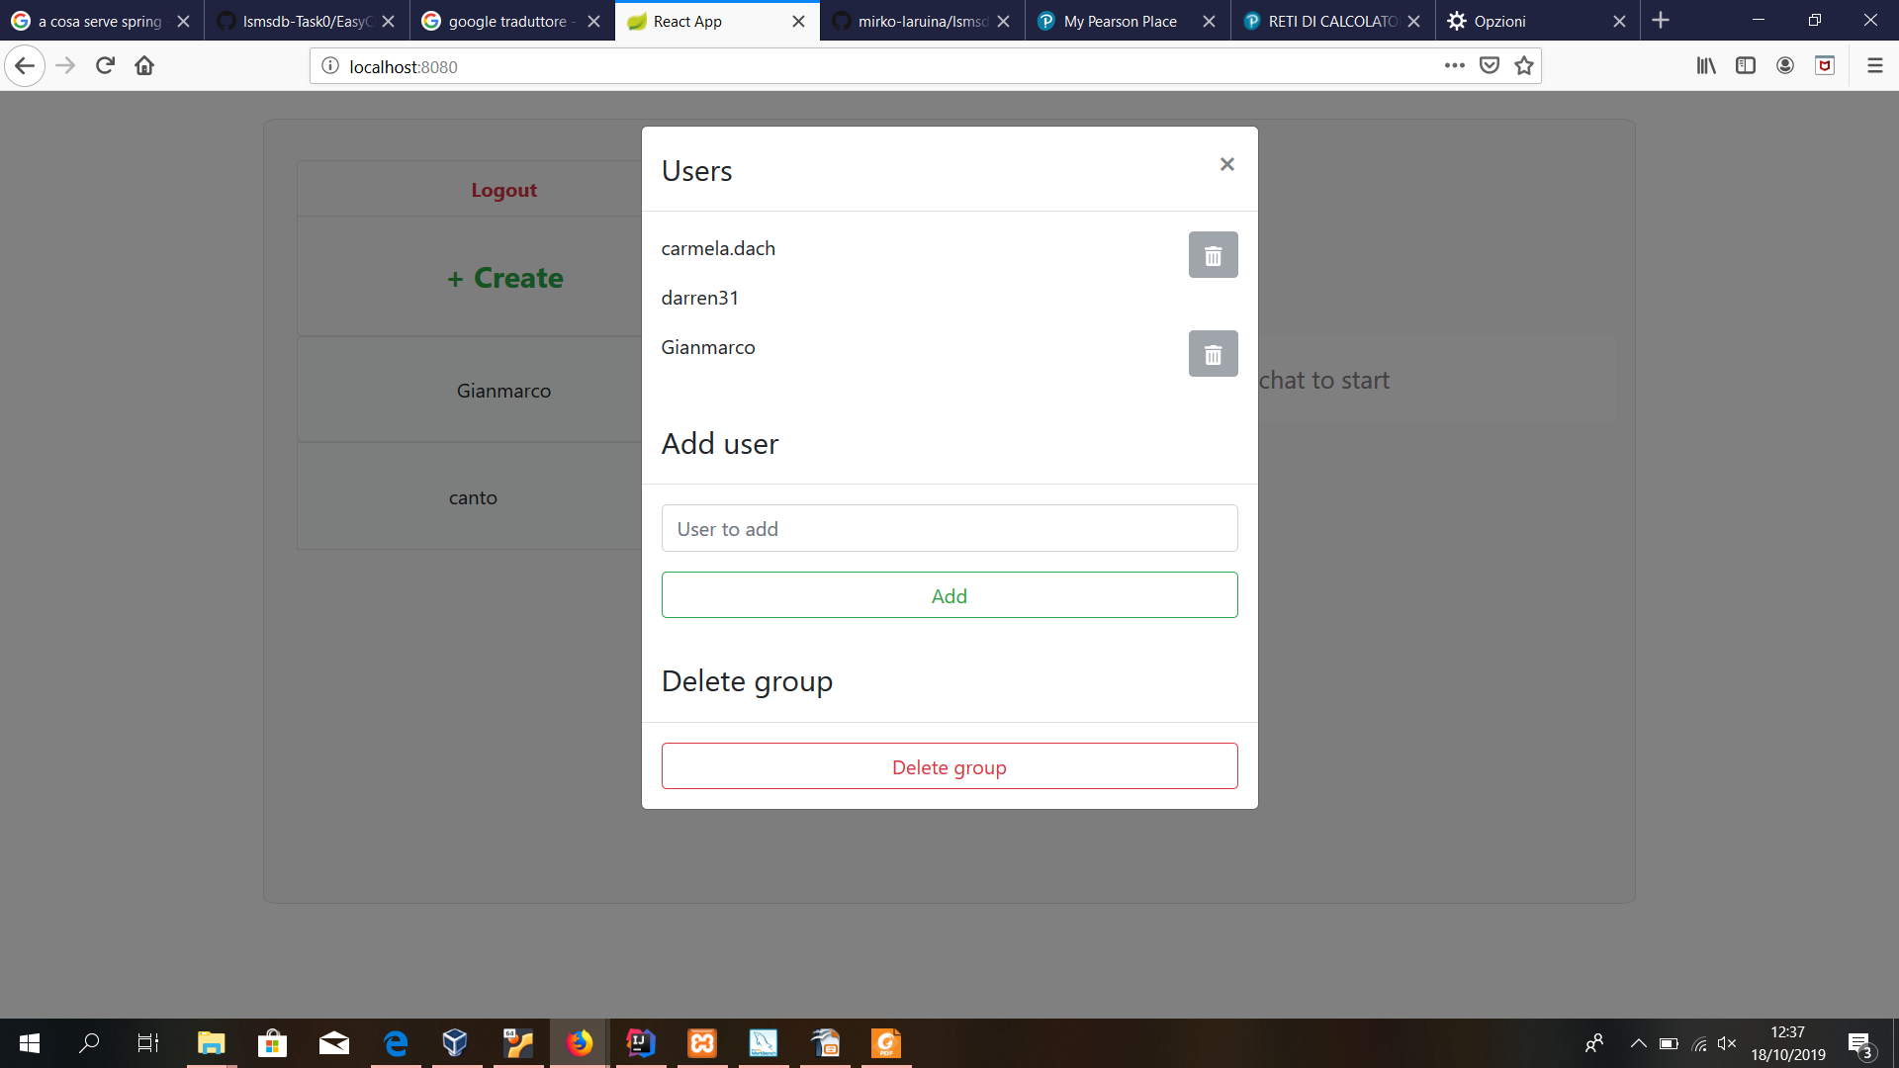
Group setting (group admin): on click
Group cancellation,members exclusion and member addition
are operations needing
group admin privilege
An admin can't decide to leave a group,if it does,group chat is deleted

Slide 8
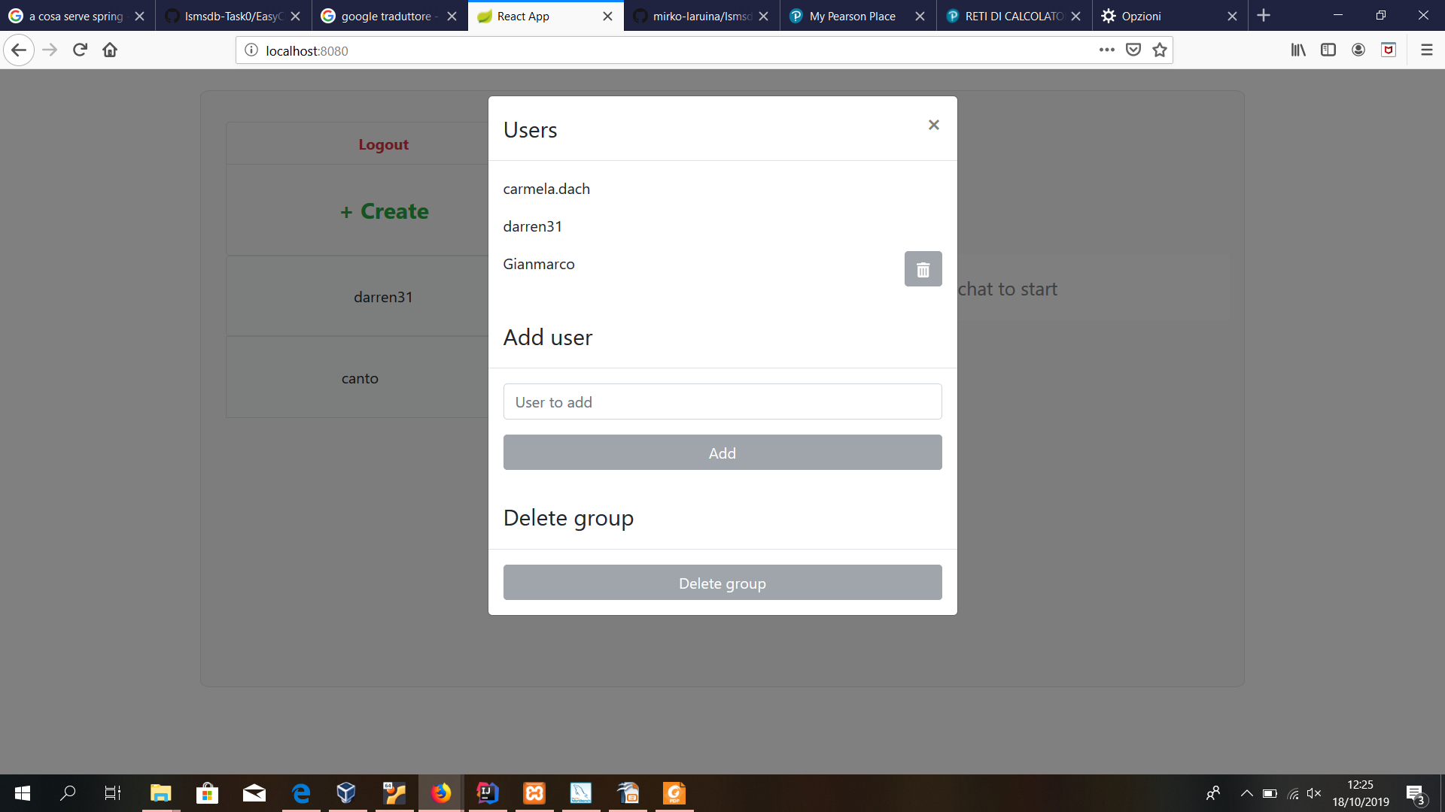
Group setting (simple user): on click
Each user can decide to leave a group
(except for admin user)
As we can see, a simple user can NOT decide
to add members or delete groups
(buttons are disabled)

