Slide 1



Variational Quantum Algorithms
Mirko Consiglio
University of Malta

Slide 2
Overview of Talk
What Makes up a VQA?
Classical Optimizer
Objective Function
Parametrized Quantum Circuit
Measurement Technique

Slide 3
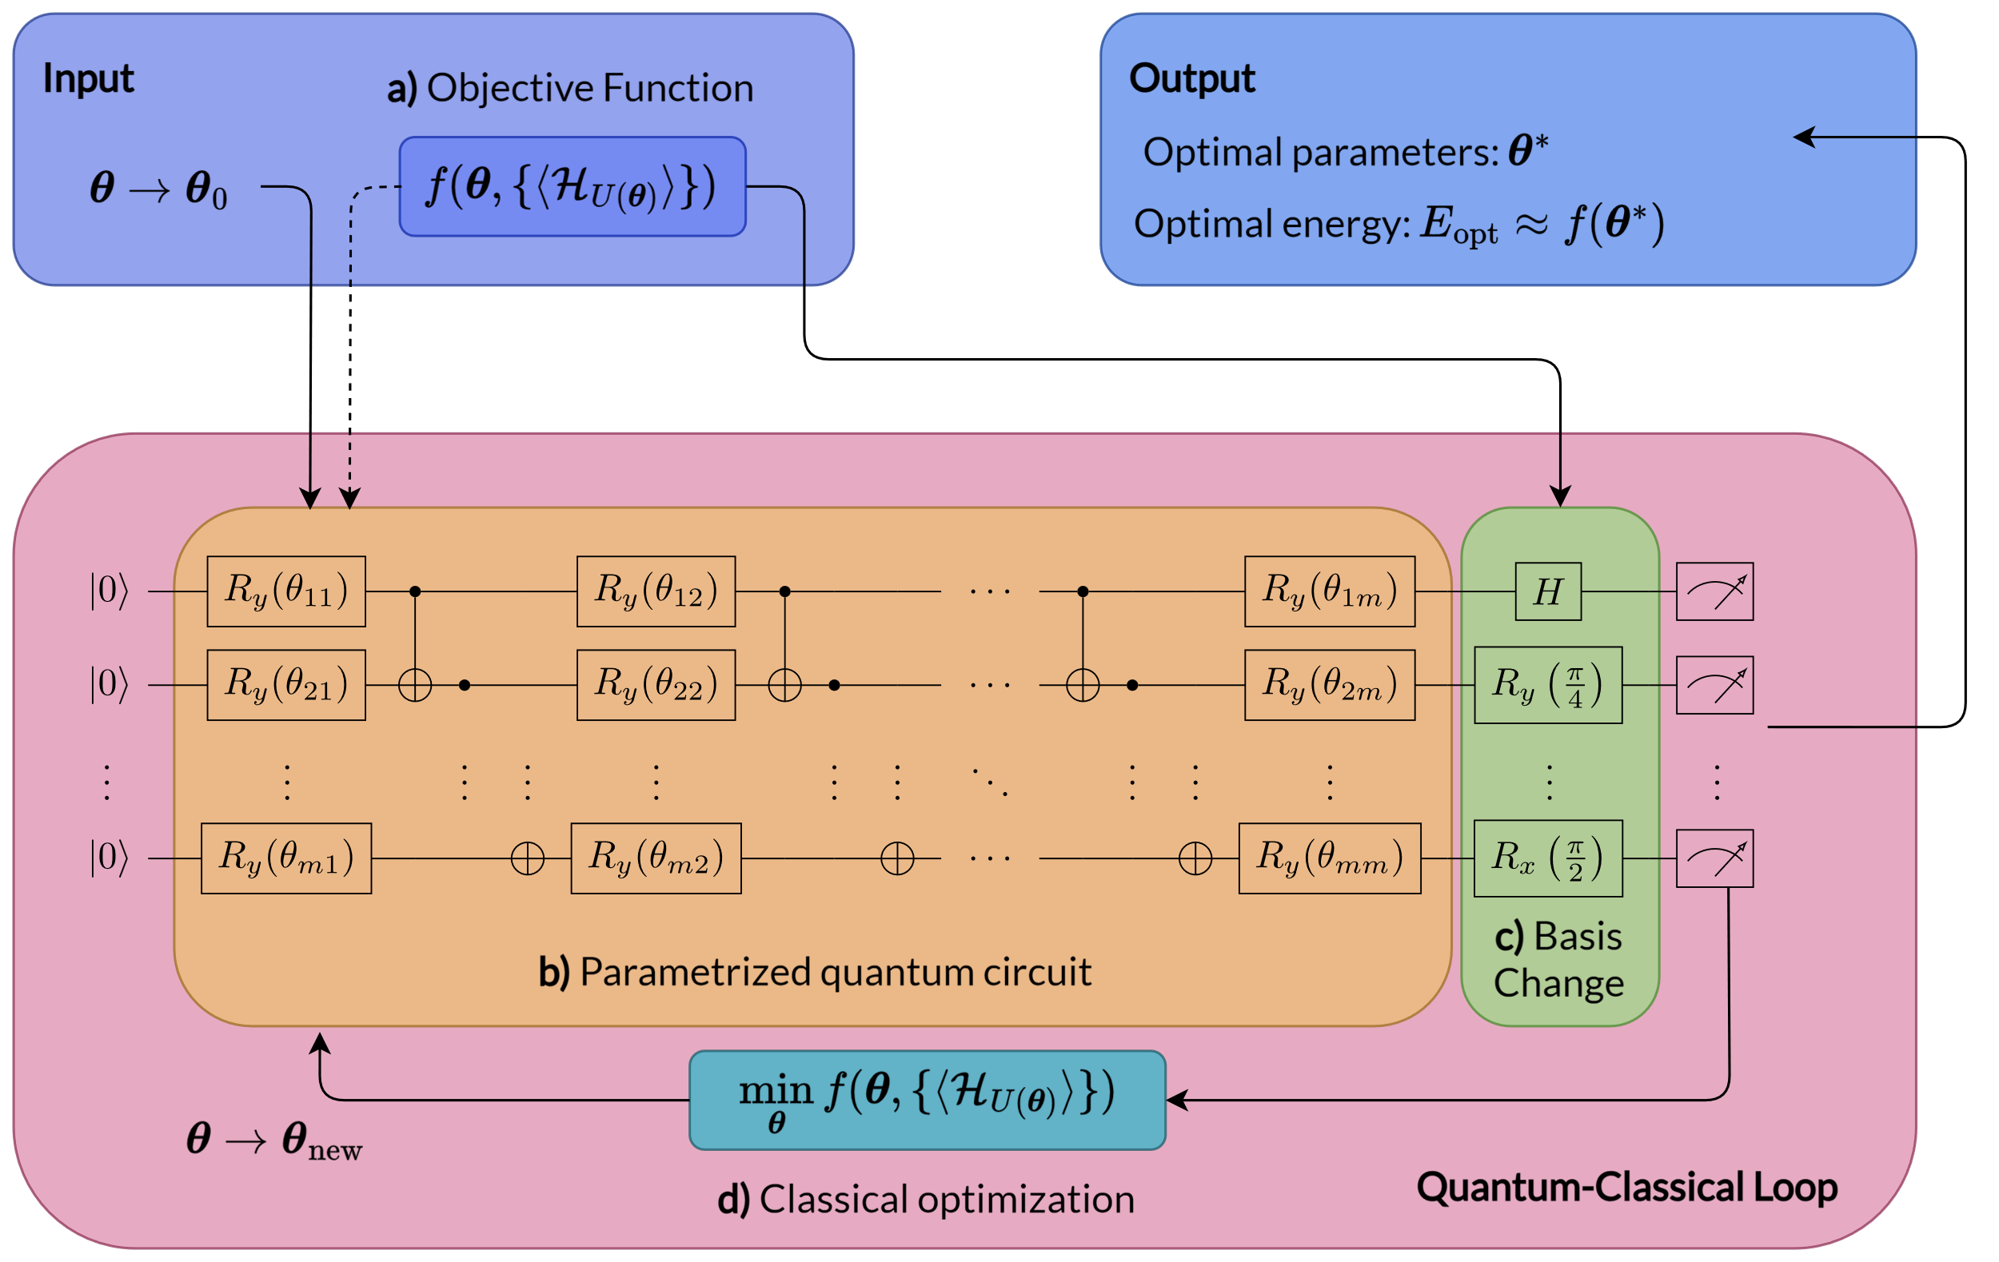
Variational Quantum Algorithms

Slide 4
What makes up a VQA?
A VQA is made up of separate modules that can be easily combined, improved and extended according to the developments in quantum technology
^{The main modules are:}
^{a) Objective Function}
b) Parametrized Quantum Circuit
^{c) Measurement Technique}
^{d) Classical Optimizer}
I will only briefly describe and discuss certain implementations of the above modules for the sake of brevity, however, for a general review on VQAs, one can look to: K. Bharti, et al., Noisy intermediate-scale quantum (NISQ) algorithms, Rev. Mod. Phys. 94, 015004, (2022).

Slide 5
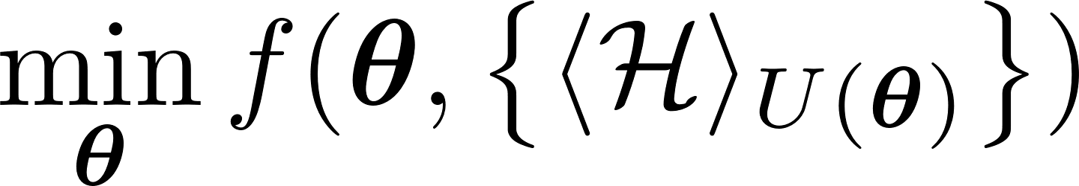
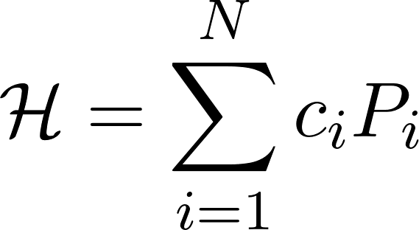
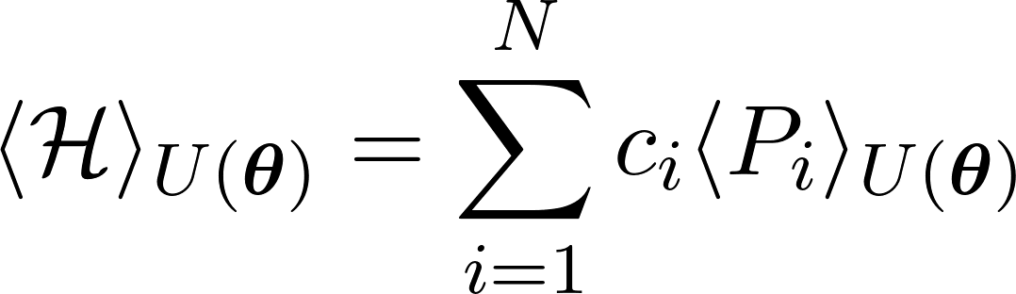
Objective Function
An objective function can be defined as
Given our parameterized unitary (PQC), we can expand it as
The next step is to decompose our Hamiltonian into Pauli strings
Finally, the expectation value can then be evaluated for each Pauli string

Slide 6
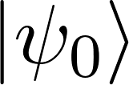
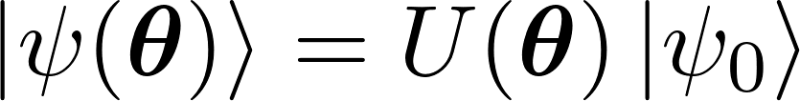
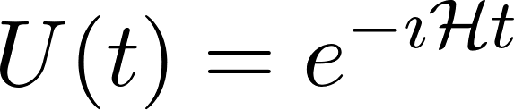
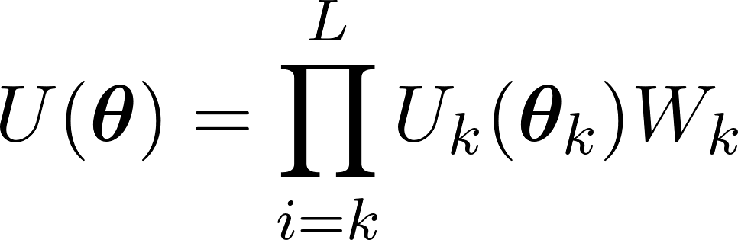
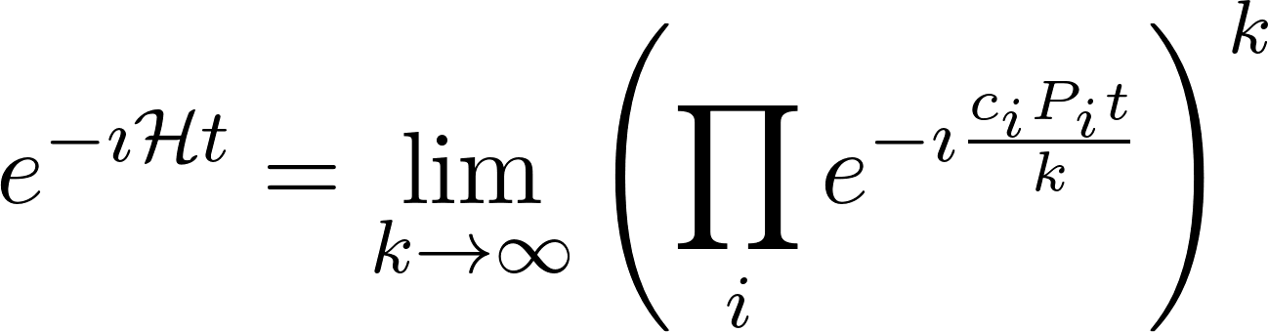

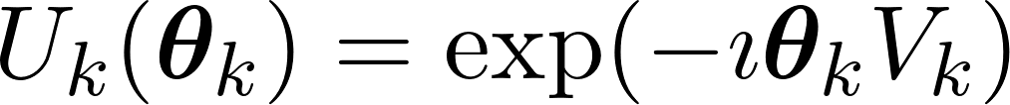
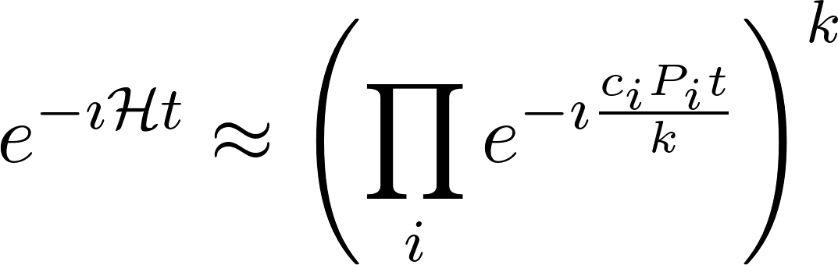

Parametrized Quantum Circuit
Given an initial state , we can prepare a quantum state as
Problem-Inspired Ansätze
Hardware-Efficient Ansätze
Given a Hamiltonian, we can get a unitary operator describing the evolution
We need Trotterization to implement it as
Which we approximate
A hardware-efficient ansatz with L layers
where we used a non-parameterized Hermitian operator
And a (two-qubit) entangling gate

Slide 7


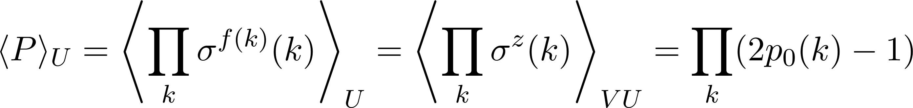
Measurement Technique
We can measure in the computational basis
We measure other basis by using rotation gates pre-measurement
By rotating every qubit k into the Z basis, we can then measure everything as
Where V is the product of one-qubit rotations, depending on the Pauli terms we want to measure

Slide 8
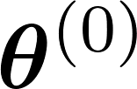

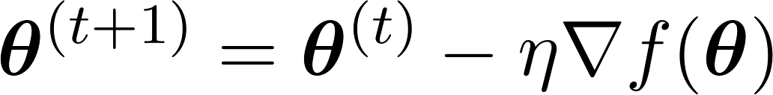
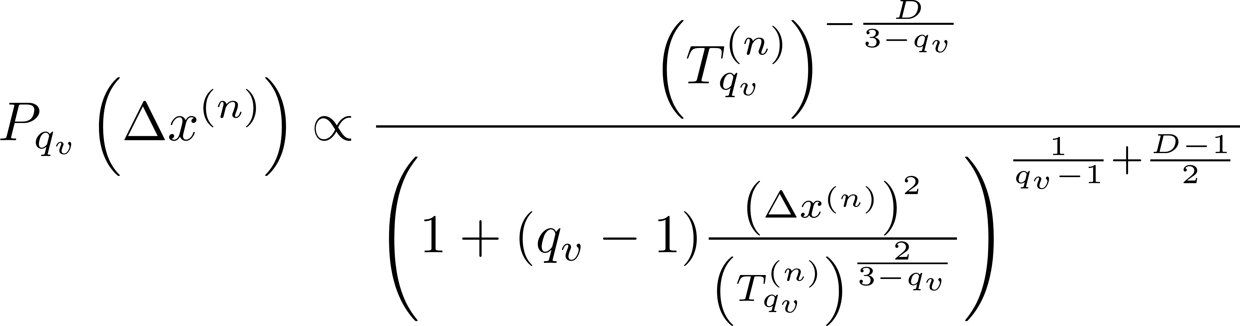
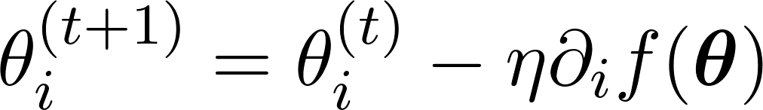
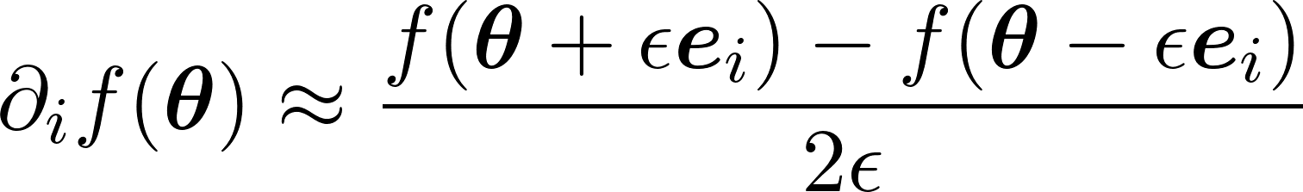
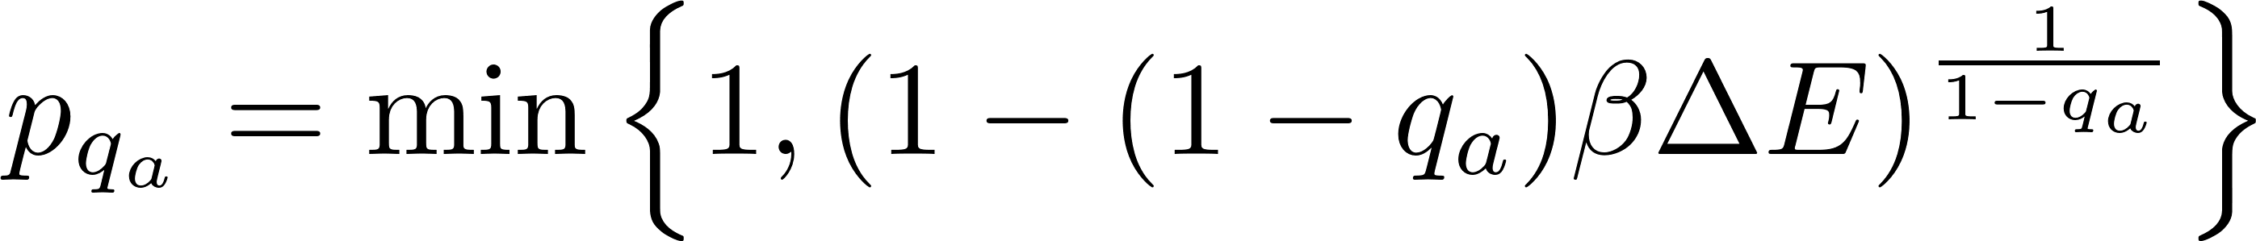
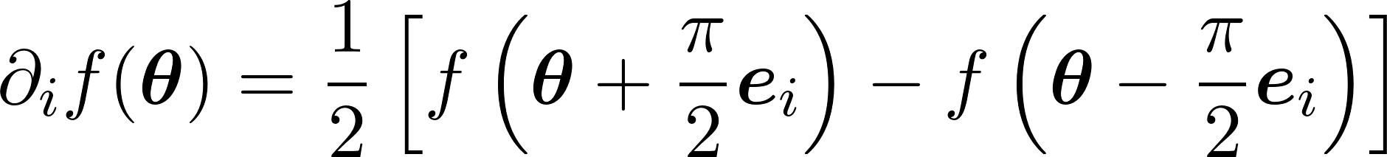
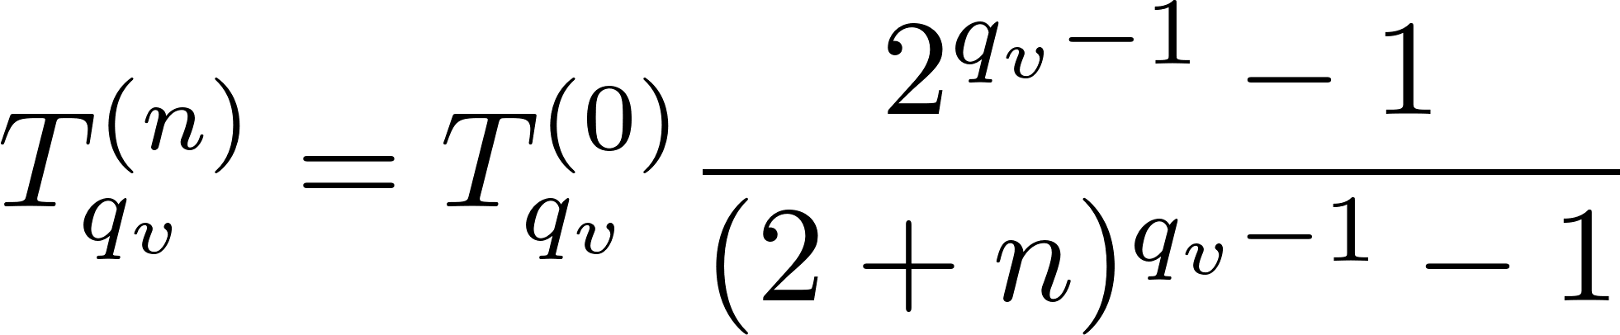
Classical Optimizer
Gradient-Based Approach
Gradient-Free Approach
Given K initial parameters , we can update at each time step t using a learning rate
Where each parameter is updated individually
There are many methods to compute the gradient, such as finite difference
Or using parameter shift rules
One interesting global approach is the generalized simulated annealing, mimicking the behaviour of annealing molten metal in metallurgy. A visiting distribution is employed to generate a trial jump distance:
Acceptance probability:
Temperature:

Slide 9
Combining it All

