Slide 1
Machine Learning & Deep Learning applications for environmental analysis and modeling
Module 1: Classical Machine Learning
20 May 2026 Mirko D’Andrea mirko.dandrea@cimafoundation.org

Slide 2
Machine Learning & Deep Learning applications for environmental analysis and modeling
Module 1: Classical Machine Learning
Date: 20 May 2026 Instructor: Mirko D’Andrea (mirko.dandrea@cimafoundation.org)
Implementation of classical ML algorithms with a focus on fire risk assessment.
Introduction to ML: fundamental concepts
Classical ML algorithms
Hands-on session:
Wildfire susceptibility using Random Forest
Module 2: Deep Learning
Final Assessment:
Evaluation for this course will be based on a written report detailing the application of the methods discussed. You must follow the entire course to be eligible for the final assessment.
Date: 27 May 2026 Instructor: Luca Monaco (luca.monaco@cimafoundation.org)
Introduction to Deep Learning: Fundamental concepts.
The Modern ML Stack:
Data management: Handling large-scale data with Zarr.
Model frameworks: Simplifying workflows via PyTorch Lightning.
Configuration management: Using Hydra for flexible experiment setups.
Experiment tracking: Logging and versioning with MLFlow.
Hands-on applications:
Precipitation forecast post-processing.
Urban thermal comfort modeling.
Notes:
Our course is structured into two main modules. Module 1 focuses on classical machine learning, where we will dive into techniques like Random Forest, decision trees, and the essential steps of feature engineering. Later, in Module 2, we will transition into deep learning architectures designed for highly complex, multi-dimensional tasks. Today, our core focus is entirely on Module 1.

Slide 3
Module 1 - Outline
Intro
Basic ML Concepts
Models overview
Wildfire susceptibility using Random Forest

Slide 4
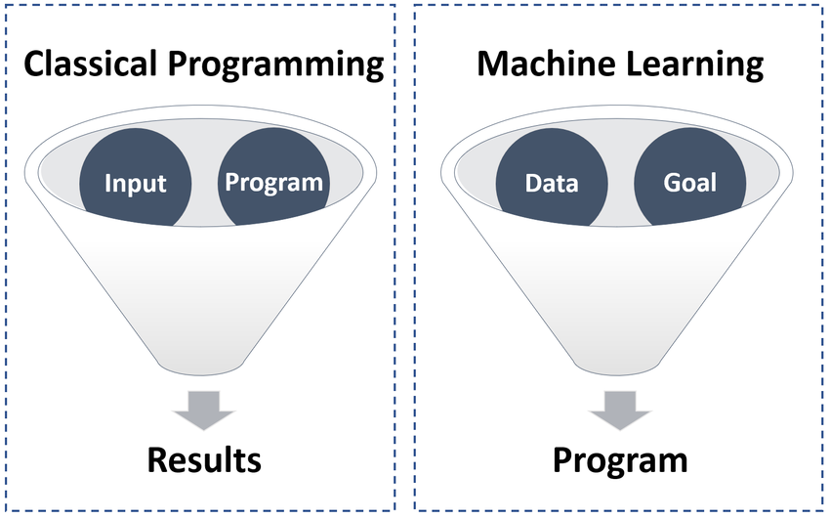
What is Machine Learning?
Machine learning (ML) is a type of computational technology that enables machines (i.e., computers) to learn and make predictions without being explicitly programmed.
ML includes algorithms capable of learning from data, through the modeling of the hidden relationships between a set of input and output variables.
Notes:
"Machine learning (ML) is a type of computational technology that enables machines (i.e., computers) to learn and make predictions without being explicitly programmed."
> "ML includes algorithms capable of learning from data, through the modeling of the hidden relationships between a set of input and output variables."
To keep it concise, the key distinction between machine learning and traditional programming is that you do not write the rules yourself—the algorithm discovers those rules directly from the data. This is fundamentally different from the physics-based models you are likely used to working with in environmental science.

Slide 5
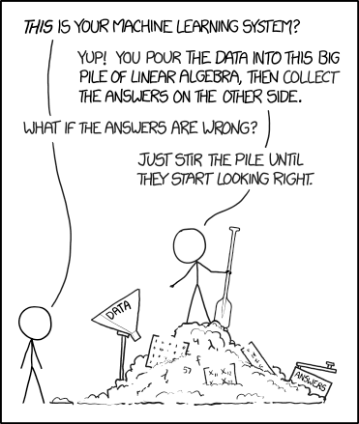
Machine Learning in environmental modeling
ML performs particularly well to model environmental hazards, which naturally present complex interactions and non-linear behaviors.
For example: wildfire occurrence can depend simultaneously on vegetation, topography, climate, human accessibility, etc.
Traditional rule-based models struggle to represent these interactions. Machine Learning can leverage this environmental data abundance and learn patterns and relations from historical data.
https://xkcd.com/1838/
Notes:
> "ML performs particularly well to model environmental hazards, which naturally present complex interactions and non-linear behaviors."
> "Wildfire occurrence can depend simultaneously on vegetation, topography, climate, human accessibility, etc."
> "Traditional rule-based models struggle to represent these interactions. Machine Learning can leverage this environmental data abundance and learn patterns and relations from historical data."
Environmental hazards are multi-factor, highly non-linear, and data-rich, which makes them a perfect fit for machine learning. Traditional rule-based models struggle to capture how dozens of variables interact at once, but ML excels at finding those hidden historical patterns.
*(Optional joke)*: As this classic XKCD comic highlights, sometimes we just pour the data into a big pile of linear algebra and stir the pile until the answers look right!

Slide 6
The first rule of Machine Learning: Garbage In -> Garbage Out !
No matter how sophisticated or advanced the algorithms or models used in data analysis, if the underlying data is flawed or inaccurate, the output will be equally flawed.
Any analysis or processing performed on flawed data will likely yield unreliable or inaccurate results.
Notes:
> "No matter how sophisticated or advanced the algorithms or models used in data analysis, if the underlying data is flawed or inaccurate, the output will be equally flawed."
This is the golden rule of machine learning. Data quality and preprocessing typically make up about 80% of the actual work. A brilliant algorithm is entirely useless if it is fed bad data. This is especially true in environmental science, where we constantly deal with failed sensors, cloud cover on satellite imagery, and messy data from completely heterogeneous sources.

Slide 7
Outline
Intro
Basic ML Concepts
Models overview
Wildfire susceptibility using Random Forest

Slide 8
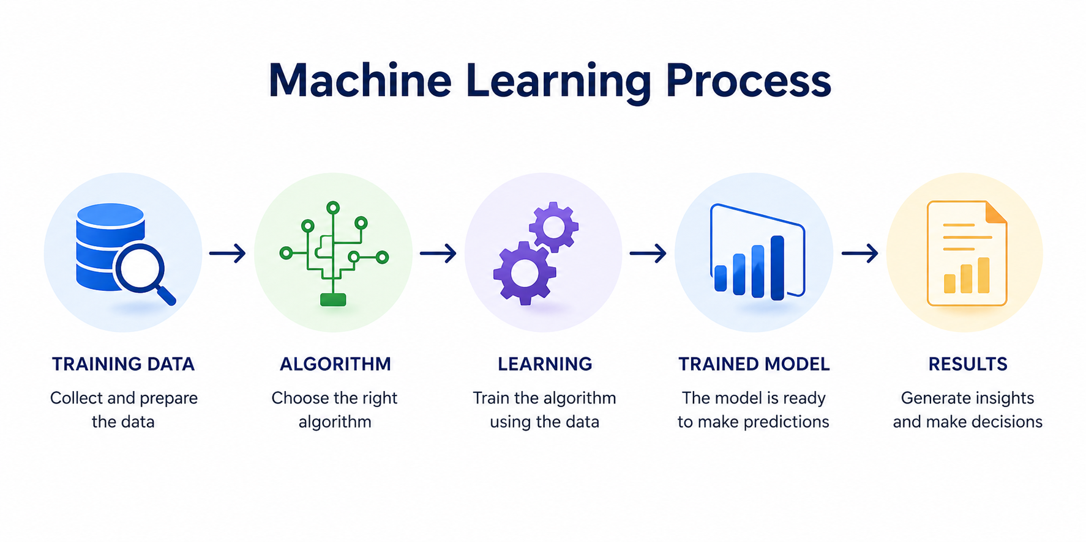
Notes:
Looking at this diagram of the pipeline, we can see exactly how the data flows from its raw state, through preprocessing, and straight into the model training phase.

Slide 9
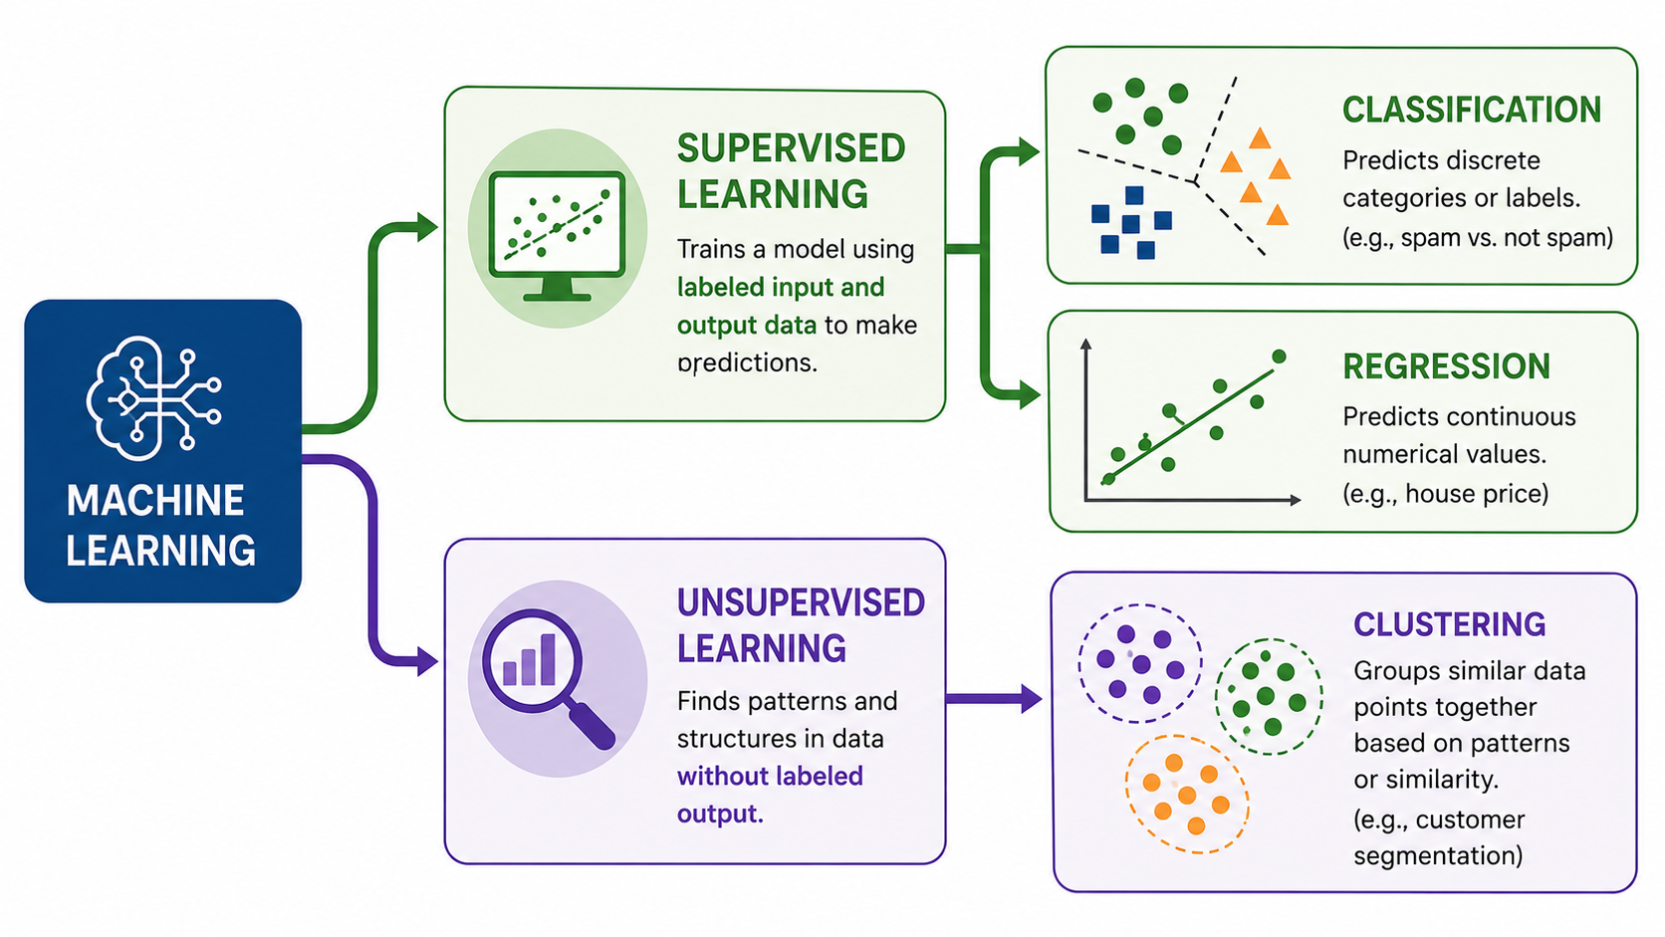
Machine Learning Tasks
Supervised and unsupervised learning are the two main machine learning categories.
The key difference between supervised and unsupervised learning is the use of labels.
Notes:
> "Supervised and unsupervised learning are the two main machine learning categories. The key difference between supervised and unsupervised learning is the use of labels."
The distinction here is straightforward. In **Supervised Learning**, you provide the model with input-output pairs—meaning you have features ($X$) and a corresponding label ($y$) so the model can learn the mapping from $X \rightarrow y$. In **Unsupervised Learning**, there are no labels; the model is left to find hidden structures or clusters on its own. In environmental applications, we spend most of our time in supervised learning, predicting things like fire occurrence, species distribution, or flood risk.

Slide 10
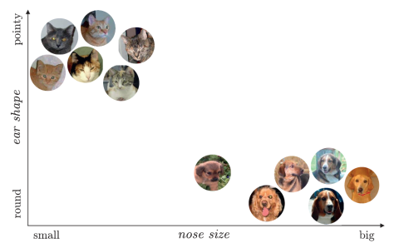
Features input variables
Labels
target variable
A feature is an individual measurable property or characteristic of a phenomenon.
Our target variable, what we would like to predict using our ML algorithm.
 | EAR SHAPE (FEATURE) | NOSE SIZE (FEATURE) | SPECIE (LABEL)
1 | POINTY | SMALL | CAT
2 | ROUND | MEDIUM | DOG
Both features and labels can be:
Numerical: continuous values that can be measured on a scale (e.g. temperature)
Categorical: discrete values that can be grouped into categories (e.g. vegetation type)
Notes:
**Features (input variables):** Individual measurable properties of a phenomenon — e.g., elevation, slope, NDVI, distance to roads.
**Labels (target variable):** What we want to predict — e.g., burned / not burned.
Both of these can be **Numerical**, meaning continuous values like temperature or elevation, or **Categorical**, representing discrete classes like vegetation type or land use. This vocabulary is foundational, so ensure you are completely comfortable with the terms "features" and "labels" before we move forward.

Slide 11
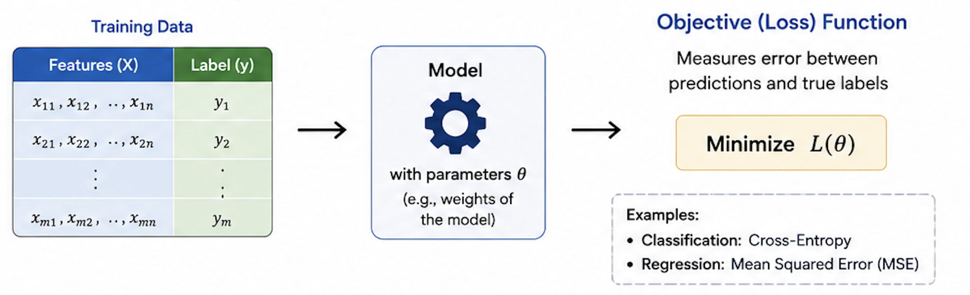
Training
The model learns the relationship between features (X) and the label (y) by minimizing an objective (loss) function on the training data, then its performance is evaluated on unseen test data.
Notes:
> "The model learns the relationship between features (X) and the label (y) by minimizing an objective (loss) function on the training data, then its performance is evaluated on unseen test data."
At a high level, the training loop works by feeding data into the model, computing its predictions, measuring the error using a loss function, and slightly adjusting the model's internal parameters. We repeat this cycle until the model generalizes well—remember, our goal is true generalization, not just pure memorization of the training data.

Slide 12
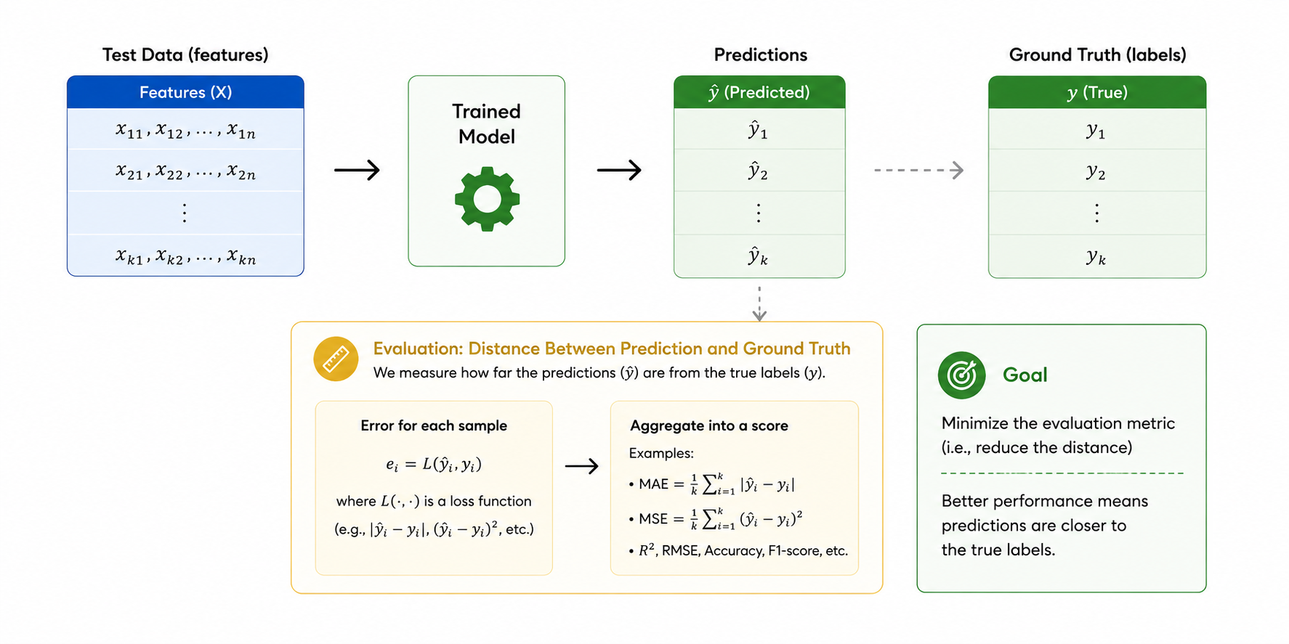
Testing
Performance of the trained model should be tested against unseen data.
Examples for Environmental Modelling:
Held-out environmental observations not used during training
Tests generalization across new locations, seasons, or events
Captures real-world variability and unseen environmental conditions
Notes:
> "Performance of the trained model should be tested against unseen data."
**Examples for Environmental Modelling:**
* Held-out environmental observations not used during training
* Tests generalization across new locations, seasons, or events
* Captures real-world variability and unseen environmental conditions
I cannot stress the phrase **"unseen data"** enough. If you evaluate your model on the same data it trained on, you are simply measuring its ability to memorize. In environmental science, "unseen" can mean testing on an entirely different geographic region, a future time period, or data captured by a completely different sensor.

Slide 13
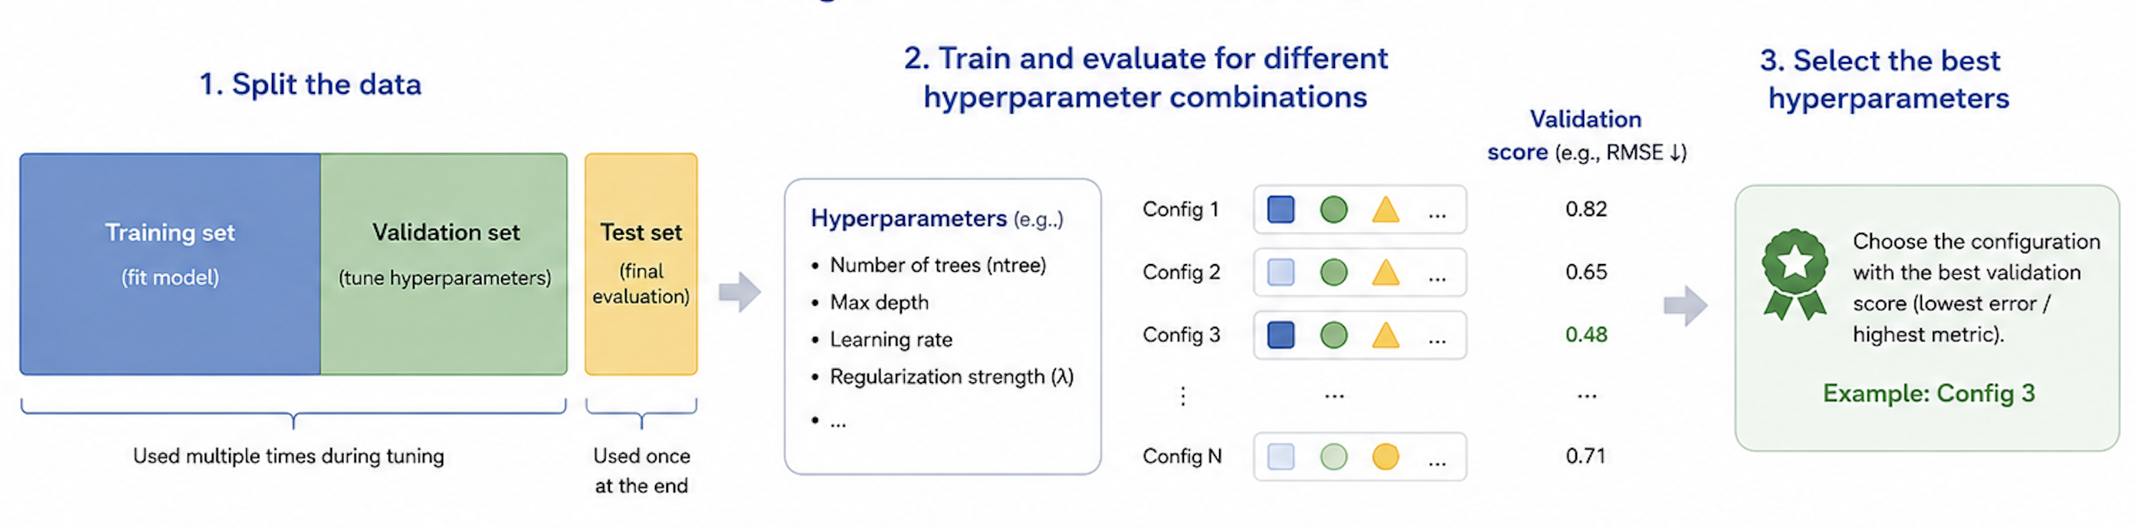
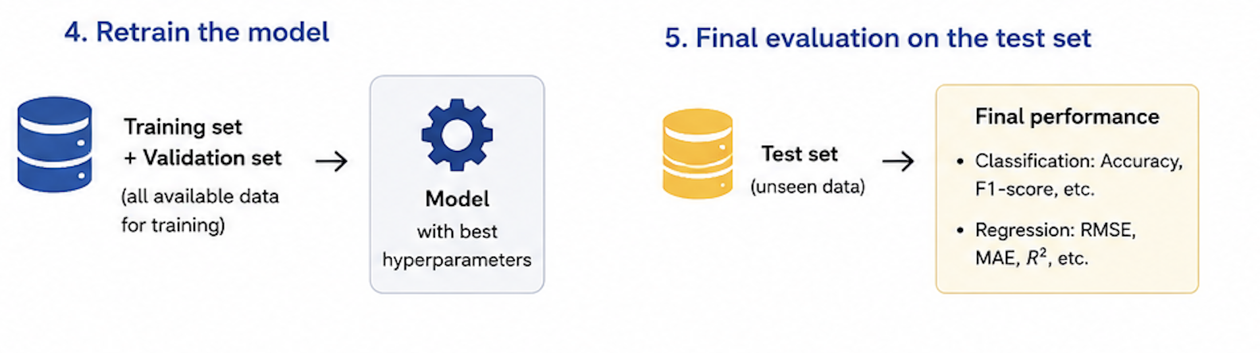
Model tuning
Models have some tunable hyperparameters that can influence the outcome of the training process
A subset of the training set called validation set is used to evaluate different hyperparameter values and select the model that generalizes best to unseen data.
Notes:
## Slide 13 — Model Tuning
> "Models have some tunable hyperparameters that can influence the outcome of the training process."
> "A subset of the training set called validation set is used to evaluate different hyperparameter values and select the model that generalizes best to unseen data."
This introduces the standard three-way split: **Train**, **Validation**, and **Test**. The training set is used to learn the core model parameters, the validation set is used to test and tune different hyperparameters, and the test set is saved for the final, completely unbiased evaluation. A very common rookie mistake is tuning your hyperparameters directly on the test set, which severely inflates your performance estimates.

Slide 14
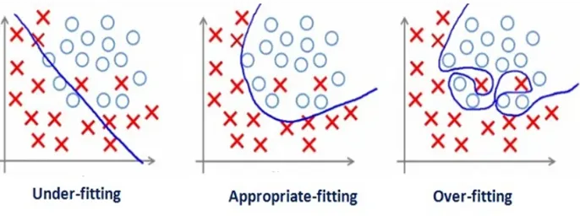

Over and under fitting
Notes:
* **Underfitting (high bias):** Occurs when the model is too simple to capture the underlying patterns in the data.
* **Overfitting (high variance):** Occurs when the model is overly complex and begins memorizing the random noise in the data.

Slide 15
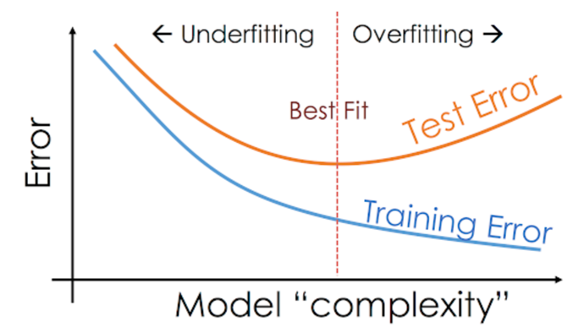
The bias variance curse
Bias = systematic mistake Variance = instability
As the complexity of model increases the bias decreases but the variance increases.
There is a trade-off between bias and variance.
You can't get both low bias
and low variance at the same time.
Notes:
This classic U-shaped curve visualizes the bias-variance tradeoff:
> "As the complexity of model increases the bias decreases but the variance increases."
> "There is a trade-off between bias and variance. You can't get both low bias and low variance at the same time."
To define them simply: **Bias** is a systematic error where the model is consistently wrong in one direction. **Variance** is instability, where the model's predictions swing drastically based on tiny changes in the input data. As we will see, Random Forest is explicitly designed to crush variance by averaging multiple decorrelated decision trees while keeping bias low.
---
Our goal is to find that perfect sweet spot right in the middle to achieve strong generalization.

Slide 16
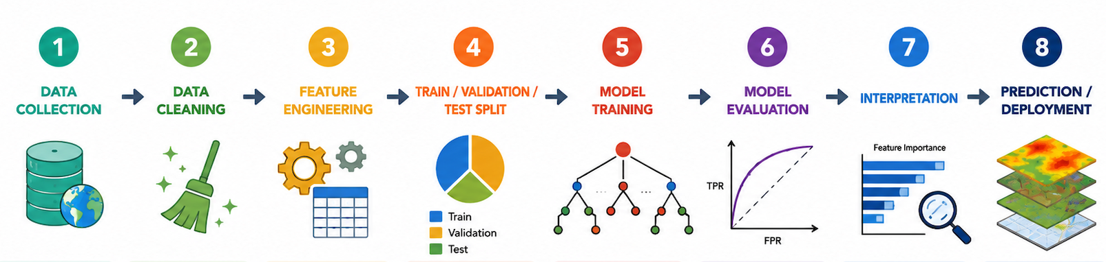
Typical ML workflow
Data preparation
Model development
Gather raw data from various sources
Example:
Satellite data, DEM, roads etc.
Handle missing values and outliers
﻿﻿Correct errors and unify formats and spatial resolution
Create meaningful predictors from raw data
﻿﻿
Example: slope, aspect, distance to roads, NDVI
Split data to train the model and evaluate it
Avoid spatial and temporal leakage
Learn relationships between predictors and target variable
Example:
Random Forest
Assess predictive performance
Metrics: Accuracy,
ROC-AUC, Confusion
Matrix, etc.
Understand which variables drive predictions
Feature importance,
Partial Dependence,
SHAP values
Apply the model to new areas or future scenarios
Generate maps and inform decisions
MULTIPLE ITERATIONS
Notes:
Our workflow is divided into two distinct phases, but notice the "multiple iterations" arrow—this is a highly cyclical process, not a straight line.
**Data Preparation:**
1. Gather raw data like satellite imagery, digital elevation models, and infrastructure maps.
2. Clean the data by handling missing values, managing outliers, and unifying spatial resolutions.
3. Engineer meaningful predictors, converting raw inputs into things like slope, aspect, or NDVI.
4. Split your data into training and evaluation sets while being hyper-vigilant about avoiding spatial and temporal leakage.
**Model Development:**
5. Train the model to learn the relationships between your predictors and targets.
6. Evaluate using metrics like Accuracy, ROC-AUC, and Confusion Matrices.
7. Interpret the inner workings using feature importance, Partial Dependence, or SHAP values.
8. Deploy the model to generate actual predictive risk maps for new areas or future timelines.

Slide 17
Outline
Intro
Basic ML Concepts
Models overview
Wildfire susceptibility using Random Forest

Slide 18
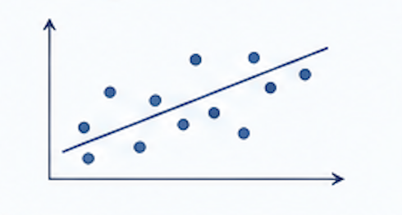
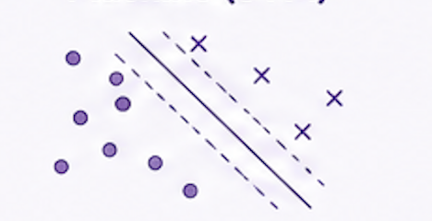
Linear & Logistic Regression Learn simple relationships between predictors and target variables.
Typical environmental applications
Temperature trends
Air quality estimation
Binary hazard occurrence
Good baseline models and useful for explainable analyses
Strengths
Simple
Fast
Highly interpretable
Limitations
Limited ability to model complex non-linear processes
Support Vector Machine (SVM)
Separates classes by finding the optimal decision boundary.
Typical environmental applications
Land-cover classification
Remote sensing
Image segmentation
Widely used in remote sensing and geospatial classification problems.
Strengths
Effective with limited datasets
Handles complex class separation
Limitations
Computationally expensive on large datasets
Less interpretable
Notes:
This slide introduces two foundational supervised-learning algorithms used in environmental data analysis.
Linear and Logistic Regression model simple relationships between predictors and a target. Linear regression handles continuous outputs (e.g. predicting temperature from elevation, time, or other covariates), while logistic regression handles binary outcomes (e.g. whether a hazard event occurs or not). Typical environmental uses include temperature trend analysis, air quality estimation from meteorological inputs, and binary hazard occurrence modelling.
Their main strengths are simplicity, speed, and interpretability — the coefficients have a direct physical meaning, which makes them excellent baseline models and useful when explainability matters (for reporting or policy contexts). The main limitation is that they assume relatively simple, mostly linear relationships, so they struggle with the complex non-linear processes typical of environmental systems.
Support Vector Machines (SVM) take a different approach: they separate classes by finding the optimal decision boundary — the hyperplane that maximises the margin between groups. With kernel functions, they can also capture non-linear separations. In the environmental domain, SVMs are widely used for land-cover classification, remote sensing, and image segmentation tasks.
Their strengths are working well even with limited training data and handling complex class separations. Limitations: they become computationally expensive on very large datasets, and the results are less interpretable than a linear model.
Key takeaway: regression methods are your transparent baseline; SVM is a strong classical option when you have moderate-sized labelled data and need robust classification — particularly common in remote sensing workflows.

Slide 19
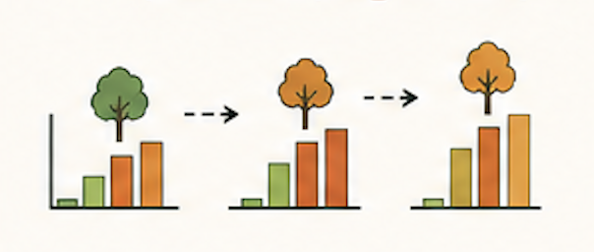
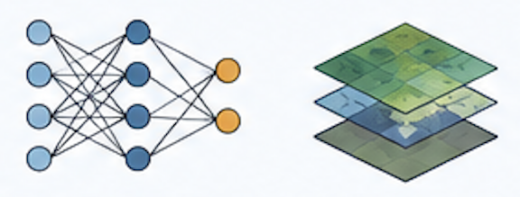
Gradient Boosting
Multiple weak learners are built sequentially, each focusing on correcting mistakes done by previous ones.
Typical environmental applications
Extreme-event prediction
Risk mapping
Environmental forecasting
High predictive performances and flexibility
Strengths
Very high predictive performance
Limitations
More difficult to interpret
Requires hyperparameter tuning
Neural Networks & Deep Learning
Learn complex hierarchical patterns from large datasets.
Typical environmental applications
Satellite image analysis
Fire and smoke detection, flood mapping, etc.
Weather prediction
Particularly powerful for computer vision and Earth observation applications.
Strengths
Excellent for images and spatial data
Can model highly complex relationships
Limitations
Requires large datasets and computation
Often behaves like a “black box”
Notes:
This slide covers two of the most powerful modern supervised methods, both heavily used in environmental science.
Neural Networks and Deep Learning learn complex, hierarchical patterns directly from large datasets. Instead of hand-crafting features, the network learns its own representations layer by layer. Typical environmental applications include satellite image analysis, fire and smoke detection, flood mapping, and weather prediction. These methods are particularly powerful for computer vision and Earth observation, where convolutional architectures can exploit the spatial structure of imagery.
Strengths: they excel on images and spatial data, and can model highly complex, non-linear relationships that simpler models cannot capture. Limitations: they require large labelled datasets and significant computational resources (often GPUs), and they often behave like a black box — making it harder to explain why a particular prediction was made, which can be an issue in scientific or regulatory contexts.
Gradient Boosting takes an ensemble approach: many weak learners — typically small decision trees — are built sequentially, with each new learner focusing on correcting the mistakes made by the previous ones. Popular implementations include XGBoost, LightGBM, and CatBoost. Environmental applications include extreme-event prediction, risk mapping, and general environmental forecasting on tabular data.
Strengths: very high predictive performance, often state-of-the-art on structured/tabular datasets, and considerable flexibility across regression and classification tasks. Limitations: harder to interpret than a single tree or linear model, and performance depends strongly on careful hyperparameter tuning (learning rate, tree depth, number of estimators, regularisation).
Key takeaway: choose deep learning when the data is large and unstructured — especially images or spatio-temporal grids. Choose gradient boosting when the data is tabular and you need top-tier accuracy with reasonable training cost.

Slide 20
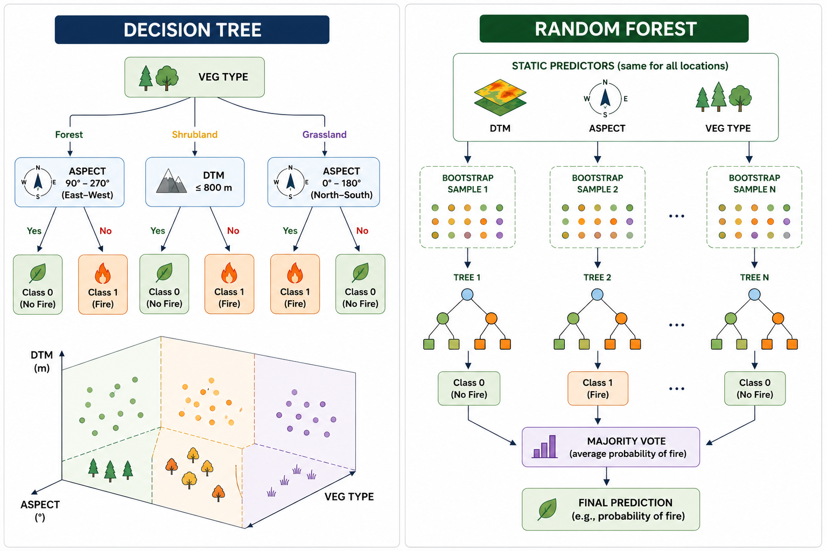
Decision Trees
A Decision Tree splits the dataset into smaller and more homogeneous groups using sequential rules on predictor variables.
How it works
Start from all observations
Select the variable that best separates classes
Split the data into branches
Repeat recursively until terminal nodes are reached
Advantages
Simple and interpretable
Handles numerical and categorical variables
Captures non-linear relationships
Main limitation
Single trees are unstable and prone to overfitting.
Notes:
> *"A Decision Tree splits the dataset into smaller and more homogeneous groups using sequential rules on predictor variables."*
**How it works:**
1. Start from all observations
2. Select the variable that best separates classes
3. Split the data into branches
4. Repeat recursively until terminal nodes
**Advantages:** Simple and interpretable; handles numerical and categorical variables; captures non-linear relationships.
**Main limitation:** Single trees are unstable and prone to overfitting.
Draw or describe a simple tree — e.g., "If slope > 20° AND vegetation = scrub → high fire risk." Decision trees are easy to visualize and explain to stakeholders.

Slide 21
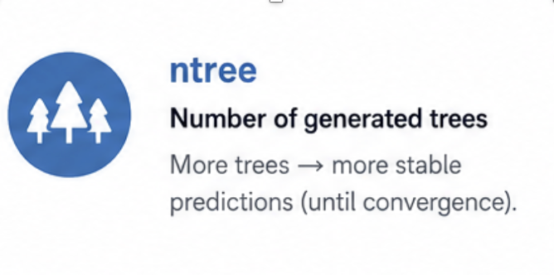
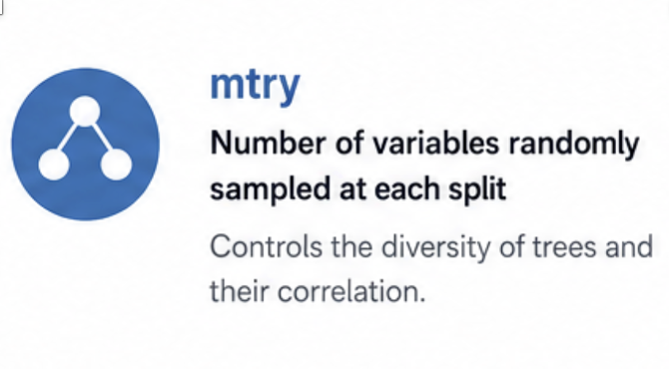
Random Forest
Random Forest is an ensemble-learning algorithm that combines predictions from many independent decision trees.
How it improves Decision Trees
Each tree is trained on:
a random subset of observations
a random subset of predictor variables
This increases model diversity and reduces overfitting.
Final prediction
Each tree produces a prediction:
classification → majority vote
probability → average probability across trees
“Random Forest trades some interpretability for better generalization and predictive robustness.”
Notes:
> *"Random Forest is an ensemble-learning algorithm that combines predictions from many independent decision trees."*
**How it improves on Decision Trees:**
- Each tree is trained on a **random subset of observations** (bagging)
- Each tree uses a **random subset of predictor variables** (feature randomization)
- This increases model diversity and reduces overfitting
**Final prediction:**
- Classification → majority vote
- Probability → average probability across trees
> *"Random Forest trades some interpretability for better generalization and predictive robustness."*
This is the core algorithm for the wildfire case study. Stress that the "randomness" is a feature, not a bug — it prevents trees from correlating with each other and reduces variance.

Slide 22
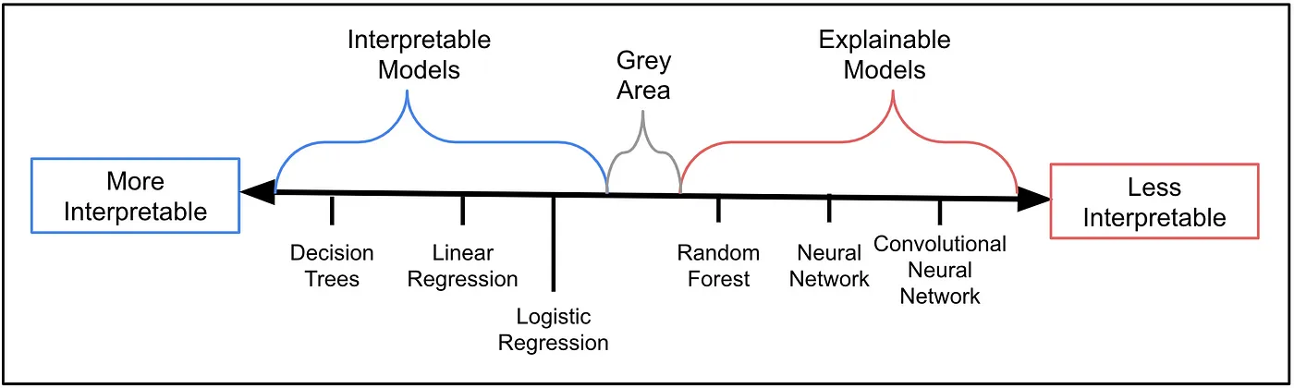
Models Interpretability
Simple models allow understanding how predictions are made, without extra tools.
Complex models often work like “black boxes”. Additional methods are needed to understand how they make predictions.
https://miro.medium.com/v2/resize:fit:1400/format:webp/1*6-QWLr9obdDlUmVLtDXPrQ.png
Explainability focuses on understanding what happens inside a model, from input to output.
Notes:
> *"Simple models allow understanding how predictions are made, without extra tools."*
> *"Complex models often work like 'black boxes'. Additional methods are needed to understand how they make predictions."*
> *"Explainability focuses on understanding what happens inside a model, from input to output."*
Reference image: interpretability spectrum from linear regression to deep neural networks.
For environmental decision-making, interpretability matters — stakeholders (fire managers, policymakers) need to trust and understand the model. Methods like feature importance and SHAP values help bridge this gap.

Slide 23
Outline
Intro
Basic ML Concepts
Models overview
Wildfire susceptibility using Random Forest

Slide 24

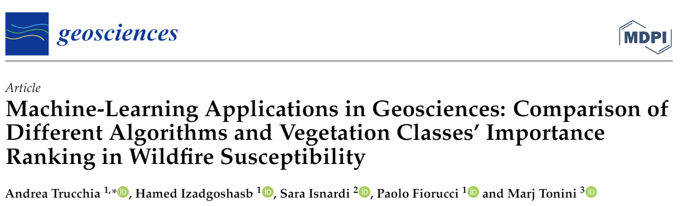

ML In practice: Random Forest for Forest Fire Susceptibility
Notes:
Introduce the practical case study. Everything discussed so far will now be applied to a real dataset.

Slide 25

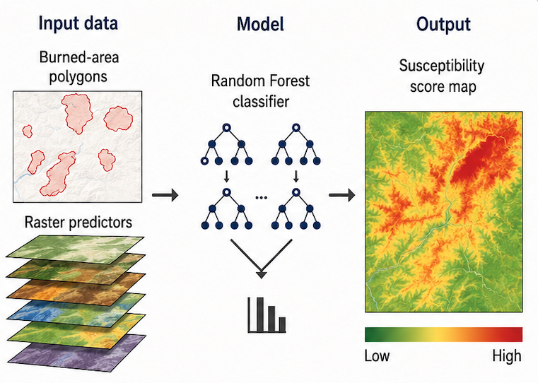



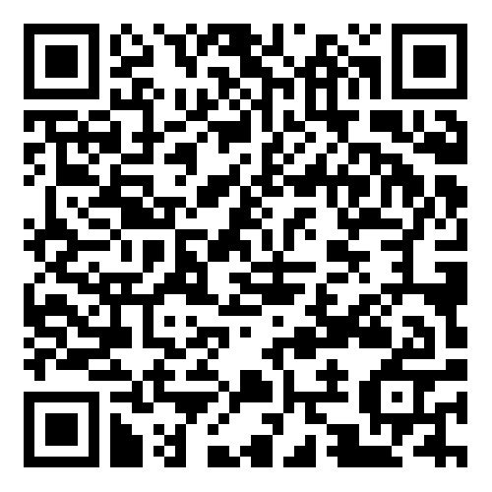

Goal: estimate the relative probability of wildfire occurrence as a proxy of wildfire susceptibility. Use occurred events, environmental and anthropogenic conditions.
Course material
https://github.com/mirkodandrea/wildfire-susceptibility-ml-lesson
Notes:
> *"Goal: estimate the relative probability of wildfire occurrence as a proxy of wildfire susceptibility. Use occurred events, environmental and anthropogenic conditions."*
**Course material:** https://github.com/mirkodandrea/wildfire-susceptibility-ml-lesson
This is a **presence-only** problem — we know where fires burned, but "absence" is ambiguous. We'll use pseudo-absences to construct a trainable dataset.

Slide 26
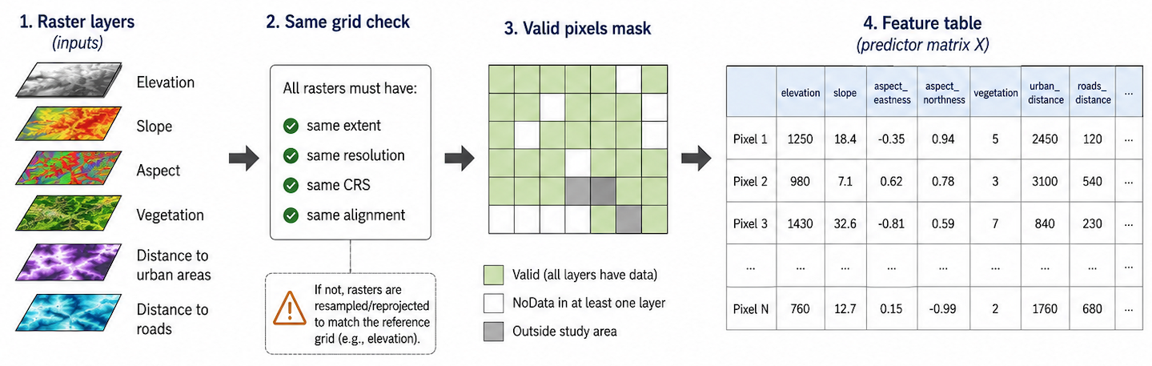
Raster Predictors and Feature Engineering
The model uses environmental and anthropogenic predictors derived from raster layers.
All rasters are aligned to the same grid and stacked to build the feature table.
Notes:
> *"The model uses environmental and anthropogenic predictors derived from raster layers. All rasters are aligned to the same grid and stacked to build the feature table."*
Describe the data pipeline: start from geospatial rasters (satellite-derived, DEM-derived, infrastructure) → align to common grid → extract pixel values → assemble feature matrix. Every row is a pixel; every column is a feature.

Slide 27
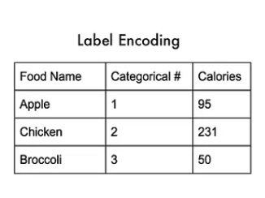
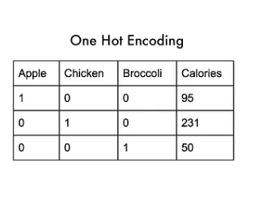
Categorical Variables
Some Random Forest implementations need numeric inputs, so categorical variables must be encoded first.
Ordinal encoding: use when categories have order, e.g. low / medium / high.
One-hot encoding: use when categories have no order, e.g. forest type or land-use class. Replace the categorical variable with 0/1 columns.
Target encoding: use label/target relation to variable to sort categories. Can introduce overfit.
For this example, we will use One Hot Encoding for the vegetation categorical variable
Notes:
> *"Some Random Forest implementations need numeric inputs, so categorical variables must be encoded first."*
**Encoding strategies:**
- **Ordinal encoding**: use when categories have order (low / medium / high)
- **One-hot encoding**: use when categories have no order (forest type, land-use class) — creates 0/1 columns
- **Target encoding**: uses label/target relation — can introduce overfit
> *"For this example, we will use One Hot Encoding for the vegetation categorical variable."*
Ask the audience: "What happens if we feed the number code directly to a tree?" The tree would treat 3111 as numerically between 312 and 3112 — which is meaningless. One-hot encoding avoids this.

Slide 28
Feature engineering, in code
# Aspect: degrees → two orthogonal components
def add_aspect_features(frame):
rad = np.deg2rad(frame["aspect"])
frame["aspect_eastness"] = np.sin(rad)
frame["aspect_northness"] = np.cos(rad)
return frame
# Vegetation: unordered codes → one binary column per class
def one_hot_encode_vegetation(frame):
dummies = pd.get_dummies(
frame["vegetation"].astype(int),
prefix="vegetation", dtype=int,
)
return dummies.reindex(
columns=VEGETATION_FEATURE_COLUMNS, fill_value=0,
).reset_index(drop=True)
Why these transforms?
Aspect is circular — 1° and 359° point nearly the same direction. Sin/cos preserve direction with no discontinuity.
Vegetation is unordered — code 3111 is not "between" 312 and 3112. One-hot encoding lets the model learn per-class effects.
Result: 18-column feature matrix ready for the Random Forest.
Notes:
**Key transforms:**
```python
# Aspect: degrees → two orthogonal components
def add_aspect_features(frame):
rad = np.deg2rad(frame["aspect"])
frame["aspect_eastness"] = np.sin(rad)
frame["aspect_northness"] = np.cos(rad)
return frame
# Vegetation: unordered codes → one binary column per class
def one_hot_encode_vegetation(frame):
dummies = pd.get_dummies(frame["vegetation"].astype(int), prefix="vegetation", dtype=int)
return dummies.reindex(columns=VEGETATION_FEATURE_COLUMNS, fill_value=0)
```
**Why these transforms?**
- **Aspect is circular** — 1° and 359° point nearly the same direction. Sin/cos preserve direction without discontinuity.
- **Vegetation is unordered** — code 3111 is not "between" 312 and 3112.
Result: 18-column feature matrix ready for the Random Forest.

Slide 29
Burned vs unburned: what the features show
Class-wise medians (continuous predictors)
Elevation: burned 467 m vs unburned 565 m — fires concentrate lower in the landscape
Slope: 21.3° vs 18.8° — burned pixels sit on steeper terrain
Aspect northness: −0.56 vs 0.00 — burned pixels skew strongly south-facing
Aspect eastness: 0.16 vs 0.00 — a small eastward tilt
Distance to urban / roads: essentially identical between classes — accessibility alone does not separate burned from unburned in this region
Takeaway: terrain (elevation, slope, aspect) carries clear discriminative signal; distance features carry almost none.
Notes:
**Class-wise medians (continuous predictors):**
- **Elevation:** burned 467 m vs unburned 565 m — fires concentrate lower in the landscape
- **Slope:** 21.3° vs 18.8° — burned pixels sit on steeper terrain
- **Aspect northness:** −0.56 vs 0.00 — burned pixels strongly south-facing
- **Aspect eastness:** 0.16 vs 0.00 — small eastward tilt
- **Distance to urban/roads:** essentially identical — accessibility alone doesn't separate classes
**Takeaway:** Terrain (elevation, slope, aspect) carries clear discriminative signal; distance features carry almost none.
---

Slide 30
Vegetation: which classes burn?
Strongly over-represented in burned pixels
Mediterranean evergreen scrub: 18.7% of burned vs 1.7% of unburned (~11× enrichment)
Shrubland and scrub: 13.3% vs 2.8% (~5×)
Warm-climate mixed forest: 21.0% vs 15.9% (moderate)
Under-represented in burned pixels
Chestnut forest: 10.7% of burned vs 26.7% of unburned
Moist-climate mixed forest: 4.5% vs 12.4%
One-hot encoding produces 12 vegetation columns, bringing the feature matrix to 18 total. The model can now learn class-specific fire propensity rather than assuming a numeric ordering.
Notes:
**Strongly over-represented in burned pixels:**
- Mediterranean evergreen scrub: 18.7% burned vs 1.7% unburned (~11× enrichment)
- Shrubland and scrub: 13.3% vs 2.8% (~5×)
- Warm-climate mixed forest: 21.0% vs 15.9% (moderate)
**Under-represented in burned pixels:**
- Chestnut forest: 10.7% burned vs 26.7% unburned
- Moist-climate mixed forest: 4.5% vs 12.4%
One-hot encoding produces 12 vegetation columns → 18-column feature matrix total. The model learns class-specific fire propensity rather than a numeric ordering.

Slide 31
What the EDA tells us before modelling
The features carry a real signal
Terrain separates classes: lower, steeper, south-facing pixels are more likely to have burned
Vegetation is the strongest single discriminator: scrub and Mediterranean classes burn far above their base rate
But no single feature is enough
Distributions overlap heavily for each individual predictor
A model needs to combine terrain and vegetation rather than threshold any one feature
Caveats to keep in mind
Contrasts are vs sampled pseudo-absences, not the true landscape
Spatial autocorrelation means nearby pixels are not independent — random splits will look optimistic
Notes:
**The features carry a real signal:**
- Terrain separates classes: lower, steeper, south-facing pixels more likely to have burned
- Vegetation is the strongest single discriminator: scrub and Mediterranean classes burn far above base rate
**But no single feature is enough:**
- Distributions overlap heavily for each individual predictor
- The model needs to combine terrain AND vegetation
**Caveats:**
- Contrasts are vs sampled pseudo-absences, not the true landscape
- Spatial autocorrelation means nearby pixels are not independent — random splits will look optimistic

Slide 32
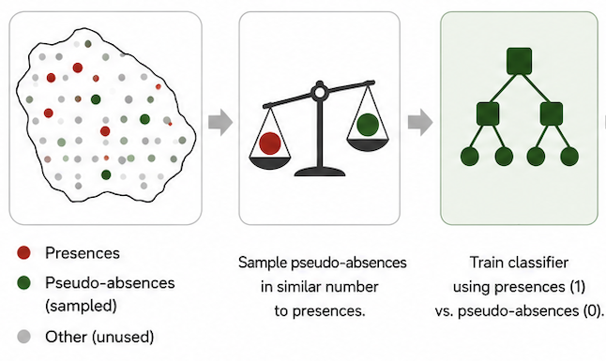
Pseudo-absences and Class Imbalance
Pseudo-absences are necessary when you have presence-only data, meaning:
we know where the event occurred
but true absences are unknown
Treating all unknown areas as absences would lead to:
Severe class imbalance
Bias toward easy background areas
Poor model generalization
Pseudo-absences are randomly generated from locations where the event is assumed not to occur.
Pseudo-absences are often sampled in similar number to presences to reduce class imbalance (50% presences, 50% pseudo absences)
Pseudo-absences provide a practical way to represent the absence class when true absences are unknown
Notes:
> *"Pseudo-absences are necessary when you have presence-only data."*
**The problem:**
- We know where fires occurred (presence)
- True absences are unknown
**Why this matters:**
- Treating all unknown areas as absences → severe class imbalance
- Model biased toward easy background areas
- Poor generalization
**Solution:** Pseudo-absences are randomly sampled from locations where fire is assumed not to occur, typically in a 1:1 ratio with presences.
> *"Pseudo-absences provide a practical way to represent the absence class when true absences are unknown."*

Slide 33
Pseudo-absences, in code
# Why pseudo-absences? Fire is rare (1–5% of pixels).
# A 1:1 burned : sampled-unburned ratio prevents the
# model from learning the trivial 'predict unburned' rule.
burned = train_period_df.loc[train_period_df["target"] == 1]
unburned = train_period_df.loc[train_period_df["target"] == 0].sample(
n=len(burned),
random_state=RANDOM_STATE,
)
# Shuffle so burned and unburned are interleaved.
train_pool = pd.concat([burned, unburned], ignore_index=True)\
.sample(frac=1, random_state=RANDOM_STATE)\
.reset_index(drop=True)
# Hold-out: KEEP real imbalance — do not balance.
test_df = add_period_labels(features, test_burned_mask, ...)
Balance for training, not for testing
1:1 ratio — forces the model to learn discriminative features, not the base rate.
Result — scores are a relative ranking, not calibrated probabilities.
Hold-out stays imbalanced — 5,806 burned out of 398,697 pixels (1.5%) — mirrors operational reality.
Notes:
**Key principle:** Balance for training, not for testing.
- Training: 1:1 ratio forces the model to learn discriminative features
- Hold-out stays imbalanced (1.5%) — mirrors operational reality
- Scores are a relative ranking, not calibrated probabilities

Slide 34
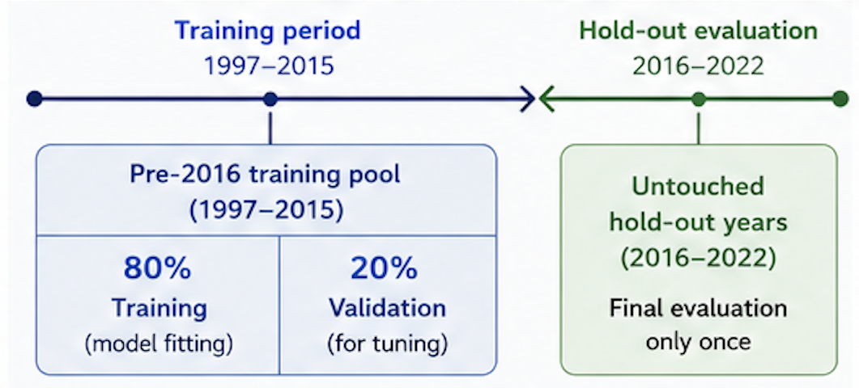
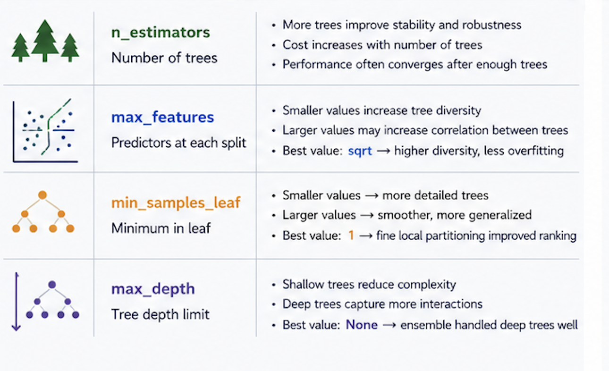
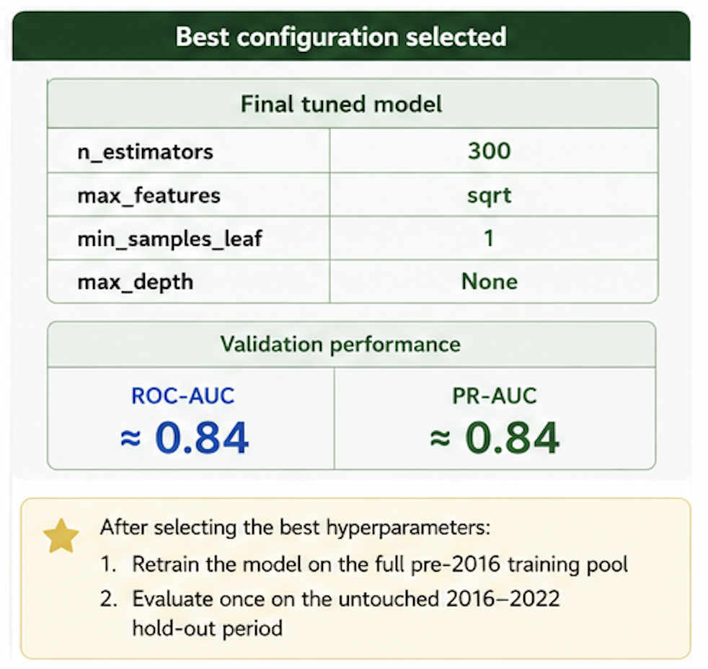
Random Forest Hyperparameter Tuning
Validation strategy used in this workflow: temporal split
Why hyperparameter tuning matters
Random Forest performance strongly depends on the choice of hyperparameters. Hyperparameter tuning aims to identify the model configuration that generalizes best to unseen data, avoiding both Underfitting and Overfitting
The tuning process is performed on a validation dataset, separate from the final hold-out test period.
Notes:
> *"Random Forest performance strongly depends on the choice of hyperparameters."*
> *"Hyperparameter tuning aims to identify the model configuration that generalizes best to unseen data, avoiding both underfitting and overfitting."*
**Validation strategy:** temporal split — training on earlier years, validating on a later period. This avoids data leakage from spatial autocorrelation.
The tuning process uses a validation dataset **separate from the final hold-out test period**.

Slide 35
Hyperparameter tuning, in code
param_grid = {
"n_estimators": [150, 300],
"max_features": ["sqrt", 0.5],
"min_samples_leaf": [1, 3, 5],
"max_depth": [None, 15],
}
# Reuse the fixed validation split — no k-fold reshuffle.
# Nearby pixels share terrain + fire history → k-fold leaks.
fold = [-1]*len(X_train) + [0]*len(X_valid)
split = PredefinedSplit(test_fold=fold)
search = GridSearchCV(
RandomForestClassifier(random_state=42, n_jobs=-1),
param_grid=param_grid,
scoring="roc_auc", cv=split,
)
search.fit(X_tune, y_tune)
Grid search with a fixed fold
24 combinations evaluated against ROC-AUC on the held-out validation rows.
PredefinedSplit — we are using a predefined split for simplicity. We should consider spatial autocorrelation. The results could be inflated.
Winner — 300 trees, sqrt features, no depth cap. Validation AUC 0.842.

Slide 36
Training the final model
Two models, two purposes
validation_model — fit on the 80% training split only, so the validation rows stay untouched and give honest tuning metrics.
rf_model — refit on the full balanced 1997–2015 pool; used for the 2016–2022 hold-out and the susceptibility map.
Selected hyperparameters
n_estimators=300, max_features="sqrt", min_samples_leaf=1, max_depth=None.

Slide 37
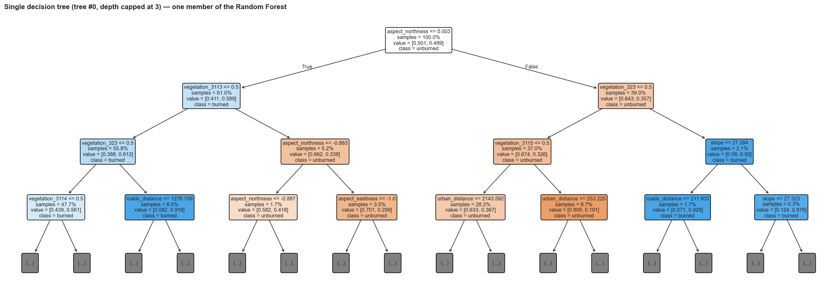
Peeking inside one tree
Root split is aspect_northness — south-facing slopes (left branch) skew "burned"; north-facing (right) skew "unburned".
Vegetation one-hots dominate deeper splits — confirms the EDA signal. One tree is noisy; the forest averages 300 of these for a stable score.

Slide 38
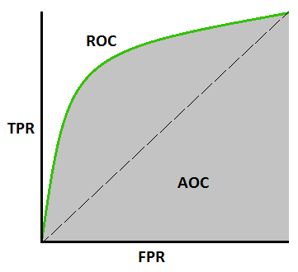
Evaluation metrics
ROC-AUC — threshold-free ranking quality
P(random burned scores > random unburned). 1.0 = perfect, 0.5 = chance.
Plots TPR vs FPR across all thresholds — no cutoff needed.
Recall@TopK% — operational metric
If we prioritize the top K% of the landscape by score, what share of future fires does that zone capture?
Speaks directly to budget-constrained decisions.
⚠ Accuracy is unsafe under 1.5% prevalence; ranking metrics are the right tool for susceptibility.
Notes:
This slide moves beyond the confusion-matrix metrics to two ranking-based scores that are better suited to a rare-event problem like fire susceptibility.
ROC-AUC stands for the Area Under the Receiver Operating Characteristic curve. The ROC curve plots the True Positive Rate against the False Positive Rate as we sweep the classification threshold from 0 to 1. The area under that curve is a single number between 0 and 1.
The intuitive interpretation: ROC-AUC is the probability that a randomly chosen burned pixel receives a higher score from the model than a randomly chosen unburned pixel. 1.0 means perfect ranking, 0.5 means the model is no better than flipping a coin, and below 0.5 means the model is systematically wrong.
The key advantage of ROC-AUC is that it is threshold-free — we do not have to commit to a specific cutoff to evaluate the model. This is useful in early model selection, where we want to compare overall discriminative power before deciding on an operational threshold.
Recall@TopK% is the operational metric. The idea: rank all pixels by their predicted score, take the top K% (say the top 10% or top 20% of the landscape), and ask what fraction of the actual future fires fall inside that zone.
This metric speaks directly to budget-constrained decisions. Fire managers cannot monitor the entire territory — they have to prioritise. Recall@Top10% tells them: if I focus my prevention resources on the 10% of the landscape my model flags as highest risk, how many fires will I actually cover.
The closing warning ties back to slide 38: accuracy is unsafe at 1.5% prevalence because a trivial 'predict unburned everywhere' model would score 98.5%. Ranking metrics like ROC-AUC and Recall@TopK% do not have this failure mode — they measure how well the model separates the rare positives from the common negatives, which is exactly what susceptibility mapping needs.

Slide 39
ROC curve + score distributions, in code
# Score the hold-out
scores = rf_model.predict_proba(X_test)[:, 1]
# ROC curve from estimator
fig, ax = plt.subplots(figsize=(6, 4.5))
RocCurveDisplay.from_estimator(
rf_model, X_test, y_test, name="Random Forest", ax=ax)
ax.plot([0, 1], [0, 1], linestyle="--")
# Score histograms by class
for target, color in [(0, "#2563eb"),
(1, "#dc2626")]:
ax.hist(scores[y_test == target],
bins=30, alpha=0.5, color=color)
# Hold-out ROC-AUC = 0.798
Two diagnostic plots
ROC curve: how well burned pixels rank above unburned ones across every threshold.
Score histograms: where each class lives along the susceptibility axis.
What to look for
ROC curve well above the diagonal — the model adds ranking value over chance.
Burned distribution shifted right of unburned — separation, not perfect overlap.

Slide 40
Recall@Top%, in code
# Operational question: if we map only the top K% of the
# landscape as high-susceptibility, what share of future
# burns falls inside that zone?
def recall_at_top_percent(y_true, score, top_share):
threshold = np.quantile(score, 1 - top_share)
return recall_score(y_true, score >= threshold)
# Score every pixel in the 2016–2022 hold-out (398,697 rows).
test_scores = rf_model.predict_proba(X_test)[:, 1]
for k in [0.10, 0.25, 0.50]:
r = recall_at_top_percent(y_test, test_scores, k)
print(f"Top {k:.0%} → {r:.1%} of burns captured")
# Top 10% → 49.5% Top 25% → 69.8% Top 50% → 86.5%
# Hold-out ROC-AUC = 0.798
Rank, don't classify
Top 10% of the map captures roughly half of 2016–2022 burned pixels — a 5× lift over the landscape base rate.
Percentile thresholds are portable across runs; raw score cutoffs are not.
ROC-AUC 0.798 — a useful ranker, not a perfect predictor. Weather and ignition aren't in the model.

Slide 41
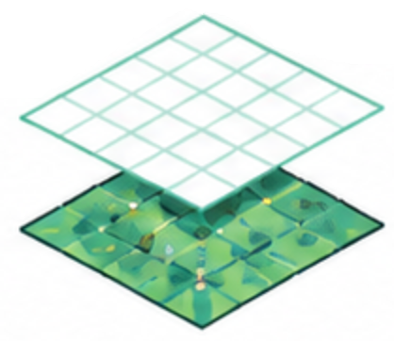
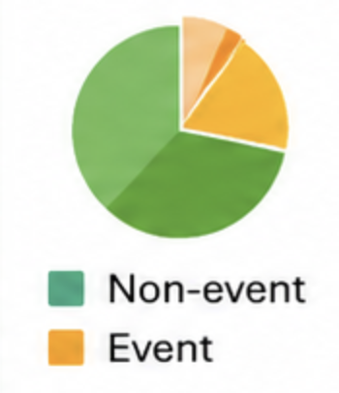
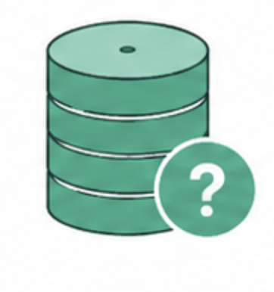

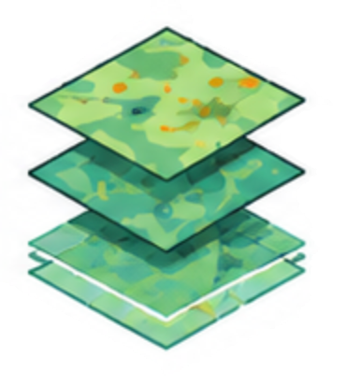

Environmental ML Challanges
Environment and geospatial data have unique characteristics that impact how we build, evaluate and apply ML models.
Good ML in environmental applications requires spatial, temporal and domain awareness.
SPATIAL
AUTOCORRELATION
Nearby locations are more similar
IMBALANCED
DATA
﻿﻿Events (e.g., fires, floods) are rare -> bias
﻿﻿Careful sampling and metrics are required
MISSING AND NOISY DATA
﻿﻿Gaps due to clouds, sensor limits etc.
﻿﻿Requires robust preprocessing
TEMPORAL
NON-STATIONARITY
﻿﻿Relationships change over time (seasons, land use, climate)
﻿﻿
HETEROGENEOUS
DATA SOURCES
﻿﻿Different resolutions, formats and scales
﻿﻿Combining in-situ, remote sensing and derived data
﻿﻿Requires harmonization and feature engineering
INTERPRETABILITY & DECISION-MAKING
﻿﻿Models must be trustworthy and explainable
﻿﻿Stakeholders need clear and actionable outputs

