Slide 1
GANs for Flow Prediction

Slide 2
Outline
GAN Approach
GAN Architectures
Image translation: GAN vs. classical NN
Conclusion

Slide 3
GAN Approach
Task (example): generate images that look like faces
Problem: hard to define explicitly what that means (“we know a face when we see it”)
Unclear what the cost function should be
GAN method: Don’t predefine criteria to optimize for, instead use a second NN to tell you if a generated image is similar to a training set (of faces)
Training the discriminator in step with the generator is a way of obtaining the “right” cost function for generating images that appear similar to those in a training set
Can be applied to image-to-image translation by supplying image as conditional input (cGAN) e.g. generate faces based on sketch

Slide 4
Classical GAN Architecture
Training Set
Latent
Space
Generator
Discriminator
“real or forged?”
Trained to generate images that fool the discriminator
Trained to tell apart generated from training images

Slide 5
Conditional GAN (cGAN) Architecture
Training Set
Latent
Space
Conditional Labels
Discriminator
Generator
“real or forged?”
Conditional (e.g. gender)

Slide 6
Translational cGAN Architecture
Translational cGAN Architecture (deterministically)
Training Conditionals
Training Images
Latent
Space
Discriminator
Generator
“real or forged?”
Conditional (e.g. sketch)

Slide 7
Image Translation Comparison: Classical NN vs. Translational cGAN
Classical NN:
Trained to perform image transformations which reduce the average training error as measured by predefined cost function
Generated image compared to ground truth during training
cGAN:
No cost function explicitly defined, instead cost function is part of training (= discriminator)
Goal of training: make it as difficult as possible to identify generated image as not from training set
Generated image compared to image transformation in training set
What are the resulting differences in the generated images?

Slide 8
Classical NN vs. Translational cGAN: Simplified Example
Task: fill in the square:
Training data:
Standard NN with MSE loss:
Clearly not from dataset
cGAN: or (depending on initialization)
Plausible result!

Slide 9
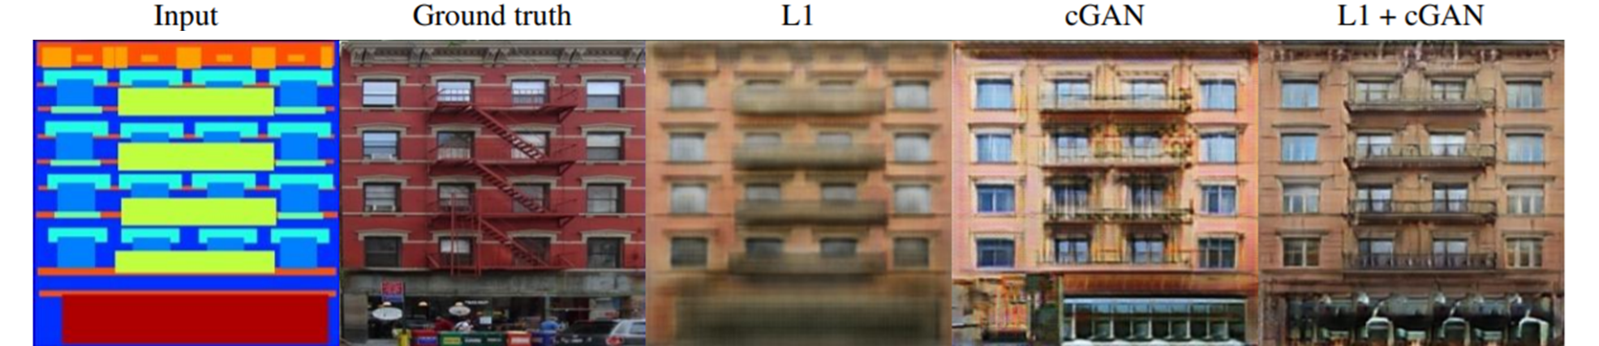
Classical NN vs. Translational cGAN: Realistic Example
Task: Reconstruct facade from schematic
Result not fully determined from training data → NN must fill in lack of information
What is at the base of the building? Storefront, Garage, advertisement?
Classical NN produces “average of possibilities”
Minimizes cost function, but easy to detect as generated
cGAN produces something concrete and plausible, but not necessarily closer to truth
Source: P. Isola, Image-to-Image Translation with Conditional Adversarial Networks, Berkeley AI Research (BAIR)

Slide 10
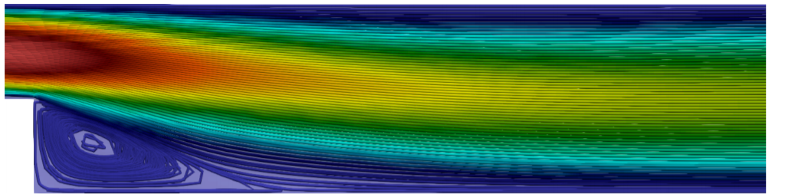
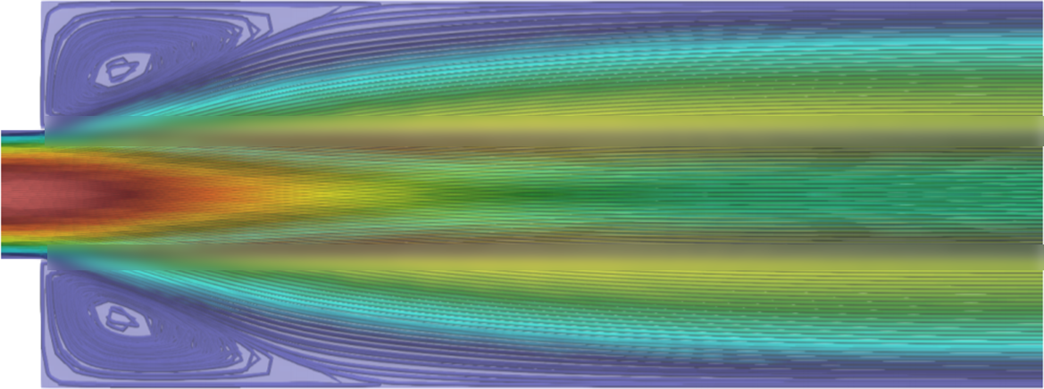




Classical NN vs. Translational cGAN: Flow Example
$$L_{1}$$
Whether flow attaches at top or bottom depends on $L_{1}/L_{2}$
NN may be trained to learn this relation
For$L_{1}=L_{2}$, the outcome is essentially random
A NN trained with MSE loss would most likely produce a superposition of both cases to minimize error
A trained discriminator network could easily identify this as a “forgery”
Adversarially trained generator would likely learn to pick and choose one
inflow
outflow
$$L_{2}$$

Slide 11
Conclusion
GANs help us find a suitable loss function (discriminator) on which to train the generator so that it produces images that are difficult to detect as not from the training set
GANs excel at obfuscating the fact that their output is machine generated
In the setting of flow prediction, this means generating images with our reduced order model that look like they could plausibly be CFD results (instead of optimizing for results closest to ground truth in an average sense)
If instead we can explicitly define what we are trying to optimize for (e.g. mean deviation from ground truth or adherence to PDE), GANs provide no obvious benefit
Will a GAN model generalize better to new geometry types? - Conceivable, but no obvious reason to believe so

