Slide 1
DripBox
Pritesh Gupta, Tejas Vyas

Slide 2
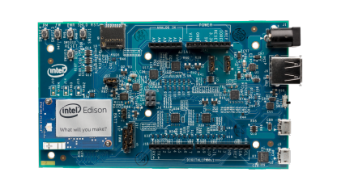
What is DripBox?
Essentially self hosted DropBox which can be accessed by users connected on the same WiFi network.

Slide 3
Why?
DropBox is not secure (can be refuted, but ultimately not at all private).
DropBox has limited storage/costs $.
Several times an overkill if you need to transfer files between your devices.
Much faster, since it is independent of the Internet for file sharing b/w the WiFi network.
Easier, no authentication required (since everyone has to be on the same network).

Slide 4
Implementation
Using Intel Edison with Arduino Kit
--which has inbuilt WiFi (and bluetooth) for connectivity.
Custom build of Linux flashed to Edison with suitable drivers (WiFi, USB, etc) and compilers (GCC, Node, NPM).
External storage such as Flash drive or memory card for extended storage (in addition to to existing on board memory).
5v – 12v power adapter for making the unit stand alone (so that it can be kept always running from a corner of the house).

Slide 5
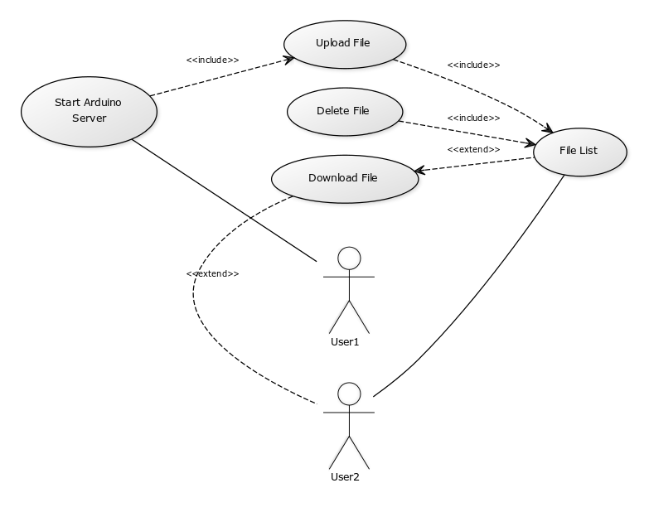
UML Use Case Diagram

Slide 6
Testing details
Since most of the application is written in Node.js/JavaScript. UI testing done using Mocha and user upload testing is done with PhantomJS (NPM modules).
For C Linux image testing, default Linux build tests used (before/after flashing).

Slide 7
Work Distribution
Pritesh Gupta:
Linux Flashing, all back end work (Node.js, file [permissions], storage and file listings).
Tejas Vyas:
Documentation, all front end work (UI, jQuery drag and drop website).

Slide 8

Video Demo
Link to Video : http://youtu.be/gCfg6v8JgoQ

Slide 9
Screenshots

Slide 10
References
NodeJS.org
Mozilla Developer Network

