Slide 1
Time Series Forecasting
Miranda Leiva Lázaro

Slide 2
Index
Understanding the data
Performing the forecast
Visualising the results
Exporting the results
Conclusions

Slide 3
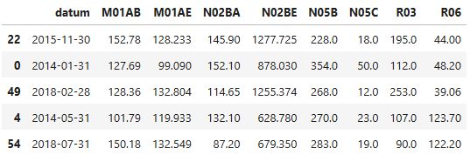
1. Understanding the data
I imported the data into a Pandas dataframe for a better management and checked its structure.
Displaying a sample helped me understand the purpose of the dataset: It is a monthly sales record of different selected drug groups.
To prevent future errors, the types of each column and the absence of null values were verified.
Drug group guide
M01AB - Acetic acid derivatives and related substances
M01AE - Propionic acid derivatives
N02BA - Salicylic acid and derivatives
N02BE/B - Pyrazolones and Anilides
N05B - Anxiolytic drugs
N05C - Hypnotics and sedatives drugs
R03 - Drugs for obstructive airway diseases
R06 - Antihistamines for systemic use
A sample of the dataset

Slide 4
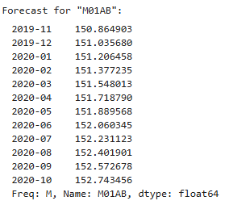
2. Performing the forecast
The time range values to be predicted were obtained by using the python sktime library for time series forecasting.
In order to perform the forecast for each drug group, I defined for each of them the train and test dataframes, a forecast horizon and a forecasting model. I trained then the models.
With both models ready, I made predictions for the defined forecast
horizons.
An example of forecast

Slide 5
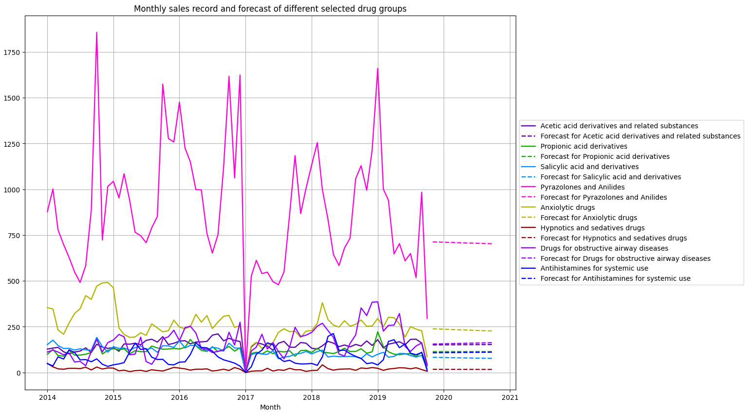
3. Visualising the results
I displayed the monthly sales record and forecast of each drug group, all together in a graph.
The graph design was carefully selected for greater attractiveness and better understanding.

Slide 6
Conclusions
The forecast reveals that drug sales will be around 80 and 160 for most of the groups, with a relative continuity.
The sales of hypnotics and sedatives drugs will be only around 10.
The sales of anxiolytic drugs will be around 240, with a slight decrease.
The number of predicted sales for the pyrazolones and anilides group presents an outlier value of around 730. A slight decrease is forecasted.

Slide 7
Thank you for your interest!

