Slide 1
Drug Action and Pharmacokinetics
Dr Sylvain Grenier
B Pharm, PharmD
Adjunct Professor
University of Ottawa
sgrenier@uottawa.ca
September 2023

Slide 2
Learning Objectives
Define pharmacology, biopharmaceutics, pharmacokinetics and pharmacodynamics and how they relate to each other.
Describe the biopharmaceutics phase.
Pharmacokinetics (PK)
  Define the four phases of PK
  Describe the absorption phase and explain the various factors related to it
  Explain how various factors affect the distribution phase
  Describe the metabolism phase
  Describe the elimination phase and explain the various factors related to it

Slide 3
Learning Objectives cont’d
Pharmacodynamics (PD)
  Explain how drugs exert their pharmacological action
  Describe how different factors can affect PK and/or PD
Discuss how PK principles can be applied in nursing care

Slide 4
Pre-reading Questions
Under what circumstances, would you the nurse be particularly interested in the pharmacokinetics of a drug?
A drug X is metabolized mostly by the liver. If the patient had renal dysfunction, would a dose adjustment be needed?
Why do some drugs get destroyed before they reach the general circulation?
Why are four half-lives almost as useful as five half-lives in clinical use? If you gave a dose of 0.25 mg of digoxin every day and the half- life was 36 hours, when would be at steady state?
Although receptors are essentially imaginary in explaining drug action, in all probability they really are what?

Slide 5
Course Outline
Definitions
  Just a few
Biopharmaceutics
Pharmacokinetics (PK)
  Absorption
  Distribution
  Metabolism
  Elimination
Pharmacodynamics (PD)
Factors altering PK/PD

Slide 6
Definitions
PHARMACOLOGY
  Science studying the action of drugs on living systems.
BIOPHARMACEUTICS
  Science dealing with the physico-chemical properties of the drug substance, the dosage form and the liberation of the active drug ingredient in the body from a given product.
  "How the drug product performs."

Slide 7
Definitions cont’d
PHARMACOKINETICS
  Science examining the changes of concentration in the different body fluids and tissues following absorption, distribution, metabolism and excretion of a drug.
  “What the body does to the drug.“
  “The movement of the drug in the body.”
PHARMACODYNAMICS
  Science correlating fluid and tissue concentrations with the therapeutic and adverse effects of the drug.
  "What the drug does to the body."

Slide 8
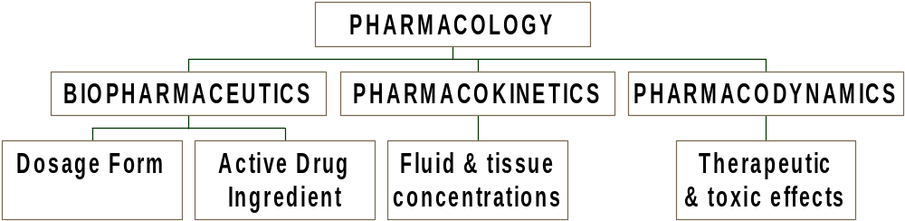
Interrelationships

Slide 9
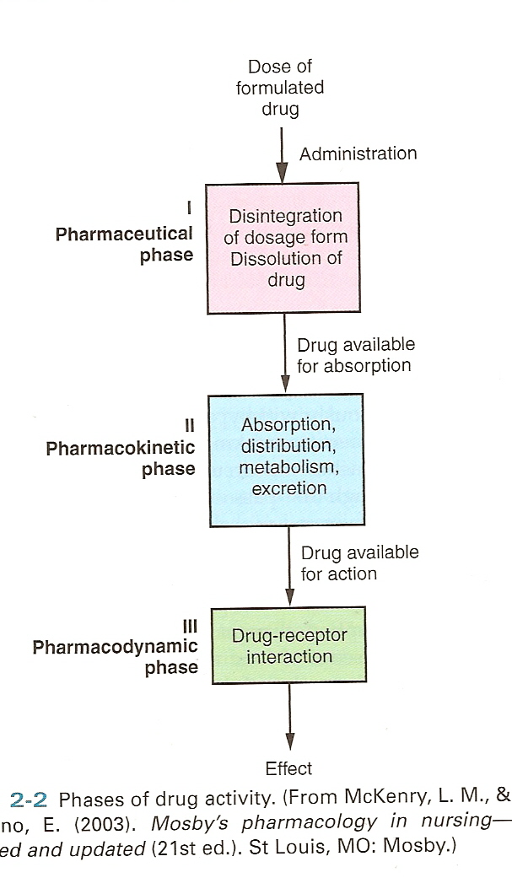
Phases of Drug Activity

Slide 10
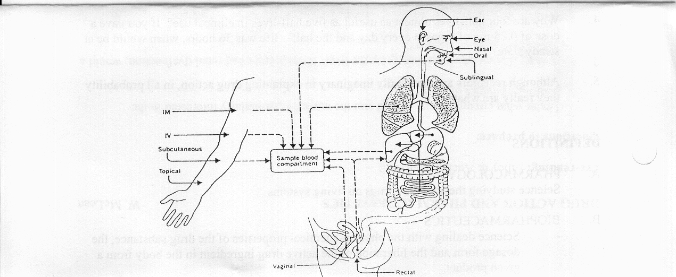
Routes of Administration

Slide 11
Biopharmaceutic Phase
Dosage form (or drug product)
  Pharmaceutical form containing the active ingredient(s)/ (drug(s)) and inert vehicle substances (excipients)
  necessary in formulating a medication of desired dosage, volume and application form, ready for administration.
Excipients:
  alcohol lactose
  dextrose colours
  starch stabilizers
  oils preservatives
  buffers and others

Slide 12
Biopharmaceutics Phase cont’d
RELEASE (liberation)
  Release of the drug from its dosage form, to produce a solution in body fluids in order to be available for absorption into cells and tissues.
  Controlling factors:
    pharmaceutical processing
    solubility (lipid VS water)
    degree of ionization (acidic VS basic)

Slide 13
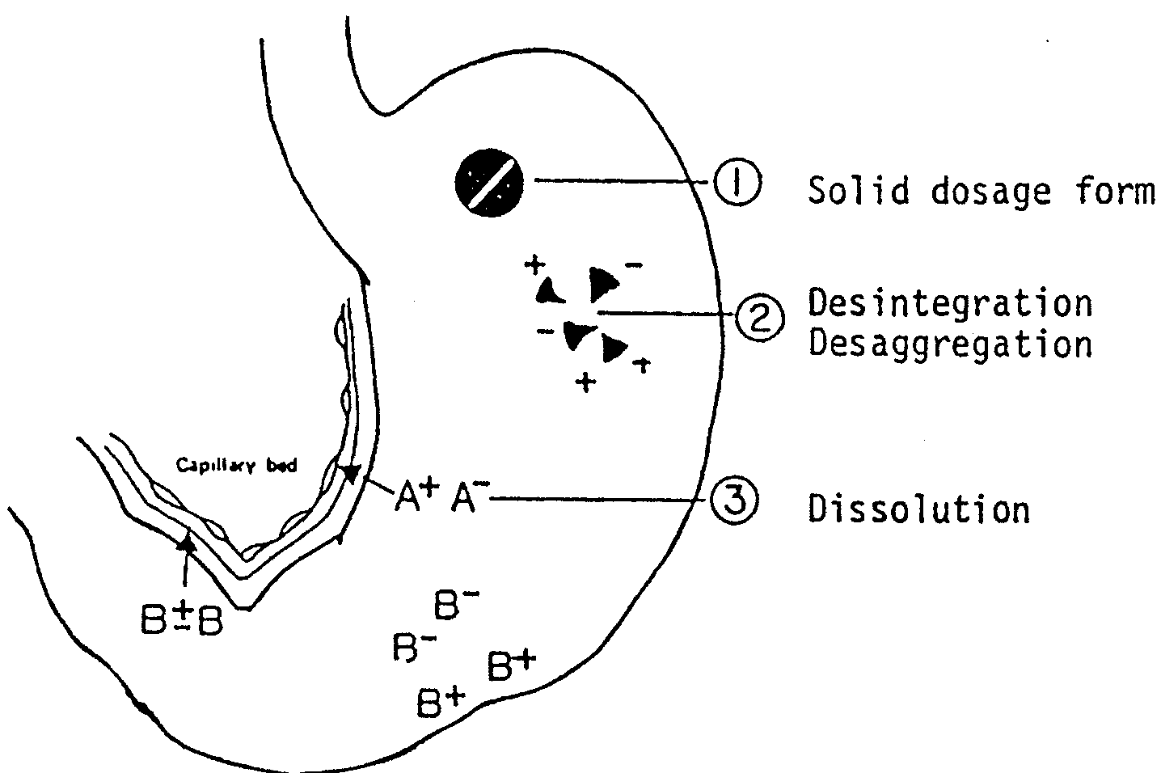
Disintegration & Dissolution

Slide 14
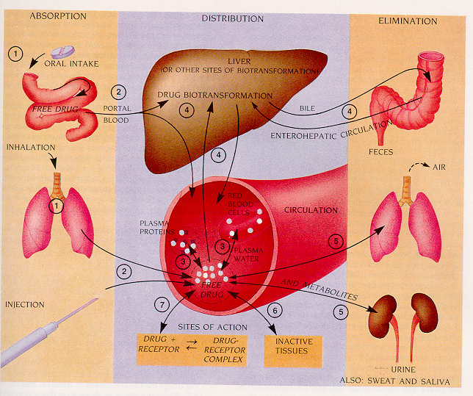
Pharmacokinetic (PK) Phases
-Absorption –Distribution –Metabolism -Elimination
Source: Kalant, Roschlau, Principles of MEDICAL PHARMACOLOGY

Slide 15
PK - Absorption Phase
Absorption
  Movement of the drug from the site of administration to the blood circulation.
Bioavailability
  Fraction of the dose which reaches the systemic circulation, upon extravascular administration.
  Extent and rate of absorption

Slide 16
Absorption cont’d
Controlling factors:
  contact time b/w the drug and the absorption site
    ex. diarrhea or vomiting: ⇑ or ⇓ GI motility due to other drugs
  competing reactions
    ex. interactions with food and drugs
  GI blood flow
    ex. ⇓ with heart failure

Slide 17
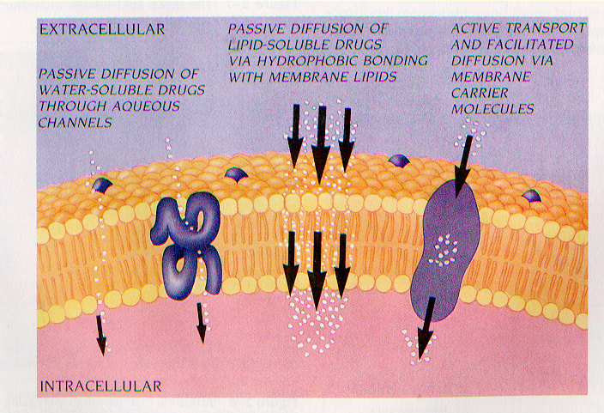
Absorption cont’d
Controlling factors cont’d:
  physico-chemical properties of the drug
    lipid soluble > water soluble,
    nonionized > ionized
Source: Kalant, Roschlau,
Principles of MEDICAL PHARMACOLOGY

Slide 18
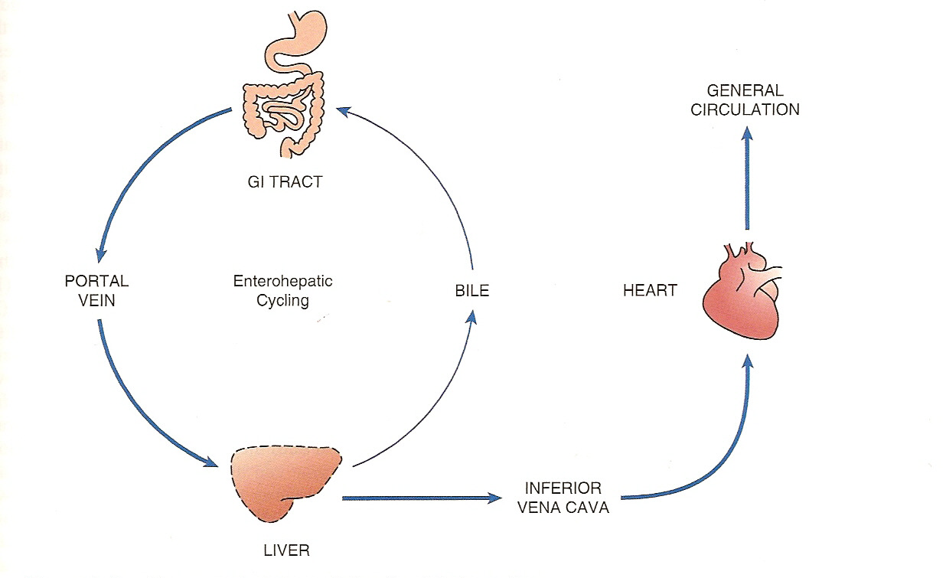
Absorption cont’d
First-pass effect:
  Metabolism (Destruction > Activation) of the drug after absorption, but before reaching the systemic circulation
    in the gut wall or in the liver
    upon oral or rectal administration

Slide 19
Absorption cont’d
Onset of action
  Time interval between administration of the dosage form and notation of the first therapeutic effects.
  Controlling factors:
    route of administration
    release of the drug
    extent and rate of absorption

Slide 20
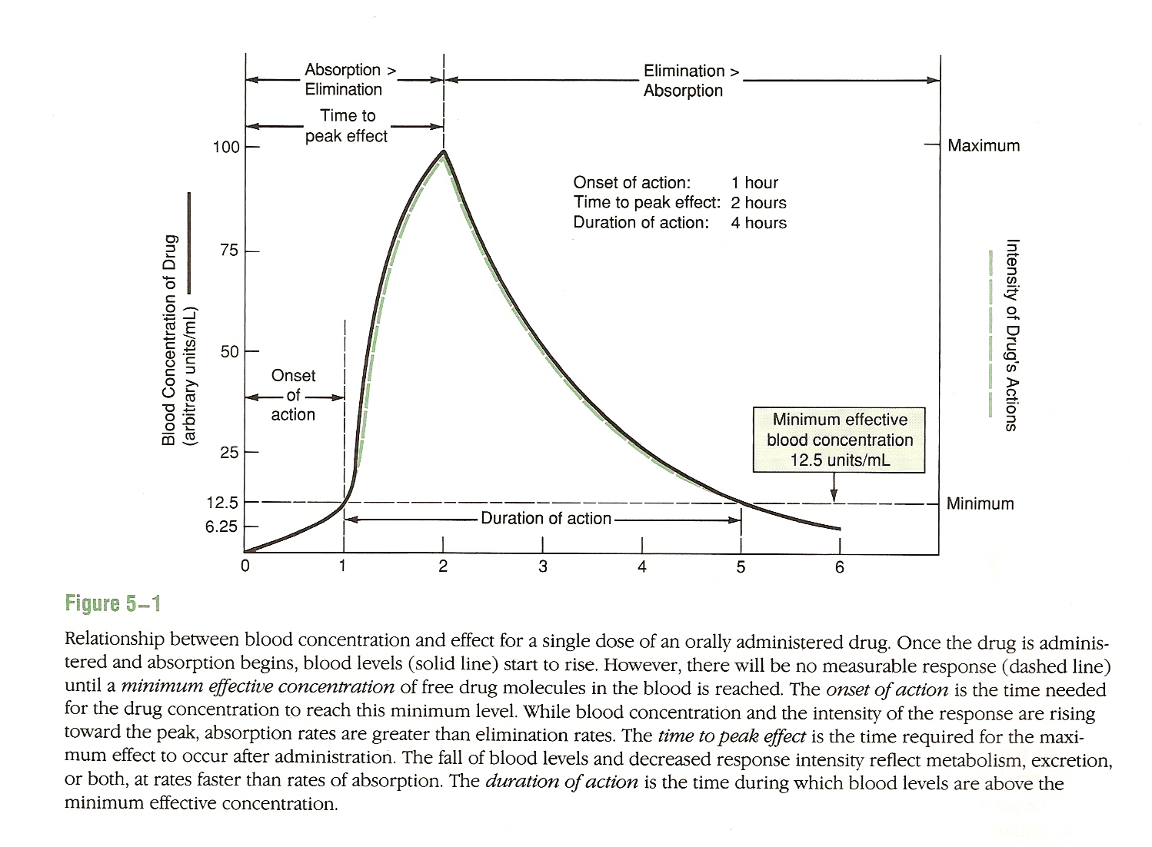
Relationship b/w Blood Concentration & Effect

Slide 21
PK - Distribution Phase
Controlling factors
  Blood flow rates in different tissues
  heart, liver, kidneys > > > bone, middle ear
  drug solubility (lipid VS water)
  drug ionization (acidic VS basic) and pH of different physiological fluids
  patient's body fat
  binding of the drug to plasma proteins (reversible)
  binding of the drug to tissue sites (reversible)

Slide 22
Distribution - special considerations
Protein-bound VS free-fraction available:
  pharmacological action, metabolism or excretion
Fat
  reservoir for storage of lipid soluble drugs
Breast milk
  Controlling factors:
    drug ionization between milk and blood
    amount of drug in maternal blood
    lipid solubility of the drug
Brain and placenta
  Presence of distribution barriers which allow the passage of lipid soluble drugs.

Slide 23
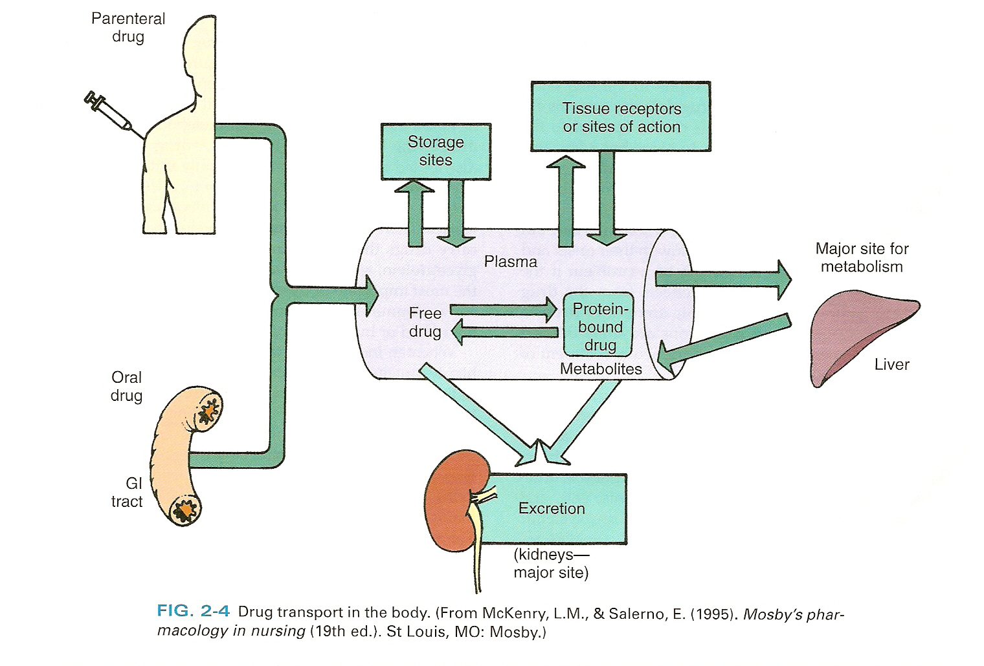
Distribution - Drug Transport

Slide 24
Metabolism phase
Chemical conversion of the drug to active or inactive compounds, often more water soluble for excretion. Primary mechanism of elimination for about 40% of drugs.
Sites of “biotransformation”:
  Major: liver
  Other: kidneys, lungs, blood, intestinal mucosa

Slide 25
Metabolism - reactions
Phase I: Non-synthetic.
  When the chemical structure of the drug is changed to produce an active or inactive compound (ex. oxidation, reduction, hydrolysis).
Phase II: Conjugation (or synthetic).
  When the drug combines with an endogenous substance to produce a soluble, compound
  (ex. alkylation, acetylation, methylation).
Notes:
All benzodiazepines are metabolized by the liver. However, some benzodiazepines (i.e. - lorazepam, oxazepam, and temazepam) do not go through cytochrome P450 metabolism (Phase I metabolism), and are only metabolized via glucuronidation (Phase II metabolism).

Slide 26
Metabolism Activity of metabolites
Most medications:
  no longer effective after they convert to metabolites
Small number of medications:
  active only after “biotransformation”
Effective both before and after biotransformation

Slide 27
Cytochrome P-450
Family of enzymes that:
  Metabolize different drugs
    « substrates »
  Can be turned off
    « inhibitors »
  Can be « revved up »
    « inducers »

Slide 28
P450 some examples
CYP3A4 Substrates | CYP3A4 Inhibitors | CYP2C9 Substrates | CYP2C9 Inhibitors
Some statins: Atorvastatin Lovastatin Simvastatin CCBs - All of them Some Benzos -diazepam -alprazolam -triazolam Others -sildenafil | Macolides -erythromycin -clarithromycin CCBs -verapamil -diltiazem Amiodarone Antiretrovirals -ritonavir -nelfinavir | Sulfonylureas S-warfarin Fluvastatin | SMX/TMP Metronidazole SSRIs -Fluoxetine -Fluvoxamine Fluconazole Amiodarone

Slide 29
Elimination phase
Elimination of the drug from the body
Routes:
  major: kidneys
  other: GI tract (feces, bile), lungs, saliva, sweat, breast milk

Slide 30
Elimination cont’d
(Elimination) Half-Life (T_{1/2})
Amount of time required to decrease the blood concentration of the parent drug by 50%
  Drug dependent
  Dose independent (with a few exceptions, ex. phenytoin, alcohol)
1 T_{1/2} : 50% of the drug has been excreted
2 T_{1/2} : 75%
3 T_{1/2} : 87.5%
4 T_{1/2} : 93.75%
5 T_{1/2} : 96.875%
6 T_{1/2} : 98.4375%
7 T_{1/2} : 99.21875%

Slide 31
Steady State & Accumulation
Drug accumulation:
  when a subsequent dose is administered before the previous one has been entirely eliminated
Steady state:
  with multiple dosing, it occurs when the
  rate of admin. = rate of elimination
  plateau of drug concentrations
  reached after 4-5 half-lives

Slide 32
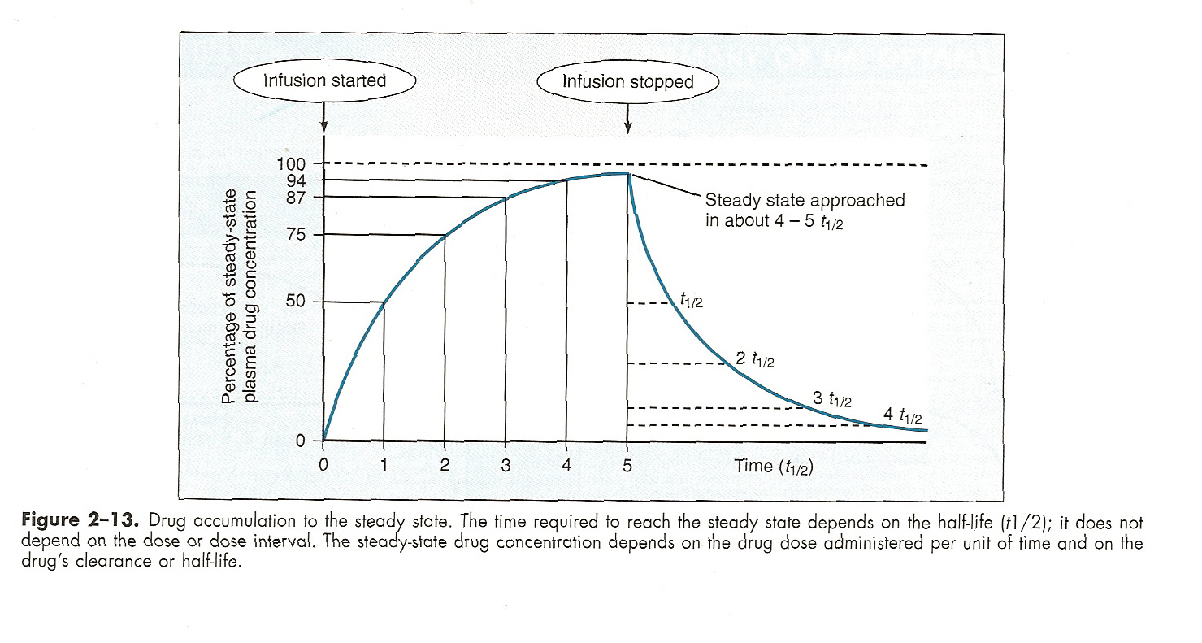
Drug Accumulation to Steady State

Slide 33
Drug Accumulation to Steady State
1 2 3 4 5 6 7
100
50
100
150
75
100
175
87,5
100
187,5
93,75
100
193,75
96,875
100
196,875
98,4375
100
198,4375
200
100
12.5
25
50

Slide 34
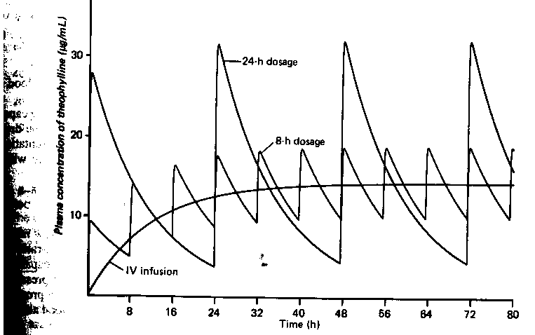
Drug Accumulation to Steady State
Source: Katzung, Basic and clinical pharmacology

Slide 35
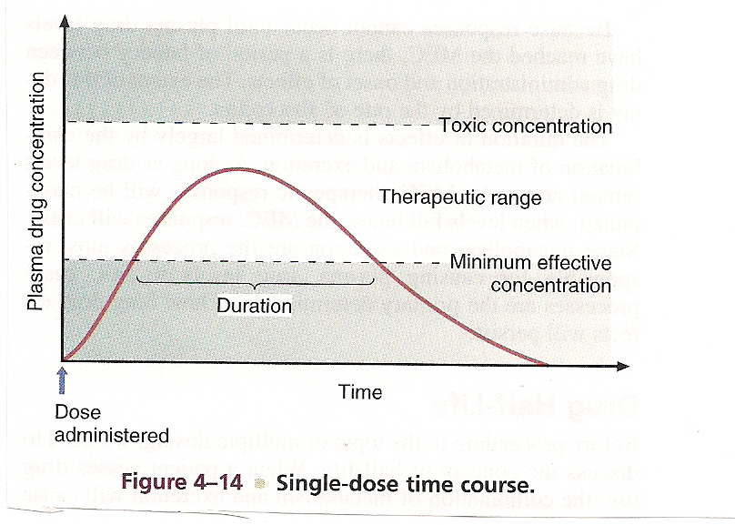
Therapeutic Range

Slide 36
Loading Doses
Clinical need:
  to attain effective blood levels quickly when drug has a long T1/2 & would take too long to reach steady state (4 T1/2’s)
So give a large dose (carefully!) to attain therapeutic range faster
Continue regular dosing which may maintain, increase or decrease level – check level

Slide 37
Drug Accumulation to Steady State with loading dose
1 2 3 4 5 6 7
200
100
100
200
100
100
200
100
100
200
100
100
200
100
100
200
100
100
200
200
100

Slide 38
Pharmacodynamics (PD)
A. ALTERATION OF CELL ENVIRONMENT
  Pharmacological action not directly dependent on the chemical structure of the drug
  Effects elicited by physico-chemical processes:
    Physical processes:
      alteration of surface tension (ex. stool softener)
      lubrication (ex. mineral oil)
      adsorption (ex. activated charcoal)
      others
    Chemical processes:
      inactivation,
      alteration of pH,
      alteration of body fluid

Slide 39
PD cont’d
B. ALTERATION OF CELL FUNCTION
  Pharmacological action directly dependent on the chemical structure of the drug
  Effects elicited by the drug attaching itself to a three-dimensional receptor

Slide 40
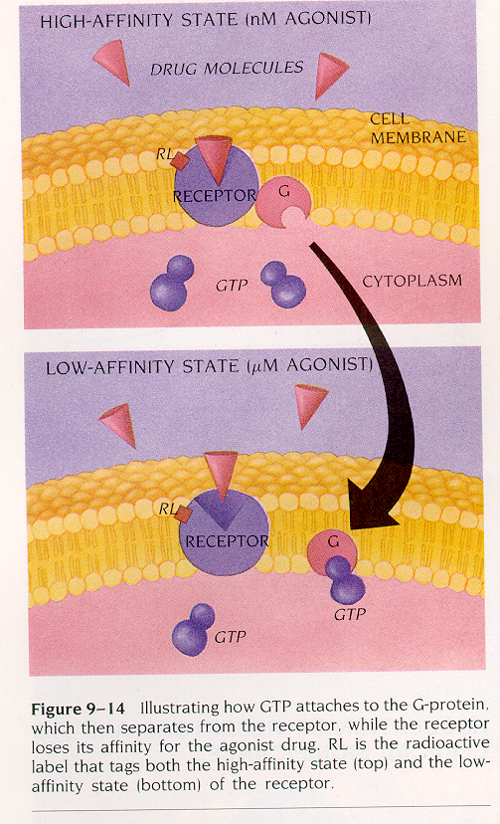
PD - Receptor theory
Receptor:
  portion of a cell or tissue to which a drug can bind, resulting in a particular effect
  nature: cellular proteins (most often, enzymes, lipids, others)
Affinity:
  tendency of the drug to combine with the receptor
Source: Kalant, Roschlau, Principles of MEDICAL PHARMACOLOGY

Slide 41
PD - Agonism vs. Antagonism
Agonism:
  when the drug has affinity for the receptor and generates a pharmacologic response
Antagonism:
  when the drug has affinity for the receptor, but does not result in pharmacologic response
    reversible or irreversible receptor binding

Slide 42
Alteration of PK & PD
A. DISEASE STATES
  Heart failure
    Decreased absorption (ex. digoxin)
    Reduced distribution (ex. digoxin)
    Reduced perfusion of:
      liver with decreased metabolism
      kidneys with decreased excretion
  Renal failure
    Decreased elimination of renally excreted drugs, with accumulation of parent compounds and active metabolites (ex. gentamicin, vancomycin, oxazepam, lorazepam)
  Liver failure
    Decreased metabolism of biotransformed drugs (ex. diazepam, cyclosporin)

Slide 43
Alteration of PK & PD cont’d
B. FOOD & DRUG INTERACTIONS
  Absorption
    Decreased / delayed / increased absorption by food
    Decreased absorption by another drug
  Distribution
    Displacement from proteins binding sites by another drug
  Metabolism
    Induction / inhibition of liver metabolism
  Elimination
    Increased / decreased renal excretion

Slide 44
Alteration of PK & PD cont’d
Additive effects:
    two drugs combined result is the sum of the individual effects
  A alone⇒1, B alone⇒ 1; A+B ⇒ 2
Synergistic effects:
    two drugs combined result is greater than the sum of both drugs’ individual effects
  A alone ⇒ 1, C alone ⇒ 1; A+C⇒ >2
Antagonistic:
    two drugs combined result is less than either active component alone
  A alone ⇒ 1, D alone ⇒ 1; A+D ⇒ <1

Slide 45
Other Factors altering PK and PD
Patient's age
Body temperature
Environment (ex. smoking)
Nutritional status and diet
Genetics
(Pharmacogenetics)
Circadian rhythm (Chronopharmacology)
Notes:
Cigarette smoking induces the activity of human cytochromes P450 (CYP) 1A2 and 2B6
It indicates the possible inhibition of CYP3A4 activities in smokers, which may cause slowed clearance and altered concentrations in plasma of drugs metabolized primarily by CYP3A4
Aldehyde dehydrogenase (ALDH) is one of the two enzymes primarily involved in alcohol metabolism. Several variants exist of the gene that produces ALDH. One of these gene variants, which generates a nonfunctional enzyme, is present in Asians but not in Caucasians and African-Americans.

Slide 46
Course Outline
Definitions
  Just a few
Biopharmaceutics
Pharmacokinetics (PK)
  Absorption
  Distribution
  Metabolism
  Elimination
Pharmacodynamics (PD)
Factors altering PK/PD

Slide 47

Questions

