Slide 1
Electrocoagulation
Overview

Slide 2
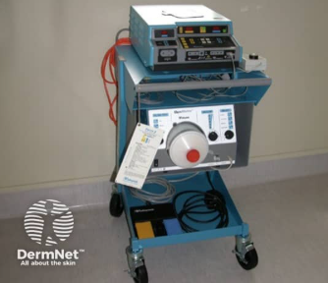
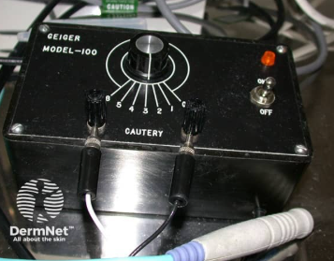
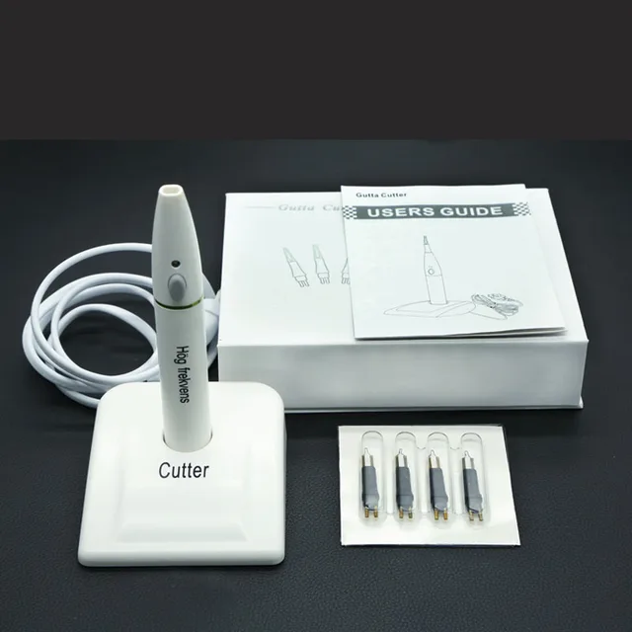
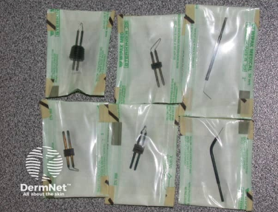
Electrocoagulation
Dermatological procedures- hemostasis or destruction of abnormal skin growths
monopolar or bipolar electrodes to produce low voltage and high-amperage current at low power

Slide 3
Indication
Superficial skin ablation: acrochordons (skin tag), actinic keratosis, small angiomas, epidermal nevus, seborrheic keratosis, verruca plana, or hemostasis for capillary bleeding
Deep skin ablation: angiofibromas, basal cell carcinoma, Bowen’s disease, squamous cell carcinoma, ingrown toenail matrixectomy, sebaceous hyperplasia, hemostasis from arterial bleeding, benign adnexal tumors (syringoma, trichoepithelioma), or verruca vulgaris

Slide 4
Contraindications
Infection at the treatment site
Not an absolute contraindication- electrosurgery in patients with cardiac pacemakers or implantable cardiac defibrillator (ICD) devices- flow of electrical can interfere with the functioning of these devices
Electrocautery-harmless to the fetus when used in the mother- reduce smoke plume exposure which can be mutagenic and carcinogenic

Slide 5
Preparation
Surrounding skin cleansed with an antiseptic agent (chlorhexidine or povidone-iodine)
Alcohol should be avoided or allowed to dry- can ignite with electrosurgery
Sterile sleeves are placed over the wand handle
New disposable electrode tips
Eye protection, gloves, and masks worn by operator

Slide 6
Technique
Procedure takes a few minutes
Apply current- heated filament/probe, which is gently touched to the skin
Heat cauterizes the tissue, destroying or coagulating the lesion or blood vessel
Post application- cleanse & antibiotic ointment prn

Slide 7
Complications
Delayed bleeding and scarring with hypopigmentation
Infection
Thermoelectric burns
Fire risk in presence of alcohol, oxygen, or bowel gases

Slide 8
Patient Information
Clean the affected area with cleansing solution and apply topical ointment twice daily if ordered
Scab may form- 5 - 14 days to drop off
Avoid excessive sun exposure- minimize hyperpigmentation

Slide 9
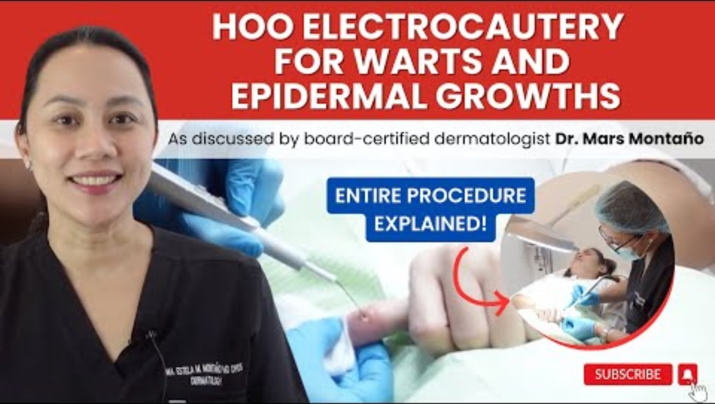
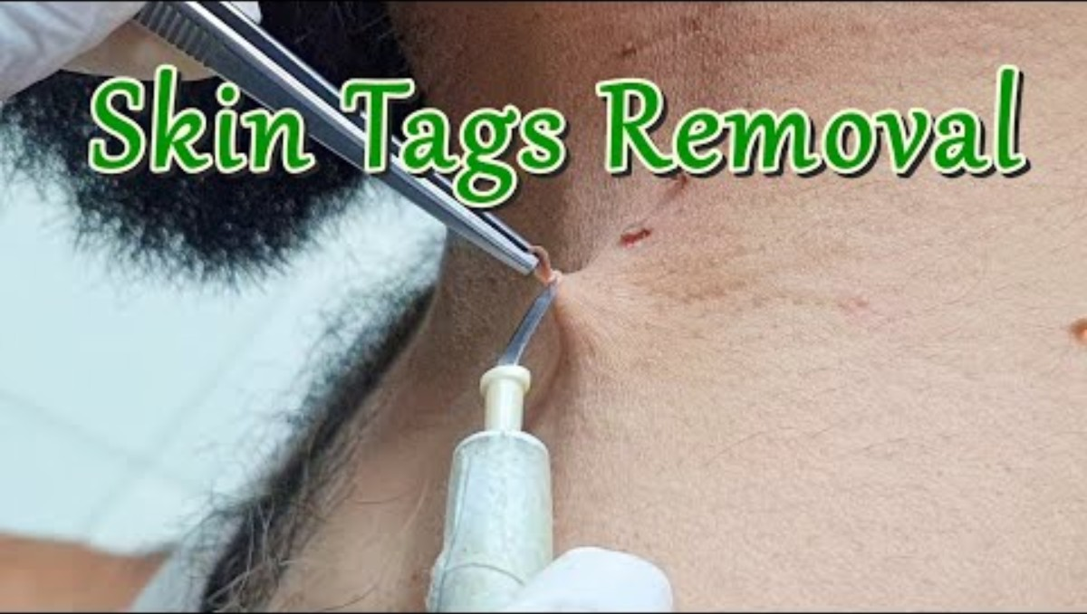
YouTube Videos
Wart Removal
Skin Tag Removal

Slide 10
References
Electrosurgery. DermNet. https://dermnetnz.org/topics/electrosurgery
Baigrie D, Qafiti FN, Buicko Lopez JL. Electrosurgery. [Updated 2023 May 22]. In: StatPearls [Internet]. Treasure Island (FL): StatPearls Publishing; 2025 Jan-. Available from: https://www.ncbi.nlm.nih.gov/books/NBK48238 0/
Garg, A. M., & Mysore, V. (2022). Dermatologic and Cosmetic Procedures in Pregnancy. Journal of cutaneous and aesthetic surgery, 15(2), 108–117. https://doi.org/10.4103/JCAS.JCAS_226_20

