Slide 1

Smart Office
Veridian Technologies
Zühlke, September 2026

Slide 2

Executive Summary
EXECUTIVE SUMMARY
Smart Office booking pilot for Veridian Technologies
Book it!
Use it or lose it.
  Our understanding of your situation
Veridian's Belgrade office (~200 employees, 150 desks, 30 parking spaces) loses usable space to no-shows and booking friction, and needs to prove the model before scaling to multiple offices and 5,000+ users.
  Our offer/solution
Three value-carrying features, already proven in a working two-day PoC: auto-release backed by hardware, booking via map or Teams/Slack, and an Agentic SDLC delivery model.
  Your benefits
  Stop paying for space nobody uses. Zero-friction booking through the channels employees already use. A governed, predictable delivery model that scales without a rewrite.
  Your investment
Phase 1 pilot: 138 person-days, €110,400 indicative, ~9–11 weeks. Full rollout scoped and priced after the pilot proves the model.
| 2

Slide 3
Client Challenge and Success
Priority problems, affected users, and how we'll measure success.
  Paid-for space, empty seats
  Booking is a chore
Desks and parking are booked but no-shows go unnoticed — nobody frees the space for someone who needs it. ~200 employees affected daily.
Grid-based booking tools add friction employees route around, from spreadsheets to sticky notes on desks.
  No real-time visibility
  Success is measured, not assumed
Facilities can't see who's actually in, so planning space and parking is a guess, not a fact.
The pilot tracks check-in rate, no-show release rate and time-to-book — real numbers before Veridian commits to full rollout.

Slide 4
Proposed Full Solution
SOLUTION
Book, check in, use, rebook
Resource booking
Map-based floor and parking picker, plus natural-language booking via Teams/Slack — same validated service, same guarantees, either way.
Check-in and auto-release
A no-show is caught and freed automatically at the deadline — backed by real sensors and LEDs, not a manual sweep. Our strongest differentiator.
Identity and governance
Microsoft Entra ID sign-in ties every action to a verified employee; every booking, check-in and release is audit-logged.
Administration and reporting
Office hours, deadlines and resource configuration, plus utilisation/no-show reporting — scoped for the phase after the pilot.
Multi-office and scale
Designed from day one for multiple offices and 5,000+ users — validated first on Veridian's Belgrade pilot site.

Slide 5
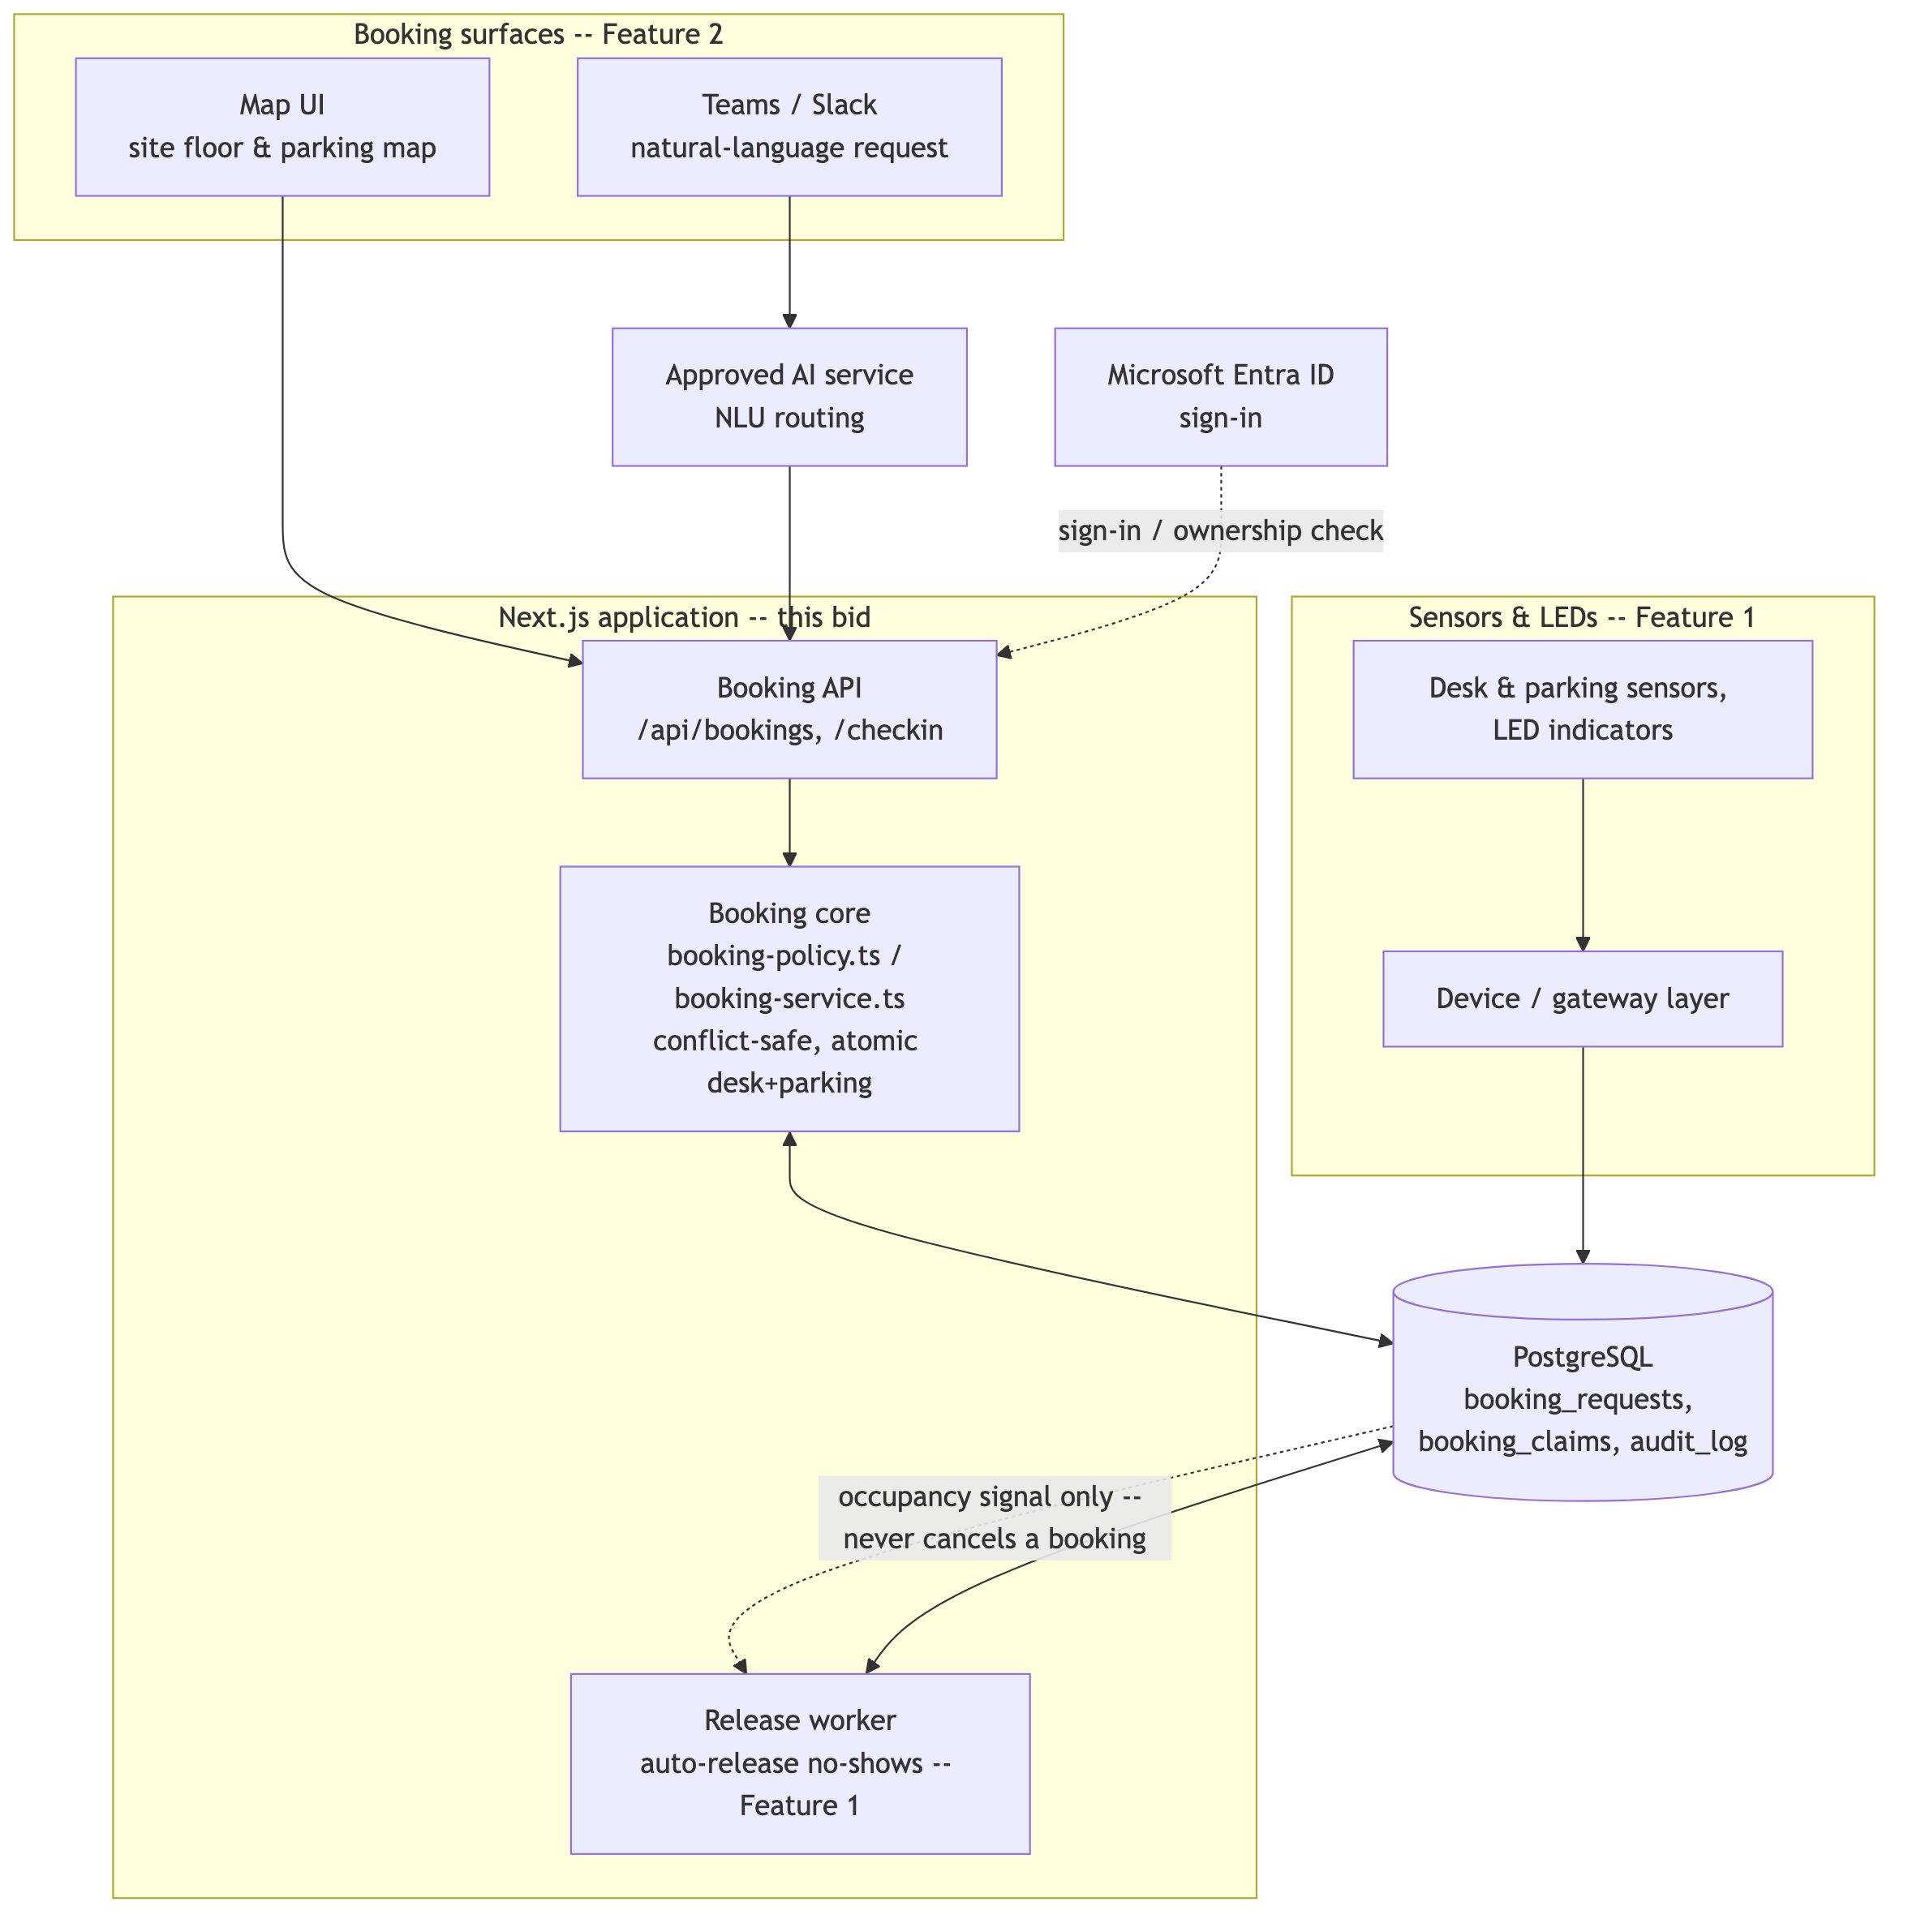
Architecture for Full Delivery
ARCHITECTURE
This bid's architecture, scoped to the pilot site and the three value-carrying features.
Data and integrations
PostgreSQL as system of record; Entra ID for identity; an approved AI service for the Teams/Slack channel; a device/gateway layer for sensors and LEDs, chosen through the pilot.
Security and privacy
Booking data reveals who sits where — treated as sensitive personal data, access scoped to the employee and admins. Only synthetic data used in build and demo.
Reliability (to validate in Discovery)
99.9% monthly availability, 15-minute recovery point, 4-hour recovery time — proposed targets, not yet load-tested.
Scale
Designed for multiple offices and 5,000+ users from one Belgrade pilot — proven at pilot scale first, then extended.
© Zühlke
2026

Slide 6
PoC Scope and Validation Goals
Two or three functionalities, chosen to test the riskiest assumption first.
  What we selected, and why
  What the PoC validates
Booking, check-in and automatic release (FR-03, FR-08, FR-09) — the one journey where conflict safety and the no-show problem meet. It's the highest-risk, highest-value assumption in the whole proposal: does automatic release actually hold under real booking pressure?
Database-enforced conflict safety holds under concurrent requests; a combined desk+parking booking succeeds or fails as one unit; a check-in deadline reliably triggers automatic release and instant rebooking — proven in a working system, not a diagram.

Slide 7
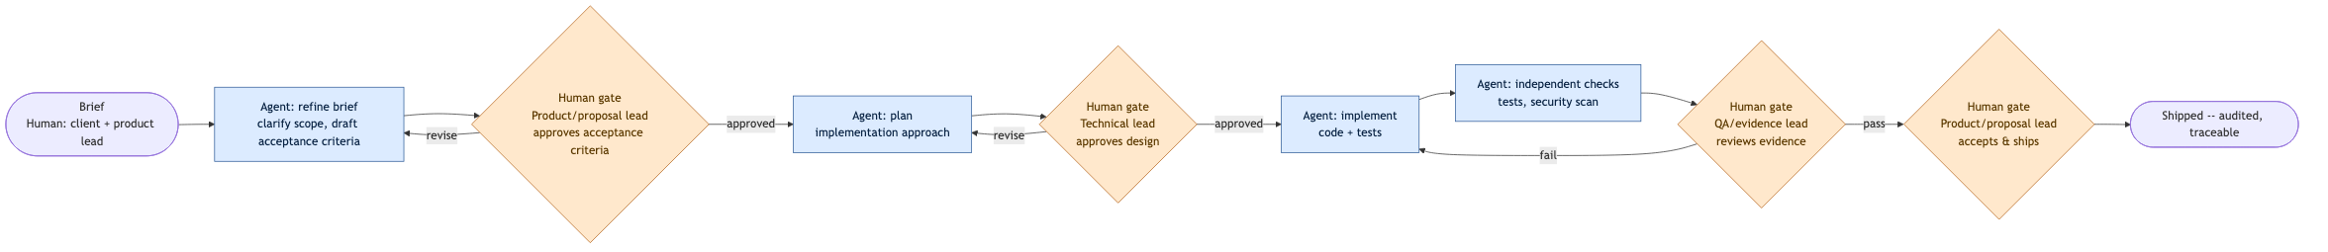
PoC Results, SDLC and Learnings
What we built, the Agentic SDLC used to build it, and what we learned.
  Working results: combined desk+parking booking (atomic); conflict-safe by database design, not application code; ownership-checked, idempotent check-in; automatic no-show release with a full audit trail — all running today, not mocked.
  Key decisions
  Three written decision records (half-day policy, specific-resource map picker, three-feature bid scope) kept the team aligned without slowing down — each one traceable in the repository.
  Biggest lesson
  Database constraints, not application code, are what make “conflict-safe” a guarantee instead of a hope — the agent proposed it, a human approved it as the load-bearing design decision.
SDLC used for the PoC

Slide 8
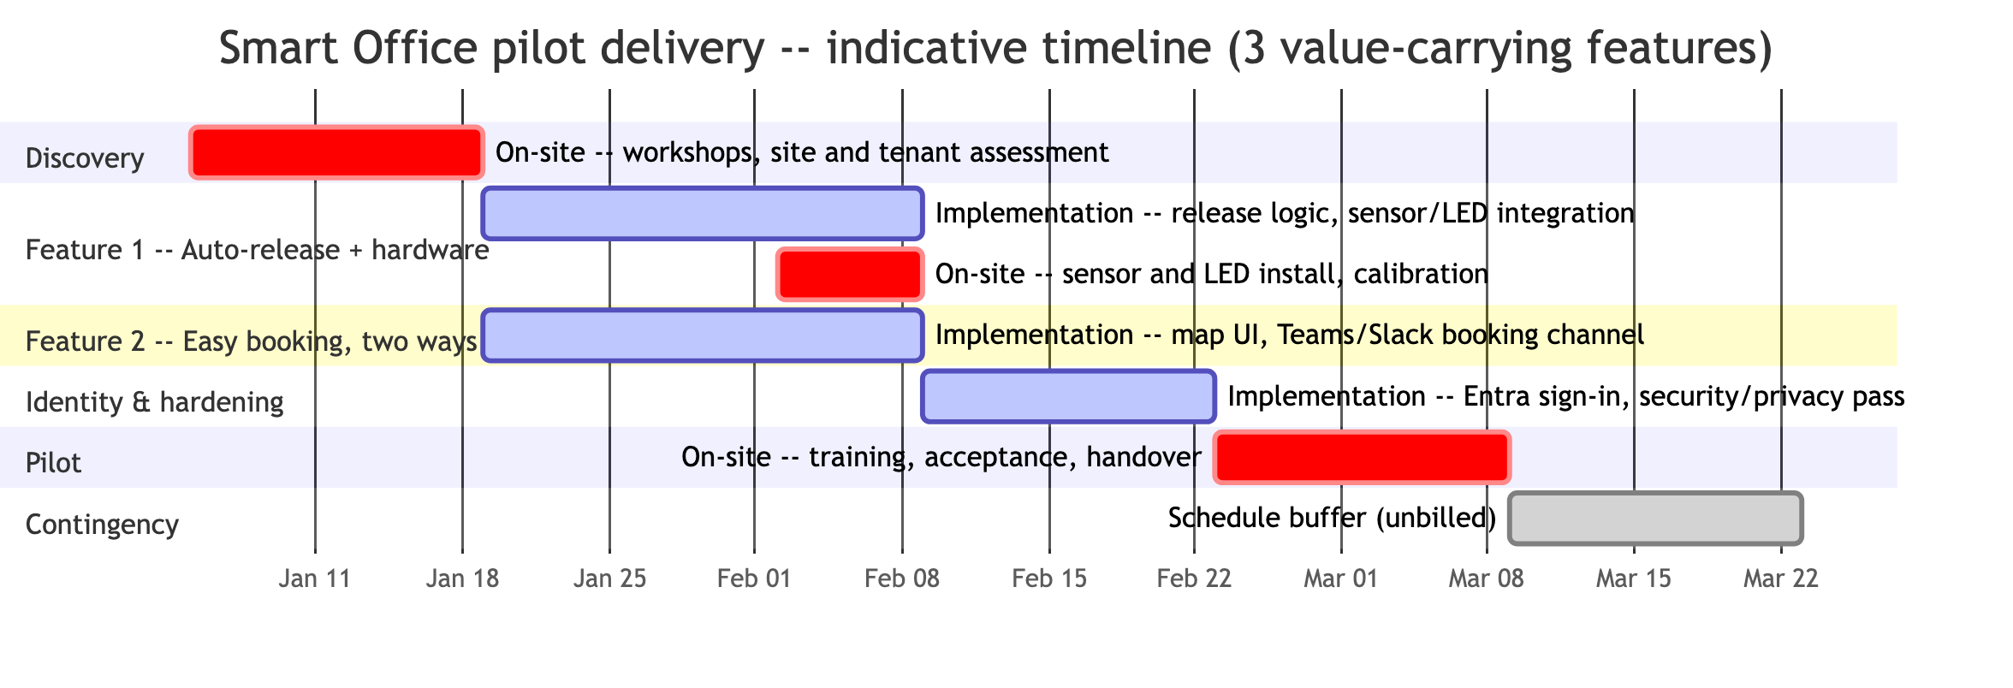
Roadmap and Team
Delivery phases, governance (phase-gate steering and acceptance review), and the team behind them.
Marija Fajht
Product/proposal lead
Milan Mirkovic
Technical lead
Vladimir Mihailovic
Frontend engineer
Petar Scepanovic
Backend engineer
Joze Vodnik
QA/evidence lead
Marko Simic
Platform/integration engineer
Governance: A joint steering point at the end of each phase, client reviewing acceptance evidence before the next phase's budget is released. Client involvement: office hours/policy input in Discovery, design approval, phase-gate acceptance.

Slide 9

Commercial Proposal
Person-days, duration and price for the Phase 1 pilot — the three value-carrying features.
Phase | Team engaged | Time period | Estimated PD | Team Daily Rate | Estimated investment
Discovery | Product/proposal lead + Technical lead | Weeks 1–2 | 20
Auto-release + hardware | Backend + Platform engineer | Weeks 3–5 | 30 | €800 | €24,000
Easy booking, two ways | Frontend + Technical lead | Weeks 3–5 | 25 | €800 | €20,000
Identity and hardening | Backend + QA/evidence lead | Weeks 6–7 | 20 | €800 | €16,000
Pilot | Product/proposal lead + QA/evidence lead | Weeks 8–9 | 20
Base total |  | ~9 weeks | 115 | €800 | €92,000
+20% contingency (23 PD, €18,400) = 138 PD, €110,400 indicative envelope, ~9–11 weeks.
Third-party, shown separately: cloud hosting €600–1,200/month; desk/parking sensors, LEDs, gateways and installation for up to 150 desk and 30 parking sensor points (supplier quote required); AI service consumption once usage patterns are known.
Phase 2+ (administration, audit/reporting, multi-office rollout) is scoped and priced in Discovery once the pilot validates the model.

Slide 10

Risks, Assumptions and Next Steps
Recommended next step: confirm the half-day policy decision and kick off a two-week, on-site Discovery.
  Half-day policy still pending a written decision
Risk: scope and price could shift. Mitigation: the full-day-only fallback is already priced (134 PD, €107,200) — confirm with the facilitator in week 1.
  External dependencies pace the calendar, not the price
Risk: Entra tenant and sensor vendor lead times can stretch the 9–11 week timeline. Mitigation: confirmed in Discovery; on-site work is billed, waiting isn't.
  Bottom-up estimate needs delivery-team validation
Risk: headcount-per-feature assumptions are indicative. Mitigation: revisit with the actual delivery team before a fixed-price commitment.
  Hardware and AI consumption costs aren't in this number yet
Risk: total cost unclear until quoted. Mitigation: sensor/LED bill of quantities and AI usage patterns both requested during Discovery.
2026
© Zühlke

