Slide 1
HW Support for Shared Memory
Cache Coherence
  Caches + multiprocessers → stale values
  System must behave as if caches are not present
  Cache coherence is implementation that ensures this via:
    Write propagation
    Write serialization
Memory Consistency
  When (in what order) should writes propagate?
  What value should a read return?
  Memory consistency is a specification.
Primitive synchronization instructions
  Certain hardware instructions are extremely useful/required for achieving synchronisation
  Memory fences: memory ordering on demand
  Read-Modify-writes: support for locks (critical sections)
  Transactional memory extensions
CS/ECE 6810 Computer Architecture

Slide 2
Lect. 5: Memory Consistency
Consider the following code:
  What are the possible outcomes? (assuming caches are coherent)
P1
P2
P3
initialization
A=0, B=0, C=0;
…
C = 1;
A = 1;
while (A==0);
B = 1;
while (B==0);
print A, C;
parallel
CS/ECE 6810 Computer Architecture

Slide 3
Lect. 5: Memory Consistency
Consider the following code:
P1
P2
P3
initialization
A=0, B=0, C=0;
…
C = 1;
A = 1;
while (A==0);
B = 1;
while (B==0);
print A, C;
parallel
A==1, C==1?
A==0, C==1?
A==0, C==0?
A==1, C==0?
Yes. This is what one would expect.
Yes. If st to B overtakes the st to A on the interconnect toward P3.
Yes. If the st to A overtakes the st to C from the same processor.
CS/ECE 6810 Computer Architecture
Notes:
If A = 0 is observable it is a violation of multi-copy atomicity. Why? Because it means that A was observed by P2 but later (in logical time), was not observed by P3.

Slide 4
Memory Consistency
Cache coherence:
  Makes caches invisible
  But does not guarantee ordering of loads and stores to different addresses in general.
Memory consistency:
  Specifies the ordering of loads and stores to different memory locations
  Defined in so called Memory Consistency Models
  Note that the memory consistency model is part of the ISA specification.
  Languages also have a memory model. Compiler enforces the language memory model leveraging the ISA consistency model.
Cache coherence is a component of memory consistency enforcement. Memory consistency is specification. Cache coherence is part of the implementation.
CS/ECE 6810 Computer Architecture

Slide 5
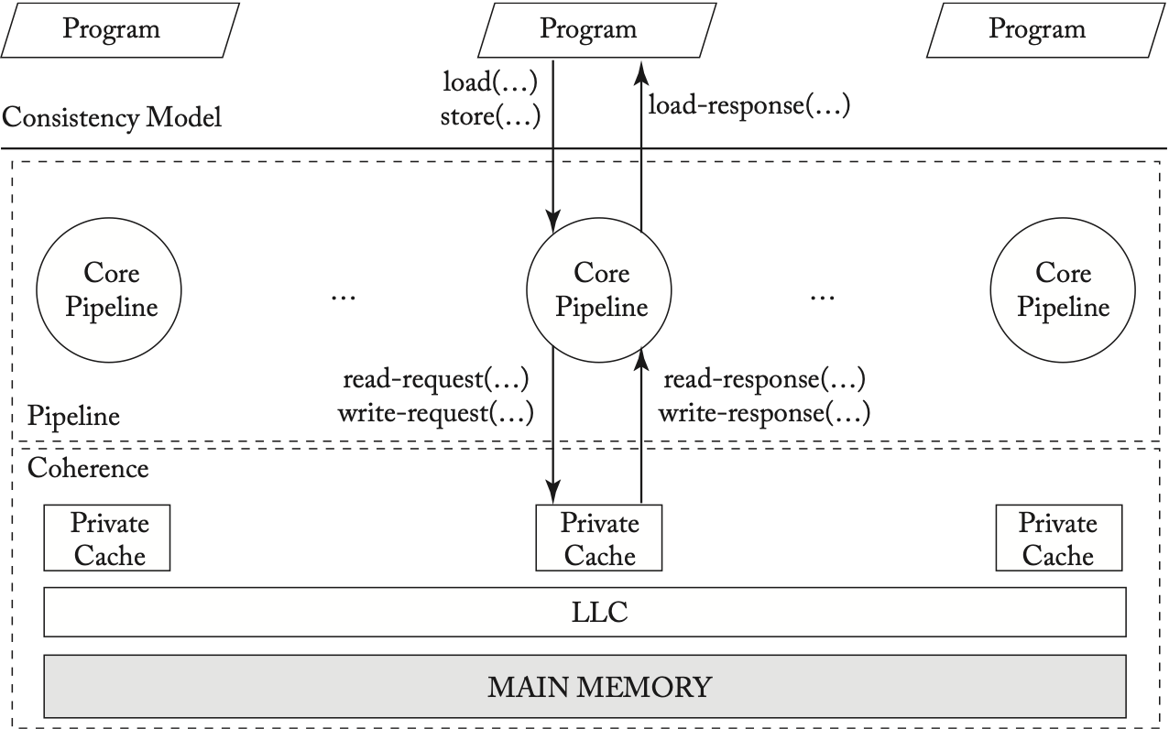
Memory Consistency vs Coherence

Slide 6
Sequential Consistency (SC)
A multiprocessor system is sequentially consistent if the result of any execution is
the same as if the operations of all the processors were executed in some sequential order, and the operations of each individual processor appear in this sequence in the order specified by its program.
[Lamport 78]
CS/ECE 6810 Computer Architecture

Slide 7
Sequential Consistency (SC)
Key ideas:
  The behaviour should be the same as in a time-shared multiprocessor
  Two aspects:
    Program order: memory ordering has to follow the individual order in each thread
    (R→R, R→W, W→W, W→R)
    Write-atomicity: there can be any interleaving of such sequential segments - but a single total order of all memory operations
  Notice that in practice many orderings are still valid
P0
P1
Pn
Memory
CS/ECE 6810 Computer Architecture

Slide 8
Example: Sequential Consistency
P1
P2
initialization
Some valid SC orderings:
P3
A=0, B=0, C=0;
…
C = 1;
A = 1;
while (A==0);
B = 1;
while (B==0);
print A;
parallel
P1: st C # C=1
P1: st A # A=1
P2: ld A # while
P2: st B # B=1
P3: ld B # while
P3: ld A # print
P1: st C # C=1
P2: ld A # while
…
P1: st A # A=1
P2: ld A # while
P2: st B # B=1
P3: ld B # while
P3: ld A # print
P1: st C # C=1
P2: ld A # while
…
P1: st A # A=1
P2: ld A # while
P3: ld B # while
…
P2: st B # B=1
P3: ld B # while
P3: ld A # print
CS/ECE 6810 Computer Architecture
Notes:
With SC, the final print of A will have to print 1.

Slide 9
Is this ordering SC?
P1
P2
P3
initialization
A=0, B=0, C=0;
…
C = 1;
A = 1;
while (A==0);
B = 1;
while (B==0);
print A;
parallel
P1: st A # A=1
P1: st C # C=1
P2: ld A # while
P2: st B # B=1
P3: ld B # while
P3: ld A # print
CS/ECE 6810 Computer Architecture

Slide 10
Is this ordering SC? Yes!
P1
P2
P3
initialization
A=0, B=0, C=0;
…
C = 1;
A = 1;
while (A==0);
B = 1;
while (B==0);
print A;
parallel
The values returned by the reads of the execution on the left matches that of the SC execution on the right!
P1: st A # A=1
P1: st C # C=1
P2: ld A # while
P2: st B # B=1
P3: ld B # while
P3: ld A # print
P1: st C # C=1
P1: st A # A=1
P2: ld A # while
P2: st B # B=1
P3: ld B # while
P3: ld A # print
CS/ECE 6810 Computer Architecture

Slide 11
Terminology
Issue: memory operation leaves the processor and becomes visible to the memory subsystem
Performed: memory operation appears to have taken place
  Performed w.r.t. processor X: as far as processor X can tell
    E.g., a store S by processor Y to variable A is performed w.r.t. processor X if a subsequent load by X to A returns the value of S (or the value of a store later than S, but never a value older than that of S)
    E.g., a load L is performed w.r.t. processor X if all subsequent stores from processor X cannot affect the value returned by L
  Globally performed or complete: performed w.r.t. to all processors
    E.g., a store S by processor Y to variable A is globally performed if any subsequent load by any processor to A returns the value of S
X consistent execution: result of any execution that matches one of the possible total orders (interleavings) as defined by model X
  “Result of an execution”: Values returned by the reads
CS/ECE 6810 Computer Architecture

Slide 12
Sequential Consistency (SC)
Sufficient conditions
  1. Threads issue memory operations in program order
  2. Before issuing next memory operation threads wait until last issued memory operation completes (i.e., performs w.r.t. all other processors)
  3. A read is allowed to complete only if the matching write (i.e., the one whose value is returned to the read) also completes
Notes:
  Condition 2 guarantees program ordering
  Condition 3 guarantees write atomicity
  These conditions are easily violated in real hardware and compilers (e.g., write buffers in hdw. and ld-st scheduling in compiler)
  In practice necessary conditions may be more relaxed
CS/ECE 6810 Computer Architecture

Slide 13
Write-Serialization vs Write-Atomicity
// Initially all values are 0.
P1 P2 P3 P4
X= 1 X=2
=X(1) =X(2)
=X(2) =X(1)
P1 P2 P3 P4
X= 1 Y=1
=X(1) =Y(1)
=Y(0) =X(0)
Violation of
Write-serialization
Violation of
Write-atomicity
CS/ECE 6810 Computer Architecture

Slide 14
How SC can be violated
Initially flag1 = flag2 = 0
P1
P2
flag1 = 1
if(flag2 == 0)
{
/* critical*/
}
flag2 = 1
if(flag1 == 0)
{
/* critical*/
}
If write-buffering is used each processor can buffer the writes
(to flag1 and flag2 resp.) and go ahead with the reads. This will
cause both reads (flag1 and flag2) to return 0, causing both P1 and P2 to enter critical section.
CS/ECE 6810 Computer Architecture

Slide 15
Efficient SC: In-window Speculation
Using speculation (for optimizing W→R, R→R)
  The later read can be issued earlier
  But memory operations complete in program order
  If an invalidate is received, speculation squashed and replayed starting from the (later) load
Write-prefetching (for optimizing W→W)
  Obtain read-exclusive out-of-order (or in parallel)
  Complete writes in program order.
CS/ECE 6810 Computer Architecture

Slide 16
Efficient SC: In-window Speculation
P1
ld x
ld y
- Load y allowed to execute before load x
- But they commit in order
- Before load y commits, if address y receives an invalidation message, speculation squashed starting from load y and retried.
CS/ECE 6810 Computer Architecture

Slide 17
Efficient SC: In-window Speculation
P1
St x
St y
Store x and Store y issued to the directory in parallel, where they execute in parallel (i.e., send invalidations, gather acknowledgements)
But in the cache, the value of x is written and made visisble to other processors before the write to y
CS/ECE 6810 Computer Architecture

Slide 18
Relaxed Memory Consistency Models
At a high level they relax ordering constraints between pairs of reads, writes, and read-write (e.g., reads are allowed to bypass writes, writes are allowed to bypass each other)
Some of the models also don’t guarantee write atomicity
Some models make synchronization explicit and different from normal loads and stores
Many models have been proposed and implemented
  Total Store Ordering (TSO) (e.g., Sparc, intel): relaxes W—>R ordering
  Partial Store Ordering (PSO) (e.g., Sparc): relaxes W—>R and W —>W
  Relaxed Memory Ordering (RMO) (e.g., Sparc): relaxes all 4 memory orders
  Release Consistency (RC) (e.g RISC-V): relaxes all 4 memory orders but provides release store and acquire load (ARM v8 has a similar model).
  IBM Power/NVIDIA PTX: relaxes all 4 memory orderings; also relaxes write atomicity; provides 2 types of barriers.
    lwsync: ensures R—>R , R—>W, and W—>W; write-atomicity still not ensured
    sync: ensures all 4 memory ordering; write atomicity also ensured.

Slide 19
Relaxed Memory Consistency Models
Note that every relaxed consistency model ensure single-thread dependencies.
  P1
  X = 2
  r1 = X
  (r1 always reads 1 irrespective of the memory model)
CS/ECE 6810 Computer Architecture

Slide 20
Relaxed Memory Consistency Models
  Whether these single threaded dependencies induce a global ordering is a different matter!!!
  Relaxed memory models have complex rules regarding that!
  We will come back to this in a couple of slides
CS/ECE 6810 Computer Architecture

Slide 21
Example: Total Store Ordering (TSO)
Reads are allowed to bypass writes (can hide write latency)
Still makes prior example work as expected,
but breaks some intuitive assumptions,
P1
P2
…
data = 1;
flag = 1;
while (flag==0);
Print data;
P1
P2
SC guarantees that A==0 and B==0 will never be printed
…
A = 1;
Print B;
B = 1;
Print A;
TSO allows it if ld B (P1) overtakes st A (P1) and ld A (P2) overtakes st B (P2)
CS/ECE 6810 Computer Architecture

Slide 22
TSO Examples
  //Initially x = 0
  P1.
  X = 1
  r1 = X
  Can r1 ever be 0? No!
  //Initially X = Y =0
  P1. P2
  X =1. Y = 1
  r1 = X r3 = Y
  r2 = Y. r4 = X
  What values do r1 and r3 read? (they have to read 1)
  Can both r2 and r4 = 0? (Yes, according to TSO)
CS/ECE 6810 Computer Architecture

Slide 23
Example: Release Consistency (RC)
Reads and writes are allowed to bypass both reads and writes (i.e., any order that satisfies control flow and data flow is allowed)
Assumes explicit synchronization operations: acquire and release So, for correct operation, our example must become:
Constraints
  All previous writes (and previous reads) must complete before a release can complete
  No subsequent reads (and subsequent writes) can complete before a previous acquire completes
  All synchronization operations must be sequentially consistent (i.e., follow the rules for SC, where an acquire is equivalent to a read and a release is equivalent to a write)
P1
P2
…
data = 1;
Release:flag=1;
Acquire:while (!flag);
Print data;
CS/ECE 6810 Computer Architecture

Slide 24
Example: Release Consistency (RC)
Example: original program order
Allowable overlaps
  Reads and writes from block 1 can appear after the acquire
  Reads and writes from block 3 can appear before the release
  Between acquire and release any order is valid in block 2 (and also 1 and 3)
Note that despite the many reorderings, this still matches our intuition of critical sections
Acquire
P1
Read/write
…
Read/write
Read/write
…
Read/write
Read/write
…
Read/write
1
2
3
Read/write
…
Read/write
1
Release
Acquire
Read/write
…
Read/write
2
Release
Read/write
…
Read/write
3
CS/ECE 6810 Computer Architecture

Slide 25
RC example: control dependency.
  //Initially X = Y =0
  P1. P2
  X =1. r1 = Y//reads 1
  Rel Y = 1 if(r1 ==1)
  r2 = X //reads 0?
CS/ECE 6810 Computer Architecture

Slide 26
RC example: control dependency.
  //Initially X = Y =0
  P1. P2
  X =1. r1 = Y//reads 1
  Rel Y = 1 if(r1 ==1)
  r2 = X //reads 0?
  Possible with RISC-V and ARM!!!
CS/ECE 6810 Computer Architecture

Slide 27
RC example: address dependency.
  //Initially X = Y =0, assume address of X = 0xffff
  P1. P2
  X =1. r1 = Y. //
  Rel Y = 0xffff r2 = *(r1) // reads 0?
CS/ECE 6810 Computer Architecture

Slide 28
RC example: address dependency.
  //Initially X = Y =0, assume address of X = 0xffff
  P1. P2
  X =1. r1 = Y. //
  Rel Y = 0xffff r2 = *(r1) // reads 0?
  No, according to RISC-V and ARM!
CS/ECE 6810 Computer Architecture

Slide 29
Implementing RC
RC with writer-initiated invalidations:
  Writes retire into write buffer (and could complete out of order)
  Reads maybe be issued out-of-order (and may complete out of order, although in practice they processors commit in order.)
  Note: Invalidates need not snoop LSQ
  A release drains the write-buffer
  All loads following an acquire are issued after the acquire.
Question: Must writes invalidate shared copies?
CS/ECE 6810 Computer Architecture

Slide 30
Implementing RC
Writes without writer-initiated invalidations
  Writes retire into write buffer
    (and complete out of order)
    But only written to the local cache – no eager invalidates.
  A release writes all dirty blocks (including the release write) in the local cache into coherent lower-level cache (memory)
  Reads maybe be issued out-of-order (but completed in inorder)
  Upon an acquire the acquire load is forced to miss the local cache and then all valid blocks self-invalidated
CS/ECE 6810 Computer Architecture

Slide 31
Implementing RC
P1
P2
…
data = 1;
Release:flag=1;
Acquire:while (!flag);
Print data;
Upon release, write buffer flushed to lower level cache
Upon acquire, local cache invalidated
CS/ECE 6810 Computer Architecture

Slide 32
RC using self-invalidations:
Does not require a sharer vector
Would still benefit from local/shared tracking
  Local data need not be written to the lower-level upon a release
  Local data need not be self-invalidated upon an acquire
  Could use the directory to track this or even the TLB. (How)?
Aside: Is the cache still coherent?
CS/ECE 6810 Computer Architecture

Slide 33
RC using self-invalidations:
Does not require a sharer vector
Would still benefit from local/shared tracking
  Local data need not be written to the lower-level upon a release
  Local data need not be self-invalidated upon an acquire
  Could use the directory to track this or even the TLB. (How)?
Aside: Is the cache still coherent?
  Yes: guarantees write serialization and write propagation
CS/ECE 6810 Computer Architecture

Slide 34
Do consistency models matter?
Not a lot of people write parallel programs using assembly!
  Use synchronization libraries mainly: locks, barriers etc.
Matters to expert programmers though who want performance
  Systems programmers (OS writers, compiler writers)
  Certain application programmers
Even they don’t program in assembly – Languages have consistency models

Slide 35
Language based consistency models
Abstraction over the ISA
Typically, a relaxed consistency model – a variant of release consistency
  Release, acquire, different types of fences and RMWs
  Lack store atomicity
Compiler implements the language model
One problem: the “out of thin air problem”

Slide 36
Out of Thin Air
Initially X = Y = 0
P1 P2
r1 = X r2 = Y
Y = r1 X = r2
Can r1 = r2 = 42?
Notes:
Languages specification might allow this. Why?
Ld → St ordering is not enforced.
Compiler might speculate the first load reads 42, then store Y=42, and after operations from P2 have performed, the prediction becomes true.

Slide 37
Out of Thin Air
Initially X = Y = 0
P1 P2
r1 = X r2 = Y
Y = r1 X = r2
Can r1 = r2 = 42?
Notes:
Note that this litmus test result should be allowed, and is allowed by some hardware : e.g., Power.

Slide 38
But wait…why don’t ISA memory model have this problem?
Because none of the hardware models allow this
Initially X = Y = 0
P1 P2
r1 = X r2 = Y
Y = r1 X = r2
Can r1 = r2 = 42? No!
Notes:
Because hardware memory models honor syntactic dependencies. The moment there is a syntactic dependency between a load and store the two operations are ordered.

Slide 39
Case study: RISC-V memory model
https://courses.cs.washington.edu/courses/csep551/19au/readings/riscv-base.pdf

Slide 40
Case-study: RISC-V memory model

Slide 41
Case-study: RISC-V memory model

