Slide 1
Dev preparation
Go to sharepoint admin and set up Application catalog site. With it we distribute apps (add ins) for Sharepoint
Sharepoint admin ->More feature ->Apps open->Upload to upload your app
Prerequisites
Node js
Yarn – as it is faster then npm
Npm
Yeoman ->globally
Gulp ->globally –this is a task runner that automate tasks
Npm install –g yo gulp
Install spfx Yeaoman generator locally ->dev znachi v dev dependencitata
npm install @microsoft/generator-sharepoint --save-dev
or
Install spfx Yeaoman generator globally
npm install @microsoft/generator-sharepoint --global --save-dev
Gulp trust-dev-cert
Use yarn to install project dependencies with SFPx
Delete
rimraf --glob node_modules
Spfx works with classic and modern site collections
Notes:
Basarat/typescript-book https://basarat.gitbook.io/typescript
Youtube channel sharepoint pnp
In browser console filter by this and it will remove the junk
-net::ERR_BLOCKED_BY_CLIENT

Slide 2
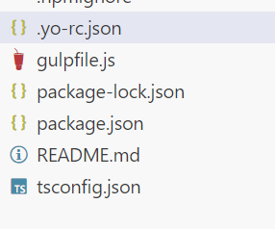
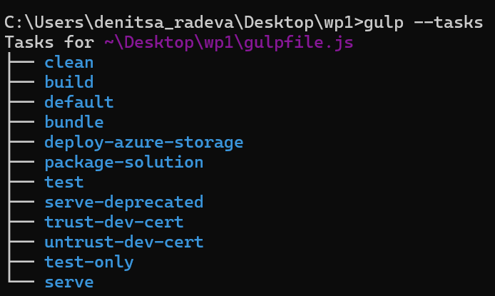
To create web part:
To delete node modules
npx rimraf node_modules
In tsconfig.json for compilerOptions
"strictNullChecks": false,
“allowSyntheticDefaultImports”: true,
"noUnusedLocals": false,
When we have the sharepoint generator to create project is
Yo @microsoft/sharepoint --skip-install
Posle vmesto npm install
Yarn install
Gulp trust-dev-cert
Gulp serve ->startira proekta
startira proekta ama bez browsera i posle f5 to launch it
Gulp serve --nobrowser -
On vs code its nice to have:
Javascript debugger
In serve.json update initialPage
with your dev tenant
https://wvckx.sharepoint.com/sites/Team-wp-dev/_layouts/workbench.aspx"
Yo-rc-json keep info what is installed and it is a starting point for yo if we want to
add another web part to the same solution
Gulpfile.js –keeps info about the tasks. It is a task runner. To check the available tasks: gulp --tasks
Package – info for the packages
Readme –what is about this project for
Tsconfig – the rules for typescript
Notes:
https://github.com/pnp/sp-dev-fx-webparts/tree/main/samples/react-list-form
https://www.youtube.com/watch?v=6HbtHVZ-3Js

Slide 3
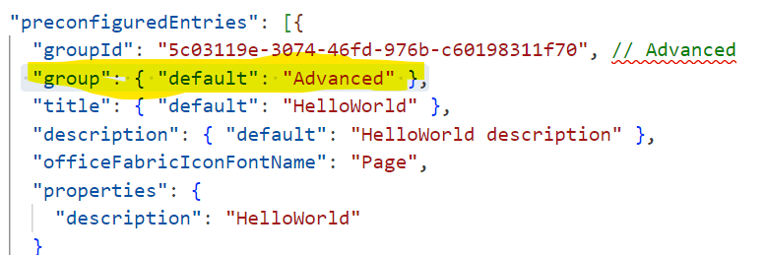
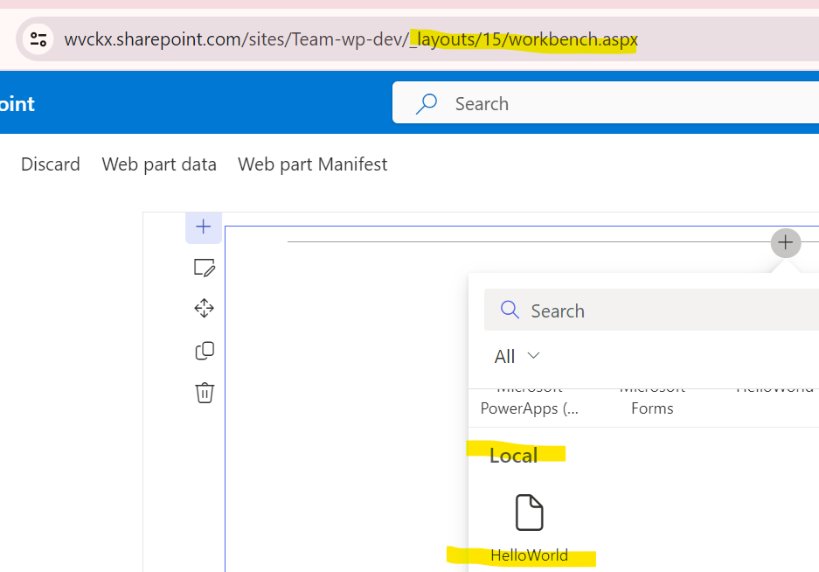
Note: it is normal to have red flag for the scss, this is only because it is not yet geenrated the css, it will be after the run build method
Manifest – this specify the web part. For ex when the user wants to add the web part to a page it will appear in a group called Advanced as this
is in our manifest
In loc folder are our localize strings for the web part
Vscode folder
Launch.json ->info about the host and launch of the web part. Ako v url se smeni sus sushtestvuvash sharepoint site shte ni
runne tam web parta. Ama triabva da sme startirali servera sus gulp serve --nobrowser

Slide 4
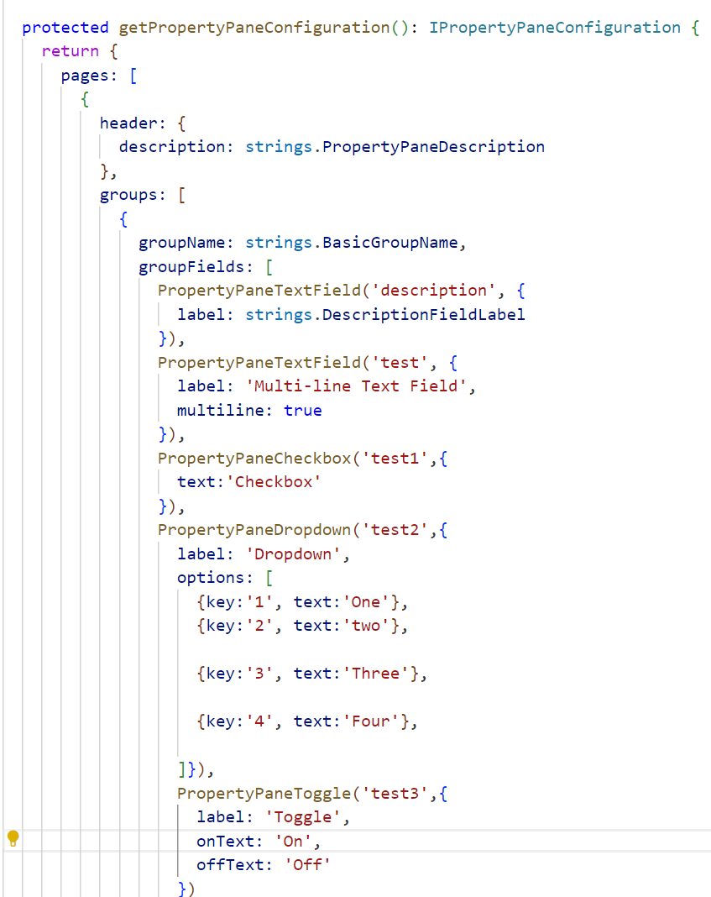
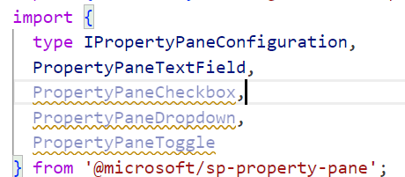
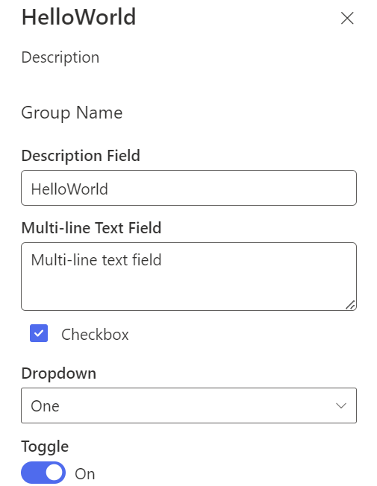
Building Web parts can be reactive (you can update the properties and it is imediatly applied on the web site) and non reactive (can’t update the props)
To create new properties, in the webpart ts file .
1.Add imports
2. Add the éléments in the props
3. In the getPropertyPaneConfiguration file in the groupFields section expose the props there
4. Use them in the html
5.Update properties section in json webpart manifest
export interface IHelloWorldWebPartProps {
description: string;
test:string;
test1:boolean;
tet2:string;
test3:boolean;
}
<p>${escape(this.properties.test)}</p>
<p>${this.properties.test1}</p>
<p>${escape(this.properties.test2)}</p>
<p>${this.properties.test3}</p>
//in the manifest we set default values
"properties": {
"description": "HelloWorld",
"test":"Multi-line text field",
"test1":true,
"test2":"2",
"test3":true
}
If we experience issue for example undefined
Gulp bundle
Notes:
https://learn.microsoft.com/en-us/sharepoint/dev/spfx/web-parts/get-started/build-a-hello-world-web-part

Slide 5
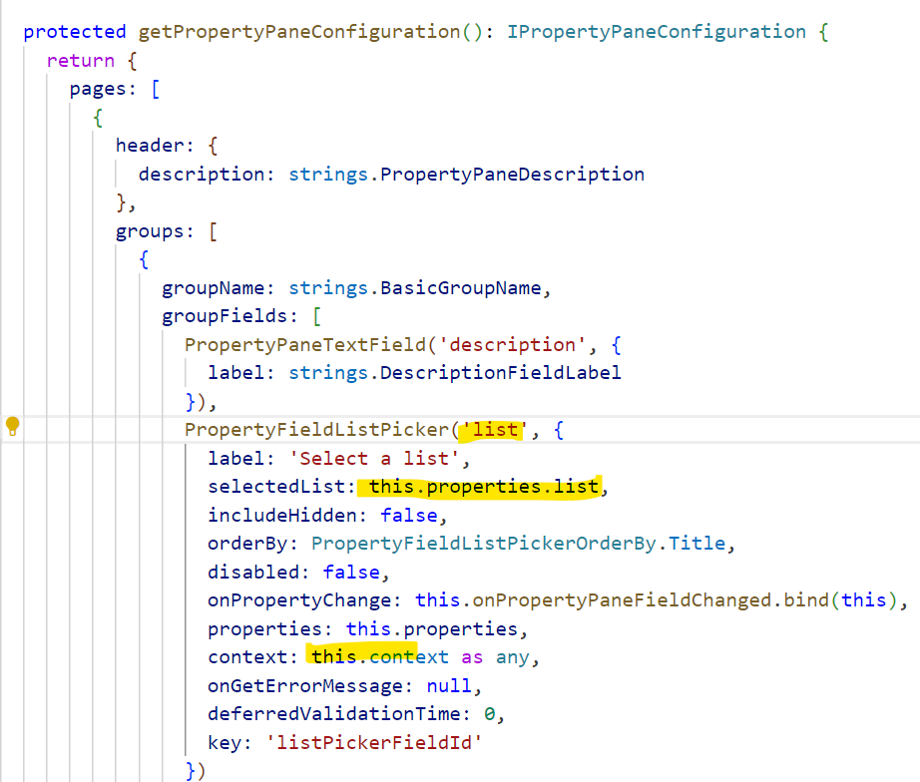
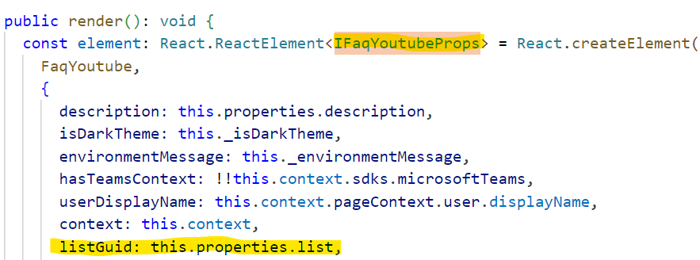
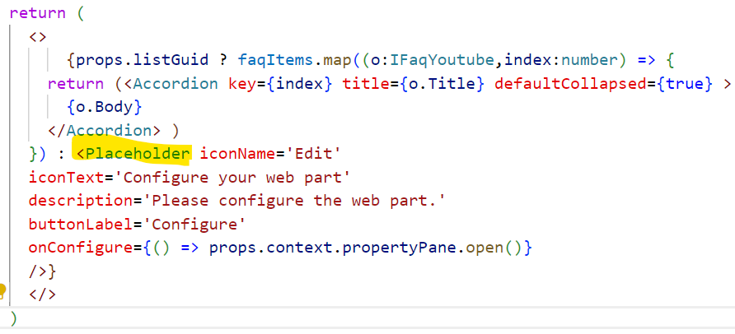
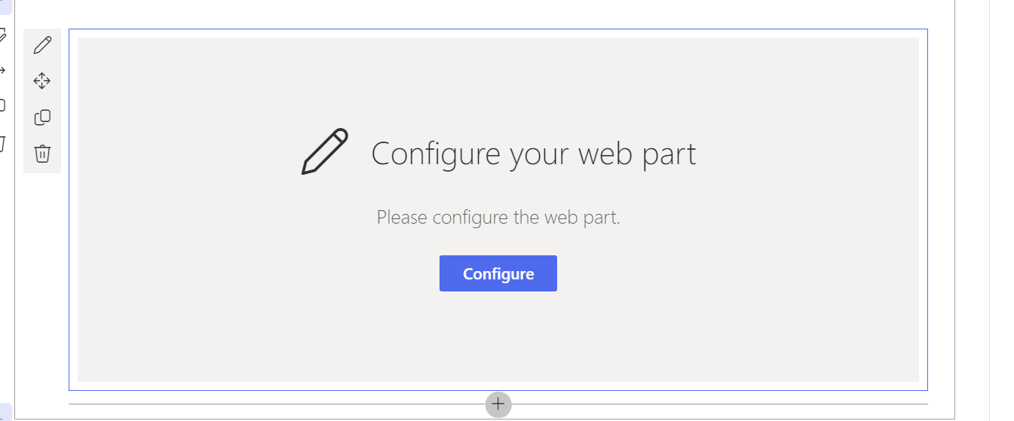
Web part -> Properties pane
Really nice library
npm install @pnp/spfx-property-controls --save --save-exact
Add your new property in ts component Props
Set it up in the wepPart element in the render
Add the custom property in the Group fileds in getPropertyPaneConfiguration
Method in the end of the wepPart.ts
(if the context in the listPicker give us error do as any: context: this.context as any,)
Add in export interface webPartPros your new prop and then assin it in the element
export interface IFaqYoutubeWebPartProps {
description: string;
list: string;
title: string;
}
If we want to display nice msg if no property is selected we can use
Notes:
https://pnp.github.io/sp-dev-fx-controls-react/controls/Placeholder/

Slide 6
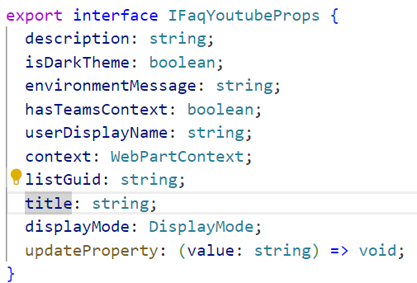
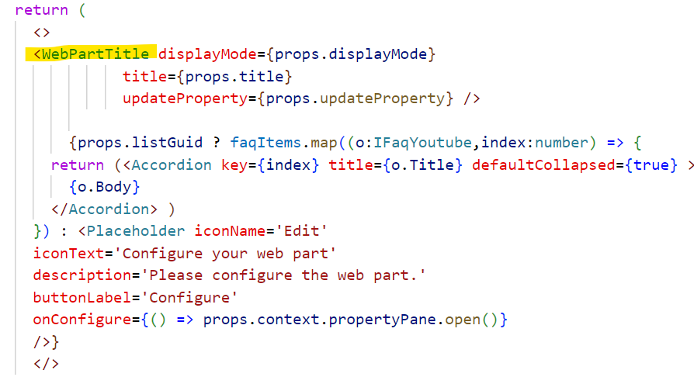
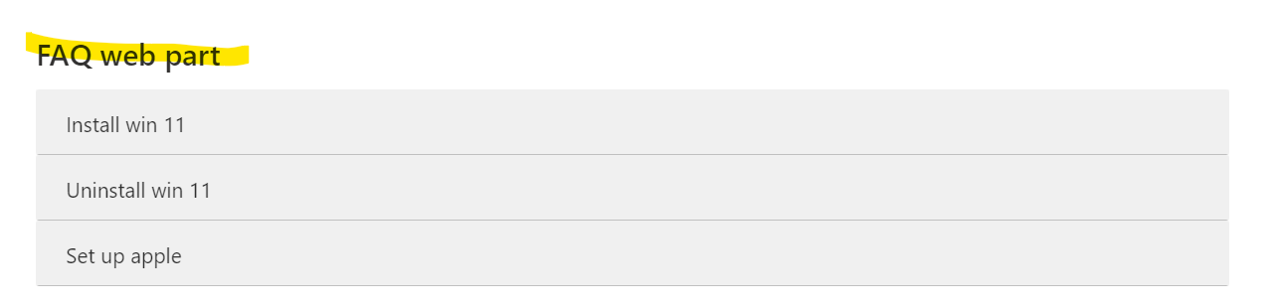
Adding title to our web part
Add title, display mde and update property to the props
Add the Web part title control and make sure you have @pnp/spfx-controls-react
Notes:
https://pnp.github.io/sp-dev-fx-controls-react/controls/WebPartTitle/
Sled 5-a minute
https://www.youtube.com/watch?v=peEgkxDwUiw&list=PLGWG_rRY_j4N8pHW9m17m_QnWu79R_8Zr&index=5

Slide 7
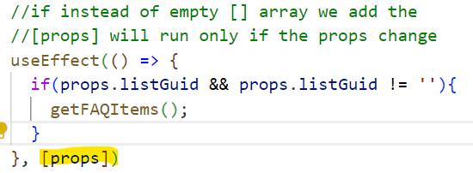
Connect to sharepoint
In the webpart.ts we define 2 new interfaces
export interface ISPLists {
value: ISPList[];
}
export interface ISPList {
Title: string;
Id: string;
}
To reference your scss styles:
${styles.helloWorld}
The webpart enables access to the page context, which exposes the
following key properties such as:
Web title ,Web absolute URL,Web server-relative URL,User sign-in name, this.context.pageContext
Getting the lists:
https://yourtenantprefix.sharepoint.com/_api/web/lists
spHttpClient – class to execute rest api sharepoint. To use it
import {
SPHttpClient,
SPHttpClientResponse
} from '@microsoft/sp-http’;
private _renderListAsync():void {
this._getListData()
.then((resp) => {
this._renderList(resp.value);
})
}
private _getListData(): Promise<ISPLists> {
return this.context.spHttpClient.get(`${this.context.pageContext.web.absoluteUrl}/_api/web/lists?$filter=Hidden eq false`, SPHttpClient.configurations.v1)
.then((response: SPHttpClientResponse) => {
return response.json();
})
.catch(() => {});
}
private _renderList(items: ISPList[]):void {
let html: string = "";
items.forEach((item: ISPList) => {
html += `
<ul class="${styles.list}">
<li class="${styles.listItem}"
<span class = "ms-font-l">${item.Title}</span>
</li>
</ul>`;
});
const listContainer: Element = this.domElement.querySelector("#spListContainer")!;
listContainer.innerHTML = html;
}
Make api calls in useEffect as ths way they run only once
useEffect(()=> {
getFAQItems();
},[])
In the end we add our html element to render method
<div id="spListContainer" />
In the render() we call our method, after the html
this._renderListAsync();
Notes:
https://learn.microsoft.com/en-us/sharepoint/dev/spfx/web-parts/get-started/connect-to-sharepoint

Slide 8
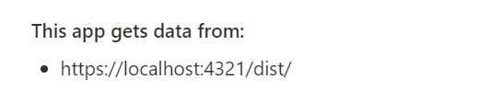

Deploy solution –polzvay 2ria nachin!
in the cmd
gulp bundle
Gulp package-solution
As we didnt properly packaged it when deployed we have this app gets data from localhost, this means the localhost needst to be running in orderfor us to see the
Web part. We will need to host our static assets somewhere (Azure CDN, SarePoint library, or Office 365 public CDN)
In order to change that: in package-solution make sure includeClientSideAssets is set to true
//2ri nachin
Make sure your write-manifest is with its default value cdnBasePath «PATH TO CDN»
Go to package-solution -> make sure that includeclientsideAssets is true
gulp clean
gulp bundle --ship
gulp --ship
gulp package-solution --ship
Then in the folder sharepoint/solution we have our pakage
Go to your app catalog (from sharepoint admin center->more features->app) and drag and drop there.
To display the app ->Home->New->App. Then the app will be visible in site contents.
To replace a deployed web part just drag and drop the new version on top of it
Notes:
https://github.com/SharePoint/sp-dev-training-spfx-spcontent

Slide 9
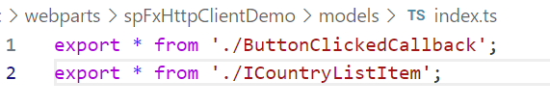
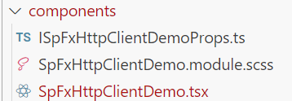

Working with data (check the link in notes)
Create a new file ICountryListItem.ts in the models
Create a new file ButtonClickedCallback.ts in the models
Create a new file index.ts in the models to act as barrel ->in it we just have export the models statements
Update props
Add your style in ./src/webparts/spFxHttpClientDemo/components/SpFxHttpClientDemo.module.scss.
Vuv componenta .tsx ni e ui-to,
A izvun componenta v .ts si pishem implementaciata na metodite
export interface ICountryListItem {
Id: string;
Title: string;
}
(in buttonClickedCallback)
export type ButtonClickedCallback = () => void;
(in models/index.ts)
export * from './ButtonClickedCallback';
export * from './ICountryListItem’;
Update the webPartProps interface
export interface ISpFxHttpClientDemoWebPartProps {
spListItems: ICountryListItem[];
onGetListItems?: ButtonClickedCallback;
isDarkTheme: boolean;
environmentMessage: string;
hasTeamsContext: boolean;
userDisplayName: string;
}
Notes:
https://learn.microsoft.com/en-us/training/modules/sharepoint-spfx-spcontent/3-exercise-get-data?source=learn

Slide 10
Npm packages
UI
@fluentui/react-components
yarn add @fluentui/react-components
Axios for api calls
Moment for datetime
npm i moment
@uifabric/icons
npm i @uifabric/icons
Other icons
npm install react-icons
Pnp –> see next slide
Ms samples for react and web parts (i have them forked):
fluent-ui-9 is for the fluent ui front end framework
react-list-form -is a web parts form
Some tricks:
Web part to take full width:
In the manifest.json after suportedHosts add
"supportsFullBleed": true,
To eliminate null error from compiler
In tsconfig in compilerOptions add
"strictNullChecks": false,
"noUnusedLocals": false,
//to use import React, {useState} from "react";
"allowSyntheticDefaultImports":true
Notes:
https://www.youtube.com/watch?v=Abo8FdQZ4D

Slide 11
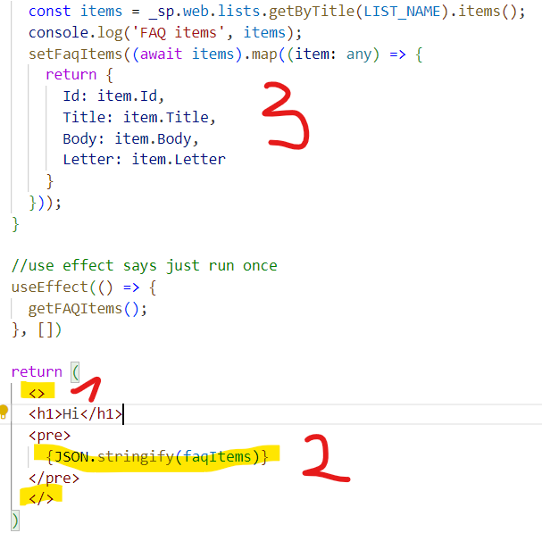
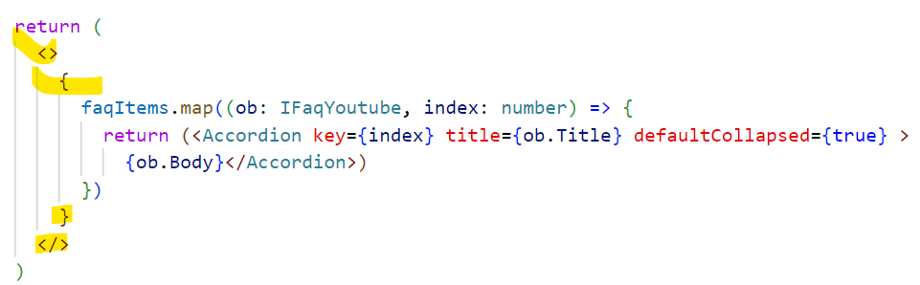
Using Pnp
In src we create a config file: pnpConfig.ts
If web is undefined or list is undefined we need specifically to import:
import {LogLevel, PnPLogging} from "@pnp/logging";
import "@pnp/sp/webs";
import "@pnp/sp/lists";
import "@pnp/sp/items";
import "@pnp/sp/batching";
Npm install @pnp/sp –save
Or
yarn add @pnp/sp
Install pnplogging
npm install @pnp/logging
Controls
npm install @pnp/spfx-controls-react --save --save-exact
For the properties pane
npm install @pnp/spfx-property-controls --save --save-exact
1 – we wrap it in <> as it wants 1 object not multiply, and we put {} round the object if it ives error
2 – we can use json.stringify for debug
3 – when we take the items for sharepoint we map them with the object we created
Json.stringify(items, null,2) ->will make it to look nicer
Notes:
https://pnp.github.io/sp-dev-fx-controls-react/

Slide 12
Some infors for React:
It is giving console error if there is no key in items. To avoid this provide index for a key
faqItems.map((o:IFAQ,index:number) => {
return (<Accordion key={index} title={o.Title} defaultCollapsed={true} >
{o.Body}
</Accordion> )

Slide 13
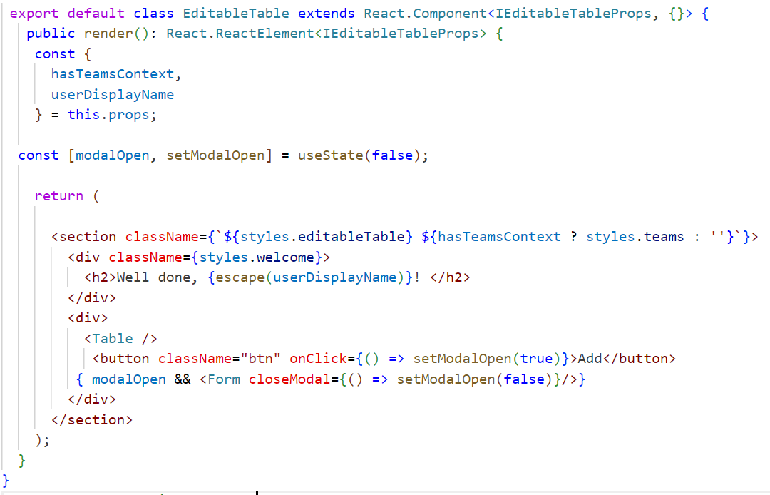
If useState or useEffect give error transform the class to const
const EditableTable = (props: IEditableTableProps) => {
const {
description,
isDarkTheme,
environmentMessage,
hasTeamsContext,
userDisplayName
} = props;
const [modalOpen, setModalOpen] = useState(false);
return (
<section className={`${styles.editableTable} ${hasTeamsContext ? styles.teams : ''}`}>
<div>
<Table />
<button className="btn" onClick={() => setModalOpen(true)}>Add</button>
{ modalOpen && <Form closeModal={() => setModalOpen(false)}/>}
</div>
</section> );}
export default EditableTable;
The usestate/useeffect issue can be fixed if we allowSinteticDefaults
In tsconfig in compilerOptions add
"allowSyntheticDefaultImports":true
Then we can say:
import React, {useState} from "react";
Written like this with extends react component gives error for useState
Notes:
https://www.youtube.com/watch?v=MINQoCSBmds

Slide 14
Kursove i tutorials
Full series from the community!
https://www.youtube.com/playlist?list=PLkNa0QIBAHZIY9YYmsKwkOfszcvO4YR0v
5 episodes for pnp components
https://www.youtube.com/watch?v=smBPrsw_Y7U&list=PLGWG_rRY_j4N8pHW9m17m_QnWu79R_8Zr&index=2

