Slide 1

Create the component file and css file to it
Import dependencies:
import * as React from "react";
import styles from "./Form.module.scss";
If it has props
import * as React from "react";
import styles from "./Form.module.scss";
export interface IFormProps{
isTrue: boolean;
closeModal: () => {};
}
export default class Form extends React.Component<IFormProps>{
render(): React.ReactElement<IFormProps> {
const { closeModal} = this.props;
return (
//we check if the class name is modal container then we close the modal
<div className={styles.modalcontainer} onClick={ (e) => {
const target = e.target as HTMLTextAreaElement;
if(target.className === styles.modalcontainer) closeModal();
}}>
<div className={styles.modal}>
<form>
<div className={styles.formgroup}>
<label htmlFor="title">Title</label>
<input name="title" />
</div>
<div className={styles.formgroup}>
<label htmlFor="body">Body</label>
<textarea name="body" />
</div>
<div className={styles.formgroup}>
<label htmlFor="letter">Letter</label>
<select name="letter">
<option value={'live'}>Live</option>
<option value={'draft'}>Draft</option>
<option value={'error'}>Live</option>
</select>
</div>
<button type="submit" className={styles.btn}>Submit</button>
</form>
</div>
</div>
); }
}
In order to close the modal only if it is clicked outside the pop up we check the event
and if the class name is our modal class name. But it is important to check the class name
from styles.className, otherwise react generate extra letters and the classname will
never be the same
If the components doesn’t have props:
export default class Table extends React.Component<{}> {
render(): React.ReactElement {
return (<div className="table-wrapper">
<table className="table">
<thead>
<tr>
<th>ID</th>
<th>Title</th>
<th className="expand">Body</th>
<th>Letter</th>
<th>Actions</th>
</tr>
</thead>
<tbody>
<tr>
<td>0</td>
<td>This is the Title</td>
<td>This is the body</td>
<td><span className="label label-live">This is the letter</span></td>
<td><span className="actions">
<BsFillTrashFill className="delete-btn"/>
<BsFillPencilFill />
</span></td>
</tr>
</tbody>
</table>
</div>
);
}
}
Notes:
https://www.youtube.com/watch?v=MINQoCSBmds

Slide 2
Passing the values and setting them up
Definition and passing value for the closeModal – it is in the place where the component is called
import * as React from 'react';
import styles from './EditableTable.module.scss';
import type { IEditableTableProps } from './IEditableTableProps';
import { escape } from '@microsoft/sp-lodash-subset';
import Table from './Table';
import Form from './Form';
import { useState } from 'react';
const EditableTable = (props: IEditableTableProps) => {
const {
description,
isDarkTheme,
environmentMessage,
hasTeamsContext,
userDisplayName
} = props;
const [modalOpen, setModalOpen] = useState(false);
return (
<section className={`${styles.editableTable} ${hasTeamsContext ? styles.teams : ''}`}>
<div className={styles.welcome}>
<h2>Well done, {escape(userDisplayName)}! </h2>
</div>
<div>
<Table />
<button className="btn" onClick={() => setModalOpen(true)}>Add</button>
{ modalOpen && <Form closeModal={() => setModalOpen(false)}/>}
</div>
</section>
);
}
export default EditableTable;
On the next age there is explanation why we use const Editabe table and not react component extend

Slide 3
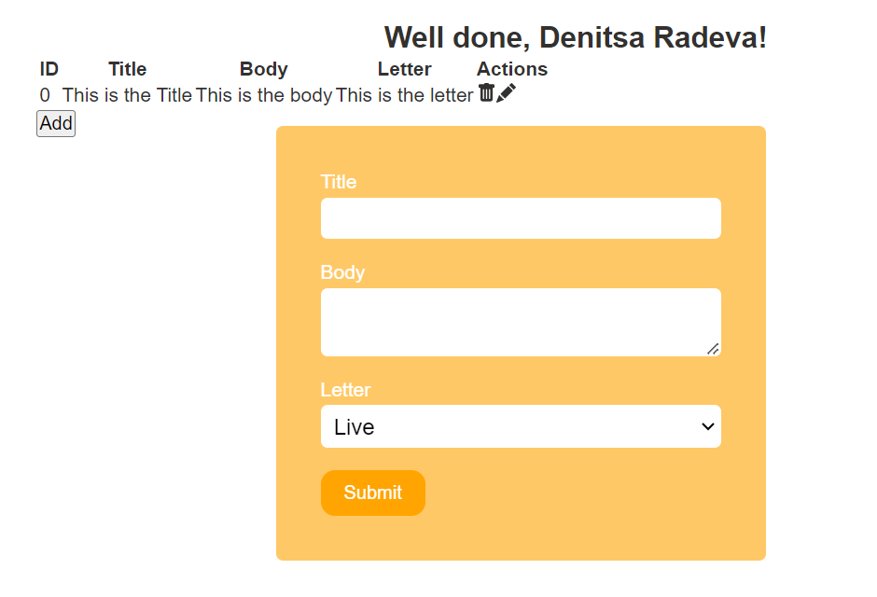
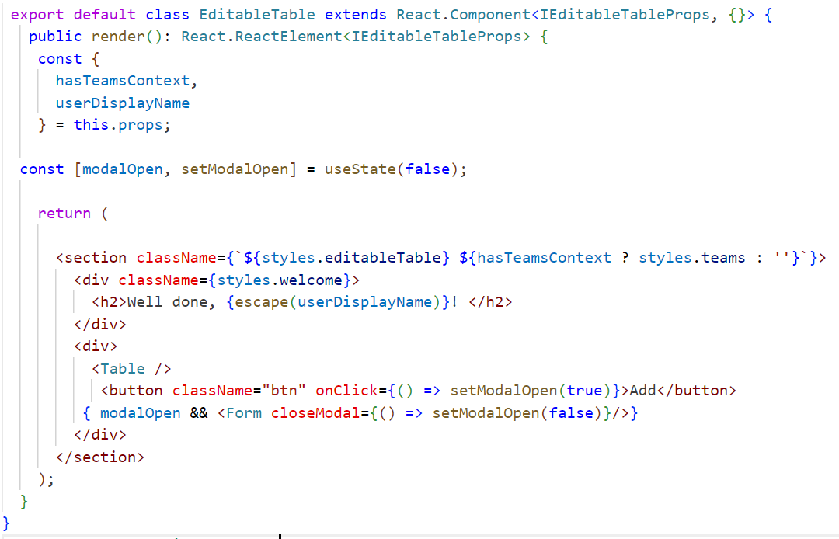
If useState or useEffect give error transform the class to const
const EditableTable = (props: IEditableTableProps) => {
const {
description,
isDarkTheme,
environmentMessage,
hasTeamsContext,
userDisplayName
} = props;
const [modalOpen, setModalOpen] = useState(false);
return (
<section className={`${styles.editableTable} ${hasTeamsContext ? styles.teams : ''}`}>
<div>
<Table />
<button className="btn" onClick={() => setModalOpen(true)}>Add</button>
{ modalOpen && <Form closeModal={() => setModalOpen(false)}/>}
</div>
</section> );}
export default EditableTable;
Written like this with extends react component gives error for useState

Slide 4
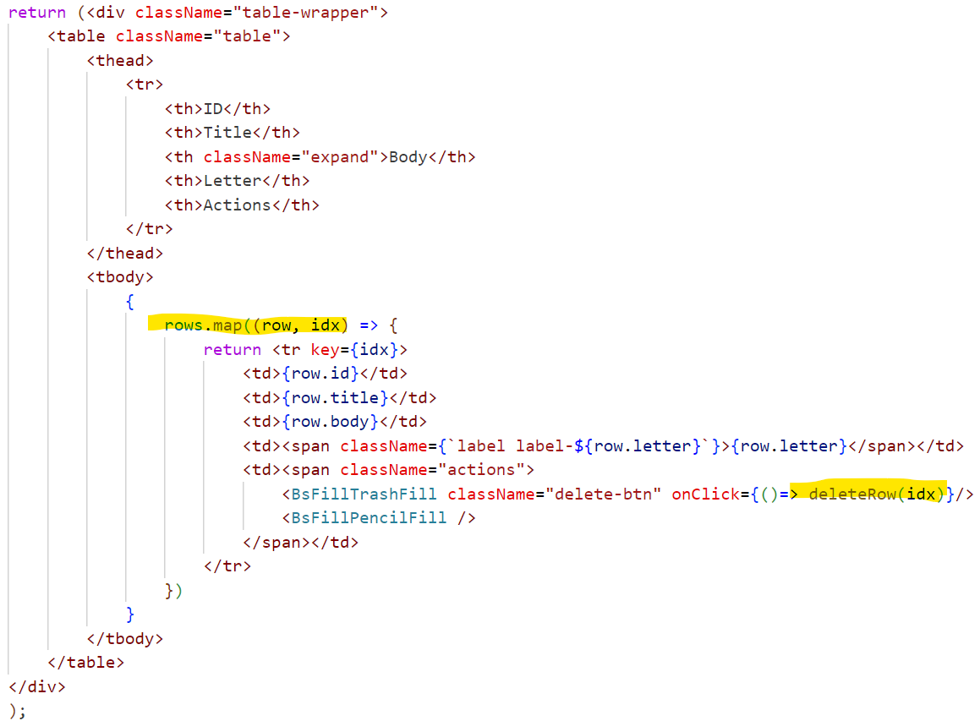
Passing collection as props and deleting a row
Dynamically change color for example of status:
Create your css
.label {
border-radius: 3px;
padding: 0.3em;
color: white;
}
.label-draft {
background-color: #777;;
}
.label-live {
background-color: #42a942;
}
.label-error {
background-color: #d9534f;
}
Then dynamically in ts
<td><span className={`label label-${row.letter}`}>{row.letter}</span></td>
Parent: EditableTable – we define the rows (for example take them from api, and then we pass them
const [rows,setRows] = useState([
{id:0, title: "Title 1",body:"This is the body 1",letter:"live"},
{id:1, title: "Title 2",body:"This is the body 2",letter:"draft"},
{id:2, title: "Title 3",body:"This is the body 3",letter:"live"},
{id:3, title: "Title 4",body:"This is the body 4",letter:"error"}
]);
const handleDeleteRow = (targetIndex:number) => {
setRows(rows.filter((_,idx:number) => idx !== targetIndex )); //_trick
}
<Table rows={rows} deleteRow = {handleDeleteRow}/>
Our table.tsx
export interface ITable {
id: number;
title:string;
body:string;
letter:string;
}
export interface ITableProps {
rows: ITable[];
deleteRow: (targetIndex:number) => void;
}
export default class Table extends React.Component<ITableProps> {
render(): React.ReactElement<ITableProps> {
const { rows,deleteRow} = this.props;

Slide 5
Adding new element to collection
1. We set up form state in the Form component:
const [formState, setFormState] = useState({
id:0,
title:"",
body:"",
letter:"live"
});
3. We define handleChange function to keep track on the changes, then add it to every form element that can change
const handleChange = (e:any) => {
setFormState({
//we copy the existing value from formState
...formState,
//when we have dynamic key we use [] to update the field
[e.target.name]: e.target.value
});
};
2. Then we change a bit the form to hold default values our formState
return (
//we check if the class name is modal container then we close the modal
<div className={styles.modalcontainer} onClick={ (e) => {
const target = e.target as HTMLTextAreaElement;
if(target.className === styles.modalcontainer) closeModal();
}}>
<div className={styles.modal}>
<form>
<div className={styles.formgroup}>
<label htmlFor="title">Title</label>
<input name="title" value={formState.title} onChange={handleChange} />
</div>
<div className={styles.formgroup}>
<label htmlFor="body">Body</label>
<textarea name="body" value={formState.body} onChange={handleChange}/>
</div>
<div className={styles.formgroup}>
<label htmlFor="letter">Letter</label>
<select name="letter" value={formState.letter} onChange={handleChange}>
<option value={'live'}>Live</option>
<option value={'draft'}>Draft</option>
<option value={'error'}>Live</option>
</select>
</div>
<button type="submit" className={styles.btn}>Submit</button>
</form>
</div>
</div>
);

Slide 6
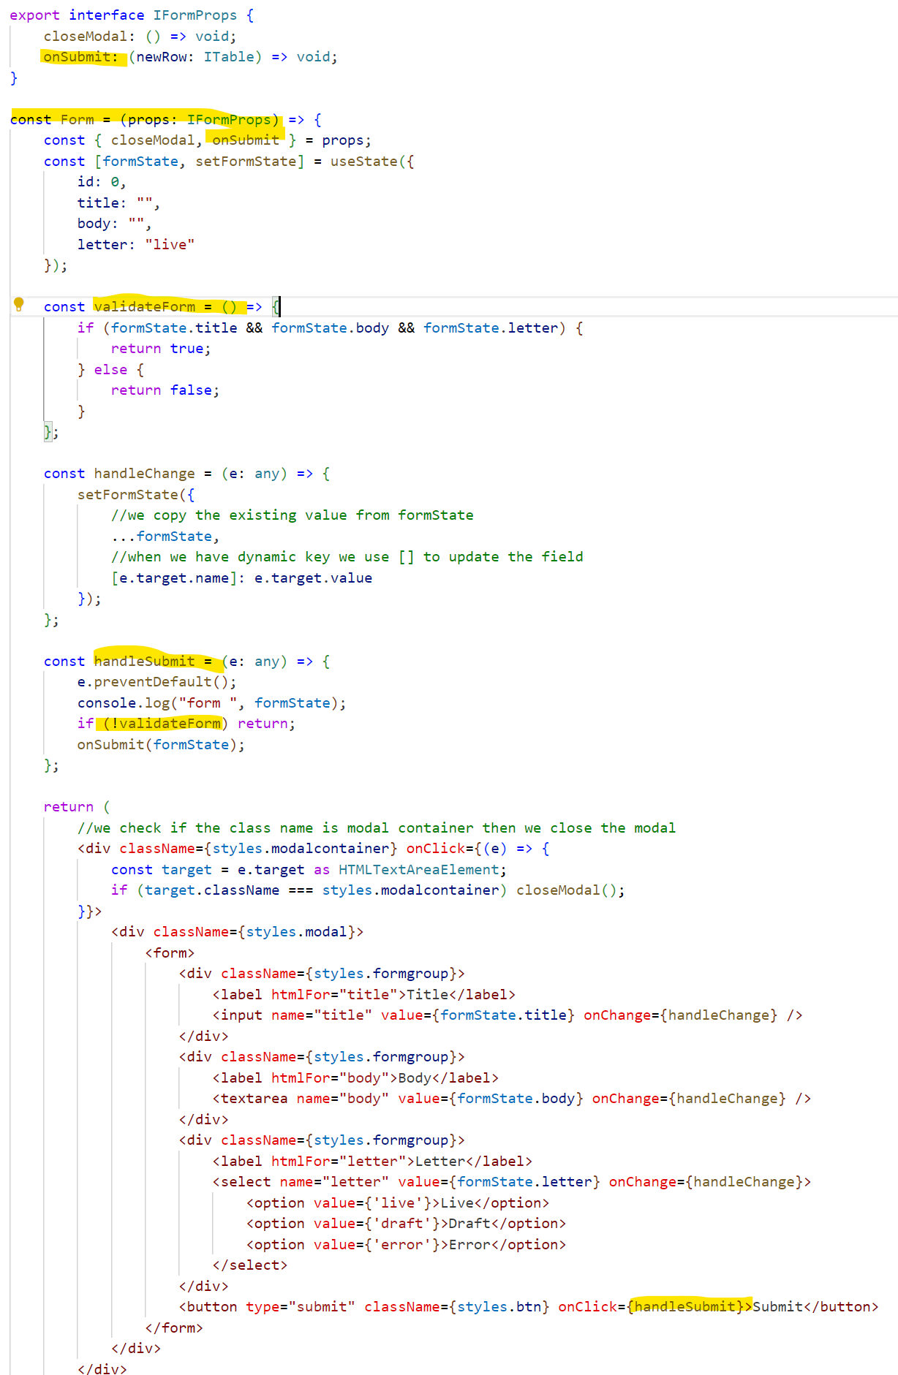
Submitting the form
Submitting the form (i had to transform the component to be const and not react component because of usestate weren’t working
In the form add click event to the button and call function handle submit
<button type="submit" className={styles.btn} onClick={handleSubmit}>Submit</button>
Define this function (again the form.tsx)
const handleSubmit = (e: any) => {
e.preventDefault();
console.log("form ", formState);
};
2. In the EditableTable (parent) create handleSubmit
const handleSubmit = (newRow:ITable) => {
//brackets [] with ... copy all existing rows, and then we add the new one
setRows([...rows,newRow]);
}
3. In EditableTable pass this function to the Form
{ modalOpen && <Form closeModal={() => setModalOpen(false)} onSubmit={handleSubmit}/>}
4. Add onSubmit to the props of Form component
export interface IFormProps {
closeModal: () => void;
onSubmit:(newRow:ITable) => void;
}
5. Update the props and handleSubmit const and add validateForm func to check if the values are empty
const Form = (props:IFormProps) => {
const { closeModal,onSubmit } = props;
const validateForm = () => {
if (formState.title && formState.body && formState.letter) {
return true;
} else {
return false;
}
};
const handleSubmit = (e: any) => {
e.preventDefault();
if(!validateForm) return;
onSubmit(formState);
};

Slide 7
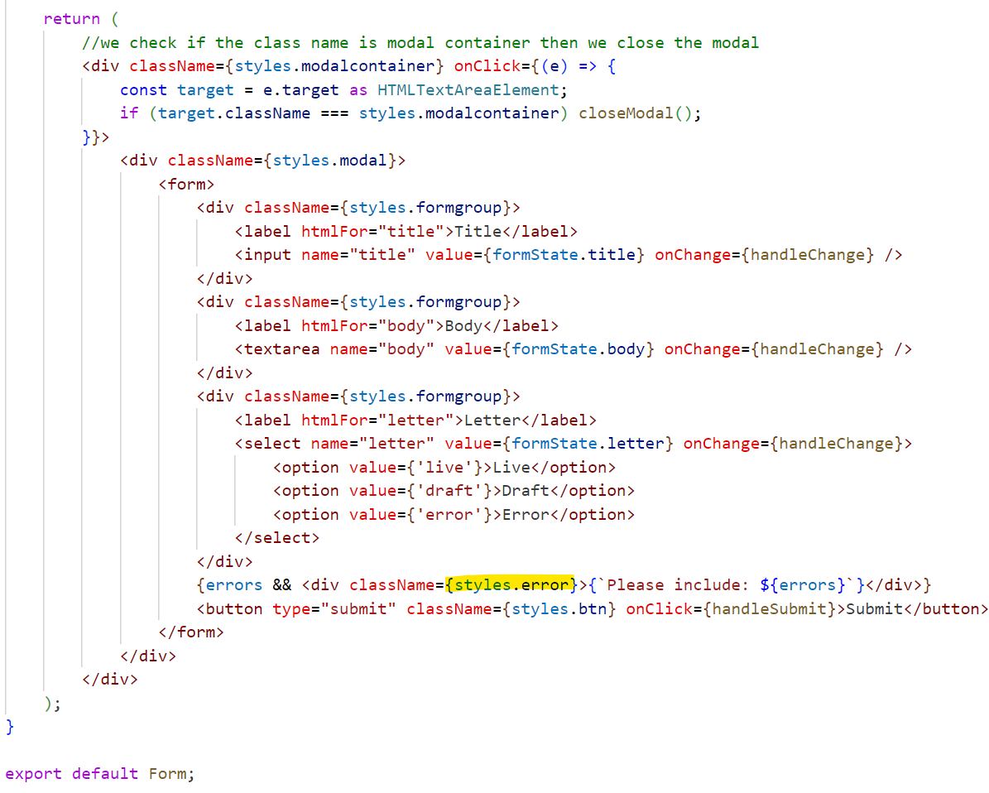
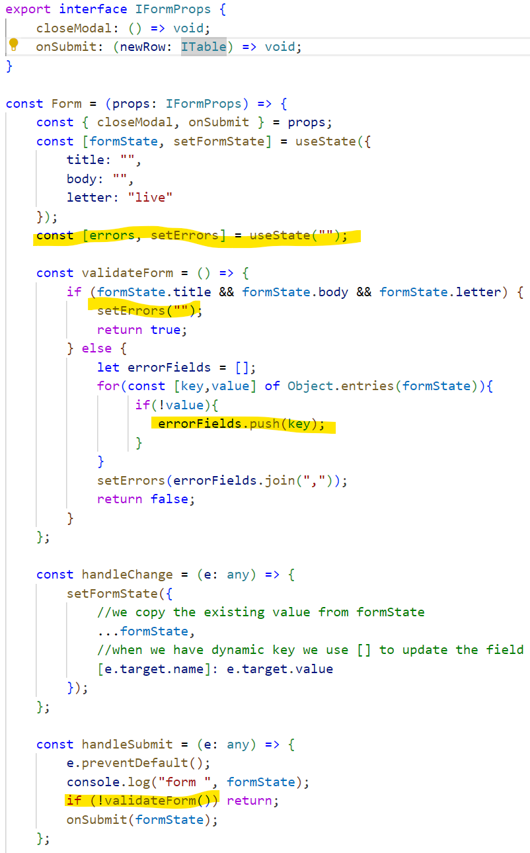
Adding error message
In the form.tsx
Add const
const [errors, setErrors] = useState(“”);
In the validateForm func add the error
const validateForm = () => {
if (formState.title && formState.body && formState.letter) {
setErrors("");
return true;
} else {
let errorFields = [];
for(const [key,value] of Object.entries(formState)){
if(!value){
errorFields.push(key);
}
}
setErrors(errorFields.join(","));
return false;
}
};
Add html
{errors && <div className = {styles.error}>{`Please include: ${errors}`}</div>}
Add css
.error {
background-color: #f8d7da;
color:#df4759;
padding: 0.5rem;
border-radius: 0.3rem;
margin-bottom: 1rem;;
}

Slide 8
Edit the form
In the main component –EditTable add const rowToEdit to track the state
const [rowToEdit, setRowToEdit] = useState(null);
2. Create handleEditRow function to open the modal and keep track of row Id
const handleEditRow = (rowId: number) => {
setRowToEdit(rowId);
setModalOpen(true);
};
3. Pass the handleEditRow function to the table and add it as props
<Table rows={rows} deleteRow = {handleDeleteRow} editRow = {handleEditRow} />
export interface ITableProps {
rows: ITable[];
deleteRow: (targetIndex:number) => void;
editRow: (rowId:number) => void;
}
const { rows,deleteRow, editRow } = this.props;
4. Add the onClick event in the pencil icon
<BsFillPencilFill onClick={()=> editRow(idx) }/>
5. Create new prop defaultValue and add it to the props
<Form closeModal={() => setModalOpen(false)} onSubmit={handleSubmit} defaultValue={rowToEdit !== null && rows[rowToEdit]}/>}
/>}
export interface IFormProps {
closeModal: () => void;
onSubmit: (newRow: ITable) => void;
defaultValue: ITable;
}
const { closeModal, onSubmit,defaultValue } = props;
6.In form change useState to use defaultValue
// || it means if the defaultValue is empty, or undefined or null use the object
const [formState, setFormState] = useState(defaultValue || {
title: "",
body: "",
letter: "live"
});
7. Modify the submit btn functionality (if we leave it instead of editing it will add new row) – in EditableTable
const handleSubmit = (newRow:ITable) => {
rowToEdit === null ?
//brackets [] with ... copy all existing rows, and then we add the new one
setRows([...rows,newRow]) :
setRows(rows.map((currRow, idx) => {
if(idx !== rowToEdit) return currRow;
return newRow;
}))
setModalOpen(false);
};
8. Set rowToEdit to null again in the form on modalClose
<Form closeModal={() => {setModalOpen(false); setRowToEdit(null);} } onSubmit={handleSubmit} defaultValue={rowToEdit !== null && rows[rowToEdit]}/>}

Slide 9
EditableTable
(final)
import styles from './EditableTable.module.scss';
import type { IEditableTableProps } from './IEditableTableProps';
import { escape } from '@microsoft/sp-lodash-subset';
import Table, { ITable } from './Table';
import Form from './Form';
import React, { useState } from 'react';
const EditableTable = (props: IEditableTableProps) => {
const {
description,
isDarkTheme,
environmentMessage,
hasTeamsContext,
userDisplayName
} = props; const [modalOpen, setModalOpen] = useState(false);
const [rows,setRows] = useState([
{ title: "Title 1",body:"This is the body 1",letter:"live"},
{title: "Title 2",body:"This is the body 2",letter:"draft"},
{title: "Title 3",body:"This is the body 3",letter:"live"},
{title: "Title 4",body:"This is the body 4",letter:"error"}
]);
const [rowToEdit, setRowToEdit] = useState(null); const handleDeleteRow = (targetIndex:number) => {
setRows(rows.filter((_,idx:number) => idx !== targetIndex ));
};
const handleEditRow = (rowId: number) => {
setRowToEdit(rowId);
setModalOpen(true);
};
const handleSubmit = (newRow:ITable) => {
rowToEdit === null ?
//brackets [] with ... copy all existing rows, and then we add the new one
setRows([...rows,newRow]) :
setRows(rows.map((currRow, idx) => {
if(idx !== rowToEdit) return currRow; return newRow;
}));
setModalOpen(false);
}; return (
<section className={`${styles.editableTable} ${hasTeamsContext ? styles.teams : ''}`}>
<div>
<Table rows={rows} deleteRow = {handleDeleteRow} editRow = {handleEditRow} />
<button className="btn" onClick={() => setModalOpen(true)}>Add</button>
{ modalOpen &&
<Form closeModal={() => {setModalOpen(false); setRowToEdit(null);} } onSubmit={handleSubmit} defaultValue={rowToEdit !== null && rows[rowToEdit]}/>}
</div>
</section>
);
}
export default EditableTable;

Slide 10
Form
(final)
import styles from "./Form.module.scss";
import React, { useState } from "react";
import { ITable } from "./Table";
export interface IFormProps {
closeModal: () => void;
onSubmit: (newRow: ITable) => void;
defaultValue: ITable;
}
const Form = (props: IFormProps) => {
const { closeModal, onSubmit,defaultValue } = props;
// || it means if the defaultValue is empty, or undefined or null use the object
const [formState, setFormState] = useState(defaultValue || {
title: "",
body: "",
letter: "live"
});
const [errors, setErrors] = useState("");
const validateForm = () => {
if (formState.title && formState.body && formState.letter) {
setErrors("");
return true;
} else {
let errorFields = [];
for(const [key,value] of Object.entries(formState)){
if(!value){
errorFields.push(key);
}
}
setErrors(errorFields.join(","));
return false;
}
};
const handleChange = (e: any) => {
setFormState({
//we copy the existing value from formState
...formState,
//when we have dynamic key we use [] to update the field
[e.target.name]: e.target.value
});
};
const handleSubmit = (e: any) => {
e.preventDefault();
console.log("form ", formState);
if (!validateForm()) return;
onSubmit(formState);
};
return (
//we check if the class name is modal container then we close the modal
<div className={styles.modalcontainer} onClick={(e) => {
const target = e.target as HTMLTextAreaElement;
if (target.className === styles.modalcontainer) closeModal();
}}>
<div className={styles.modal}>
<form>
<div className={styles.formgroup}>
<label htmlFor="title">Title</label>
<input name="title" value={formState.title} onChange={handleChange} />
</div>
<div className={styles.formgroup}>
<label htmlFor="body">Body</label>
<textarea name="body" value={formState.body} onChange={handleChange} />
</div>
<div className={styles.formgroup}>
<label htmlFor="letter">Letter</label>
<select name="letter" value={formState.letter} onChange={handleChange}>
<option value={'live'}>Live</option>
<option value={'draft'}>Draft</option>
<option value={'error'}>Error</option>
</select>
</div>
{errors && <div className={styles.error}>{`Please include: ${errors}`}</div>}
<button type="submit" className={styles.btn} onClick={handleSubmit}>Submit</button>
</form>
</div>
</div>
);
}
export default Form;

Slide 11
Table
(final)
import React from "react";
import { BsFillTrashFill, BsFillPencilFill } from "react-icons/bs";
import styles from "./Table.module.scss";
export interface ITable {
title: string;
body: string;
letter: string;
}
export interface ITableProps {
rows: ITable[];
deleteRow: (targetIndex:number) => void;
editRow: (rowId:number) => void;
}
export default class Table extends React.Component<ITableProps> {
render(): React.ReactElement<ITableProps> {
const { rows,deleteRow, editRow } = this.props;
console.log(rows);
return (<div className="table-wrapper">
<table className="table">
<thead>
<tr>
<th>Title</th>
<th className="expand">Body</th>
<th>Letter</th>
<th>Actions</th>
</tr>
</thead>
<tbody>
{
rows.map((row, idx) => {
return <tr key={idx}>
<td>{row.title}</td>
<td><span className={styles.tst}>{row.body}</span></td>
<td><span className={`label-${row.letter}`}>{row.letter}</span></td>
<td><span className="actions">
<BsFillTrashFill className="delete-btn" onClick={()=> deleteRow(idx)}/>
<BsFillPencilFill onClick={()=> editRow(idx) }/>
</span></td>
</tr>
})
}
</tbody>
</table>
</div>
);
}
}
Tsconfig
{
"extends": "./node_modules/@microsoft/rush-stack-compiler-4.7/includes/tsconfig-web.json",
"compilerOptions": {
"target": "es5",
"forceConsistentCasingInFileNames": true,
"module": "esnext",
"moduleResolution": "node",
"jsx": "react",
"declaration": true,
"sourceMap": true,
"experimentalDecorators": true,
"skipLibCheck": true,
"outDir": "lib",
"inlineSources": false,
"strictNullChecks": false,
"noUnusedLocals": false,
"noImplicitAny": true,
"allowSyntheticDefaultImports":true,
"typeRoots": [
"./node_modules/@types",
"./node_modules/@microsoft"
],
"types": [
"webpack-env"
],
"lib": [
"es5",
"dom",
"es2015.collection",
"es2015.promise",
"es2017"
]
},
"include": [
"src/**/*.ts",
"src/**/*.tsx"
]
}

