Slide 1
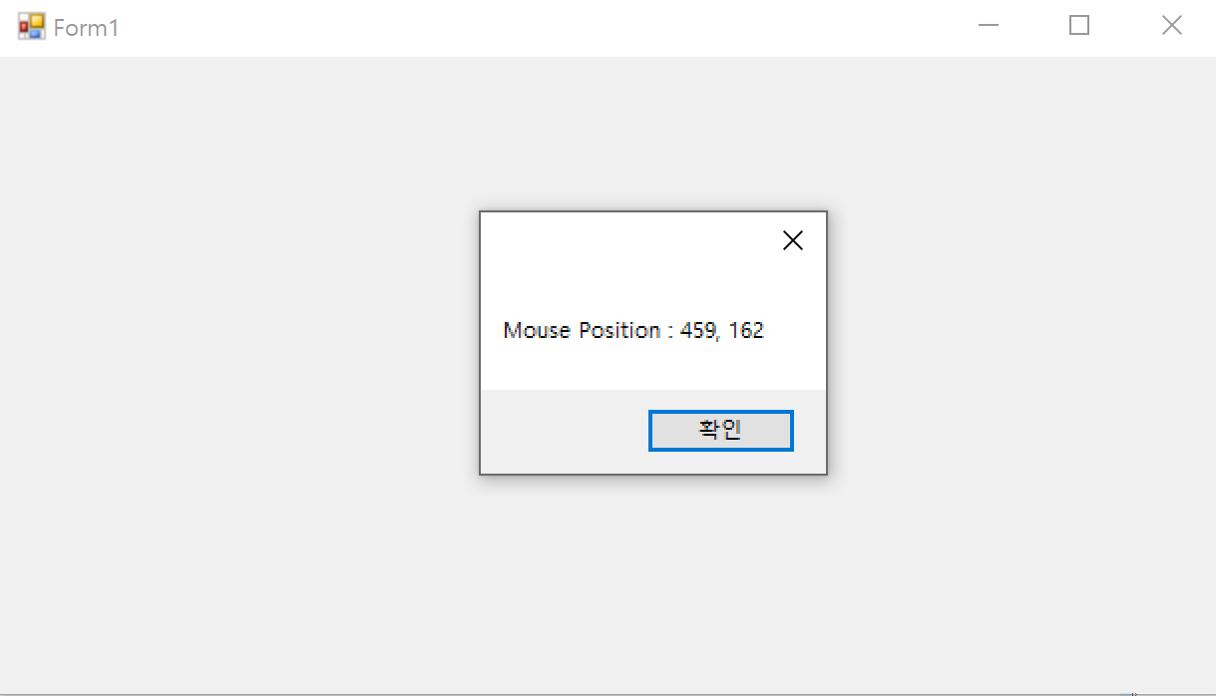
using System;
using System.Windows.Forms;
namespace project
{
public partial class Form1 : Form
{
public Form1()
{
InitializeComponent();
}
private void Form1_MouseEnter(object sender, EventArgs e)
{
Point mousePoint = PointToClient(MousePosition);
string msg = "Mouse Position : " + mousePoint.X + ", " + mousePoint.Y;
MessageBox.Show(msg);
}
}
}

Slide 2
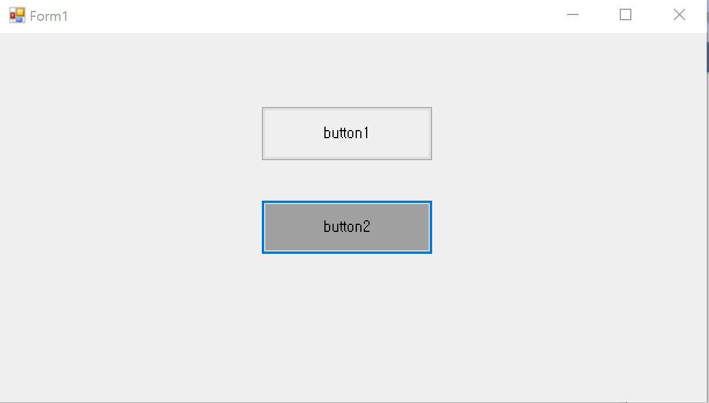
using System;
using System.Windows.Forms;
namespace project
{
public partial class Form1 : Form
{
public Form1()
{
InitializeComponent();
}
private void button1_Click(object sender, EventArgs e)
{
this.button1.BackColor = SystemColors.Control;
this.button2.Focus();
if (this.button2.Focused)
this.button2.BackColor = SystemColors.ControlDark;
}
private void button2_Click(object sender, EventArgs e)
{
this.button2.BackColor = SystemColors.Control;
this.button1.Focus();
if (this.button1.Focused)
this.button1.BackColor = SystemColors.ControlDark;
}
}
}

Slide 3
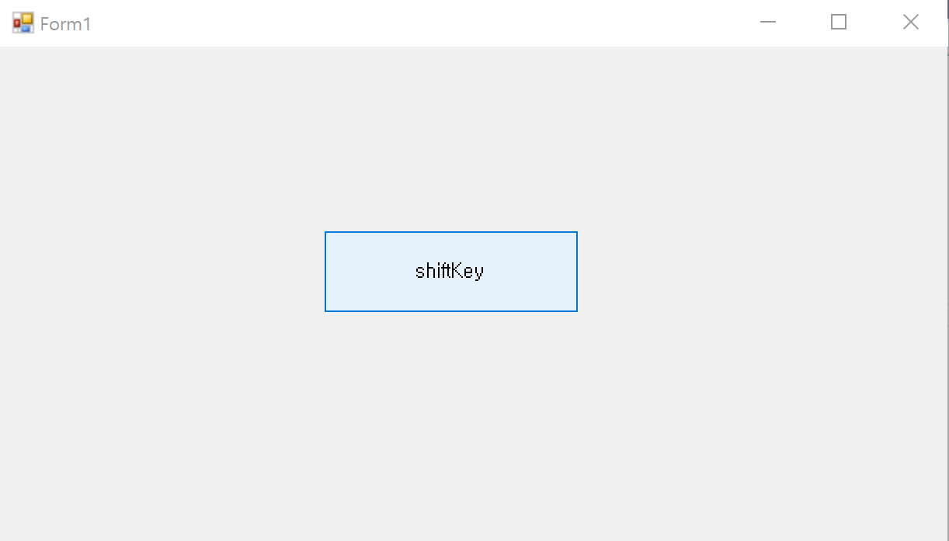
using System;
using System.Windows.Forms;
namespace project
{
public partial class Form1 : Form
{
public Form1()
{
InitializeComponent();
}
public int xPt, yPt;
public static readonly int MOVE = 10;
private void button1_KeyUp(object sender, KeyEventArgs e)
{
this.xPt = this.button1.Location.X;
this.yPt = this.button1.Location.Y;
switch (e.KeyCode)
{
case Keys.Left:
xPt -= MOVE; break;
case Keys.Right:
xPt += MOVE; break;
case Keys.Up:
yPt -= MOVE; break;
case Keys.Down:
yPt += MOVE; break;
}
this.button1.Text = e.KeyCode.ToString();
this.button1.Location = new Point(xPt, yPt);
}
}
}

Slide 4
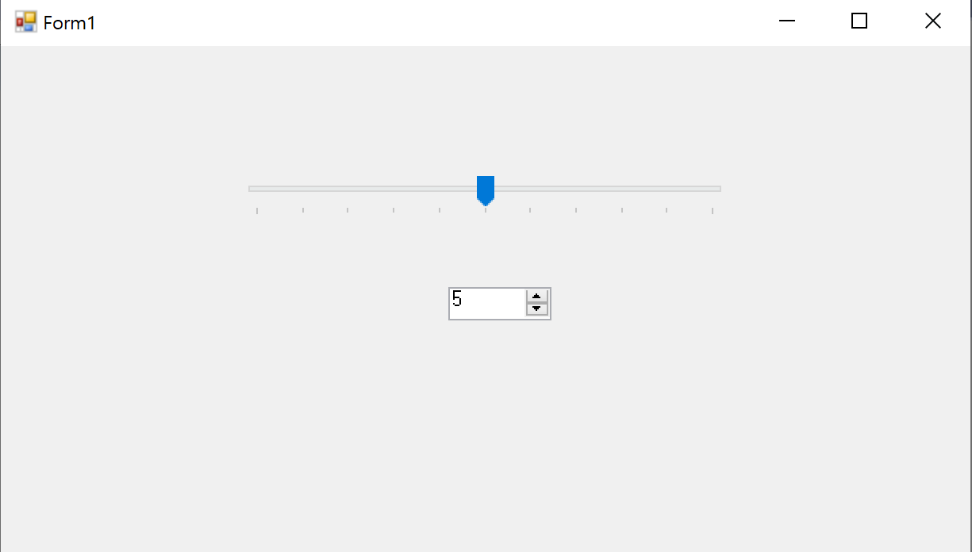
using System;
using System.Windows.Forms;
namespace project
{
public partial class Form1 : Form
{
public Form1()
{
InitializeComponent();
}
private void trackBar1_Scroll(object sender, EventArgs e)
{
numericUpDown2.Value = trackBar1.Value;
}
private void numericUpDown2_ValueChanged(object sender, EventArgs e)
{
trackBar1.Value = (int)numericUpDown2.Value;
}
}
}

Slide 5
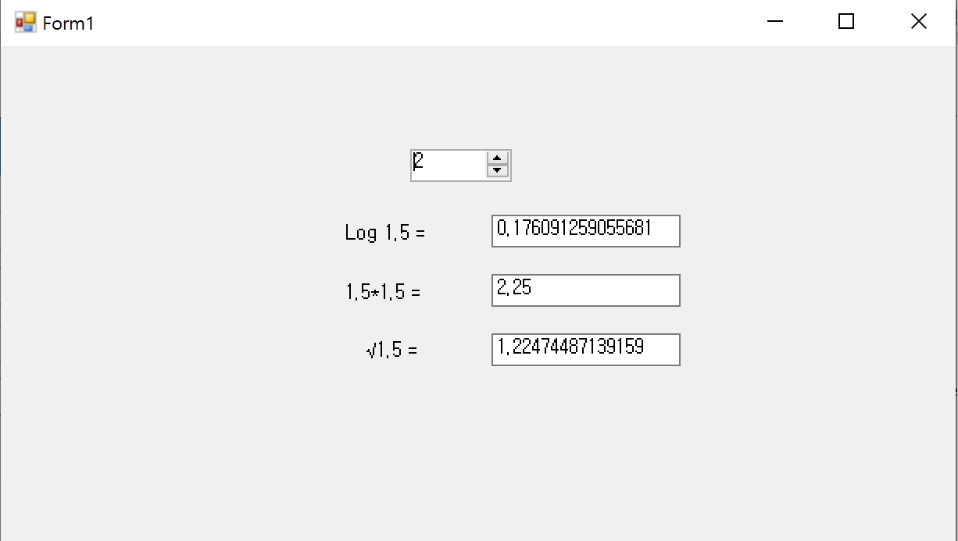
using System;
using System.Windows.Forms;
namespace project
{
public partial class Form1 : Form
{
public Form1()
{
InitializeComponent();
}
private void numericUpDown1_ValueChanged(object sender, EventArgs e)
{
decimal d = numericUpDown1.Value;
label1.Text = "Log " + d + " = ";
textBox1.Text = System.Math.Log10((double)d).ToString();
label2.Text = d + "*" + d + " = ";
textBox2.Text = System.Math.Pow((double)d, 2).ToString();
label3.Text = "√" + d + " = ";
textBox3.Text = System.Math.Sqrt((double)d).ToString();
}
}
}

Slide 6
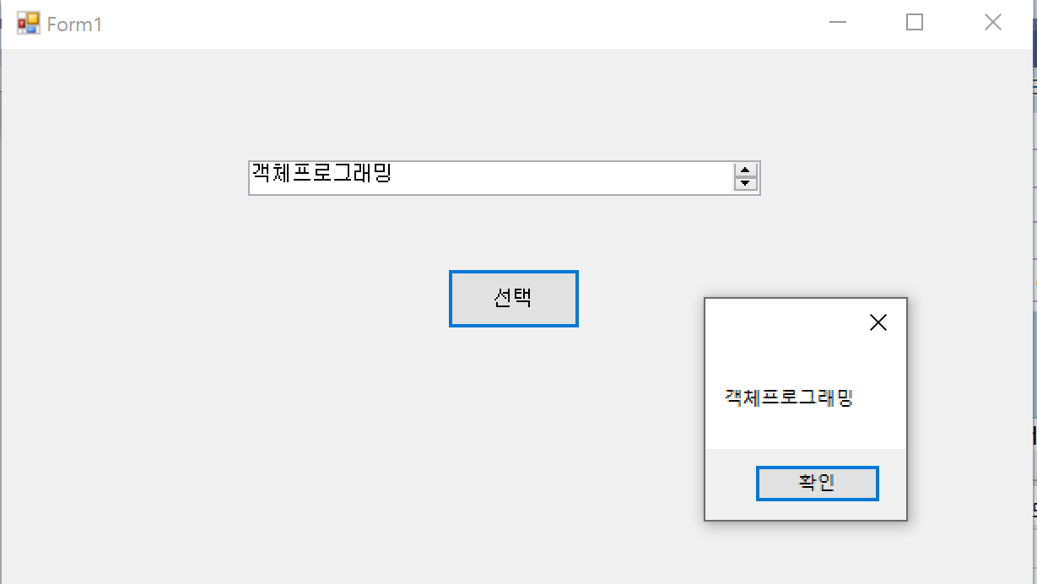
using System;
using System.Windows.Forms;
namespace project
{
public partial class Form1 : Form
{
public Form1()
{
InitializeComponent();
}
private void button1_Click(object sender, EventArgs e)
{
MessageBox.Show(domainUpDown1.SelectedItem.ToString());
}
}
}

Slide 7
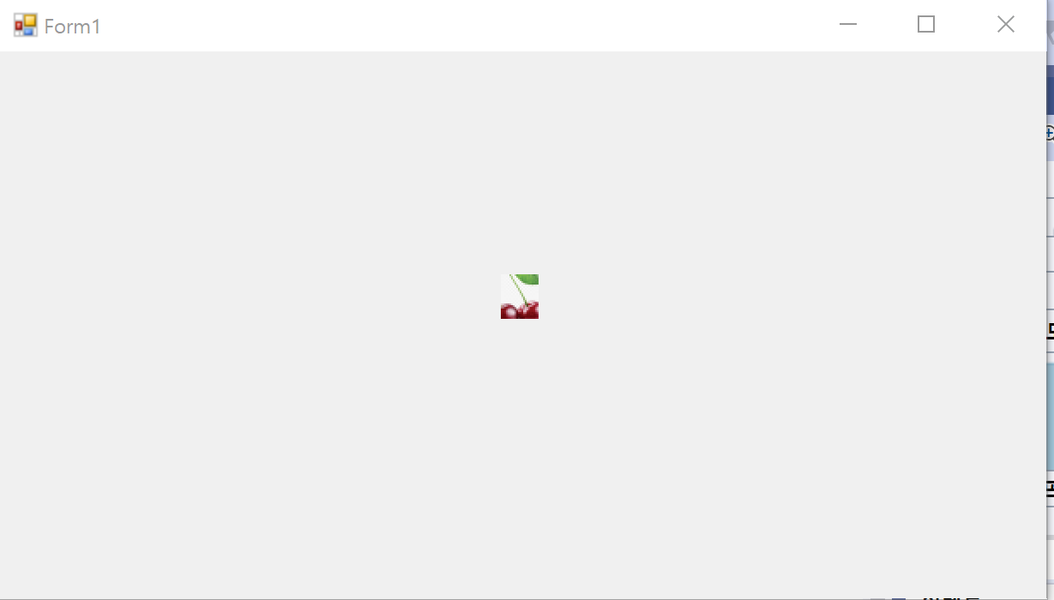
using System;
using System.Windows.Forms;
namespace project
{
public partial class Form1 : Form
{
public Form1()
{
InitializeComponent();
}
private int index = 0;
private void timer1_Tick(object sender, EventArgs e)
{
index %= imageList1.Images.Count;
label1.Image = imageList1.Images[index++];
}
}

Slide 8
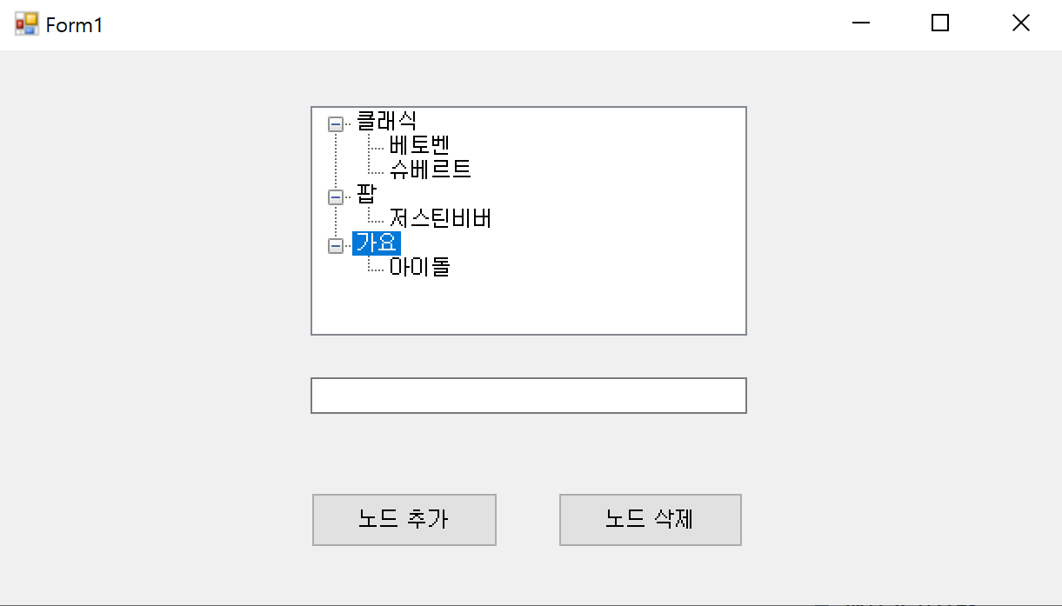
using System;
using System.Windows.Forms;
namespace project
{
public partial class Form1 : Form
{
public Form1()
{
InitializeComponent();
}
private void button1_Click(object sender, EventArgs e)
{
if (textBox1.Text != "" && treeView1.SelectedNode != null)
{
// 선택된 노드가 있으면, 그 노드의 자식 노드로 추가한다.
treeView1.SelectedNode.Nodes.Add(
new TreeNode(textBox1.Text, 1, 1));
textBox1.Text = "";
textBox1.Focus();
}
}
private void button2_Click(object sender, EventArgs e)
{
treeView1.Nodes.Remove(treeView1.SelectedNode);
}
}
}

