Slide 1

multithreading / multiprocessing
Miroslav Ledecký, Tomás Marczi

Slide 2
python - multithreading
start() - Start the thread’s activity
run() - Method representing the thread’s activity
join() - Wait until the thread terminates
shares memory
condition object - condition variable is associated with some kind of LOCK

Slide 3
C vs python
Matrix multiplication without multithreading (matrix dimensions: [3x9000])
Python: 0.054s
C: 0.001s
Python: High-level language
C: Low-level language (compared to Python)

Slide 4
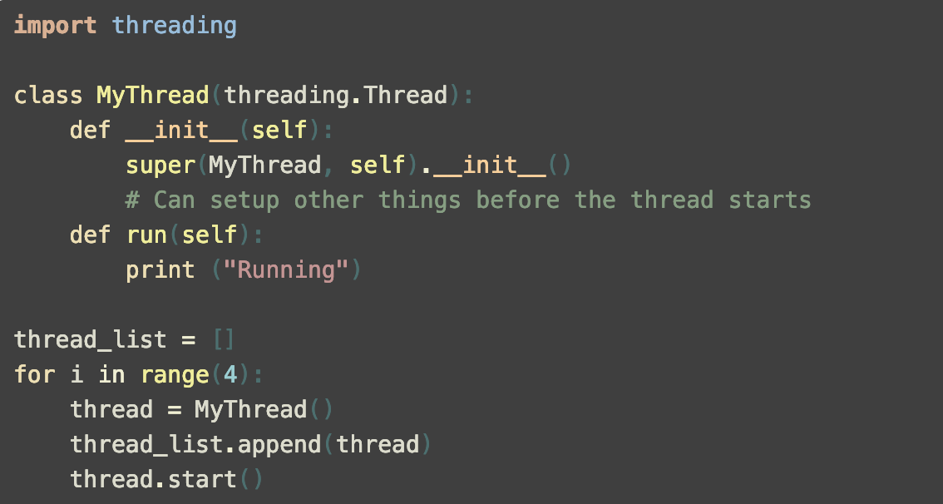
multithreading - class

Slide 5
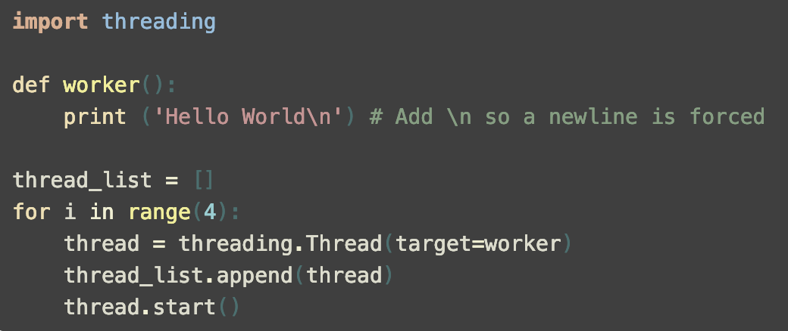
multithreading - function

Slide 6
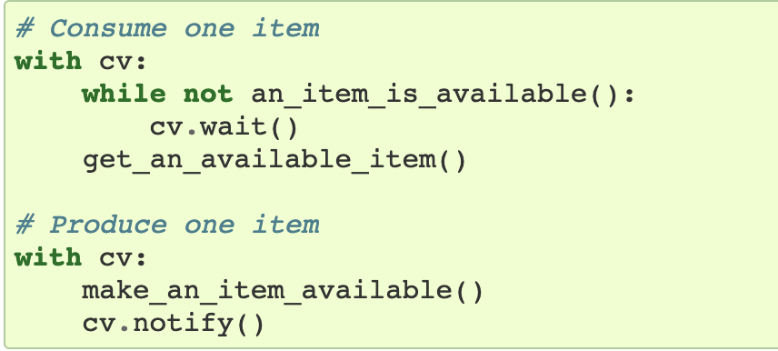
Condition object

Slide 7
Global interpreter lock (gil)
only for multithreading
2 ways for solving the problem:
multiprocessing
IronPython 2.7

Slide 8
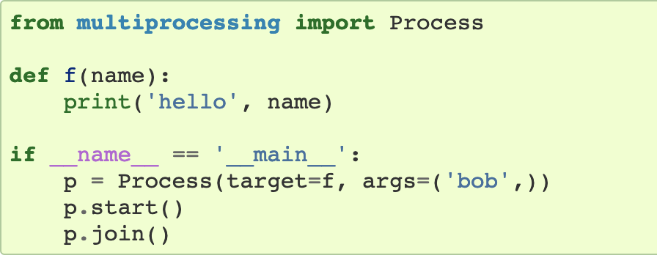
multiprocessing (vs multithreading)
separate memory spaces
multiple CPU cores
bypassing GIL limitation

Slide 9
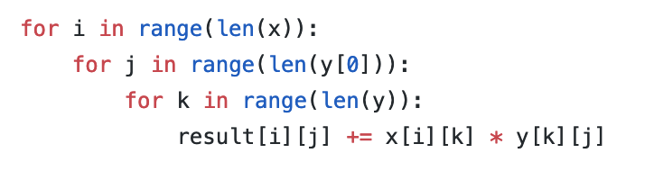
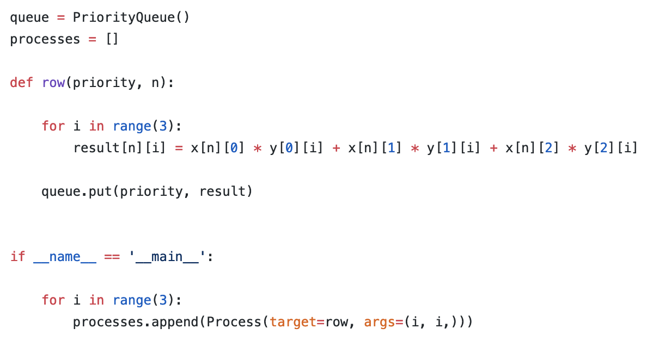
matrix multiplication problem
Type to enter a caption.
Type to enter a caption.

Slide 10
Matrix multiplication - execution time
(matrix dimensions: [3x999999])
Matrix: 5.3s
Matrix multiprocessing: 1.25s
Matrix multithreading (IronPython): 0.05s

Slide 11
fibonacci sequence - execution time
Fib (32bit): 633.25s
Fib (64bit): 52.89s
Fib multiprocessing (64bit): 14.84s
Fib multiprocessing (32bit): 177.58s
Fib multithreading (IronPython - 64bit): 57.9s
Fib multithreading (IronPython - 32bit): 101.2s
Fib multithreading sync (IronPython – 64bit): 126.88s
Fib multithreading sync (IronPython – 32bit): 214.18s

Slide 12
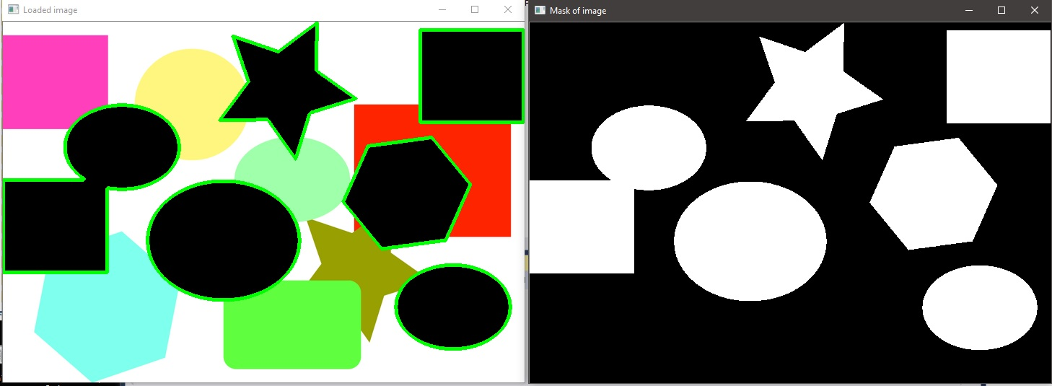
Finding shapes in image - execution time
Shape: 1.31s
Shape threading: 1.18s

Slide 13
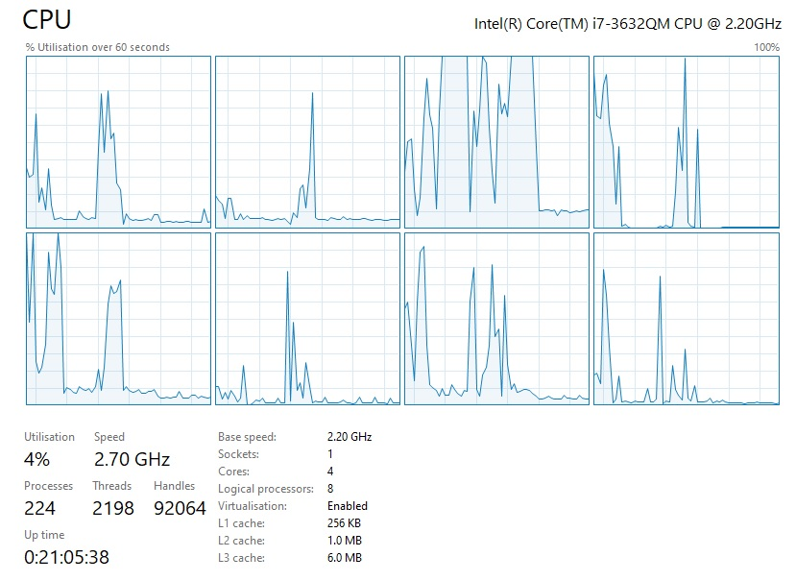
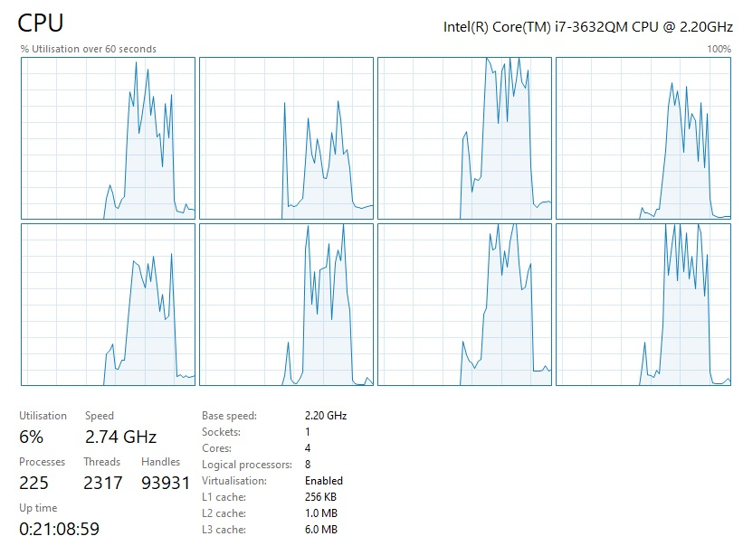
Fib - single vs multi processing

Slide 14
sources
https://docs.python.org/3/library/threading.html
https://docs.python.org/3/library/multiprocessing.html
https://nitratine.net/blog/post/python-threading-basics/

Slide 15
thanks for your attention

