Slide 1
Matlab modelling

Slide 2
Content
Directory 설명
각 directory별 file들 설명
Analysis
Receiver
Transmitter
Common
GUI 설명
Function hierarchy
Receiver
Transmitter

Slide 3
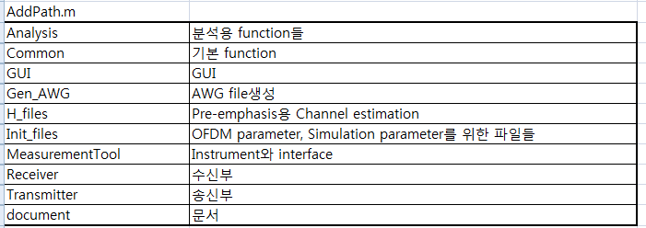
directory 구조

Slide 4
Analysis
File name | Description
BER2Q.m | BER to Q
CSFigure.m | Constellation
EbNo2SNR.m | EbNo 2 SNR for OFDM
EsNo2EbNo.m | EsNo 2 EbNo for OFDM
FrameAnalysis.m | Analysis for each frame
OFD.m | Spectrum
OTD.m | Power in time domain
SNR2EbNo.m | SNR 2 EbNo for OFDM
cfo_calc.m | CFO estimation from DC interval
idealBER_EBNO.m | Ideal BER as a function of EbNo for OFDM
osnr2snr.m | OSNR to SNR
snr2osnr.m | SNR to OSNR

Slide 5
Common
File name | description
AutoCorr.m | Auto correlation
CrossCorr.m | Cross correlation
Get_int.m | CRT
NLowPassFilter.m | Low pass filter
NLowPassFilter1.m | Low pass filter

Slide 6
Receiver files
File name | Description
NRx1Frame.m | 1 frame receiver ( Specific for off-line experiment )
RxMain.m | 1 frame receiver
OFDE.m | OFDE for CD compensation
SPMPostComp.m | SPM compensation for nonlinear
NRxAGC.m | Automatic Gain control
NRxFindCS_MIMO_energy.m | Frame symbol synchronization ( only for simulation )
NRxSCFOcor.m | CFO estimation and compensation
NRxFindSync.m | Symbol synchronization
NRxChannelEst.m | Channel estimation
ISFA.m | ISFA
FFTnComp.m | Data symbol( Channel equalization, CPE estimation )
NRxDemapper.m | Demapper

Slide 7
Transmitter files
File name | Description
TxMain.m | TX main
IFFTnAddCP_PreComp.m | IFFT
NCalDelay_ver2.m | Delay calculation for subband ( band division )
NMapper.m | Mapper
NPilot.m | Pilot subcarrier add
NPrecompCD.m | Precompensation
Preamble_PreComp.m | Insert training symbols

Slide 8
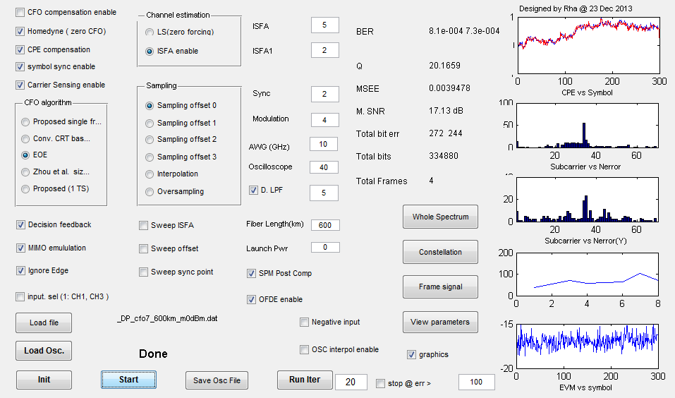
GUI

Slide 9
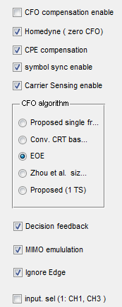
GUI 1
Carrier frequency offset compensation
Homodyne ( disable시 DC interval을 이용하여 given CFO estimation)
Common phase error( phase rotation) compensation
Symbol synchronization ( to find the start of symbol)
Frame synchronization ( to find the start of frame )
Carrier frequency offset estimation type
Single frequency CFO based on CRT ( two training symbols)
Conventional CFO based on CRT ( two training symbols)
EEO (Combined with Zhou’s algorithm)
Zhou’s algorithm
Single frequency CFO based on CRT ( one training symbol)
Decision feedback phase rotation
MIMO emulation (1: MIMO, 0: SISO)
Extend subcarriers to apply ISFA to edge subcarriers
Input channel selection ( 1:CH1, CH3, 0:CH2, CH4)

Slide 10
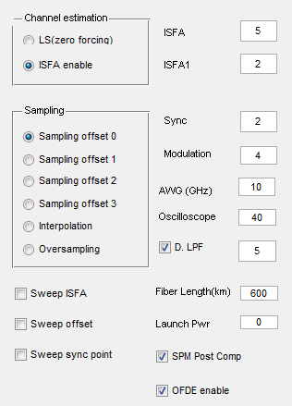
GUI II
Channel estimation (zero forcing)
ISFA disable
ISFA enable
with ISFA size(amplitude) of
and ISFA1 size(I,Q separate) of
Symbol synchronization point
Sampling offset selection (Obsolete)
Sampling offset 0
Sampling offset 1
Sampling offset 2
Sampling offset 3
Interpolation
Overampling
QAM : 2⁴ QAM
The sampling rate of transmitted signal (GHz)
The sampling rate of incoming signal (GHz)
Sweep ISFA size to find the
optimum ISFA size
ISFA from 0 to
and ISFA1 size from 0 to
Low pass filter cut off frequency (GHz)
Fiber length
Sweep the sampling offset
Launch power(?):
Sweep the syncpoint from 0 to
Enable self phase modulation (SPM) post compensation
OFDE enable

Slide 11
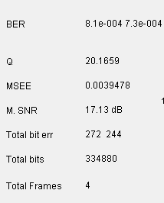
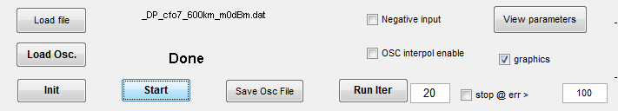
GUI III
읽은 파일 이름 display
File read (C1, C2, C3, C4로 시작하거나, I.xxx, Q.xxx로 된 파일set이어야 함.)
File read시 CH1, CH2를 negative로 read함
Oscilloscope를 trigger하고 data읽어옴.
Oscilloscope data is interpolated using time information of triggered data
Frame decoding (NRx1Frame.m 을 실행시킴)
Initialize
OFDM parameters (InitOFDM_xxx.m)
BER related parameters
20개의 frame을 decoding할 때까지
진행,
한 frame의 error개수가 100개가 넘어가면 stop함.
Save the current data in file (C1xxx, C2xx, C3xxx, C4xxx)

Slide 12
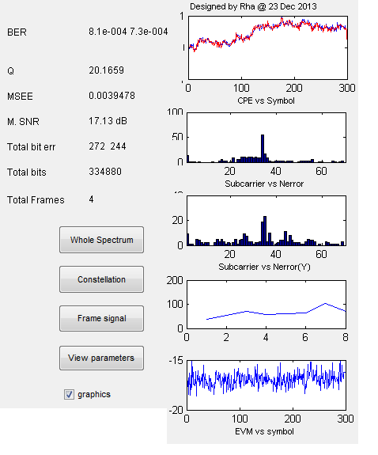
GUI IV
BER ( X pol, Y pol )
The estimated CPE ( one frame)
Mean square estimation error of CFO
Mean SNR
Accumulated bit errors as a function of subcarrier (X pol)
The total number of bit errors
(X pol, Y pol)
The total number of bits
The total number of frames
Accumulated bit errors as a function of subcarrier (Y pol)
Spectrum of input signal
Constellation
Frame별 bit error개수의 추이
Time domain signal
Display OFDM parameters
Display graphic data
EVM vs symbol ( one frame)

Slide 13
Hierarchy of receiver
NRx1Frame.m
 | RxMain.m
 |  | OFDE.m
 |  | SPMPostComp.m
 |  | NRxAGC.m
 |  | NRxFindCS_MIMO_energy.m
 |  | NRxSCFOcor.m
 |  | NRxFindSync.m
 |  | NRxChannelEst.m
 |  |  | CalcH2.m
 |  | ISFA.m
 |  | FFTnComp.m
 |  |  | FFTnRemoveCP.m
 |  | NRxDemapper.m
 |  |  | NRxDemapper_sc.m
 |  |  | NRxDemapper_simple.m

Slide 14
Hierarchy of transmitter
run_gen_AWG.m
 | InitOFDM_06Oct.m
 | ReInitOFDM.m
 | NCalDelay_ver2.m
 | GenStim.m
 | TxMain.m
 |  | NMapper.m
 |  |  | NMapper_sc.m
 |  |  | NMapper_simple.m
 |  | NPilot.m
 |  | IFFTnAddCP_PreComp.m
 |  |  | ifft_band.m
 |  | NPrecompCD.m
 |  |  | NPrecompCD_ver1.m
 |  |  | NPrecompCD_ver2.m
 |  |  | NPrecompCD_ver3.m
 |  |  | NPrecompCD_ver4.m
 | gennerate_AWG.m

