Slide 1
Thesis Defense
LightWave: An Interactive
Estimation of Indirect
Illumination Using
Waves of Light
By:
Michael Robertson
Friday, December 7, 2012

Slide 2
General Goal
We want to render indirect illumination with indirect shadowing in real-time.
But, until recent developments in technology, realistic lighting of scene has only been achievable offline.
Now, real-time rendering is possible but we must make tradeoffs between scientific accuracy and performance.

Slide 3
Why?
The desire to accurately recreate our world using computer graphics for:
  Entertainment: Games, Animated Movies
  Science: Weather Forecasts, Simulations
  Medicine: Body Scans
  Architecture, Design, and more...

Slide 4
Terminology
Direct Illumination
  Direct Shadows
Indirect Illumination
  Indirect Shadows
Global Illumination

Slide 5
The Problem
Direct Illumination =
  Easy, stops at first surface it hits
Indirect Illumination =
  Hard, bounces infinitely
  Indirect Illumination can be expressed accurately using a Neumann Series

Slide 6
Indirect Illumination
Neumann Series =
Indirect Illumination =
Neumann Series of form =
- gε = direct term
- gMgε = once scattered
- gMgMgε = twice scattered, and so on...
Notes:
Neumann Series is a mathematical series of this form:
where T is an operator and therefore T^k is a notation for k consecutive operations of operator T
This tells us that indirect illumination can be calculated by summing the light that hits a surface due to the reflection or bouncing of light n-times all the way up to infinity or until the light is fully absorbed by the surfaces it hits.
The more terms we include in the calculation, the better the approximation will be but with worse performance.
→ We want to avoid this.

Slide 7
Historical Inspirations
Prior to the 19th century
  Light was regarded as a stream of particles
  Explained reflection and refraction
1801: Light rays interfere (wave-like)
1873: Light was compared to a form of high-frequency electromagnetic wave
1905: Einstein proposed that the energy of light waves is quantized in particles called photons.
Notes:
Quantization is the idea of constraining elements that are continuous into discrete sets
Conclusion: Light acts like a wave and a particle
Many other lighting techniques use the idea of light acting as a particle in order to depict light travel throughout a scene. (Photon Mapping)
I would like to use a hybrid approach that depicts light as a particle and a wave.

Slide 8
Goals
Indirect illumination with indirect shadows
Fully dynamic light and objects
Scalable
  Scene Complexity
  Support variety of hardware capabilities
Implement using the GPU through the use of OpenGL and GLSL

Slide 9
Related Work
Instant Radiosity (Keller 1997)
  Virtual Point Lights (VPL's)
  Each VPL acts independently as a producer of indirect light
  VPL's are generated at the hit points of the photons as they are traced into the scene from the primary light source
  The contributions of each VPL is summed through the use of multiple rendering passes.

Slide 10
Related Work
Instant Radiosity (Keller 1997)
  Limitations: multiple rendering passes were required for dynamic objects or lights and limited to simple scenes
  VPL's are used for other purposes: area lights, high dynamic range (HDR) environment maps, subsurface light scattering

Slide 11
Related Work
Shadow Maps (Williams 1978), (Reeves, Salesin, and Cook 1987)
  Method of rendering shadows
  Shadow Maps are created in a render pass where the view of the scene is computed from the light's perspective.
  Calculate the distances to the nearest surface for each pixel and store in a texture or buffer.
  Use these distances for comparison when rendering the scene from the camera's perspective to determine whether a surface point is in shadow.

Slide 12
Scientifically Correct Versus
Visually Appealing
All techniques are approximations, since an infinite number of bounces of light would need to be calculated to get correct lighting.
For real-time applications, we must err on the side of performance, but indirect has been shown to be perceptually importance so we can't ignore it.
Realism is determined partially on whether the scene is visually pleasing to the eye.
Notes:
so major approximations can be made to increase performance provided the result is visually pleasing.

Slide 13
Related Work
Perceptual Influence of Approximate Visibility in Indirect Illumination (Yu 2009)
  The most obvious lighting is direct lighting (high-frequency)
  Indirect lighting usually has smooth changes in intensity allowing for interpolations.
  Visibility determination for indirect shadows is the most expensive calculation.
  Conclusion: “Accurate visibility is not required and certain approximations may be introduced”
Notes:
High-frequency meaning that changes in direct lighting can be extreme. (going from direct light to being completed shadowed by another object)
Direct lighting can't be approximated, but it is the cheapest to render anyways, so this is not a problem.

Slide 14
Perceptual Influence...
Conducted study using mostly computer scientists with imaging backgrounds.
Involved looking at different renderings of the same scene using an offline reference rendering and different real-time approximated renderings.
Approximated renderings of indirect shadows ranged from imperfect visibility to no visibility.
2 studies:
  Blind ranking of all renderings
  Estimate difference from reference based on a number scale
Notes:
Imperfect visibility is done using shadow maps on a simplified point-based representation of the objects in the scene.
No visibility ignores indirect shadows.

Slide 15
Perceptual Influence...
Results:
  The reference and all approximated renderings were found to be equally realistic with the no visibility rendering slightly less realistic.
  All of the approximated renderings were found to be “very much similar” to the reference except for the no visibility rendering which was found to be “moderately similar.”
Notes:
The study gives validity to the use of different approximations for indirect lighting and shadows.
The imperfect visibility rendering was found to be the most realistic which leads to the idea that randomly corrupted visibility is better than incorrect visibility.\
All the approximations had noticeable differences in the rendering, but many of them were still considered to be very realistic.
With these findings in mind, we can move on to my implementation.

Slide 16
General Implementation
Render indirect illumination using VPL's
  Ignore the bouncing of indirect light
  Simplify the Neumann series to just one iteration
Use shadow maps for direct shadows and indirect shadows
Provide 2 different techniques of rendering indirect shadows: accurate visibility and “integrated” visibility

Slide 17
Implementation Specifics -
Working Environment
CPU code is written in C++ using OpenGL.
GPU code is written in GLSL.
  This allows us to write our own lighting calculations rather than use the default settings.
Hardware:
  CPU: AMD Athlon 64 X2 Dual Core 5200+ 2.61GHz
  GPU: Nvidia GeForce GTX 465 (1GB mem)

Slide 18
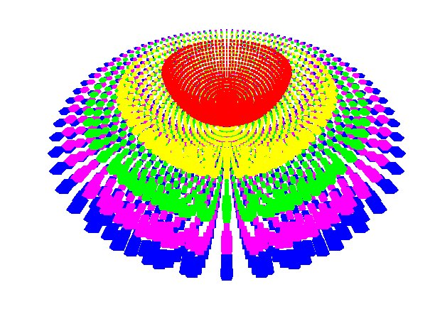
Implementation Specifics -
VPL Organization
VPL's will structured in such a way as to simulate the flowing of waves from the primary light source.
This allows light to reach areas not visible to the primary light source.

Slide 19
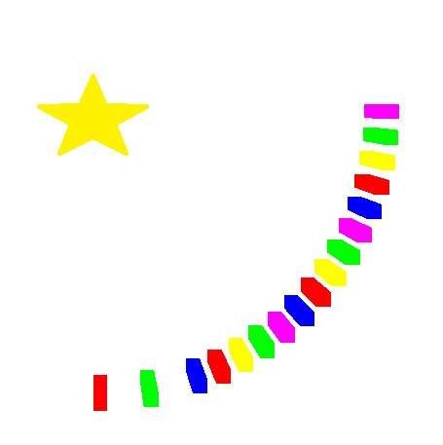
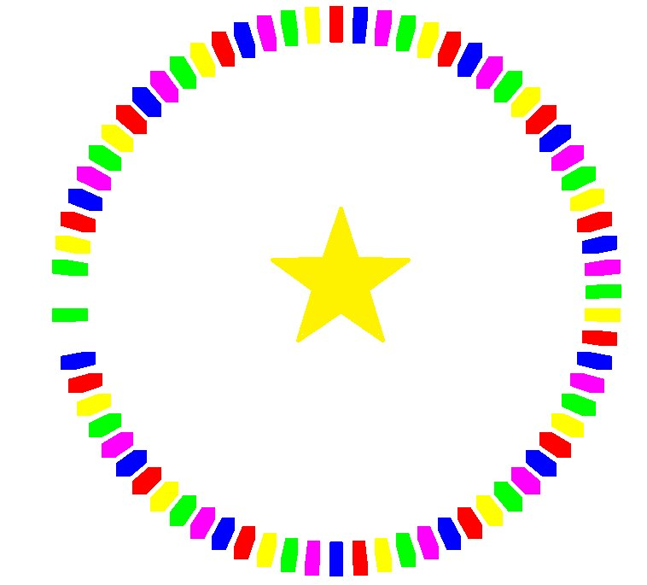
Implementation Specifics -
VPL Organization
Default: 6485 total VPL's. Every 5 degrees around the horizontal axis of the light (left) and every 5 degrees around the vertical axis (right).

Slide 20
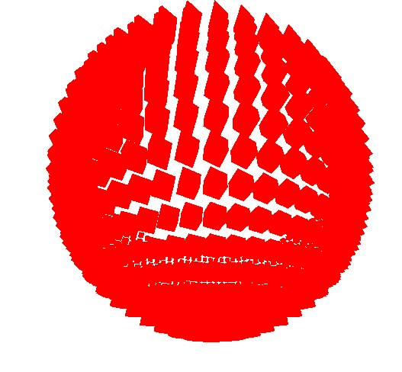
Implementation Specifics -
VPL Organization
This forms a hemisphere around the primary light. (left) Default: 5 stacked hemispheres (right)

Slide 21
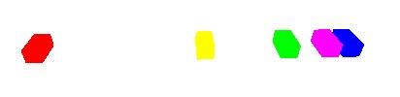
Implementation Specifics -
VPL Organization
The distance between each “shell” of VPL's will be logarithmic.
The attenuation of the light produced by a VPL in each shell will be exponential.
  The amount of drop off in the intensity of the light will increase exponentially per shell.

Slide 22
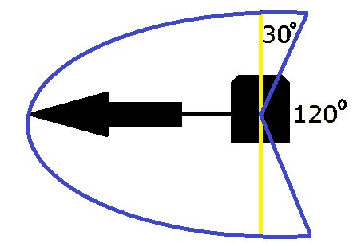
Implementation Specifics -
VPL Contributions
In keeping with the wave theme: VPL's viewable range for contributing light will be extended.

Slide 23
Implementation Specifics -
Shadows
Direct shadows will be computed using a single shadow map.
Indirect Shadows will be computed using 2 different methods:
  Accurate Visibility: Use 20 shadow maps each computed using the perspective of a randomly chosen VPL to cast shadows.
  Integrated Visibility: Use 5 shadow maps each computed using the perspective of a specific VPL to cast shadows.

Slide 24
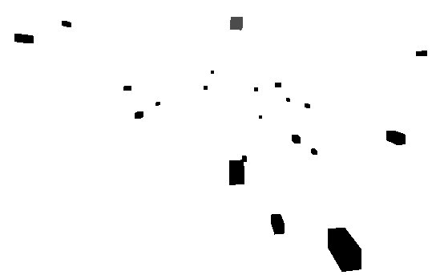
Implementation Specifics -
Accurate Shadows
Compute 20 shadow maps using randomly chosen VPL's (right)
This will result in 20 indirect shadows using accurate visibility.
1 shadow per shadow map

Slide 25
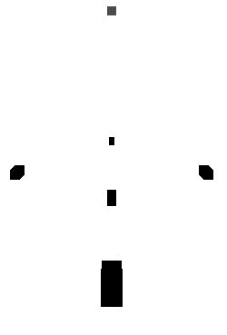
Implementation Specifics -
Integrated Shadows
Compute 5 shadow maps using specific VPL's (right)
We then interpolate between shadow maps in order to create additional shadows based on the number of steps taken.
8-24+ shadows per shadow map

Slide 26
Implementation Specifics -
Integrated Shadows
This is done by calculating the coordinate corresponding to our given vertex in 2 given shadow maps.
We then calculate a vector connecting these 2 coordinates.
We step across the vector using the user-specified number of steps resulting in in-between coordinates.
At each step, we determine whether the vertex would be in shadow using this in-between coordinate and 1 of the 2 shadow maps.

Slide 27
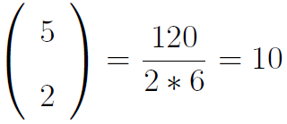
Implementation Specifics -
Integrated Shadows
The in-between coordinates in the 1st half of the vector will use the 1st shadow map and the 2nd half will use the 2nd shadow map.
We do this for all possible combinations of the 5 shadow maps:
Then the total number of indirect shadows shadows will be:

Slide 28
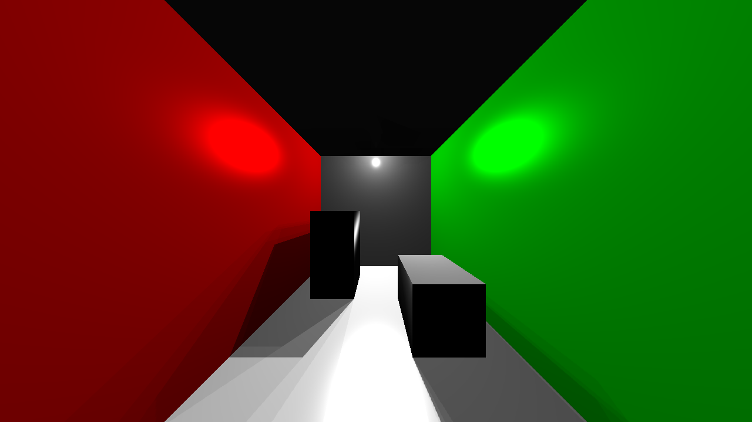
Implementation Specifics -
Integrated Shadows
Why interpolate? Why not just use 5 shadows?

Slide 29

Implementation Specifics -
Integrated Shadows
Compared to integrated shadows: (smoother)

Slide 30
Memory Analysis
Shadow Maps
The default resolution will be 1280x720.
The shadow maps should be a ratio of this resolution.
The larger they are, the less jaggies they show. (Examples next)
For this implementation, I'll be using shadow maps 3X larger than the resolution.
  3840x2160

Slide 31

Memory Analysis
Shadow Maps
Shadow Maps half of the screen resolution:
  640x360

Slide 32

Memory Analysis
Shadow Maps
Shadow Maps same size as screen resolution: 1280x720

Slide 33

Memory Analysis
Shadow Maps
Shadow Maps twice the screen resolution:
  2560x1440

Slide 34
Memory Analysis
Shadow Maps
Shadow Maps 3X the screen resolution:
  3840x2160

Slide 35
Memory Analysis
Shadow Maps
Knowing the texture size of the shadow maps and knowing that they store floats, we can calculate the amount of memory required for the GPU:
(3840*2160*4)/(1024*1024) = 31.64MB per SM
Accurate Shadows (21 total SM):
(3840*2160*4*21)/(1024*1024) = 664.45MB
Integrated Shadows (6 total SM):
(3840*2160*4*6)/(1024*1024) = 189.84MB

Slide 36
Memory Analysis
Shadow Maps
Recall the GPU I'm using was: Nvidia GeForce GTX 465 (1GB mem) allowing me to run either implementation.
But many computers today have GPU's with 256MB or 512MB of available memory.
A goal was to have the implementation be scalable, so integrated shadows looks more appealing in memory use.

Slide 37
Implementation Specifics -
CPU Responsibilities
Initializing the window, variables, and textures.
Compute the VPL data (position, normals) and store in textures. This is updated every time the light is moved.
Generate all of the shadow maps by rendering the scene from the perspective of each light (not seen by user). This is done every time an object or the light is moved.

Slide 38
Implementation Specifics -
GPU Responsibilities
Lighting calculations using the VPL data and shadow maps passed in from the CPU.
Lighting calculations are done per-vertex.
GPU is preferred in this area due to the ability to excel in parallel processing of data.
Since the same calculations are done for every vertex, we can do this is parallel.

Slide 39
Results
In order to show how scalable the implementation is, the results will show the differences in performance (frames per second) when changing different parameters including:
  Screen Resolution (and Shadow Map size)
  Number of VPL's (increase the angle from 5 degrees or reducing the number of shells)
  Number of shadow maps (for accurate shadows)
  Number of steps to integrate (integrated shadows)

Slide 40
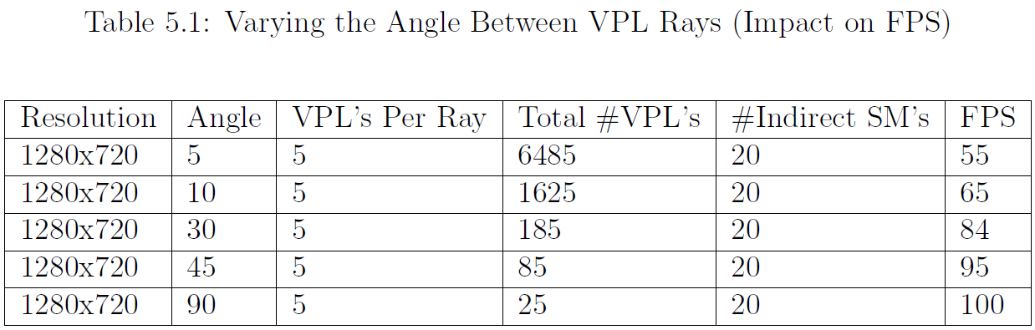
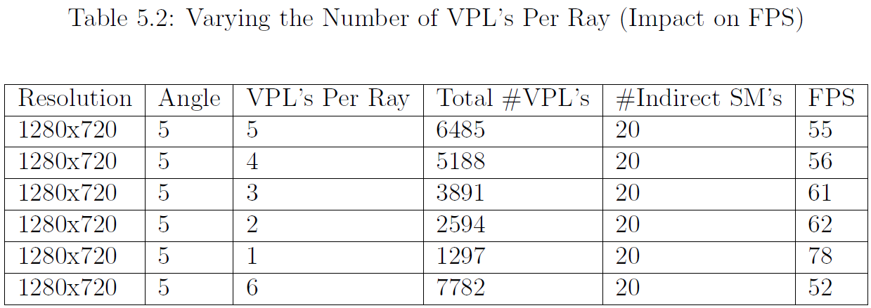
Results – Accurate Shadows

Slide 41
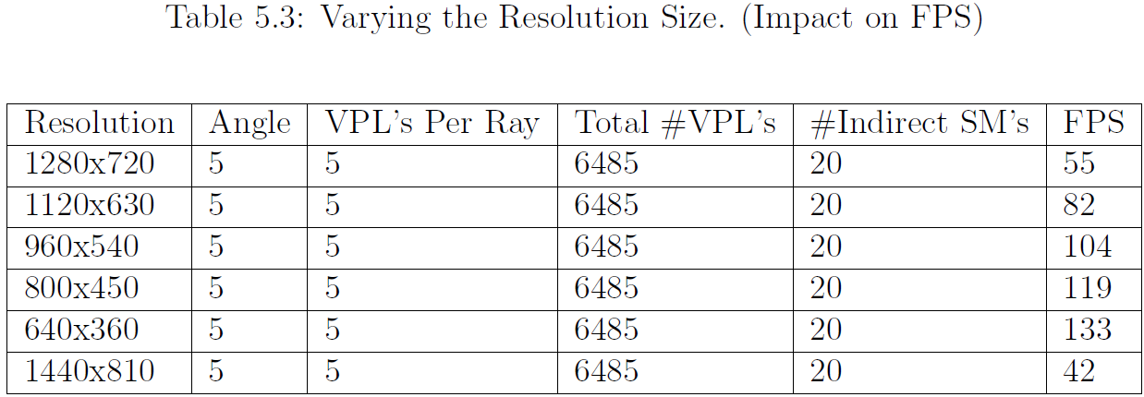
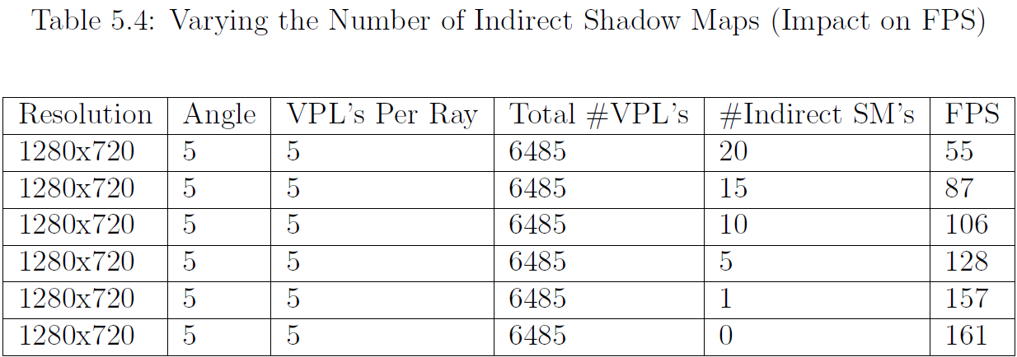
Results – Accurate Shadows

Slide 42
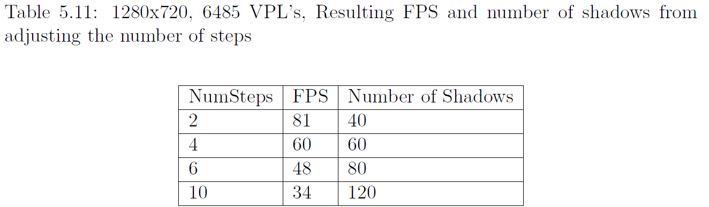
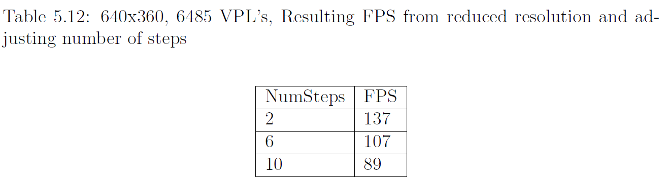
Results – Integrated Shadows

Slide 43
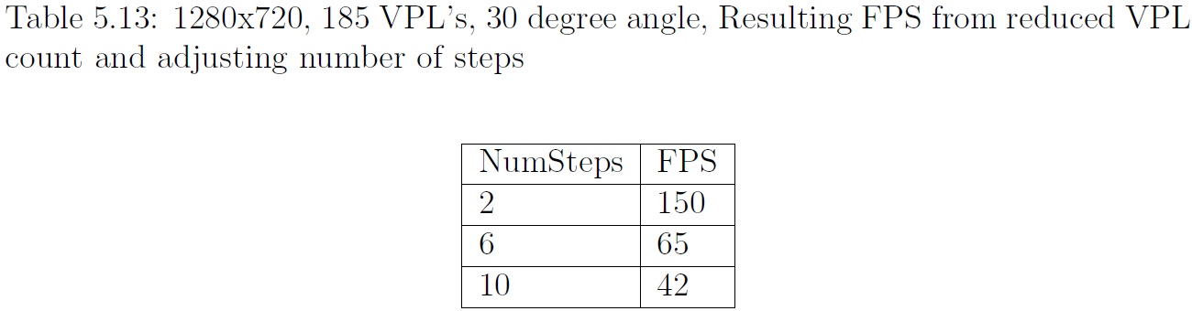
Results – Integrated Shadows

Slide 44
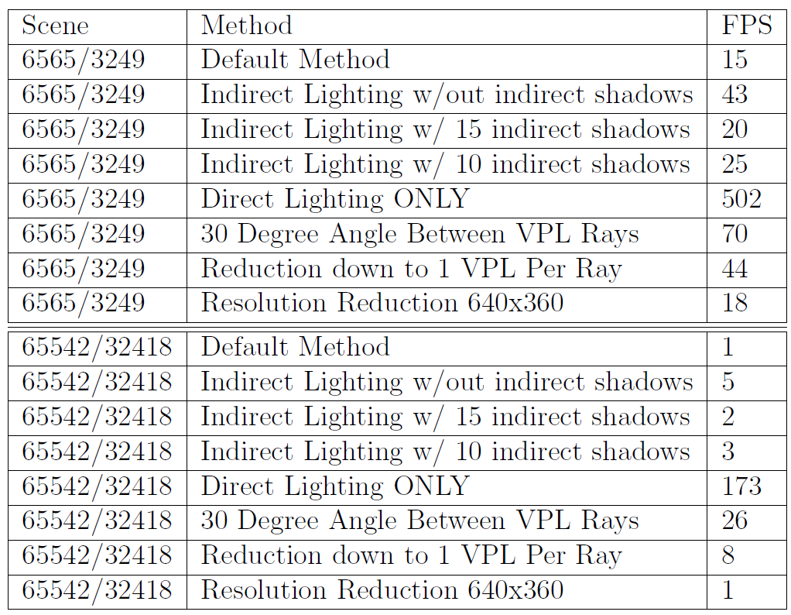
Scene Complexity
Accurate Shadows

Slide 45
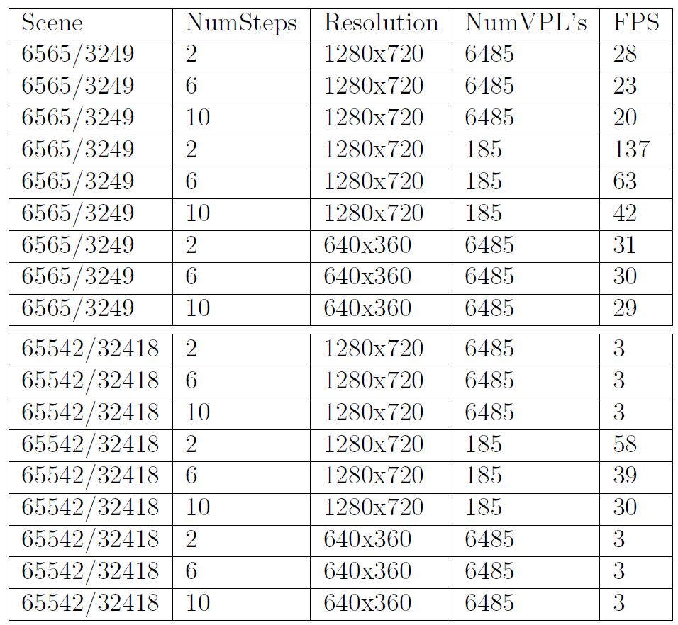
Scene Complexity
Integrated Shadows

Slide 46
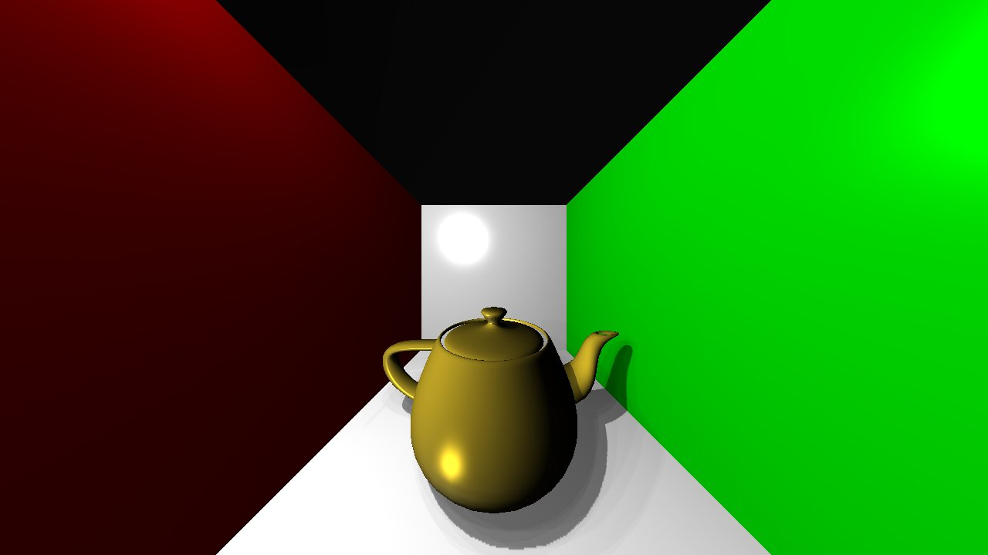
Scene Complexity
Accurate Shadows

Slide 47

Scene Complexity
Integrated Shadows

Slide 48
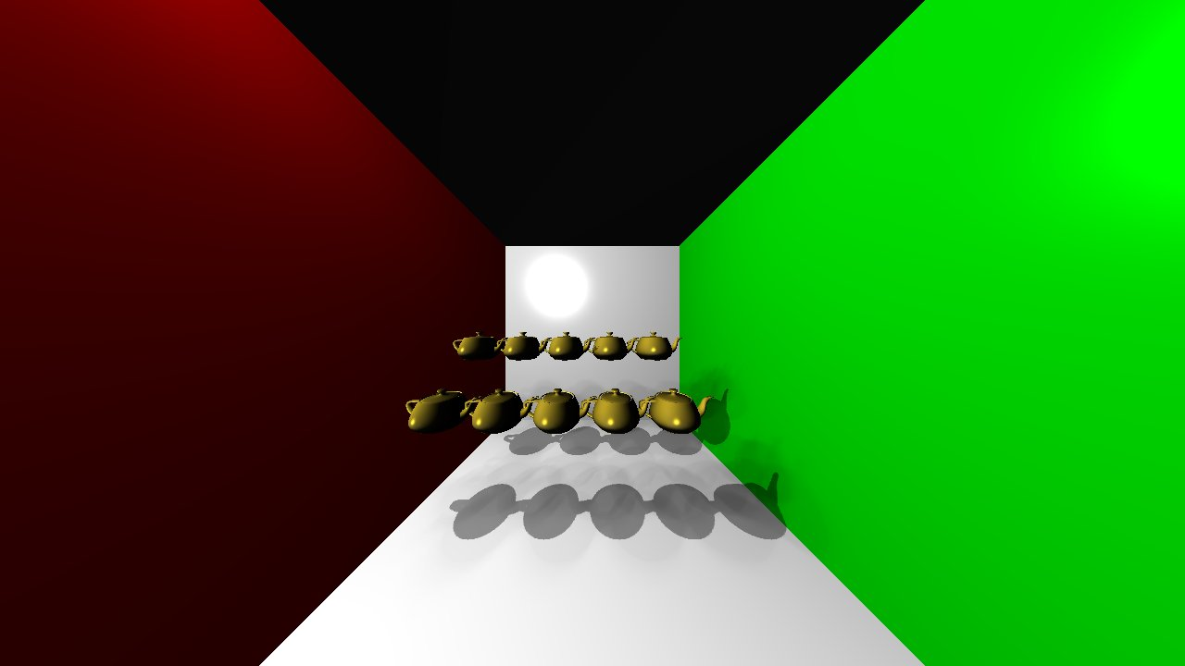
Scene Complexity
Integrated Shadows

Slide 49
Goals Met?
Indirect illumination with indirect shadows (accurate shadows and integrated shadows)
Fully dynamic light and objects (demo)
Scalable (adjustable parameters to increase performance)
  Scene Complexity(26-58FPS for 65k+ triangles)
  Support variety of hardware capabilities (reduced memory version, demo on laptop)
Implement using the GPU through the use of OpenGL and GLSL (done)

Slide 50
Conclusions
Indirect shadows are expensive to compute.
  Many shadows must be present in order to make them look smooth.
  The number of accurate shadows using this size of shadow maps is too limited and 1 shadow per shadow map is inefficient.
  Best to approximate indirect shadows using some type of interpolation technique.
  With further advancements in GPU memory, accurate shadows will get better.

Slide 51
Conclusions
The integrated shadows gave better results than the accurate shadows in terms of FPS, memory use, and number of shadows and therefore appear more realistic since smoother shadows are more visually pleasing.
With better GPU's, we can increase the number of shadow maps and shadows as well as increase the shadow map size and the number of interpolation steps for the integrated shadows.

Slide 52
Limitations
Accurate shadow number are limited by the capability of the GPU.
For fully dynamic scenes with high scene complexity, VPL count has to be lowered to limited the number of vertex calculations.
Common VPL limitations: singularities exist at boundary edges such as where 2 walls meet resulting in darkening due to VPL's being at discrete locations.

Slide 53
Possible Future
Improvements
Both shadowing technqiues will improve with GPU advancement.
Use the idea of Virtual Ray Lights (Novak 2012). VRL's are different from VPL's in that they are line segments that are integrated across to remove singularities. Instead, I could use VPL's that are semicircles (wave-like) and integrate across them.
Incorporate other related works not listed here such as matrix sampling or neighborhood optimizations.

Slide 54
Demo
Desktop Hardware:
  CPU: AMD Athlon 64 X2 Dual Core 5200+ 2.61GHz
  GPU: Nvidia GeForce GTX 465 (1GB mem)
Laptop Hardware:
  CPU: Intel Core 2 Duo P8700 2.53GHz
  GPU: ATI Mobility Radeon HD 3650 (512 MB mem)

