Slide 1
Curiosity in RL
West SA Meeting

Slide 2
Agenda
RL Overview
RL vs other learning methods
Discussion
Lab Setup
Hands on experiments & exploration

Slide 3
Why care about RL
ML methodology capable of reaching AI
Independent* learner
Multi-task capable
Augment with human value systems
How is RL different from other types of learning -- discussion

Slide 4
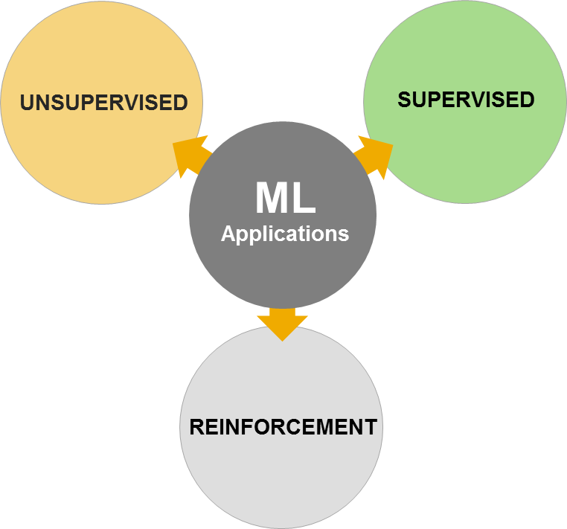
Three Types of Learning
Notes:
Computers are great at optimizing, but not so great at goal-setting. Or even using common sense.

Slide 5
Three Types of Learning
ML applications fall into three broad contexts
Supervised learning
Dataset + labels/annotations
Unsupervised learning
Dataset (without labels/annotations)
Reinforcement learning
No initial dataset
Dataset accumulated with experience
ML agents interact with environment (trial and error)
UNSUPERVISED
SUPERVISED
ML
Applications
REINFORCEMENT

Slide 6
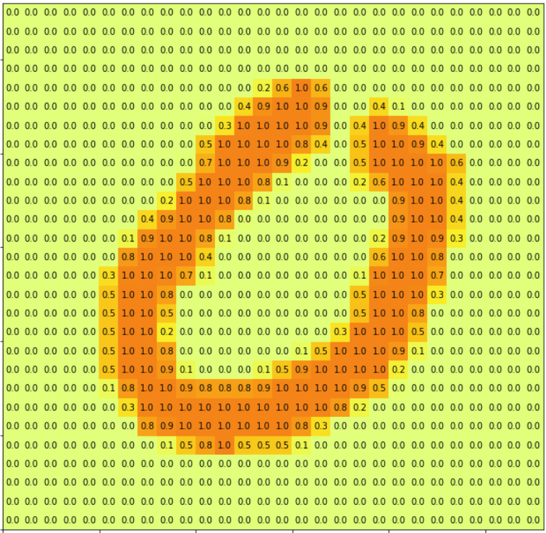
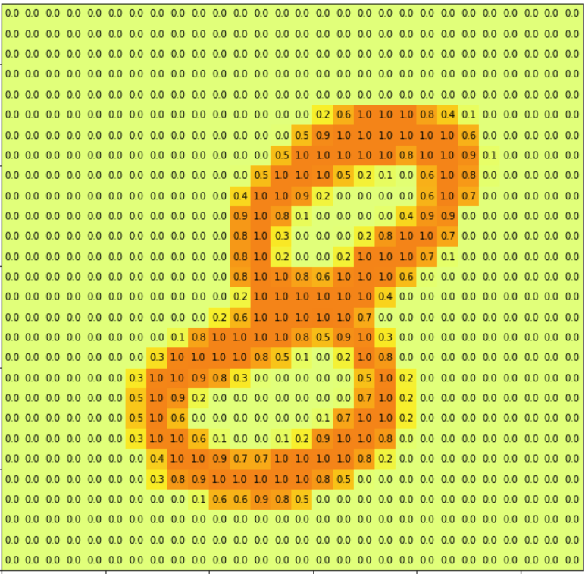
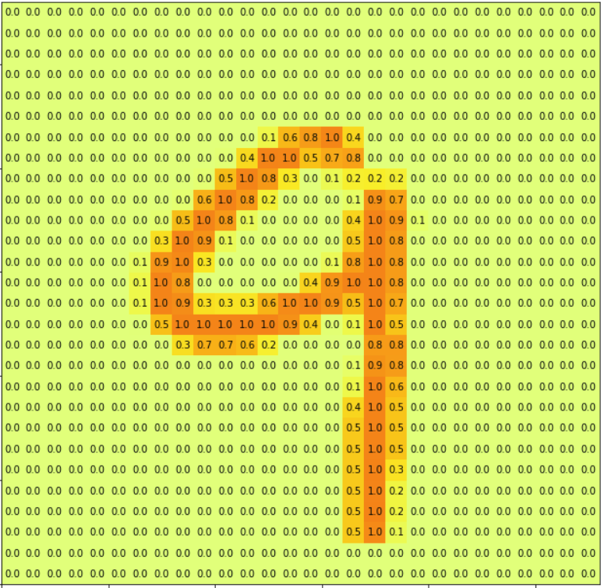
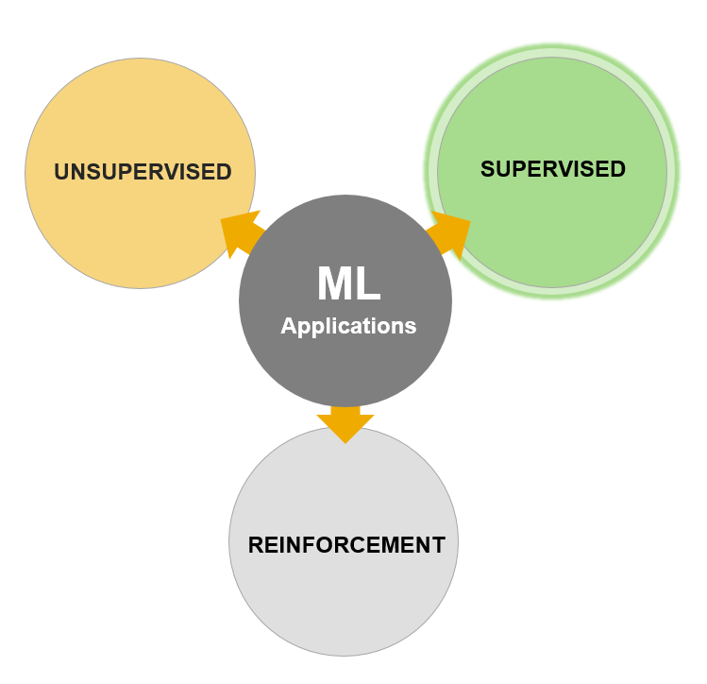
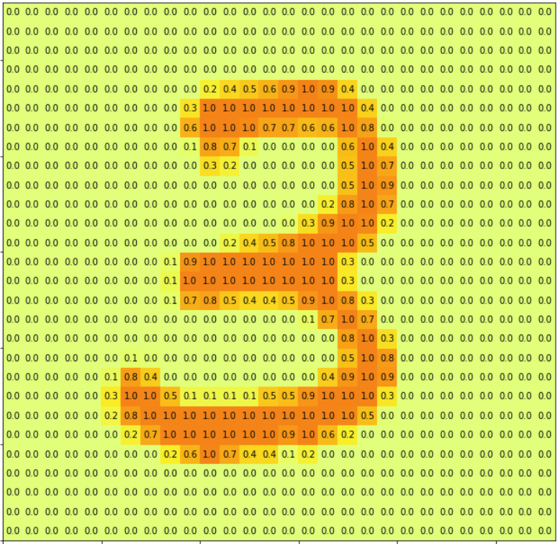
Supervised Learning
2
~100,000s of examples
Each example consists of
Data [ Vector ]
Label(s)
sample #1
3
…
.
.
.
N
label #1: 8, ‘eight’, [ 0, 0, 0, 0, 0, 0, 0, 0, 1, 0 ]

Slide 7
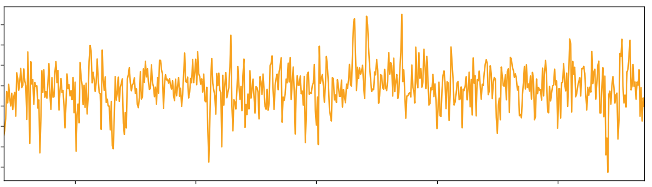
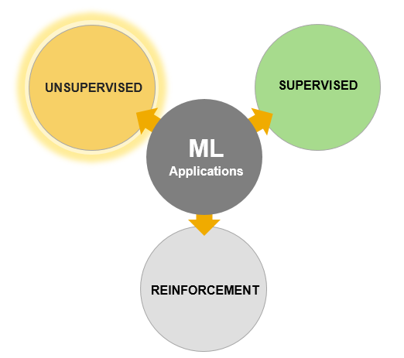
Unsupervised Learning
Time Series Data
In unsupervised learning, no labels are available
Typically larger datasets (millions)
Each example consists of
Data [ Vector ]
No Labels
Gene Sequence Data
A G A T A A G A A G T G T T G T G G A A A A G T A T G T T G
T A T T T A G A A G T A A G T G A T G G T T A T T T G G A G
T A A G T A G G T A G A A T T A A G A G G T T A T A G G G A
A A G G G A A T T G G T G G A A G G T G A T T T A A T G A A
G A A T G T T T G T G A T T A G G A T A G T A T G T A A G A
A T A G A G A T T G G A A T G G G G G G A T G A T G A T T A
A T G A A G T T T A G G A G G T G T A T G A A T G A G A A G
T T A G G G A A G G A T T A A T G T G T A A G G G T A T T A
G G A A A A T G G A A A A A T T A T G G G T T T T T G T G G
A G G G A G T G T A A A G T G G T G T G G A A A A G A T T G
A G G T G A G A T A T T A A A T A T G G T G G A A T A A T G
G G T T A T A T A G A T T A T T T A T G T T G T G G T A T G
G A G G G T G G T A G A G A A T T G A T A A G G T A G G A T
A A T A T T A G A A G A A G G A A T G A T T T A A G T T T G
G G T T G G G A T T A T T T T A G G A T A G A G G G T A T A
T T G G A T G A G G G A G G G T A T T T G G A A G A T G A A
T A G G G G T G T A G T G A G G T T G G G T A T A T G G T G
A T T G G T T T A A A A A T G A A T G G G G A T T A G A A G
G T A A G T A A A T T A G A A G T T G T A A G G A A T T T T
A G A G T A T G G G G T T T T T A G T G G A A A A A G A A A
A G T G G T T G G G A G G G G G G G T G T T A T T G T T G G
T A A T A A T G G G G T G A G A A A T A G A T T G A T A A T
G T A A T T A T T G A A A T T T G G A T A G T A A G T T T A
G G G T A A G G G G A G T G G G T T T G T T G T T A G G T T
A T A A A G T T G T T T A G G G G A T A A T A G A T A G A G
G G G T G A T T T T T T T T T A T A T A T T A A T A G A G G
G T A A A A A A G G T G T G T A A A T A T T A A G T T T T T
T T A A T G A A A T T G T A T T T G A T A A T A A A G A T T
A G A G A A T T A T T G G A A G T G A T A T T G G T G T G G
G G G T A T T A T A G T G G A T T A G G A T A T A A A T T G

Slide 8
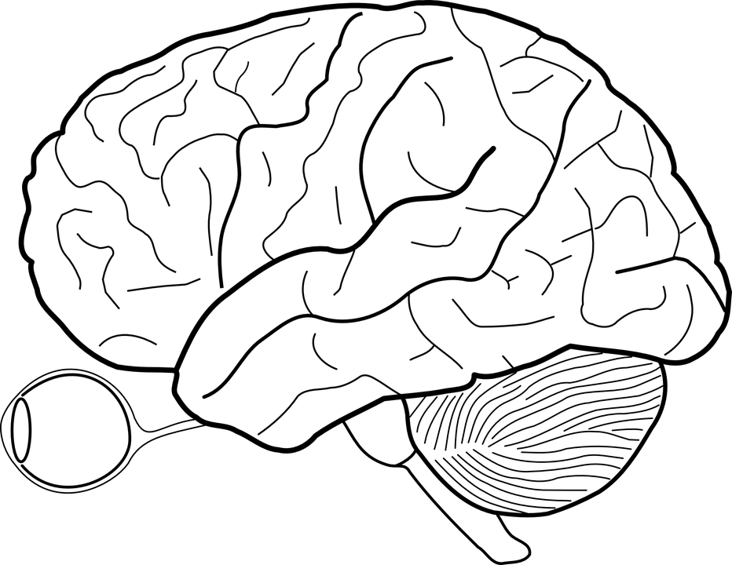
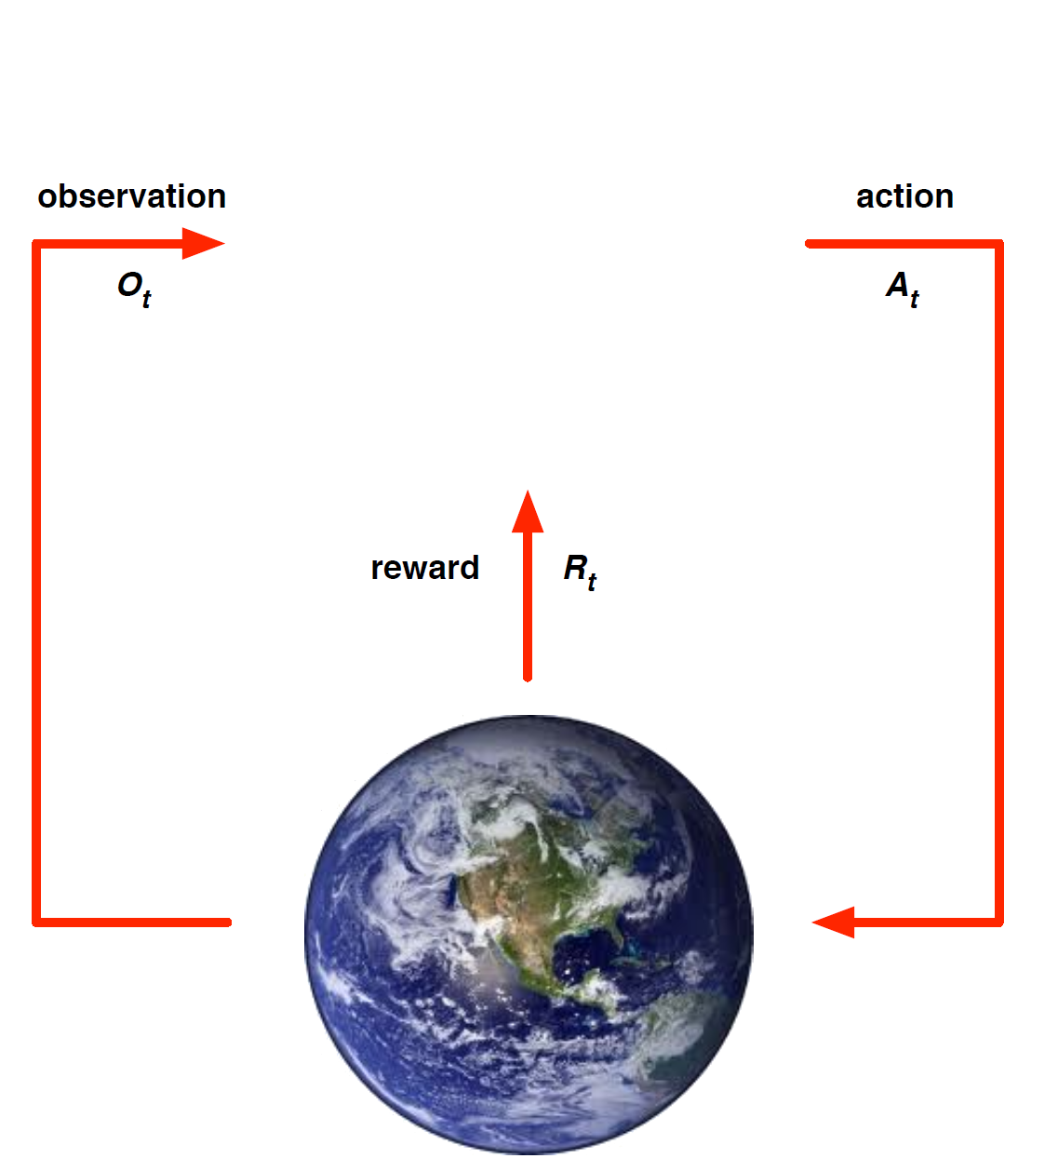
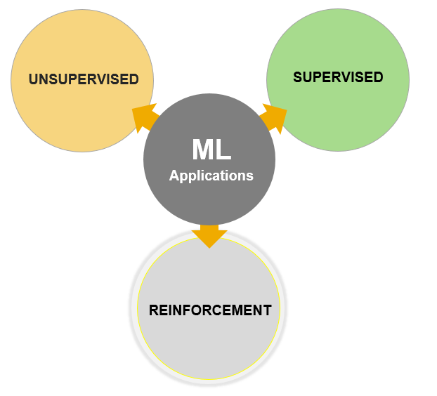

Reinforcement Learning
Agent
RL: Dataset built with experience
Experience = Current Env. State + Action + Next Env. State
RLRL Feedback Loop
At each step the agent
Executes action: $A_{t}$
Receives observation: $O_{t}$
Receives reward: $R_{t}$
The environment
Receives action: $A_{t}$
Emits observation: $O_{t+1}$
Emits reward: $R_{t+1}$
Environment

Slide 9
Under the hood
./run-pytorch-rl.sh
[ ngc. pytorch container + TF + GPUs ] x-11 authentication clone
[ virtual framebuffer ] ./launch_notebook.sh
[ jupyter notebook ] @ port 8888
[ gym ]
ssh @ container host [ + x11]
ssh tunnel @ jupyter port

Slide 10
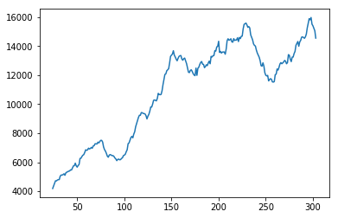
Think about the reward / learning curve
Monitor progress @
Jupyter Notebook -- text output
Tensorboard live plot; TODO @ Eric
Total reward
[ intrinsic + extrinsic ]

Slide 11
Discussion on Rewards
What makes a good reward/penalty strategy?
I.e. what kind of agent do we want to raise?
Can anticipate [ e.g., predict future state + reward ]
Can imitate
Curios / non-Curios
Cooperative / Competitive
…

Slide 12
Curiosity
An Information-Theoretic Approach to Curiosity-Driven Reinforcement Learning 2011 -- Still, Precup
"We provide a fresh look at the problem of exploration in reinforcement learning, drawing on ideas from information theory. First, we show that Boltzmann-style exploration, one of the main exploration methods used in reinforcement learning, is optimal from an information-theoretic point of view. Second, we address the problem of curiosity-driven learning. We propose that, in addition to maximizing the expected return, a learner should chose a policy that maximizes the predictive power of its own behavior, measured by the information that the most recent state-action pair carries about the future. This makes the world “interesting” and exploitable. The general result has the form of Boltzmann-style exploration with a bonus that contains a novel exploration-exploitation trade-off that emerges from the proposed optimization principle. Importantly, this exploration-exploitation trade-off is also present when the “temperature”-like parameter in the Boltzmann distribution tends to zero, i.e. when there is no exploration due to randomness. As a result, exploration emerges as a directed behavior that optimizes information gain, rather than being modeled solely as behavior randomization."

Slide 13
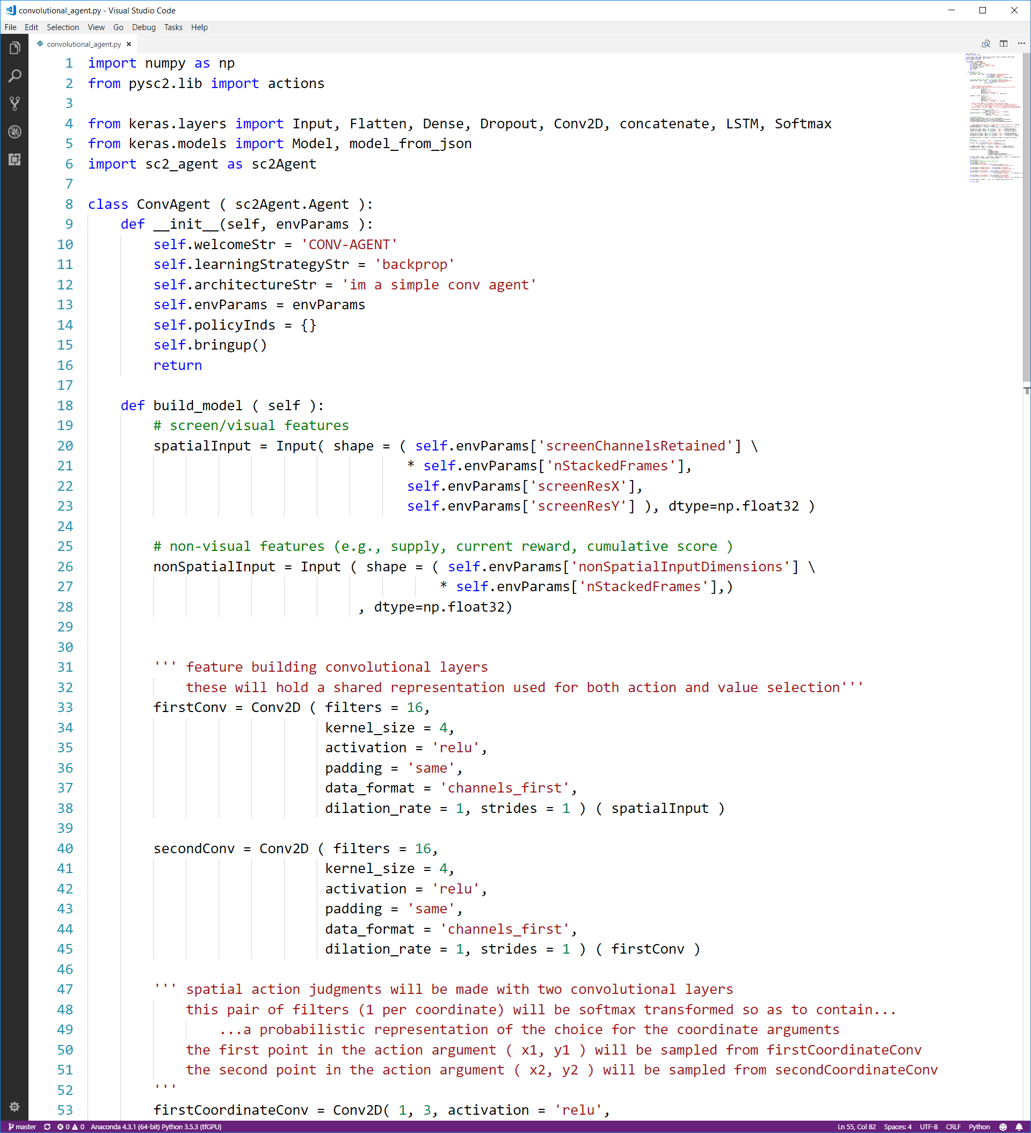
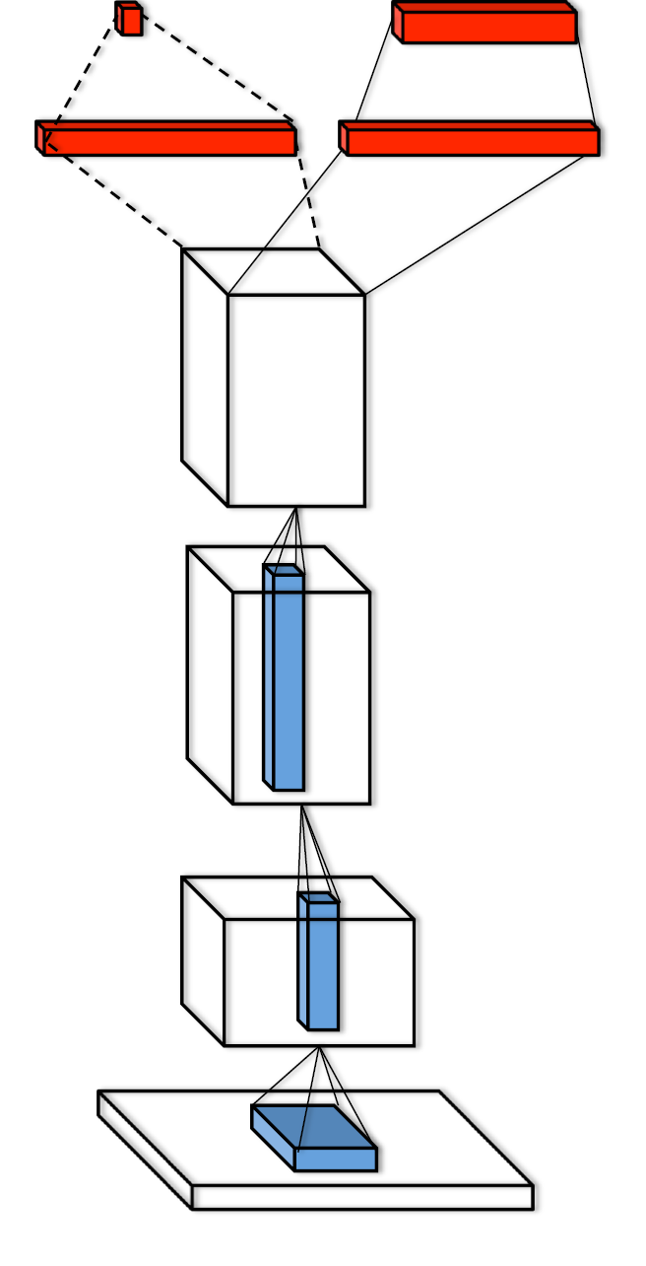
Make an agent
value
action

Slide 14
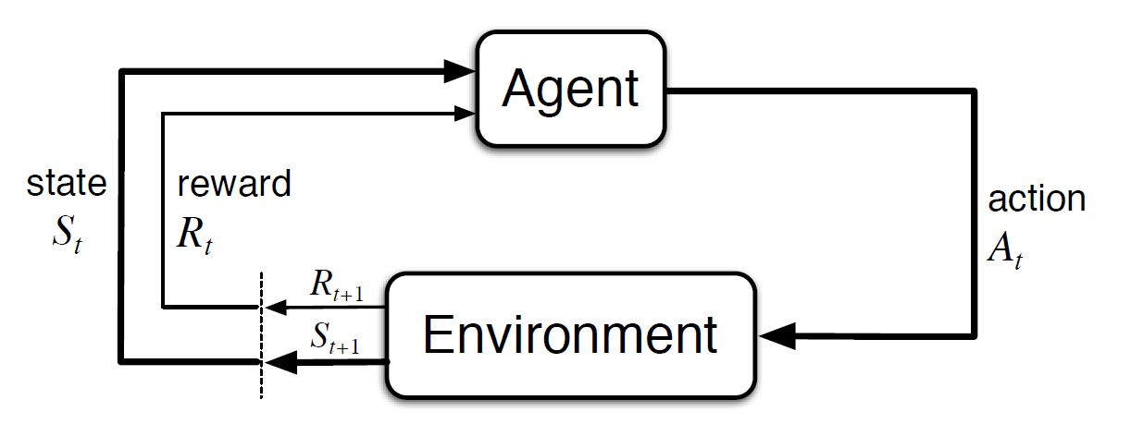
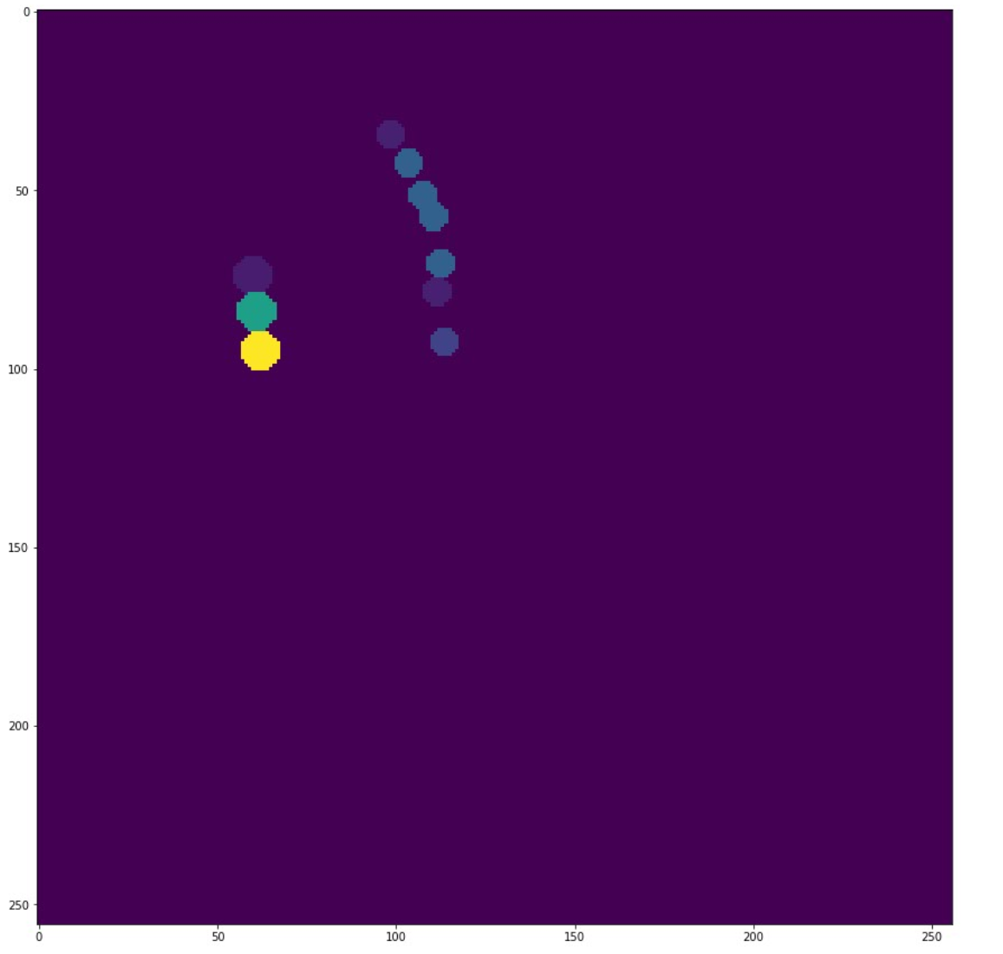
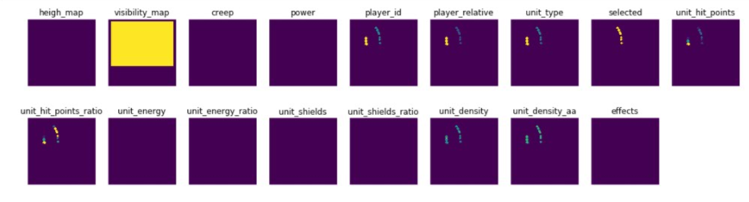
Sc2 DL AGENT
How good is the current state?
What action to take to maximize future reward?
VALUE₀
ACTION₀
STATE₀
REWARD₀
Reward for getting to this state

Slide 15
TRAJECTORY
AGENT
VALUE₀
AGENT
VALUE₁
AGENT
VALUE₂
AGENT
VALUE₃
ACTION₀
ACTION₁
ACTION₂
ACTION₃
STATE₀
STATE₁
STATE₂
STATE₃
REWARD₀
REWARD₁
REWARD₂
REWARD₃

Slide 16

Learning
AGENT
VALUE₀
AGENT
VALUE₁
ACTION₀
ACTION₁
STATE₀
STATE₁
STATE₂
REWARD₀
REWARD₁
Advantage = ( Reward_{t} + $λ$*Value_{t+1} ) - Value_{t}

Slide 17
Appendix

Slide 18
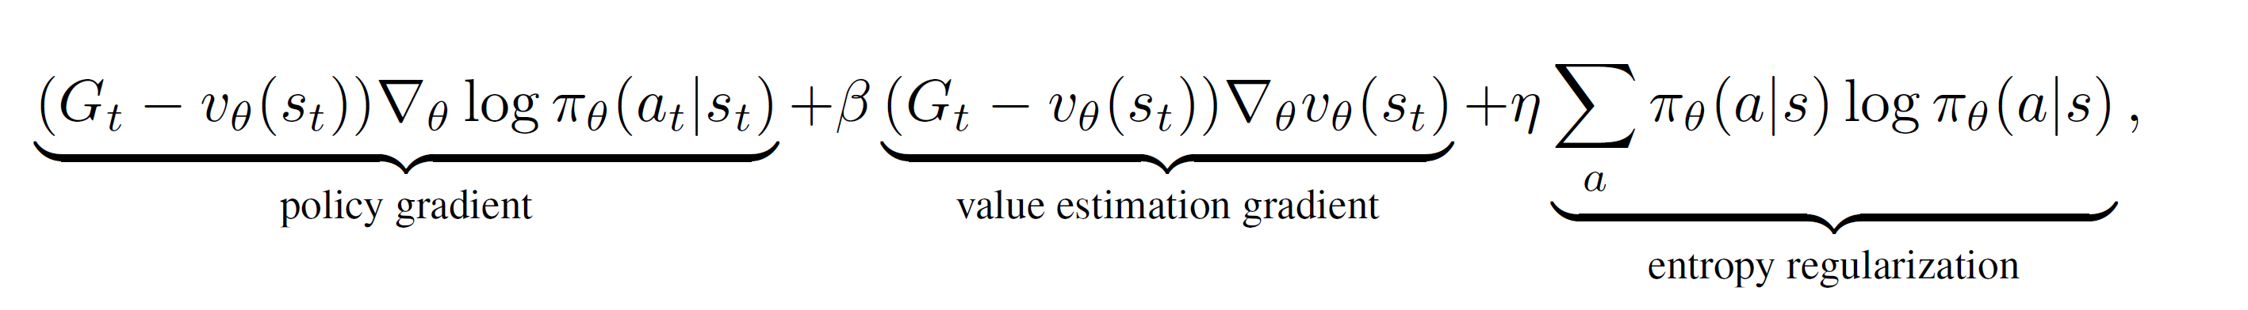
A3c/A2c Learning LoSS

Slide 19
RL – reinforcement learning
[ machine ] learning methodology with the following ingredients
Agent(s) [ input: world state, output: action ]
in the case of DL the agent is a neural network
To choose an action we run forward pass inference on this network
using the current [ and past ] states as input
To update the agent we sample a random* batch of recent actions and outcomes
We update ourselves according to several terms
[ 1 – upweight/downweight chosen actions by mis-predicted total future rewards [ mis-predicted rewards in a unrolled trajectory of len < 100 ]
[ 2 – entropy : penalize over-confident action choices [ can be disabled in competitive settings ]
[ 3 – curiosity :
[ …
[ what do you think we should reward/penalize ?
World(s) steps & responds
Data = Experience =
{ { timestamp,
observedState[s] = [ frame-set ],
extrinsicReward,
chosen action
Algorithm = Agent Update

