Slide 1
Project kickoff
presentation
eGain
2025 - Functional Presentation
By Andrey Neudachin

Slide 2
eGain - Functional Portion
Contents
1.
System Design & Architecture Tech Stack
2.
Technical Implementation
3.
Challenges Faced
4.
Future Improvements
5.
Add section title
6.
Add section title

Slide 3
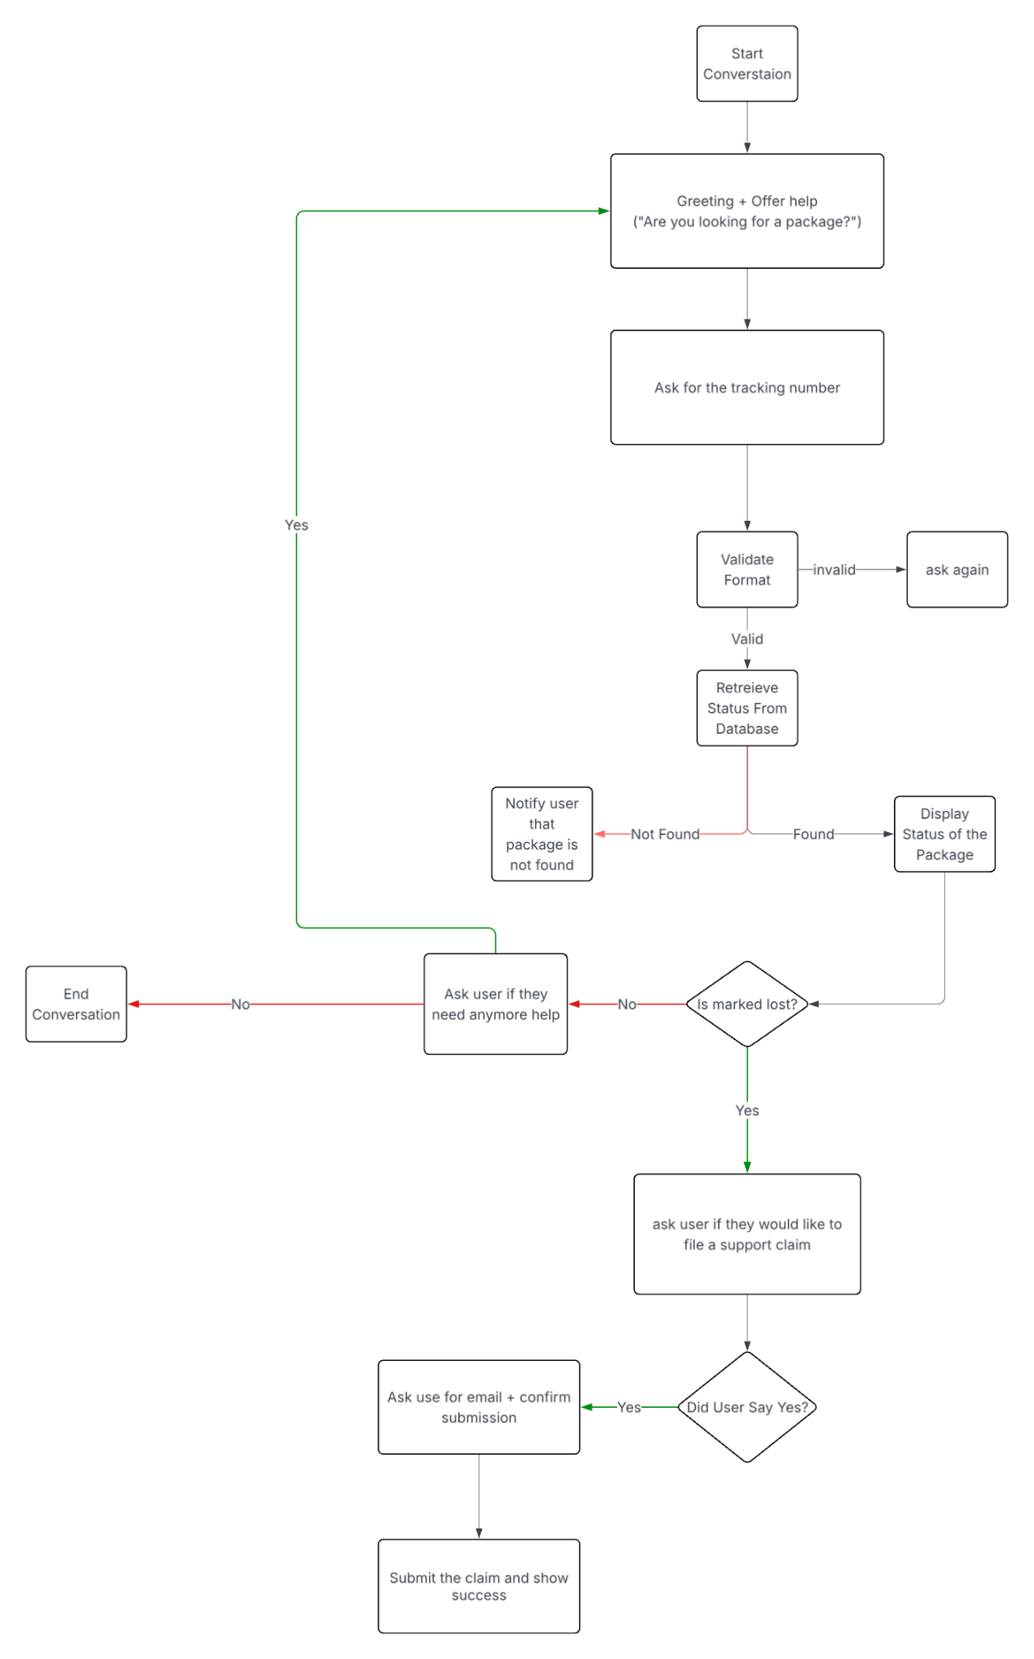
eGain - Functional Portion
Flow Chart

Slide 4
eGain - Functional Portion
System Design & Architecture Tech Stack:
Key Design Decisions:
Backend: FastAPI (Python) + Uvicorn ASGI server
Conversational State Machine Pattern
1
Frontend: Next.js 16 + React 19 + TypeScript + Tailwind CSS 4
Session-Based Architecture
2
Communication: REST API with JSON
Component-Based UI
3

Slide 5
eGain - Functional Portion
Conversational State Machine Pattern
4 states:
awaiting_tracking →
awaiting_claim_confirmation →
awaiting_claim_email → claim_created
Maintains conversation context per session
Natural dialogue flow for package tracking → claim filing

Slide 6
eGain - Functional Portion
Session-Based Architecture
Server-side session management with 1-hour TTL
In-memory storage for rapid prototyping
Session validation on all protected endpoints

Slide 7
eGain - Functional Portion
Component-Based UI
Modular React components: ChatInterface (container) → ChatInput + MessageBubble (presentational)
Clean separation of concerns
Reusable, testable components

Slide 8
eGain - Functional Portion
Technical Implementation
11 REST endpoints (/chat/start, /chat/message, /chat/track, /chat/claim, etc.)
Validation: Regex-based tracking number (^[A-Z]{2}\d{9}$) + email validation
Mock Database: 8 sample packages with statuses (in_transit, delivered, lost)

Slide 9
eGain - Functional Portion
Challenges Faced
Problem 1
Needed to remember tracking number when asking follow-up questions (claim confirmation, email)
Solution
Implemented state machine with context object that persists tracking_number across conversation steps

Slide 10
eGain - Functional Portion
Challenges Faced
Problem 2
Needed persistent sessions but no database requirement
Solution
Built custom CookieStore class with in-memory dict + expiration logic (1-hour TTL)

Slide 11
eGain - Functional Portion
Challenges Faced
Problem 2
Parsing user responses like "yes", "yeah", "sure" vs "no", "nope"
Solution
Lowercase normalization + keyword checking (if "yes" in user_input.lower())

Slide 12
Company Name
Future Improvements
Database Implementation
Natural Language Processing
Enhanced Features
Add PostgreSQL/MongoDB for session + claims storage
Integrate LLM (GPT-4/Claude) for better intent recognition
Handle typos, ambiguous queries, multi-intent messages
Handle typos, ambiguous queries, multi-intent messages
File upload for claim photos (damaged package evidence)
Email notifications when claim status changes
Multi-language support
Package delivery notifications via webhooks
Claim status tracking page (not just chatbot)
Implement Redis for session caching (faster lookups)
Database migrations support with tools like Alembic

Slide 13
Thank you

