Slide 1
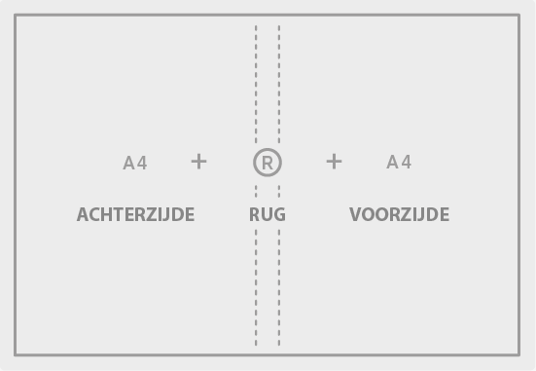

The Ramen_Lord
Book of Ramen
Mike Satinover & Scott Satinover
The Ramen_Lord Book of Ramen
By Mike Satinover (Ramen_Lord)
& Scott Satinover, Ph.D

Slide 2
The Ramen_Lord
Book of Ramen
Mike Satinover & Scott Satinover
The Ramen_Lord Book of Ramen
By Mike Satinover (Ramen_Lord)
& Scott Satinover, Ph.D

