Slide 1
A semiempirical-Hamiltonian bottleneck, and an architecture that works around it
What limits machine learning of adjacent-lanthanide separation
Bogdan Mironov · with K. Vogiatzis · August 2026
Notes:
Two results. First, a chemistry measurement: the semiempirical method everyone uses for these complexes gets the lanthanide contraction 2.5x too small, which explains a long run of null 3D results in the literature. Second, a modelling result: if you split the prediction into a block level and a within-block shape, 3D structure finally contributes, and we confirm it on data that took no part in any choice.

Slide 2
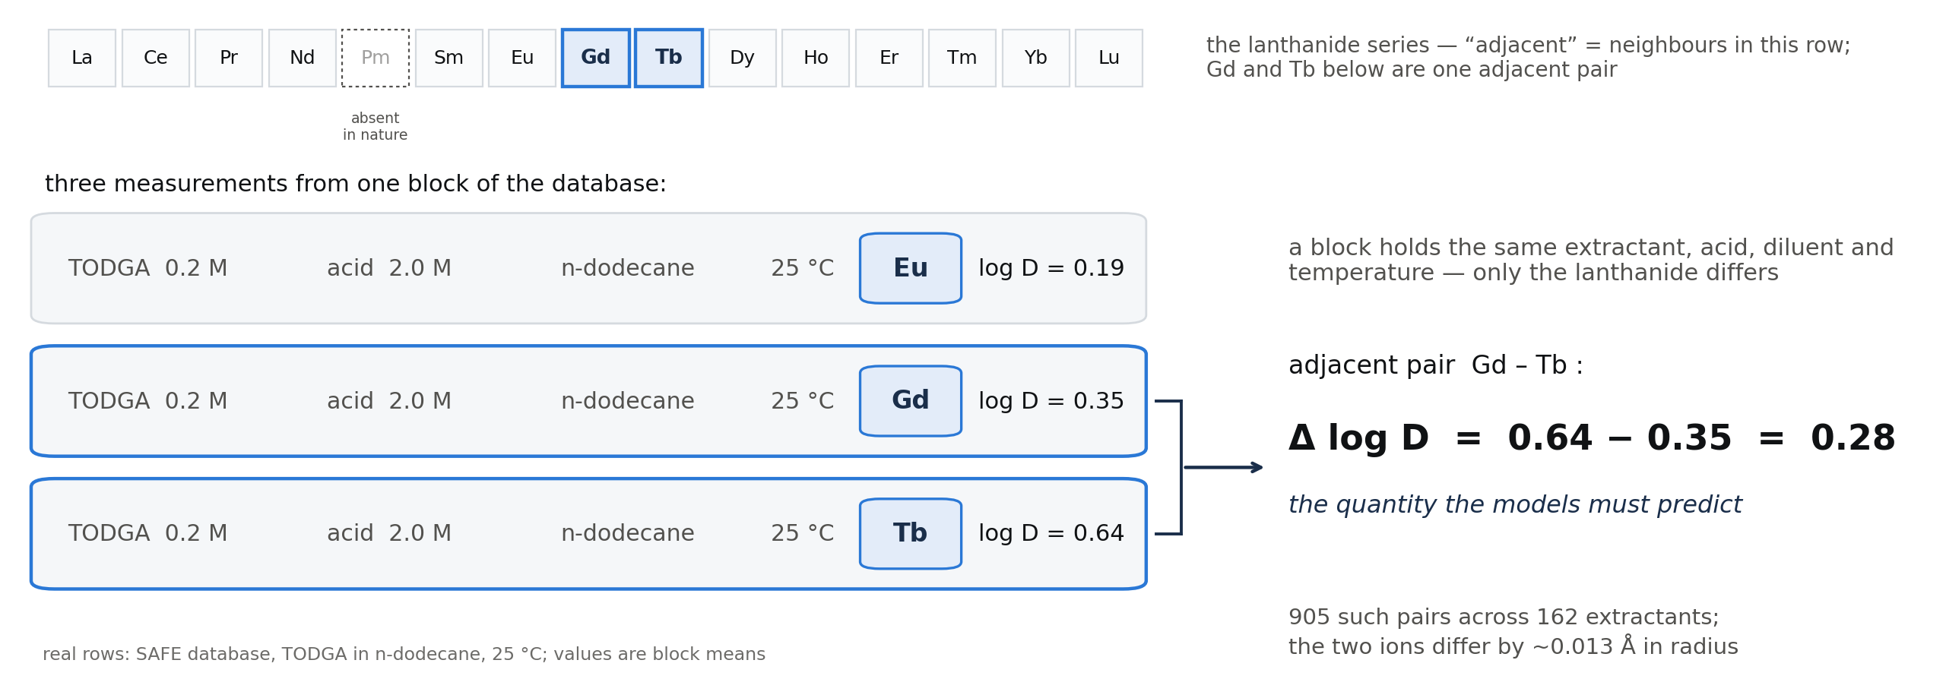
Adjacent lanthanides are the industrially hard case
Separation factor between neighbours is what industry pays for — and what models are worst at.
Notes:
Rare-earth separation is a solvent-extraction problem. Neighbouring lanthanides differ by about 0.013 angstrom in ionic radius, so their distribution coefficients are nearly identical and hundreds of stages are needed. Predicting the SEPARATION between neighbours is the quantity of industrial value, and it is much harder than predicting the absolute distribution coefficient. Note Pm is absent from all experimental data, so Nd-Sm is never counted as adjacent.

Slide 3
Data and evaluation: extractants are held out, and we score separations
 | value
measurements (log D) | 4,746
extractants / lanthanides | 162 / 14
3D complexes (Architector + GFN2-xTB) | 956
cross-validation | leave-extractants-out, 5 folds × 3 repeats
scored quantity | R² of predicted adjacent-pair log SF (905 pairs)
zero on this metric | predicting the average separation
Everything reported here is out-of-fold under this protocol.
Notes:
The split is by extractant, so an extractant never appears in both train and test — this is the regime that matters for screening new ligands. The metric compares two metals measured under the same extractant and the same conditions, so everything shared by the two cancels. R-squared of zero means you did as well as predicting the average separation; published models sat near +0.14 before this work.

Slide 4
PART I
Do the 3D structures encode the contraction?
— A measurement on the Hamiltonian, not on the models
— 71 ligands × 15 lanthanides × 2 methods, 2,130 optimisations

Slide 5
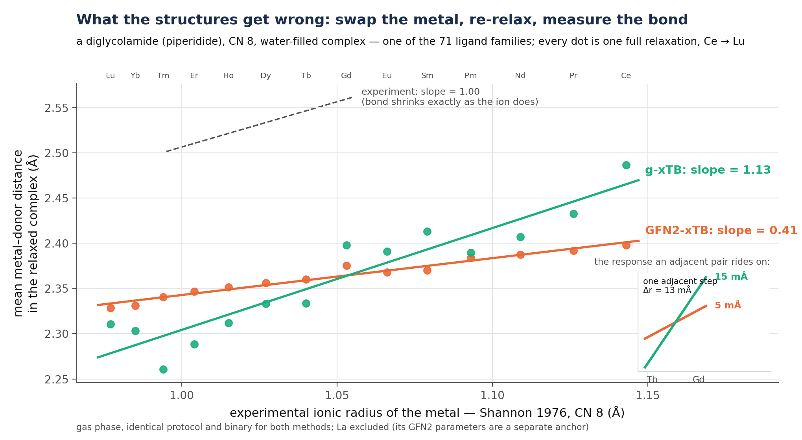
We measure the contraction as a per-ligand slope, at fixed ligand environment
Slope against Shannon radii; 1.00 would be exact agreement with experiment.
Notes:
The design: take one ligand, substitute every lanthanide into the same coordination environment, optimise, and regress the mean metal-donor distance against the Shannon ionic radius. The slope is the compliance c_L: 1.00 means the computed structure follows experiment exactly. Prior benchmarks report per-complex RMSD against X-ray or DFT, which cannot see a correlated trend error — bonds can each be acceptable while the series derivative is badly wrong.

Slide 6
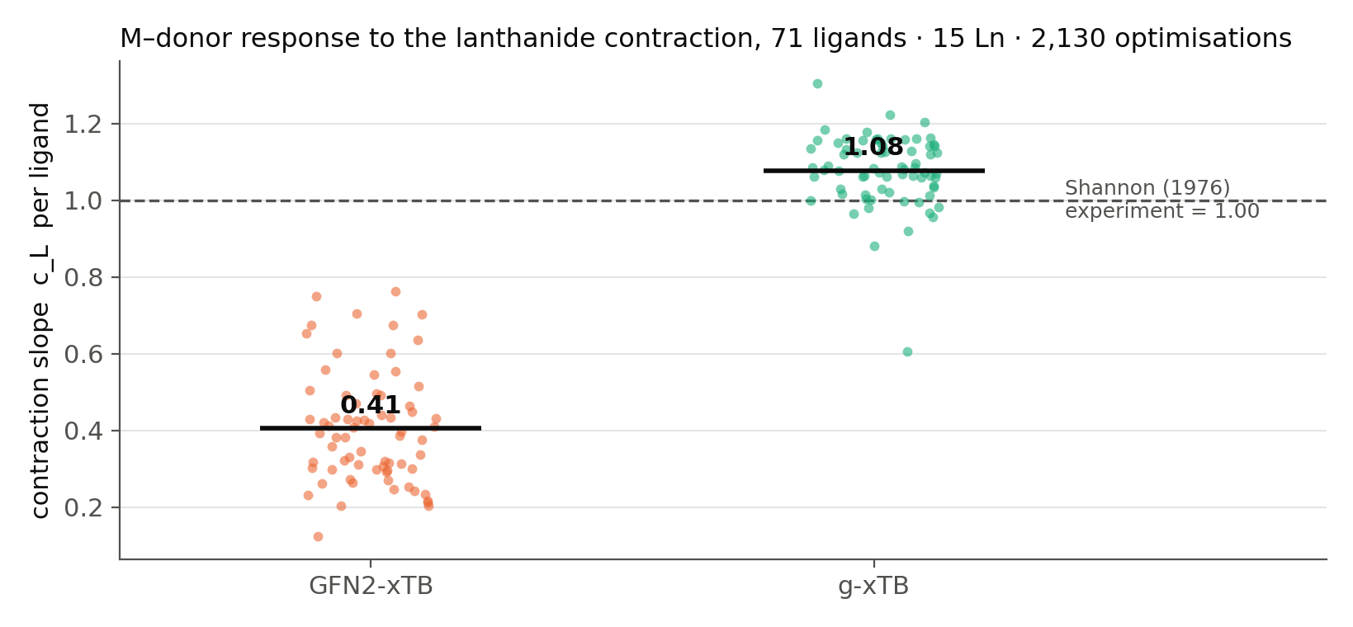
GFN2-xTB under-responds by 2.5×; g-xTB is within 8 % of experiment
71 ligands, one protocol, one binary. Improves on 71 of 71; paired p = 4.9 × 10⁻⁵².
Notes:
GFN2-xTB gives 0.405 +- 0.145, i.e. it reproduces only 40 % of the real contraction. g-xTB, which puts the f electrons in the valence, gives 1.078 +- 0.094. The improvement holds on 71 of 71 ligands, paired p = 5e-52, and replicates in solvent and on an independent pilot. GFN2's per-ligand slope is also mostly noise: only 23 % of its non-linear response is shared across ligands, against 96 % for g-xTB. This is, to our knowledge, the first lanthanide GEOMETRY validation of g-xTB — its own preprint benchmarks energies.

Slide 7
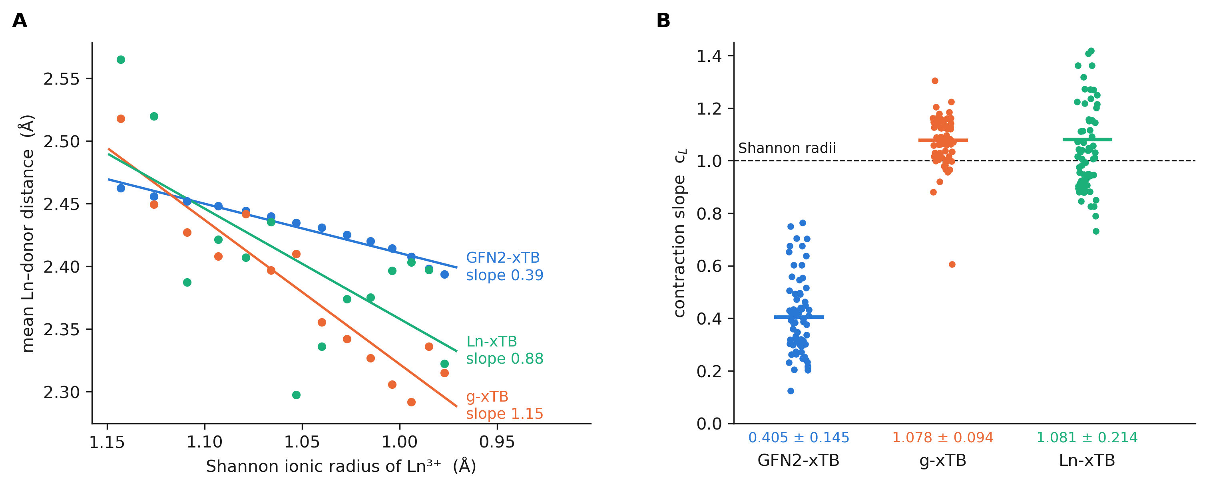
A third Hamiltonian, Ln-xTB: the right slope, but not the shape
Ln-xTB 1.081 ± 0.214 vs g-xTB 1.078 ± 0.094: same mean, 2.3× the spread, series fit R² 0.43 vs 0.82.
Notes:
Ln-xTB, published this year, keeps GFN2's physics — f in the core, the same 5d6s6p valence — and simply re-fits the twenty lanthanide parameters element by element against all-electron bond lengths. Same 71 ligands, same protocol, all 2,130 optimisations converged. Its mean compliance is 1.08, identical to g-xTB's. So the slope was a parameterisation property, exactly as we argued: fix the linear-in-Z interpolation and the contraction comes back. But the series is jagged — a linear fit explains 43 percent of it against 82 for g-xTB — with a tenth-of-an-angstrom dip at gadolinium that every ligand shares. A profile shared by every ligand is a signature of independent per-element fits, not chemistry. Only the f-in-valence method is both right on average and regular, and none of the three per-ligand slopes predicts measured selectivity.

Slide 8
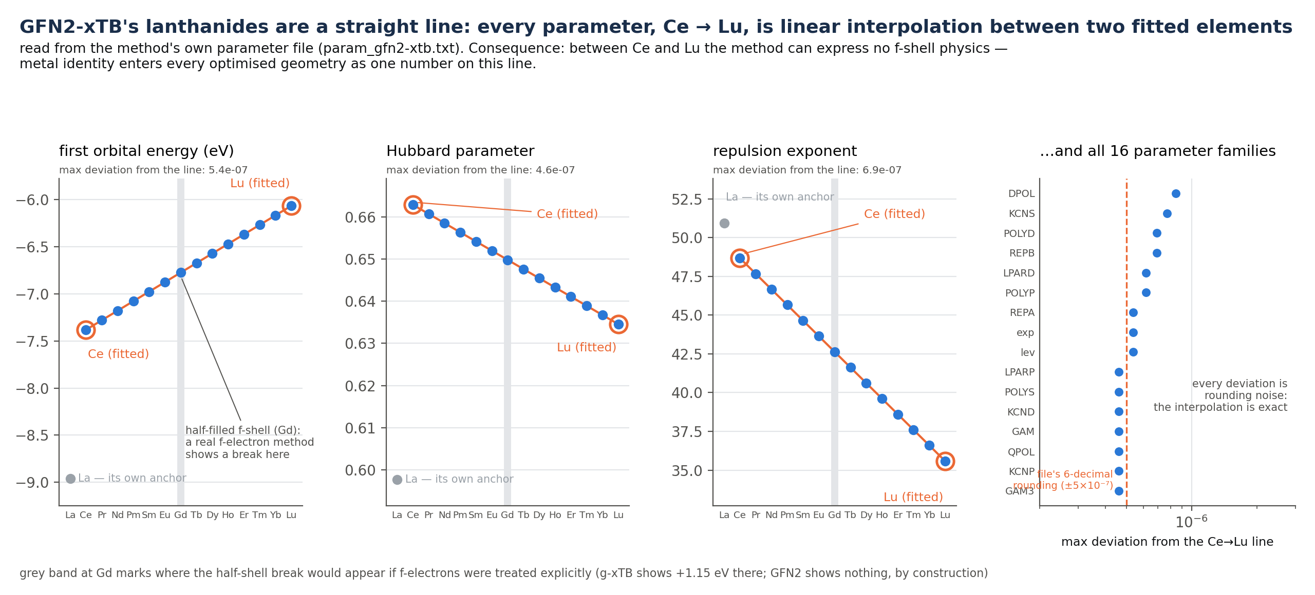
The cause is in the parameter file: every lanthanide is a linear interpolation
All 16 parameter families are linear in Z to rounding precision.
Notes:
Every GFN2 parameter from Ce to Lu is linear interpolation between two fitted anchors, to file precision. Metal identity therefore enters a GFN2 geometry as a single linear-in-Z scalar: no f shell, no crystal field, no gadolinium break. That is a design decision by the method's authors, documented in their own files — not a bug we found — but it has a consequence nobody had connected: any 3D descriptor built on these geometries carries one number about the metal, and that number is already in the model as the tabular ionic radius.

Slide 9
The prediction this makes: 3D encoders should be interchangeable — and they are
Eight independent 3D encoders span an effective rank of 1.05 of 8.
Architecture changes move the predictions no more than reseeding the same architecture does.
At the pair level, the two best encoders correlate at r = 0.963.
A simplicial network over Vietoris–Rips complexes and a distance graph network make almost the same predictions.
Better geometry does not help either.
g-xTB geometries: +0.004, not significant. Structures rebuilt in exact correspondence (455× cleaner): −0.013.
So the ceiling on the 3D channel is set by the Hamiltonian, not by the network.
Notes:
This is the retrodiction that makes the chemistry finding load-bearing rather than a curiosity. If metal identity enters the geometry as one scalar, then every encoder reading those geometries is reading the same one scalar, and no architecture can rescue it. We measured that directly: effective rank 1.05 of 8. And when we swapped in the physically correct g-xTB geometries, the score did not move, because 96 % of what changed is a pure function of metal identity, which the model already had.

Slide 10
PART II
Then how do we make 3D contribute at all?
— Change what the model is asked to predict
— Level and shape are different problems

Slide 11
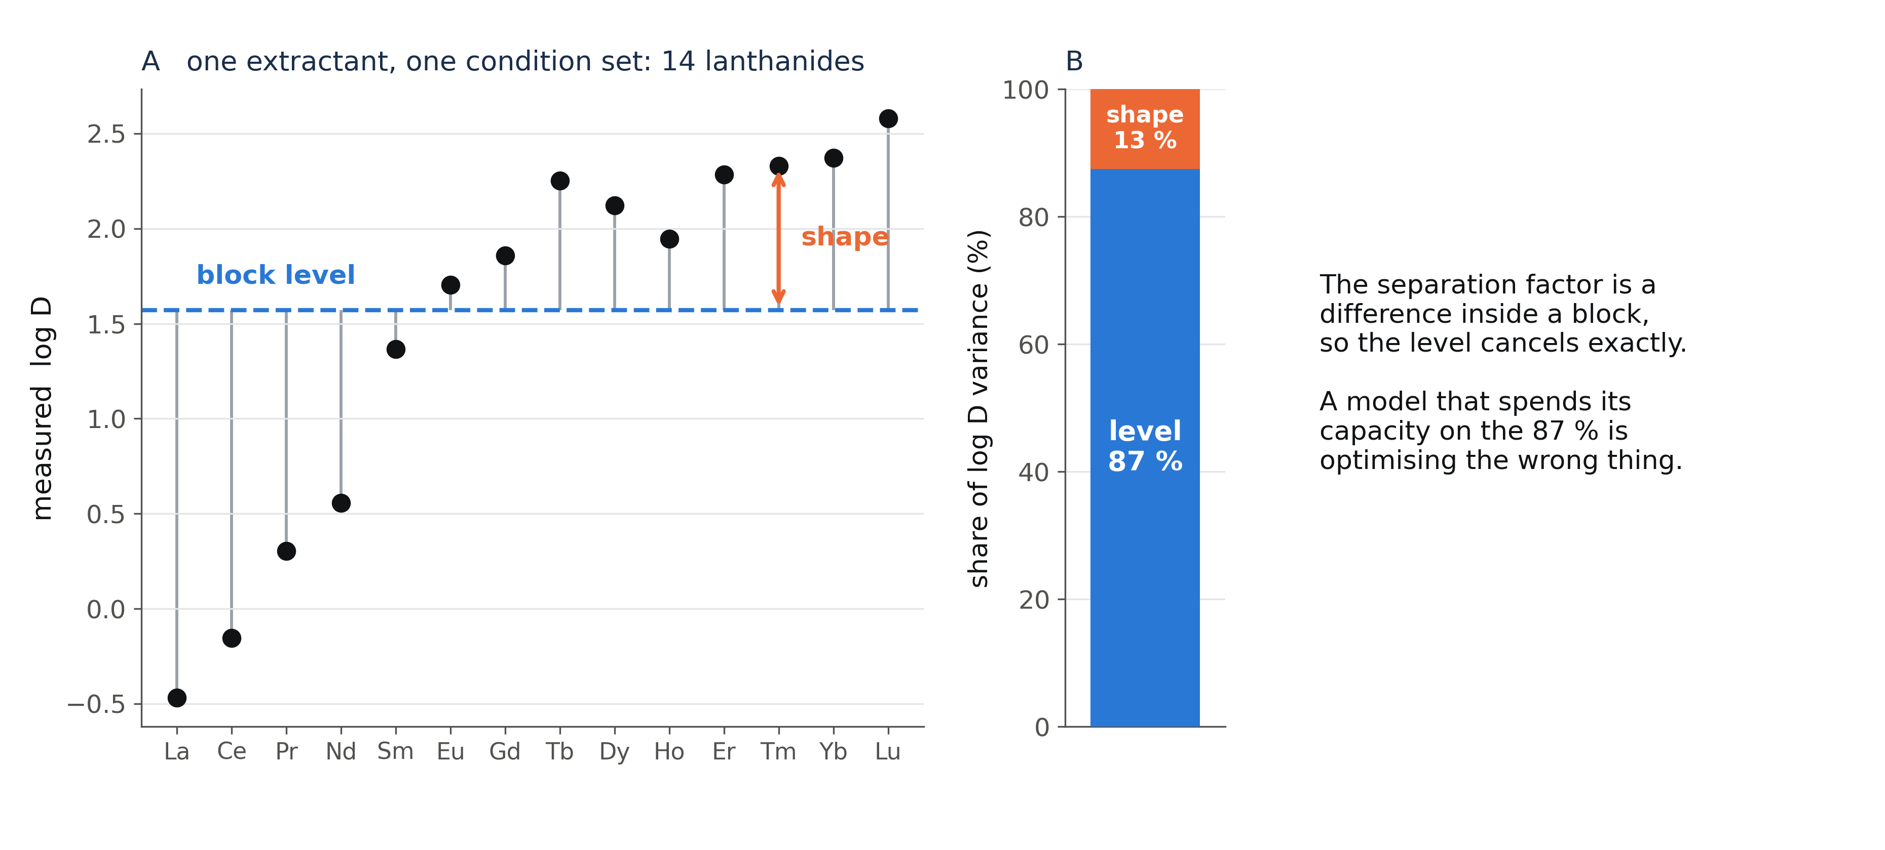
87 % of the signal is the block level — and the metric reads none of it
Notes:
Here is one extractant at one condition set, with 14 lanthanides. The block sits at some level, and within the block the metals tilt. Decomposed over the whole dataset, 87 % of log D variance is the level and 13 % is the within-block shape. The separation factor is a difference inside a block, so the level cancels exactly. A model trained to minimise error on log D spends nearly all its capacity on the part of the signal that the metric throws away.

Slide 12
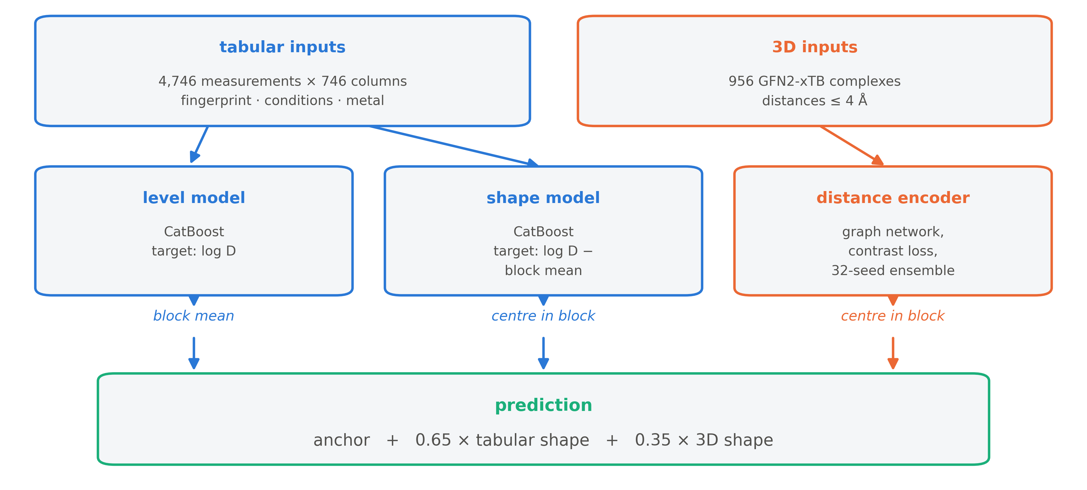
So predict the level and the shape with separate models
Notes:
The level model is an ordinary gradient-boosted tree on log D. The shape model is the same learner trained on a different target: log D minus its block mean — so it cannot see the loud between-block signal at all. The 3D encoder is block-centred the same way. The prediction is the block anchor plus a weighted sum of the two shape sources. The anchor is constant inside a block, so it cancels in every scored comparison: it is there to place the prediction, not to win points.

Slide 13
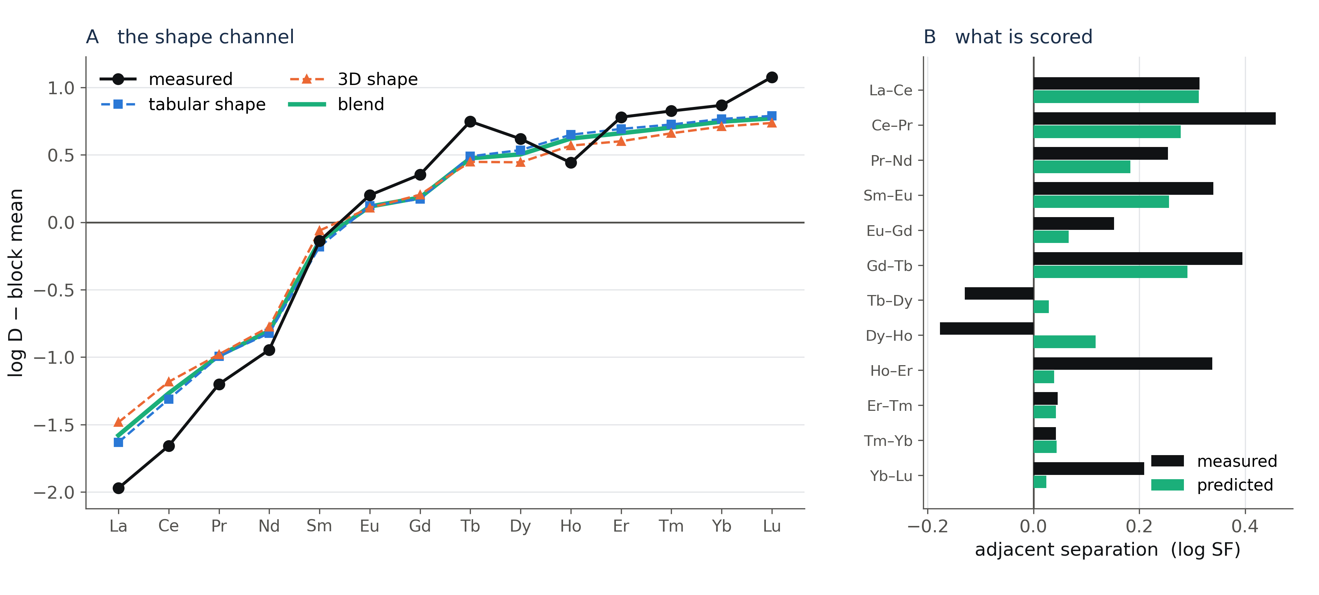
On a real block: both shape sources track the tilt, the 3D one differently
Notes:
Same block as before, now with the block mean removed. Black is measured, blue the tabular shape, orange the 3D shape, green the blend. On the right are the twelve adjacent separations this block contributes to the metric — note Nd-Sm is absent because Pm does not exist in the data. You can see both the successes and the failures: Tb-Dy and Dy-Ho have the wrong sign here.

Slide 14
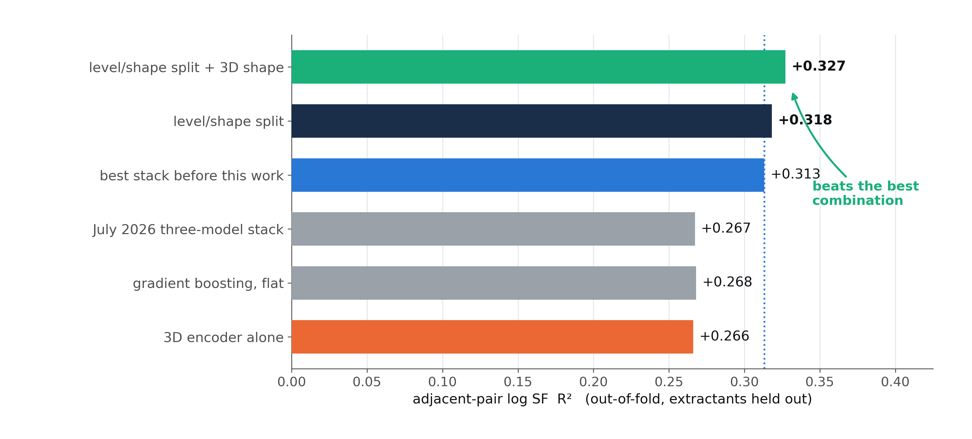
One model with this split beats every combination we ever fitted
Every bar is out-of-fold, leave-extractants-out, on the same 905 adjacent pairs.
Notes:
The flat champion sits at +0.268. Splitting level from shape takes the same learner and the same features to +0.318 — that alone beats the previous best system, a pair-fitted combination of three different models at +0.313. Adding the 3D shape gives +0.327. Two things to notice: the architectural effect is larger than the 3D effect, and the 3D encoder alone is only +0.266, so this is complementarity, not a strong standalone model.

Slide 15
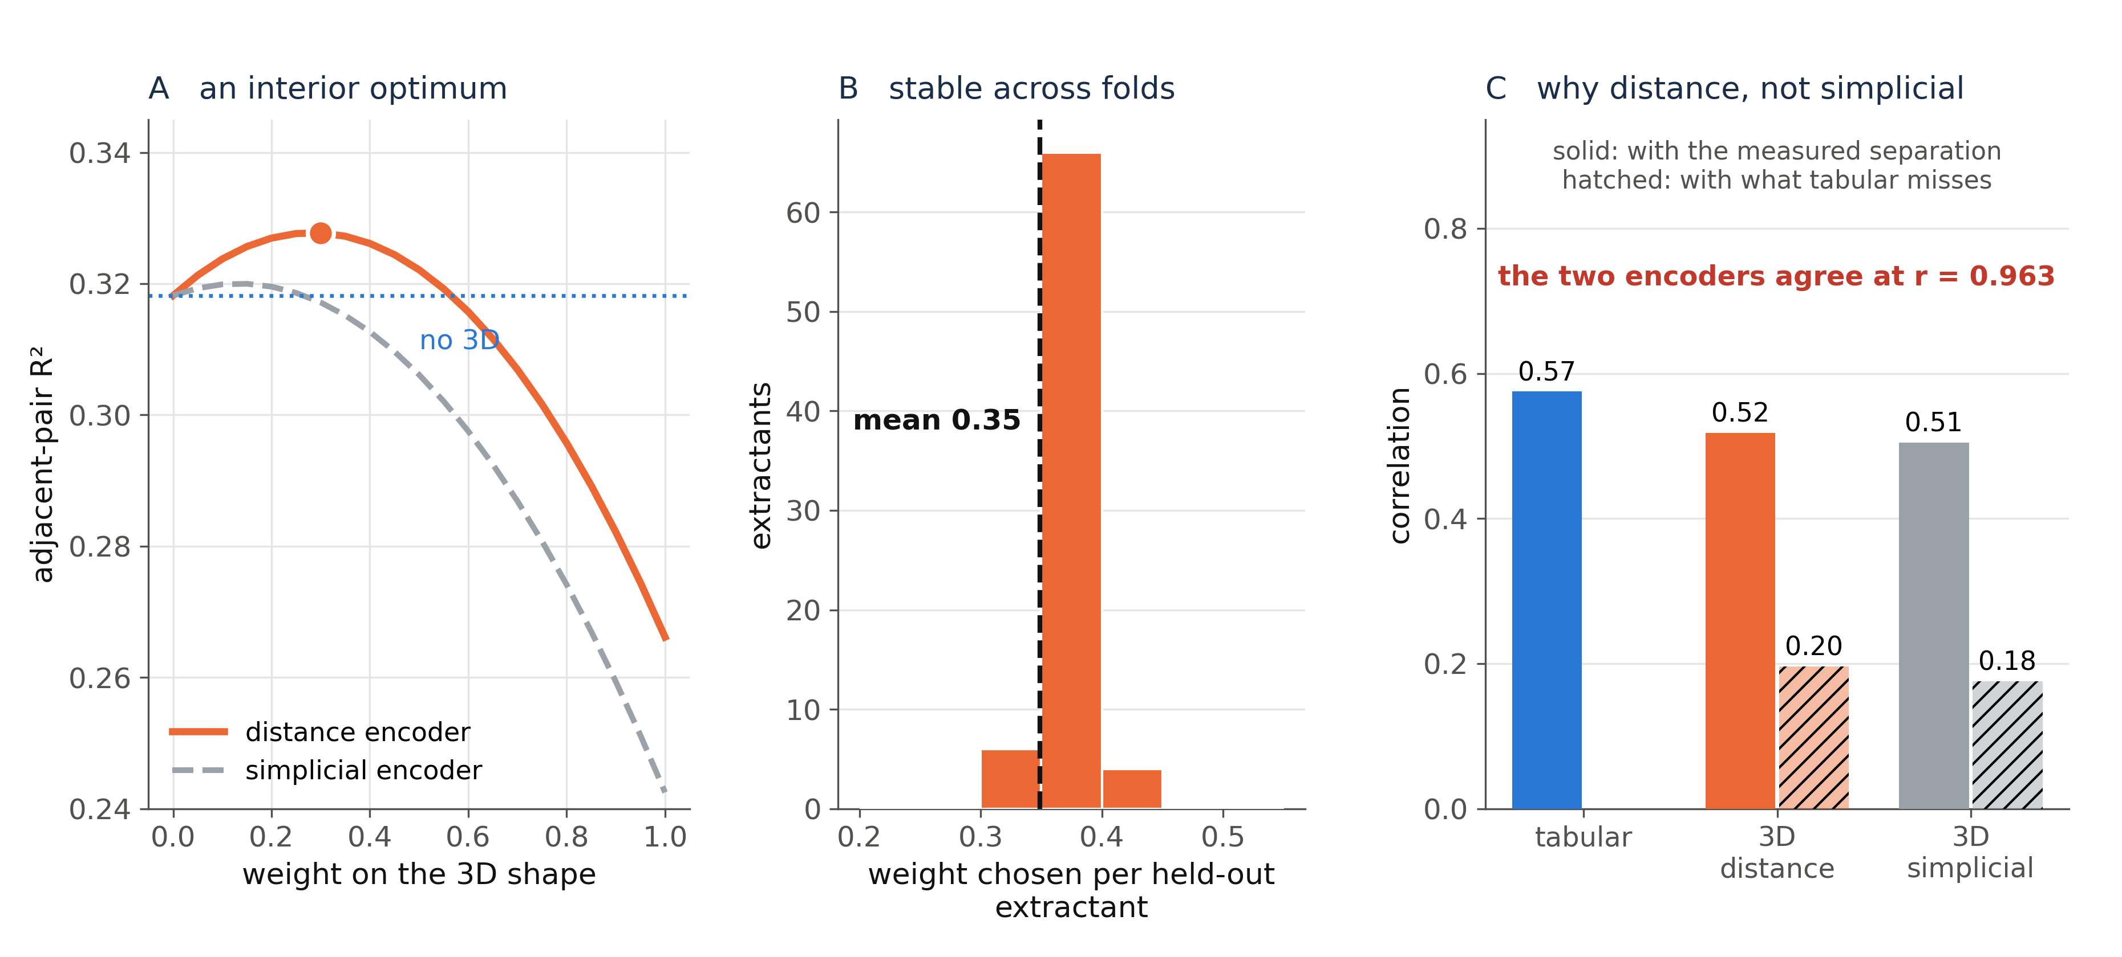
The 3D weight is fitted, has an interior optimum, and picks the distance encoder
Notes:
Panel A: sweeping the mixing weight gives a smooth interior optimum near 0.3 for the distance encoder, and a monotone decline for the simplicial one. Panel B: chosen nested per held-out extractant, the weight lands at 0.35 with a narrow range, so it is not a fragile choice. Panel C is the mechanism: both encoders correlate with what the tabular model misses at about 0.2, but they correlate with each other at 0.963, so the blend takes one and ignores the other. This is the pair-level version of the rank-1.05 result from Part I.

Slide 16
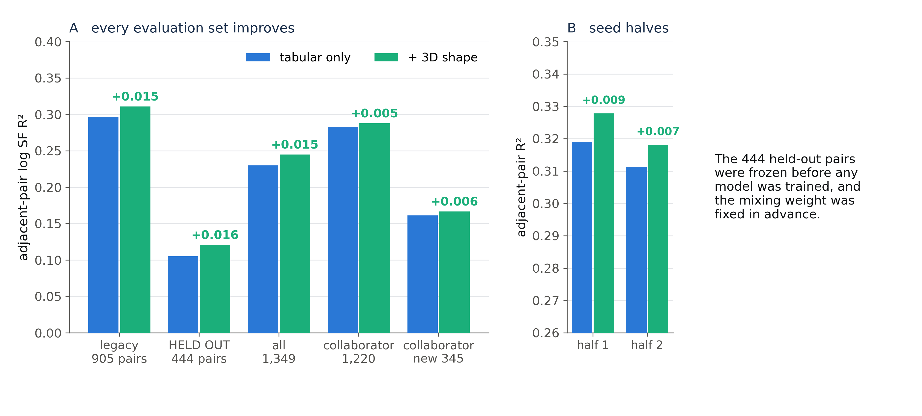
The gain holds on 444 pairs that took no part in any decision
Pre-registered rule, fixed weight, one look.
Notes:
The honesty problem: we had tuned on the same 905 pairs for months. So we froze a population that had never been used — 444 adjacent pairs that appear only when the geometry quality filter is relaxed — and we committed the decision rule to git, with the weight fixed at 0.35, before the deciding model finished training. The contrast is +0.016 there, the same size as on the legacy set. It also holds on the collaborator's independently rebuilt dataset, including his 345 brand-new pairs, and on independent halves of both seed ensembles.

Slide 17
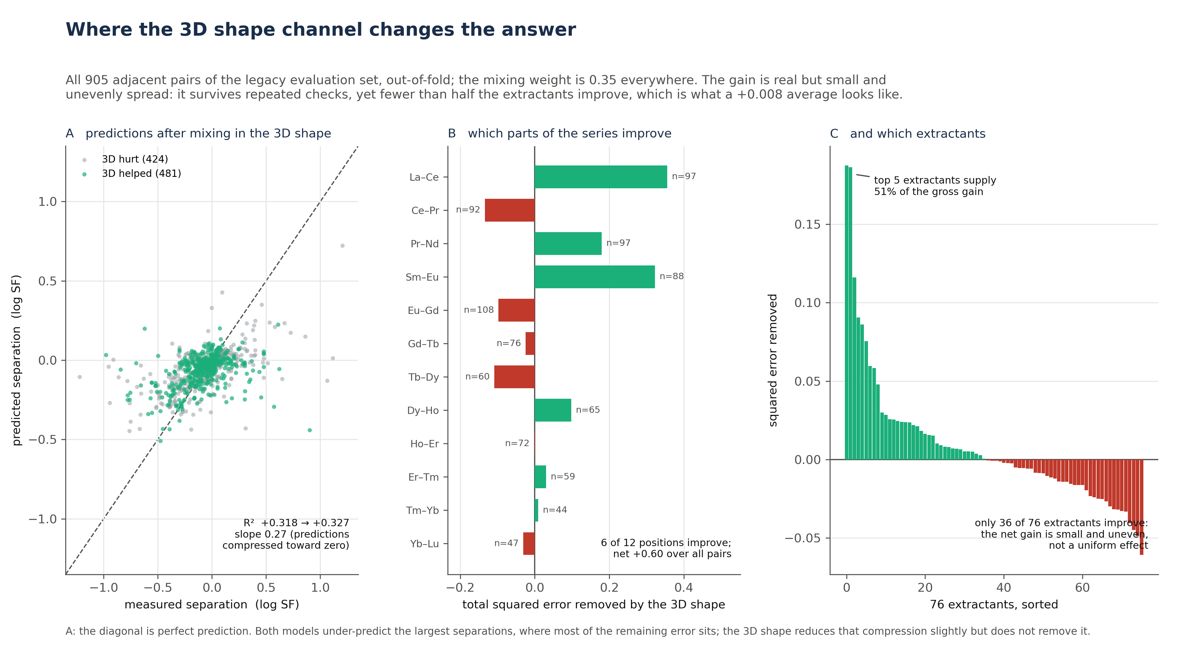
Being honest about size: the 3D gain is small and unevenly spread
Notes:
This is what a +0.008 average actually looks like. Only 481 of 905 pairs improve, 6 of 12 series positions, and 36 of 76 extractants; the top five extractants supply half the gross gain. It is a real effect that survives a pre-registered held-out check, and it is a small one. Panel A also shows the bigger remaining problem: the regression slope of predicted on measured is 0.27, so we systematically under-predict the largest separations — which is where most of the remaining error sits.

Slide 18
PART III
What does not work — four negative results
— Each one was expected to work
— Each was tested at the same rigour as the positive

Slide 19
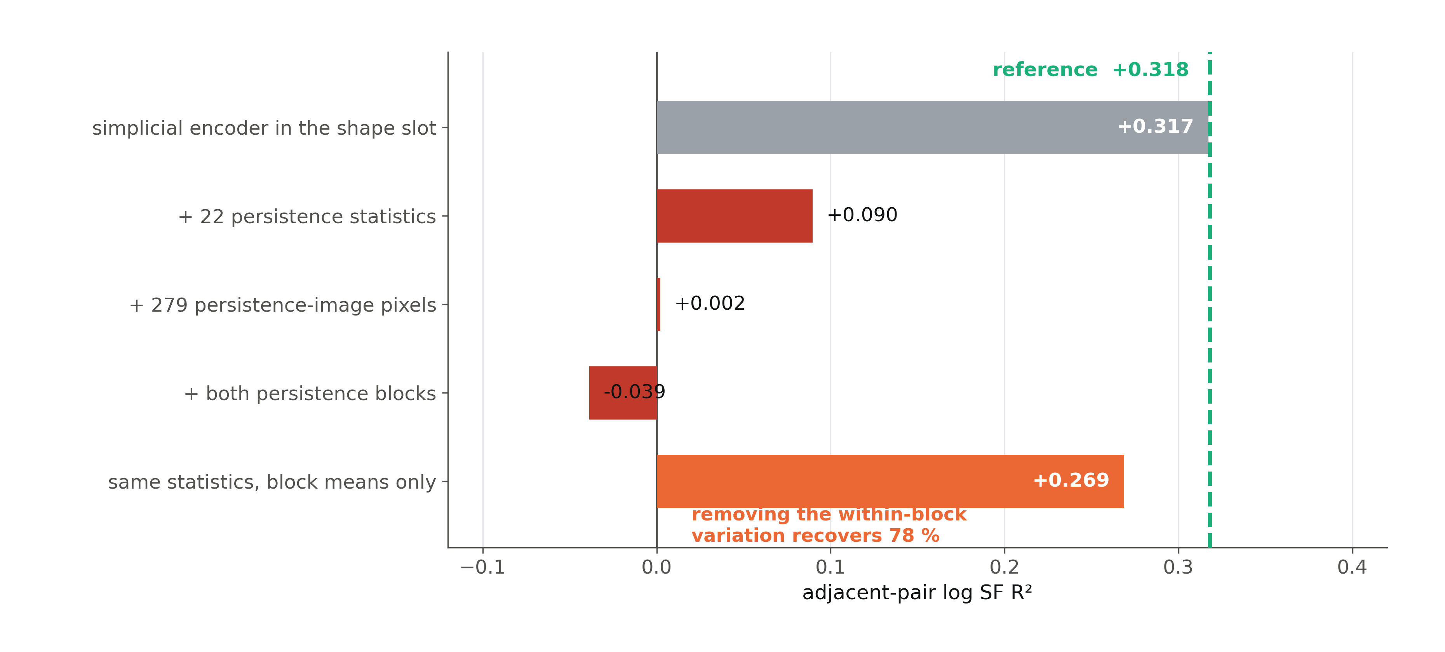
Topological representations add nothing beyond the distance encoder
I expected the split to protect against this. It does the opposite.
Notes:
Given the same slot, the simplicial network gets a fitted weight of 0.01 and contributes nothing — it is 96 % redundant with the distance encoder. Triangles are not better than edges at matched seeds. Persistence descriptors are worse than useless: 22 persistence statistics take the shape model from +0.318 to +0.090, and the persistence images to +0.002. The bottom bar is the control that explains it: replace each column by its within-block mean — same columns, same between-block information, no within-block variation — and 78 % of the damage disappears. The harm is specifically in how these descriptors vary across metals inside a block, which is the only thing the shape model looks at.

Slide 20
Three more negatives, each with the check that killed it
what we tried | result | why it fails
Conditions as within-pair differences | +0.004 | largest raw correlate in the data (|r| ≈ 0.36), but extractant-specific — does not transfer out of fold
Training directly on all 6,389 within-block pairs | +0.191 alone | 7× more supervision, strong standalone model, but its errors duplicate the existing arms
Quantum energies: g-xTB metal-swap series | p 0.010 → 0.15 | pilot signal did not survive a 14,000-point frozen-cage replication with a matched control
Every one of these is in the register with the data that killed it.
Notes:
Each of these had a good prior. The conditions channel is the strongest raw correlate anywhere in our data, and it still does not generalise to unseen extractants. The all-pairs model is the one whose training population matches the metric exactly, and it learns nothing the row models did not already know. The energy result is the one I most wanted to be true: a pilot on relaxed structures gave p = 0.010, so we ran 14,000 single points overnight on frozen cages with the other Hamiltonian as control, and the effect attenuated to p = 0.15. Same sign, no significance.

Slide 21
PART IV
Independent check, and honest limits
— A collaborator built a different model on the same data
— What the labels can and cannot support

Slide 22
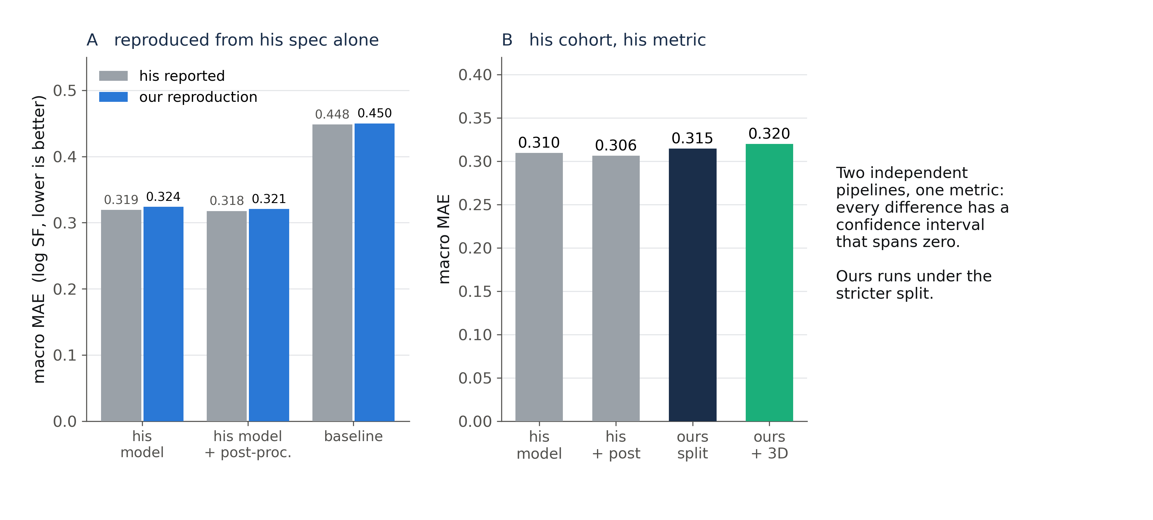
An independently built model reproduces — and ties with ours
Reproduced from the written spec; the head-to-head difference is within noise.
Notes:
A collaborator built a completely different system on the same measurements: an antisymmetric pair-feature random forest with its own cohort definition and its own metric. Panel A: we reimplemented his pipeline from his written spec alone — his repository was not on our machine — and reproduced his headline numbers within his own stated tolerance. Panel B: scored on his cohort with his metric, his model and ours are statistically indistinguishable; every paired bootstrap interval spans zero. Ours does it under a stricter cross-validation. Two independent pipelines converging on the same number is evidence about the problem, not about either model.

Slide 23
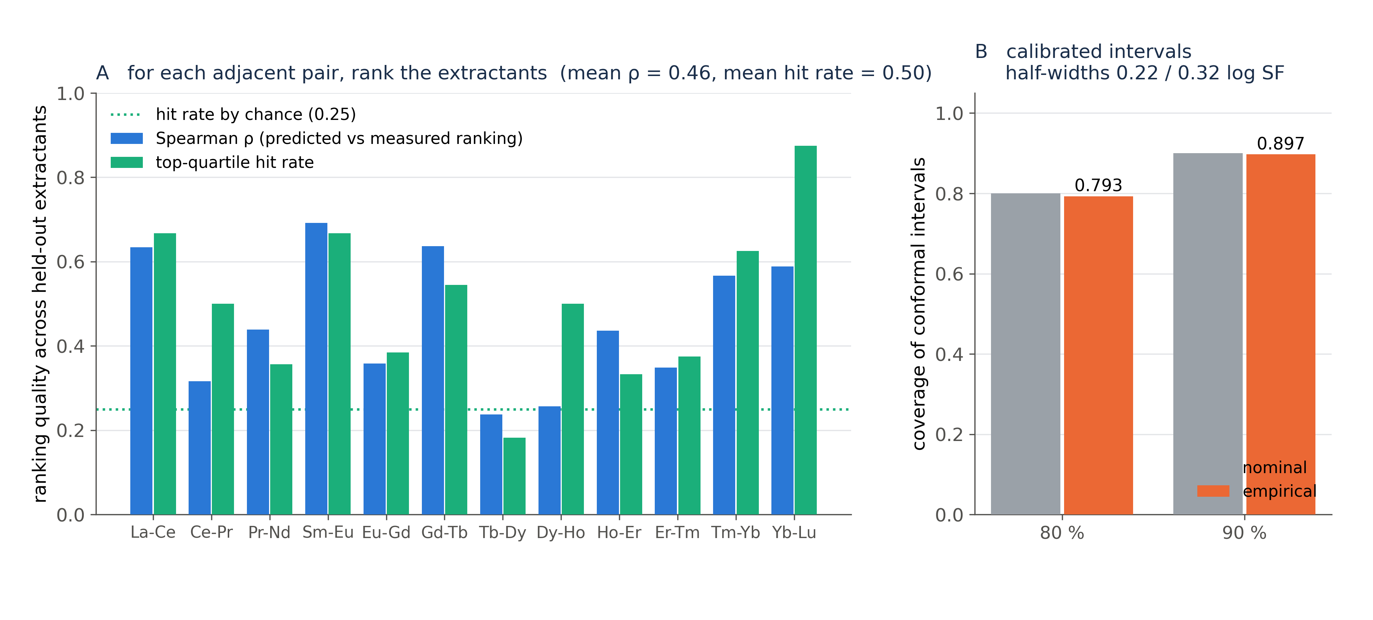
What R² = 0.33 buys a screening user: ranking, and honest intervals
Ranking held-out extractants doubles the odds of a top-quartile pick; the intervals are calibrated.
Notes:
R² undersells the practical value. Panel A: for each adjacent pair, rank the held-out extractants by predicted separation and compare with the measured ranking. Mean Spearman 0.46 over the twelve positions; the predicted top quartile contains a measured top-quartile ligand half of the time, against a quarter by chance. Sm–Eu, Gd–Tb, La–Ce and Yb–Lu rank best; Tb–Dy and Dy–Ho barely above chance. Panel B: split-conformal intervals, calibrated leave-one-extractant-out, cover 79 and 90 percent at nominal 80 and 90, with half-widths of 0.22 and 0.32 log units. Abstaining on uncertain pairs lowers the error but not R², because the confident pairs are the small separations.

Slide 24
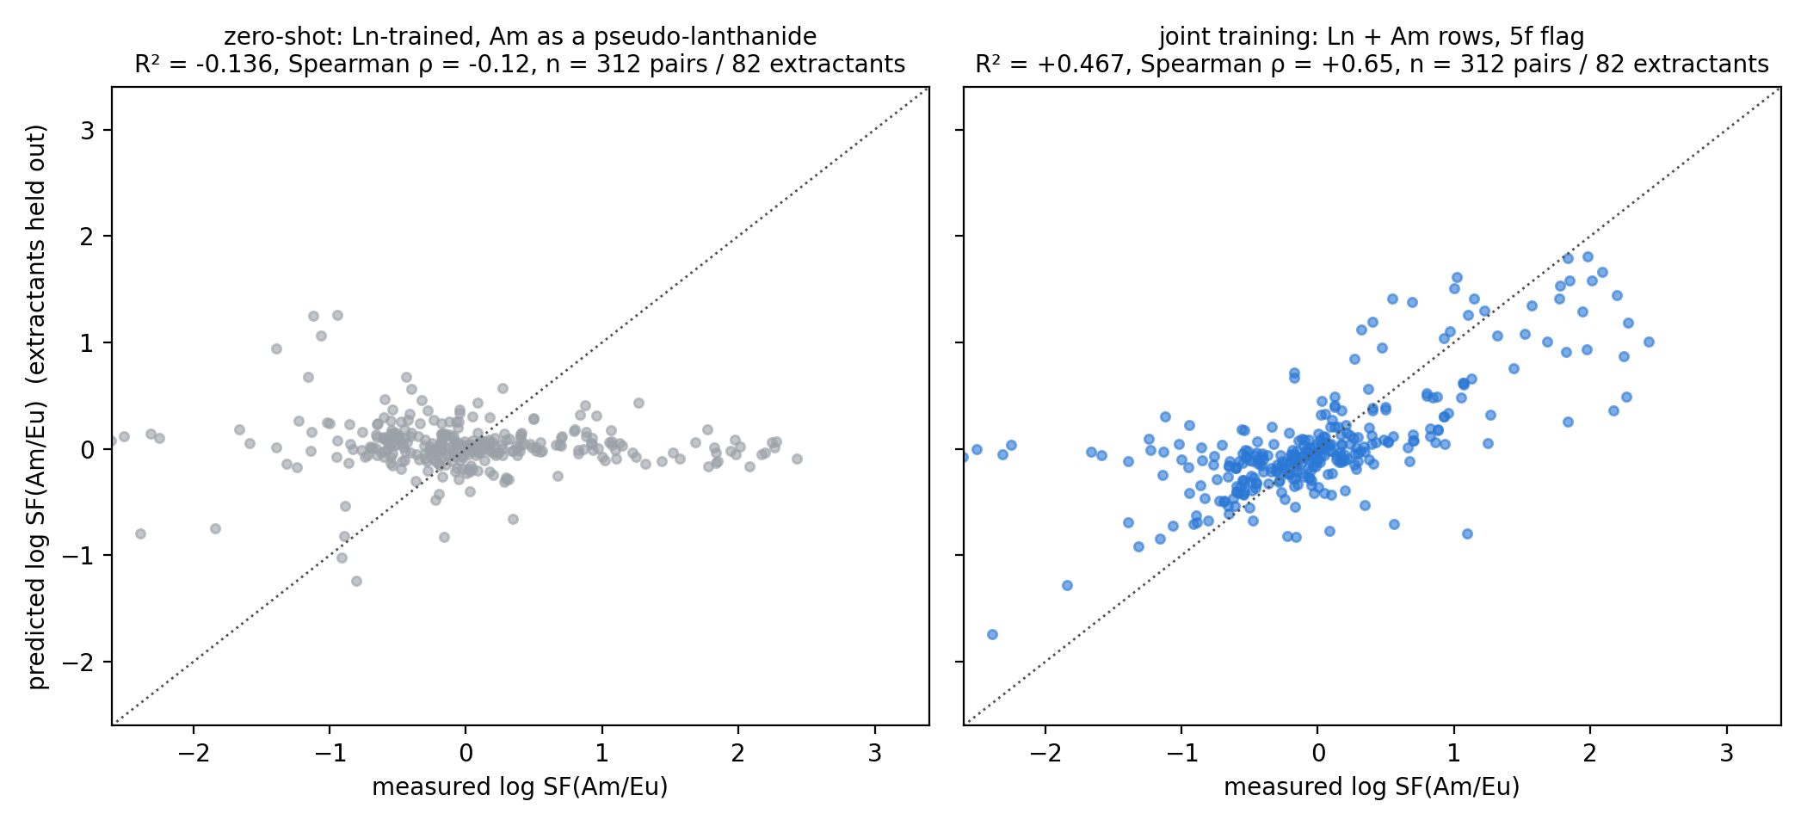
Taking the model to americium: family-level transfer only
Zero-shot fails as it should; joint training matches a no-model family lookup (R² 0.47 vs 0.47), within-family R² 0.02.
Notes:
The same database holds 1,815 americium rows, 95 percent on ligands we already model, giving 312 Am/Eu separation factors on 82 extractants under identical conditions — the SANEX chemistry. Left: treating Am as a lanthanide at its radius predicts nothing, which is the right answer, because An/Ln selectivity is soft-donor covalency, not size. Right: with Am rows in training the held-out score is R² 0.47 — but a control that predicts a held-out extractant from the mean of its ligand family scores the same, and within a family the model has no skill. So the model learns which ligand classes separate Am from Eu and in which direction, nothing finer; and the lanthanide target does not move. Same limitation as on the lanthanide side: the descriptors carry the family.

Slide 25
What the labels can support — and a claim we had to withdraw
We previously quoted a ceiling of R² ≈ 0.53. It is not defensible.
The estimator behind it divided the noise of one subset by the variance of a different, wider one; on its own subset it implies a ceiling below the score models already achieve.
What is defensible: a separation reproduces to ~0.16 log units.
Measured across independent condition sets, against a spread of ~0.22 — so the noise cancellation on differencing is real, roughly 6× tighter than the levels it is computed from.
But no point ceiling is identifiable from this dataset.
70 % of scored pairs come from cells with no replicate at all, and the replicated cells are selected non-randomly. A ceiling needs designed replication, not opportunistic duplicates.
Correcting our own published-in-talks number, before someone else has to.
Notes:
I want to flag this because we had it in earlier talks. The 0.53 number was withdrawn inside our own repository by a later analysis and kept being quoted anyway. The honest statement is the middle one: separations are far more reproducible than the levels they come from, there is clearly headroom above 0.33, and we cannot put a number on the limit with this data.

Slide 26
Summary
The semiempirical geometries barely encode the contraction.
GFN2-xTB reproduces 40 % of it; g-xTB is within 8 %. The cause is linear-in-Z parameterisation, and it explains why 3D encoders are interchangeable and why better geometry does not help.
Separating level from shape is worth more than any representation change.
+0.268 → +0.318 with the same learner and the same features; that single model beats our previous best combination of three.
3D contributes only through the shape channel: +0.008, confirmed on held-out pairs.
First configuration in this project where 3D survives next to the strongest tabular model instead of being absorbed by it.
Four representation ideas failed, and the controls say why.
Topology is redundant; persistence descriptors inject within-block noise; conditions do not transfer; the energy signal did not replicate.
Next: designed replication for a real ceiling; the under-prediction of large separations; structures for the americium complexes.
Notes:
If you take one thing away: on this problem, what you ask the model to predict matters more than what you feed it. And the reason 3D underperforms is not the network — it is that the electronic structure method hands you one number about the metal.

Slide 27
Thank you
Data: SAFE solvent-extraction database · Structures: Architector + GFN2-xTB / g-xTB
Code, out-of-fold predictions and every negative result: github.com/mironovb/lanthanidestrain
Notes:
Questions I expect: (1) why not DFT — cost, 956 complexes times 15 metals; and the point is precisely what the cheap method does to downstream ML. (2) Is +0.008 worth it — on its own, marginal; as evidence about where 3D can act, it is the whole point. (3) Ln-xTB (Zhang 2026) is the obvious third Hamiltonian and we have not run it yet.

Slide 28
BACKUP
Supporting material

Slide 29
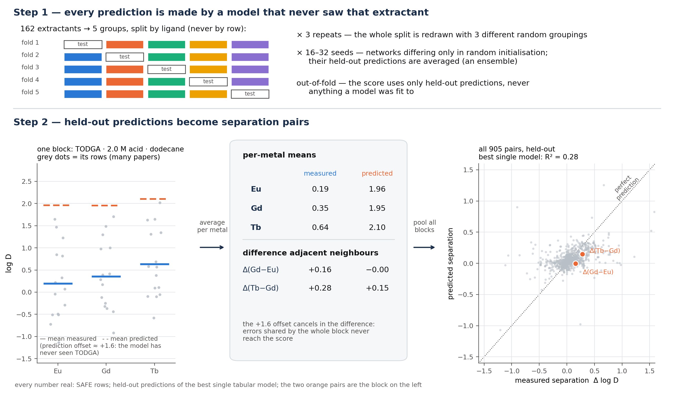
Backup: the evaluation protocol and pair construction
Notes:
Leave-extractants-out, 5 folds x 3 repeats. Replicates within a (block, metal) cell are averaged before differencing, so a metal measured ten times does not dominate one measured once.

Slide 30
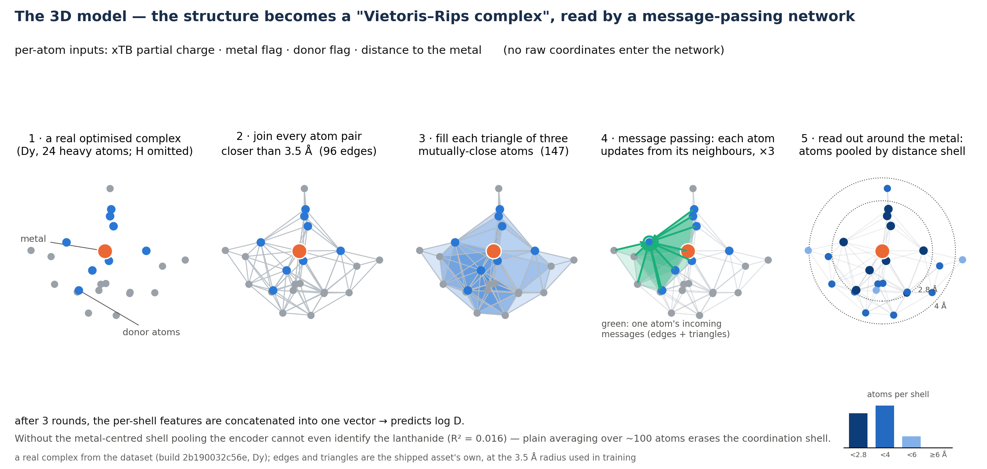
Backup: what the 3D encoder actually reads
Notes:
Vietoris-Rips complex over the heavy atoms of one complex, with message passing over edges and (for the simplicial variant) triangles, then a metal-shell readout.

Slide 31
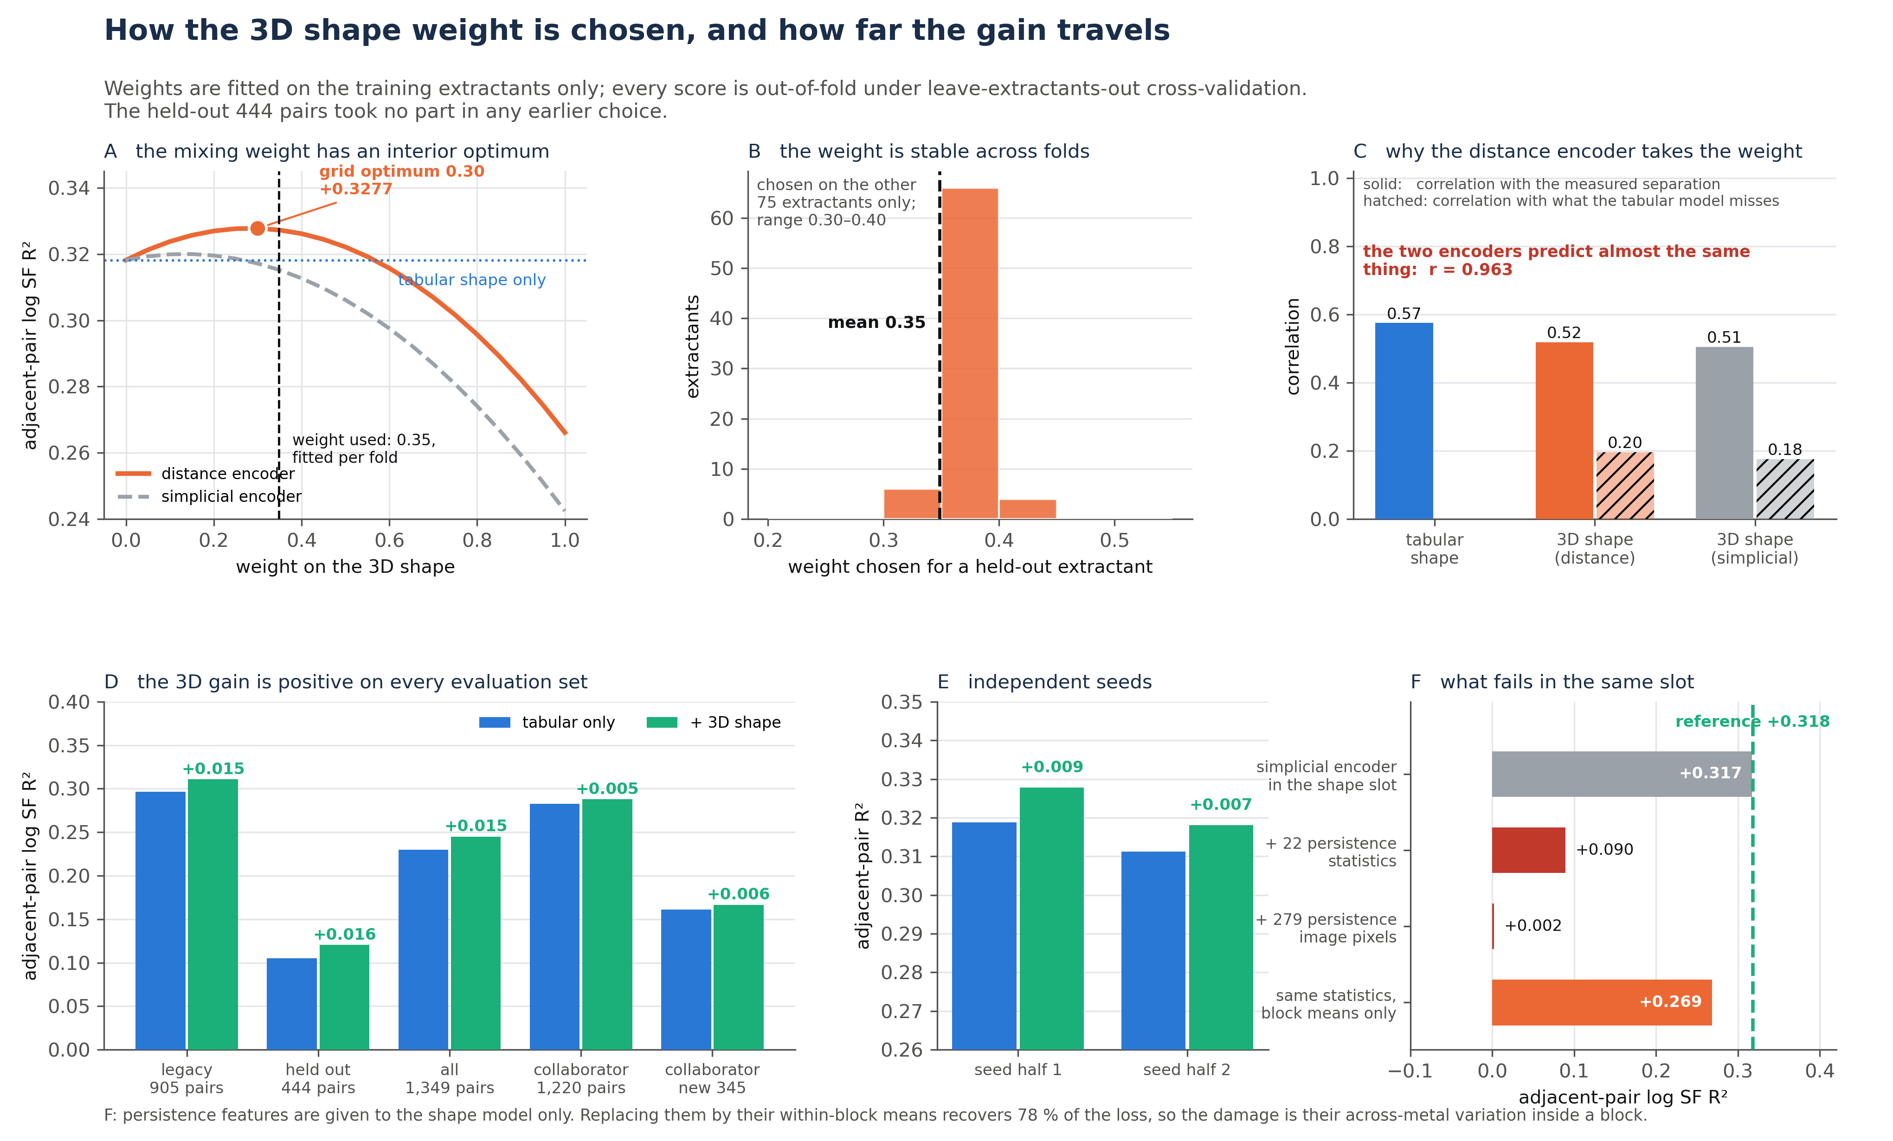
Backup: how the mixing weight and the evidence were computed
Notes:
Full evidence panel: weight curve, nested selection, encoder correlation structure, cross-population gains, seed halves, and the representations that fail in the same slot.

Slide 32
Backup: the label-side series shape
quantity | value
LOEO R² from pair identity alone | +0.066
split-half reliability of the 12-position profile | r = 0.75
structure beyond a radius ramp | p = 2 × 10⁻¹³
only positive mean position | Eu–Gd
largest negative position | Gd–Tb
Notes:
A 12-value lookup on pair identity alone reaches +0.066 out-of-fold. The profile is reproducible across extractant halves and is not a smooth radius ramp — it has structure at the half-shell. The learned models already contain this, but as a data observation it may be of independent interest.

