Slide 1
Predicting Adjacent-Lanthanide Selectivity from 3D Structure
Dataset, models, complete findings — and a new benchmark on the chemistry underneath
Bogdan Mironov · discussion with Prof. K. Vogiatzis · August 2026
Notes:
30-second framing: this is the project you emailed about. Three parts: the ML result you asked about, a chemistry finding that explains its ceiling, and where the remaining signal is. Everything is leave-extractants-out and out-of-fold.

Slide 2
Your question first: “constantly more accurate — am I right?”
The precise answer before the evidence
As a single model — no longer.
With the right loss, gradient boosting on 2D descriptors reaches 0.278 — above the 3D encoder alone (0.266) and above July's full combination (0.267).
As part of the best system — yes, and it is the largest component.
0.313 with the 3D encoder vs 0.291 without; pair-fitted weights: 3D 0.46, boosting 0.42, fingerprint 0.11.
The defensible claim is complementarity: the 3D encoder corrects errors the 2D models share. It has never been that the encoder outranks them.
Notes:
He is reacting to the July numbers: boosting 0.142, fingerprint 0.221, 3D 0.238, stack 0.267. On those, his reading was fair. Two things changed: the boosting loss (RMSE->Quantile 0.6, +0.136) and the 3D contrast weight (2->4, +0.015). Say plainly: single-model superiority is gone; complementarity survived and the best system still needs the 3D arm, largest stack weight 0.46. If he pushes: the strict-key bound is slide 11, don't dodge it.

Slide 3
Adjacent lanthanides are the hard case of rare-earth separation
Liquid–liquid extraction with designed organic extractants is the industrial route to rare-earth separation; neighbouring pairs (Nd/Pr, Dy/Tb) are the bottleneck.
Adjacent trivalent ions differ by ~0.013 Å in ionic radius — the lanthanide contraction — and by essentially nothing else a classical descriptor sees.
Target capability: predict the DIFFERENCE in log D between adjacent lanthanides with the same extractant under the same conditions → in-silico screening for a target pair.
Metric throughout: R² of the predicted adjacent-pair log separation factor (905 pairs). Zero = no better than the average separation for every pair.
Notes:
Industrial context: solvent extraction is THE separation route; adjacent pairs (Nd/Pr for magnets, Dy/Tb) are the expensive ones. Metric intuition: R^2=0 already means 'predicts the average separation'; sign accuracy ~0.5. The contraction is 0.013 A per step — smaller than thermal vibration amplitudes. That is why this is a needle-in-haystack representation problem.

Slide 4
Data: the SAFE solvent-extraction database
DOI-linked, condition-resolved literature measurements
stage | content
raw source | SAFE database: 48,138 curated measurements · 31 elements · 181 publications, each row DOI-linked
per-row conditions | extractant SMILES + conc., acid + conc., diluent, metal + oxidation state, temperature, modifiers
modelled subset | 4,746 measurements · 162 extractants · 14 lanthanides (Pm absent in nature) · target: log D
blocking | composition block = one extractant × one binned condition set; pairs differenced within blocks only
Notes:
Provenance matters to him. SAFE is literature-curated; every row carries its DOI and full conditions. 181 distinct publications. The replicate structure (same system, different labs) is what later gives us the label-noise floor and the ceiling estimate. The modelled subset is the trivalent lanthanides with buildable complexes.

Slide 5
From SMILES to simplicial complex
step | tool | output
complex assembly | Architector | 3D guess per (extractant, Ln, anion/water fill), CN 8–9
relaxation | GFN2-xTB, ALPB water | 956 unique optimised complexes, force-checked
atom features | xTB Mulliken charges | per-atom charges; metal/donor flags; distances to metal
topological object | Vietoris–Rips @ 3.5 Å | nodes + edges + triangles per complex — the 3D encoder input
tabular features | RDKit · ECFP · conditions | 746 columns incl. 64 condition columns
Notes:
Walk the table once. Emphasise: no raw coordinates enter the network — charges, flags, metal distances on a fixed topological object. 956 unique complexes; convergence independently force-checked. VR at 3.5 A keeps triangles: that IS the simplicial structure.

Slide 6
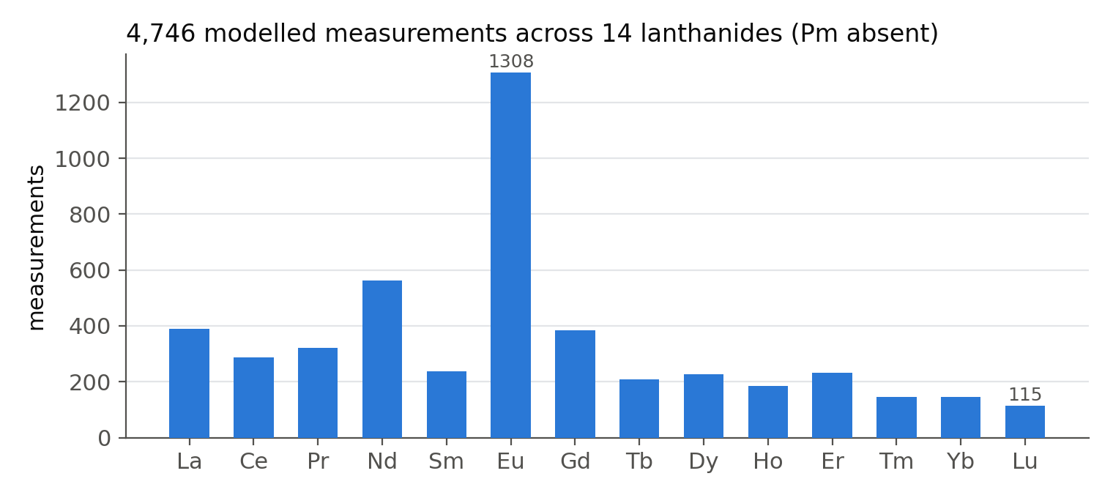
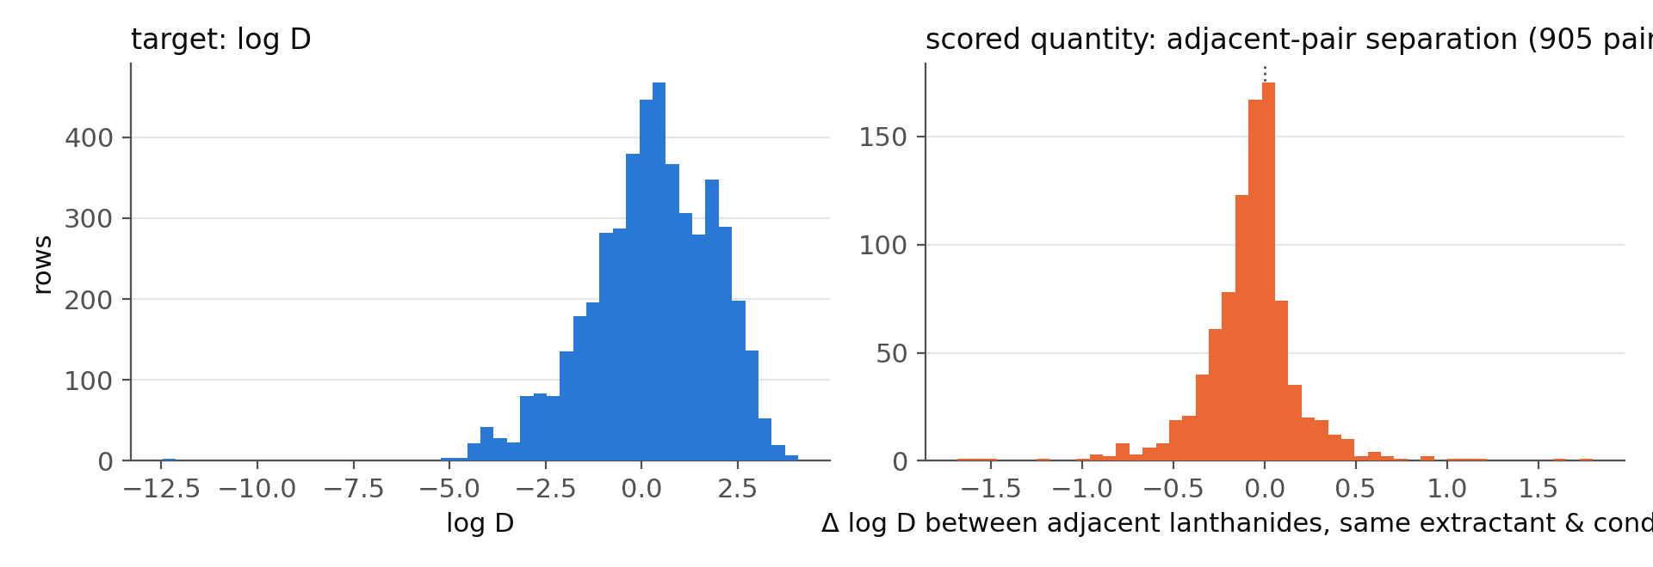
The data at a glance
Notes:
Top: coverage is uneven (Eu, Am-adjacent studies dominate); minimum ~120 rows per lanthanide. Bottom right is the quantity actually scored: heavy-tailed, sd 0.27, mean |sep| 0.18 log units.

Slide 7
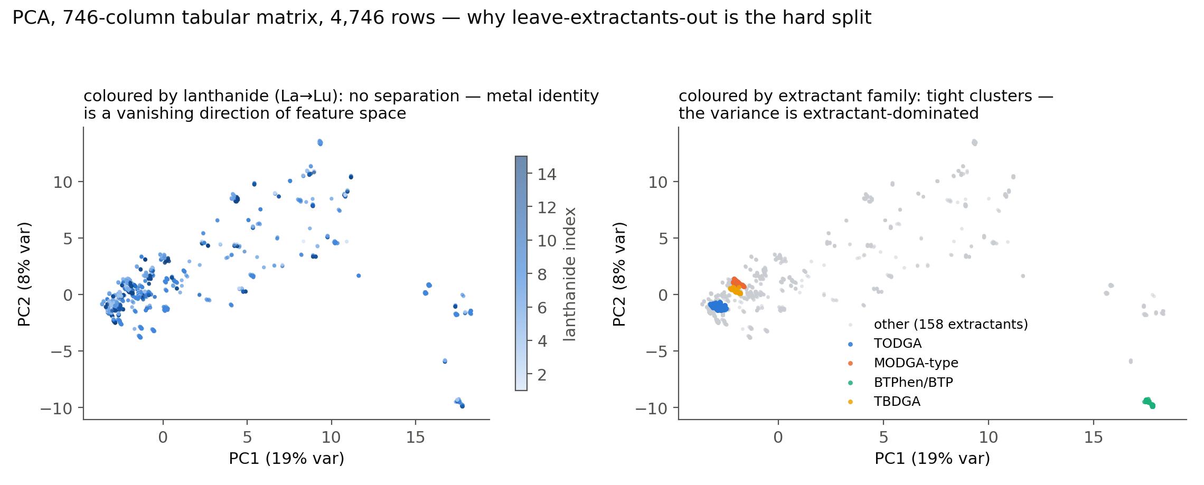
Why leave-extractants-out is the hard split
PCA of the standardised 746-column matrix (winsorised at ±4σ)
Notes:
The one-figure argument for the whole difficulty. Left: metal colouring is invisible — lanthanide identity is a vanishing direction. Right: extractant families are tight clusters; TODGA alone is 1,553 rows. Generalisation must cross clusters while resolving a signal orthogonal to them. If asked: 19%+8% variance on PC1/2 after winsorisation; before it, a few outlier rows dominated.

Slide 8
Evaluation protocol
Leave-extractants-out grouped CV, 5 folds × 3 repeats: no ligand in both train and test.
Adjacent pairs built inside composition blocks; replicate measurements of the same (block, metal) averaged first so each contributes one point.
All reported models are 16–32-seed ensembles scored out-of-fold; deterministic training for paired seed-vs-seed contrasts.
Measured per-seed sd of a paired Δ: 0.0285 → 8 seeds resolve only ~0.028. Every confirmatory claim in this talk uses 24–32 paired seeds.
Notes:
The three defences: grouped CV so no ligand leaks; replicate averaging inside blocks so a 10x-measured metal doesn't dominate; seed ensembles scored OOF. Per-seed sd of a paired delta is 0.0285 — this number drives every design decision in act 3. 8 seeds resolve 0.028; the true effects are 0.01-0.02; hence 24-32 seeds for anything confirmatory.

Slide 9
Three model families, one pair-fitted combination
arm | input | key design point
gradient boosting (CatBoost) | 746 tabular columns | loss function decisive (next slides)
fingerprint network | ECFP + descriptors | scaling repair took pairs R² 0.005 → 0.221
3D encoder (simplicial) | VR complex | message passing over nodes/edges/triangles; metal-centred distance-histogram pooling
combination | all three | weights fitted on PAIR vectors, nested per held-out extractant (NNLS)
Notes:
The stacking detail is load-bearing: fit weights on rows and 79% goes to the model best at levels and worst at pairs. Fitting on pair vectors, nested per held-out extractant, was worth +0.056. The metal-centred histogram pooling: without it the 3D encoder cannot even recover the lanthanide index (R^2 0.016) because mean-pooling 100 atoms erases 0.01-A shell shifts.

Slide 10
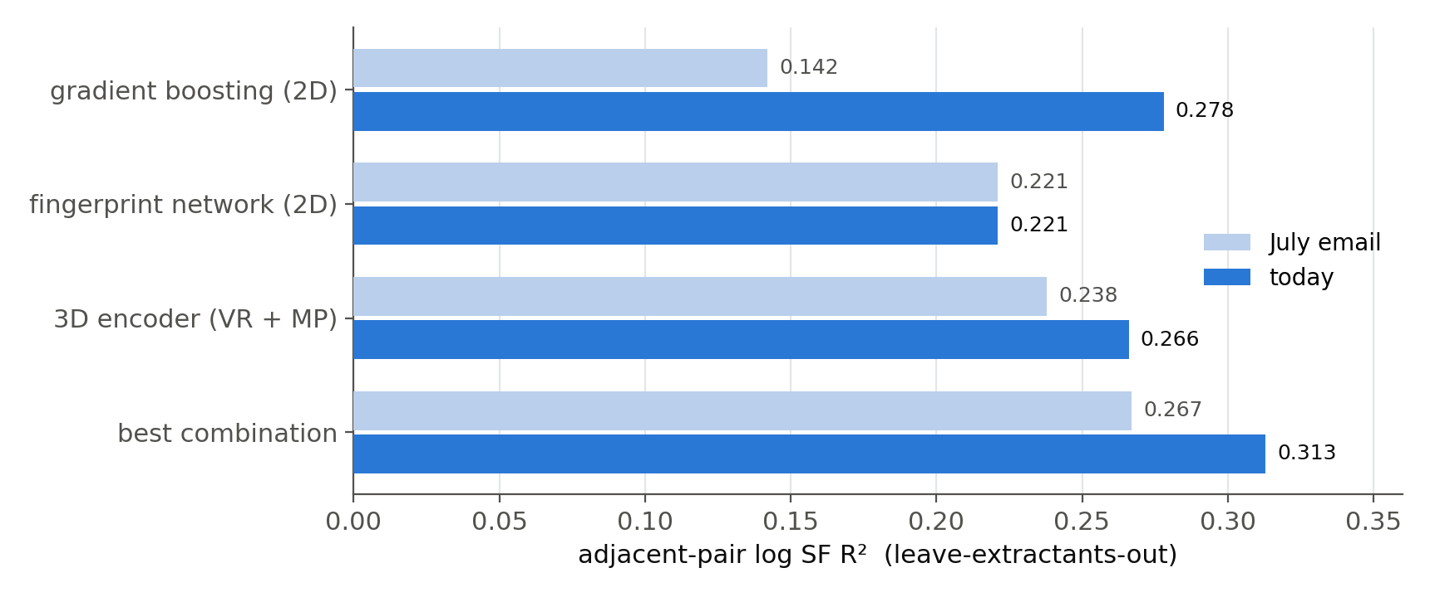
Results: July → today
Both improvements are objective-function changes — no architecture changed
The tabular gain came stepwise: RMSE → MAE (+0.107) → Quantile(0.6) → re-tuned depth/rsm under that loss. The 3D gain is the contrast-weight change (slide 16).
Notes:
CatBoost chain: RMSE->MAE (+0.107) -> Quantile(0.6) -> hyperparameters re-tuned under the winning loss (+0.021 more; +0.016 of it confirmed on a held-out third). 3D: contrast weight 2->4. Fingerprint unchanged. If asked why quantile: log D has a heavy left tail; an upper quantile down-weights it.

Slide 11
The best system, and its honest boundary
configuration | adjacent-pair R² | 3D marginal
best 2D single (tuned boosting) | +0.278 | —
2D stack (boosting + fingerprint) | +0.291 | —
2D stack + 3D encoder | +0.313 | +0.023
same, strict condition key (1,417 pairs) | +0.210 vs +0.200 | +0.010
published July stack, for reference | +0.267 | +0.038
The 3D contribution shrank as partners improved — complementarity means a stronger partner leaves less to correct.
Strict key = only the lanthanide varies inside a block. The honest statement: part of the 3D gain lives in condition binning.
Status: exploratory. Both improved components were tuned inside this population; a fresh held-out split is the next step.
Notes:
Three caveats live HERE, not in backup: (1) contribution shrank 0.038->0.023 as partners improved — predicted by the error-correlation mechanism; (2) strict key halves it, and the published contribution was already indistinguishable there — some of the 3D gain lives in condition binning; (3) exploratory: both improved components tuned on data inside this population; every clean held-out partition is spent. Next confirmatory step = fresh split.

Slide 12
Act 2 — why doesn't 3D do more? The Hamiltonian is rank-1 in the metal
GFN2-xTB treats f-electrons in-core; every lanthanide parameter from Ce to Lu is linear interpolation between two fitted anchors (residual 5×10⁻⁷ — the file's printed precision).
Consequence: metal identity enters every geometry as ONE scalar, linear in Z. No f-shell, no gadolinium break, no tetrad effect — by construction.
Retrodiction confirmed: eight different 3D encoders are mutually interchangeable — effective rank 1.05 of 8; two architectures correlate at 0.986, same as two seed-ensembles of one.
And that one scalar is already a tabular column (Shannon ionic radius) — an encoder reading these geometries re-derives a feature the models already have.
Notes:
The parameter file: every lanthanide parameter Ce(58)->Lu(71) is linear interpolation between two anchors, residual 5e-7 = printed precision. Authors' documented design (f-in-core), not our discovery — the CONSEQUENCE is ours: one scalar of metal information, already present as the Shannon radius column. Retrodicts encoder interchangeability: 8 encoders, effective rank 1.05; two architectures correlate 0.986 = two seeds of one architecture.

Slide 13
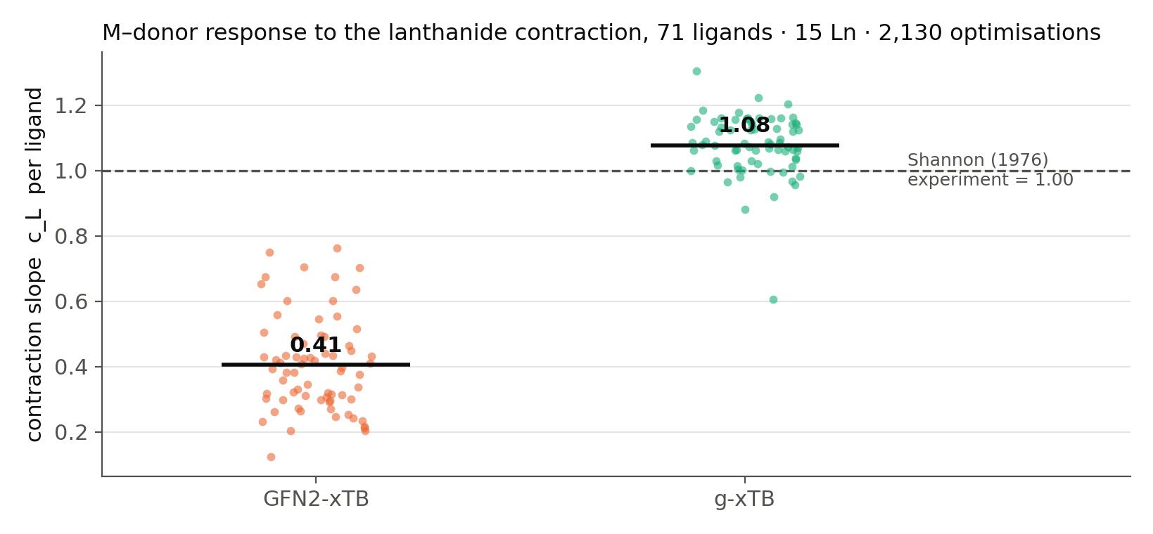
Measuring the damage against experiment
Per-ligand contraction slope, fixed ligand environment, 71 ligands · 15 Ln · 2,130 optimisations
g-xTB (Grimme 2025, f-electrons in valence) improves the contraction response on 71 of 71 ligands, p = 5×10⁻⁵². GFN2's per-ligand slope is mostly noise: 23 % cross-ligand reproducibility vs 96 %.
Notes:
Construction: take one relaxed anchor per ligand family, substitute all 15 lanthanides, re-relax — series in correspondence, so the slope is clean of conformer noise. c_L = d<M-donor>/d r_Shannon; experiment = 1.00 by construction. GFN2 0.41 (2.47x under), g-xTB 1.08. 71/71 ligands improve, paired p=5e-52. Replicated in implicit solvent and on an independent 6-ligand pilot. GFN2's response is also mostly noise: 23% shared across ligands vs 96%.

Slide 14
Is this new? — what the literature already knows (web check, Aug 2026)
prior work | what it established | what it did not do
Bursch/Hansen/Grimme 2017 | GFN1 usable for Ln geometries: 80 complexes, RMSD 0.65 Å vs X-ray | no cross-series trend analysis
Zhang et al., JCC 2026 (Ln-xTB) | GFN2 Ln bond MAD 0.134 Å vs DFT; new params reach 0.037 Å | absolute errors vs DFT, not the contraction slope vs experiment
g-xTB preprint (2025) | ~32k relative energies incl. actinides; f-populations as fit targets | no lanthanide geometry validation
New here: the contraction SLOPE as the observable (per-ligand, fixed environment, vs Shannon experiment); the 2.47× correlated trend error that per-complex MAD cannot see; the first lanthanide-geometry validation of g-xTB; and the chain to ML encoder rank collapse.
Before submission: obtain the Ln-xTB full text (closest prior art, this year) — and run the same benchmark on Ln-xTB, which is also our pre-registered falsifying test.
Notes:
Be precise here; he will know the Grimme literature. Bursch 2017: GFN1, 80 complexes, per-complex RMSD vs CSD — no series trend. Ln-xTB (Zhang, JCC 2026, NEW): GFN2 Ln bond MAD 0.134 A vs DFT — absolute errors, reference is DFT not experiment; I could not access full text yet — obligation to read before submission. g-xTB preprint: ~32k relative ENERGIES, no lanthanide geometry validation at all. So: the DERIVATIVE observable, the experiment reference, the g-xTB geometry validation, and the link to ML rank collapse are ours. Natural follow-up: run the same benchmark on Ln-xTB — also the pre-registered falsifying test.

Slide 15
Fixing the chemistry does not fix the score
All 956 complexes re-optimised with g-xTB; matched pairs, identical rows
representation-side intervention | Δ adjacent R² | verdict
g-xTB geometries (correct contraction) | +0.004 (p = 0.68) | null
structures in correspondence (455× less conformer noise) | −0.013 | negative
conditions modulating the 3D embedding (FiLM) | −0.108 (p = 0.003) | harmful
direct pair head + reconciliation | −1.16 | catastrophic
One apparent positive (+0.033, p = 0.02, 7/8 seeds) was calibration: one rescaling constant on the OLD geometry recovered 237 % of it.
The information the models lack is not in the coordinates. Geometric fidelity is not the bottleneck for this property.
Notes:
The punchline of act 2. Four representation-side interventions, all null/harmful, all powered. Tell the shrinkage story: a +0.033 p=0.02 7/8-seed 'gain' died because rescaling the OLD geometry by one constant recovered 237% of it — R² on a weak baseline rises when predictions shrink. Conclusion: the missing information is not in the coordinates.

Slide 16
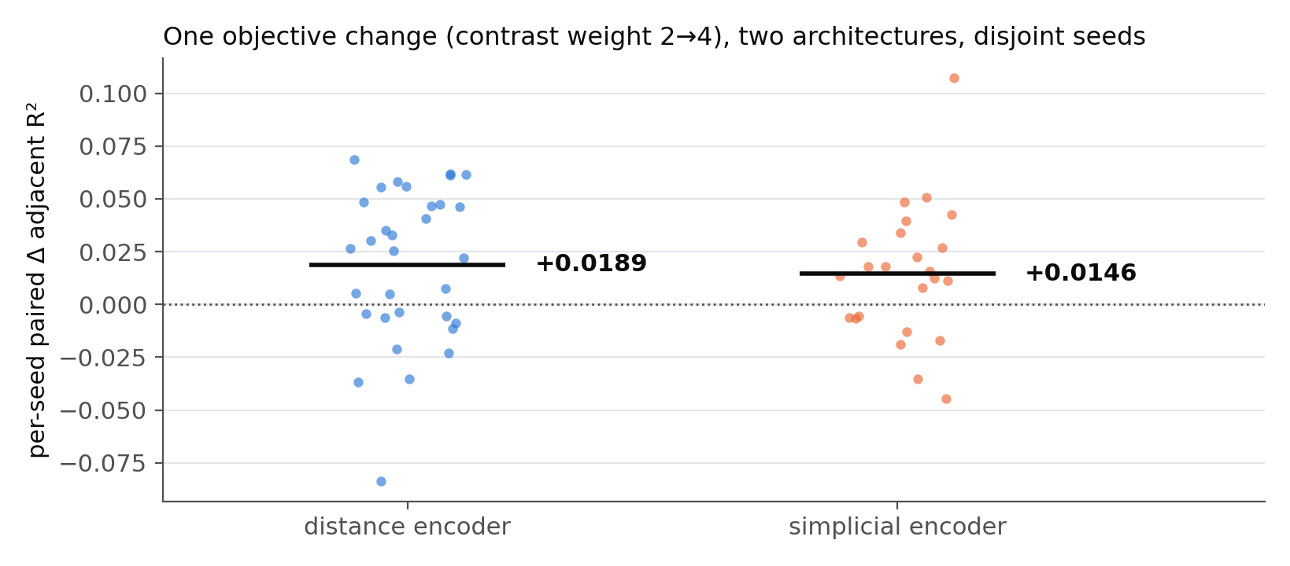
What does move the metric: aligning the loss with the scored contrast
Up-weighting the within-block contrast term: +0.0142 (distance encoder, 40 independent seeds) and +0.0146 (simplicial, 24 seeds) — the same effect on two architectures. Cost: overall log D R² −0.015.
Notes:
The same single change — contrast-term weight 2->4 — on both encoders, disjoint seed sets: +0.0142 (40 seeds, p=0.014) and +0.0146 (24 seeds, p=0.035). Objective-level effect, not encoder artefact. Cost: overall log D dips 0.015 — a selectivity setting. History note if asked: an early 8-seed estimate said +0.027; independent seeds halved it — the power lesson of slide 18.

Slide 17
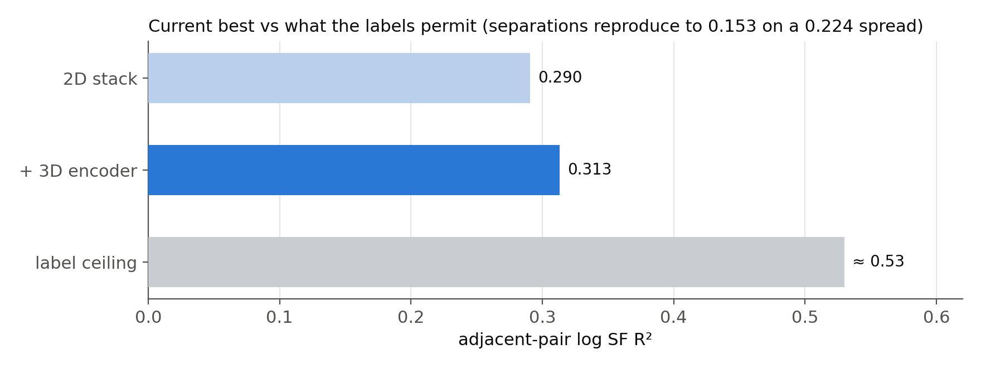
Headroom: the labels support ≈ +0.53
The same adjacent separation measured in independent blocks reproduces to 0.153 on a spread of 0.224 — condition effects cancel on differencing. We are at ~60 % of the ceiling; geometry explains ~1 % of pair variance under either Hamiltonian.
Notes:
Naive noise math gives an impossible negative ceiling (within-block scatter 0.72-0.95 > separation spread 0.224) — resolved because condition effects are shared by both metals of a pair and cancel on differencing: repeated separations reproduce to 0.153. Ceiling 1-(0.153/0.224)^2 ~ 0.53, a LOWER bound. We are at ~60%. Remaining signal: conditions, direct pair modelling — not geometry (~1%).

Slide 18
Methodology: three false positives were caught in one week
Power: per-seed sd 0.0285 → n = 8 resolves ~0.028 while true effects are 0.01–0.02. Three n ≤ 8 'significant' gains dissolved on independent seeds; confirmatory runs now use 24–32.
Scale-free check: on a weak baseline R² rises when predictions shrink toward the mean; requiring Pearson² sign agreement killed a p = 0.02 artefact.
Silent no-ops: five CLI flags were accepted, recorded as enabled, and ignored by architectures lacking them — including the pair head, untested for the whole study. A capability gate now raises instead.
Selection hygiene: every axis clearing +0.02 on screening data (four) failed held-out. Pre-registration with the bar and null-consequence committed before data exists is now standard.
Notes:
Each has a one-line story: (1) C8 geometry-only +0.033 -> scale-free check reversed it; (2) a quantile setting +0.017 on 4/4 seeds -> +0.002 at 8; (3) plw4 +0.027 p=0.021 -> +0.014 pooled over 40 independent seeds. Silent no-ops: 5 flags incl. the pair head — accepted, logged as enabled, ignored; untested for the entire study without anyone knowing. Gate now raises.

Slide 19
Summary — three claims, four things to discuss
1. The 3D encoder is necessary for the best result via complementarity (0.313 vs 0.291, largest weight) — no longer the strongest single model; contribution shrinks under strict blocking.
2. The 3D ceiling is the Hamiltonian's: GFN2 is rank-1 in the metal and under-predicts the contraction 2.47×; g-xTB fixes the chemistry (8 % of experiment, 71/71 ligands) and the score does not move. The benchmark is new — validated against the literature — and stands alone.
3. The lever for selectivity is the objective: every surviving gain came from aligning the loss with the scored contrast, transferring across architectures.
Discuss: (a) fresh held-out split for confirmation; (b) the contraction benchmark as a standalone paper — incl. running it on Ln-xTB (Zhang 2026, closest prior art); (c) direct pair modelling toward +0.53; (d) whether VR complementarity merits a methods note given the strict-key bound.
Notes:
Suggested order on the call: answer his question (2 min), best-system numbers (5), contraction benchmark + novelty (10), negatives + what works (5), discussion (rest). If time is short, slides 2, 11, 13, 14 are the talk.

