Slide 1
Predicting adjacent-lanthanide selectivity from 3D structure
What the data supports, and what limits it
Bogdan Mironov · August 2026
Notes:
Order: problem, data, evaluation, the 3D model + how it predicts, results, why capped, the chemistry benchmark, what moves the score, summary.

Slide 2
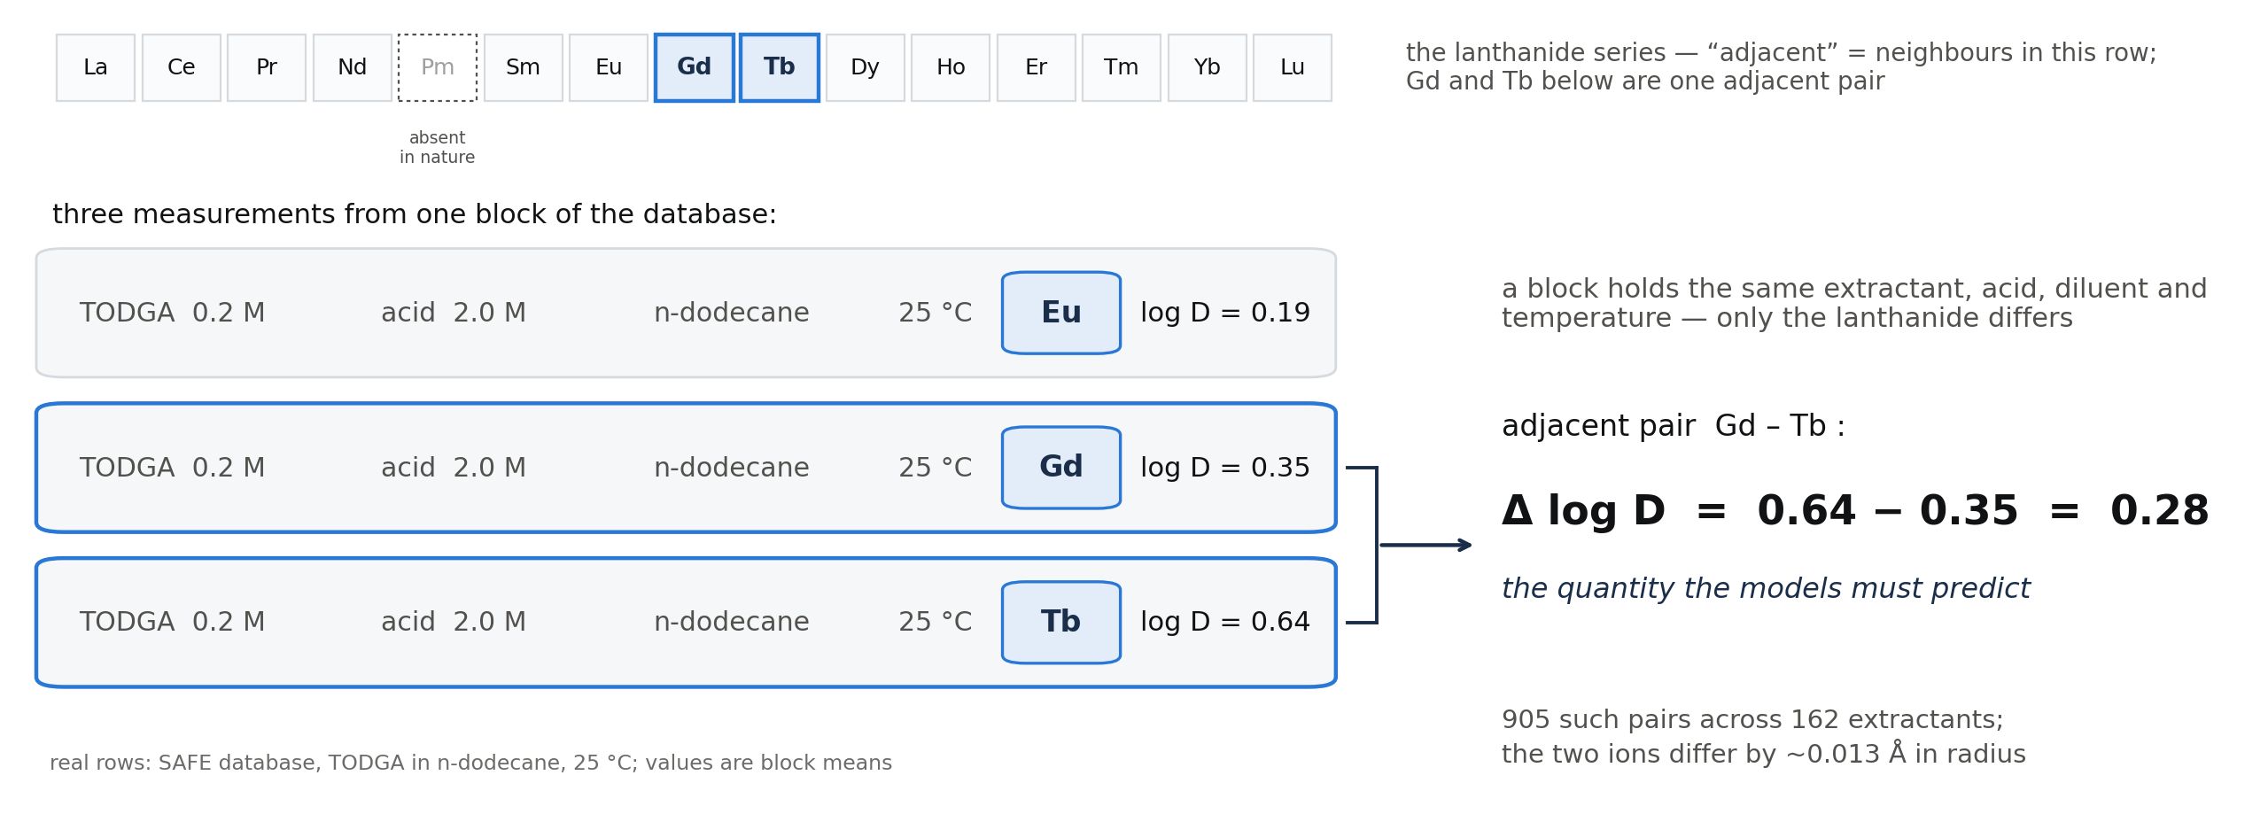
The problem: separating neighbouring lanthanides
Rare earths are separated by liquid–liquid extraction with designed organic molecules (extractants). Neighbouring lanthanides are the hard case: their 3+ ions differ by ~0.013 Å in radius and in almost nothing else.
We predict how well an extractant separates two neighbouring lanthanides — the difference in log D under identical conditions:
Notes:
Adjacent pairs (Nd/Pr, Dy/Tb) are the expensive separations. The schematic defines the predicted quantity. R2=0 already means predicting the average separation; best sign accuracy ~0.67.

Slide 3
Data: a curated literature database, then quantum-chemistry structures
source | SAFE database: 48,138 measurements · 31 elements · 181 publications, every row DOI-linked with full conditions (extractant, acid, diluent, concentrations, temperature)
modelled subset | 4,746 measurements · 162 extractants · 14 lanthanides · target: log D
step | tool | output
assemble the extraction complex | Architector | 3D structure guess per (extractant, lanthanide, nitrate/water fill), coordination number 8–9
relax it | GFN2-xTB (tight-binding QM), water solvation | 956 unique optimised complexes, convergence force-checked
descriptors | RDKit, fingerprints, conditions | 746-column table per measurement
Notes:
SAFE: DOI-linked, condition-resolved; replicates across labs are real replicates (later gives the noise floor). 956 complexes; convergence force-checked independently.

Slide 4
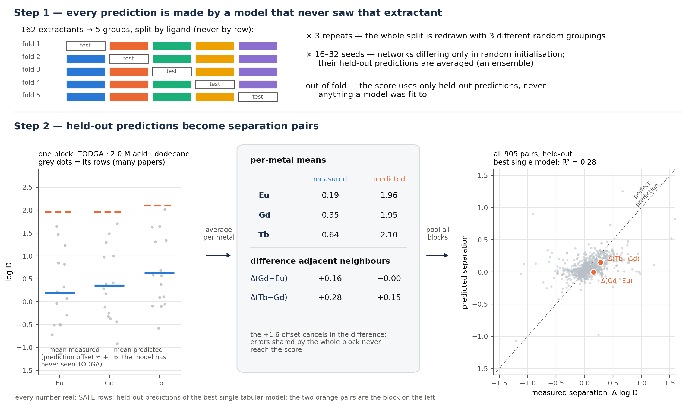
How every number in this talk is evaluated
Notes:
Grouped CV = no ligand leakage; replicate averaging inside blocks; ensembles scored out-of-fold. Step 2 walks a real TODGA block: the +1.6 offset on an unseen extractant cancels in the difference — why the metric differences within blocks. Per-seed sd of a paired delta 0.0285 -> confirmatory runs use 24-32 seeds.

Slide 5
Three models
Model 1 — gradient-boosted trees (CatBoost) on the 746 descriptor columns. No 3D input.
Model 2 — a neural network on molecular fingerprints. No 3D input.
Model 3 — a network that reads the optimised 3D structure of the extraction complex itself (next slides).
Each predicts log D per measurement; separations are differences of predictions inside a block. The final system is a weighted combination of the three, weights fitted per held-out extractant on the separations directly.
Notes:
Two conventional (no 3D input): boosted trees on 746 columns; fingerprint network. Third reads the optimised 3D structure (next two slides). Combination = per-extractant NNLS on the separation vectors, nested.

Slide 6
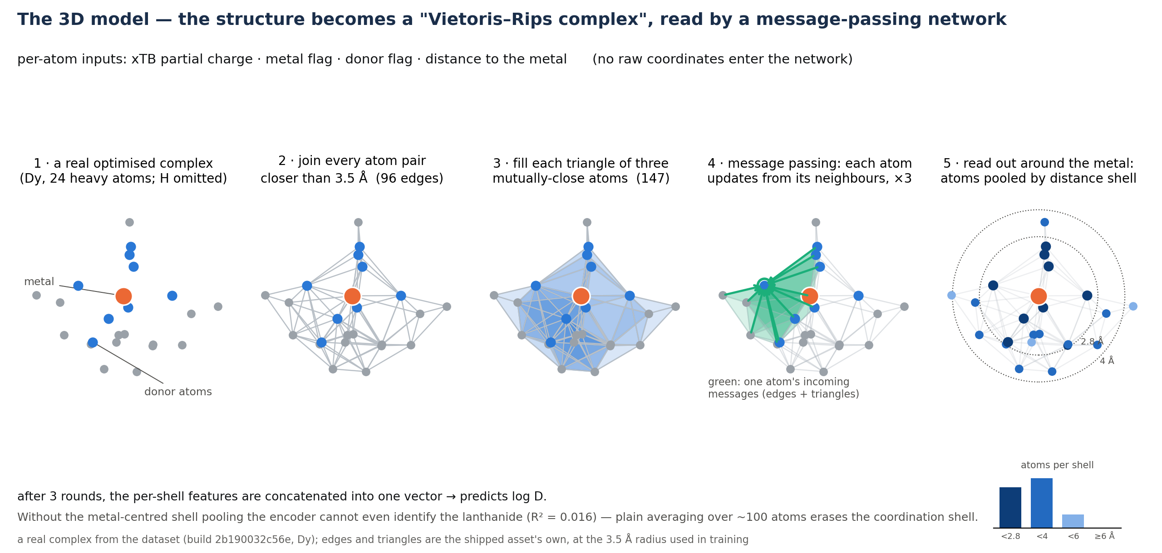
Model 3: reading the 3D structure
Notes:
Panels are a REAL Dy complex from the shipped asset: its true 96 edges and 147 triangles at the 3.5 A training radius. Message passing: one donor's incoming messages highlighted. Readout is metal-centred by distance shell — without it the encoder cannot even identify the lanthanide (R2 0.016).

Slide 7
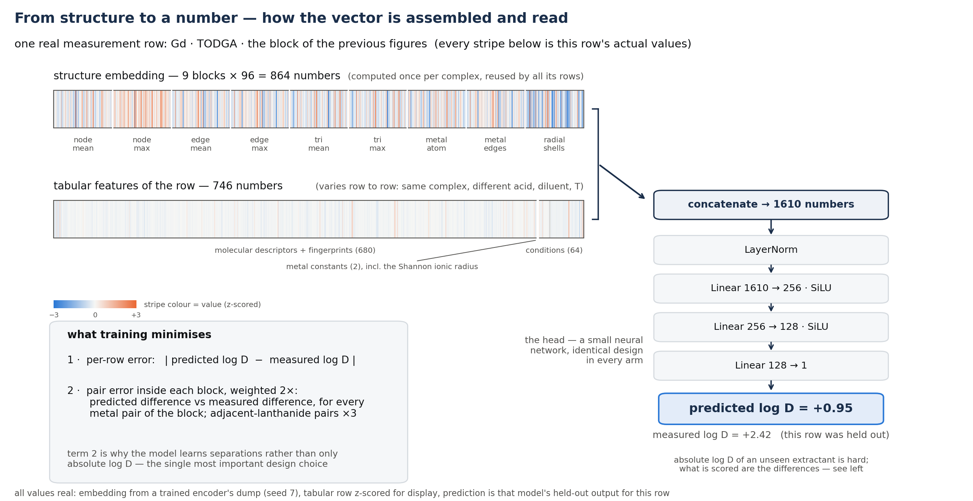
From structure to a number
Notes:
One real Gd/TODGA row, end to end: the actual 864-number embedding (9 named readout blocks), the row's 746 tabular values, concatenate 1610, the real head, the model's real held-out prediction (+0.95 vs measured +2.42 — absolute log D of an unseen extractant is hard; differences are what is scored). Loss card: per-row Huber + within-block pair term (weight 2, adjacent x3) — term 2 is why it learns separations; the next slides change exactly that weight.

Slide 8
Results
model (adjacent-pair R², held-out extractants) | score
gradient-boosted trees, descriptors only | 0.278
fingerprint network | 0.221
best 3D structure model | 0.266
combination of the two conventional models | 0.291
combination including the 3D model | 0.313
control: trees + 84 3D-derived descriptor columns | −0.02 (collapses)
The 3D model adds +0.023 to the best conventional combination and carries the largest fitted weight (0.46). Handing the same 3D information to the trees as descriptors does not reproduce it — it subtracts.
Under stricter condition blocking the margin is +0.010; the 0.313 is exploratory until confirmed on a fresh held-out split.
Notes:
Loss functions matter more than architectures. Rows: trees 0.278 (RMSE->quantile + re-tune; +0.016 confirmed held-out); fingerprint 0.221; best single 3D arm 0.266 (distance encoder with the new contrast weight; the simplicial ensemble is 0.239->0.243 with it); 2D stack 0.291; +3D 0.313, marginal +0.023, largest weight 0.46. Control row: same trees + 84 3D-derived descriptor columns COLLAPSES to -0.02 -> the encoder is not replicable by cheap descriptors; over that stack its marginal is +0.041. Caveats aloud: strict key +0.010; 0.313 exploratory (no clean held-out partition remains -> fresh split next).

Slide 9
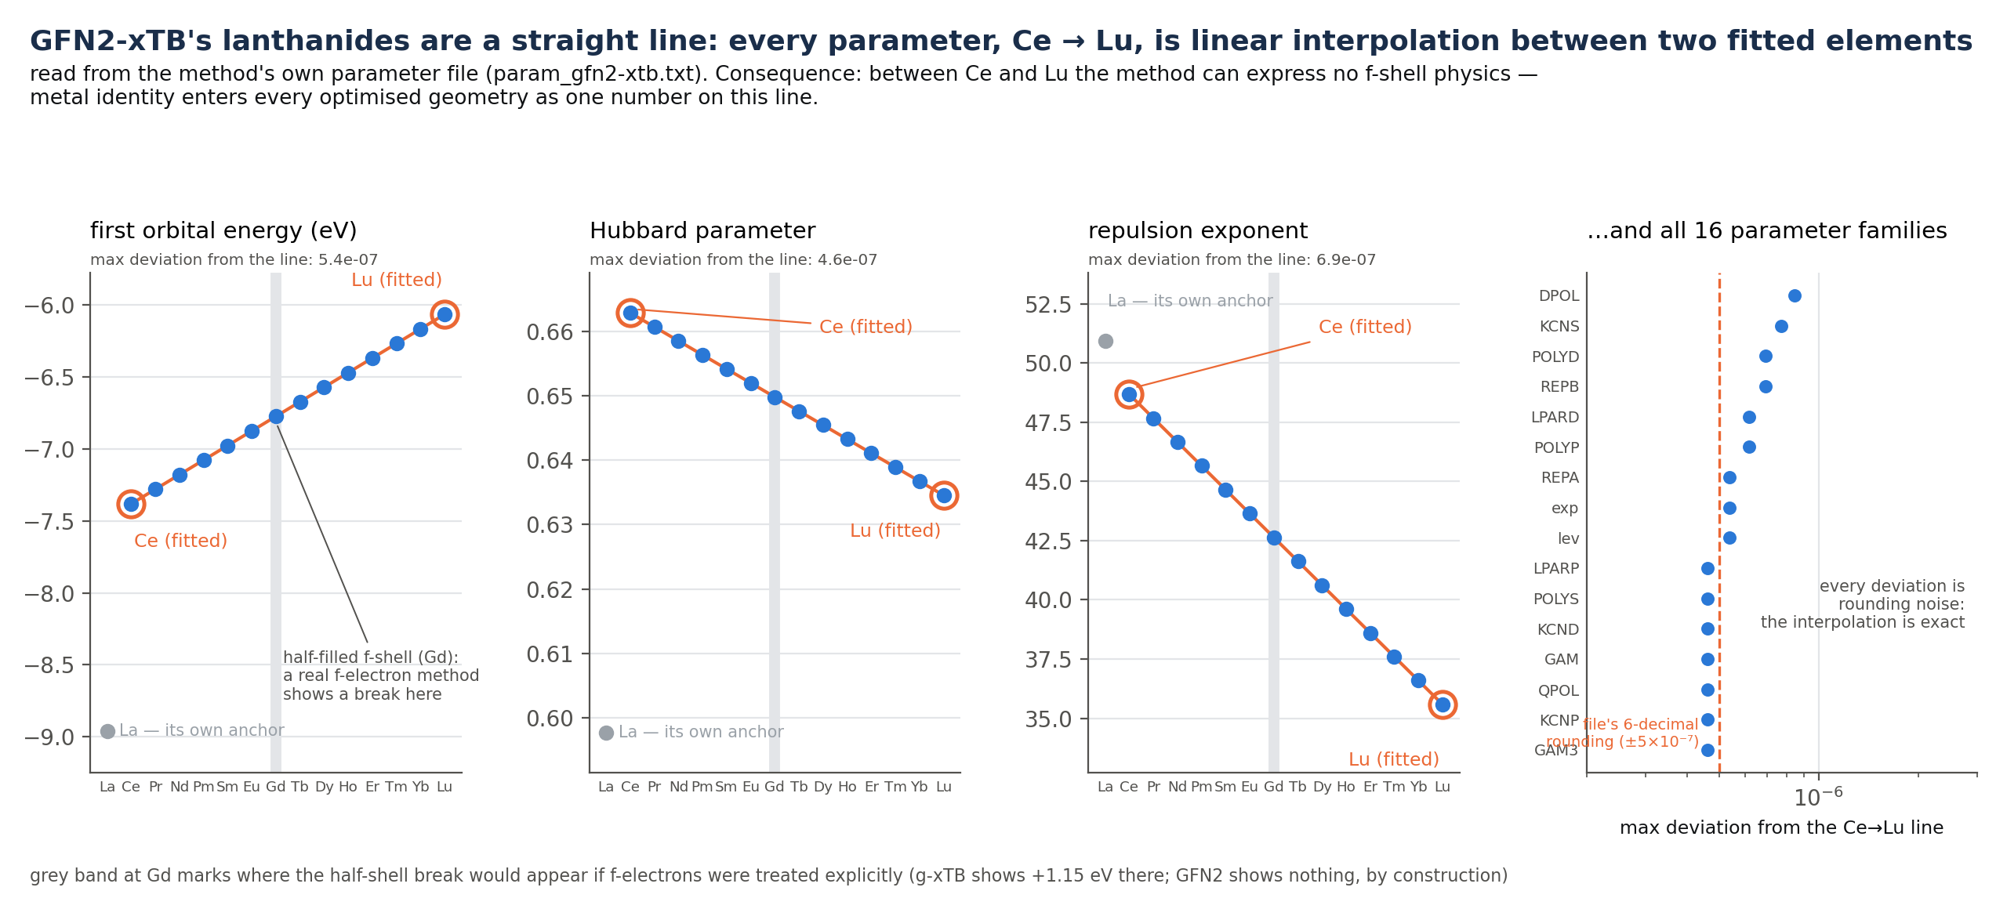
Why the 3D signal is capped: the quantum chemistry underneath
To GFN2-xTB, lanthanide identity is one number on a straight line — and that number is already a descriptor column (the Shannon ionic radius). Eight different 3D architectures give statistically identical predictions (correlation 0.986 = seed noise).
Notes:
The method's own parameters vs Z: every lanthanide between the two circled anchors IS the straight line — panel 4 proves it for all 16 parameter families (deviations = the file's rounding). Grey band at Gd = where a real f-shell puts a break; GFN2 cannot, by construction. Empirical consequence already measured: eight 3D encoders statistically identical (r 0.986 = seed noise). The one number the geometry can carry is already a descriptor column.

Slide 10
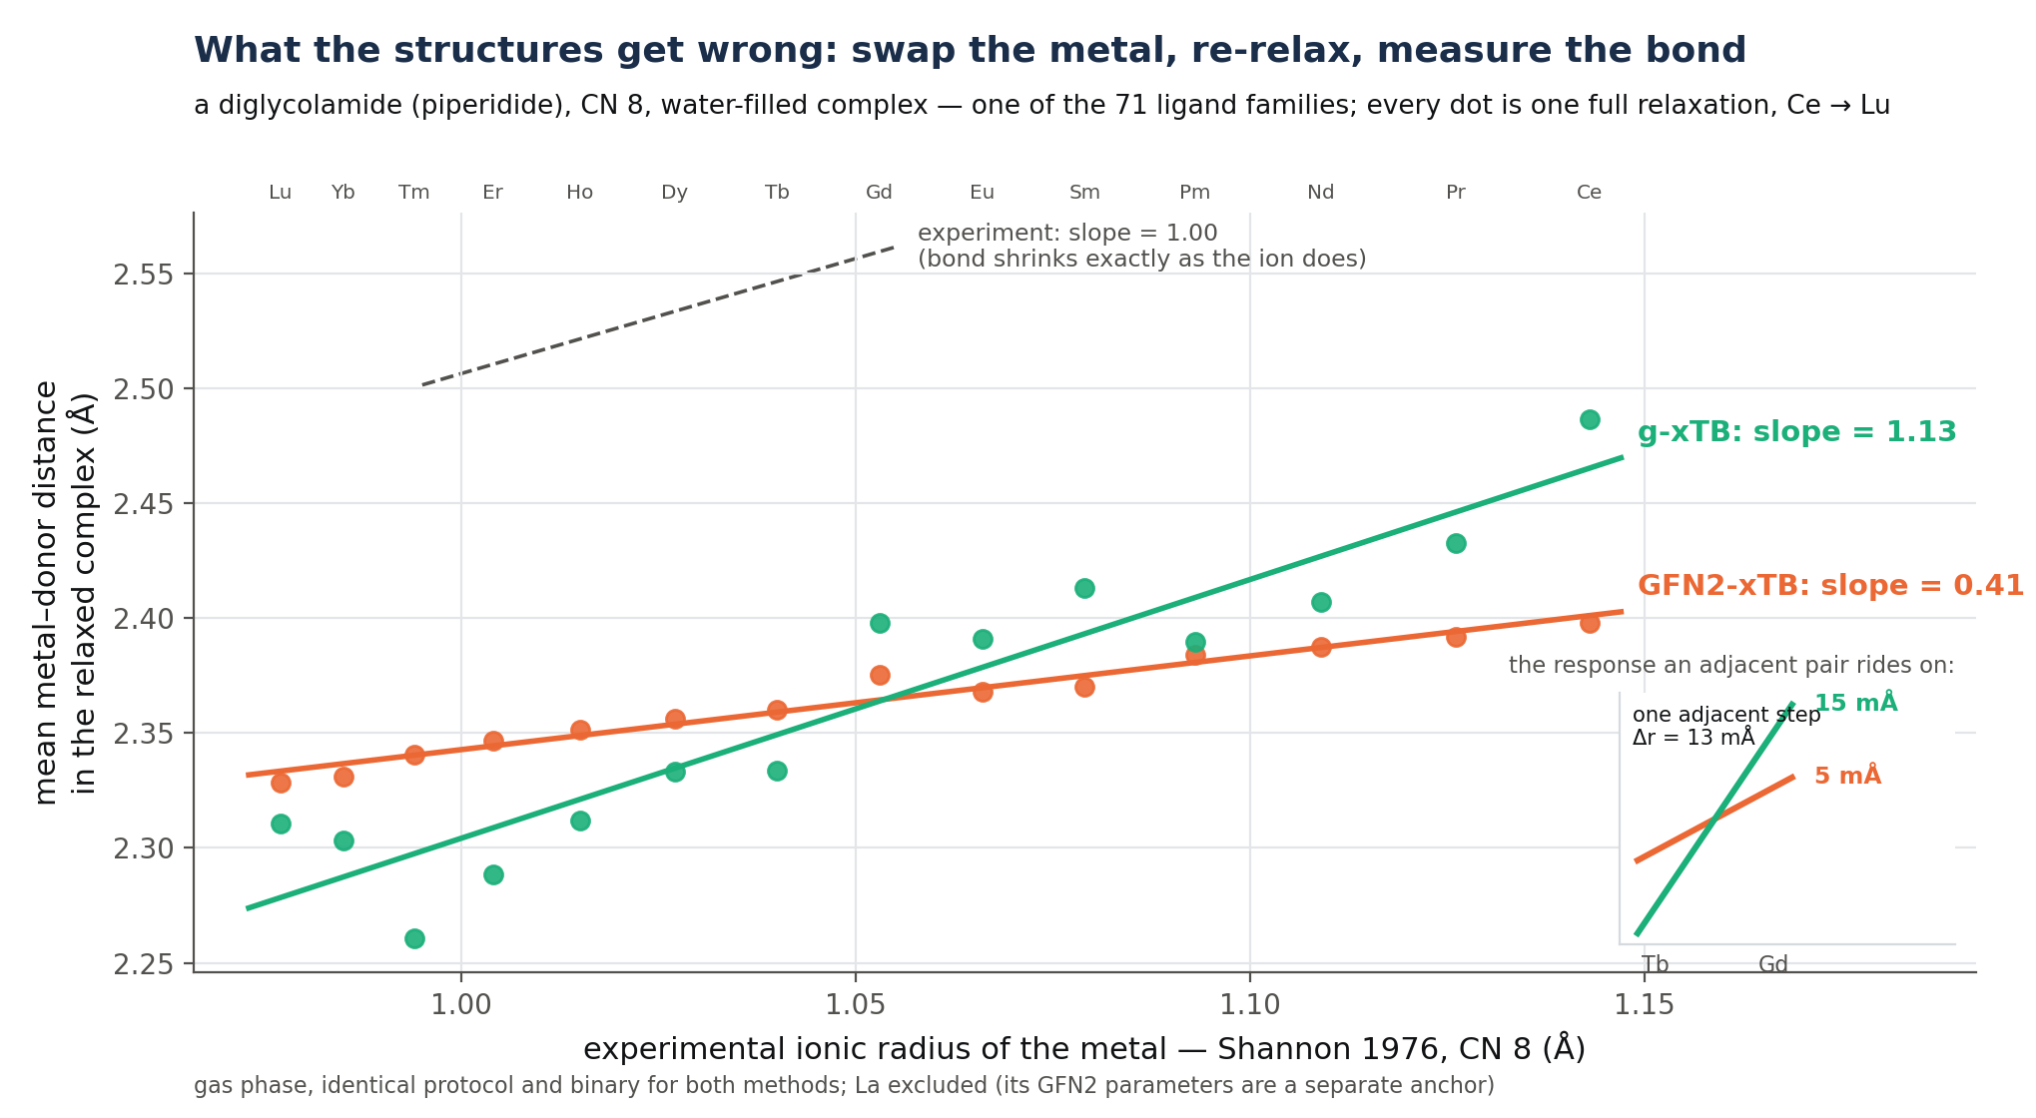
Measuring what the structures get wrong: the contraction response
Notes:
Define the observable: fixed ligand cage, swap the metal, re-relax, bond vs experimental radius; slope 1 = tracks reality. Inset: one adjacent step (Tb-Gd, 13 mA) -> 5 mA response under GFN2 vs 15 mA under g-xTB — the physical signal an adjacent pair rides on, ~3x. This ligand is CN 8; fits use CN 8 radii.

Slide 11
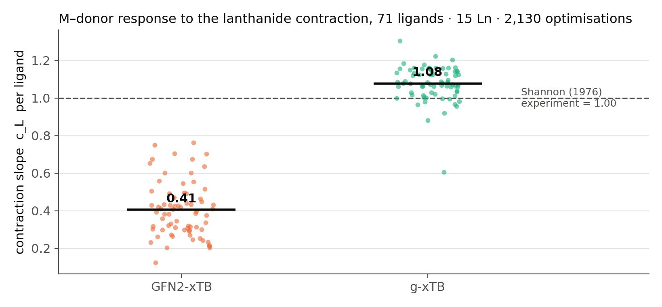
Across 71 ligands: GFN2-xTB under-responds 2.5×; g-xTB gets it right
New in this measurement: published benchmarks score individual complexes against DFT or X-ray. The response to the contraction — the trend across the series, against experimental radii — had not been measured for any tight-binding method, and g-xTB's lanthanide geometries had never been tested (its paper validates energies).
Notes:
Population version: GFN2 mean 0.41, mostly noise (23% cross-ligand reproducibility vs 96%); g-xTB 1.08, improving 71/71 ligands, p=5e-52; replicated in solvent. Novelty (web-checked): prior work scored per-complex bond errors vs DFT/X-ray (Bursch 2017; Ln-xTB 2026); the response slope vs EXPERIMENT had not been measured, and g-xTB had no lanthanide geometry validation at all. Obligation: read Ln-xTB in full; run it through this benchmark.

Slide 12
Fixing the structures does not fix the prediction — the loss function does
changing the structures | Δ score | changing the objective | Δ score
g-xTB geometries (correct contraction physics) | +0.004 (n.s.) | trees: RMSE → quantile loss + re-tune | +0.136
conformer noise removed (455× cleaner series) | −0.013 | contrast weight 2→4, distance encoder (32 seeds) | +0.019 p=0.006
conditions injected into the 3D representation | −0.108 | same change, July-baseline simplicial model (32 seeds) | +0.017 p=0.003
Every structure-side improvement left the score unchanged or worse; every surviving gain came from aligning the training loss with the scored separation — the same change, on both encoders, from disjoint seed sets, passing the anti-calibration check (pre-registered).
The labels support roughly R² ≈ 0.53 (repeat measurements of the same separation agree to 0.153 on a spread of 0.224). Current best: 0.31. Geometry explains about 1 % of the remaining variance.
Notes:
Decisive: re-optimise all 956 complexes with g-xTB, retrain matched: +0.004 n.s. Cleaning conformer noise 455x: worse. Conditions into the representation: -0.108. What paid: quantile loss on trees (+0.136 cumulative) and the contrast weight 2->4 — final, pre-registered, both encoders, disjoint seeds, n=32 each: dist +0.0189 p=0.006, simplicial +0.0165 p=0.003, BOTH passing the scale-free anti-calibration check. Ceiling: separations reproduce to 0.153 on 0.224 spread -> ~0.53; we are at 0.31; geometry ~1% of pair variance.

Slide 13
Summary
1. The best system includes the 3D structure model: 0.313 vs 0.291 without it, largest fitted weight — and its contribution is not reproducible by handing the trees 3D-derived descriptors (those collapse the model).
2. The ceiling on 3D is the quantum chemistry: GFN2-xTB carries no f-shell physics and under-responds to the lanthanide contraction 2.5×. Fixing the chemistry (g-xTB: within 8 %, 71/71 ligands, p = 5×10⁻⁵²) does not move the prediction — a new, standalone benchmark result.
3. What moved predictions was aligning the training loss with the scored separation — the one fully pre-registered positive: +0.019 / +0.017 on the two encoders, 32 disjoint seeds each, both passing the anti-calibration check.
Next: a fresh held-out split to confirm 0.313; the contraction benchmark as a paper (add Ln-xTB, Zhang 2026); predicting separations directly, toward the 0.53 the labels support.
Notes:
If time is short: S8 and S11 are the talk. Call order suggestion: S2 (2 min), S8 (5), S9-S11 (10), S12 (3), discussion.

