Slide 1

Defining Classes
SoftUni Team
Technical Trainers
Software University
https://softuni.bg

Slide 2
Table of Contents
Project Architecture
Classes
Class Definition Syntax
Scope and Namespace
The Class Object
Metaclasses
2

Slide 3
Have a Question?
sli.do
#python-advanced

Slide 4

Project Architecture
Splitting Code into Logical Parts

Slide 5
Splitting Code into Methods
We use methods to split code into functional blocks
Improves code readability
Allows for easier debugging
for move in moves:
for row in range(len(room)):
for col in range(len(room[row])):
if room[row][col] == 'b':
…
for move in moves:
move_enemies()
killer_check()
move_player(move)

Slide 6

Splitting Code into Methods
A single method should complete a single task
do_magic ( … )
deposit_or_withdraw ( … )
deposit_and_get_balance ( … )
parse_data_and_return_result ( … )
withdraw ( … )
deposit ( … )
getBalance ( … )
toString ( … )

Slide 7
Problem: Rhombus of Stars
Draw on the console a rhombus of stars with a size of n
n = 3
n = 2
n = 1
*
* *
* * *
* *
*
*
* *
*
*

Slide 8
Solution: Rhombus of Stars
size = int(input())
for star_count in range(1, size):
print_row(size, star_count)
for star_count in range(size, 0, -1):
print_row(size, star_count)
# Continues to the next slide
Reusing code

Slide 9
Solution: Rhombus of Stars
# Continues from previous slide
def print_row(size, star_count):
for row in range(size – star_count):
print(" ", end="")
for row in range(1, star_count): print("*", end=" ")
print("*")

Slide 10

Classes
Building Data Functionality Together

Slide 11
Classes Definition
Classes provide the means of building data functionality together
Classes create new types of objects that allow instances of that type to be made
Each class instance can have attributes for maintaining its state
Class instances can also have methods for modifying its state
11

Slide 12
Class Definition Syntax
Class Name
class Person:
def __init__(self, name, age):
self.name = name
self.age = age
Class Method
Instance Attribute
12

Slide 13
The __init__() Method
When a class defines an __init__() method, this method is invoked for the newly-created class instance
class Laptop:
def __init__(self, name, model):
self.name = name
self.model = model
my_laptop = Laptop("Inspiron 15", "Dell")
13

Slide 14
self keyword
self is used to represent the instance of the class
You can access the attributes and methods of the class
It binds the attributes with the given arguments
class Laptop:
def __init__(self, name, model):
self.name = name
self.model = model
14

Slide 15
Problem: Class Book
Create a class called Book
Upon initialization it should receive a name, author and pages (number)
Submit only the class in the judge system
Use test code to test your code
book = Book("My Book", "Me", 200)
print(book.name)
print(book.author)
print(book.pages)
My Book
Me
200
15

Slide 16

Solution: Class Book
class Book:
def __init__(self, name, author, pages):
self.name = name
self.author = author
self.pages = pages
16

Slide 17

Scope and Namespace
Local, Global and Built-In Namespace

Slide 18
What is Namespace?
A mapping from names to objects
Examples:
Built-in names for example the abs() function
Global names in a module
Local names on a function invocation
There is no relation between names in different namespaces
18

Slide 19
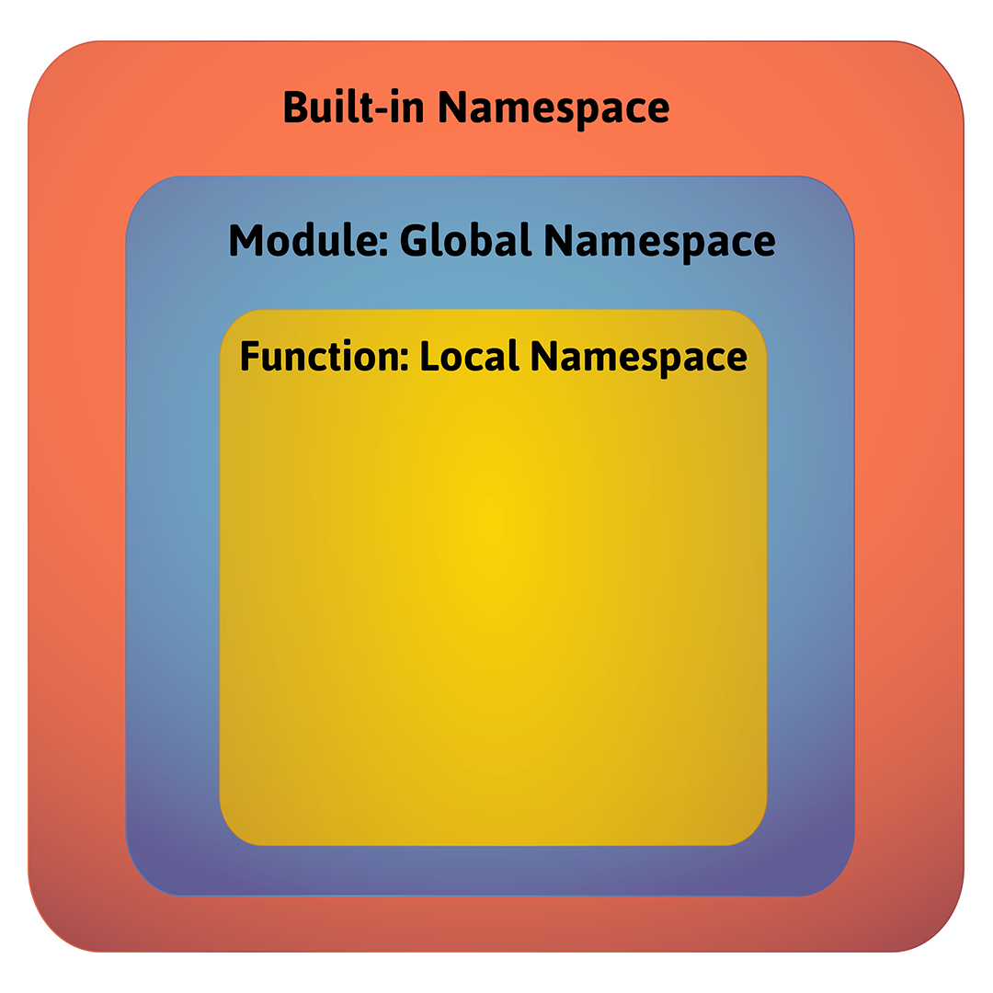
Namespaces Order

Slide 20
What is a Scope?
A region in a program where a namespace is directly accessible
In most of the cases there are at least three nested scopes:
The innermost which is searched first
The scopes of any enclosing functions
The next-to-last scope (module's global names)
The outermost (built-in names)
20

Slide 21
Scopes Example
def scopes():
def local_scope():
text = "local text"
Local Scope
def nonlocal_scope():
nonlocal text
text = "nonlocal text"
Nonlocal Scope
def global_scope():
global text
text = "global text"
Global Scope
21

Slide 22
Problem: Scope Mess
Fix the provided code, so it prints the result expected
Download code from here
# current output
global
outer: local
inner: nonlocal
outer: local
global
# expected output
global
outer: local
inner: nonlocal
outer: nonlocal
global: changed!
22

Slide 23

Solution: Scope Mess
Here are the changes that need to be made
def inner():
nonlocal x
x = "nonlocal"
print("inner:", x)
def change_global():
global x
x = "global: changed!"
23

Slide 24

The Class Object

Slide 25
Class Objects
They support two kinds of operations: attribute references and instantiation
Attribute references
Use standard syntax: obj.name
Valid attribute names are the ones in the class's namespace
Instantiation
Uses function notation
25

Slide 26
Attribute References Example
class MyClass:
"""A simple example class"""
i = 12345
def f(self):
return 'hello world'
MyClass.i and MyClass.f are valid attribute references
Class attributes can also be assigned, so you can change the value of MyClass.i by assignment
26

Slide 27
Instantiation Example
x = MyClass()
Creates a new instance of the class and assigns this object to the local variable x
The instantiation operation creates an empty object
Many classes create objects with instances customized to a specific initial state
Therefore a class may define a special method named __init__()
27

Slide 28
Problem: Music
Create a class Music that receives title, artist and lyrics upon initialization
It should have 2 methods
get_info() - returns 'This is {title} from {artist}'
play() - returns the lyrics
Submit only the class in the judge system
Test your code with your own examples
28

Slide 29
Solution: Music
class Music:
def __init__(self, title, artist, lyrics):
self.title = title
self.artist = artist
self.lyrics = lyrics
def print_info(self):
return f'This is "{self.title}" from "{self.artist}"'
def play(self):
return self.lyrics
29

Slide 30
Metaprogramming
& Metaclasses

Slide 31
Metaprogramming
A programming technique in which computer programs have the ability to treat other programs as their data
A program can be designed to read, generate, analyze or transform other programs, and even modify itself while running
Python supports a form of metaprogramming for classes called metaclasses
31

Slide 32
Metaclasses
Metaprogramming relies on a type of class that is called the "metaclass"
A "metaclass" is the class of a class
This type of class holds the instructions about the behind-the-scenes code generation that takes place when another piece of code is being executed
A class defines how an instance of the class (i.e. an object) behaves while a "metaclass" defines how a class behaves
32

Slide 33
Metaclasses (2)
class Person:
pass
person = Person()
type(person) # <class '__main__.Person'>
type(Person) # <class 'type'>
In the Python realm, a class can be one of two varieties, referred to as old-style and new-style classes
Python 3.x supports only the new-style
33

Slide 34
Metaclasses (3)
class FoodType(object):
def __init__(self, f_type):
self.f_type = f_type
def get_f_type(self):
return self.f_type
Normally, we define a class using the class keyword
def init(self, f_type):
self.f_type = f_type
def get_f_type(self):
return self.f_type
FoodType = type('FoodType', (object, ), { '__init__': init,
'get_f_type' : get_f_type,})
This syntax is a substitute for type class
34

Slide 35

Summary
Classes provide means of building data functionality together
A namespace is a mapping from names to objects
A scope is a region in a program where a namespace is directly accessible
Class Objects support two kinds of operations: attribute references and instantiation

Slide 36
Questions?
Notes:
36

Slide 37

License
This course (slides, examples, demos, exercises, homework, documents, videos and other assets) is copyrighted content
Unauthorized copy, reproduction or use is illegal
© SoftUni – https://about.softuni.bg
© Software University – https://softuni.bg
Notes:
37

Slide 38
Trainings @ Software University (SoftUni)
Software University – High-Quality Education, Profession and Job for Software Developers
softuni.bg, softuni.org
Software University Foundation
softuni.foundation
Software University @ Facebook
facebook.com/SoftwareUniversity
Software University Forums
forum.softuni.bg
38
Notes:
38

