Slide 1
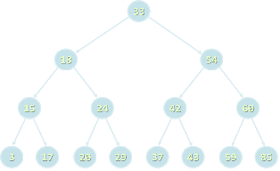




Trees and Traversals
Trees, Tre-Like Structures, Binary Search Trees, Balanced Trees, Tree Traversals, DFS and BFS
Svetlin Nakov
Technical Trainer
www.nakov.com
Telerik Software Academy
academy.telerik.com

Slide 2
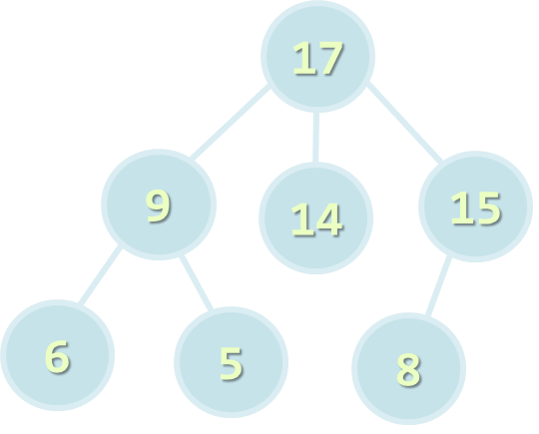

Table of Contents
Tree-like Data Structures
Trees and Related Terminology
Implementing Trees
Traversing Trees
DFS and BFS Traversals
Balanced Search Trees
Balanced Trees in .NET

Slide 3
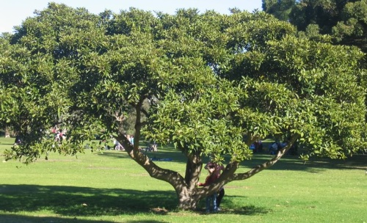
Tree-like Data Structures
Trees, Balanced Trees, Graphs, Networks

Slide 4

Tree-like Data Structures
Tree-like data structures are:
Branched recursive data structures
Consisting of nodes
Each node connected to other nodes
Examples of tree-like structures
Trees: binary, balanced, ordered, etc.
Graphs: directed / undirected, weighted, etc.
Networks

Slide 5
Tree-like Data Structures
Network
2
5 (20)
Tree
1
5 (10)
Project Manager
10 (40)
20(20)
6
15 (15)
3
Team Leader
De-signer
QA Team Leader
15 (30)
5 (5)
4
5
Developer 1
Developer 3
Tester 1
Tester 2
7
Developer 2
1
14
4
21
Graph
11
12
19
31

Slide 6

Trees and Related Terminology
Node, Edge, Root, Children, Parent, Leaf, Binary Search Tree, Balanced Tree

Slide 7
Trees
Tree data structure – terminology
Node, edge, root, child, children, siblings, parent, ancestor, descendant, predecessor, successor, internal node, leaf, depth, height, subtree
17
Depth 0
Height = 3
9
14
15
Depth 1
6
5
8
Depth 2

Slide 8
Binary Trees
Binary trees: the most widespread form
Each node has at most 2 children
Root node
Right child
17
Left subtree
9
15
Right child
6
5
8
10
Left child

Slide 9
Binary Search Trees
Binary search trees are ordered
For each node x in the tree
All the elements of the left subtree of x are ≤ x
All the elements of the right subtree of x are > x
Binary search trees can be balanced
Balanced trees have height of ~ log(x)
Balanced trees have for each node nearly equal number of nodes in its subtrees

Slide 10
Binary Search Trees (2)
Example of balanced binary search tree
If the tree is balanced, add / search / delete operations take approximately log(n) steps
17
9
19
6
12
25

Slide 11
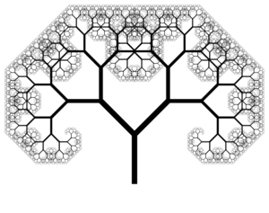
Implementing Trees
Recursive Tree Data Structure

Slide 12
Recursive Tree Definition
The recursive definition for tree data structure:
A single node is tree
Tree nodes can have zero or multiple children that are also trees
Tree node definition in C#
The value contained in the node
public class TreeNode<T>
{
private T value;
private List<TreeNode<T>> children;
…
}
List of child nodes, which are of the same type

Slide 13
TreeNode<int> Structure
List<TreeNode<int>> children
int value
TreeNode<int>
7
children
19
children
21
children
14
children
1
children
31
children
23
children
6
children
12
children

Slide 14

Implementing TreeNode<T>
public TreeNode(T value)
{
this.value = value;
this.children = new List<TreeNode<T>>();
}
public T Value
{
get { return this.value; }
set { this.value = value; }
}
public void AddChild(TreeNode<T> child)
{
child.hasParent = true;
this.children.Add(child);
}
public TreeNode<T> GetChild(int index)
{
return this.children[index];
}

Slide 15
Implementing Tree<T>
The class Tree<T> keeps tree's root node
public class Tree<T>
{
private TreeNode<T> root;
public Tree(T value, params Tree<T>[] children) : this(value)
{
foreach (Tree<T> child in children)
{
this.root.AddChild(child.root);
}
}
public TreeNode<T> Root
{
get { return this.root; }
}
}
Flexible constructor for building trees

Slide 16
Building a Tree
Constructing a tree by nested constructors:
Tree<int> tree =
new Tree<int>(7,
new Tree<int>(19,
new Tree<int>(1),
new Tree<int>(12),
new Tree<int>(31)),
new Tree<int>(21),
new Tree<int>(14,
new Tree<int>(23),
new Tree<int>(6))
);
7
19
21
14
1
12
31
23
6

Slide 17
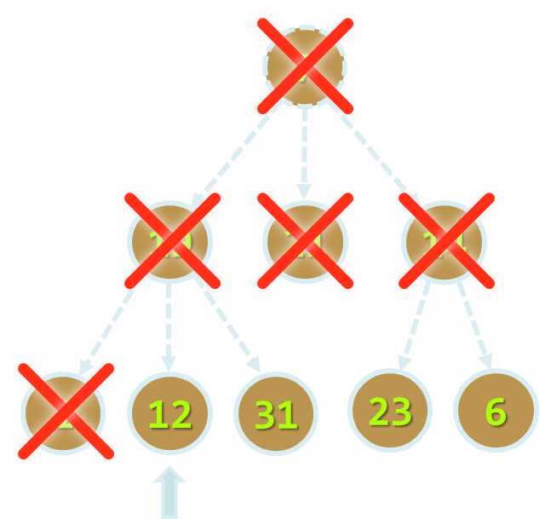
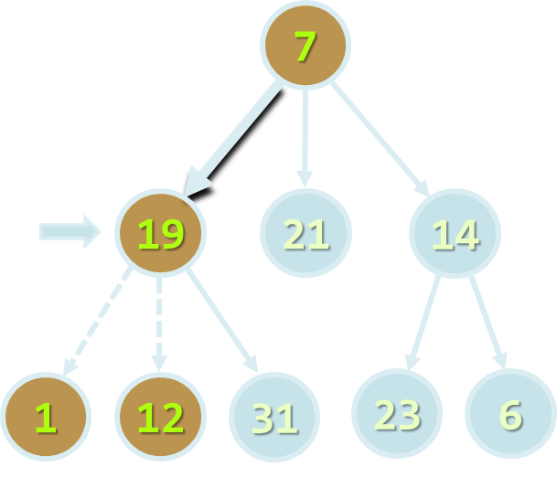
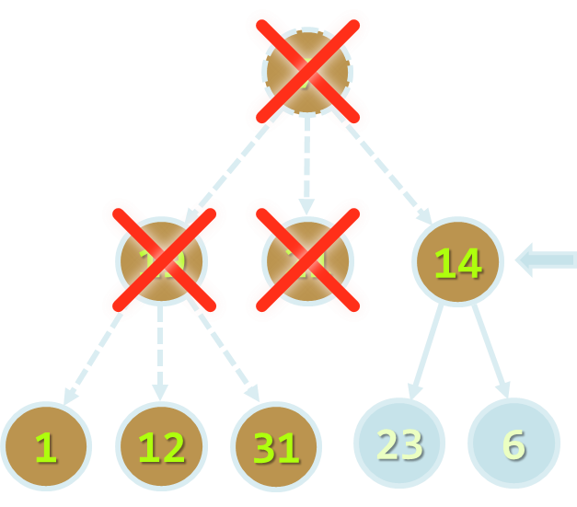
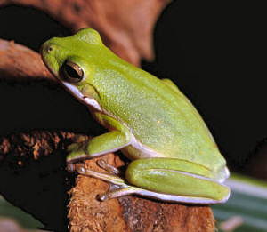


Tree Traversals
DFS and BFS Traversals

Slide 18

Tree Traversal Algorithms
Traversing a tree means to visit each of its nodes exactly one in particular order
Many traversal algorithms are known
Depth-First Search (DFS)
Visit node's successors first
Usually implemented by recursion
Breadth-First Search (BFS)
Nearest nodes visited first
Implemented by a queue

Slide 19
Depth-First Search (DFS)
Depth-First Search first visits all descendants of given node recursively, finally visits the node itself
DFS algorithm pseudo code
9
7
DFS(node)
{
for each child c of node
DFS(c);
print the current node;
}
4
5
8
19
21
14
1
2
3
6
7
1
12
31
23
6

Slide 20
DFS in Action (Step 1)
Stack: 7
Output: (empty)
7
19
21
14
1
12
31
23
6

Slide 21
DFS in Action (Step 2)
Stack: 7, 19
Output: (empty)
7
19
21
14
1
12
31
23
6

Slide 22
DFS in Action (Step 3)
Stack: 7, 19, 1
Output: (empty)
7
19
21
14
1
12
31
23
6

Slide 23
DFS in Action (Step 4)
Stack: 7, 19
Output: 1
7
19
21
14
1
12
31
23
6

Slide 24
DFS in Action (Step 5)
Stack: 7, 19, 12
Output: 1
7
19
21
14
1
12
31
23
6

Slide 25
DFS in Action (Step 6)
Stack: 7, 19
Output: 1, 12
7
19
21
14
1
12
31
23
6

Slide 26
DFS in Action (Step 7)
Stack: 7, 19, 31
Output: 1, 12
7
19
21
14
1
12
31
23
6

Slide 27
DFS in Action (Step 8)
Stack: 7, 19
Output: 1, 12, 31
7
19
21
14
1
12
31
23
6

Slide 28
DFS in Action (Step 9)
Stack: 7
Output: 1, 12, 31, 19
7
19
21
14
1
12
31
23
6

Slide 29
DFS in Action (Step 10)
Stack: 7, 21
Output: 1, 12, 31, 19
7
19
21
14
1
12
31
23
6

Slide 30
DFS in Action (Step 11)
Stack: 7
Output: 1, 12, 31, 19, 21
7
19
21
14
1
12
31
23
6

Slide 31
DFS in Action (Step 12)
Stack: 7, 14
Output: 1, 12, 31, 19, 21
7
19
21
14
1
12
31
23
6

Slide 32
DFS in Action (Step 13)
Stack: 7, 14, 23
Output: 1, 12, 31, 19, 21
7
19
21
14
1
12
31
23
6

Slide 33
DFS in Action (Step 14)
Stack: 7, 14
Output: 1, 12, 31, 19, 21, 23
7
19
21
14
1
12
31
23
6

Slide 34
DFS in Action (Step 15)
Stack: 7, 14, 6
Output: 1, 12, 31, 19, 21, 23
7
19
21
14
1
12
31
23
6

Slide 35
DFS in Action (Step 16)
Stack: 7, 14
Output: 1, 12, 31, 19, 21, 23, 6
7
19
21
14
1
12
31
23
6

Slide 36
DFS in Action (Step 17)
Stack: 7
Output: 1, 12, 31, 19, 21, 23, 6, 14
7
19
21
14
1
12
31
23
6

Slide 37
DFS in Action (Step 18)
Stack: (empty)
Output: 1, 12, 31, 19, 21, 23, 6, 14, 7
Traversal finished
7
19
21
14
1
12
31
23
6

Slide 38
Breadth-First Search (BFS)
Breadth-First Search first visits the neighbor nodes, later their neighbors, etc.
BFS algorithm pseudo code
BFS(node)
{
queue ← node
while queue not empty
v ← queue
print v
for each child c of v
queue ← c
}
1
7
2
3
4
19
21
14
5
6
7
8
9
1
12
31
23
6

Slide 39
BFS in Action (Step 1)
Queue: 7
Output: 7
7
19
21
14
1
12
31
23
6

Slide 40
BFS in Action (Step 2)
Queue: 7, 19
Output: 7
7
19
21
14
1
12
31
23
6

Slide 41
BFS in Action (Step 3)
Queue: 7, 19, 21
Output: 7
7
19
21
14
1
12
31
23
6

Slide 42
BFS in Action (Step 4)
Queue: 7, 19, 21, 14
Output: 7
7
19
21
14
1
12
31
23
6

Slide 43
BFS in Action (Step 5)
Queue: 7, 19, 21, 14
Output: 7, 19
7
19
21
14
1
12
31
23
6

Slide 44
BFS in Action (Step 6)
Queue: 7, 19, 21, 14, 1
Output: 7, 19
7
19
21
14
1
12
31
23
6

Slide 45
BFS in Action (Step 7)
Queue: 7, 19, 21, 14, 1, 12
Output: 7, 19
7
19
21
14
1
12
31
23
6

Slide 46
BFS in Action (Step 8)
Queue: 7, 19, 21, 14, 1, 12, 31
Output: 7, 19
7
19
21
14
1
12
31
23
6

Slide 47
BFS in Action (Step 9)
Queue: 7, 19, 21, 14, 1, 12, 31
Output: 7, 19, 21
7
19
21
14
1
12
31
23
6

Slide 48
BFS in Action (Step 10)
Queue: 7, 19, 21, 14, 1, 12, 31
Output: 7, 19, 21, 14
7
19
21
14
1
12
31
23
6

Slide 49
BFS in Action (Step 11)
Queue: 7, 19, 21, 14, 1, 12, 31, 23
Output: 7, 19, 21, 14
7
19
21
14
1
12
31
23
6

Slide 50
BFS in Action (Step 12)
Queue: 7, 19, 21, 14, 1, 12, 31, 23, 6
Output: 7, 19, 21, 14
7
19
21
14
1
12
31
23
6

Slide 51
BFS in Action (Step 13)
Queue: 7, 19, 21, 14, 1, 12, 31, 23, 6
Output: 7, 19, 21, 14, 1
7
19
21
14
1
12
31
23
6

Slide 52
BFS in Action (Step 14)
Queue: 7, 19, 21, 14, 1, 12, 31, 23, 6
Output: 7, 19, 21, 14, 1, 12
7
19
21
14
1
12
31
23
6

Slide 53
BFS in Action (Step 15)
Queue: 7, 19, 21, 14, 1, 12, 31, 23, 6
Output: 7, 19, 21, 14, 1, 12, 31
7
19
21
14
1
12
31
23
6

Slide 54
BFS in Action (Step 16)
Queue: 7, 19, 21, 14, 1, 12, 31, 23, 6
Output: 7, 19, 21, 14, 1, 12, 31, 23
7
19
21
14
1
12
31
23
6

Slide 55
BFS in Action (Step 16)
Queue: 7, 19, 21, 14, 1, 12, 31, 23, 6
Output: 7, 19, 21, 14, 1, 12, 31, 23, 6
7
19
21
14
1
12
31
23
6

Slide 56
BFS in Action (Step 17)
Queue: 7, 19, 21, 14, 1, 12, 31, 23, 6
Output: 7, 19, 21, 14, 1, 12, 31, 23, 6
The queue is empty → stop
7
19
21
14
1
12
31
23
6

Slide 57
Binary Trees DFS Traversals
DFS traversal of binary trees can be done in pre-order, in-order and post-order
Pre-order: root, left, right → 17, 9, 6, 12, 19, 25
In-order: left, root, right → 6, 9, 12, 17, 19, 25
Post-order: left, right, root → 6, 12, 9, 25, 19, 17
17
9
19
6
12
25

Slide 58
Iterative DFS and BFS
What will happen if in the Breadth-First Search (BFS) algorithm a stack is used instead of queue?
An iterative Depth-First Search (DFS) – in-order
BFS(node)
{
queue ← node
while queue not empty
v ← queue
print v
for each child c of v
queue ← c
}
DFS(node)
{
stack ← node
while stack not empty
v ← stack
print v
for each child c of v
stack ← c
}

Slide 59



Trees and Traversals
Live Demo

Slide 60


Balanced Search Trees
AVL Trees, B-Trees, Red-Black Trees, AA-Trees

Slide 61
Balanced Binary Search Trees
Ordered Binary Trees (Binary Search Trees)
For each node x the left subtree has values ≤ x and the right subtree has values > x
Balanced Trees
For each node its subtrees contain nearly equal number of nodes → nearly the same height
Balanced Binary Search Trees
Ordered binary search trees that have height of log₂(n) where n is the number of their nodes
Searching costs about log₂(n) comparisons

Slide 62
Balanced Binary Search Tree – Example
33
18
54
15
24
42
60
3
17
20
29
37
43
59
85

Slide 63
Balanced Binary Search Trees
Balanced binary search trees are hard to implement
Rebalancing the tree after insert / delete is complex
Well known implementations of balanced binary search trees
AVL trees – ideally balanced, very complex
Red-black trees – roughly balanced, more simple
AA-Trees – relatively simple to implement
Find / insert / delete operations need log(n) steps

Slide 64
B-Trees
B-trees are generalization of the concept of ordered binary search trees
B-tree of order d has between d and 2*d keys in a node and between d+1 and 2*d+1 child nodes
The keys in each node are ordered increasingly
All keys in a child node have values between their left and right parent keys
If the b-tree is balanced, its search / insert / add operations take about log(n) steps
B-trees can be efficiently stored on the disk

Slide 65
B-Tree – Example
B-Tree of order 2 (also known as 2-3-4-tree):
17
21
7
11
18
20
26
31
2
4
5
6
8
9
12
16
22
23
25
27
29
30
32
35

Slide 66
Balanced Trees in .NET
.NET Framework has several built-in implementations of balanced search trees:
SortedDictionary<K,V>
Red-black tree based map of key-value pairs
OrderedSet<T>
Red-black tree based set of elements
External libraries like "Wintellect Power Collections for .NET" are more flexible
http://powercollections.codeplex.com

Slide 67
Summary
Trees are recursive data structure – node with set of children which are also nodes
Binary Search Trees are ordered binary trees
Balanced trees have weight of log(n)
Graphs are sets of nodes with many-to-many relationship between them
Can be directed/undirected, weighted / unweighted, connected / not connected, etc.
Tree / graph traversals can be done by Depth-First Search (DFS) and Breadth-First Search (BFS)

Slide 68


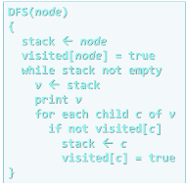
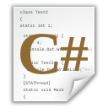
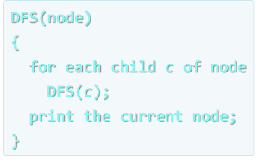
Trees and Traversals
http://academy.telerik.com

Slide 69
Exercises
You are given a tree of N nodes represented as a set of N-1 pairs of nodes (parent node, child node), each in the range (0..N-1). Example:
Write a program to read the tree and find:
the root node
all leaf nodes
all middle nodes
7
2 4
3 2
5 0
3 5
5 6
5 1
3
5
2
0
1
6
4
the longest path in the tree
* all paths in the tree with given sum S of their nodes
* all subtrees with given sum S of their nodes

Slide 70
Exercises (2)
Write a program to traverse the directory C:\WINDOWS and all its subdirectories recursively and to display all files matching the mask *.exe. Use the class System.IO.Directory.
Define classes File { string name, int size } and Folder { string name, File[] files, Folder[] childFolders } and using them build a tree keeping all files and folders on the hard drive starting from C:\WINDOWS. Implement a method that calculates the sum of the file sizes in given subtree of the tree and test it accordingly. Use recursive DFS traversal.

Slide 71




Free Trainings @ Telerik Academy
C# Programming @ Telerik Academy
csharpfundamentals.telerik.com
Telerik Software Academy
academy.telerik.com
Telerik Academy @ Facebook
facebook.com/TelerikAcademy
Telerik Software Academy Forums
forums.academy.telerik.com

