Slide 1
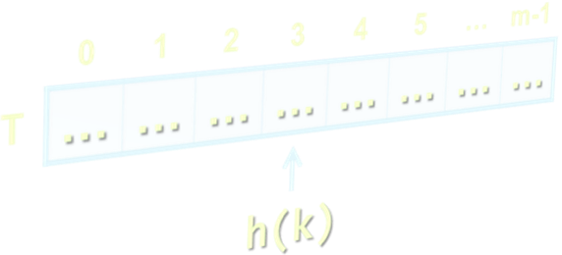
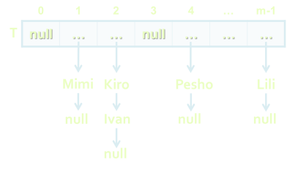


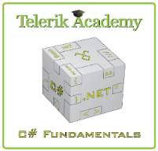
Dictionaries, Hash Tables and Sets
Dictionaries, Hash Tables, Hashing, Collisions, Sets
Svetlin Nakov
Technical Trainer
www.nakov.com
Telerik Software Academy
academy.telerik.com

Slide 2
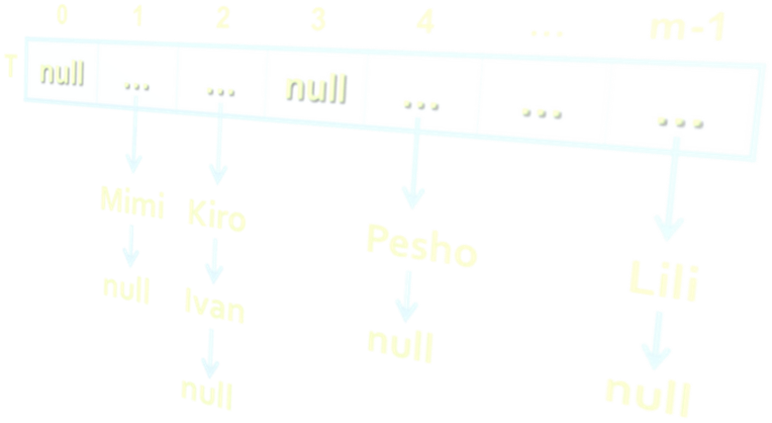

Table of Contents
Dictionaries
Hash Tables
Dictionary<TKey, TValue> Class
Sets: HashSet<T> and SortedSet<T>

Slide 3
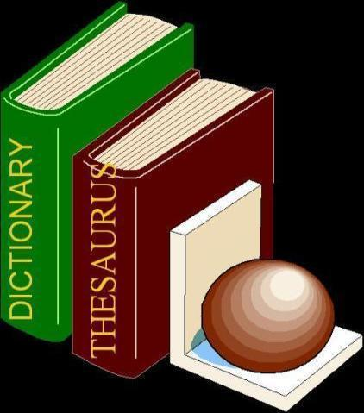

Dictionaries
Data Structures that Map Keys to Values

Slide 4
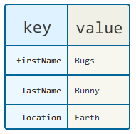
The Dictionary (Map) ADT
The abstract data type (ADT) "dictionary" maps key to values
Also known as "map" or "associative array"
Contains a set of (key, value) pairs
Dictionary ADT operations:
Add(key, value)
FindByKey(key) → value
Delete(key)
Can be implemented in several ways
List, array, hash table, balanced tree, ...

Slide 5
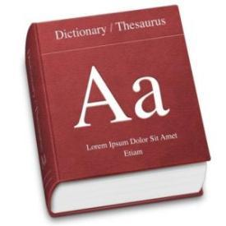
ADT Dictionary – Example
Example dictionary:
Key | Value
C# | Modern object-oriented programming language for the Microsoft .NET platform
CLR | Common Language Runtime – execution engine for .NET assemblies, integral part of .NET Framework
compiler | Software that transforms a computer program to executable machine code
… | …

Slide 6
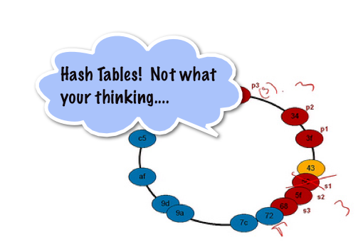
Hash Tables
What is Hash Table? How it Works?

Slide 7
Hash Table
A hash table is an array that holds a set of (key, value) pairs
The process of mapping a key to a position in a table is called hashing
0 | 1 | 2 | 3 | 4 | 5 | … | m-1
T
… | … | … | … | … | … | … | …
Hash function h: k → 0 … m-1
h(k)
Hash table of size m

Slide 8
Hash Functions and Hashing
A hash table has m slots, indexed from 0 to m-1
A hash function h(k) maps keys to positions:
h: k → 0 … m-1
For any value k in the key range and some hash function h we have h(k) = p and 0 ≤ p < m
0 | 1 | 2 | 3 | 4 | 5 | … | m-1
T
… | … | … | … | … | … | … | …
h(k)

Slide 9
Hashing Functions
Perfect hashing function (PHF)
h(k) : one-to-one mapping of each key k to an integer in the range [0, m-1]
The PHF maps each key to a distinct integer within some manageable range
Finding a perfect hashing function is in most cases impossible
More realistically
Hash function h(k) that maps most of the keys onto unique integers, but not all

Slide 10

Collisions in a Hash Table
A collision is the situation when different keys have the same hash value
h(k₁) = h(k₂) for k₁ ≠ k₂
When the number of collisions is sufficiently small, the hash tables work quite well (fast)
Several collisions resolution strategies exist
Chaining in a list
Using the neighboring slots (linear probing)
Re-hashing (second hash function)
...

Slide 11

Collision Resolution: Chaining
h("Pesho") = 4
h("Kiro") = 2
h("Mimi") = 1
h("Ivan") = 2
h("Lili") = m-1
Chaining elements in case of collision
collision
0 | 1 | 2 | 3 | 4 | … | m-1
T
null | … | … | null | … | … | …
Mimi
Kiro
Pesho
Lili
null
Ivan
null
null
null

Slide 12
Hash Tables and Efficiency
Hash tables are the most efficient implementation of ADT "dictionary"
Add / Find / Delete take just few primitive operations
Speed does not depend on the size of the hash-table (constant time)
Amortized complexity O(1)
Example: finding an element in a hash-table with 1 000 000 elements, takes just few steps
Finding an element in array of 1 000 000 elements takes average 500 000 steps

Slide 13
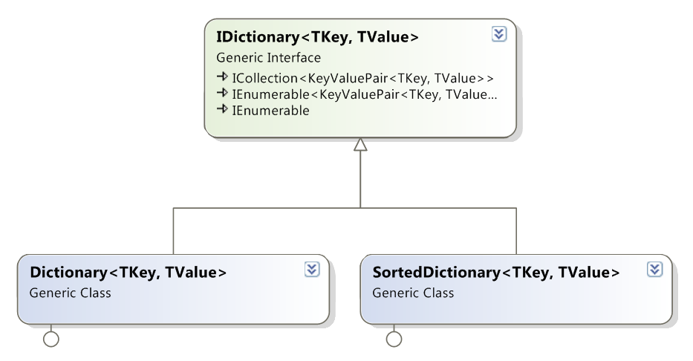
Dictionaries: .NET Interfaces and Implementations

Slide 14

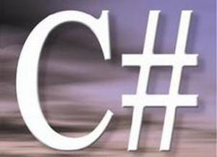
Hash Tables in C#
The Dictionary<TKey,TValue> Class

Slide 15
Dictionary<TKey,TValue>
Implements the ADT dictionary as hash table
The size is dynamically increased as needed
Contains a collection of key-value pairs
Collisions are resolved by chaining
Elements have almost random order
Ordered by the hash code of the key
Dictionary<TKey,TValue> relies on
Object.Equals() – for comparing the keys
Object.GetHashCode() – for calculating the hash codes of the keys

Slide 16
Dictionary<TKey,TValue> (2)
Major operations:
Add(TKey,TValue) – adds an element with the specified key and value
Remove(TKey) – removes the element by key
this[] – get / add / replace of element by key
Clear() – removes all elements
Count – returns the number of elements
Keys – returns a collection of the keys
Values – returns a collection of the values

Slide 17
Dictionary<TKey,TValue> (3)
Major operations:
ContainsKey(TKey) – checks whether the dictionary contains given key
ContainsValue(TValue) – checks whether the dictionary contains given value
Warning: slow operation – O(n)
TryGetValue(TKey, out TValue)
If the key is found, returns it in the TValue
Otherwise returns false

Slide 18

Dictionary<TKey,TValue> – Example
Dictionary<string, int> studentsMarks =
new Dictionary<string, int>();
studentsMarks.Add("Ivan", 4);
studentsMarks.Add("Peter", 6);
studentsMarks.Add("Maria", 6);
studentsMarks.Add("George", 5);
int peterMark = studentsMarks["Peter"];
Console.WriteLine("Peter's mark: {0}", peterMark);
Console.WriteLine("Is Peter in the hash table: {0}",
studentsMarks.ContainsKey("Peter"));
Console.WriteLine("Students and grades:");
foreach (var pair in studentsMarks)
{
Console.WriteLine("{0} --> {1}", pair.Key, pair.Value);
}

Slide 19


Dictionary<TKey,TValue>
Live Demo

Slide 20

Counting the Words in a Text
string text = "a text, some text, just some text";
IDictionary<string, int> wordsCount =
new Dictionary<string, int>();
string[] words = text.Split(' ', ',', '.');
foreach (string word in words)
{
int count = 1;
if (wordsCount.ContainsKey(word))
count = wordsCount[word] + 1;
wordsCount[word] = count;
}
foreach(var pair in wordsCount)
{
Console.WriteLine("{0} -> {1}", pair.Key, pair.Value);
}

Slide 21

Counting the Words in a Text
Live Demo

Slide 22
Nested Data Structures
Data structures can be nested, e.g. dictionary of lists: Dictionary<string, List<int>>
static Dictionary<string, List<int>> studentGrades =
new Dictionary<string, List<int>>();
private static void AddGrade(string name, int grade)
{
if (! studentGrades.ContainsKey(name))
{
studentGrades[name] = new List<int>();
}
studentGrades[name].Add(grade);
}

Slide 23
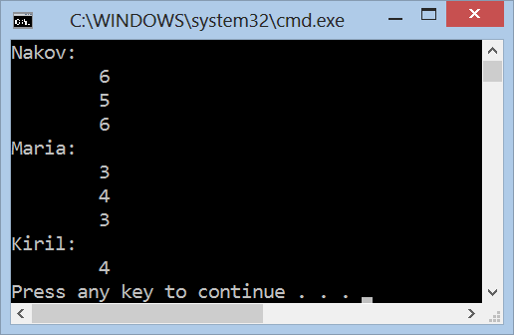
Dictionary of Lists
Live Demo

Slide 24
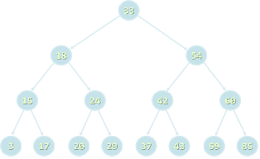

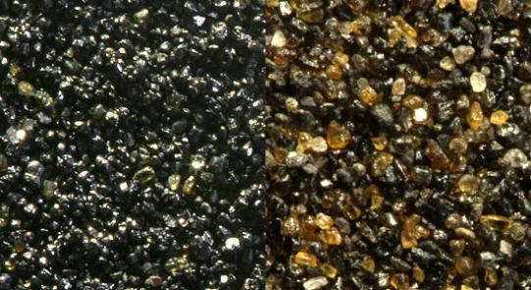
Balanced Tree Dictionaries
The SortedDictionary<TKey,TValue> Class

Slide 25
SortedDictionary <TKey,TValue>
SortedDictionary<TKey,TValue> implements the ADT "dictionary" as self-balancing search tree
Elements are arranged in the tree ordered by key
Traversing the tree returns the elements in increasing order
Add / Find / Delete perform log₂(n) operations
Use SortedDictionary<TKey,TValue> when you need the elements sorted by key
Otherwise use Dictionary<TKey,TValue> – it has better performance

Slide 26
Counting Words (Again)
string text = "a text, some text, just some text";
IDictionary<string, int> wordsCount =
new SortedDictionary<string, int>();
string[] words = text.Split(' ', ',', '.');
foreach (string word in words)
{
int count = 1;
if (wordsCount.ContainsKey(word))
count = wordsCount[word] + 1;
wordsCount[word] = count;
}
foreach(var pair in wordsCount)
{
Console.WriteLine("{0} -> {1}", pair.Key, pair.Value);
}

Slide 27
Counting the Words in a Text
Live Demo

Slide 28

Comparing Dictionary Keys
Using custom key classes in Dictionary<TKey, TValue> and SortedDictionary<TKey,TValue>

Slide 29
IComparable<T>
Dictionary<TKey,TValue> relies on
Object.Equals() – for comparing the keys
Object.GetHashCode() – for calculating the hash codes of the keys
SortedDictionary<TKey,TValue> relies on IComparable<T> for ordering the keys
Built-in types like int, long, float, string and DateTime already implement Equals(), GetHashCode() and IComparable<T>
Other types used when used as dictionary keys should provide custom implementations

Slide 30


Implementing Equals() and GetHashCode()
public struct Point
{
public int X { get; set; }
public int Y { get; set; }
public override bool Equals(Object obj)
{
if (!(obj is Point) || (obj == null)) return false;
Point p = (Point)obj;
return (X == p.X) && (Y == p.Y);
}
public override int GetHashCode()
{
return (X << 16 | X >> 16) ^ Y;
}
}

Slide 31



Implementing IComparable<T>
public struct Point : IComparable<Point>
{
public int X { get; set; }
public int Y { get; set; }
public int CompareTo(Point otherPoint)
{
if (X != otherPoint.X)
{
return this.X.CompareTo(otherPoint.X);
}
else
{
return this.Y.CompareTo(otherPoint.Y);
}
}
}

Slide 32
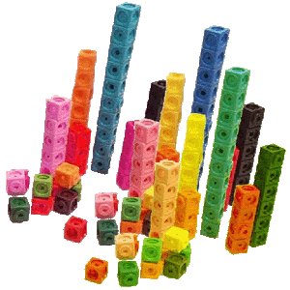

Sets
Sets of Elements

Slide 33
Set and Bag ADTs
The abstract data type (ADT) "set" keeps a set of elements with no duplicates
Sets with duplicates are also known as ADT "bag"
Set operations:
Add(element)
Contains(element) → true / false
Delete(element)
Union(set) / Intersect(set)
Sets can be implemented in several ways
List, array, hash table, balanced tree, ...

Slide 34
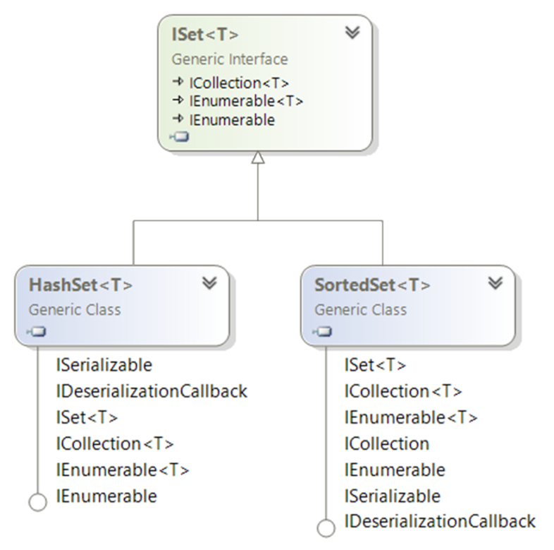
Sets: .NET Interfaces and Implementations

Slide 35
HashSet<T>
HashSet<T> implements ADT set by hash table
Elements are in no particular order
All major operations are fast:
Add(element) – appends an element to the set
Does nothing if the element already exists
Remove(element) – removes given element
Count – returns the number of elements
UnionWith(set) / IntersectWith(set) – performs union / intersection with another set

Slide 36

HashSet<T> – Example
ISet<string> firstSet = new HashSet<string>(
new string[] { "SQL", "Java", "C#", "PHP" });
ISet<string> secondSet = new HashSet<string>(
new string[] { "Oracle", "SQL", "MySQL" });
ISet<string> union = new HashSet<string>(firstSet);
union.UnionWith(secondSet);
PrintSet(union); // SQL Java C# PHP Oracle MySQL
private static void PrintSet<T>(ISet<T> set)
{
foreach (var element in set)
{
Console.Write("{0} ", element);
}
Console.WriteLine();
}

Slide 37
SortedSet<T>
SortedSet<T> implements ADT set by balanced search tree (red-black tree)
Elements are sorted in increasing order
Example:
ISet<string> firstSet = new SortedSet<string>(
new string[] { "SQL", "Java", "C#", "PHP" });
ISet<string> secondSet = new SortedSet<string>(
new string[] { "Oracle", "SQL", "MySQL" });
ISet<string> union = new HashSet<string>(firstSet);
union.UnionWith(secondSet);
PrintSet(union); // C# Java PHP SQL MySQL Oracle

Slide 38


HashSet<T> and SortedSet<T>
Live Demo

Slide 39

Summary
Dictionaries map key to value
Can be implemented as hash table or balanced search tree
Hash-tables map keys to values
Rely on hash-functions to distribute the keys in the table
Collisions needs resolution algorithm (e.g. chaining)
Very fast add / find / delete – O(1)
Sets hold a group of elements
Hash-table or balanced tree implementations

Slide 40

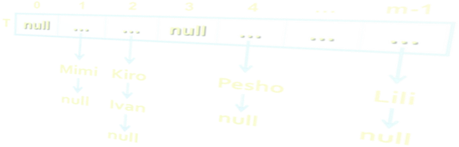
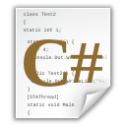
Dictionaries, Hash Tables and Sets
http://academy.telerik.com

Slide 41
Exercises
Write a program that counts in a given array of double values the number of occurrences of each value. Use Dictionary<TKey,TValue>.
Example: array = {3, 4, 4, -2.5, 3, 3, 4, 3, -2.5}
-2.5 → 2 times
3 → 4 times
4 → 3 times
Write a program that extracts from a given sequence of strings all elements that present in it odd number of times. Example:
{C#, SQL, PHP, PHP, SQL, SQL } → {C#, SQL}

Slide 42
Exercises (2)
Write a program that counts how many times each word from given text file words.txt appears in it. The character casing differences should be ignored. The result words should be ordered by their number of occurrences in the text. Example:
is → 2
the → 2
this → 3
text → 6
This is the TEXT. Text, text, text – THIS TEXT! Is this the text?

Slide 43
Exercises (3)
Implement the data structure "hash table" in a class HashTable<K,T>. Keep the data in array of lists of key-value pairs (LinkedList<KeyValuePair<K,T>>[]) with initial capacity of 16. When the hash table load runs over 75%, perform resizing to 2 times larger capacity. Implement the following methods and properties: Add(key, value), Find(key)→value, Remove( key), Count, Clear(), this[], Keys. Try to make the hash table to support iterating over its elements with foreach.
Implement the data structure "set" in a class HashedSet<T> using your class HashTable<K,T> to hold the elements. Implement all standard set operations like Add(T), Find(T), Remove(T), Count, Clear(), union and intersect.

Slide 44
Exercises (4)
* A text file phones.txt holds information about people, their town and phone number:
Duplicates can occur in people names, towns and phone numbers. Write a program to read the phones file and execute a sequence of commands given in the file commands.txt:
find(name) – display all matching records by given name (first, middle, last or nickname)
find(name, town) – display all matching records by given name and town
Mimi Shmatkata | Plovdiv | 0888 12 34 56
Kireto | Varna | 052 23 45 67
Daniela Ivanova Petrova | Karnobat | 0899 999 888
Bat Gancho | Sofia | 02 946 946 946

Slide 45
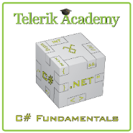



Free Trainings @ Telerik Academy
C# Programming @ Telerik Academy
csharpfundamentals.telerik.com
Telerik Software Academy
academy.telerik.com
Telerik Academy @ Facebook
facebook.com/TelerikAcademy
Telerik Software Academy Forums
forums.academy.telerik.com

