Slide 1



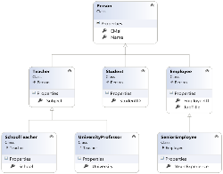


Object-Oriented Programming Fundamental Principles – Part I
Inheritance, Abstraction, Encapsulation
Object-Oriented

Slide 2

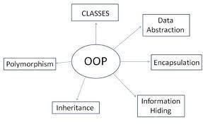
Table of Contents
Fundamental Principles of OOP
Inheritance
Class Hierarchies
Inheritance and Access Levels
Abstraction
Abstract Classes
Interfaces
Encapsulation

Slide 3

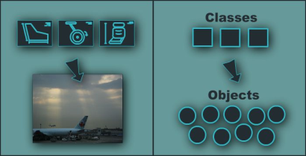
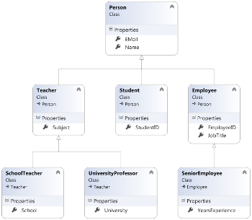
Fundamental Principles of OOP
Object-Oriented
Notes:
(c) 2006 National Academy for Software Development - http://academy.devbg.org*
3##

Slide 4
Fundamental Principles of OOP
Inheritance
Inherit members from parent class
Abstraction
Define and execute abstract actions
Encapsulation
Hide the internals of a class
Polymorphism
Access a class through its parent interface
4

Slide 5
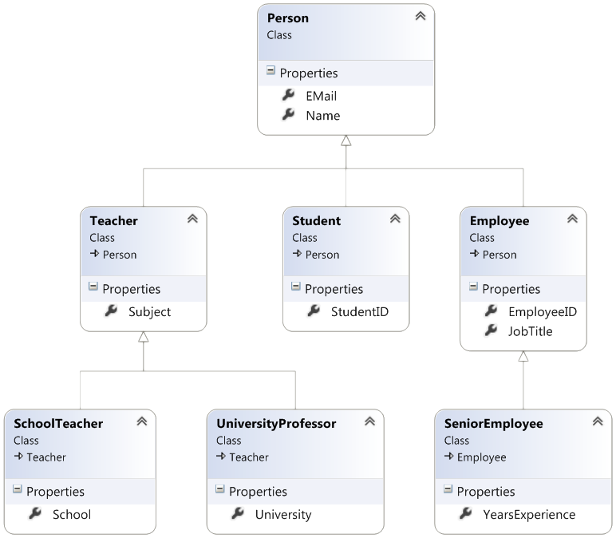
Inheritance
Notes:
(c) 2006 National Academy for Software Development - http://academy.devbg.org*
5##

Slide 6
Classes and Interfaces
Classes define attributes and behavior
Fields, properties, methods, etc.
Methods contain code for execution
Interfaces define a set of operations
Empty methods and properties, left to be implemented later
public class Labyrinth { public int Size { get; set; } }
public interface IFigure { void Draw(); }

Slide 7
Inheritance
Inheritance allows child classes to inherit the characteristics of an existing parent (base) class
Attributes (fields and properties)
Operations (methods)
Child class can extend the parent class
Add new fields and methods
Redefine methods (modify existing behavior)
A class can implement an interface by providing implementation for all its methods
7

Slide 8
Types of Inheritance
Inheritance terminology
base class /
parent class
derived class
inherits
class
implements
interface
derived interface
extends
base interface
8

Slide 9

Inheritance – Benefits
Inheritance has a lot of benefits
Extensibility
Reusability (code reuse)
Provides abstraction
Eliminates redundant code
Use inheritance for buidling is-a relationships
E.g. dog is-a animal (dogs are kind of animals)
Don't use it to build has-a relationship
E.g. dog has-a name (dog is not kind of name)
9
Notes:
Extensibility / Polymorphism: New functionality may be easily plugged in without changing existing classes as long the new plug-in classes extend given base classes.
Reusability: For a set of similar applications a framework can be defined using a core set of classes that are to be extended by classes that fill in the application-dependent part.
Information Hiding: If a more general class using a simpler contract is sufficient, details from extending classes may be hidden to some of the client classes. This allows them to be more independent from possible changes and diminishes the load of contracts that must be understood by a reader of these client classes.
(c) 2006 National Academy for Software Development - http://academy.devbg.org*
9##

Slide 10
Inheritance
Inheritance implicitly gains all members from another class
All fields, methods, properties, events, …
Some members could be inaccessible (hidden)
The class whose methods are inherited is called base (parent) class
The class that gains new functionality is called derived (child) class

Slide 11
Inheritance – Example
Base class
Person
+Name: String
+Address: String
Derived class
Derived class
Employee
Student
+Company: String
+Salary: double
+School: String

Slide 12
Class Hierarchies
Inheritance leads to a hierarchies of classes and / or interfaces in an application:
Game
SinglePlayerGame
MultiplePlayersGame
Minesweeper
Solitaire
BoardGame
…
…
Chess
Backgammon
12

Slide 13
Inheritance in .NET
A class can inherit only one base class
E.g. IOException derives from SystemException and it derives from Exception
A class can implement several interfaces
This is .NET’s form of multiple inheritance
E.g. List<T> implements IList<T>, ICollection<T>, IEnumerable<T>
An interface can implement several interfaces
E.g. IList<T> implements ICollection<T> and IEnumerable<T>
13

Slide 14


How to Define Inheritance?
Specify the name of the base class after the name of the derived (with colon)
Use the keyword base to invoke the parent constructor
public class Shape
{ … }
public class Circle : Shape
{ … }
public Circle (int x, int y) : base(x)
{ … }

Slide 15
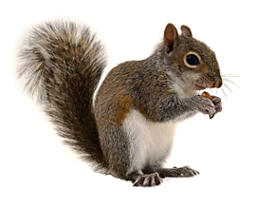
Simple Inheritance Example
public class Mammal
{
public int Age { get; set; }
public Mammal(int age)
{
this.Age = age;
}
public void Sleep()
{
Console.WriteLine("Shhh! I'm sleeping!");
}
}

Slide 16

Simple Inheritance Example (2)
public class Dog : Mammal
{
public string Breed { get; set; }
public Dog(int age, string breed)
: base(age)
{
this.Breed = breed;
}
public void WagTail()
{
Console.WriteLine("Tail wagging...");
}
}

Slide 17

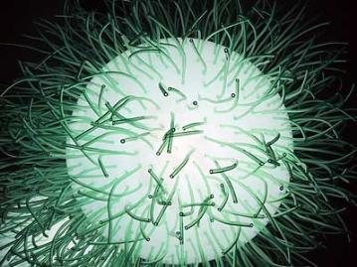
Simple Inheritance
Live Demo

Slide 18
Access Levels
Access modifiers in C#
public – access is not restricted
private – access is restricted to the containing type
protected – access is limited to the containing type and types derived from it
internal – access is limited to the current assembly
protected internal – access is limited to the current assembly or types derived from the containing class

Slide 19
Inheritance and Accessibility
class Creature
{
protected string Name { get; private set; }
private void Talk()
{
Console.WriteLine("I am creature ...");
}
protected void Walk()
{
Console.WriteLine("Walking ...");
}
}
class Mammal : Creature
{
// base.Talk() can be invoked here
// this.Name can be read but cannot be modified here
}

Slide 20
Inheritance and Accessibility (2)
class Dog : Mammal
{
public string Breed { get; private set; }
// base.Talk() cannot be invoked here (it is private)
}
class InheritanceAndAccessibility
{
static void Main()
{
Dog joe = new Dog(6, "Labrador");
Console.WriteLine(joe.Breed);
// joe.Walk() is protected and can not be invoked
// joe.Talk() is private and can not be invoked
// joe.Name = "Rex"; // Name cannot be accessed here
// joe.Breed = "Shih Tzu"; // Can't modify Breed
}
}

Slide 21

Inheritance and Accessibility
Live Demo

Slide 22
Inheritance: Important Aspects
Structures cannot be inherited
In C# there is no multiple inheritance
Only multiple interfaces can be implemented
Static members are also inherited
Constructors are not inherited
Inheritance is transitive relation
If C is derived from B, and B is derived from A, then C inherits A as well

Slide 23
Inheritance: Important Features
When a derived class extends its base class
It can freely add new members
Cannot remove derived ones
Declaring new members with the same name or signature hides the inherited ones
A class can declare virtual methods and properties
Derived classes can override the implementation of these members
E.g. Object.ToString() is virtual method

Slide 24



Abstraction
Notes:
(c) 2006 National Academy for Software Development - http://academy.devbg.org*
24##

Slide 25

Abstraction
Abstraction means ignoring irrelevant features, properties, or functions and emphasizing the relevant ones ...
... relevant to the given project
With an eye to future reuse in similar projects
Abstraction helps managing complexity
"Relevant" to what?
25

Slide 26
Abstraction (2)
Abstraction is something we do every day
Looking at an object, we see those things about it that have meaning to us
We abstract the properties of the object, and keep only what we need
E.g. students get "name" but not "color of eyes"
Allows us to represent a complex reality in terms of a simplified model
Abstraction highlights the properties of an entity that we need and hides the others
26

Slide 27

Abstraction in .NET
In .NET object-oriented programming abstraction is achieved in several ways:
Abstract classes
Interfaces
Inheritance
Control
+click()
ButtonBase
+Color : long
Button
RadioButton
CheckBox
27

Slide 28

Abstraction in .NET – Example
System.Object
System.MarshalByRefObject
System.ComponentModel.Component
System.Windows.Forms.Control
System.Windows.Forms.ButtonBase
System.Windows.Forms.Button
28

Slide 29
Interfaces
An interface defines a set of operations (methods) that given object should perform
Also called "contract" for providing a set of operations
Defines abstract behavior
Interfaces provide abstractions
You invoke the abstract actions
Without worrying how it is internally implemented
29

Slide 30
Interfaces (2)
Interfaces describe a prototype of group of methods (operations), properties and events
Can be implemented by a given class or structure
Define only the prototypes of the operations
No concrete implementation is provided
Can be used to define abstract data types
Can be inherited (extended) by other interfaces
Can not be instantiated

Slide 31
Interfaces – Example
public interface IShape
{
void SetPosition(int x, int y);
int CalculateSurface();
}
public interface IMovable
{
void Move(int deltaX, int deltaY);
}
public interface IResizable
{
void Resize(int weight);
void Resize(int weightX, int weightY);
void ResizeByX(int weightX);
void ResizeByY(int weightY);
}

Slide 32
Interfaces – Example (2)
public interface IPerson
{
DateTime DateOfBirth // Property DateOfBirth
{
get;
set;
}
int Age // Property Age (read-only)
{
get;
}
void Print(); // Method for printing
}

Slide 33
Interface Implementation
Classes and structures can implement (support) one or several interfaces
Implementer classes must implement all interface methods
Or should be declared abstract
class Rectangle : IShape
{
public void SetPosition(int x, int y) { … }
public int CalculateSurface() { … }
}

Slide 34
Interface Implementation (2)
class Rectangle : IShape, IMovable
{
private int x, y, width, height;
public void SetPosition(int x, int y) // IShape
{
this.x = x;
this.y = y;
}
public int CalculateSurface() // IShape
{
return this.width * this.height;
}
public void Move(int deltaX, int deltaY) // IMovable
{
this.x += deltaX;
this.y += deltaY;
}
}

Slide 35

Interfaces and Implementation
Live Demo

Slide 36
Abstract Classes
Abstract classes are special classes defined with the keyword abstract
Mix between class and interface
Partially implemented or fully unimplemented
Not implemented methods are declared abstract and are left empty
Cannot be instantiated directly
Child classes should implement all abstract methods or be declared as abstract too
36

Slide 37
Abstract Classes (2)
Abstract methods are an empty methods without implementation
The implementation is intentionally left for the descendent classes
When a class contains at least one abstract method, it is called abstract class
Abstract classes model abstract concepts
E.g. person, object, item, movable object

Slide 38
Abstract Class – Example
abstract class MovableShape : IShape, IMovable
{
private int x, y;
public void Move(int deltaX, int deltaY)
{
this.x += deltaX;
this.y += deltaY;
}
public void SetPosition(int x, int y)
{
this.x = x;
this.y = y;
}
public abstract int CalculateSurface();
}

Slide 39
Interfaces vs. Abstract Classes
C# interfaces are like abstract classes, but in contrast interfaces:
Can not contain methods with implementation
All interface methods are abstract
Members do not have scope modifiers
Their scope is assumed public
But this is not specified explicitly
Can not define fields, constants, inner types and constructors

Slide 40
Abstract Classes – Example
public abstract class Animal : IComparable<Animal>
{
// Abstract methods
public abstract string GetName();
public abstract int Speed { get; }
// Non-abstract method
public override string ToString()
{
return "I am " + this.GetName();
}
// Interface method
public int CompareTo(Animal other)
{
return this.Speed.CompareTo(other.Speed);
}
}

Slide 41
Abstract Classes – Example (2)
public class Turtle : Animal
{
public override int Speed { get { return 1; } }
public override string GetName()
{ return "turtle"; }
}
public class Cheetah : Animal
{
public override int Speed { get { return 100; } }
public override string GetName()
{ return "cheetah"; }
}

Slide 42
Abstract Classes
Live Demo

Slide 43

Abstract Data Types
Abstract Data Types (ADT) are data types defined by a set of operations (interface)
Example: IList<T> in .NET Framework
«interface»
IList<T>
+Add(item : Object)
+Remove(item : Object)
+Clear()
…
LinkedList<T>
List<T>
43

Slide 44
Inheritance Hierarchies
Using inheritance we can create inheritance hierarchies
Easily represented by UML class diagrams
UML class diagrams
Classes are represented by rectangles containing their methods and data
Relations between classes are shown as arrows
Closed triangle arrow means inheritance
Other arrows mean some kind of associations

Slide 45
UML Class Diagram – Example
interface
Shape
struct
ISurfaceCalculatable
Point
#Position:Point
+CalculateSurface:float
+X:int
+Y:int
+Point
Square
Rectangle
struct
Color
-Size:float
-Width:float
-Height:float
+RedValue:byte
+Square
+GreenValue:byte
+CalculateSurface:float
+Rectangle
+BlueValue:byte
+CalculateSurface:float
+Color
FilledSquare
FilledRectangle
-Color:Color
-Color:Color
+FilledSquare
+FilledRectangle

Slide 46
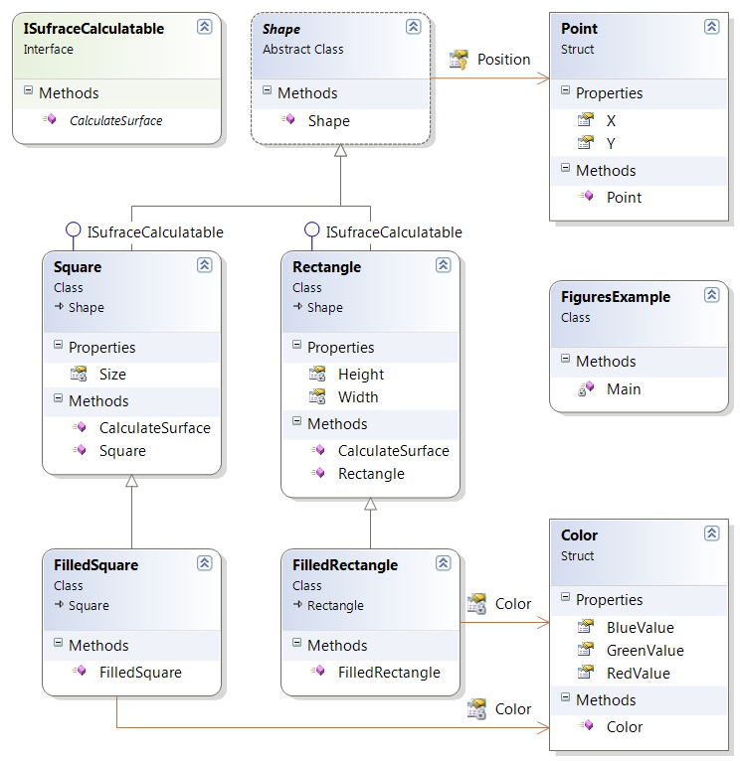
Class Diagrams in Visual Studio
Live Demo

Slide 47


Encapsulation
Notes:
(c) 2006 National Academy for Software Development - http://academy.devbg.org*
47##

Slide 48
Encapsulation
Encapsulation hides the implementation details
Class announces some operations (methods) available for its clients – its public interface
All data members (fields) of a class should be hidden
Accessed via properties (read-only and read-write)
No interface members should be hidden
48

Slide 49
Encapsulation – Example
Data fields are private
Constructors and accessors are defined (getters and setters)
Person
-name : string
-age : TimeSpan
+Person(string name, int age)
+Name : string { get; set; }
+Age : TimeSpan { get; set; }
49

Slide 50
Encapsulation in .NET
Fields are always declared private
Accessed through properties in read-only or read-write mode
Constructors are almost always declared public
Interface methods are always public
Not explicitly declared with public
Non-interface methods are declared private / protected
50

Slide 51
Encapsulation – Benefits
Ensures that structural changes remain local:
Changing the class internals does not affect any code outside of the class
Changing methods' implementation does not reflect the clients using them
Encapsulation allows adding some logic when accessing client's data
E.g. validation on modifying a property value
Hiding implementation details reduces complexity → easier maintenance
51

Slide 52
Encapsulation
Live Demo
Notes:
(c) 2006 National Academy for Software Development - http://academy.devbg.org*
52##

Slide 53


Object-Oriented Programming Fundamental Principles – Part I
Questions?
http://academy.telerik.com

Slide 54
Exercises
We are given a school. In the school there are classes of students. Each class has a set of teachers. Each teacher teaches a set of disciplines. Students have name and unique class number. Classes have unique text identifier. Teachers have name. Disciplines have name, number of lectures and number of exercises. Both teachers and students are people. Students, classes, teachers and disciplines could have optional comments (free text block).
Your task is to identify the classes (in terms of OOP) and their attributes and operations, encapsulate their fields, define the class hierarchy and create a class diagram with Visual Studio.
54

Slide 55
Exercises (2)
Define abstract class Human with first name and last name. Define new class Student which is derived from Human and has new field – grade. Define class Worker derived from Human with new property WeekSalary and WorkHoursPerDay and method MoneyPerHour() that returns money earned by hour by the worker. Define the proper constructors and properties for this hierarchy. Initialize a list of 10 students and sort them by grade in ascending order (use LINQ or OrderBy() extension method). Initialize a list of 10 workers and sort them by money per hour in descending order. Merge the lists and sort them by first name and last name.
55

Slide 56
Exercises (3)
Create a hierarchy Dog, Frog, Cat, Kitten, Tomcat and define useful constructors and methods. Dogs, frogs and cats are Animals. All animals can produce sound (specified by the ISound interface). Kittens and tomcats are cats. All animals are described by age, name and sex. Kittens can be only female and tomcats can be only male. Each animal produces a specific sound. Create arrays of different kinds of animals and calculate the average age of each kind of animal using a static method (you may use LINQ).
56

Slide 57
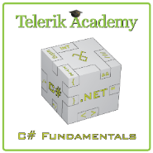



Free Trainings @ Telerik Academy
C# Programming @ Telerik Academy
csharpfundamentals.telerik.com
Telerik Software Academy
academy.telerik.com
Telerik Academy @ Facebook
facebook.com/TelerikAcademy
Telerik Software Academy Forums
forums.academy.telerik.com

