Slide 1
Docker & ASP.NET Core 2.1
Miroslav Popović
@miroslavpopovic
https://miroslavpopovic.com

Slide 2
Docker & ASP.NET Core 2.1
Miroslav Popović
@miroslavpopovic
https://miroslavpopovic.com

Slide 4
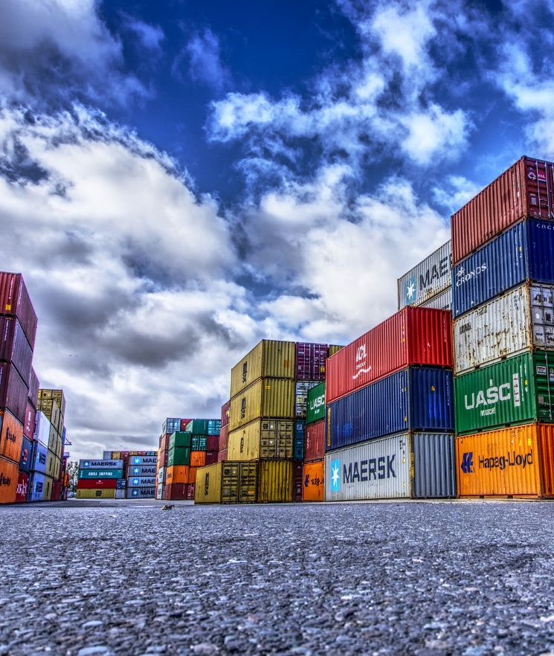
Introduction

Slide 5
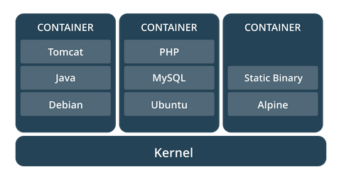
What are containers?
A stand-alone, executable software packages
Encapsulates the app and dependencies
Share the same OS kernel
Isolate software from surroundings
Build once, run everywhere
Shipping containers paradigm
Notes:
https://techcrunch.com/2016/10/16/wtf-is-a-container/
https://medium.freecodecamp.org/a-beginner-friendly-introduction-to-containers-vms-and-docker-79a9e3e119b
https://www.sdxcentral.com/cloud/containers/definitions/what-are-containers-like-docker-linux-containers/
https://www.docker.com/what-container
The image is from Docker documentation

Slide 6
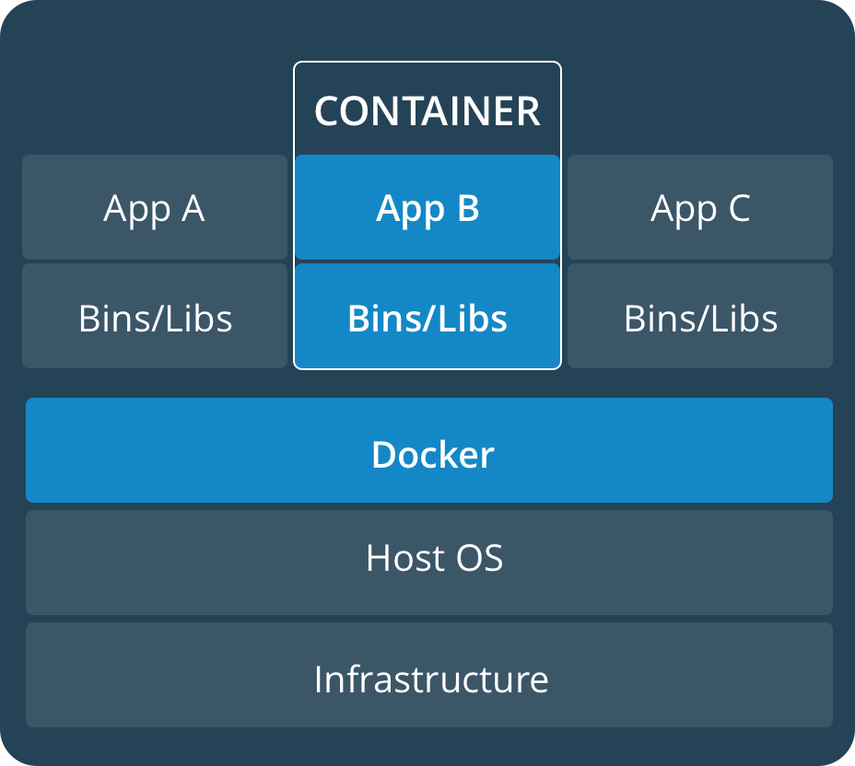
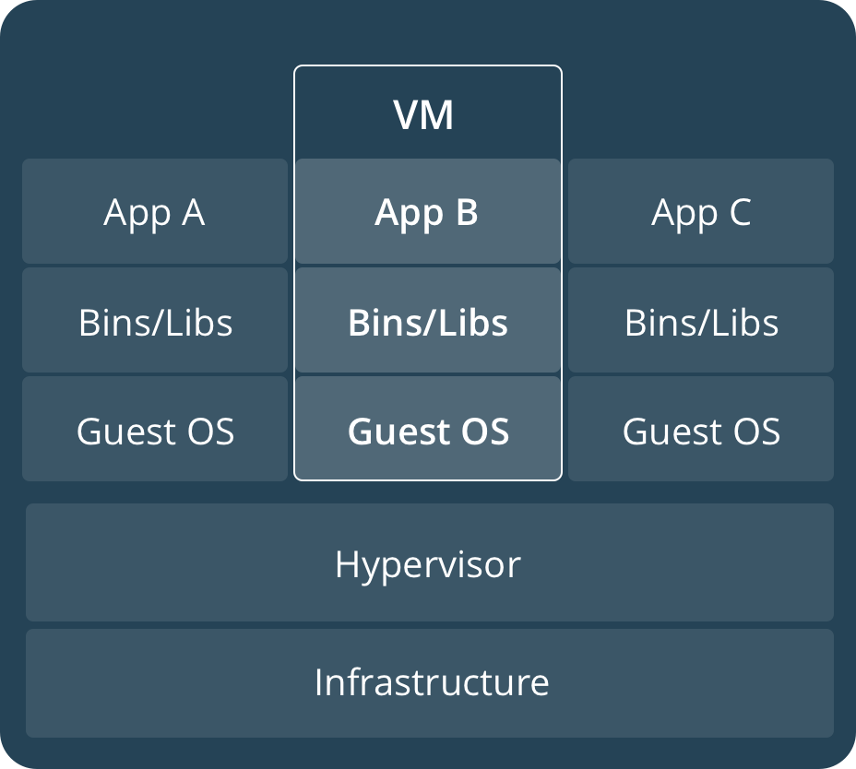
So, like Virtual Machines?
No, more lightweight
Runs as a process
Smaller
Faster
Notes:
The image is from Docker documentation

Slide 7
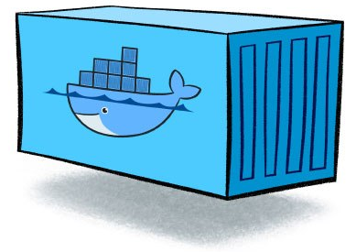
Image vs. container
images / layers
container
WordPress : Php
wordpress:latest
new WordPress()
WordPress instance
Php : Debian
php:7.2-apache
Debian : Scratch
debian:stretch-slim
> docker run
Scratch : System.Object
scratch
Docker daemon
machine
Notes:
Container image from https://www.nebulaworks.com/blog/2016/08/04/docker-container-basics-operations-guide-part-1-3/
- A container is launched by running an image. An image is an executable package that includes everything needed to run an application--the code, a runtime, libraries, environment variables, and configuration files.
- A container is a runtime instance of an image--what the image becomes in memory when executed (that is, an image with state, or a user process).

Slide 8
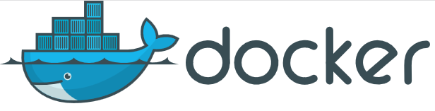
Docker
Open-Source
Linux and Windows based
Easy to use
Fast
Docker Hub
Modularity and scalability
Docker compose

Slide 9

ASP.NET Core
Rewritten from scratch
Open-source
High performance
Multi-platform

Slide 10

Demo

Slide 11
Command line for Docker
docker --version
docker info
docker image ls
docker container ls (--all)
docker run hello-world - (download and) run image
docker build -t imagename . - build image
docker run -d -p 3000:80 imagename
docker container stop imagename
docker tag imagename username/repository:tag
docker push username/repository:tag
docker run -p 3000:80 username/repository:tag
Notes:
docker build -t friendlyhello . # Create image using this directory's Dockerfile
docker run -p 4000:80 friendlyhello # Run "friendlyname" mapping port 4000 to 80
docker run -d -p 4000:80 friendlyhello # Same thing, but in detached mode
docker container ls # List all running containers
docker container ls -a # List all containers, even those not running
docker container stop <hash> # Gracefully stop the specified container
docker container kill <hash> # Force shutdown of the specified container
docker container rm <hash> # Remove specified container from this machine
docker container rm $(docker container ls -a -q) # Remove all containers
docker image ls -a # List all images on this machine
docker image rm <image id> # Remove specified image from this machine
docker image rm $(docker image ls -a -q) # Remove all images from this machine
docker login # Log in this CLI session using your Docker credentials
docker tag <image> username/repository:tag # Tag <image> for upload to registry
docker push username/repository:tag # Upload tagged image to registry
docker run username/repository:tag # Run image from a registry

Slide 12
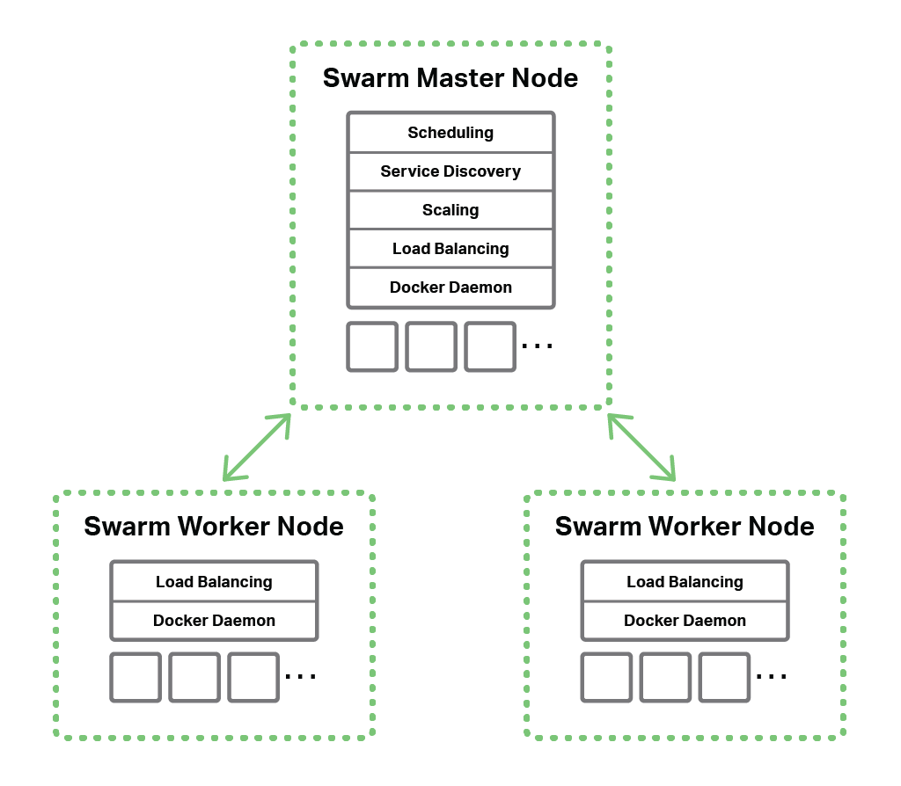
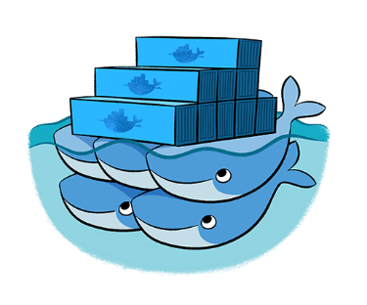

Docker Swarm / Kubernetes
Notes:
Orchestration
Image from: https://shadrin.org/nginx/blog/content/docker-swarm-load-balancing-nginx-plus.html

Slide 13

Closing up

Slide 14
Scenarios
Running Linux software on Windows
Using tools without installation
Integration
Continuous integration
Continuous delivery
AWS or Azure deployment
…

Slide 15

Problems
Most of them are not Docker related
Edge versions
Caching
…
Community

Slide 16
Further research
Docs
https://docs.docker.com/
.NET Core sample - https://docs.docker.com/engine/examples/dotnetcore/
ASP.NET Core docs - https://docs.microsoft.com/en-us/aspnet/core/host-and-deploy/docker/
Docker for .NET Developers by Steve Gordon
https://www.stevejgordon.co.uk/docker-dotnet-developers-part-1
Quick intro to Docker and Docker Compose by João Antunes
https://blog.codingmilitia.com/2018/01/31/quick-intro-to-docker-and-docker-compose-angular-aspnetcore-postgres-app
ASP.NET Core 2.0 in Docker by Mark Rendle
https://vimeo.com/233915427
Pluralsight courses
https://app.pluralsight.com/library/courses/deployment-pipeline-aspdotnet-core-docker/
Sample
https://github.com/miroslavpopovic/docker-aspnetcore-sample-1

Slide 17
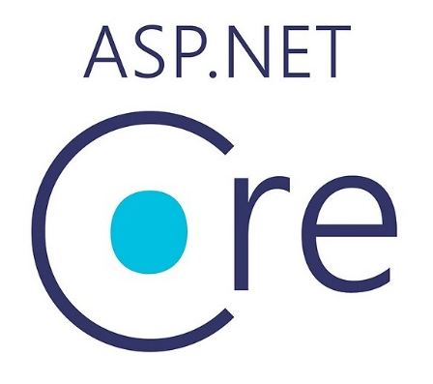
Thank you! Questions?
&
@miroslavpopovic
https://miroslavpopovic.com

