Slide 1


Slide 2
Laka tranzicija na HTML5 koristeći MVVM
Radenko Zec, Lanaco Miroslav Popović, Abacus

Slide 3
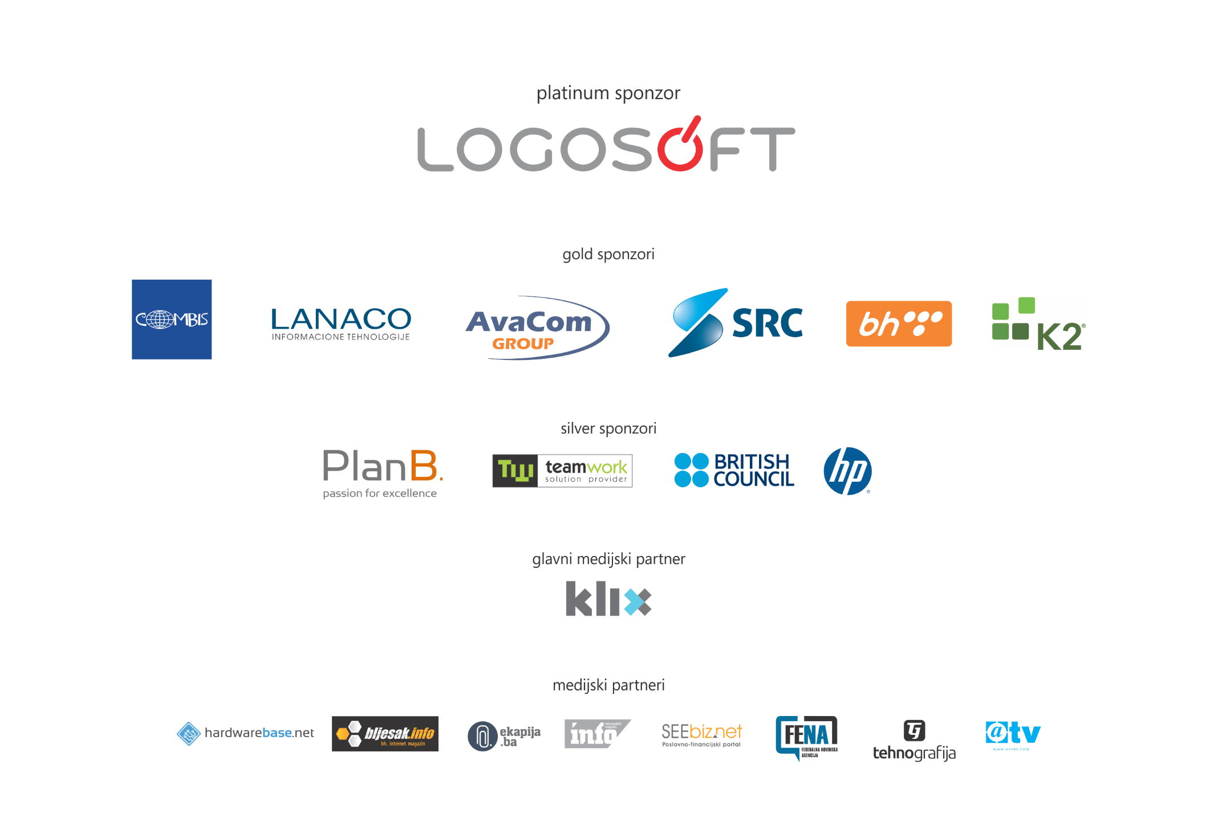

Slide 4


Slide 5

Opet tranzicija? pa dokle više…
Notes:
http://en.wikipedia.org/wiki/File:Paris_Tuileries_Garden_Facepalm_statue.jpg

Slide 6


Zašto?
Notes:
HTML5
raširenost
razni tipovi uređaja
isti kod na različitim platformama
JavaScript je postao najkorišteniji programski jezik na planeti
community
šabloni (patterns)
biblioteke (libraries & frameworks)
sveprisutnost (browseri, server side, client side...)

Slide 7
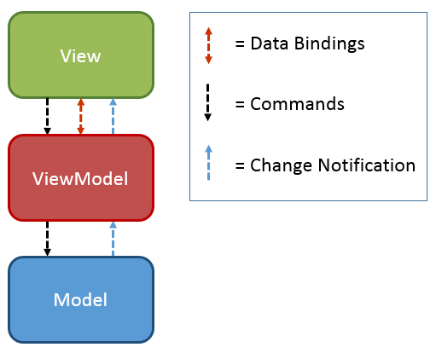
MVVM
John Gossman, Microsoft, 2005.
WPF, Silverlight - mnoštvo biblioteka
Notes:
UI šablon (pattern)
potreba za razdvajanjem poslovne logike i UI
MV* = MVC, MVP, MVVM...
Model-View-ViewModel
John Gossman, Microsoft, 2005.
podrazumjeva binding podataka na UI
WPF, Silverlight - mnoštvo biblioteka
HTML5/JavaScript - Knockout
Šabloni su najbitniji element tranzicije

Slide 8
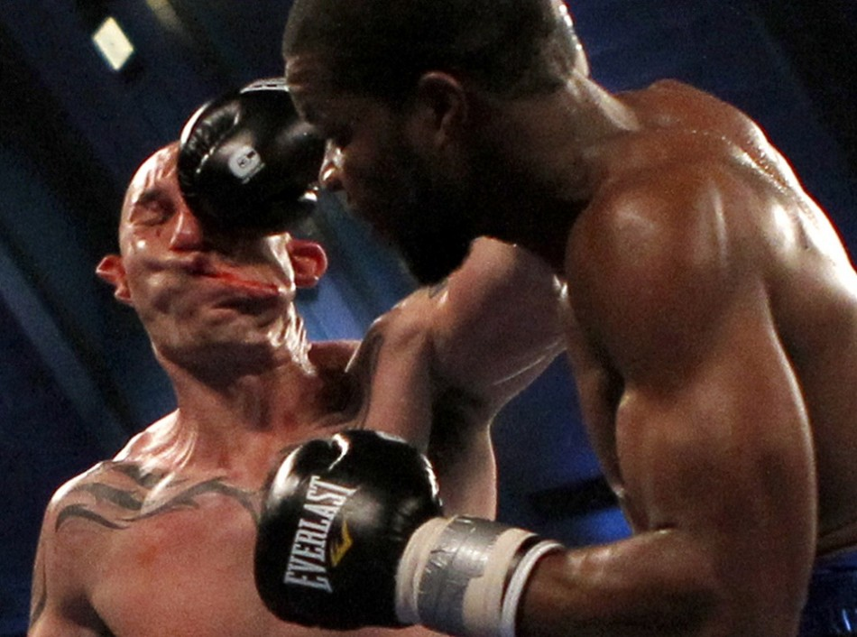

Notes:
Ko je ovaj čiko? Nagrada!
http://www.ibtimes.co.uk/articles/335019/20120430/tony-pietrantonio-photo-punch-lavarn-harvell-knockout.htm#page1
Harvell vs Pietrantonio
Boxer Lavarn Harvell leaves mark on Tony Pietrantonio during third round of light heavyweight boxing match in Atlantic City, New Jersey on 28 April, 2012. Punch was so hard that Pietrantonio instantly fell to the canvas and lost the fight.

Slide 9





Knockout.js
UI interaktivnost
Razdvaja poslovnu logiku i UI
Declarative bindings
Observables
MVVM
Dobra podrška za browsere
6+
2+

Slide 10
Knockout u 3 koraka
<input data-bind="value: firstName" />
var viewModel = { firstName: ko.observable("Radenko") };
ko.applyBindings(viewModel);

Slide 11
DEMO

Slide 12

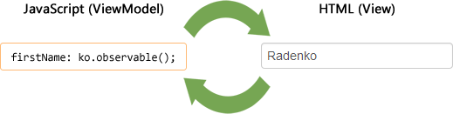
Observable
ko.observable();
Dvosmjerni binding
Ručno praćenje izmjena sa subscribe
Notes:
http://www.elisabethhubert.com/2012/01/the-secret-ingredient-to-experience-innovation/

Slide 13

Computed
ko.computed();
Observable čija vrijednost zavisi od drugih property-a
Notes:
http://www.sodahead.com/fun/user/question-190133/?page=9

Slide 14

ObservableArray
ko.observableArray();
Prate se izmjene niza (dodavanje i uklanjanje elemenata)
Notes:
Ne prate se izmjene pojedinih elemenata ako oni nisu observable
http://www.treehugger.com/natural-sciences/migrating-insects-use-wind-to-travel-efficiently-at-speeds-of-up-to-60-mph.html

Slide 15
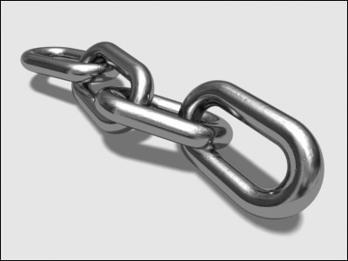
Bindings
data-bind="..." - HTML5 data atribut
<input type="text“ data-bind="enable: canEdit, value: price" />
<select data-bind="options: colors, value: selectedColor, optionsText: 'name', optionsValue: 'key'"></select>
<button data-bind="click: save">OK</button>
Notes:
http://www.tech-search.co.uk/supply_chain.html

Slide 16
Knockout bindings
click
disable
enable
event
options
selectedOptions
uniqueName
value
submit
checked
css
html
style
text
attr
hasfocus
visible
optionsText
optionsValue
foreach
if
ifnot
with
template
Notes:
Plavi – controlling text and appearance
Zeleni – control flow
Crveni – Working with form fields
Narandžasti - template

Slide 17
Tok – Control flow
foreach, if, ifnot, with
<ul data-bind="foreach: items">
<li>Price: <span data-bind="text: price"></span> </li> <ul>

Slide 18
Tok - Containerless Syntax
<ul> <!-- ko foreach: items --> <li>Price: <span data-bind="text: price"></span> </li> <!-- /ko --> <ul>

Slide 19
Templates
Ugrađeni template engine – foreach, if, with…
template binding (native, jQuery.tmpl)
<div data-bind="template: { name: 'personTemplate', data: buyer }"></div>
<script type="text/html" id="person-template"> <h3 data-bind="text: name"></h3> <p>Credits: <span data-bind="text: credits"></span> </p> </script>

Slide 20
DEMO

Slide 21

Proširivost
Notes:
http://nomadaq.blogspot.com/2012/12/filip-dujardin-arquitectura-ficcion.html

Slide 22
Custom Bindings
ko.bindingHandlers.myBinding = { init: function ( element, valueAccessor, allAccessor) { // Poziva se pri prvoj primjeni na element // Postavljanje početnog stanja, event handlera, itd. }, update: function ( element, valueAccessor, allAccessor) { // Prvi put i pri svakoj izmjeni observable vrijednosti // Izmjeniti DOM element ovdje... } };
<div data-bind="myBinding: value"></div>
Notes:
http://kotaku.com/lego/

Slide 23
DEMO

Slide 24
Extending Observables
ko.extenders
Primjer: Knockout-Validation
firstName: ko.observable().extend({ required: true }); email: ko.observable().extend({ email: true }); username: ko.observable().extend({ pattern: '^[a-z0-9]+$' });

Slide 25

Notes:
http://www.icanhasinternets.com/2012/07/10-easy-tips-and-tricks-to-using-pinterest/tips-and-tricks/

Slide 26
JSON
ko.toJS, ko.toJSON
ajax pozivi $.ajax({ url: '...', data: ko.toJS(this) });
debugging data-bind="text: ko.toJSON($root)"

Slide 27
Podaci sa servera
var serverModel = @Html.Raw(Json.Encode(Model));
ASP.NET MVC (Pascal case) => JavaScript (Camel case)
Json.NET, ServiceStack.JsonSerializer
Notes:
Moguće je “renderovati” server-side view model u JSON i na taj način izbjeći dodatne ajax pozive
Korisno je konvertovati Pascal Casing sa server side view modela u Camel Casing na client side JSON-u
U te svrhe koristimo Json.NET ili ServiceStack.JsonSerializer

Slide 28
Praćenje promjena
this.dirtyFlag = new ko.dirtyFlag(this);
<button data-bind=“ click: save, enable: dirtyFlag.isDirty()"> Save </button>

Slide 29
Update / Revert / Commit pattern
var VM = function (data) { this.name = ko.observable(); this.cache = function () { }; this.update(data); }; ko.utils.extend(VM.prototype, { update: function (data) { this.name(data.name || '- new -'); this.cache.latestData = data; }, revert: function () { this.update(this.cache.latestData); }, commit: function () { this.cache.latestData = ko.toJS(this);} });

Slide 30

Za kraj…
http://knockoutjs.com/
http://knockmeout.net/
... za nastavak Durandal - http://durandaljs.com/
Notes:
Knockout nam omogućava primjenu znanja stečenog u WPF / SL na HTML5 Visual Studio 2012 ima odličan editor za JavaScript, a Web Essentials i podršku za KO data-bind atribute

Slide 31
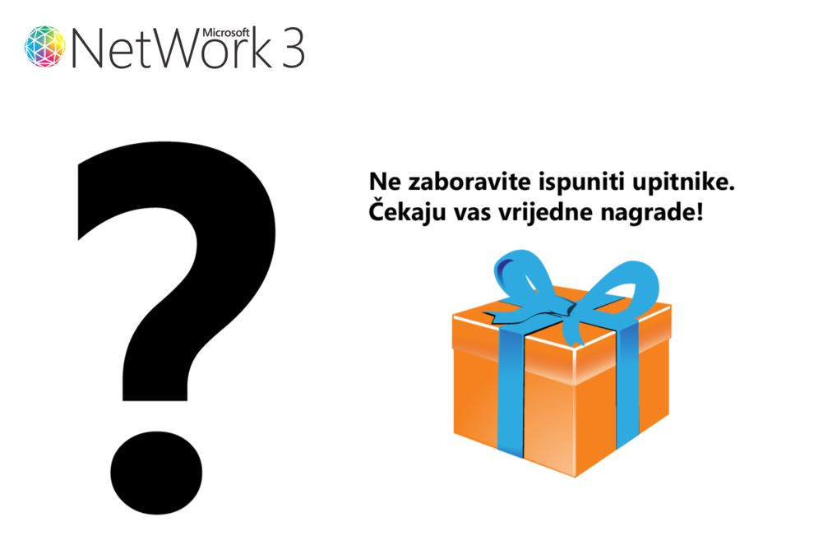

Slide 32


