Slide 2

Building production-ready APIs with ASP.NET Core 3.0
Miroslav Popovic Technical Lead, Seavus d.o.o.
https://miroslavpopovic.com
@miroslavpopovic

Slide 3
Introduction

Slide 4

REST(ful)
REST
architecture type that’s using the existing web infrastructure
RESTful
services that implement REST architecture
Web resources – identified with URL address
HTTP verbs – GET, POST, PUT, DELETE, PATCH…
JSON or XML
Strict and pragmatic approach

Slide 5
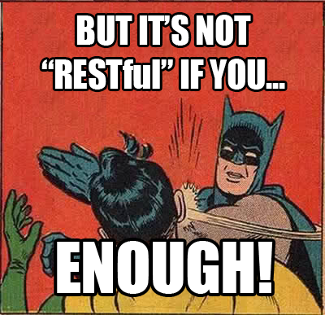

Slide 6
ASP.NET Core Benefits
Performance
Cross-platform
Open source
Dependency injection
Middleware / action filters
Endpoint routing (conventions and attributes)
Content negotiation (JSON, XML,…)

Slide 7
ASP.NET Core Benefits (cont.)
Configuration
environment specific
user secrets…
Logging
Security
Embedded authorization
HTTPS by default
Conventions
[ApiController]
ActionResult<T>
Analyzers

Slide 8
ASP.NET Core 3.0
Endpoint routing changes
HostBuilder instead of WebHostBuilder
New JSON API
Utf8JsonReader, Utf8JsonWriter, JsonDocument, JsonSerializer
Json.NET removed from shared framework
New MVC service registration methods
AddControllers()
SPA authentication with IdentityServer

Slide 9
Production-ready?

Slide 10
Best practices
IActionResult, ActionResult<T>
View Models
Model / input validation
Exception handling
Logging
Paging

Slide 11
Security
HTTPS
OAuth 2.0
Token based authentication
Identity Server 4
https://identityserver.io/
Third party
Auth0 - https://auth0.com/
Okta - https://developer.okta.com/
…

Slide 12
Testing
Unit testing & Integration testing
Manual testing
Tools (Postman, Fiddler…)
Stress/load testing
https://loader.io/
https://artillery.io/
https://gatling.io/ …

Slide 13
Documentation
http://swagger.io/ -> https://www.openapis.org/
Swagger -> Open API Specification 3.0
API framework
Docs
Define an API
Automate API testing
Code generation
...
API Analyzers - Microsoft.AspNetCore.Mvc.Api.Analyzers
Swashbuckle or NSwag and Swagger UI

Slide 14

Rainbows and unicorns
Image source: https://www.percussion.com/blog/2015/March/unicorns-and-rainbows-wont-help-your-social-media-data-will
Notes:
Image source: https://www.percussion.com/blog/2015/March/unicorns-and-rainbows-wont-help-your-social-media-data-will

Slide 15
Usage limiting
Limit per token
With middleware or action filter
https://github.com/stefanprodan/AspNetCoreRateLimit
Limit per Client IP
Limit per Client ID header

Slide 16
Versioning
URL
/api/v2/games/
Query string
/api/games?api-version=2
Custom request header
api-version: 2
Accept header
Accept: application/json;v=2
Microsoft.AspNetCore.Mvc.Versioning
Supports all types, query string by default (?api-version=2)

Slide 17
Monitoring
Simple logging – errors, logs
Performance tracking
Usage tracking
Azure – Azure Monitor, Application Insights, Log Analytics …
ASP.NET Core Health Checks
Third-party monitoring services
https://newrelic.com/
https://stackify.com/
https://www.monitis.com/
https://www.runscope.com/
…

Slide 18
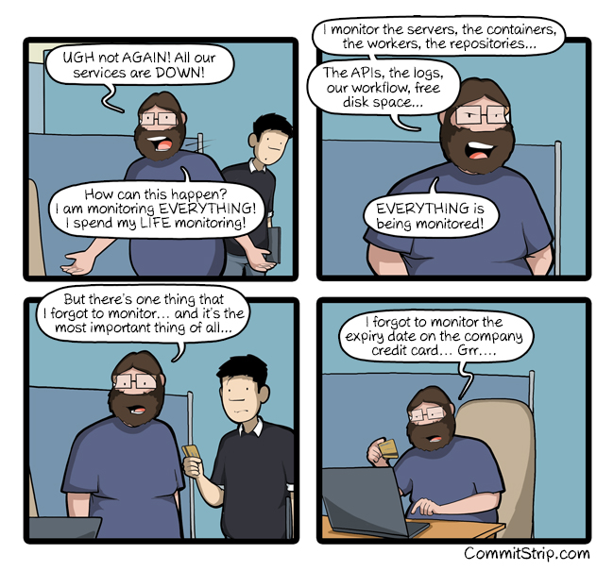

Slide 19
Closing up

Slide 20
Summary
Basics – REST, ASP.NET Core
Best practices
Security
Testing
Documentation
Limiting
Versioning
Monitoring

Slide 21
Further reading
https://github.com/microsoft/api-guidelines
Specifications
HATEOAS – Hypermedia as the Engine of Application State
https://ionwg.org/ - The ION Hypermedia Type
http://jsonapi.org/ - JSON API Specification
http://json-schema.org/ - JSON (Hyper-)Schema...
http://graphql.org/ - GraphQL
APIs
https://dev.twitter.com/rest/public - Twitter REST
https://developer.github.com/v3/ - GitHub REST / v4 GraphQL
https://stripe.com/docs/api - Stripe
https://www.twilio.com/docs/api/rest - Twilio

Slide 22
Samples
https://github.com/nbarbettini/BeautifulRestApi
samples and video course
https://github.com/dodyg/practical-aspnetcore
200+ ASP.NET Core samples
https://github.com/miroslavpopovic/production-ready-apis-sample-3.0

Slide 23
Thank you!
Questions?
https://miroslavpopovic.com
@miroslavpopovic

