Slide 1



Razvoj modernog web-a u Microsoft svijetu
Miroslav Popović

Slide 2
Moderni web
Post web 2.0 era
HTML5
JavaScript renesansa
Post jQuery
Libraries and Frameworks
Client side package managers & build tools
SPA – Single Page Applications
JavaScript transpilers
CSS3, CSS4, CSS preprocessors
Notes:
Transpilers: Traceur / Babel

Slide 3


Slide 4
Visual Studio vOld
Visual Studio .NET, 2003, 2005, 2008, 2010
Web razvoj tijesno vezan uz ASP.NET
Nepraktičan za jednostavne statičke sajtove
Kaskanje za web standardima
ASP.NET MVC
HTML5 sveprisutnost
Windows Store apps

Slide 5

2012 / 2013

Slide 6
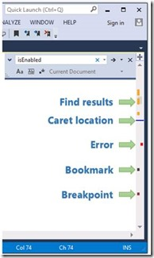
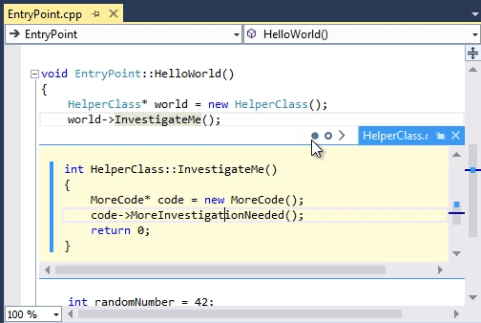
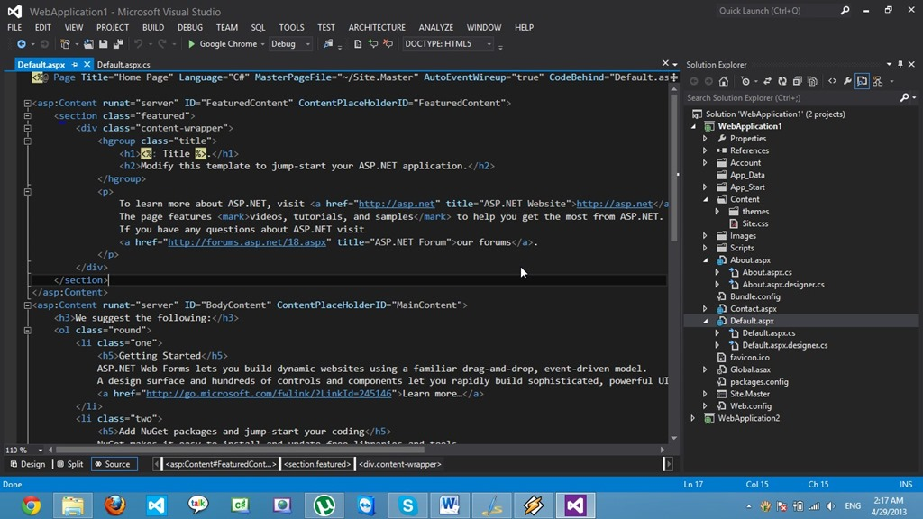
Generalna poboljšanja
Redizajn interfejsa
Potpuno novi web editori
Poboljšana pretraga / Quick Launch
Asinhrono učitavanje projekata
Preview fajlova
Podrška za više browsera
Peek Definition
Napredni scrollbar
Ugrađena podrška za Git
Notes:
VS 2012 What’s new: https://msdn.microsoft.com/en-us/library/vstudio/bb386063%28v=vs.110%29.aspx
VS 2013 What’s new: https://msdn.microsoft.com/en-us/library/bb386063.aspx
Više o novom editoru: http://madskristensen.net/post/my-road-to-visual-studio-2013
Stari editor – mix između C++ i C#, sa kodom još iz 90-ih. Imao je čak dependency na FrontPage.
Quick Launch: http://blogs.msdn.com/b/zainnab/archive/2013/07/17/visual-studio-2013-quick-launch.aspx
Async project loading: http://blogs.msdn.com/b/visualstudio/archive/2013/10/14/asynchronous-solution-load-performance-improvements-in-visual-studio-2013.aspx
Preview tab: http://blogs.msdn.com/b/zainnab/archive/2012/06/19/visual-studio-2012-new-features-preview-tab.aspx
Browser switcher:
http://www.hanselman.com/blog/ExtendingTheVisualStudio11WebBrowserChooserAndBrowseWithMenuToIncludeDeveloperProfiles.aspx
http://www.hanselman.com/blog/CrossBrowserDebuggingIntegratedIntoVisualStudioWithBrowserStack.aspx
Peek Definition: https://msdn.microsoft.com/en-us/library/dn160178.aspx
Enhanced scrollbar: http://blogs.msdn.com/b/zainnab/archive/2013/07/02/visual-studio-2013-preview-enhanced-scroll-bar.aspx
Git support: http://www.hanselman.com/blog/GitSupportForVisualStudioGitTFSAndVSPutIntoContext.aspx

Slide 7
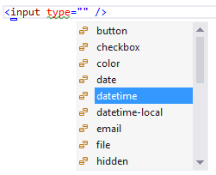
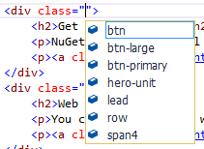
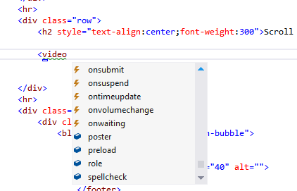
HTML
Puna HTML5 podrška – IntelliSense, code snippets, WAI-ARIA, data-* atributi
Automatska indentacija i formatiranje koda
IntelliSense za CSS class / id
Notes:
Code snippets – audio, video

Slide 8
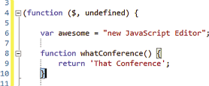
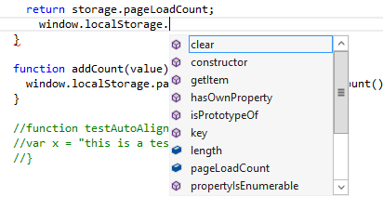
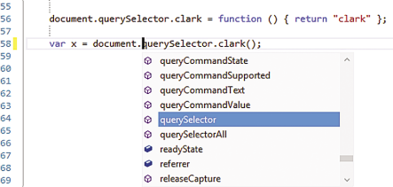
JavaScript
ECMAScript 5 podrška
IntelliSense – DOM, HTML5 API (npr. localStorage), RequireJS moduli…
Podrška za XML komentare, _references.js
Strict mode – ‘use strict’
Notes:
ECMAScript 5 - VS 2012
ECMAScript 6 – VS 2013
IntelliSense za RequireJS module – VS 2013 update 3

Slide 9
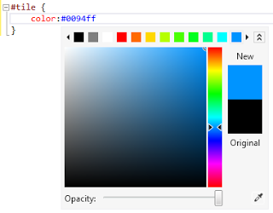
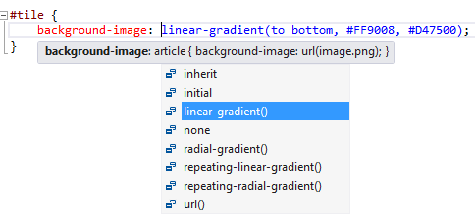
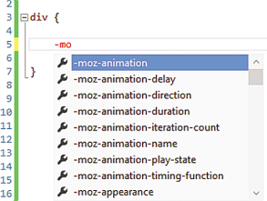
CSS
CSS3 – IntelliSense, validacija
CSS selectors level 4
Novi selector za boje
Vendor prefiksi
Tolerancija za CSS Hacks
CSS drag/drop – fontovi, slike, drugi CSS fajlovi
Notes:
CSS Selectors level 4 – VS 2013 Update 3

Slide 10

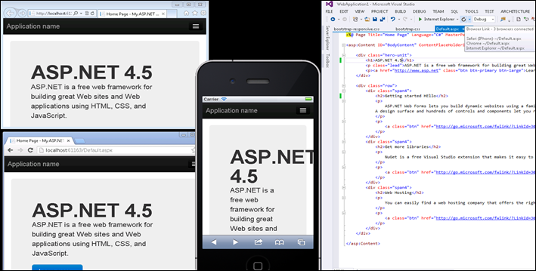
Browser Link
Povezuje Visual Studio i browsere
Prva verzija radi refresh svih povezanih browsera
Posjeduje API za proširenja
Browser Link Dashboard – pokretanje akcija i kontrola browsera
Notes:
http://www.asp.net/visual-studio/overview/2013/using-browser-link

Slide 11
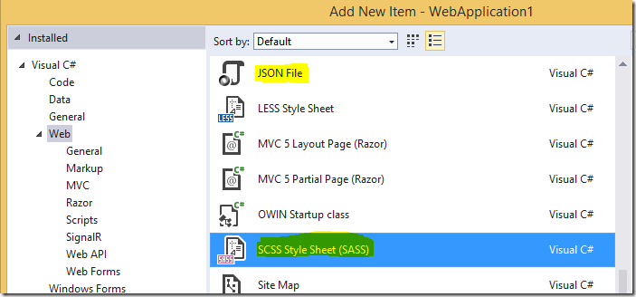
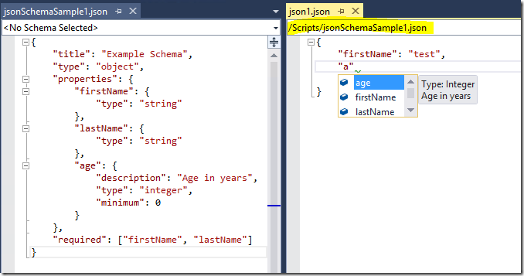
Ostalo
Bojenje koda – CoffeeScript, Mustache, Handlebars
IntelliSense za Knockout bindings i AngularJS directive
Less i Sass preprocesori
JSON fajlovi
TypeScript
Community Edition 2013 / 2015

Slide 13
Šta je Web Essentials?
Open-source ekstenzija za Visual Studio – web team playground
http://vswebessentials.com/
Proširenja za HTML, CSS, JS i BrowserLink
Verzija za VS 2012, VS 2013, VS 2015
WE 2012 / 2013 - Node.js based tools
Static bundling & minification
Image optimization & .sprite
JSHint
Source maps
LESS/SASS kompilacija i CSS preview
CoffeeScript preview…

Slide 14
2015

Slide 15
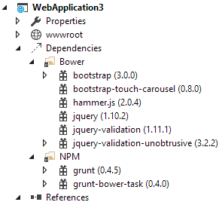
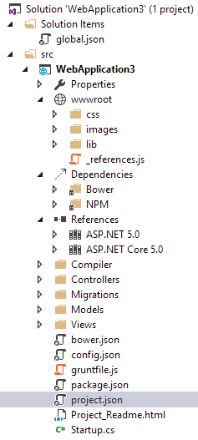
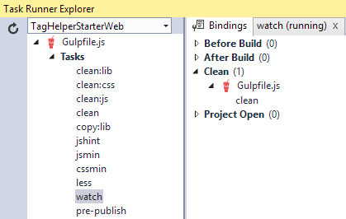
Visual Studio 2015
Nova struktura web projekta
Client-side package managers
NuGet nije dovoljan?
Npm i Bower
Jspm?
Client-side build alati
MSBuild
Grunt i Gulp
Task Runner Explorer
Notes:
https://www.visualstudio.com/en-us/downloads/visual-studio-2015-downloads-vs.aspx

Slide 16

Visual Studio Code

Slide 17
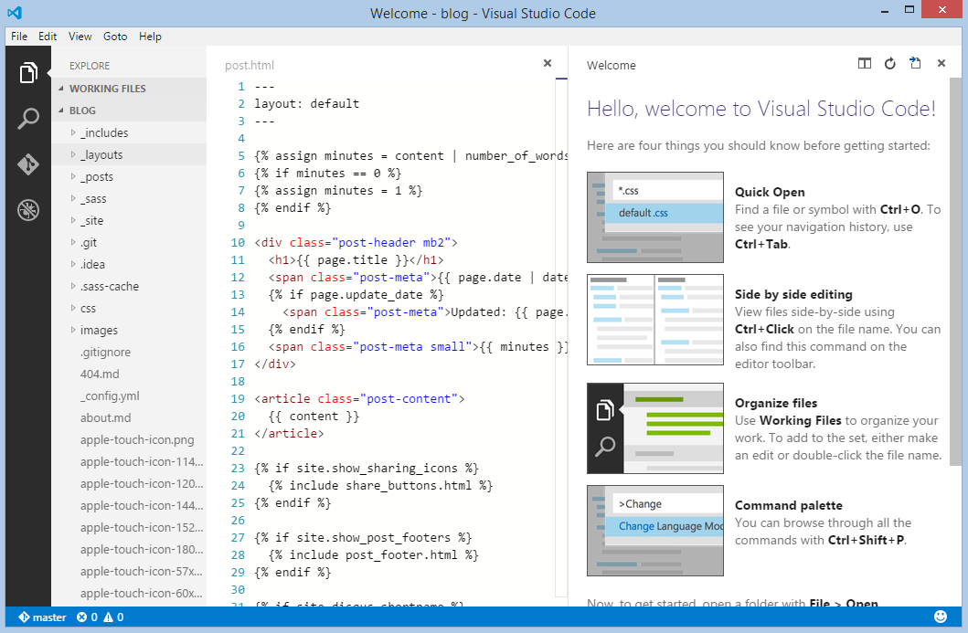
Visual Studio Code
Novi multiplatformski editor
https://code.visualstudio.com/
ASP.NET 5 i Node.js editor
+ debugger
Ugrađena Git podrška

Slide 18


Ostali alati

Slide 19
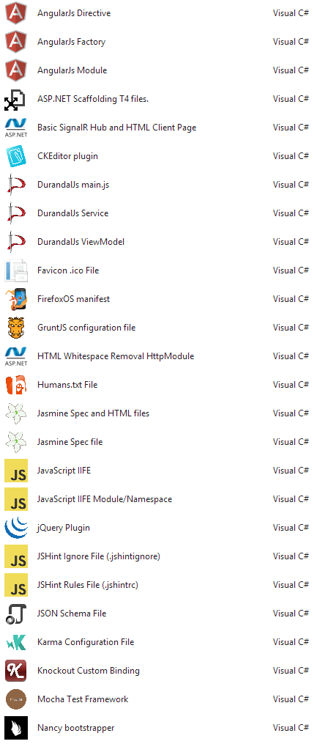
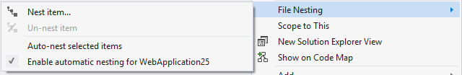
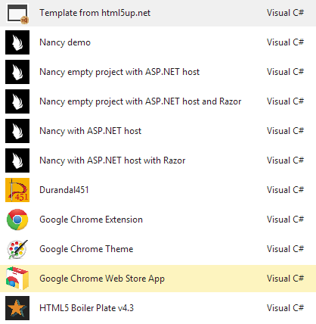
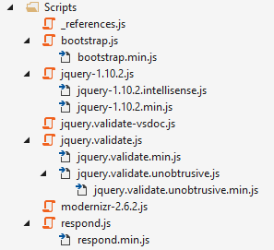
Dodaci za Visual Studio
JetBrains ReSharper
SideWaffle
GitHub for VS
File Nesting
EditorConfig
Chutzpah Jasmine, Qunit, Mocha
KarmaTestAdapter Karma (Protractor)

Slide 20
Pogled u budućnost
Umjesto zaključka
Notes:
Umjesto zaključka

Slide 21
Predviđanja
ES6/7 + moduli
CSS4
Web Components
Angular
React – JSX
Jspm
Aurelia

Slide 22
DEMO

Slide 23
Hvala! Pitanja?
Primjeri + prezentacija: https://github.com/miroslavpopovic/web-ms-2015

