Slide 1


What’s new in .NET Core 3.0
Miroslav Popovic Technical Lead, Seavus https://miroslavpopovic.com @miroslavpopovic

Slide 2
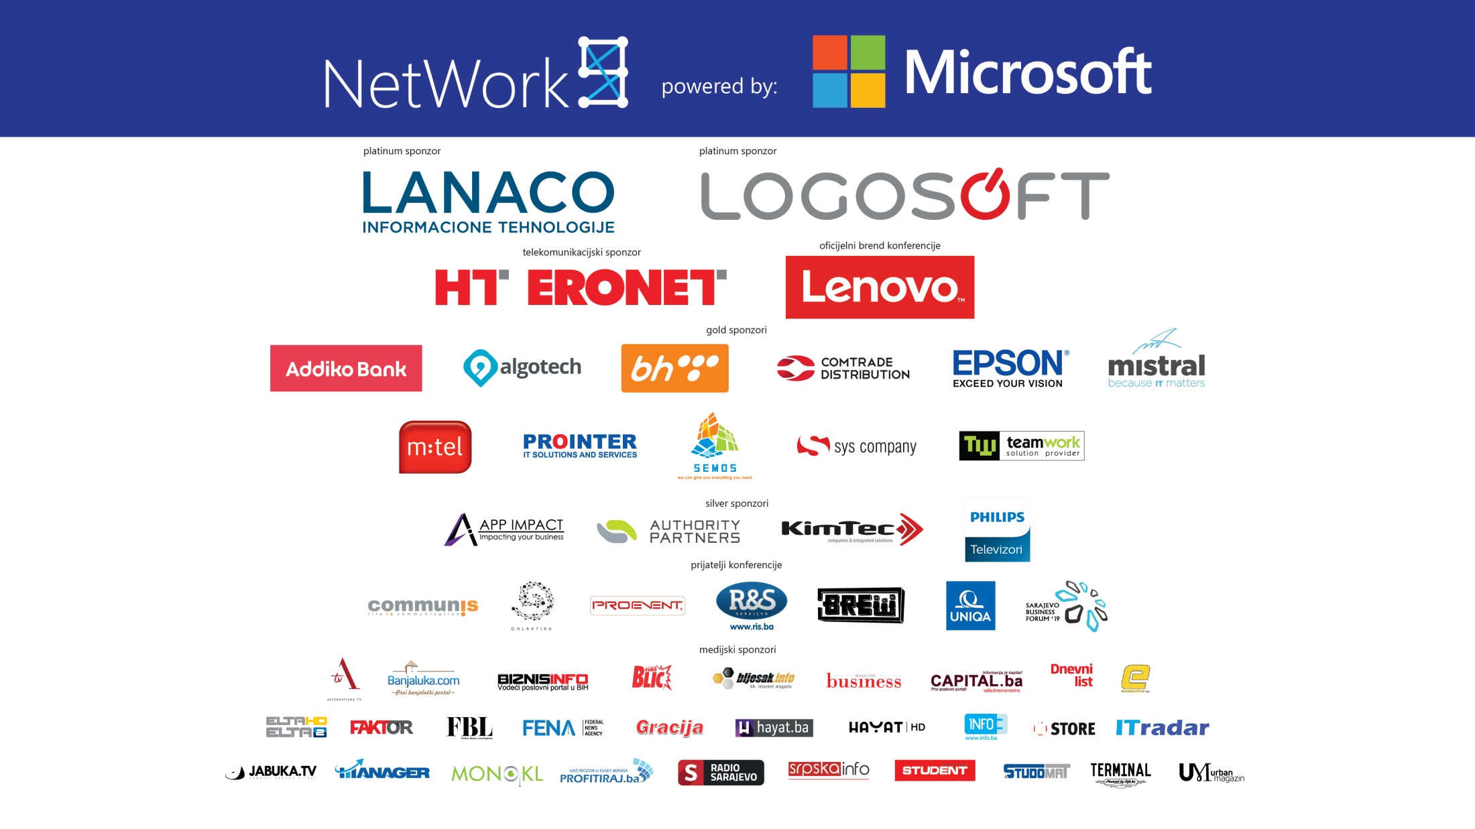

Slide 3

Standards and Languages

Slide 4

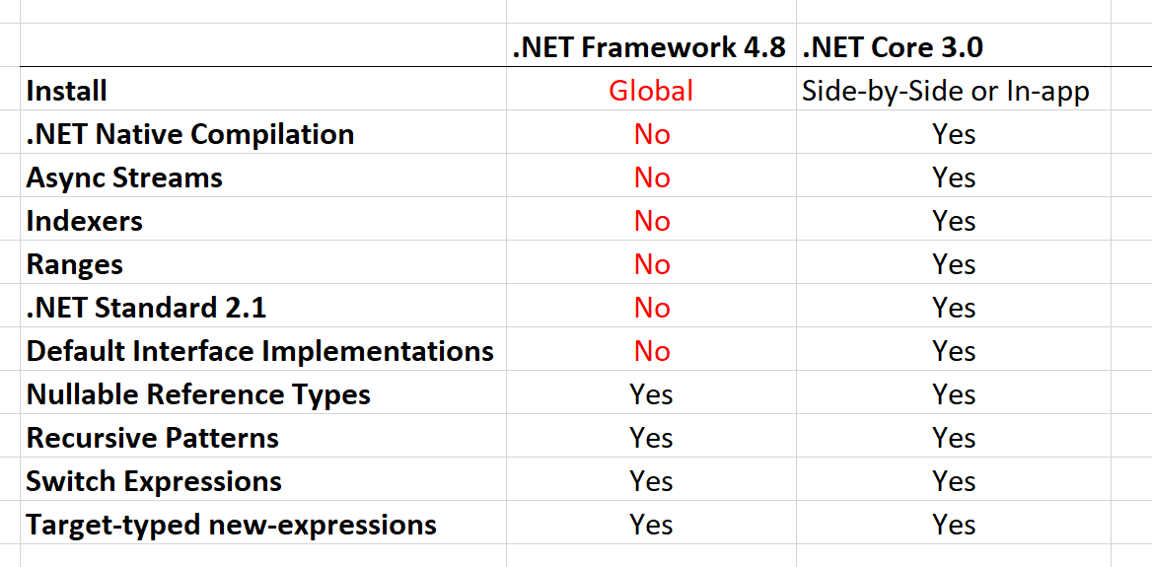
.NET Standard 2.1
Span<T>
Index and Range
IAsyncEnumerable<T>
Reflection emit and capability APIs
SIMD Hardware Intrinsics API [post 1, post 2]
DbProviderFactories
No support in full .NET Framework
Notes:
IAsyncEnumerable<T> - for async streams
Reflection emit and capability APIs - for dynamic code generation, checks and generating code
SIMD API
using Intel SSE, SSE2, AVX2, ARM, ARM64 directly from managed code
moving from C++ portion of runtime to C#
better for JIT targeting
optimized basic operations in BCL, such as string comparison
DbProviderFactories - use ADO.NET provider without knowing its type at compile type

Slide 5

C# 8
Index and Range
Async streams [tutorial]
Using declarations
using var reader = file.OpenText();
Switch expressions
Default implementation for interface members
IEEE 754-2008 floating point API improvements [introduction]
Notes:
Async streams - with IAsyncEnumerable<T>
Floating point changes - alignment and fixes for platforms implementations

Slide 6

F#
F# 4.6 [announcement]
dotnet fsi - F# interactive

Slide 7

.NET Core BCL and Tools

Slide 8

JSON
System.Text.Json
Utf8JsonReader
Utf8JsonWriter
JsonDocument
Upcoming:
POCO serializer
POCO deserializer
Announcement / Roadmap

Slide 9
BCL improvements
Span<T> and Memory<T> optimizations
String types optimized when used as keys with Dictionary<TKey, TValue>
Brotli compression support in HttpClient
Notes:
Span<T> added in .NET Core 2.1

Slide 10
.NET Core tools
Local dotnet tools
dotnet-tools.json
dotnet new tool-manifest
dotnet tool list (-g)
dotnet tool restore / run / install / uninstall
Dotnet build copies dependencies by default
no need for dotnet publish
Tiered compilation on by default
ARM64 for Linux [status]
Install on Linux with Snap [setup]
Notes:
Tiered
Optimize for both startup and throughput
Was opt-in, under a switch in .NET Core 2.1 and 2.2
ARM64
Primary use case - IoT scenarios
.NET Core 2.1 - added ARM32 for Linux
.NET Core 2.2 - added ARM32 for Windows

Slide 11
.NET Core other
AssemblyDependencyResolver [samples]
Assembly Unloadability [samples]
Windows Native Interop [samples]
DLLMap and Native image resolver events [samples]
Serial Port APIs supported on Linux [samples]
System.Devices.Gpio - for IoT ports [samples]
TLS 1.3 & OpenSSL 1.1.1 on Linux
Cryptography
AES-GCM & AES-CCM algorithms
Cryptographic key import / export
Notes:
AssemblyDependencyResolver - for plugin scenarios, dynamically loaded assemblies
Unloadability - for plugins, scripts, web sites
Windows Native
P/Invoke since .NET Core 1.0
CoCreate COM APIs and Activate WinRT APIs in .NET Core 3.0
NativeLibrary APIs - multiplatform
Serial Port
Controlling Arduino with .NET using Raspberry Pi
Flash Arduino from Raspberry Pi
System.Devices.Gpio
separate NuGet package
GPIO, PWM, SPI and I2C APIs
TLS 1.3 - Linux only, with OpenSSL lib... Windows and macOS support will be provieded by respective operating system in future
Crypthographic key import / export - various formats

Slide 12

Windows Desktop

Slide 13
Windows Desktop
Windows Forms
WPF
WinUI
Open-source
How to port desktop applications to .NET Core 3.0
Notes:
Why Windows Desktop on Core?
Performance
Side by side execution
Self-contained exe
BCL improvements
Open-source

Slide 14
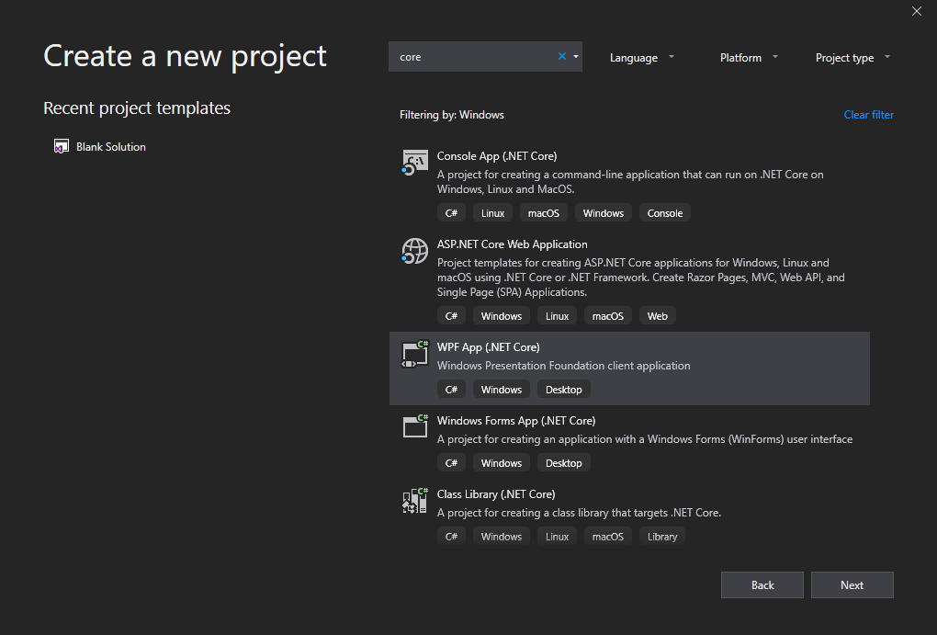
Tools
dotnet new wpf
dotnet new winforms
.NET Core apps have .exe by default
MSIX Deployment for Desktop apps

Slide 15
ASP.NET Core

Slide 16
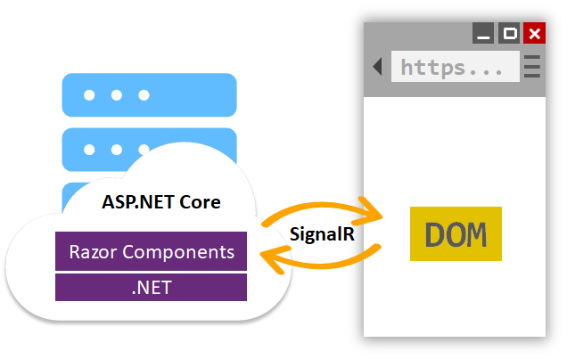
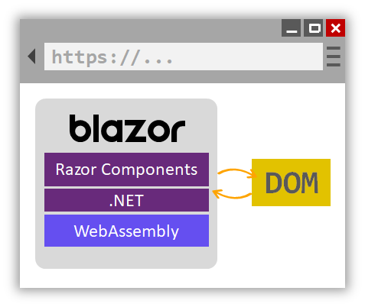
ASP.NET Core Razor Components
Project templates in VS 2019
.razor files
Hosting on server and client (Blazor)
JavaScript interop - IJSRuntime interface
Class libraries for sharing components
MVC and Razor Pages integration Html.RenderComponentAsync<Counter>()
Server-side prerendering
Integrated with Endpoint routing
Built in support for forms and validation
Notes:
Check out the documentation
https://docs.microsoft.com/en-us/aspnet/core/razor-components/components?view=aspnetcore-3.0

Slide 17
ASP.NET Core
Json.NET removed from shared framework
services.AddMvc().AddNewtonsoftJson();
Runtime compilation removed
not depending on Roslyn, but can be added manually
System.IO.Pipelines on HttpContext
Generic host inside templates [docs]
HostBuilder instead WebHostBuilder
Endpoint routing improvements
Notes:
Endpoint routing
Endpoint class,
New MapXxx() extension methods
CORS
HealthChecks

Slide 18
SPA templates improvements
Upgraded Angular to version 7
SPA authentication with IdentityServer [docs]
services .AddIdentityServer() .AddApiAuthorization<ApplicationUser, ApplicationDbContext>();
services .AddAuthentication() .AddIdentityServerJwt();
Notes:
SPA auth not available from VS
dotnet new react -au Individual
Angular template has at least one problem
React has multiple issues

Slide 19
SignalR improvements
Client-to-server streaming [docs]
https://streamr.azurewebsites.net/
Endpoint Routing support
app.UseRouting(routes => { routes.MapApplication(); routes.MapHub<ChatHub>(“hubs/chat”); });
Long Polling for Java clients (if WebSockets aren’t supported)

Slide 20
Templates

Slide 21
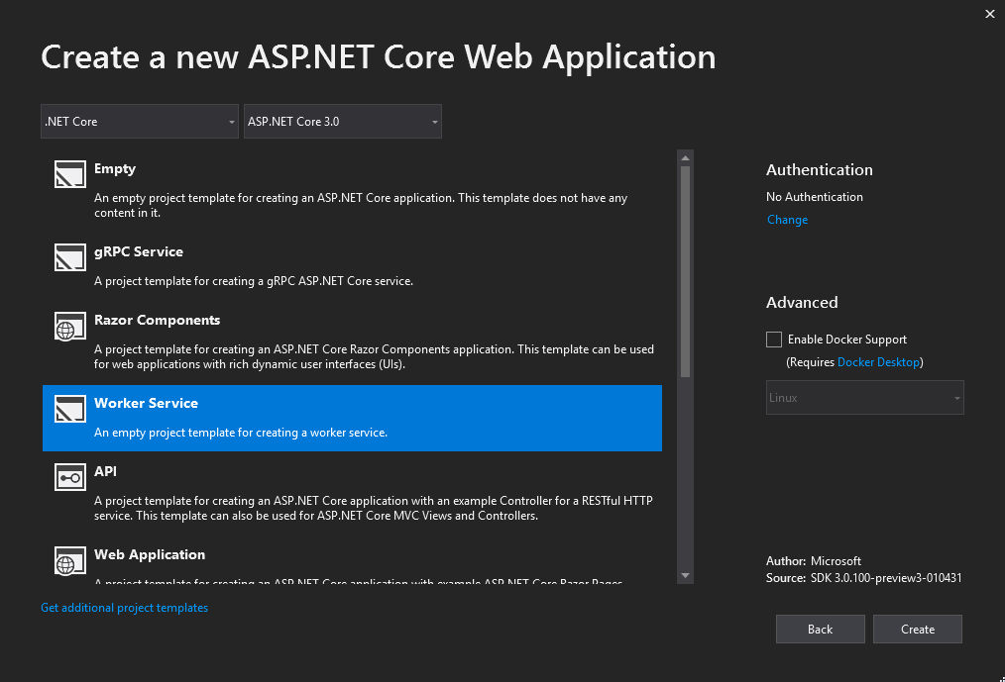
Worker Service template
Long running background processes
Like Windows Service or Linux Daemon
Logging, DI, Configuration… but without web dependencies

Slide 22
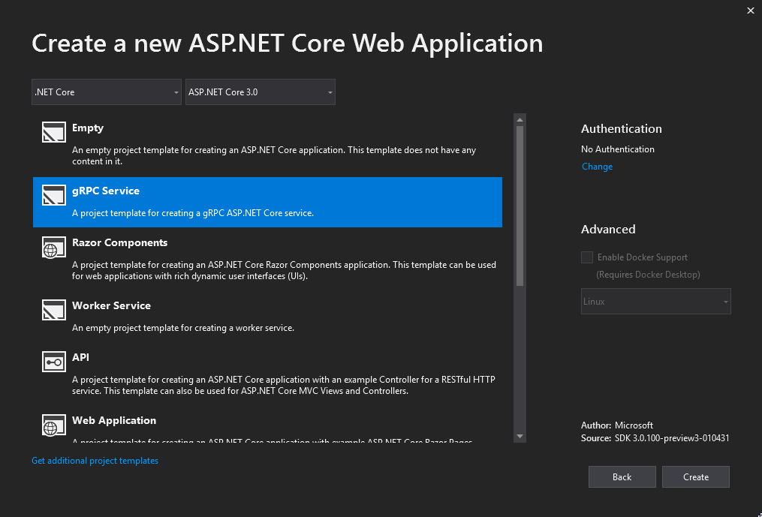
gRPC template
HTTP/2 transport
Protocol Buffers
https://github.com/grpc/grpc-dotnet/

Slide 23

Docker
Memory limits fix
Switch to Microsoft Container Registry (MCR) FROM mcr.microsoft.com/dotnet/core/sdk:3.0

Slide 24
Other

Slide 25
Entity Framework Core
EF 6.3 ported to .NET Core
Lots of breaking changes
Cosmos DB support
LINQ improvements
C# 8 support
like async streams and nullable reference types
Database views reverse engineering - using Query types
Property bag entities
EF Core no longer part of ASP.NET Core shared framework

Slide 26
Blazor
Full stack web development with C# and WebAssembly
https://blazor.net/
Still in experimental phase
Still no release date

Slide 27
Closing Up...

Slide 28
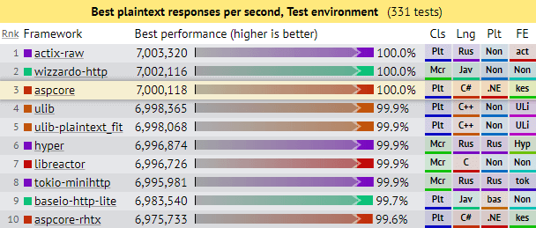
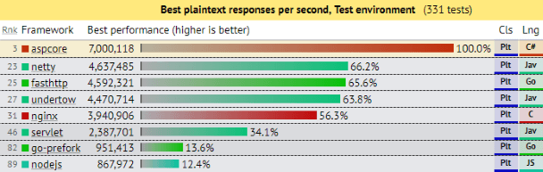
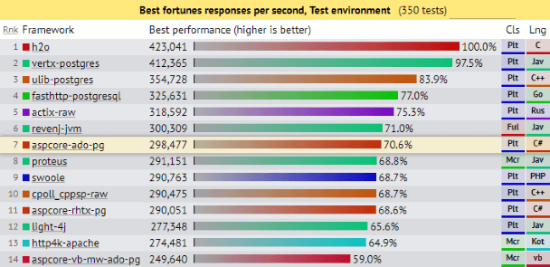
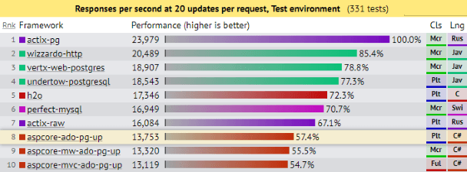
Current performance
ASP.NET Core: Saturating 10GbE at 7+ million request/s
Notes:
Current perfornance with ASP.NET Core 2.2

Slide 29
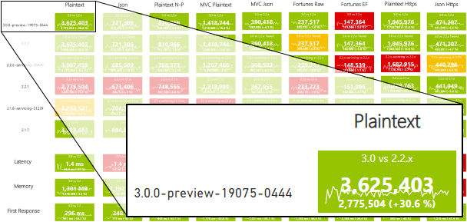
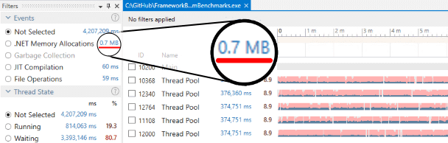
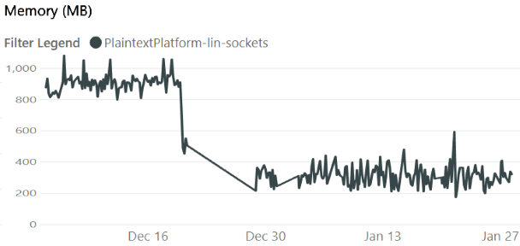
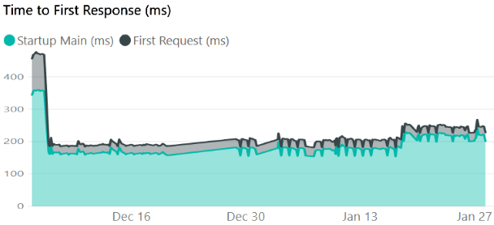
Future performance
https://aka.ms/aspnet/benchmarks
6 minutes, 64 connections, 120.000.000 requests
Notes:
Current perfornance with ASP.NET Core 2.2

Slide 30
References
Announcing .NET Core 3 Preview 1
Announcing .NET Core 3 Preview 2
ASP.NET Core updates in .NET Core 3.0 Preview 2
Announcing .NET Core 3 Preview 3
ASP.NET Core updates in .NET Core 3.0 Preview 3
What is new in EF Core 3.0
Announcing .NET Standard 2.1
Blazor 0.9.0 experimental release now available
ASP.NET Community Standup - https://live.asp.net/

Slide 31
Conclusion
Bunch of new features
Performance, performance, performance
Play with it:
https://dotnet.microsoft.com/download/dotnet-core/3.0
https://visualstudio.microsoft.com/vs/preview/
Options > Projects and Solutions > .NET Core > Use previews of .NET Core SDK
Release - late Q3, 2019.
https://github.com/miroslavpopovic/what-is-new-in-dotnet-core-3

Slide 32
Thank you!
Miroslav Popovic Technical Lead, Seavus https://miroslavpopovic.com @miroslavpopovic

Slide 33


