Slide 2

What’s new in .NET Core 3.0
Miroslav Popovic Technical Lead, Seavus d.o.o.
https://miroslavpopovic.com
@miroslavpopovic

Slide 3
Standards and Languages

Slide 4
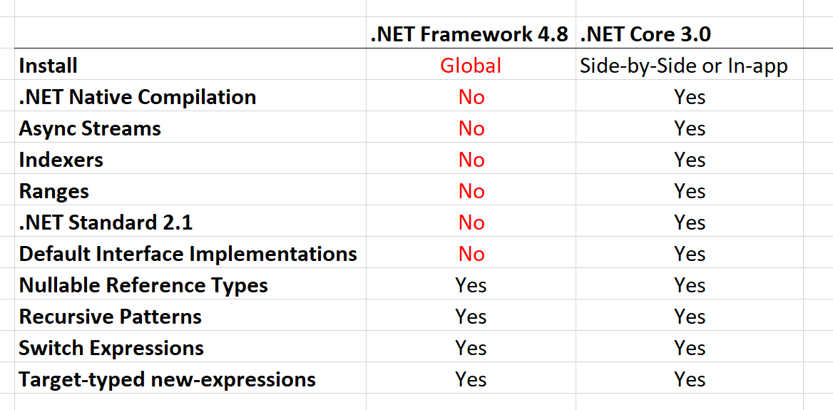

.NET Standard 2.1
Span<T>
Index and Range
IAsyncEnumerable<T>
Reflection emit and capability APIs
SIMD Hardware Intrinsics API [post 1, post 2]
DbProviderFactories
No support in full .NET Framework
Notes:
IAsyncEnumerable<T> - for async streams
Reflection emit and capability APIs - for dynamic code generation, checks and generating code
SIMD API
using Intel SSE, SSE2, AVX2, ARM, ARM64 directly from managed code
moving from C++ portion of runtime to C#
better for JIT targeting
optimized basic operations in BCL, such as string comparison
DbProviderFactories - use ADO.NET provider without knowing its type at compile type

Slide 5

C# 8
Index and Range
Async streams [tutorial]
Using declarations
using var reader = file.OpenText();
Switch expressions
Default implementation for interface members
IEEE 754-2008 floating point API improvements [introduction]
Notes:
Async streams - with IAsyncEnumerable<T>
Floating point changes - alignment and fixes for platforms implementations

Slide 6

F#
F# 4.6 [announcement]
dotnet fsi - F# interactive

Slide 7
.NET Core BCL and tools

Slide 8

JSON
System.Text.Json
Utf8JsonReader
Utf8JsonWriter
JsonDocument
JsonSerializer [info and samples]
Announcement / Roadmap

Slide 9
BCL improvements
Span<T> and Memory<T> optimizations
String types optimized
when used as keys with Dictionary<TKey, TValue>
HttpClient
Brotli compression
HTTP/2 [announcement]
Microsoft.Data.SqlClient
Notes:
Span<T> added in .NET Core 2.1

Slide 10
.NET Core tools
Local dotnet tools
dotnet-tools.json > dotnet new tool-manifest
dotnet tool restore / run / install / uninstall
dotnet build copies dependencies by default
no need for dotnet publish
dotnet publish for single-file exe [more info]
Tiered compilation on by default
ARM64 for Linux [status] ???
Install on Linux with Snap [setup]
Notes:
Tiered
Optimize for both startup and throughput
Was opt-in, under a switch in .NET Core 2.1 and 2.2
ARM64
Primary use case - IoT scenarios
.NET Core 2.1 - added ARM32 for Linux
.NET Core 2.2 - added ARM32 for Windows

Slide 11
.NET Core other
AssemblyDependencyResolver [samples]
Assembly Unloadability [samples]
Windows Native Interop [samples]
DLLMap and Native image resolver events [samples]
Serial Port APIs supported on Linux [samples]
System.Devices.Gpio - for IoT ports [samples]
TLS 1.3 & OpenSSL 1.1.1 on Linux
Cryptography
AES-GCM & AES-CCM algorithms
Cryptographic key import / export
Notes:
AssemblyDependencyResolver - for plugin scenarios, dynamically loaded assemblies
Unloadability - for plugins, scripts, web sites
Windows Native
P/Invoke since .NET Core 1.0
CoCreate COM APIs and Activate WinRT APIs in .NET Core 3.0
NativeLibrary APIs - multiplatform
Serial Port
Controlling Arduino with .NET using Raspberry Pi
Flash Arduino from Raspberry Pi
System.Devices.Gpio
separate NuGet package
GPIO, PWM, SPI and I2C APIs
TLS 1.3 - Linux only, with OpenSSL lib... Windows and macOS support will be provieded by respective operating system in future
Crypthographic key import / export - various formats

Slide 12
Windows Desktop

Slide 13
Windows Desktop
Windows Forms
WPF
WinUI
Open-source
How to port desktop applications to .NET Core 3.0
Notes:
Why Windows Desktop on Core?
Performance
Side by side execution
Self-contained exe
BCL improvements
Open-source

Slide 14
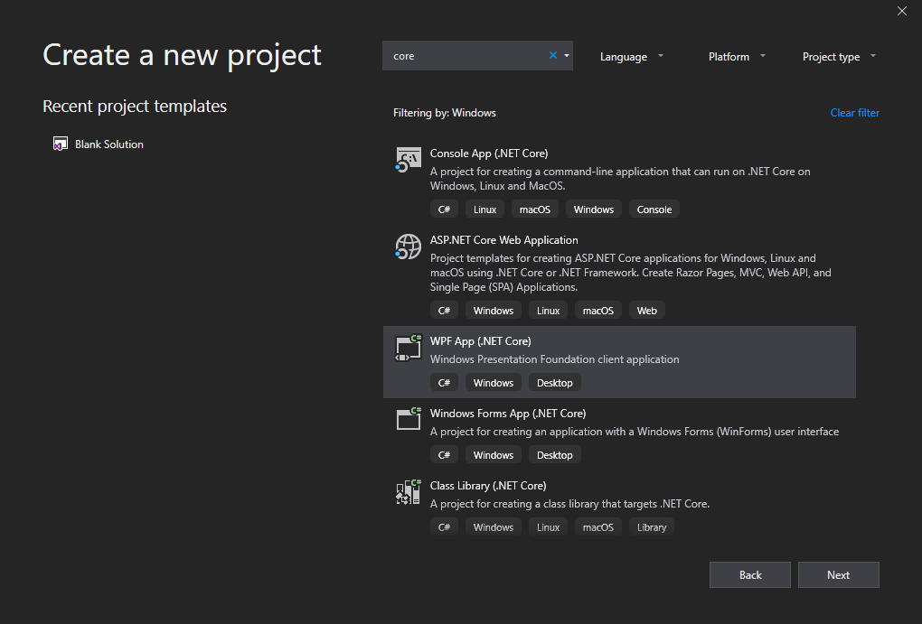
Tools
dotnet new wpf
dotnet new winforms
.NET Core apps have .exe by default
MSIX Deployment for Desktop apps
WinForms Chart

Slide 15
ASP.NET Core

Slide 16
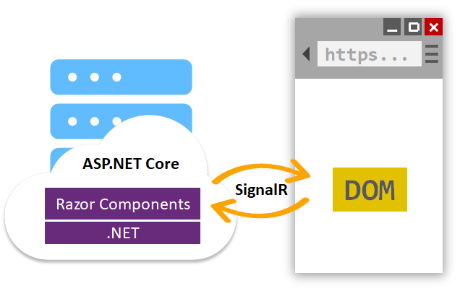
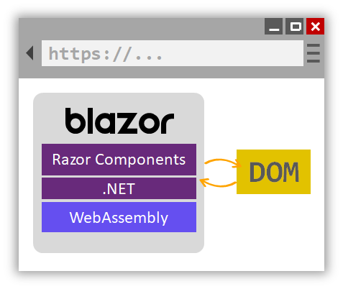
Server-side Blazor
Hosting on server and client (Blazor)
Project templates in VS 2019
.razor files
JavaScript interop - IJSRuntime interface
Class libraries for sharing components
MVC and Razor Pages integration (<Counter>)
Server-side prerendering
Reconnect interface
Built in support for forms and validation
Notes:
Check out the documentation
https://docs.microsoft.com/en-us/aspnet/core/razor-components/components?view=aspnetcore-3.0

Slide 17
Endpoint routing
app.UseRouting(); app.UseAuthentication(); app.UseAuthorization(); app.UseCors(); app.UseEndpoints(endpoints => { endpoints.MapControllers(); endpoints.MapRazorPages(); endpoints.MapBlazorHub(); endpoints.MapHub<ChatHub>(„hubs/chat“); endpoints.MapGrpcService<CalculatorService>(); });

Slide 18
ASP.NET Core
Json.NET removed from shared framework
services.AddMvc().AddNewtonsoftJson();
Runtime compilation removed
not depending on Roslyn, but can be added manually
System.IO.Pipelines on HttpContext
Generic host inside templates [docs]
HostBuilder instead of WebHostBuilder
More options for MVC service registration
AddControllers()
AddControllersWithViews()
AddRazorPages()
Notes:
Endpoint routing
Endpoint class,
New MapXxx() extension methods
CORS
HealthChecks

Slide 19
SPA templates improvements
Upgraded Angular to version 7
SPA authentication with IdentityServer [docs]
services .AddIdentityServer() .AddApiAuthorization<ApplicationUser, ApplicationDbContext>();
services .AddAuthentication() .AddIdentityServerJwt();
Notes:
SPA auth not available from VS
dotnet new react -au Individual
Angular template has at least one problem
React has multiple issues

Slide 20
SignalR improvements
Client-to-server streaming [docs]
https://streamr.azurewebsites.net/
Long Polling for Java clients
if WebSockets aren’t supported

Slide 21
Templates

Slide 22
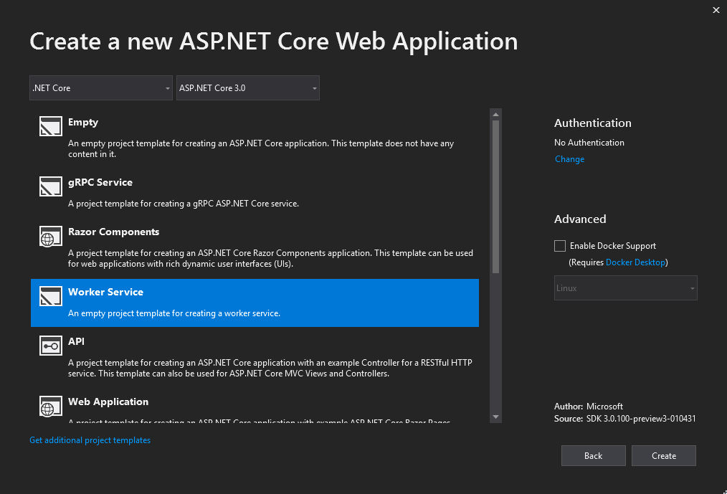
Worker Service template
Long running background processes
Windows Service or Linux Daemon
Logging, DI, Configuration…
but without web dependencies
Microsoft.NET.Sdk.Worker

Slide 23
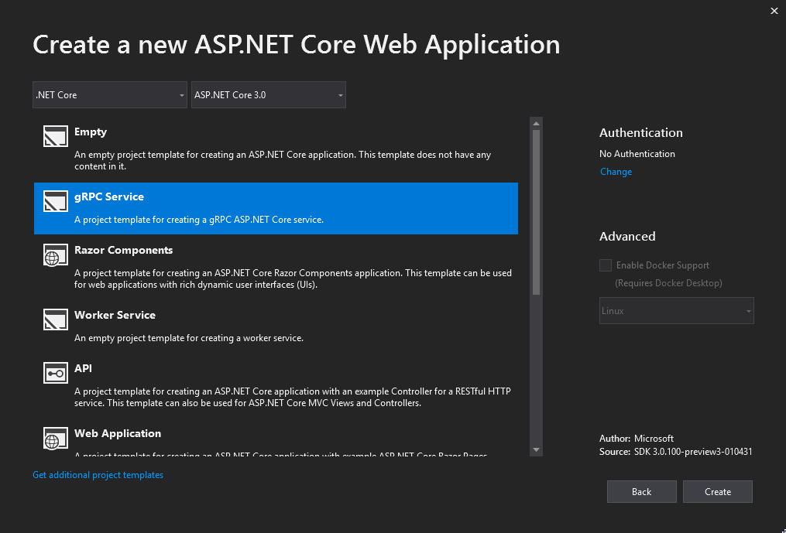
gRPC template
HTTP/2 transport
Protocol Buffers
Design-time code generation
https://github.com/grpc/grpc-dotnet/

Slide 24
Docker
Memory limits fix
Better CPU limits (--cpus)
Switch to Microsoft Container Registry (MCR)
FROM mcr.microsoft.com/dotnet/core/sdk:3.0
PowerShell Core in SDK image

Slide 25
Other

Slide 26
Entity Framework Core
EF 6.3 ported to .NET Core
Lots of breaking changes
Cosmos DB support
LINQ improvements
C# 8 support
like async streams and nullable reference types
Database views reverse engineering
using Query types Entities without keys
Property bag entities
EF Core no longer part of ASP.NET Core shared framework
Targets .NET Standard 2.1

Slide 27
Client-side Blazor
Full stack web development with C# and WebAssembly
https://blazor.net/
First preview is out! [announcement]
Released with future .NET Core (> 3.0)

Slide 28
Closing up…

Slide 29
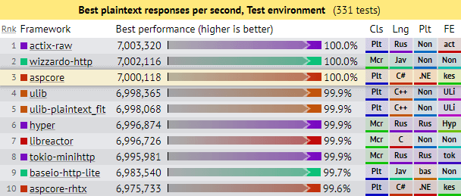
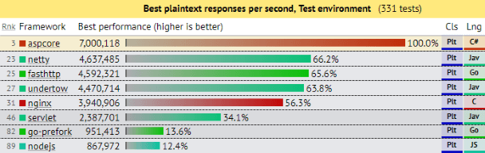
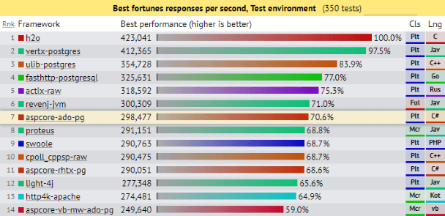
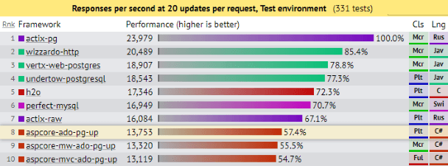
Current performance
ASP.NET Core: Saturating 10GbE at 7+ million request/s
Notes:
Current perfornance with ASP.NET Core 2.2

Slide 30
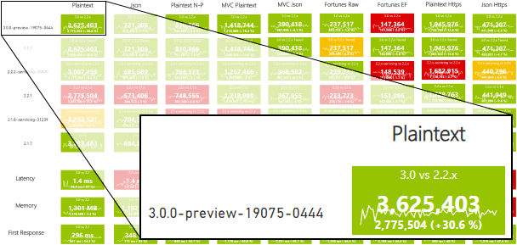
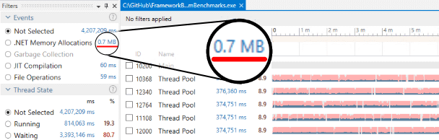
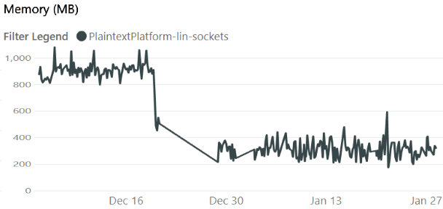
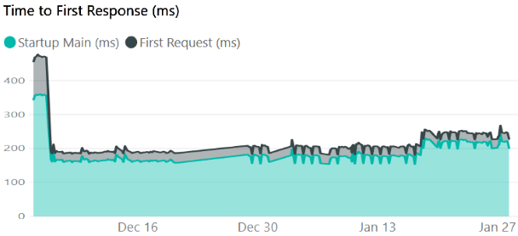
Future performance
https://aka.ms/aspnet/benchmarks
6 minutes, 64 connections, 120.000.000 requests

Slide 31
References
Announcing .NET Standard 2.1
.NET Core announcements
Preview 1, Preview 2, Preview 3, Preview 4, Preview 5
ASP.NET Core announcements
Preview 2, Preview 3, Preview 4, Preview 5
Entity Framework Core announcements
What is new in EF Core 3.0, Preview 4
ASP.NET Community Standup
https://live.asp.net/
Microsoft Build 2019

Slide 32
Conclusion
Bunch of new features
Performance, performance, performance
Play with it:
https://dotnet.microsoft.com/download/dotnet-core/3.0
https://visualstudio.microsoft.com/vs/preview/
Options > Projects and Solutions > .NET Core > Use previews of .NET Core SDK
Release - September 2019.
https://github.com/miroslavpopovic/what-is-new-in-dotnet-core-3

Slide 33
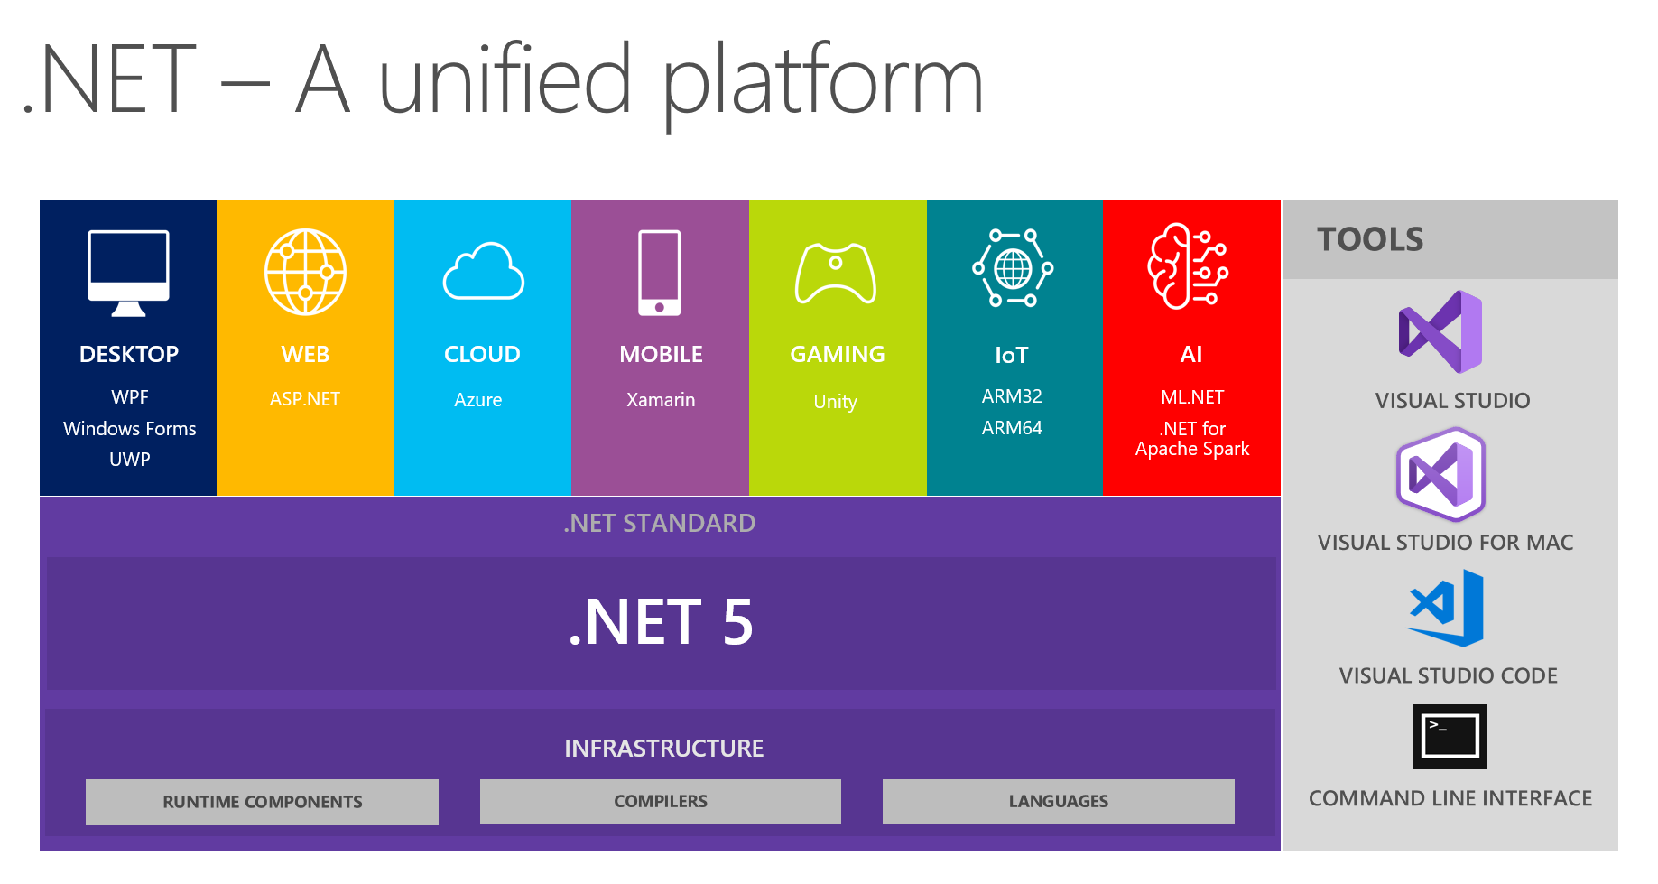
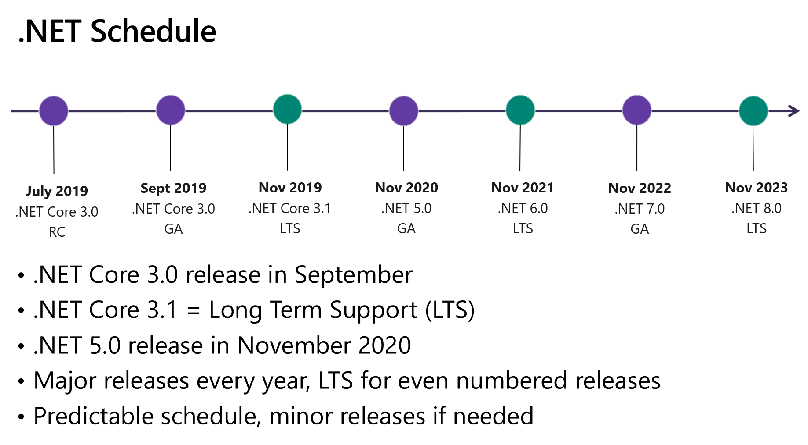
.NET 5!
https://devblogs.microsoft.com/dotnet/introducing-net-5/

Slide 34
Thank you!
Questions?
https://miroslavpopovic.com
@miroslavpopovic

