Slide 1

What’s new in .NET Core 3.x
Miroslav Popovic Technical Lead, Seavus d.o.o.

Slide 2
Standards and Languages

Slide 3
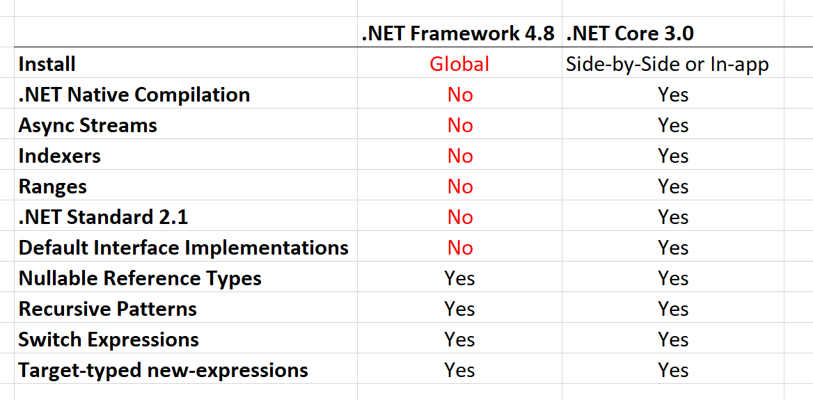
.NET Standard 2.1
Span<T>
Index and Range
IAsyncEnumerable<T>
Reflection emit and capability APIs
Hardware Intrinsics API [post]
DbProviderFactories
No support in full .NET Framework
Notes:
IAsyncEnumerable<T> - for async streams
Reflection emit and capability APIs - for dynamic code generation, checks and generating code
Hardware Intrinsics API
using Intel SSE, SSE2, AVX2, ARM, ARM64 directly from managed code
moving from C++ portion of runtime to C#
better for JIT targeting
optimized basic operations in BCL, such as string comparison
DbProviderFactories - use ADO.NET provider without knowing its type at compile type

Slide 4

C# 8
Index and Range
Async streams [tutorial]
Using declarations
using var reader = file.OpenText();
Switch expressions
Default implementation for interface members
IEEE 754-2008 floating point API improvements [introduction]
Notes:
Async streams - with IAsyncEnumerable<T>
Floating point changes - alignment and fixes for platforms implementations

Slide 5

F#
F# 4.7 [announcement]
F# Core targets .NET Standard 2.0
dotnet fsi - F# interactive

Slide 6
.NET Core BCL and tools

Slide 7

JSON
System.Text.Json
Utf8JsonReader
Utf8JsonWriter
JsonDocument
JsonSerializer [info and samples]
Announcement

Slide 8
BCL improvements
Span<T> and Memory<T> optimizations
String types optimized when used as keys with Dictionary<TKey, TValue>
HttpClient
Brotli compression
HTTP/2 [announcement]
Microsoft.Data.SqlClient
New networking primitives
System.Net.EndPoint, IConnectionListener, IConnectionListenerFactory…
Notes:
Span<T> added in .NET Core 2.1
Preview 8 support for new networking primitives - https://devblogs.microsoft.com/aspnet/asp-net-core-and-blazor-updates-in-net-core-3-0-preview-8/

Slide 9
.NET Core tools
Local dotnet tools
dotnet-tools.json
dotnet new tool-manifest
dotnet tool list (-g)
dotnet tool restore / run / install / uninstall
Notes:
Tiered
Optimize for both startup and throughput
Was opt-in, under a switch in .NET Core 2.1 and 2.2
ARM64
Primary use case - IoT scenarios
.NET Core 2.1 - added ARM32 for Linux
.NET Core 2.2 - added ARM32 for Windows

Slide 10
Build tools improvements
.NET Core SDK is significantly smaller [info]
Dotnet build copies dependencies by default
no need for dotnet publish
Self-contained executable
ReadyToRun compilation
Assembly linking and trimming
Tiered compilation on by default
ARM64 for Linux - in nightly [status]

Slide 11
.NET Core other
AssemblyDependencyResolver [samples]
Assembly Unloadability [samples]
Windows Native Interop [samples]
DLLMap and Native image resolver events [samples]
Serial Port APIs supported on Linux [samples]
System.Devices.Gpio - for IoT ports [samples]
TLS 1.3 & OpenSSL 1.1.1 on Linux
Cryptography
AES-GCM & AES-CCM algorithms
Cryptographic key import / export
Notes:
AssemblyDependencyResolver - for plugin scenarios, dynamically loaded assemblies
Unloadability - for plugins, scripts, web sites
Windows Native
P/Invoke since .NET Core 1.0
CoCreate COM APIs and Activate WinRT APIs in .NET Core 3.0
NativeLibrary APIs - multiplatform
Serial Port
Controlling Arduino with .NET using Raspberry Pi
Flash Arduino from Raspberry Pi
System.Devices.Gpio
separate NuGet package
GPIO, PWM, SPI and I2C APIs
TLS 1.3 - Linux only, with OpenSSL lib... Windows and macOS support will be provieded by respective operating system in future
Crypthographic key import / export - various formats

Slide 12
Windows Desktop

Slide 13
Windows Desktop
Windows Forms
Designer is in preview
Migrate Windows Forms apps to .NET Core 3.0
WPF
Migrate WPF apps to .NET Core 3.0
Migration tools
CsprojToVs2017
dotnet try-convert
WinUI
Open-source
Notes:
Why Windows Desktop on Core?
Performance
Side by side execution
Self-contained exe
BCL improvements
Open-source

Slide 14
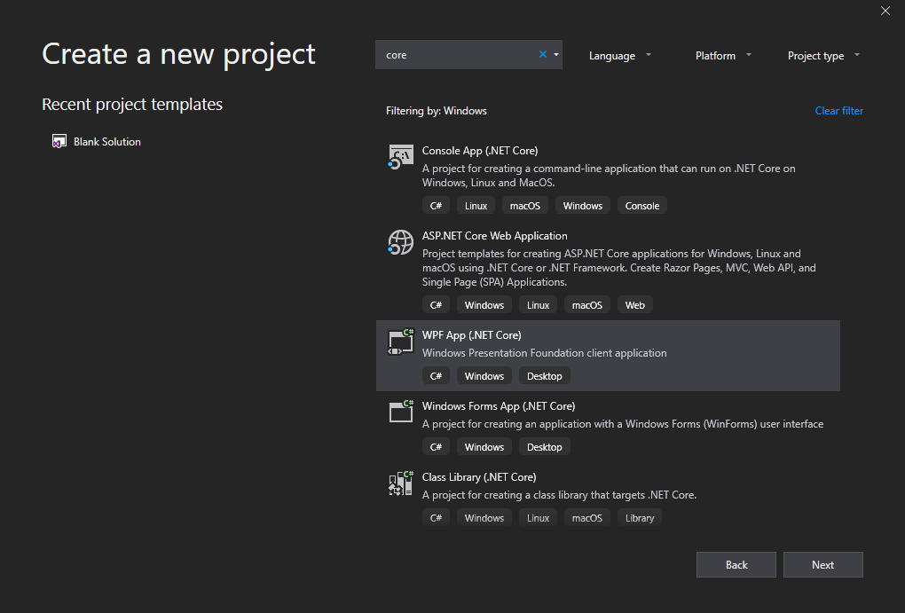
Tools
dotnet new wpf
dotnet new winforms
.NET Core apps have .exe by default
MSIX Deployment for Desktop apps
WinForms Chart

Slide 15
ASP.NET Core

Slide 16
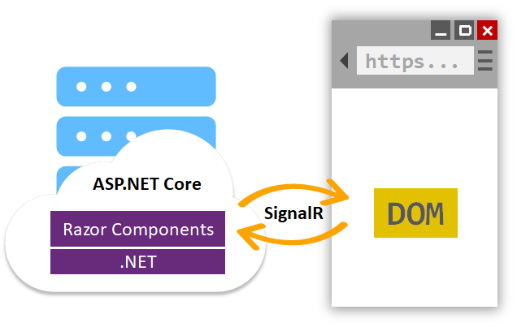
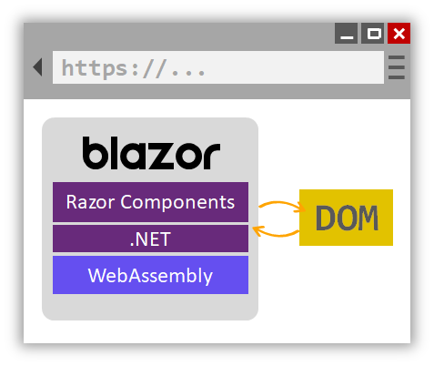
Blazor Server
Project templates in VS 2019
.razor files
Hosting on server and client (Blazor)
JavaScript interop - IJSRuntime interface
Class libraries for sharing components
MVC and Razor Pages integration (<Counter>)
Server-side prerendering
Reconnect interface
Integrated with Endpoint routing
Built in support for forms and validation
Notes:
Check out the documentation
https://docs.microsoft.com/en-us/aspnet/core/razor-components/components?view=aspnetcore-3.0

Slide 17
Endpoint routing
app.UseRouting(); app.UseAuthentication(); app.UseAuthorization(); app.UseCors(); app.UseEndpoints(endpoints => { endpoints.MapControllers(); endpoints.MapRazorPages(); endpoints.MapBlazorHub(); endpoints.MapHub<ChatHub>(„hubs/chat“); endpoints.MapGrpcService<CalculatorService>(); });

Slide 18
ASP.NET Core
Json.NET removed from shared framework
System.Text.Json used by default
services.AddMvc().AddNewtonsoftJson();
System.IO.Pipelines on HttpContext
Generic host inside templates [docs]
HostBuilder instead WebHostBuilder
More options for MVC service registration
AddControllers()
AddControllersWithViews()
AddRazorPages()
Certificate and Kerberos authentication
HTTP/2 by default in Kestrel
Templates cleanup
Notes:
Endpoint routing
Endpoint class,
New MapXxx() extension methods
CORS
HealthChecks

Slide 19
SPA templates improvements
Upgraded Angular to version 8
SPA authentication with IdentityServer [docs]
services.AddIdentityServer() .AddApiAuthorization<ApplicationUser, ApplicationDbContext>(); services.AddAuthentication() .AddIdentityServerJwt();
app.UseAuthentication(); app.UseIdentityServer();
Notes:
SPA auth not available from VS
dotnet new react -au Individual
Angular template has at least one problem
React has multiple issues

Slide 20
SignalR improvements
Client-to-server streaming [docs]
https://streamr.azurewebsites.net/
Endpoint Routing support
Auto-reconnect for JavaScript and .NET clients
Long Polling for Java clients
if WebSockets aren’t supported
Notes:
- By default, the client will try to reconnect immediately and after 2, 10, and 30 seconds

Slide 21
Templates

Slide 22
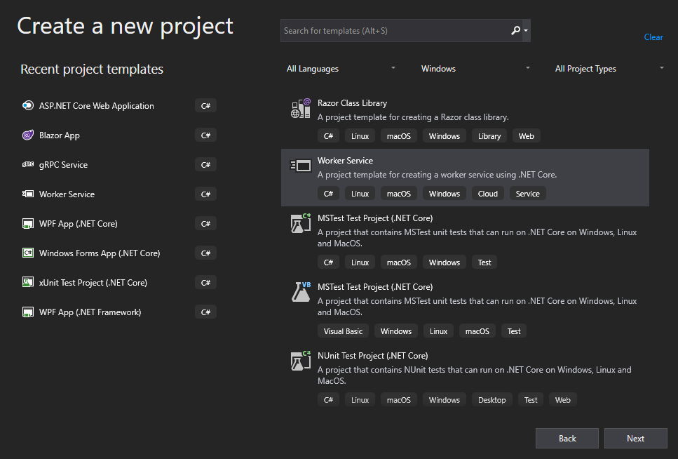
Worker Service template
Long running background processes
Windows Service or Linux Daemon
Logging, DI, Configuration…
but without web dependencies
Microsoft.NET.Sdk.Worker

Slide 23
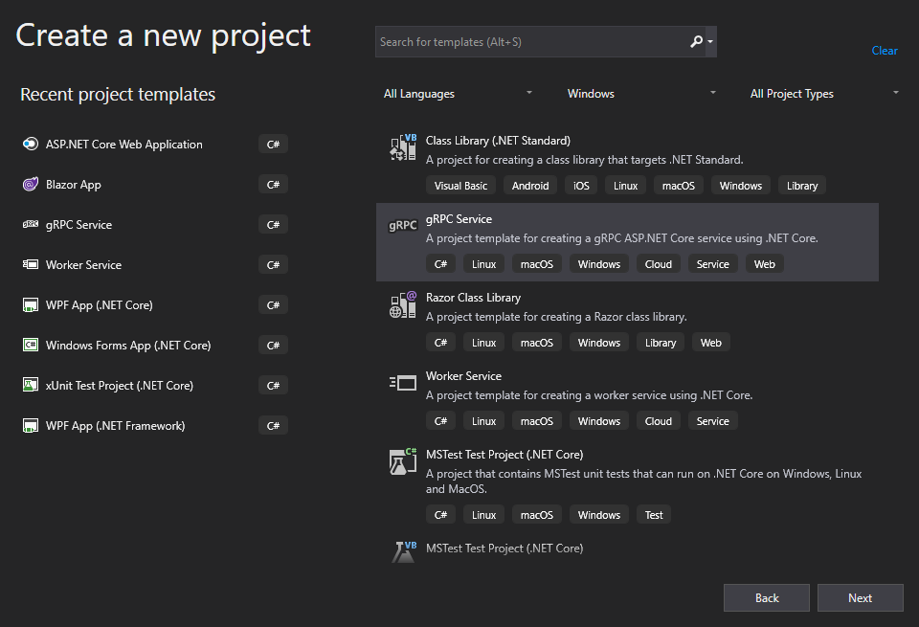
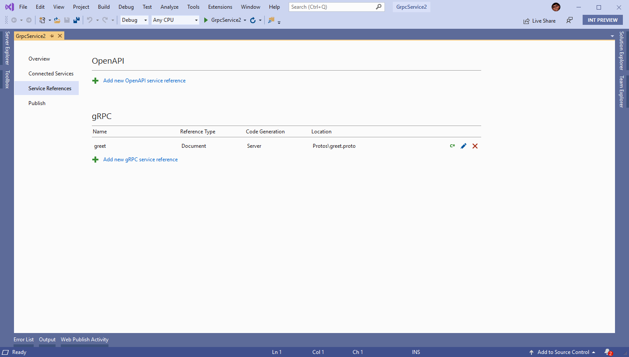
gRPC template
HTTP/2 transport
Protocol Buffers
Design-time code generation
https://github.com/grpc/grpc-dotnet/
ServiceReference tooling in VS
swagger.json – NSwag
.proto – Grpc.Tools

Slide 24

Docker
Memory limits fix
Better CPU limits (--cpus)
Switch to Microsoft Container Registry (MCR)
FROM mcr.microsoft.com/dotnet/core/sdk:3.0
PowerShell Core in SDK image

Slide 25
Other

Slide 26
Entity Framework Core
EF 6.3 ported to .NET Core
Lots of breaking changes
LINQ improvements
Cosmos DB support
C# 8 support
like async streams and nullable reference types
Microsoft.Data.SqlClient
Database views reverse engineering
using Query types Entities without keys
EF Core no longer part of ASP.NET Core shared framework
3.0 targets .NET Standard 2.1
3.1 targets .NET Standard 2.0

Slide 27
Blazor WebAssembly
Full stack web development with C# and WebAssembly
https://blazor.net/
In preview from April [announcement]
To be released on May 2020

Slide 28
Closing up…

Slide 29
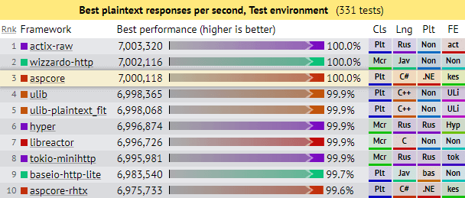
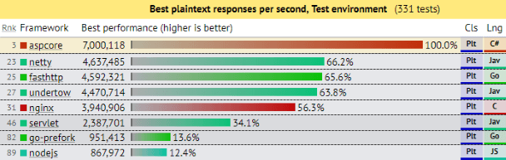
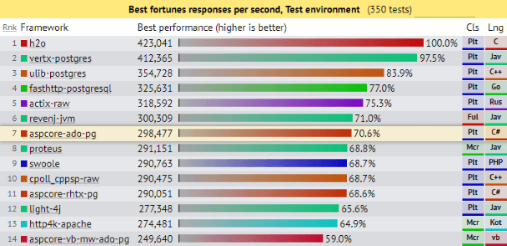
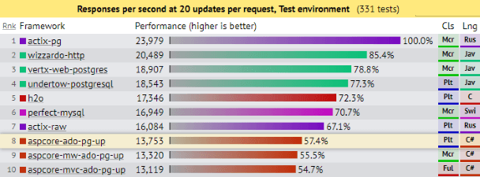
.NET Core 2.2 performance
ASP.NET Core: Saturating 10GbE at 7+ million request/s
Notes:
Current perfornance with ASP.NET Core 2.2

Slide 30
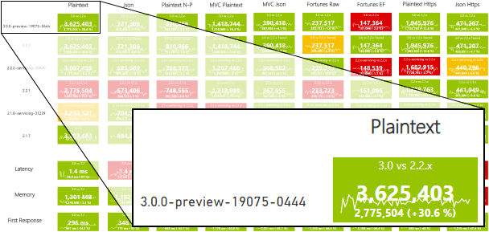
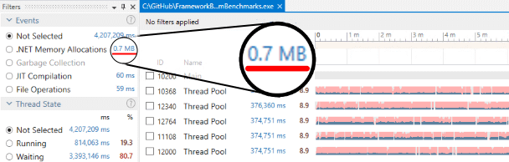
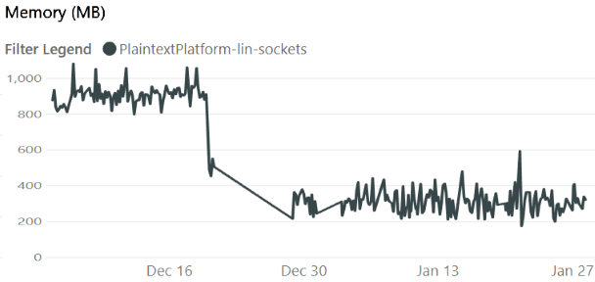
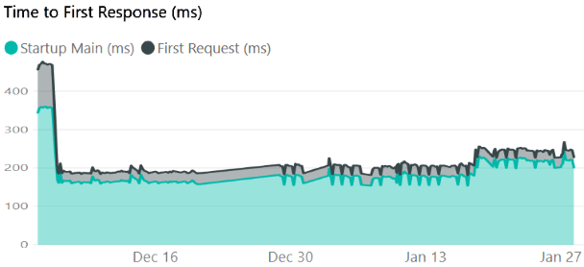
.NET Core 3.0 performance
https://aka.ms/aspnet/benchmarks
6 minutes, 64 connections, 120.000.000 requests

Slide 31
References
What’s new in .NET Core 3.0
Announcing .NET Standard 2.1
Performance improvements in .NET Core 3.0
.NET Core 3.0 announcements
Preview: 1, 2, 3, 4, 5, 6, 7, 8, 9, RC1
Final announcement
.NET Core 3.1
Preview: 1, 2, 3
Final announcement
ASP.NET Core 3.0 announcements
Preview: 2, 3, 4, 5, 6, 7, 8, 9, RC1
Final announcement
ASP.NET Core 3.1 announcements
Preview: 1, 2, 3
Final announcement
Entity Framework Core announcements
What is new in EF Core 3.0
Preview: 4, 6, 7, 8, 9, RC1
3.0 final announcement
3.1 final announcement

Slide 32
Conclusion
Bunch of new features
Performance, performance, performance
Released - September 2019.
https://github.com/miroslavpopovic/what-is-new-in-dotnet-core-3
And coming up next........

Slide 33
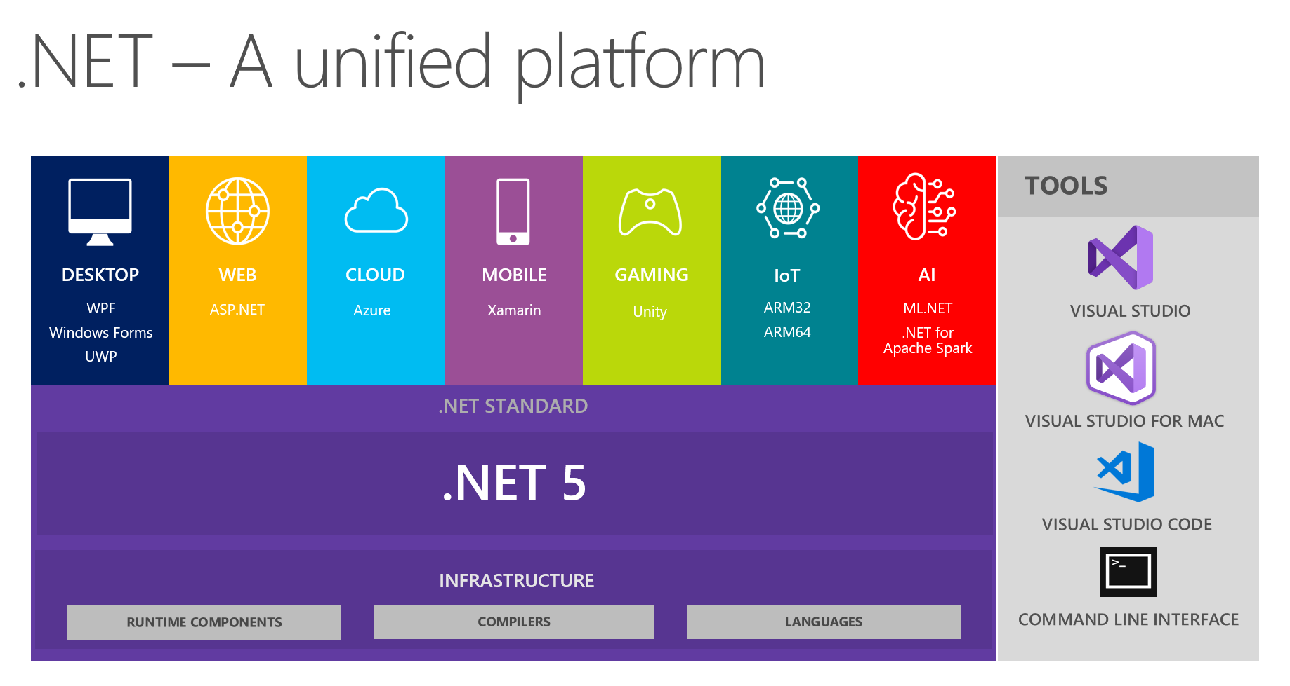
.NET 5!

Slide 34
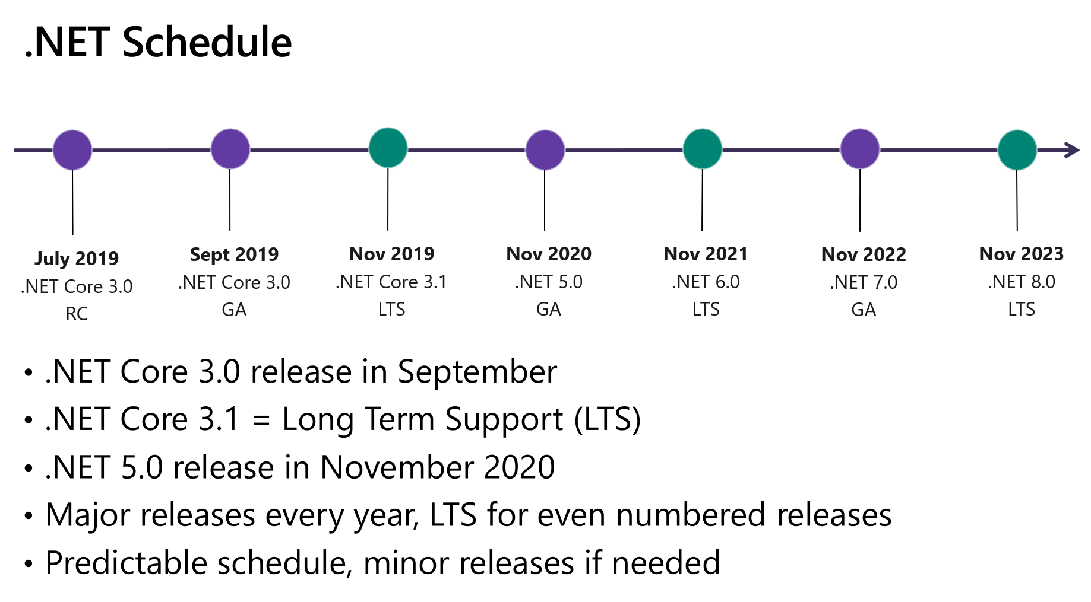
.NET 5!
https://devblogs.microsoft.com/dotnet/introducing-net-5/

Slide 35
Thank you!
Questions?

