Slide 1




Linguistic Change in Open Source Software
Miroslav Tushev, Saket Khatiwada and Anas Mahmoud
35th IEEE International Conference on Software Maintenance and Evolution
Division of Computer Science and Engineering
Louisiana State University
2019
Notes:
I’m a phd student in Computer Science and Engineering….

Slide 2
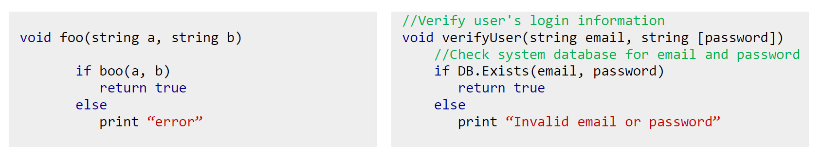
Developers’ Language
Notes:
We all know that the source code has 2 components – semantics and syntax. Semantics - the meaning - what does this program do, syntax – the form or structure of expression, statements, program units.
Semantically equivalent, but syntax is different. The diff comes from developer defined language. Or lexicon. It’s not clear from 1st example what’s happening there. But clear from the 2nd piece of code.
We are trying to understand how lexicon evolves over time in OSS projects. Where you have developers from diff. backgrounds contributing to projects.

Slide 3
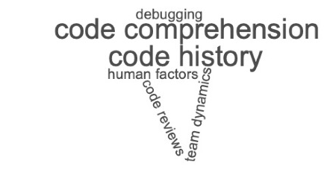
Motivation
Understand evolutionary characteristics of code lexicon
Applications
Notes:
What can we gain from studying the evolution of language? The most obv is to generate documentation of softw history. When developers jump into a project the first thing they do is read identifier names to understand what’s going on.
Make them all straight. Not in a cloud. Separate them.

Slide 4
Research Questions
RQ₁: Do OSS projects experience linguistic change over time?
RQ₂: Do different syntactic forms of code lexicon evolve differently?
RQ₃: What OSS development factors impact linguistic change?
Notes:
To understand the magnitude of the change, we formulated the following research questions

Slide 5
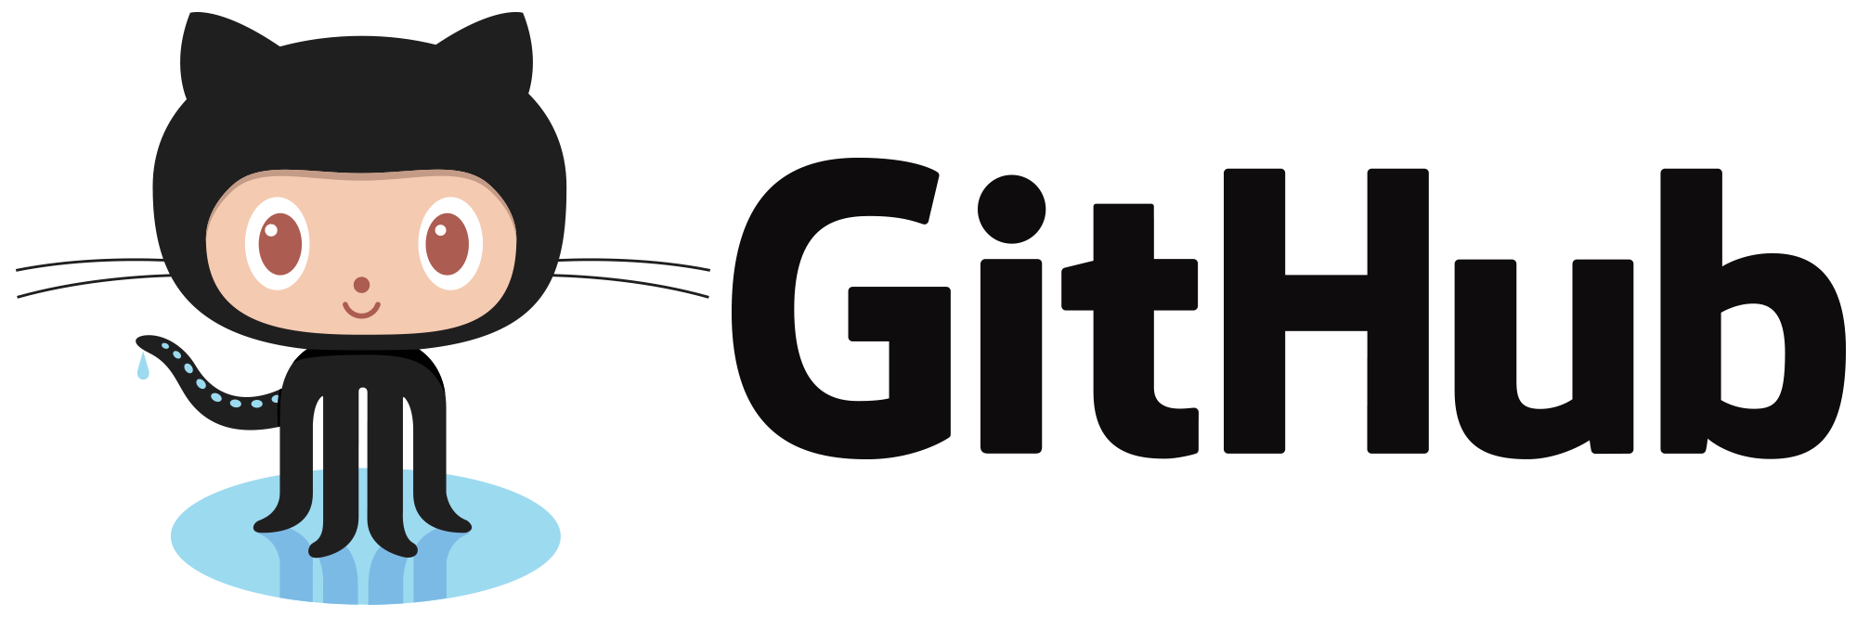
Data Collection
Java, C#, Python, JavaScript
GitHub starring
500 x 4 projects
Notes:
We wanted to generate a massive dataset of projects.
Starring can be used as a proxy for project popularity. The more history it has.

Slide 6

Lexicon Extraction
//Verify user's email and password
public void verify_user(string username, string password)
{
if (DB.Exists(username, password))
LaunchPage(“home.aspx?d=”+ hashUP(username, password));
else
{
Exception.log =311;
DisplayMsg(“Invalid user name or password”));
}
}
verify
user
Email
password
name
db
exist
launch
page
Home
d
hash
up
display
msg
Invalid
Stop words removal
PL word removal
Splitting
Stemming

Slide 7
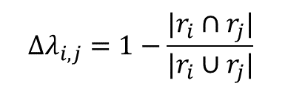
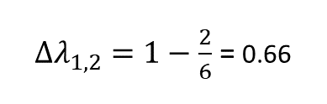
Quantifying Linguistic Change
$$Δλ_{i,j}=1−\frac{|r_{i}∩r_{j}|}{|r_{i}∪r_{j}|}$$
r₀
r₁
r₂
r_{n}
r₁ = {cat, dog, bird, fish}
r₂ = {cat, dog, snake, bison}
$Δλ_{1,2}=1−\frac{2}{6}$ = 0.66

Slide 8
RQ₁ (results): Linguistic Change Over Time
90% of the projects
50% of the projects

Slide 9
RQ₁ (summary)
Majority of OSS projects exhibit significant shift in their linguistic identity over time
Notes:
This seems like a trivial assumption, but we needed that evidence that developer language evolves over time

Slide 10
RQ₂: Do different syntactic forms of code lexicon evolve differently?

Slide 11
Syntactic Forms Found in Lexicon
Natural Words
button
string
toolbox
function
event
Short Forms
btn
str
tbx
func
evt
Misspellings
buton
streng
tolbox
funtcion
evnt

Slide 12

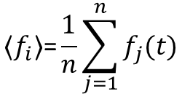
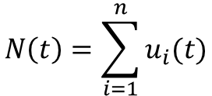
Lexicon Word Fitness
$$f_{i}\left(t\right)=\frac{u_{i}(t)}{N(t)}$$
$$N\left(t\right)=\sum_{i=1}^{n}{u_{i}(t)}$$
$$\text{⟨}f_{i}\text{⟩}\text{=}\frac{1}{n}\sum_{j=1}^{n}{f_{j}(t)}$$
r₀
r₁
r₂
r_{n}

Slide 13
RQ₂: Syntactic Fitness Analysis
Notes:
Talk about id length. It’s mixed. No length is better. Some misspellings keep reappearing again and again

Slide 14
RQ₂: Results
Different syntactic forms have different survival capacity

Slide 15
RQ₂: Impact
Identify and protect optimal naming conventions
¹J. Hofmeister, J. Siegmund, and D. V. Holt, “Shorter identifier namestake longer to comprehend,” in International Conference on SoftwareAnalysis, Evolution and Reengineering, 2017, pp. 217–227
D. Binkley, D. Lawrie, S. Maex, and C. Morrell, “Identifier length and limited programmer memory,” Science of Computer Programming, vol. 74, no. 7, pp. 430–445, 2009.
E. Avidan and D. Feitelson, “Effects of variable names on comprehension an empirical study,” in International Conference on Program Comprehension, 2017, pp. 55–65.

Slide 16
RQ₃ OSS Factors vs. Linguistic Change
What OSS development factors impact linguistic change?
Number of contributors
Number of releases
Number of commits
Notes:
OS projects unite developers from all over the world, more developers means more change?
Commits = productivity – active projects experience more change?

Slide 17
RQ₃ (results): OSS Factors vs. Linguistic Change
 |  | Java |  | C# |  | Python |  | JavaScript
 |  | Code | Comment | Code | Comment | Code | Comment | Code | Comment
Contributors | B | 6.91 | 1.20 | 6.25 | 6.15 | 3.11 | 0.11 | 14.52 | 11.81
Releases | B | 27.99 | 27.80 | 26.65 | 31.65 | 24.24 | 25.47 | 27.04 | 26.06
Commits | B | 7.00 | 3.94 | 6.78 | 6.83 | 5:03 | 3.32 | 12.17 | 8.65
OLS Regression
Notes:
Remove the table. Just leave significance

Slide 18
RQ₃: Results
Linguistic change can be significantly predicted by the number of published releases and number of commits
Number of contributors tends to show mixed results.

Slide 19
RQ₃: Impact
More contributors != more change
Different contributors have different impact on linguistic identity

Slide 20
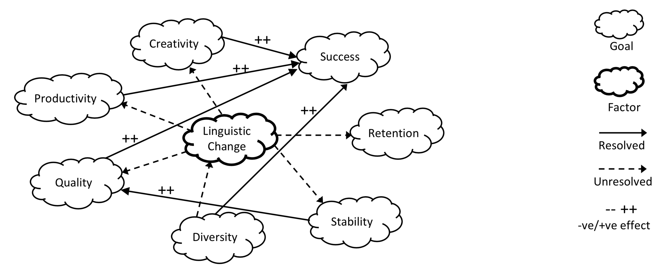
Future Work
Notes:
Read para in the proposal in the end
Ultimate goal – we wanna solve this graph

Slide 21


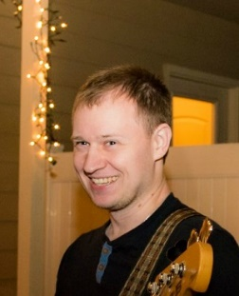

Miroslav Tushev
Ph.D. student
Division of Computer Science and Engineering
Louisiana State University
@MiroslavTushev
CCF-1821525
Notes:
Find a pic of question mark in the middle

