Slide 1


Digital Discrimination in Sharing Economy A Requirements Engineering Perspective
Miroslav Tushev, Fahimeh Ebrahimi and Anas Mahmoud
28th IEEE International Requirements Engineering Conference
Division of Computer Science and Engineering
Louisiana State University
July 2020
Notes:
Name and slide number on the top visible all the time

Slide 2








Sharing Economy
Miroslav Tushev
Notes:
We all know that the source code has 2 components – semantics and syntax. Semantics - the meaning - what does this program do, syntax – the form or structure of expression, statements, program units.
Semantically equivalent, but syntax is different. The diff comes from developer defined language. Or lexicon. It’s not clear from 1st example what’s happening there. But clear from the 2nd piece of code.
We are trying to understand how lexicon evolves over time in OSS projects. Where you have developers from diff. backgrounds contributing to projects.

Slide 3


Sharing Economy (cont’d)
3
Miroslav Tushev
289k
from roughly $15 billion today to around
$335 billion by 2025.
277k
Notes:
Blurry pics
Too big
Smaller icons
Write on top what they mean

Slide 4
Sharing Economy (discrimination)
4
Miroslav Tushev
Obstacles for minorities
Design decisions often enable discrimination behavior
Notes:
Blurry pics
Too big
Smaller icons
Write on top what they mean

Slide 5
Motivation and Objective
5
Miroslav Tushev
Objective – to establish preliminary perspective on digital discrimination in sharing economy
Motivation – to help developers engineer software that’s immune to discrimination by design
Notes:
Objective and motivation
Spell it out on the slide – animation one after another
The obj is to quantify the impact of diff types of maintenance on code lexicon
The motivation is to lay out a Prelimenary foundation for modelling linguistic history of soft system

Slide 6



Where to find discrimination concerns?
6
Miroslav Tushev
#AirbnbWhileBlack

Slide 7





Data Collection
7
Miroslav Tushev
Twitter
November 1st, 2019– December 31st, 2019
Notes:
We wanted to generate a massive dataset of projects.
Starring can be used as a proxy for project popularity. The more history it has.

Slide 8
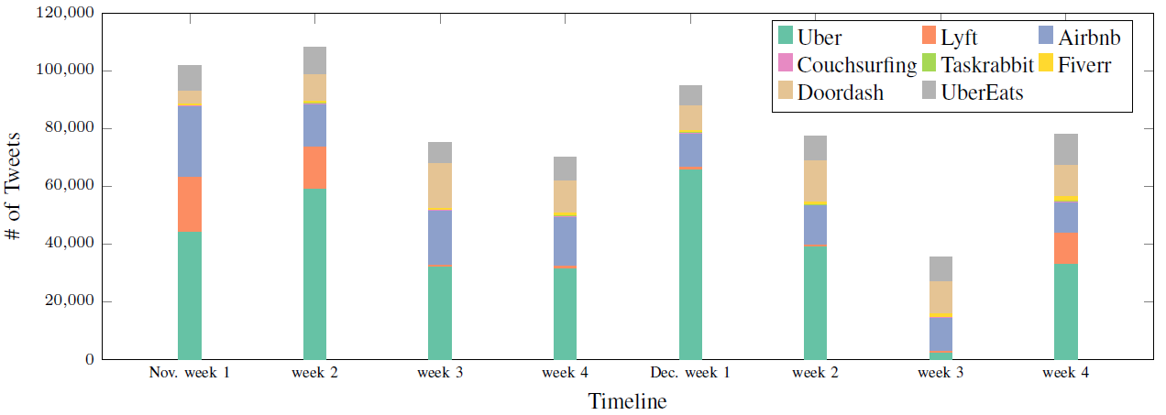
Data Collection (cont’d)
8
Miroslav Tushev
Twitter API
667,806 tweets
Notes:
We wanted to generate a massive dataset of projects.
Starring can be used as a proxy for project popularity. The more history it has.

Slide 9
Data Analysis
9
Miroslav Tushev
Do users report discrimination over social media?
Extract and classify discrimination-related tweets

Slide 10

Snowballing Method
10
Miroslav Tushev
If you leave Lyft scooters and Lime scooters in the middle of the sidewalk, it becomes inaccessible to disabled people.
This issue which is a serious one shows some of the discriminations which disabled people can come across.
disability
discrimination
@Airbnb you have racist host users who deny stay to guests that are not clearly white .
accessibility
@Airbnb explain why your racist homeowners denied a reservation made by… …black user
racism
UBER driver really watched me cross the street, looked at me, canceled the ride and pulled off immediately...
cancel
…
…
…

Slide 11
Snowballing Method (cont’d)
11
Miroslav Tushev
Does the tweet describe a discrimination incident?
What is the broad type of the discrimination concern raised in the tweet?
Are there any other keywords that are strongly associated with the identified concern?

Slide 12
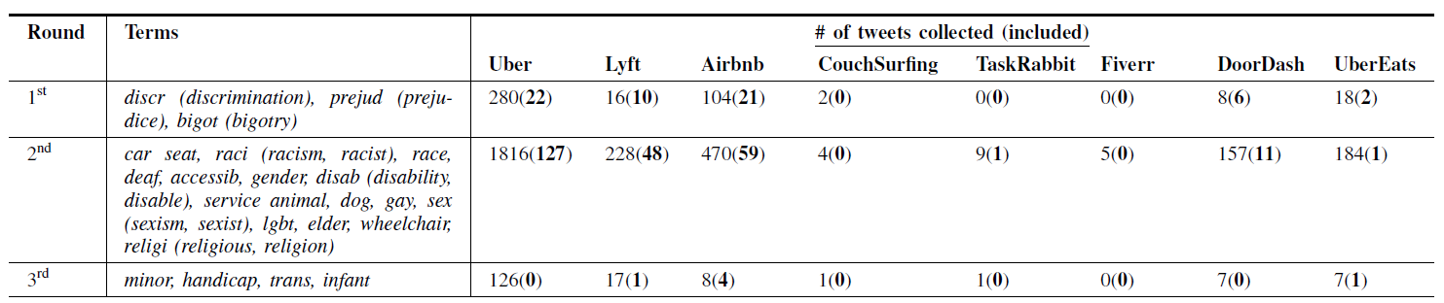
Snowballing Method (cont’d)
12
Miroslav Tushev

Slide 13





Discrimination Types
13
Miroslav Tushev
Racism
Disability
Sexism
Parental
Other

Slide 14
Racism and Ableism
14
Miroslav Tushev
@DoorDash please tell your drivers to consider disabled customers before telling them come out to retrieve their orders. It’s highly offensive.
@Airbnb you have racist host users who deny stay to guests that are not clearly white .

Slide 15
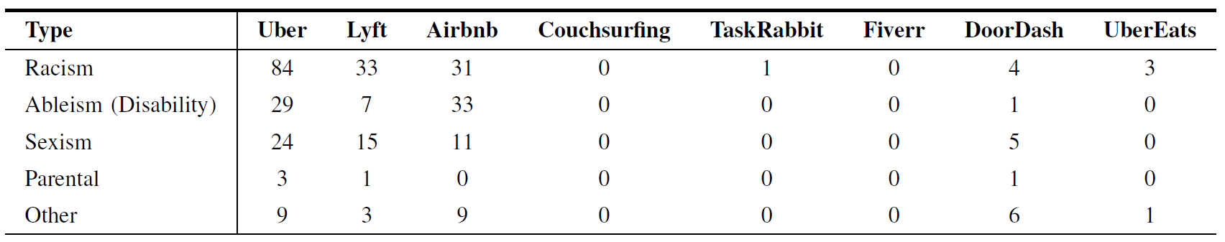
Results
15
Miroslav Tushev

Slide 16
Results (cont’d)
16
Miroslav Tushev
Discrimination concerns exist on Twitter, but scarce
Many tweets do not provide details on discrimination
Majority of tweets are from consumer perspective

Slide 17

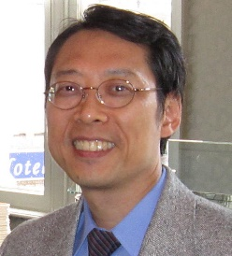
Domain Model
17
Miroslav Tushev
Conceptual modeling frameworks aim to offer succinct representations of certain aspects of complex realities through a small number of modeling constructs, with the intent that they can support some kinds of analysis.
Eric Yu

Slide 18
Domain Model - Notation
18
Miroslav Tushev
Goal
Concern
Feature
Suggested Feature
- hurts
mitigates
? unknown
+ helps
leads to

Slide 19
Domain Model - Generation
19
Miroslav Tushev
Tweets
cancel, rating, profile picture, racism, safety…
((Digital discrimination) OR discrimination OR racism OR sexism OR ableism OR disability OR accessibility) AND (ridesharing OR Uber OR Lyft OR Airbnb OR Couchsurfing OR Doordash OR UberEats OR TaskRabbit OR Fiverr OR (Sharing Economy) OR (gig economy))
Literature

Slide 20
Domain Model - Example
20
Miroslav Tushev
Trust
-
Racism
Cancel

Slide 21
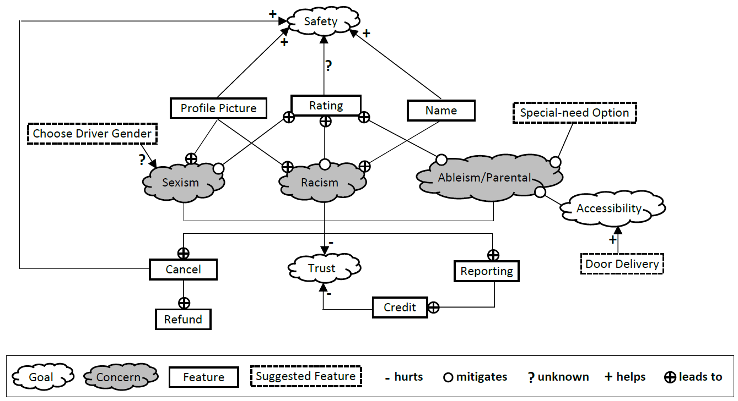
Domain Model – User Goals
21
Miroslav Tushev

Slide 22

Domain Model - Trust
22
Miroslav Tushev
As a black person I know not to trust AirBnB as they had a problem a few years back where racists would cancel the listing or raise the rates when someone of color tried to rent. It got so bad that there is a Airbnb type company for people of color

Slide 23
Domain Model - Results
23
Miroslav Tushev

Slide 24
Domain Model - Accessibility
24
Miroslav Tushev
“...I am a wheelchair user and unfortunately, the host misrepresented the accessibility of their house...

Slide 25
Domain Model – Functional Features
25
Miroslav Tushev

Slide 26

Domain Model - Cancel
26
Miroslav Tushev
So an @Uber driver cancels my trip
because I wasn’t physically able to walk and meet her” and “I’ve now had four drivers cancel on me in a row outside a gay venue @uber

Slide 27
Domain Model - Refund
27
Miroslav Tushev
“@Uber doesn’t want to refund me for a racist driver canceling my trip” and “.. the cabin refunded and canceled us when they found out about my service dog which is very illegal, especially since it’s an Airbnb”

Slide 28
Domain Model – Profile Picture
28
Miroslav Tushev
“@denvercoder I wouldn’t use AirBnB anyway because they want a pictures of you. It’s none of their business what race I am. The only reason I can see why they want a photo is so people can discriminate based on race.”

Slide 29
Domain Model – Name
29
Miroslav Tushev
“speaking from experience always keep a friend with a white-sounding name close if you planning on getting an @Airbnb or holla at @Uber in NYC anytime soon“

Slide 30
Domain Model – Rating
30
Miroslav Tushev
“My Uber driver said you choose to be gay, so why get offended if somebody says he doesn’t like you? It’s just an opinion. 1 star rating mate”

Slide 31
Domain Model – Reporting
31
Miroslav Tushev
“@AskLyft Cool! This will be my second report this month. It’s also my second lyft ride this month. What is lyft doing to ensure their drivers understand that accommodating service animals is not optional”

Slide 32
Domain Model – Credit
32
Miroslav Tushev
“... we’re sorry drivers don’t care that you’re disabled, here’s $3 in credit for future trips ...”

Slide 33
Domain Model – User-Suggested Features
33
Miroslav Tushev

Slide 34
Domain Model – Special Need
34
Miroslav Tushev
“@Uber why do you not have a handicap
option??? People in wheelchairs need #uber too.”

Slide 35
Domain Model – Door Delivery
35
Miroslav Tushev
“@DoorDash please add a door-delivery option to help disabled customers who cant come out to retrieve their orders”.

Slide 36
Domain Model – Choosing Driver’s Gender
36
Miroslav Tushev
“@Uber can we pls weed folks out before you pick them up. let me choose my driver’s gender. The point is that we should all have options that make us feel comfortable with”
“@Alt Deadpool @AskLyft @Uber Support I have a problem with you choosing based on gender because its sexist. Not to mention impractical business-wise because women drivers represent UNDER 10% of drivers yet 50% of passengers. are you ready to pay double/triple the fares for your gender-based employment discrimination”

Slide 37
Implications
37
Miroslav Tushev
Found presence of discrimination concerns
Generated a model
Model as a reference for developers

Slide 38
Roadmap
38
Miroslav Tushev
More data
Better techniques
Extrinsic evaluation
Notes:
Read para in the proposal in the end
Ultimate goal – we wanna solve this graph

Slide 39



Miroslav Tushev
Ph.D. student
Division of Computer Science and Engineering
Louisiana State University
@MiroslavTushev
miroslavtushev.com
Notes:
Find a pic of question mark in the middle

