Slide 1

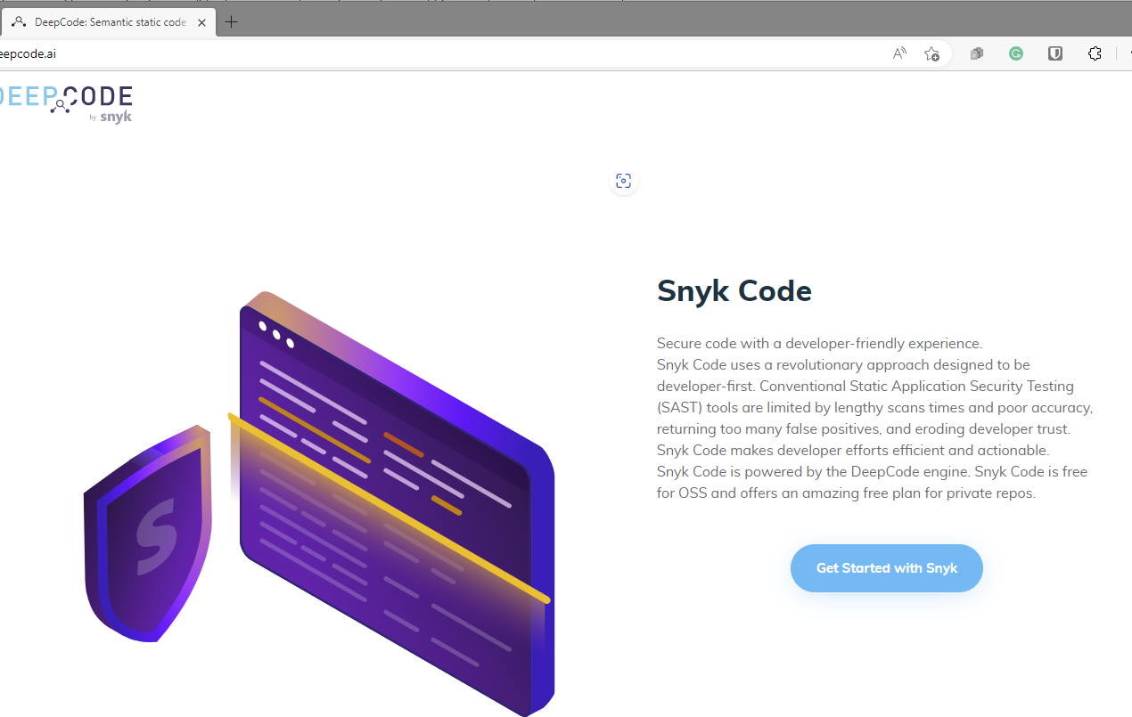
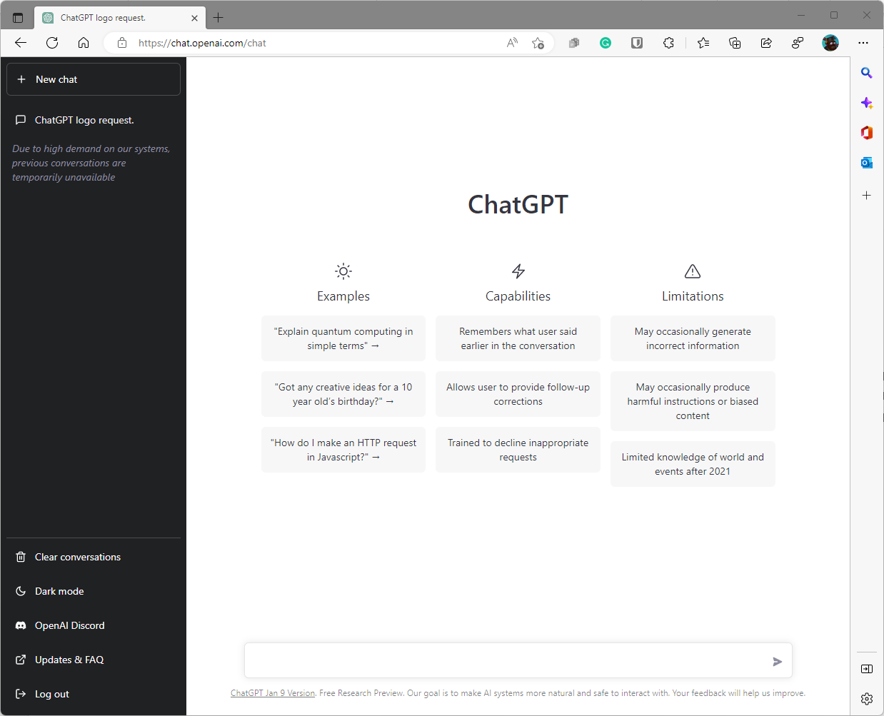
Build your own co-pilot Hackathon
Miroslaw Staron

Slide 2

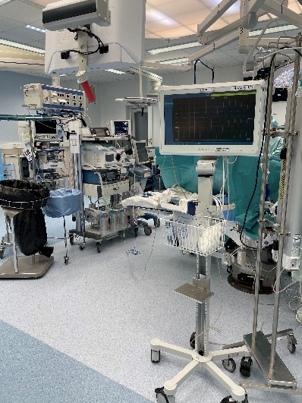

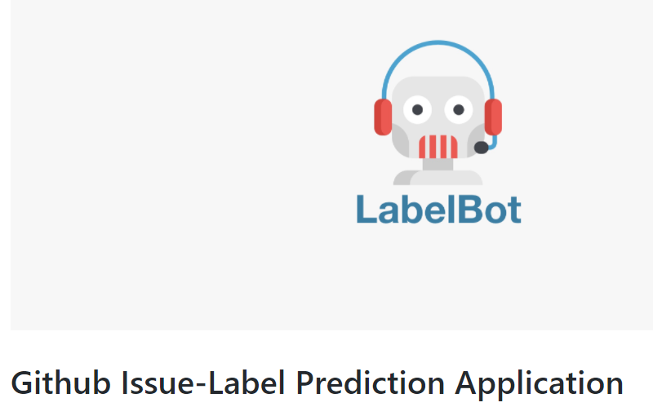
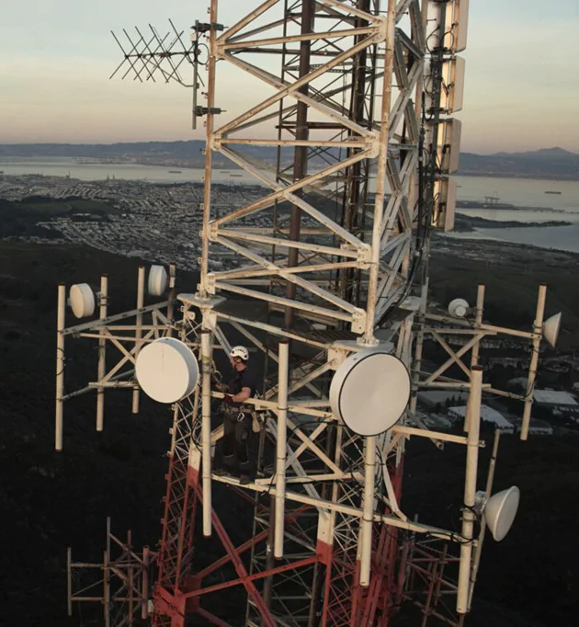
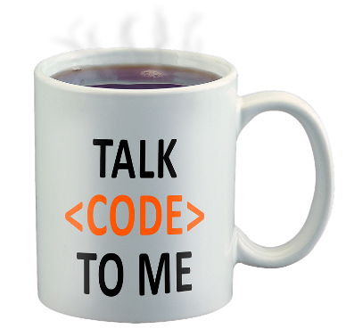

Who am I?
Programmer, Architect, Professor in Software Engineering at Chalmers | University of Gothenburg
Specialization in
Machine learning in software engineering
Federated learning in SE and ICU
Autonomous artificial intelligence-based measurement, machine reasoning
Main collaborations
Ericsson
Software center
Microsoft Research
Sahlgrenska University Hospital (NICU)
AI Sweden
GitHub - Microsoft-Project/Microsoft-Bot
www.gu.se/ai
SE metrics (Software Engineering)

Slide 3
Agenda for today
9.00 – 9.45: Meet and greet, welcome to the Hackathon, theory behind the models
9.45 – 11.00: Tutorial (working together) on creating extensions in Visual Studio Code
11.00 – 12.00: Brainstorming on which task you want to do after lunch
12.00 – 13.00: Lunch
13.00 – 13.30: Short check-in and presentation of ideas
13.30 – 15.00: Finalizing your solution
15.30 – 16.30: Presentations
16.30 – 17.00: check-out and next steps

Slide 4
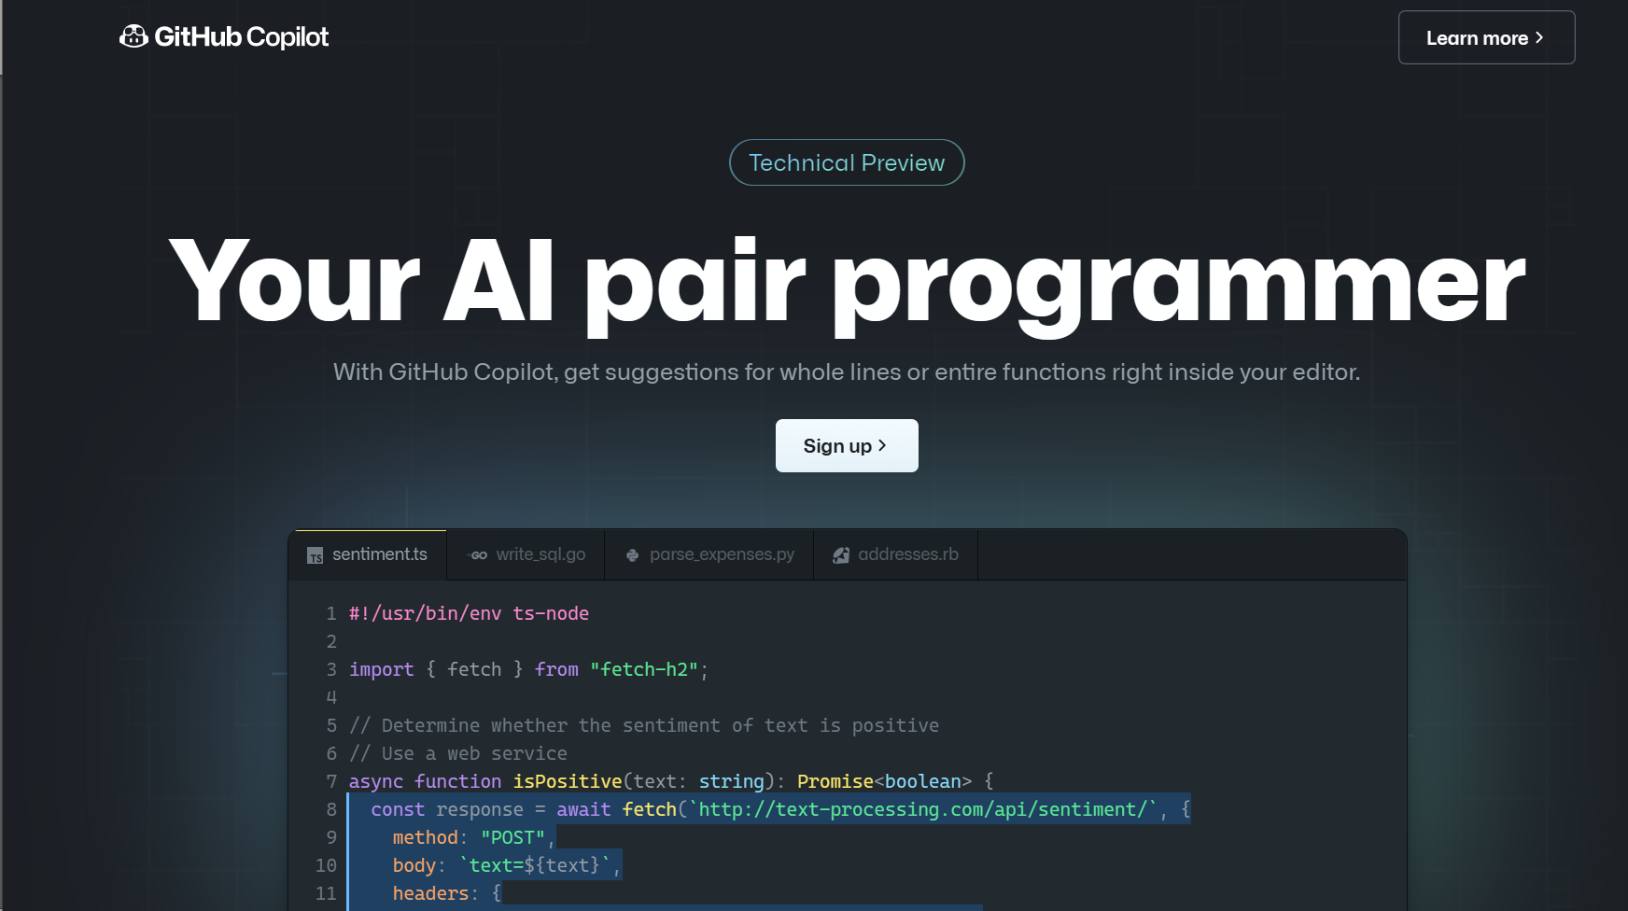
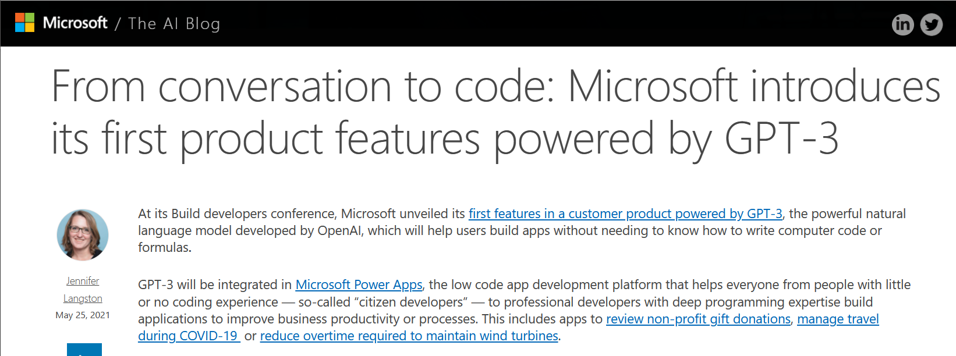
What is OpenAI, CodeX and ChatGPT?
OpenAI: Novel ML model
Large natural language model – GPT-3
Linked to automated tasks, e.g. text creation (GAN)
CodeX: OpenAI/GPT-3 for code
Trained on Github code
Linked to common programming tasks, like code completion, bug fixing

Slide 5
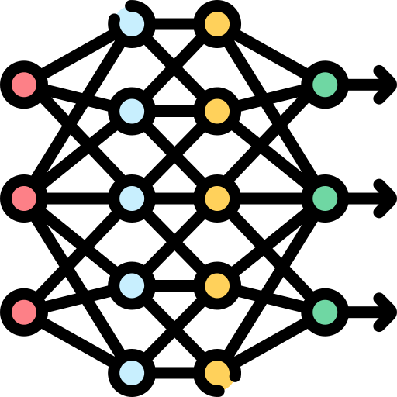




Models and products
Product, e.g., ChatGPT
Output
Prompt
Input processor
Language model (e.g. GPT-3/4/SW3, BERT)
Output processor
Asks the tool
Turns the prompt into an input vector to a model
Predicts a token
Turns the prediction into an output
Provides a response

Slide 6


Github CoPilot
Github CoPilot
…
Output
Prompt
CodeX
VS.Code tabs
Output processor
VS.code add-in
VS.Code add-in
# this is a fibonacci sequence
Takes code from open tabs and makes a linear sequence
Predicts the next token
Extracts only the code that has been generated
Shows 10 suggestions and selects the top 1
Adds the code after the prompt

Slide 7
How a model works

Slide 8
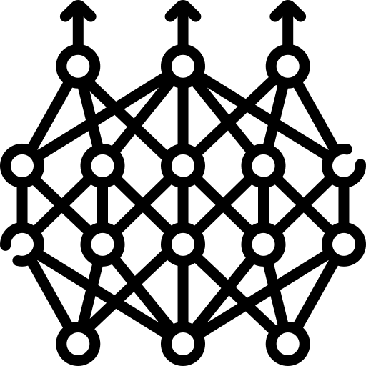
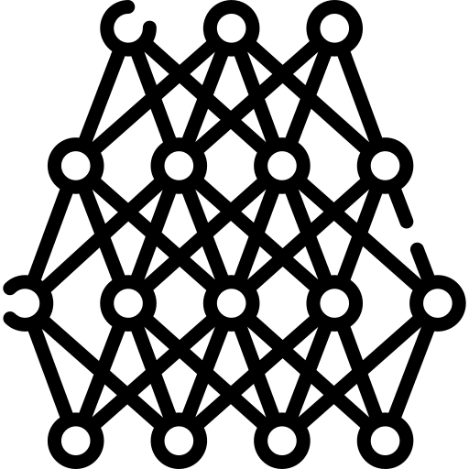

Transformer models
Output probabilities
Linear model
Transformers are networks of networks
Multiple heads provide better context for the generation of text
They can be arbitrary deep and arbitrary wide
Feed forward network
Feed forward network
Encoder-decoder attention head
Attention heads
Attention heads
Attention heads
Encoder
Decoder
Input embeddings
Output embeddings

Slide 9
Process of tokenization and masking
int *main(int argc, void **argv)
Input program
int main int argc void argv
Tokenized program
int main int <mask> void argv
Masked program

Slide 10
Tokenization

Slide 11
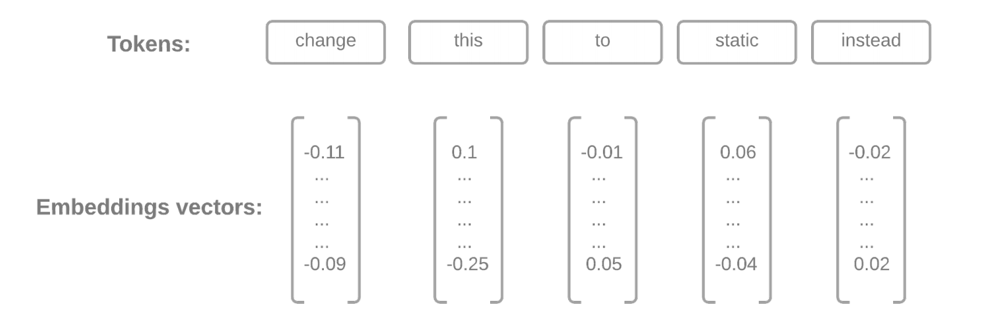
Creating embeddings, i.e. similarities of words
We see words
CodeX/ACoRA/BERT sees vectors of similarity
Source: J. Dudek, M. Saarijävi, Automatic Code-Review Assistant with focus on security in the context of the Android Open-Source Project, MSc thesis

Slide 12
What does this really mean?
instead
to
We can plot these vectors on an n-dimensional space and use vector arithmetic.
change
[-0.11, -0.09]
static
this
Please note that I’m using a simplification variant here, for pedagogical reasons – instead of n-dimensions, I only use two. In practice I use t-SNE transformation to transform n-dimensions into two/three for plotting

Slide 13
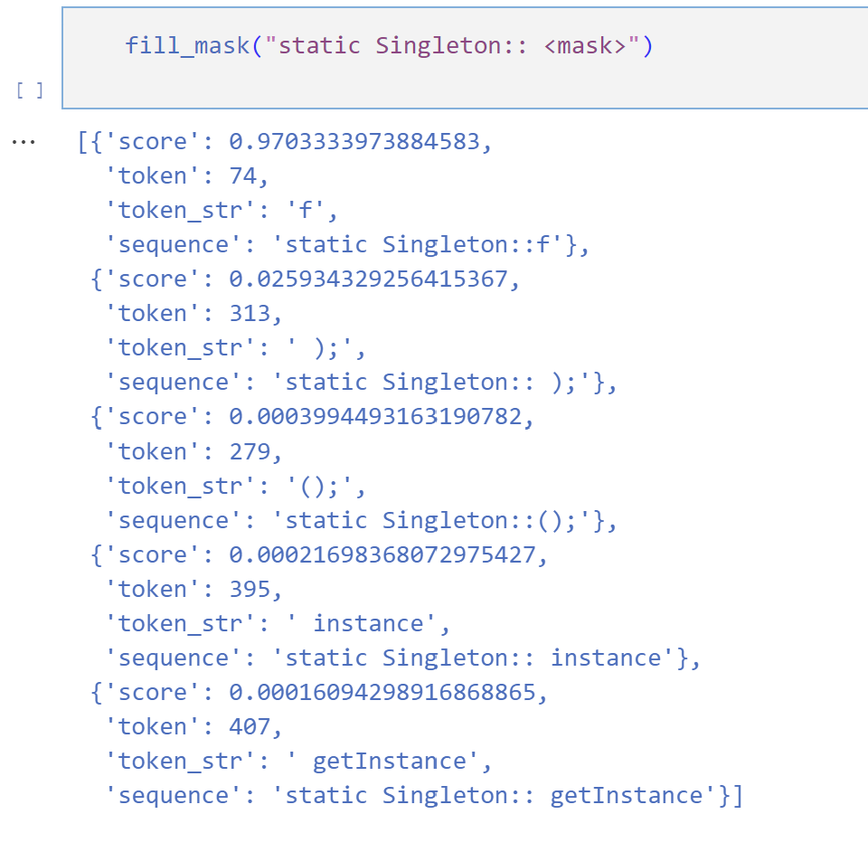
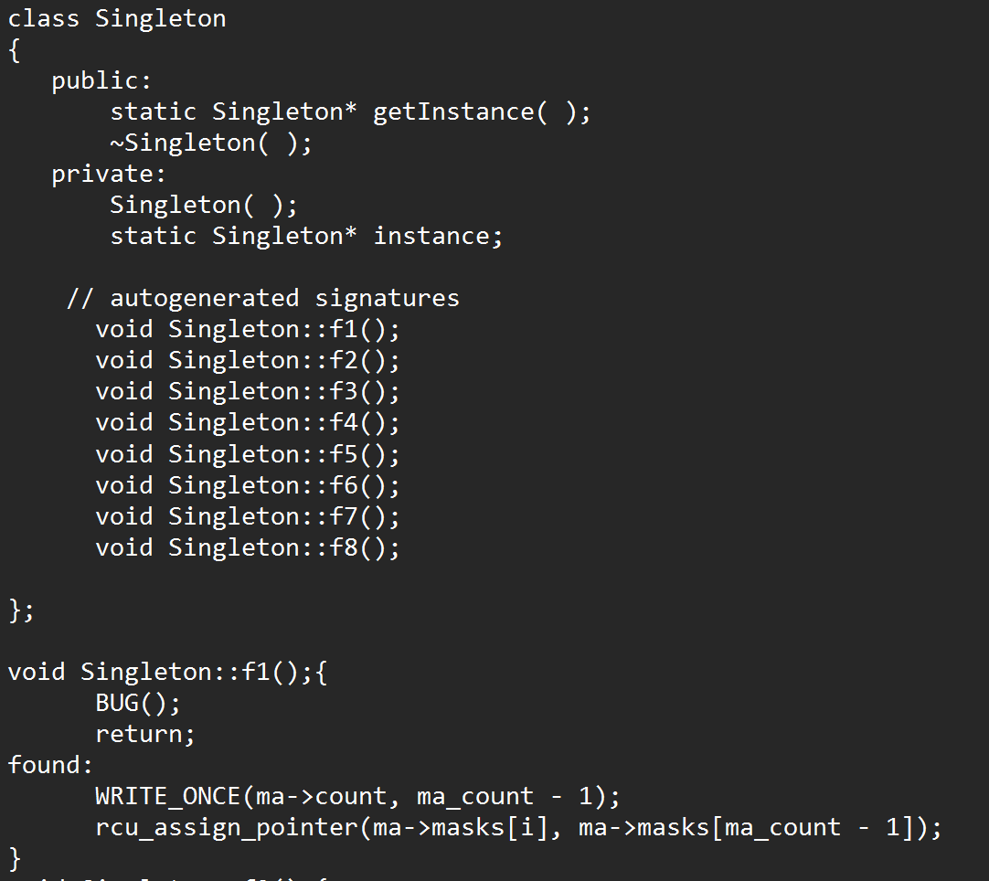
How do we get a suggestion from such a model?
We ask the model to fill in the blanks: <mask>
The model provides us with suggestions and their probability
The suggestions are based on the training set

Slide 14
Now, to the task today
https://github.com/miroslawstaron/build_your_copilot_hackathon

