Slide 1
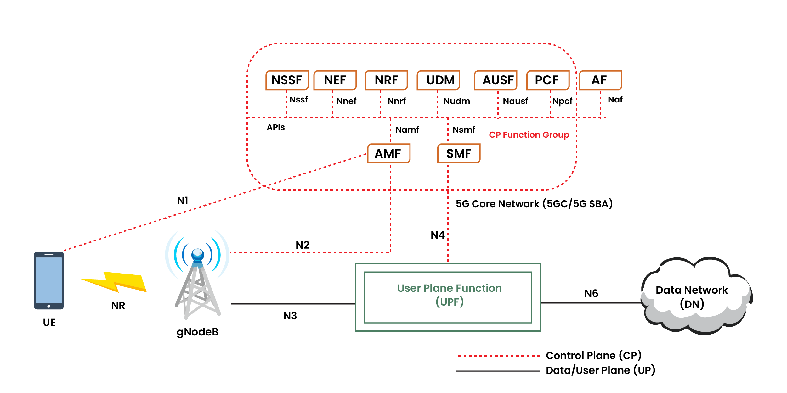
3GPP TS 22.104
Chapter A.2.2.3
Mobile Robots
Customer requirement:
Our products must support
the function of Mobile Robots
NFR1234 Regarding mobile robots,
as described in TS 22.104, V19.1.0 (2023-09),
chapter A.2.2.3, Use Case 1:
UPF shall take less than X ms (one way latency),
with Y% reliability.
Notes:
https://www.google.com/url?sa=i&url=https%3A%2F%2Fwww.calsoftinc.com%2Fblogs%2F5g-service-based-architecture-sba.html&psig=AOvVaw1fKAIT1r5-3D5Ego2GYkKe&ust=1726300585223000&source=images&cd=vfe&opi=89978449&ved=0CBQQjRxqFwoTCPCYyoO5v4gDFQAAAAAdAAAAABA0

